Slide 1
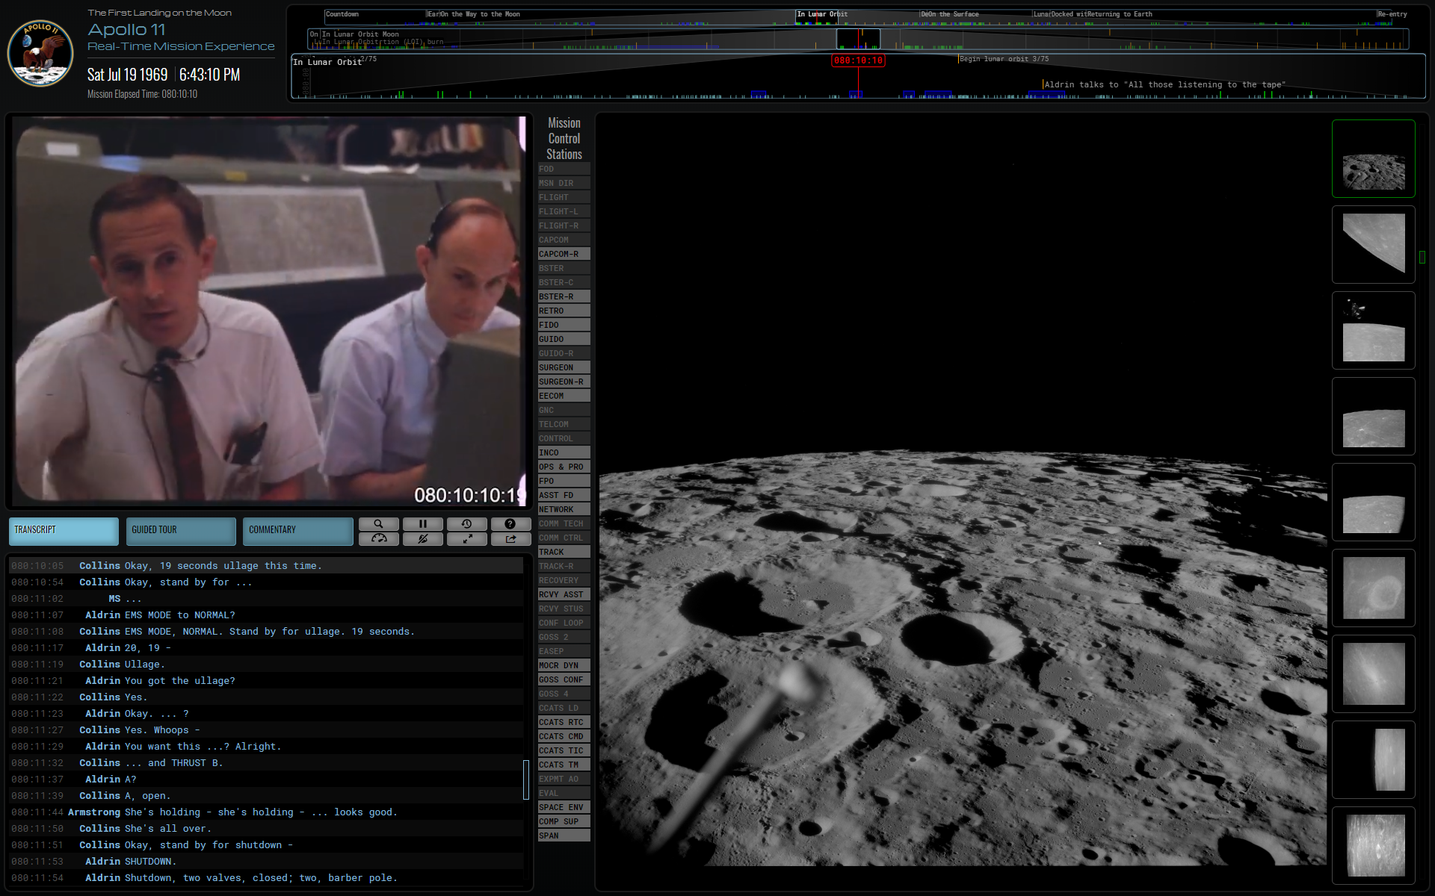
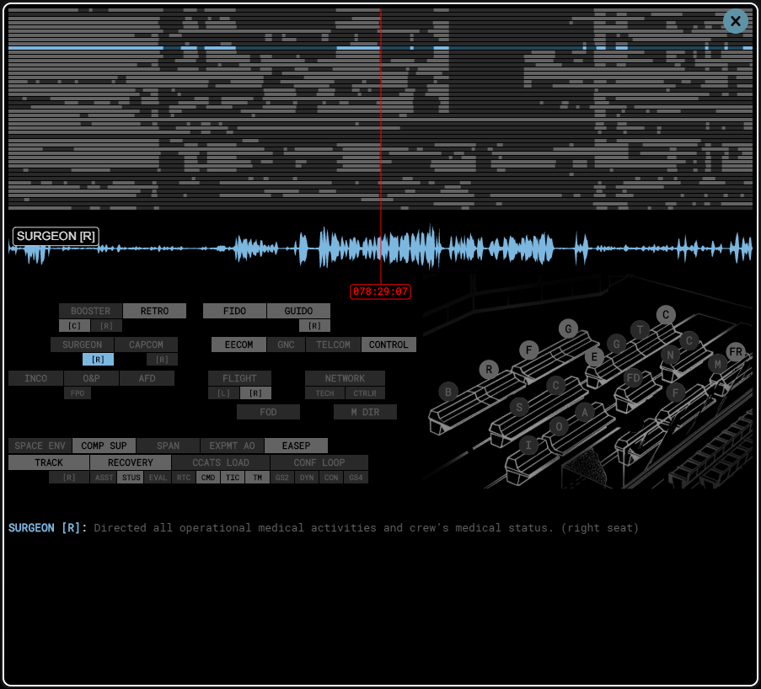
Mission Time
Time navigation
(three levels of zoom)
Timed Mission Photography
Mission Film/TV
Mission Control Audio Panel
Mission Control Seat Positions
(light grey indicates activity)
Transcript, Tour, and Commentary
Mission Audio Channels
(light grey indicates activity)
Actions
search, telemetry, play/pause/mute, full-screen, share
Open Mission Control Audio
(light grey indicates activity)

Slide 2
Mission Time
Transcript, Tour, and Commentary
Time navigation
(three levels of zoom)
Mission Film/TV
Timed Mission Photography
Open Mission Control Audio
(light grey indicates activity)
Mission Audio Channels
(light grey indicates activity)
Mission Control Audio Panel
Actions
search, telemetry, play/pause/mute, full-screen, share
Mission Control Seat Positions
(light grey indicates activity)

