Slide 1
General Contractor Project
Bryan Fendley
Trave McFarland
Dexter Andrews

Slide 2
Role assignments
Parts A+B - Trave
Parts C+F - Dexter
Parts D+E - Bryan
Parts G+H - All

Slide 3
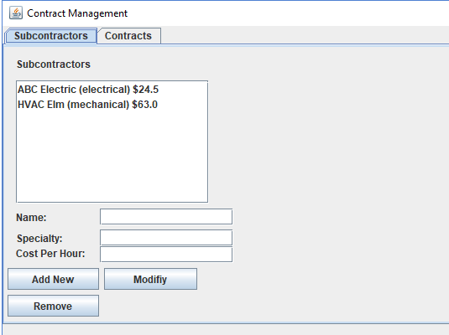
Parts A+B
The user will be able to add a subcontractor to the repository by typing in a name, specialty, and cost per hour. Doing this gives the opportunity to edit these parts of the subcontractor as well without adding a new one.

Slide 4
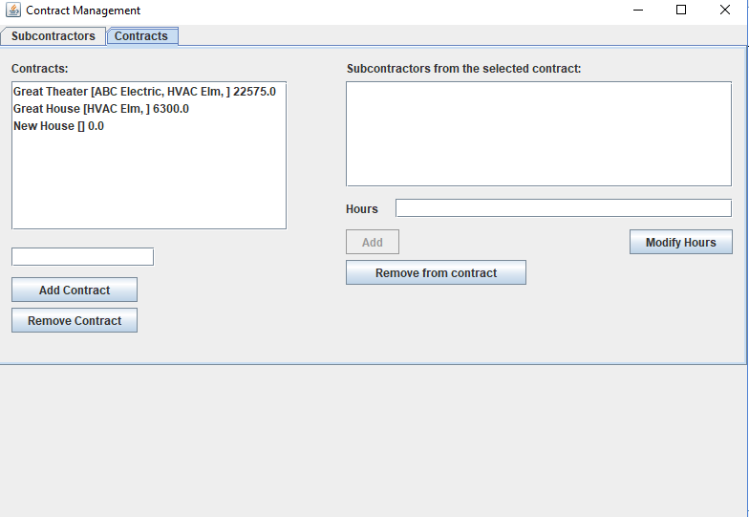
Parts C+F
The remove function is available in the contract panel by being able to remove a contract as a whole and by being able to remove a subcontractor from a specific contract. This removal of the subcontractor from a contract is a part of modifying the contract. The subcontract panel also gives the user the opportunity to remove a subcontractor as a whole from the repository.

Slide 5
Parts D+E
The user will be able to add a contract simply by typing into the text field on the left side and adding the contract. The user will be able to see the subcontractors assigned to the contract. Using this list they are able to modify the contract by adding subcontractors, changing the hours each subcontractor is assigned in each contract, and removing subcontractors from each contract.

Slide 6
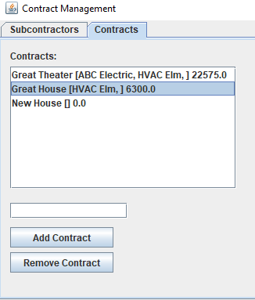
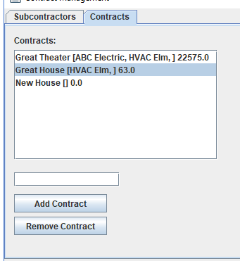
Part G
The contract price displayed is automatically updated in this first panel, HVAC Elm is assigned 100 hours at a cost of 63 dollars per hour. The price equates to 6300 dollars. The second panel shows the screen after the hours assigned to HVAC elm is reduced to 1 hour.

Slide 7
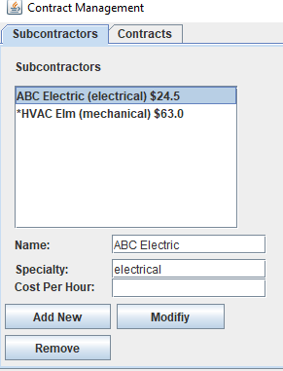
Part H
The symbol * is used to denote a subcontractor that is not currently assigned to a contract. In this case HVAC Elm is unused.

