Slide 1
COVID-19 Travel Tracker
A data-driven approach to tracking domestic spread of the novel coronavirus
Benjamin I Ferleger
April 15, 2020

Slide 2
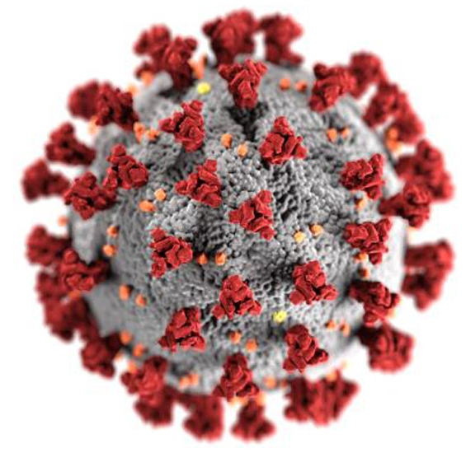
Problem Statement
COVID-19 has fundamentally changed our lives
Prevention of similar events in the future will require solutions with data-driven bases
Problem statement: How long do infected individuals spend undiagnosed and at large in the general public?
*CDC/ Alissa Eckert, MS; Dan Higgins, MAMS

Slide 3
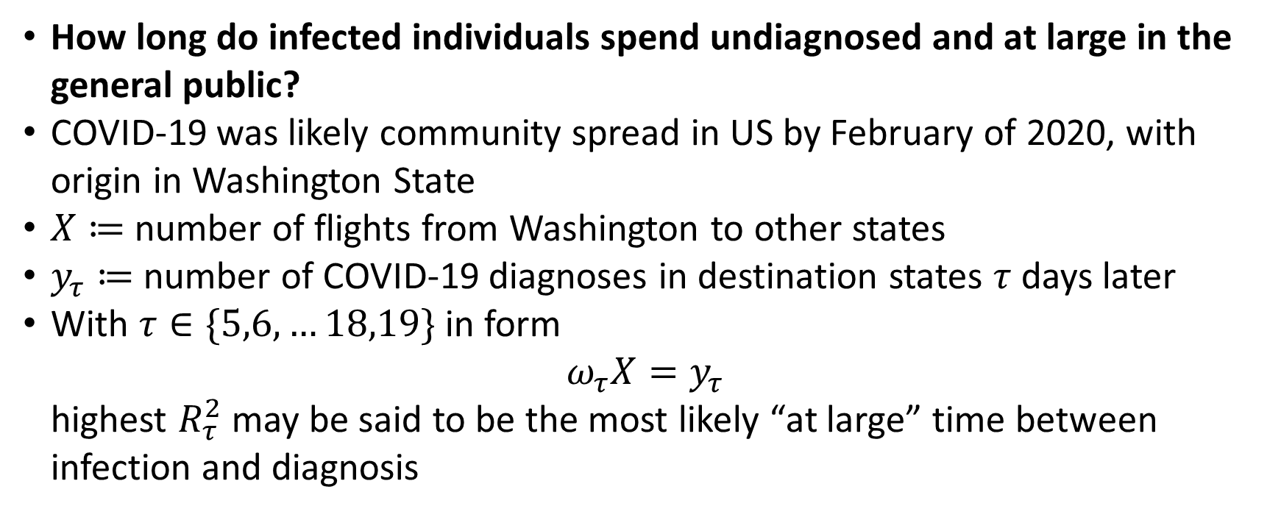
Hypothesis
How long do infected individuals spend undiagnosed and at large in the general public?
COVID-19 was likely community spread in US by February of 2020, with origin in Washington State
$X≔$ number of flights from Washington to other states
$y_{τ}≔$ number of COVID-19 diagnoses in destination states $τ$ days later
With $τ∈\{5,6,…18,19\}$ in form
$ω_{τ}X=y_{τ}$
highest $R_{τ}^{2}$ may be said to be the most likely “at large” time between infection and diagnosis

Slide 4
Data Sources
Number of cases COVID-19 per day:
https://github.com/nytimes/covid-19-data
<1 MB
Flights per day, January 2020:
https://www.transtats.bts.gov/DL_SelectFields.asp?Table_ID=236
48.3 MB

Slide 5
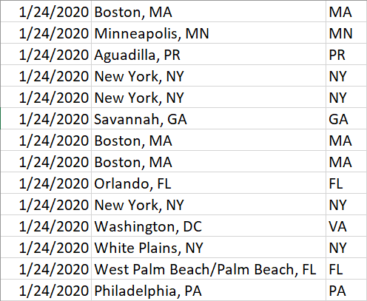
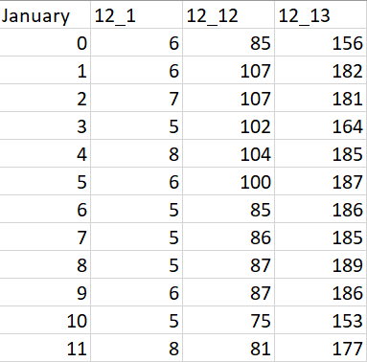
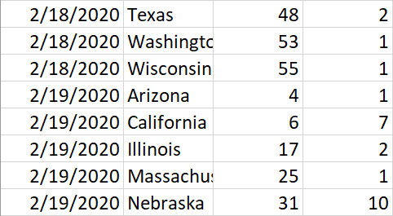
Data Pre-Processing
COVID-19 Data
Number of total cases per state on a given date easily accessible
Flight data
Original data includes date, origin state, and destination state for every individual flight in January 2020
Extract number of flights with identical origin and destination states on each date
Focus on flights from Washington State
Reduce >48MB to approx. 600 KB

Slide 6
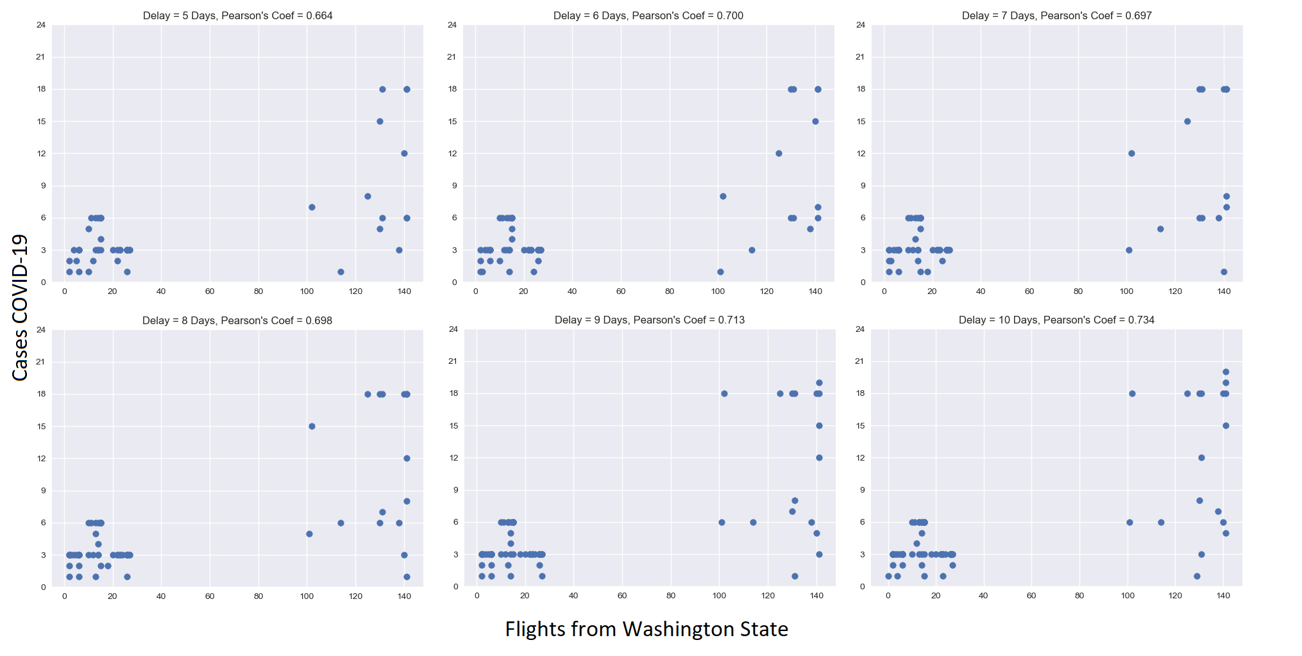
Data Analysis

Slide 7
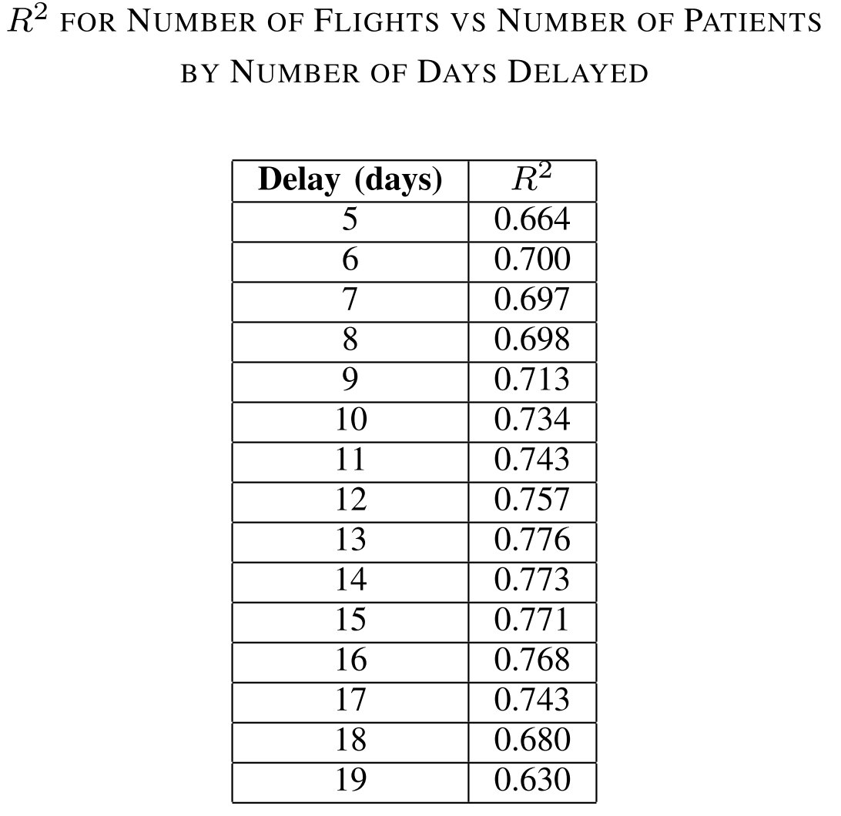
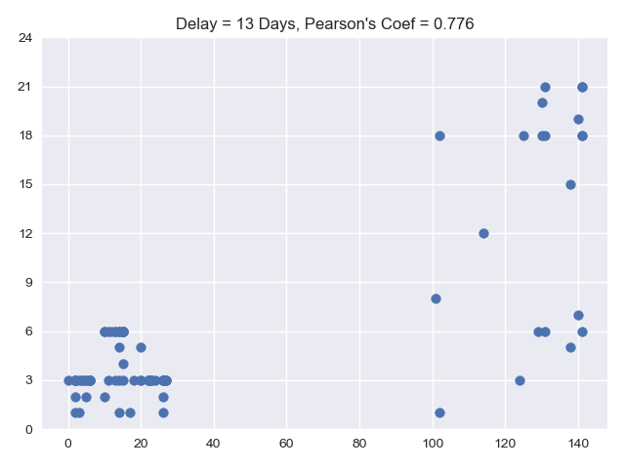
Preliminary Conclusions
$τ=13$ days is most likely period between infection and diagnosis

Slide 8
Next Steps
Expand analysis to look at flights from all states with infections
Introduce additional public transport methods and international travel from known infected nations
How well “lock-down” measures reduced spread
Ultimately, generate model for point at which states should shut down travel in the event of future pandemics
Project of interest to:
Government entities looking to prevent spread of infectious disease
Private entities looking to predict breakdown of transportation
Health consulting firms

Slide 9
COVID-19 Travel Tracker
A data-driven approach to tracking domestic spread of the novel coronavirus
Benjamin I Ferleger
April 15, 2020

