Slide 1
Memory Management in Vulkan™ and DX12 Adam Sawicki Developer Technology Engineer, AMD

Slide 2
Agenda
Introduction
Memory Types
Tips & Tricks
Libraries
Conclusions

Slide 3
Introduction

Slide 4
The challenge
Previous generation APIs (OpenGL™, DirectX® 11) manage memory automatically.
You create a resource (e.g. texture, constant buffer), backing memory is allocated automatically.
New APIs (Vulkan™, DirectX® 12) are lower level, require explicit memory management.
ID3D11Texture2D* pTexture;
pD3D11Device->CreateTexture2D(&desc, nullptr, &pTexture);

Slide 5
The challenge
Create resource
Query it for:
supported memory types
required size & alignment
It is now your responsibility to:
(Sub-)allocate block of memory
Bind them together

Slide 6
Advantages
Explicit memory management makes it possible to:
better manage memory
better optimize for specific platforms
alias (overlap) transient resources
Notes:
better manage memory - You have higher-level knowledge of your resources and their categories e.g. which ones are important. In old APIs driver had to guess.
better optimize for specific platforms - UMA (integrated graphics), NUMA (discrete graphics), various hardware vendors.
alias (overlap) transient resources - Easier when you use render frame graph.

Slide 7
Memory Types

Slide 8
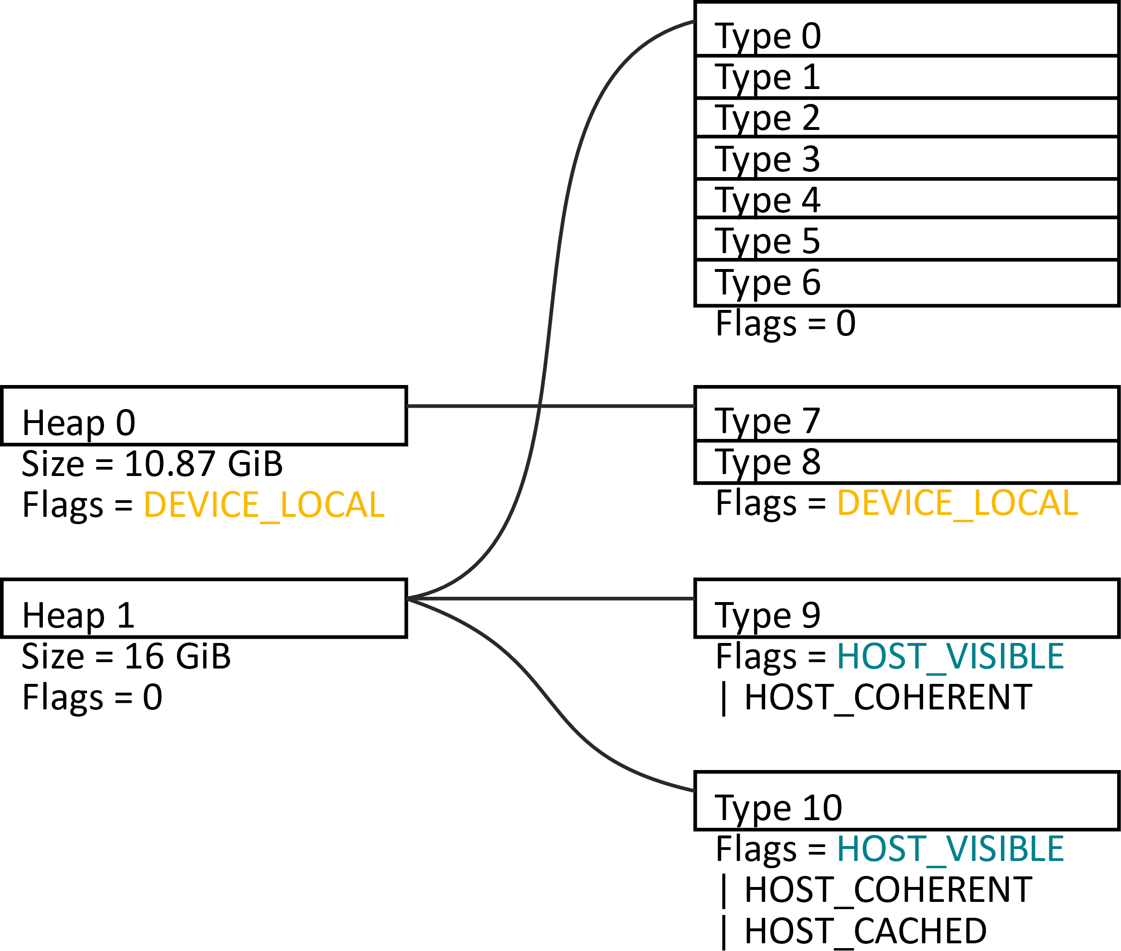
Memory types: NVIDIA
Example: NVIDIA GeForce GTX 1080 Ti
Video memory
D3D12_MEMORY_POOL_L1
System memory
D3D12_MEMORY_POOL_L0
Notes:
Drivers from different GPU vendors provide different Vulkan™ memory heaps and types.

Slide 9
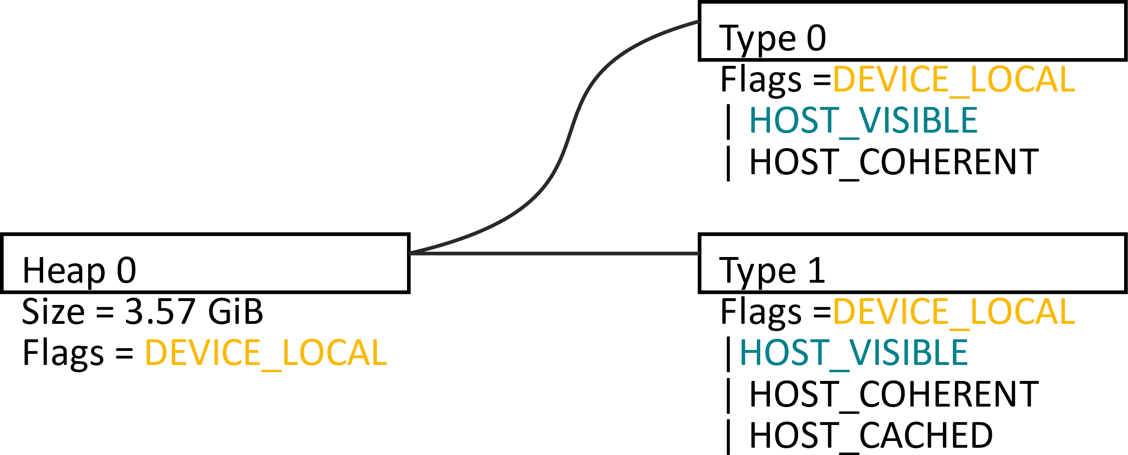
Memory types: Intel
Example: Intel Iris Plus Graphics 640
Unified memory

Slide 10
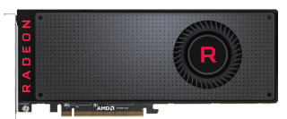
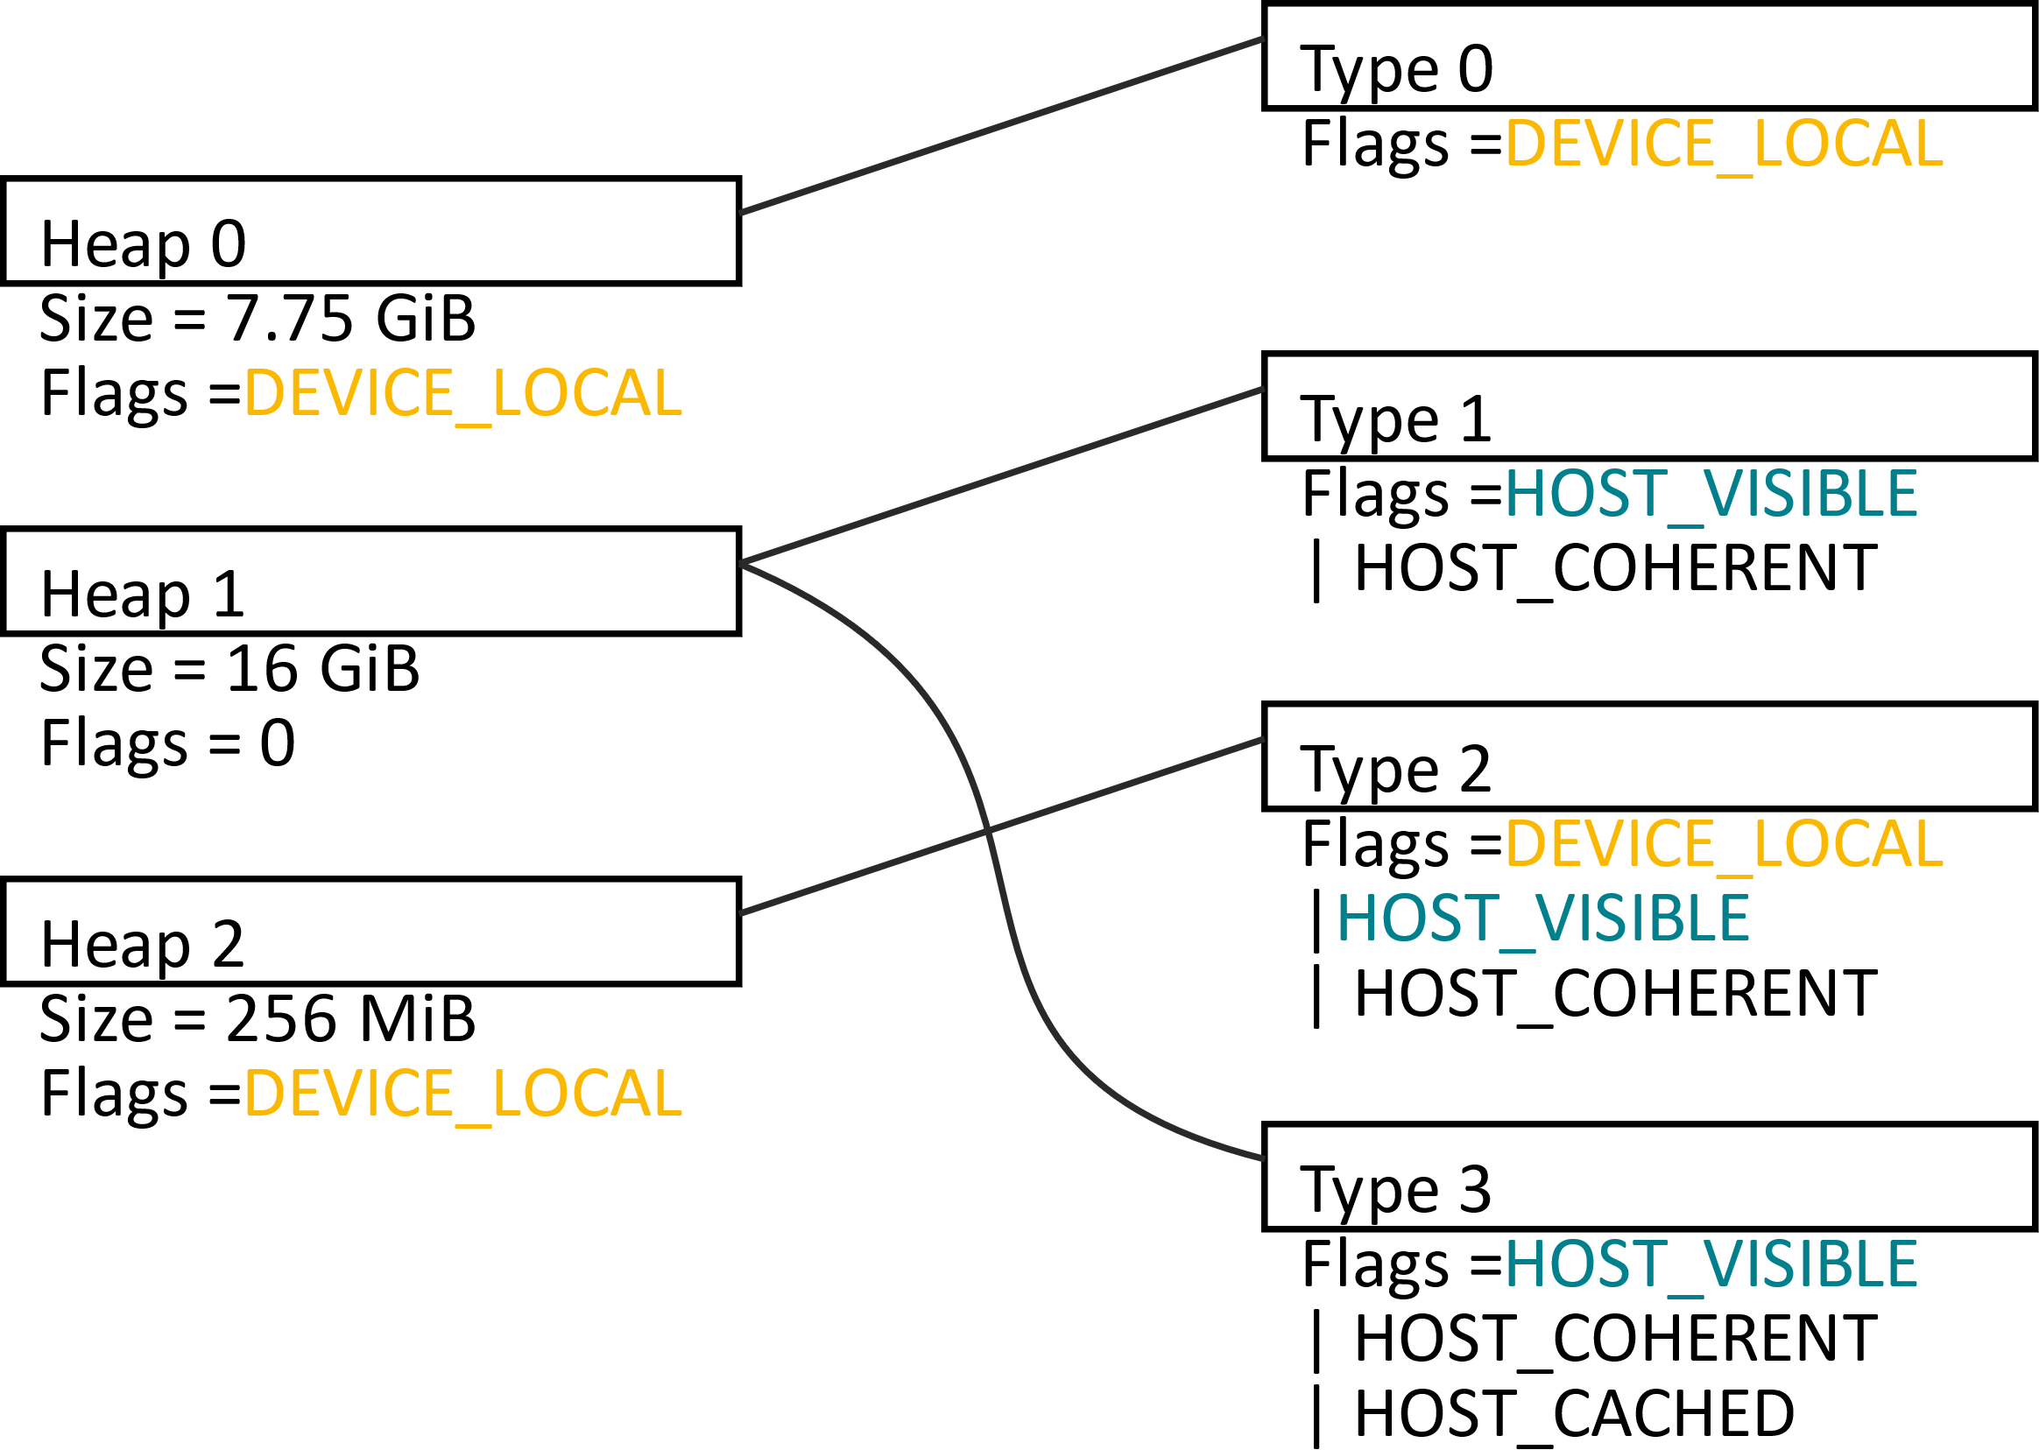
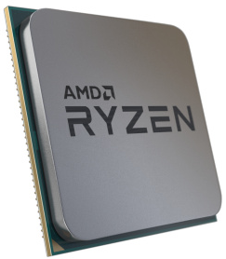
Memory types: AMD
Video memory
System memory
Example: AMD Radeon™ RX “Vega”
Vega is a codename for AMD architecture and is not a product name.

Slide 11
DEVICE_LOCAL
D3D12_HEAP_TYPE_DEFAULT
Video memory. Fast access from GPU.
No direct access from CPU – mapping not possible.

Slide 12
DEVICE_LOCAL
Good for resources written and read frequently by GPU.
Good for resources uploaded once (immutable) or infrequently by CPU, read frequently by GPU.
Notes:
Good for resources written and read frequently by GPU - e.g. render target textures.
Good for resources uploaded once (immutable) or infrequently by CPU, read frequently by GPU - e.g. textures, vertex buffers, constant buffers.
Allocate highest priority resources that get accessed more often first.

Slide 13
HOST_VISIBLE
D3D12_HEAP_TYPE_UPLOAD
System memory. Accessible to CPU – mapping possible.
Uncached. Writes may be write-combined.
Access from GPU possible but slow
Across PCIe® bus, reads cached on GPU.

Slide 14
HOST_VISIBLE
Good for CPU-side (staging) copy of your resources – used as source of transfer.
Data written by CPU, read once by GPU (e.g. constant buffer) may work fine (always measure!)
Cache on GPU may help.
Large data read by GPU – place here as last resort.
Large data written and read by GPU – shouldn’t ever be here.
Notes:
Large data read or written by GPU (e.g. textures, vertex buffers) – place here as last resort.
Large data written and read by GPU (e.g. render targets) – shouldn’t ever be here.

Slide 15
DEVICE_LOCAL + HOST_VISIBLE
Special pool of video memory.
Exposed on AMD only. 256 MiB.
Fast access from GPU.
Accessible to CPU – mapping possible.
Written directly to video memory.
Writes may be write-combined.
Uncached. Don’t read from it.
Notes:
Best to write it sequentially and never read from it.

Slide 16
DEVICE_LOCAL + HOST_VISIBLE
Good for resources updated frequently by CPU (dynamic), read by GPU.
Direct access by both CPU and GPU – you don’t need to do explicit transfer.
Use as fallback if DEVICE_LOCAL is small and oversubscribed.
Notes:
Good for resources updated frequently by CPU (dynamic), read by GPU - e.g. buffers/textures changed with every frame or draw call.
Direct access by both CPU and GPU – you don’t need to do explicit transfer. Alternative is to transfer from HOST_VISIBLE to DEVICE_LOCAL.
Use as fallback if DEVICE_LOCAL is small and oversubscribed.

Slide 17
HOST_VISIBLE + HOST_CACHED
D3D12_HEAP_TYPE_READBACK
System memory
CPU reads and writes cached (write-back).
GPU access through PCIe.
GPU reads snoop CPU cache.

Slide 18
HOST_VISIBLE + HOST_CACHED
Good for resources written by GPU, read by CPU – results of computations.
Direct access by both CPU and GPU – you don’t need to do explicit transfer.
Use for any resources read or accessed randomly on CPU.
Notes:
Good for resources written by GPU, read by CPU - results of computations, e.g. screen capture, average scene luminance for HDR tone mapping.
Direct access by both CPU and GPU – you don’t need to do explicit transfer. Alternative is to transfer from DEVICE_LOCAL to HOST_VISIBLE.
Use for any resources read or accessed randomly on CPU, e.g. CPU-side vertex buffer used as source of transfer to GPU, but also for collision detection.

Slide 19
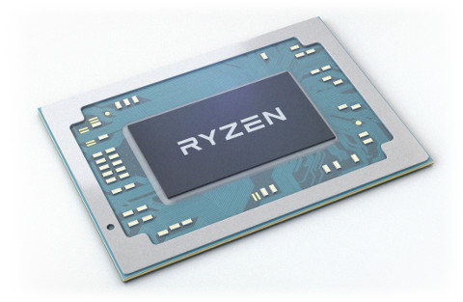
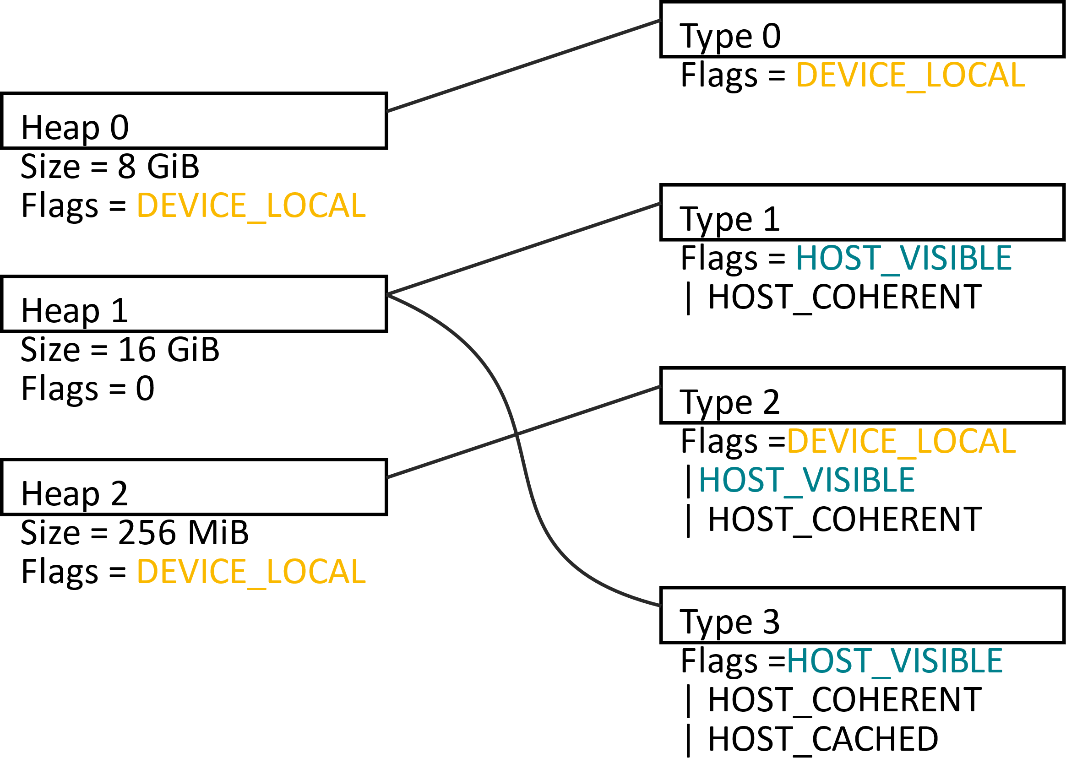
Memory types: AMD APU
AMD integrated graphics reports various memory types, like discrete AMD GPU.
Reported DEVICE_LOCAL heap can be any size, 0 B … few GiB.
Unified
memory

Slide 20
Memory types: AMD APU
Memory is really unified – all heaps are equally fast.
If you detect integrated graphics: VK_PHYSICAL_DEVICE_TYPE_INTEGRATED_GPU:
Count size of all memory heaps together.
Put your resources in whatever memory type meets your requirements.
Notes:
Count size of all memory heaps together – don’t assume only DEVICE_LOCAL is available or fast to access by the GPU.
Put your resources in whatever memory type meets your requirements – not necessarily DEVICE_LOCAL.

Slide 21
Tips & Tricks

Slide 22
Suballocation
Don’t allocate separate memory block for each resource (DX12: CreateCommittedResource).
small limit on maximum number of allocations (e.g. 4096)
allocation is slow
Prefer not to allocate or free memory blocks during gameplay to avoid hitching.
If you need to, you can do it on background thread.
Notes:
Don’t allocate separate memory block for each resource (DX12: CreateCommittedResource) – unless you write “Hello World!” / “first triangle” sample.

Slide 23
Suballocation
Allocate bigger blocks and sub-allocate ranges for your resources (DX12: CreatePlacedResource).
256 MiB is good default block size.
For heaps <= 1 GiB use smaller blocks (e.g. heap size / 8).

Slide 24
Over-commitment
What happens when you exceed the maximum amount of physical video memory?
It depends on the driver.
Allocation may fail (VK_ERROR_OUT_OF_DEVICE_MEMORY).
Allocation may succeed (VK_SUCCESS). Some blocks are silently migrated to system memory.
Blocks may be migrated to system memory anyway.
You are not alone – other applications can use video memory.
Using blocks migrated to system memory on GPU degrades performance.

Slide 25
Over-commitment – Vulkan™
Size of memory heap: VkMemoryHeap::size.
No known way to manually control residency of memory blocks.
No known way to query amount of used or available free memory.
You need to estimate.

Slide 26
Over-commitment – Vulkan™
Sum up the size of your VkDeviceMemory blocks.
Remember about implicit resources that also occupy memory.
Leave some margin free (e.g. 20% of DEVICE_LOCAL, 33% of DEVICE_LOCAL + HOST_VISIBLE).
Notes:
Remember about implicit resources that also occupy memory:
DEVICE_LOCAL: swapchain images: You can estimate the size based on their format, extent, count.
DEVICE_LOCAL + HOST_VISIBLE: descriptors, pipeline state objects, query results (e.g. 32 MiB)
HOST_VISIBLE: command buffers (few hundred MiB)

Slide 27
Over-commitment – DX12
Size of memory types:
DXGI_ADAPTER_DESC
Current usage and available budget for your program:
DXGI_QUERY_VIDEO_MEMORY_INFO
You can register for notifications:
IDXGIAdapter3::RegisterVideoMemoryBudgetChangeNotificationEvent

Slide 28
Over-commitment – DX12
You can page allocated blocks (heaps) in and out of video memory:
ID3D12Device::Evict, MakeResident, ID3D12Device3::EnqueueMakeResident
You can set residency priorities to resources:
ID3D12Device1::SetResidencyPriority
You can inform DX12 about minimum required memory:
IDXGIAdapter3::SetVideoMemoryReservation
Notes:
You can page allocated blocks (heaps) in and out of video memory
You can set residency priorities to resources
You can inform DX12 about minimum required memory (working set)

Slide 29
Mapping
void* ptr;
Having entire memory block persistently mapped is generally OK.
You don’t need to unmap before using on GPU.
Exceptions:
Vulkan™, AMD, Windows® version < 10: Blocks of DEVICE_LOCAL + HOST_VISIBLE memory that stay mapped for the time of any call to Submit or Present are migrated to system memory.
Keeping many large memory blocks mapped may impact stability or performance of debugging tools.
Notes:
DX12 documentation also mentions that on ARM®, READBACK heap doesn’t support persistently mapped memory. Map only when needed.

Slide 30

Transfer
Copy queue is designed for efficient transfer via PCIe
Use it in parallel with 3D rendering, even asynchronously to rendering frames. Good for texture streaming.
Use it also for defragmentation of GPU memory in the background.
Do your transfers long before the data is needed on graphics queue.
GPU to (the same) GPU copies are much faster on graphics queue.
Use it if graphics queue needs to wait for transfer result anyway.
Notes:
Copy queue is designed for efficient transfer via PCIe (between system memory and video memory, between GPUs)

Slide 31
Libraries

Slide 32
Direct3D Residency Starter Library
https://github.com/Microsoft/DirectX-Graphics-Samples/tree/master/Libraries/D3DX12Residency
Library from Microsoft®
MIT license
easy to integrate – single C++ header
manages residency of DX12 heaps / committed resources
implements essentially the same memory management behavior that a DX11 app would get

Slide 33
Direct3D Residency Starter Library
Instead of just calling ExecuteCommandLists:
you pass command lists to be executed together with a list of resources they use
the library:
queries GXGI for memory budget
calls Evict for least recently used resources
calls MakeResident for resources that are going to be used
calls ExecuteCommandLists

Slide 34
Vulkan Memory Allocator
https://gpuopen.com/gaming-product/vulkan-memory-allocator/
Library from AMD
MIT license
easy to integrate – single header
interface in C (same style as Vulkan™), implementation in C++
well documented
Already used in some AAA titles.
Releasing final version 2.0.0 now!
See also Dustin Land et al. talk “Getting Explicit: How Hard is Vulkan Really?”

Slide 35
Vulkan Memory Allocator
Functions that help to choose the correct and optimal memory type based on intended usage.
Functions that allocate memory blocks, reserve and return parts of them to the user.
Library keeps track of allocated memory blocks, used and unused ranges inside them,
respects alignment and buffer/image granularity.
Notes:
Functions that help to choose the correct and optimal memory type based on intended usage. - Required or preferred traits of the memory expressed using higher-level description comparing to Vulkan™ flags.

Slide 36
Vulkan Memory Allocator
Functions that create image/buffer, (sub-)allocate memory for it and bind them together – all in one call.
VkBufferCreateInfo bufferInfo = { VK_STRUCTURE_TYPE_BUFFER_CREATE_INFO };
bufferInfo.size = 65536;
bufferInfo.usage = VK_BUFFER_USAGE_VERTEX_BUFFER_BIT | VK_BUFFER_USAGE_TRANSFER_DST_BIT;
VmaAllocationCreateInfo allocInfo = {};
allocInfo.usage = VMA_MEMORY_USAGE_GPU_ONLY;
VkBuffer buffer;
VmaAllocation allocation;
vmaCreateBuffer(allocator, &bufferInfo, &allocInfo, &buffer, &allocation, nullptr);

Slide 37
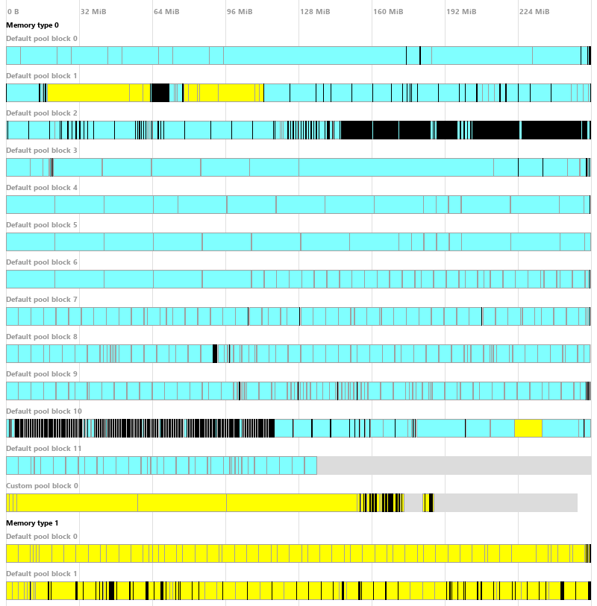
VmaDumpVis.py
Auxiliary tool that visualizes JSON dump from Vulkan Memory Allocator.
python VmaDumpVis.py -o Image.png VmaDump.json
Released just now!
Image
Buffer

Slide 38
Conclusions

Slide 39
Conclusions
New graphics APIs (Vulkan™, DirectX 12) require more explicit memory management.
Creating resources is a multi-stage process.
Former driver magic is now under your control.
You need to deal with differences between GPUs.
By following good practices you can achieve optimal performance on any GPU.
There are open-source libraries that can help you with this task.

Slide 40
References
Vulkan Memory Allocator (AMD) https://gpuopen.com/gaming-product/vulkan-memory-allocator/
Direct3D Residency Starter Library (Microsoft) https://github.com/Microsoft/DirectX-Graphics-Samples/tree/master/Libraries/D3DX12Residency
Vulkan Device Memory, Timothy Lottes, GPUOpen https://gpuopen.com/vulkan-device-memory/
Vulkan Memory Management, Chris Hebert, NVIDIA Developer https://developer.nvidia.com/vulkan-memory-management
What’s your Vulkan Memory Type?, Mathias Schott & Jeff Bolz, NVIDIA Developer https://developer.nvidia.com/what%E2%80%99s-your-vulkan-memory-type
DX12 Do’s And Don’ts, NVIDIA Developer https://developer.nvidia.com/dx12-dos-and-donts
Vulkan Hardware Database, Sascha Willems http://vulkan.gpuinfo.org/

Slide 41
Thank you
Dominik Baumeister
Lou Kramer (@lou_auroyup)
Matthäus G. Chajdas (@NIV_Anteru)
Rys Sommefeldt (@ryszu)
Timothy Lottes (@TimothyLottes)

Slide 42
Disclaimer & Attribution
The information presented in this document is for informational purposes only and may contain technical inaccuracies, omissions and typographical errors.
The information contained herein is subject to change and may be rendered inaccurate for many reasons, including but not limited to product and roadmap changes, component and motherboard version changes, new model and/or product releases, product differences between differing manufacturers, software changes, BIOS flashes, firmware upgrades, or the like. AMD assumes no obligation to update or otherwise correct or revise this information. However, AMD reserves the right to revise this information and to make changes from time to time to the content hereof without obligation of AMD to notify any person of such revisions or changes.
AMD MAKES NO REPRESENTATIONS OR WARRANTIES WITH RESPECT TO THE CONTENTS HEREOF AND ASSUMES NO RESPONSIBILITY FOR ANY INACCURACIES, ERRORS OR OMISSIONS THAT MAY APPEAR IN THIS INFORMATION.
AMD SPECIFICALLY DISCLAIMS ANY IMPLIED WARRANTIES OF MERCHANTABILITY OR FITNESS FOR ANY PARTICULAR PURPOSE. IN NO EVENT WILL AMD BE LIABLE TO ANY PERSON FOR ANY DIRECT, INDIRECT, SPECIAL OR OTHER CONSEQUENTIAL DAMAGES ARISING FROM THE USE OF ANY INFORMATION CONTAINED HEREIN, EVEN IF AMD IS EXPRESSLY ADVISED OF THE POSSIBILITY OF SUCH DAMAGES.
ATTRIBUTION
© 2018 Advanced Micro Devices, Inc. All rights reserved. AMD, the AMD Arrow logo, Radeon and combinations thereof are trademarks of Advanced Micro Devices, Inc. in the United States and/or other jurisdictions. OpenGL and Vulkan are trademarks of Khronos Group, Inc. PCIe is a registered trademark of PCI-SIG. Microsoft, Windows and DirectX are registered trademarks of Microsoft Corp. Other names are for informational purposes only and may be trademarks of their respective owners.

Slide 43


Slide 44
Backup

Slide 45
Dedicated allocation
Some resources may benefit from having their own, dedicated memory block instead of region suballocated from a bigger block.
Driver may use additional optimizations.
Use for:
Render targets, depth-stencil, UAV
Very large buffers and images (dozens of MiB)
Large allocations that may need to be resized (freed and reallocated) at run-time.

Slide 46
Dedicated allocation
DX12:
ID3D12Device::CreateCommittedResource function
Vulkan™:
VK_KHR_dedicated_allocation extension

Slide 47
Cache control
Vulkan™ : Any memory type that doesn’t have HOST_COHERENT flag needs manual cache control:
vkInvalidateMappedMemoryRanges before read on CPU
vkFlushMappedMemoryRanges after write on CPU
In practice, all PC GPU vendors (AMD, Intel, NVIDIA) support HOST_COHERENT on every memory type that is HOST_VISIBLE.
No need to worry about it on current Windows PCs.
Notes:
Unmap doesn’t do it automatically. You can Unmap or leave memory mapped, but you need to Flush/Invalidate anyway.

Slide 48
Aliasing
You can alias different resources – bind them to the same or overlapping range of memory.
It saves memory.
Good for transient resources (e.g. render targets) used only during part of the frame.
After the memory was used by different resource, treat your resource as uninitialized.
…unless you really know what you’re doing.

Slide 49
Miscellaneous
Vulkan™: Memory requirements (e.g. size) can vary for different resources (e.g. images) even when created with same parameters (format, width, height, mip levels etc.)
It really happens in the wild. Be prepared for that. Don’t cache result. Query each resource for requirements.
Don’t use images with TILING_LINEAR (DX12: LAYOUT_ROW_MAJOR) unless you have to.
Use TILING_OPTIMAL (DX12: LAYOUT_UKNOWN).
Copy images from/to buffers.

Slide 50
Miscellaneous
Avoid VK_IMAGE_LAYOUT_GENERAL (D3D12: D3D12_RESOURCE_STATE_GENERIC_READ). Always transition image to appropriate VK_IMAGE_LAYOUT_*_OPTIMAL.
Avoid VK_SHARING_MODE_CONCURRENT on render target textures. It disables DCC compression.
Prefer VK_SHARING_MODE_EXCLUSIVE and do explicit queue family ownership transfer barriers.
Avoid VK_IMAGE_CREATE_MUTABLE_FORMAT_BIT.
If you really need different formats e.g. to interpret as linear/sRGB, use it together with VK_KHR_image_format_list extension.

