Slide 1
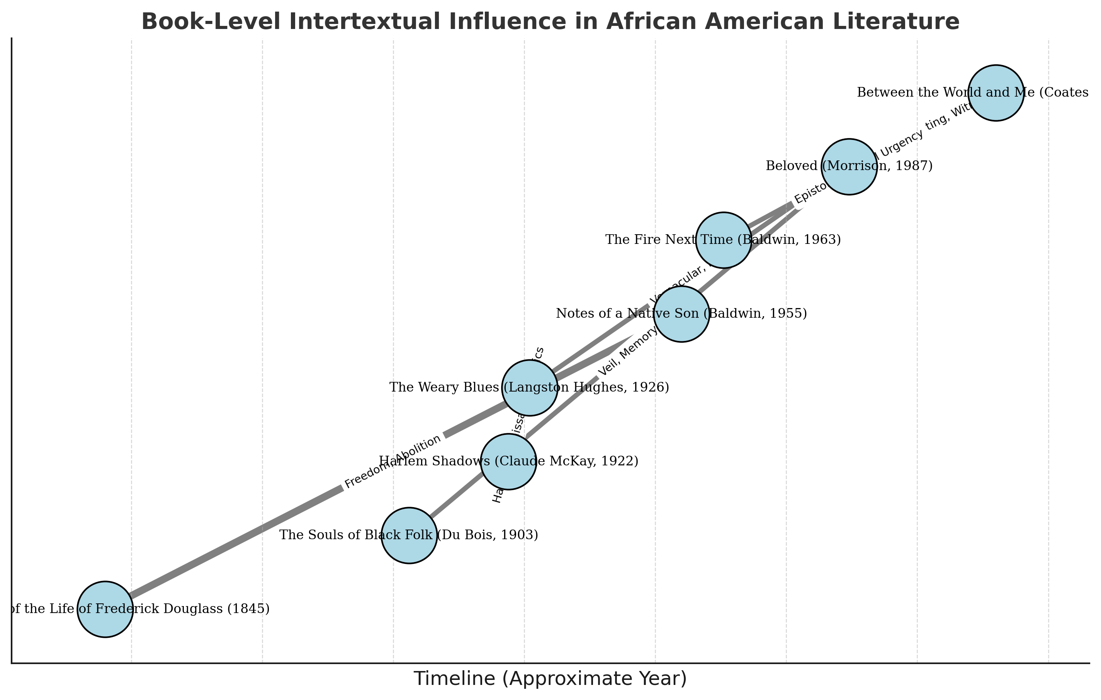
Book-Level Intertextual Influence in African American Literature

Slide 2

Explore Interactive Version (Local Link)

