Slide 1

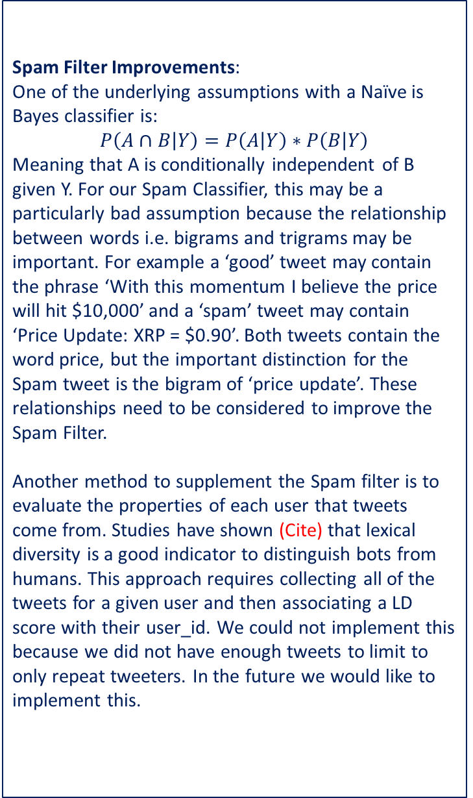
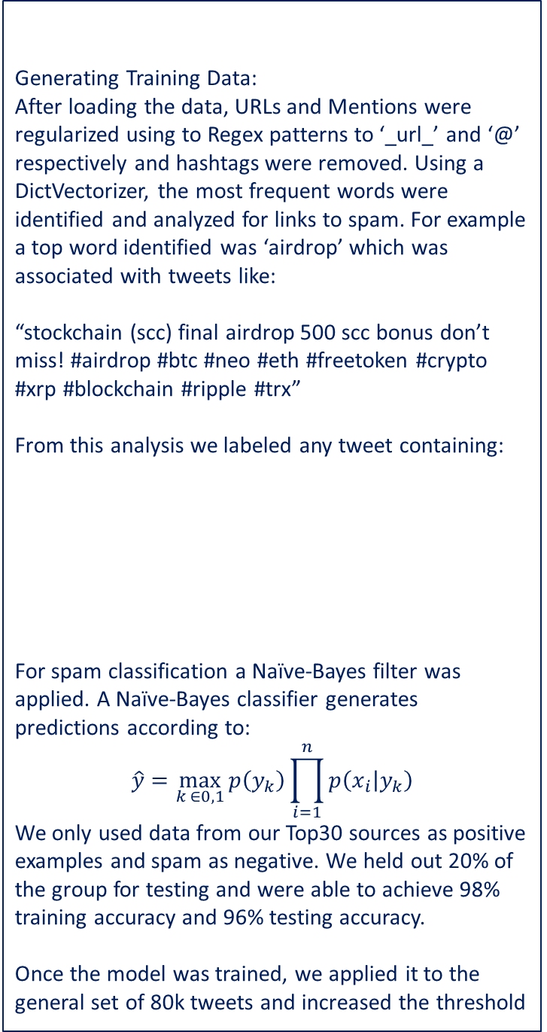
Using Twitter Sentiment Classification to Predict Hourly Changes in XRP Price Braden Fineberg (bfine@seas.upenn.edu) , Matt Oslin (muslin@seas.upenn.edu) , Sam Weintraub (sweint@seas.upenn.edu)
"stockchain (scc) final airdrop 500 scc bonus don't miss!\n airdrop bounty btc neo eth freetoken crypto xrp blockchain ripple trx tron trx binance freetoken airdrops \n https:// docs.google.com/forms/d/e/1fai pqlsc-ghga_-ausoepcc2fpr6exobnyku_s2noxq07gdjufvhwkq/viewform \xa0 …"
Summary
Spam Filter (Cont.)
Results
Data Collection & Pre-processing
Tweets:
Web-scraper on ‘Top 30 Crypto Accounts to Follow’ → Good data (17000 tweets)
Web-scraper on words containing ‘XRP or Ripple’ from April 13 to April 25 → 80k tweets
Include samples
Web-scraper returned the following string which was split into a pandas data frame using Regex patterns.
XRP Price Data:
XRP api queried hourly..
Naïve Bayes
Logisitc Regression
Neural Net
Models
Future Work
Spam Filter Improvements:
One of the underlying assumptions with a Naïve is Bayes classifier is:
$$P\left(A∩B | Y\right)=P\left(A | Y\right)∗P\left(B | Y\right)$$
Meaning that A is conditionally independent of B given Y. For our Spam Classifier, this may be a particularly bad assumption because the relationship between words i.e. bigrams and trigrams may be important. For example a ‘good’ tweet may contain the phrase ‘With this momentum I believe the price will hit $10,000’ and a ‘spam’ tweet may contain ‘Price Update: XRP = $0.90’. Both tweets contain the word price, but the important distinction for the Spam tweet is the bigram of ‘price update’. These relationships need to be considered to improve the Spam Filter.
Another method to supplement the Spam filter is to evaluate the properties of each user that tweets come from. Studies have shown (Cite) that lexical diversity is a good indicator to distinguish bots from humans. This approach requires collecting all of the tweets for a given user and then associating a LD score with their user_id. We could not implement this because we did not have enough tweets to limit to only repeat tweeters. In the future we would like to implement this.
Spam Filter
Generating Training Data:
After loading the data, URLs and Mentions were regularized using to Regex patterns to ‘_url_’ and ‘@’ respectively and hashtags were removed. Using a DictVectorizer, the most frequent words were identified and analyzed for links to spam. For example a top word identified was ‘airdrop’ which was associated with tweets like:
“stockchain (scc) final airdrop 500 scc bonus don’t miss! #airdrop #btc #neo #eth #freetoken #crypto #xrp #blockchain #ripple #trx”
From this analysis we labeled any tweet containing:
For spam classification a Naïve-Bayes filter was applied. A Naïve-Bayes classifier generates predictions according to:
$$\hat{y}=\max_{k ∈0,1}{p\left(y_{k}\right)\prod_{i=1}^{n}{p\left(x_{i} | y_{k}\right)}}$$
We only used data from our Top30 sources as positive examples and spam as negative. We held out 20% of the group for testing and were able to achieve 98% training accuracy and 96% testing accuracy.
Once the model was trained, we applied it to the general set of 80k tweets and increased the threshold
Top Spam Words
ICO | Freetoken | Token
Airdrop | Bigpumpgroup | Current Price
Free | Cryptobot | XRPticker

