Slide 1
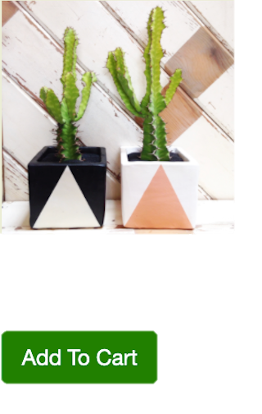
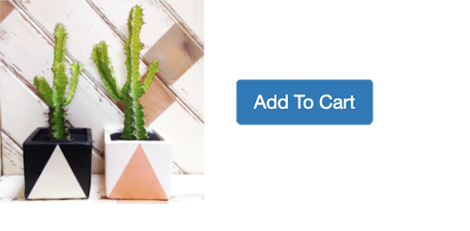
A / B Testing
A
B
Original
Modified
Changed placement & size of price
0 in cart
$14.99
Changed button color to match the greeny theme
+ eye-catching
Beautiful prickly pair in modern geometric pots. $14.99
0 in cart
Beautiful prickly pair in modern geometric pots.
Expected Results
1.
Time to Completion
Prices are located closer to the item itself & the ”Add to Cart” button, making the user flow more intuitive
2.
Return Rate
Prices have larger font sizes so it’s easier for users to add up items correctly to $150 on the 1st try & wouldn’t need to return to the shopping page again after checkout
ACTUAL Results
1.
Time to Completion
| fail to reject null
| statistically insignificant
There was a clicking bug in the checkout button in Version B & users were confused as to how to complete the task
2.
Return Rate
| reject null
| statistically significant
From the two batches of users testing Version B (pre & post bug fix), both had lower return rates due to both the bug (initially) & the larger font size

