Slide 1
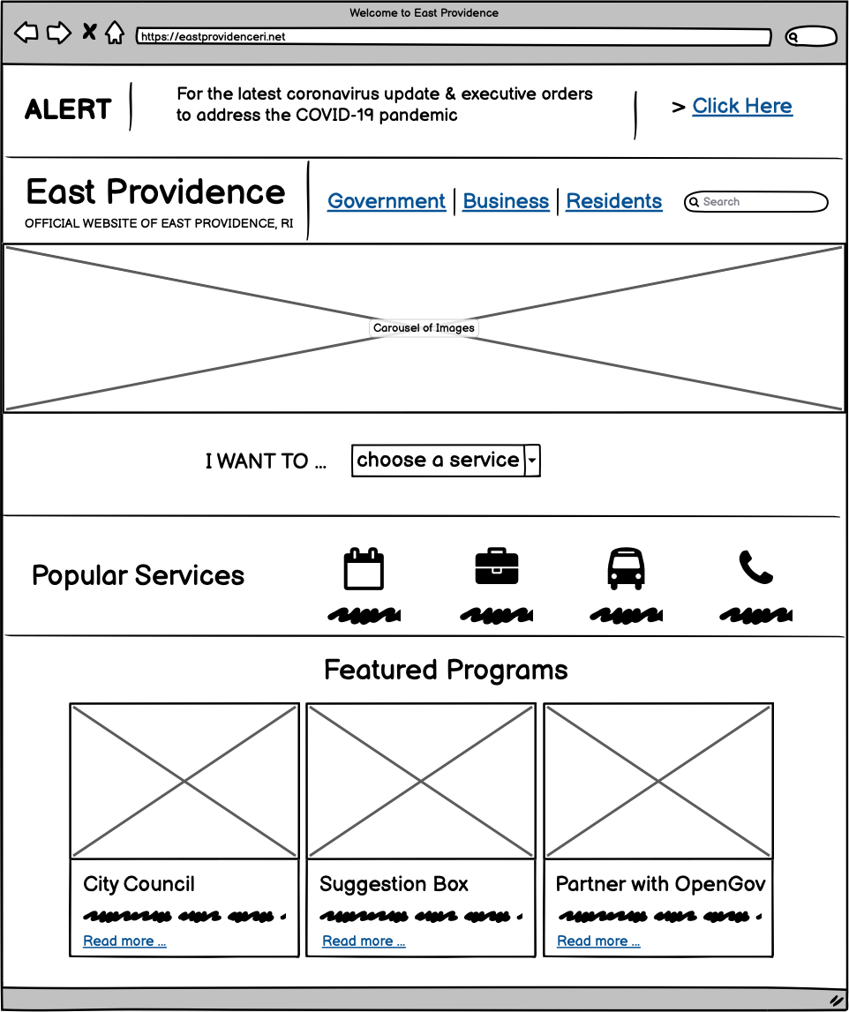
Reduced size of banner
Would choose a milder shade of red
Place title against white background for clarity & simplicity
Places one single image/article for better focus
Provides all impotant/common functions in one place
Quick access to most commonly used features
Uses icons for better understanding/usability
Uses card-like stack to organize recent event info + new programs
Groups functions by category (e.g. popularity, featured, etc)

Slide 2
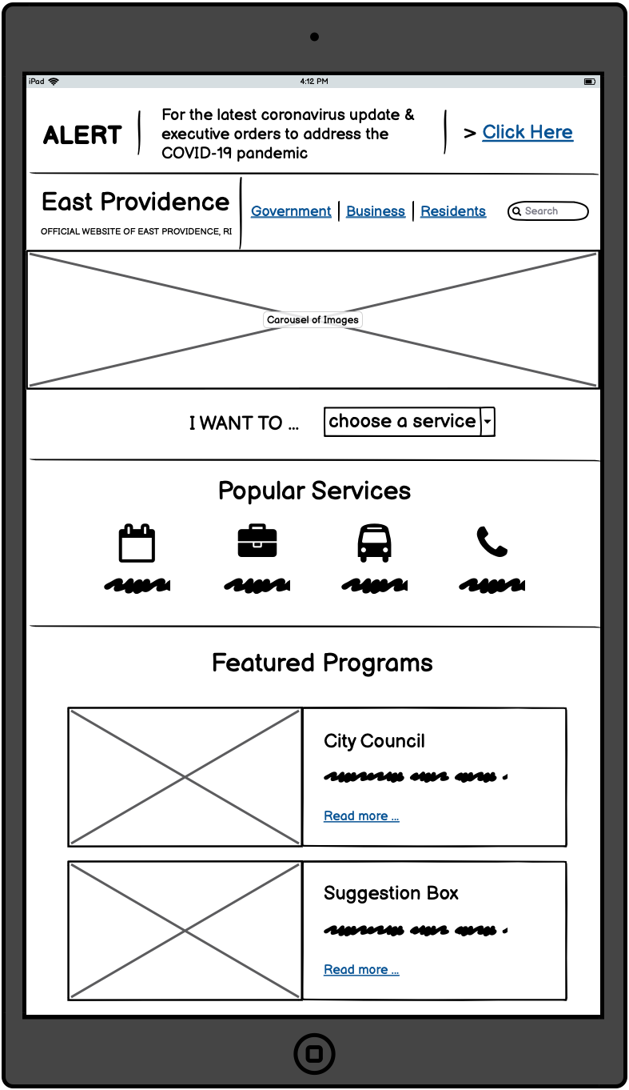
Shrinks font to adjust responsively
Moves section title from side to top for better view on tablets
Changes cards from a horizontal to vertical layout
for better view on tablets

Slide 3
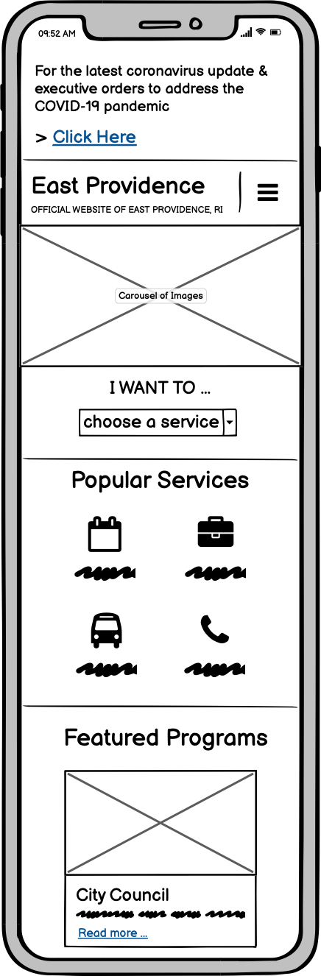
Shrinks text into one blurb for better view on phones
Changes navigation bar to menu icon
Changes to vertical layout of text + button
Changes grouping of icons & number of icons per row
Inherits vertical layout from tablet view, but with text underneath image

Slide 4
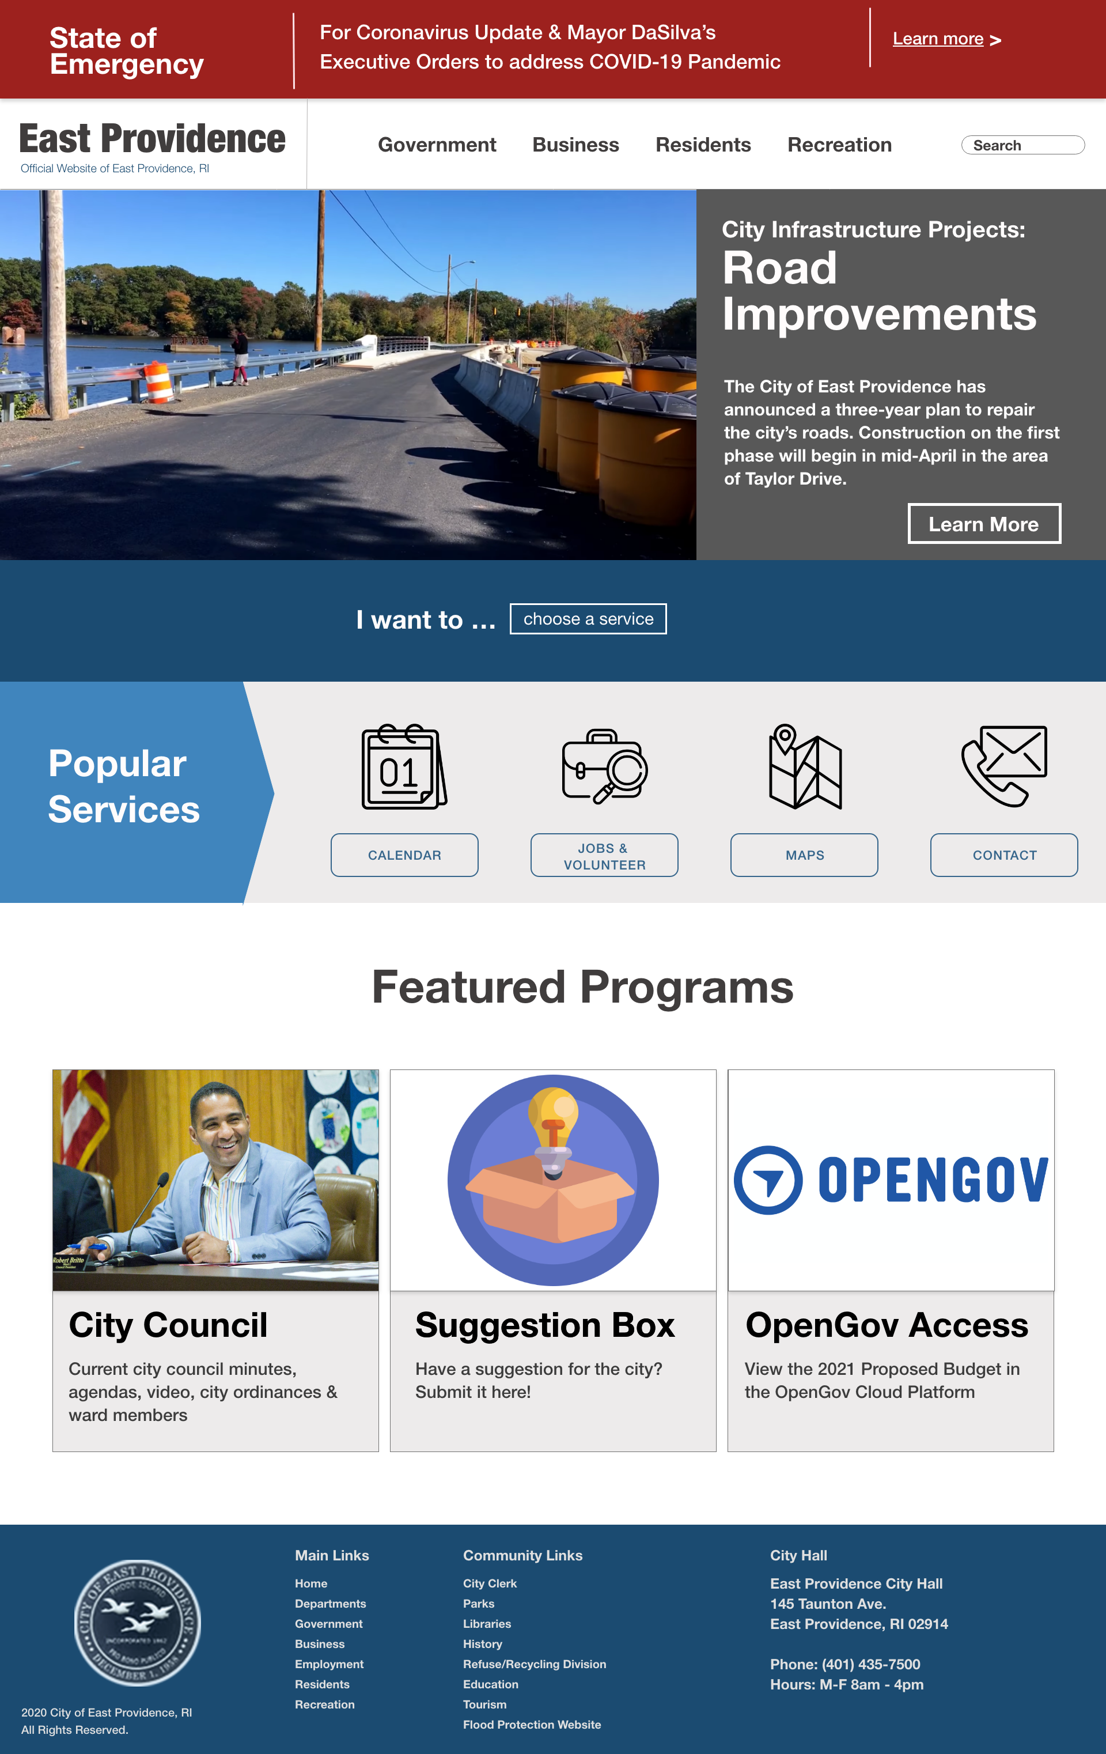
Banner with slight shadowing to grab attention, makes it ”stand out”
Choose a milder shade of red
Flex container with columns to divide title + navigation bar
Uses dropdown menu to contain various functions
Uses row to contain columns of icon + text that adapts responsively
Uses the bootstrap card element with image & shadowing

Slide 5
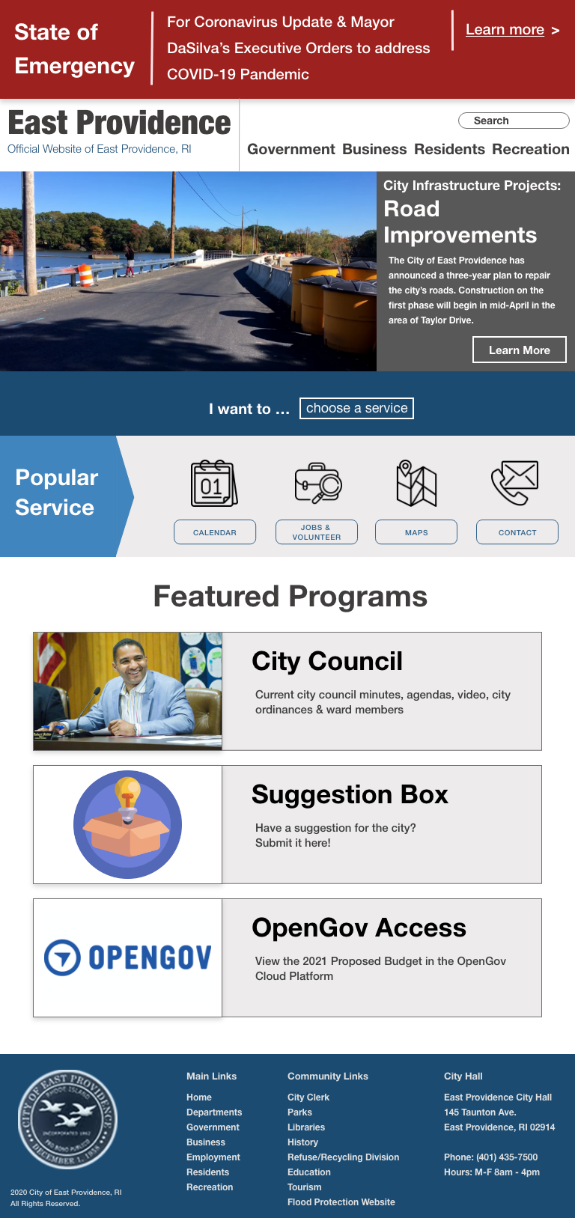
Shrinks font to adjust responsively without losing readibility
Changes cards from a horizontal to vertical layout

Slide 6
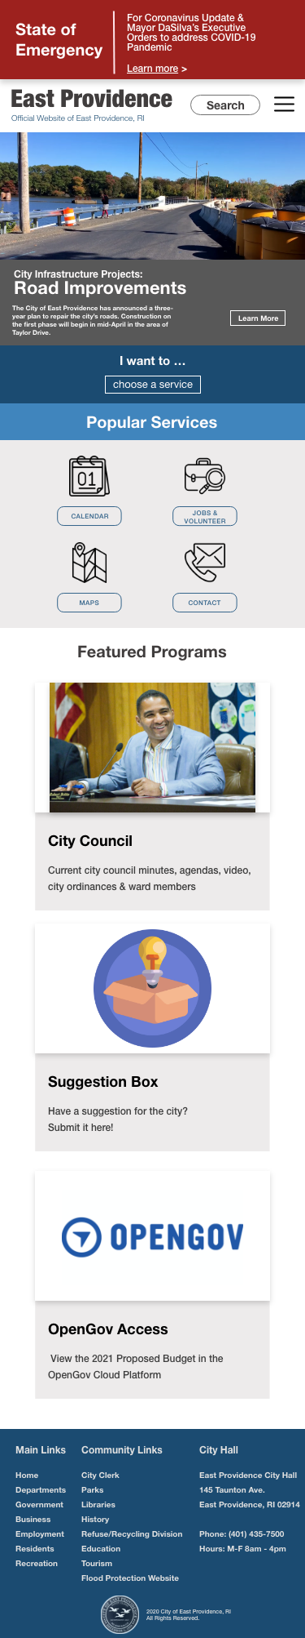
Shrinks text into one blurb
Changes navigation bar to menu icon
Changes grouping of icons & number of icons per row
Inherits vertical layout from tablet view but shifting text beneath iamge
Moves image of seal from beside to under text

