Slide 1




Ivermectin And Cancer

Slide 2
Ivermectin's role in Cancer
-Apoptosis Caspase 3 and 9
-Autophagy Pak1
-Mtor/Atk1
-Viral Load Suppression
-Parasite load Suppression
-Stops Cancer Stem Cells
-Directly Effect TME (Tumor Micro Environment)
PAK1-mediated cytostatic autophagy, caspase-dependent apoptosis and immunogenic cell death (ICD) through the modulation of some pathways, including the WNT-T cell factor (TCF), Hippo and Akt/ mTOR pathways. Ivermectin can affect the growth and proliferation of cancer cells and plays several different roles, such as its functions as an RNA helicase, a small-molecule mimetic of the surface-induced dissociation (SID) peptide, an activator of chloride channel receptors, and an inducer of mitochondrial dysfunction and oxidative stress. In addition, ivermectin induces the multidrug resistance protein (MDR), has potent anti-mitotic activity, targets angiogenesis and inhibits cancer stem-like cells (CSCs)

Slide 3
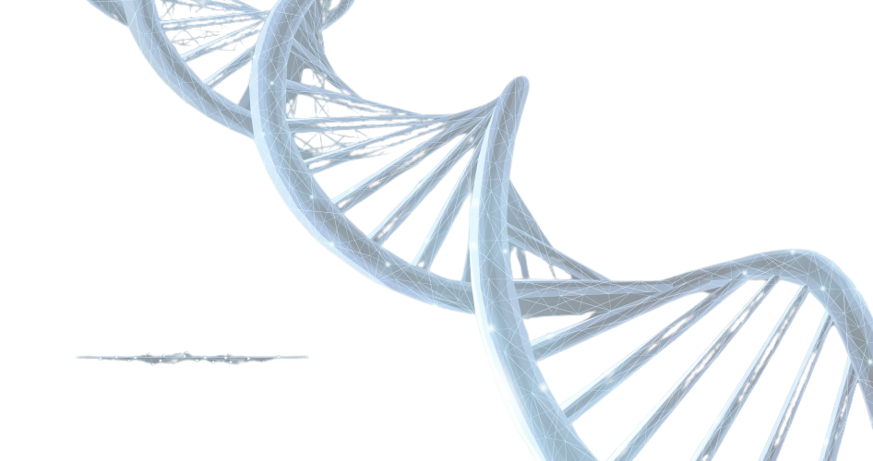
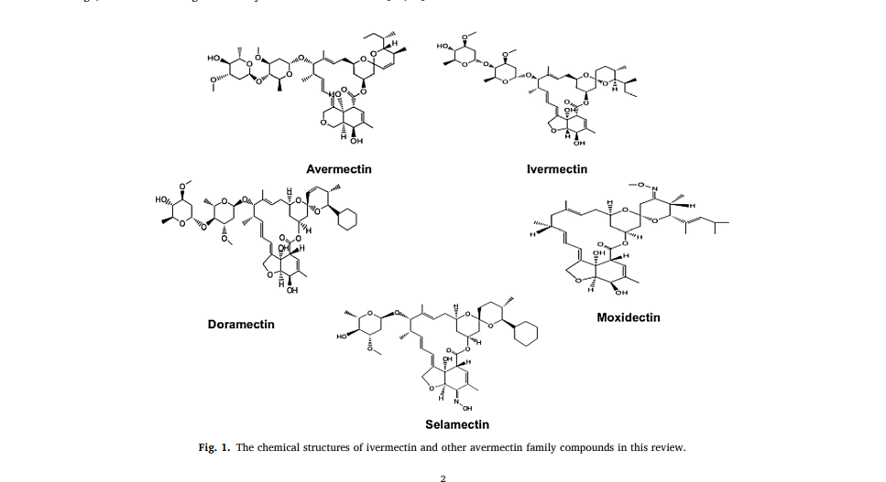

Slide 4

Major Causes of Cancer
Viral Load (EBV, Gingivitis, Hpv, Cyto, H.Pylori , Hepatitis B, C, Herpes)
Fungus Converts (Candida then Mold) Carbon Cycle Stages
Communication Breakdown
EMF over exposure
Unchecked CSC (Cancer Stem Cells)
Nagalase degrades G protein ligands crucial to seeing the cancer TME
Always compounding issues resulting in further depletion of Nutrients
Microbiome (Why)All disease rooted here now ask why) Breastfed? Overuse antibiotics?
Major and Minor Nutrient Deficiencies (role of minerals in cancer)
TRAUMAS
Cell Pathogen Colonization (parasites, amalgam, dental issues ,
Breeding of these colonies with parasites suppressing Autophagy and Apoptosis Pathways
Mtor, CSC, P53, p21, Akt1, Caspase3 and 9
Unchecked ROS (ETC Malfunction)
Electricity Lost in the cell
Compounding Immune over response
Ivermectin also needs 90 nutrients 60 of them needed in a bioavailble form because it is no longer in the food so we must supplement.

Slide 5
Major Causes of Cancer cont.
Periodontal Cavity Microbes and Parasites hang out in old root canals and bad teeth these colonies over time go systemic from the swallowing , as well as the occasional and over occasional leaky gut in most of our members
Amalgamation will change up to 70 percent of the gut microbiome to antibiotic resistant this is not organic mercury as you may of read about in alchemy studies this is inorganic and will also eat the mylein sheath of the brain.
Mineral deficiencies such as Iodine, magnesium , selenium , zinc, iodine , vitamin D all play a role in immune modulation without cofactors like magnesium there isn't a vitamin on earth that will help you so add A,B-Vitamins to that list and most Likely C.
-EAA must be accounted for
-Remember Ivermectin is a tool not a cure all
-Constant exposure to Xenoestrogen - soft plastics - modified fried chicken
Mold , Mycotoxins.
Lets Look at the Carbon Cycle

Slide 6




Carbon Cycle Illustrated
Bacteria
(Garbage Collectors)
Mould
Undertakers
Then.....
Then.....
Yeast / Fungus (Exterminators)
Finally the matter turns to dust.....

Slide 7
Ivermectin and Viruses
The basis of ivermectin’s broad-spectrum antiviral activity appears to relate to the fact that ivermectin binds to, and inhibits, the nuclear transport role of the host importin (IMP ) protein [11,18,20], which is known to mediate nuclear import of various viral proteins and key host factors, but other possible antiviral actions of ivermectin have been proposed (e.g., [12]), including in the case of SARS-CoV-2 (e.g., [21,22]). From 2012 onwards, there have multiple reports that ivermectin has antiviral properties [4,5,7–17] towards a growing number of RNA viruses, including human immunodeficiency virus(HIV)-1,influenza, flaviruses such as dengue virus (DENV) and Zika virus (ZIKV) and, most notably, SARS-CoV-2 (COVID-19) [17]. Evidence for activity against DNA viruses is more limited, but encompasses Pseudorabies, polyoma and adenoviruses.
Ivermectin as an IMP Targeting Agent with Antiviral Activity Transport into and out of the nucleus is central to eukaryotic cell and tissue function, with a key role to play in viral infection, where a common strategy used by viruses is to antagonize the cellular antiviral response [14,27]. The targeting signal-dependent mediators of this transport are the members of the IMP superfamily of proteins, of which there are multiple and forms [14,27]. The pathway mediated by the IMP / 1 heterodimer is the best characterized pathway by which host proteins, including members of the signal transducers and activators of transcription (STATs) and nuclear factor kappa-light-chain-enhancer of activated B cells (NF-B) transcription factor families, enter the nucleus through nuclear envelope-embedded nuclear pores. A large number of viral proteins (e.g., [27,28]) also use this pathway (see Figure 1), where IMP within the IMP / 1 heterodimer performs the adaptor role of specific targeting signal recognition, while IMP 1 performs the main nuclear roles of binding to/translocation through the nuclear pores, and release of the nuclear import cargo within the nucleus (Figure 1) [27].

Slide 8
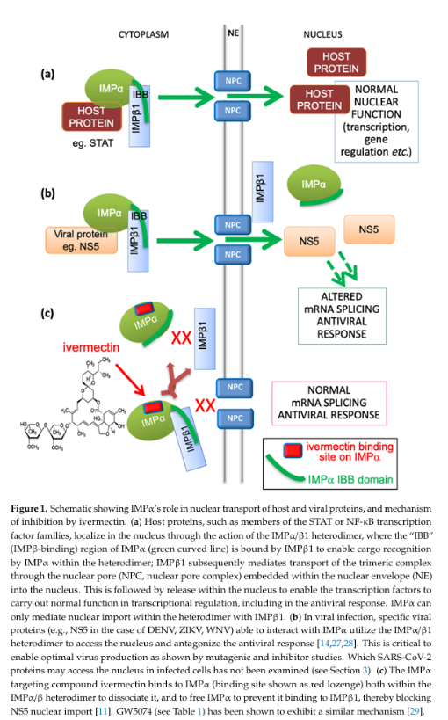
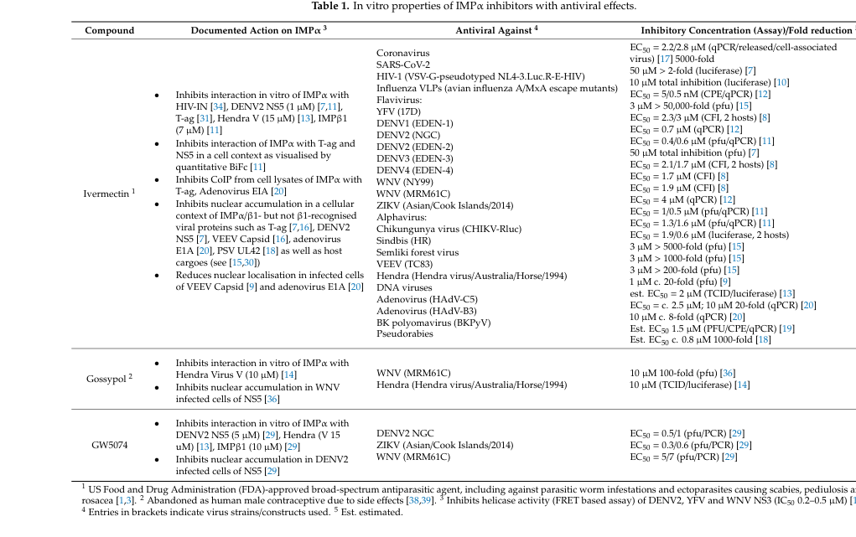

Slide 9
Ivermectin, a dihydro derivative of avermectin (AVM), was introduced into the veterinary, agricultural and aquaculture markets for animal health in 1981. Ivermectin was soon adopted in 1987 as a human medicine that was originally used for the treatment of onchocercia- sis, a parasitic infection. Since then, ivermectin has also been used to control other human diseases and has exerted a significant effect on human health and welfare. In the past decade, many published studies have attempted to determine the role of ivermectin in cancer.
In this review, we summarize the published studies to define the current progress in the characterization of ivermectin. Ivermectin causes cell death in cancer cell lines by inducing PAK1-mediated cytostatic autophagy, caspase-dependent apoptosis and immunogenic cell death (ICD) through the modulation of some pathways, including the WNT-T cell factor (TCF), Hippo and Akt/ mTOR pathways. Ivermectin can affect the growth and proliferation of cancer cells and plays several different roles, such as its functions as an RNA helicase, a small-molecule mimetic of the surface-induced dissociation (SID) peptide, an activator of chloride channel receptors, and an inducer of mitochondrial dysfunction and oxidative stress. In addition, ivermectin induces the multidrug resistance protein (MDR), has potent anti-mitotic activity, targets angiogenesis and inhibits cancer stem-like cells (CSCs). Many studies have proven that ivermectin exerts anti- tumor effects and might thus benefit patients with cancer after sufficient clinical trials.

Slide 10
Here, we systematically summarize the anticancer effect and mechanism of IVM by cancer type, which is of great significance for the repositioning of IVM for cancer treatment.
Breast Cancer -
Breast cancer is a malignant tumor produced by gene mutation in breast epithelial cells caused by multiple carcinogens. The incidence of breast cancer has increased each year, and it has become one of the female malignant tumors with the highest incidence in globally. On average, a new case is diagnosed every 18 seconds worldwide. After treatment with IVM, the proliferation of multiple breast cancer cell lines including MCF-7, MDA-MB-231 and MCF-10 was significantly reduced. The mechanism involved the inhibition by IVM of the Akt/mTOR pathway to induce autophagy and p-21-activated kinase 1 (PAK1)was the target of IVM for breast cancer [32]. Furthermore, Diao’s study showed that IVM could inhibit the proliferation of the canine breast tumor cell lines CMT7364 and CIPp by blocking the cell cycle without increasing apoptosis, and the mechanism of IVM may be related to the inhibition of the Wnt pathway [33]. Triple-negative breast cancer (TNBC) refers to cancer that is negative for estrogen receptor, progesterone receptor, and human epidermal growth factor receptor 2(HER2) and is the most aggressive subtype of breast cancer with the worst prognosis. In addition, there is also no clinically applicable therapeutic drug currently [34,35]. A drug screening study of TNBC showed that IVM could be used as a SIN3-interaction domain (SID) mimic to selectively block the interaction between SID and paired a-helix2. In addition, IVM regulated the expression of the epithelial mesenchymal-transition (EMT) related gene E-cadherin to restore the sensitivity of TNBC cells to tamoxifen, which implies the possibility that IVM functions as an epigenetic regulator in the treatment of cancer[36]. Recent studies have also found that IVM could promote the death of tumor cells by regulating the tumor microenvironment in breast cancer. Under the stimulation of a tumor microenvironment with a high level of adenosine triphosphate (ATP) outside tumor cells, IVM could enhance the P2 × 4/ P2 × 7/Pannexin-1 mediated release of high mobility group box-1 protein (HMGB1) [37]. However, the release of a large amount of HMGB1 into the extracellular environment will promote immune cell-mediated immunogenic death and inflammatory reactions, which will have an inhibitory effect on the growth of tumor cells. Therefore, we believe that the anticancer effect of IVM is not limited to cytotoxicity, but also involves the regulation of the tumor microenvironment. IVM regulates the tumor microenvironment and mediates immunogenic cell death, which may be a new direction for research exploring anticancer mechanisms in the future.

Slide 11
Stomach Cancer
Gastric cancer is one of the most common malignant tumors world wide. In the past year, more than one million patients with gastric cancer have been diagnosed worldwide [38]. Nambara’s study showed that IVM could significantly inhibit the proliferation of gastric cancer cells in vivo and in vitro and that the inhibitory effect of IVM depended on the expression of Yes-associated protein 1(YAP1)[39]. The gastric cancer cell lines MKN1 and SH-10-TC have higher YAP1 expression than MKN7 and MKN28 cells, so MKN1 and SH-10-TC cells are sensitive to IVM, while MKN7 and MKN28 are not sensitive to IVM.YAP1 plays an onco genic role in tumorigenesis, indicating the possibility of the use of IVM as a YAP1 inhibitor for cancer treatment [40]. In a study that screened Wnt pathway inhibitors, IVM inhibited the proliferation of multiple cancers, including the colorectal cancer cell lines CC14, CC36, DLD1, and Ls174 T, and promoted apoptosis by blocking the Wnt pathway [41]. After intervention with IVM, the expression of caspase-3 in DLD1 and Ls174 T cells increased, indicating that IVM has an apoptosis-inducing effect and inhibits the expression of the downstream genes AXIN2, LGR5, and ASCL2 in the Wnt/β-catenin pathway. Hepatocellular carcinoma is the fourth leading cause of cancer death worldwide. Approximately 80% of cases of liver cancer are caused by hepatitis B virus (HBV) and hepatitis C virus (HCV) infection [42]. IVM could inhibit the development of hepatocellular carcinoma by blocking YAP1 activity in spontaneous liver cancer Mob1b-/- mice [43].Chol angiocarcinoma is a malignant tumor that originates in the bile duct inside and outside the liver. Intuyod’s experiment found that IVM inhibited the proliferation of KKU214 cholangiocarcinoma cells in a dose- and time-dependent manner [44]. IVM halted the cell cycle in S phase and promoted apoptosis. Surprisingly, gemcitabine-resistant KKU214 cells showed high sensitivity to IVM, which suggested that IVM shows potential for the treatment of tumors that are resistant to conventional chemotherapy drugs.

Slide 12

Ivermectin and Urinary System
Urinary systems cancer Renal cell carcinoma is a fatal malignant tumor of the urinary system derived from renal tubular epithelial cells. Its morbidity has increased by an average of 2% annually worldwide and the clinical treatment ef fect is not satisfactory [45–47]. Experiments confirmed that IVM could significantly inhibit the proliferation of five renal cell carcinoma cell lines without affecting the proliferation of normal kidney cells, and its mechanism may be related to the induction of mitochondrial dysfunc tion [48]. IVM could significantly reduce the mitochondrial membrane potential and inhibit mitochondrial respiration and ATP production. The presence of the mitochondrial fuel acetyl-L-carnitine (ALCAR), and the antioxidant N-acetyl-L-cysteine (NAC), could reverse IVM-induced in hibition. In animal experiments, the immunohistochemical results for IVM-treated tumor tissues showed that the expression of the mito chondrial stress marker HEL was significantly increased, and the results were consistent with those of the cell experiments. Prostate cancer is a malignant tumor derived from prostate epithelial cells, and its morbidity is second only to that of lung cancer among men in Western countries [49]. In Nappi’s experiment, it was found that IVM could enhance the drug activity of the anti-androgen drug enzalutamide in the prostate cancer cell line LNCaP and reverse the resistance of the prostate cancer cell line PC3 to docetaxel [50]. Interestingly, IVM also restored the sensitivity of the triple-negative breast cancer to the anti-estrogen drug tamoxifen [36], which also implies the potential for IVM to be used in endocrine therapy. Moreover, IVM was also found to have a good inhibitory effect on the prostate cancer cell line DU145

Slide 13
Hematological cancer
Leukemia is a type of malignant clonal disease caused by abnormal hematopoietic stem cells [52]. In an experiment designed to screen potential drugs for the treatment of leukemia, IVM preferentially killed leukemia cells at low concentrations without affecting normal hemato poietic cells [51]. The mechanism was related to the increase in the influx of chloride ions into the cell by IVM, resulting in hyperpolar ization of the plasma membrane and induction of reactive oxygen spe cies (ROS) production. It was also proven that IVM has a synergistic effect with cytarabine and daunorubicin on the treatment of leukemia. Wang’s experiment found that IVM could selectively induce mitochon drial dysfunction and oxidative stress, causing chronic myeloid leuke mia K562 cells to undergo increased caspase-dependent apoptosis compared with normal bone marrow cells [53]. It was also confirmed that IVM inhibited tumor growth in a dose-dependent manner, and dasatinib had improved efficacy

Slide 14
Reproductive system cancer
Cervical cancer is one of the most common gynecological malig nancies, resulting in approximately 530,000 new cases and 270,000 deaths worldwide each year. The majority of cervical cancers are caused by human papillomavirus (HPV) infection [54,55]. IVM has been proven to significantly inhibit the proliferation and migration of HeLa cells and promote apoptosis [56]. After intervention with IVM, the cell cycle of HeLa cells was blocked at the G1/S phase, and the cells showed typical morphological changes related to apoptosis. Ovarian cancer is a malignant cancer that lacks early clinical symptoms and has a poor therapeutic response. The 5-year survival rate after diagnosis is approximately 47% [27,57]. In a study by Hashimoto, it found that IVM inhibited the proliferation of various ovarian cancer cell lines, and the mechanism was related to the inhibition of PAK1 kinase [58]. In research to screen potential targets for the treatment of ovarian cancer through the use of an shRNA library and a CRISPR/Cas9 library, the oncogene KPNB1 was detected. IVM could block the cell cycle and induce cell apoptosis through a KPNB1-dependent mechanism in ovarian cancer [59]. Interestingly, IVM and paclitaxel have a syner gistic effect on ovarian cancer, and combined treatment in in vivo ex periments almost completely inhibited tumor growth. Furthermore, according to a report by Zhang, IVM can enhance the efficacy of cisplatin to improve the treatment of epithelial ovarian cancer, and the mecha nism is related to the inhibition of the Akt/mTOR pathway [60].

Slide 15
Brain glioma
Glioma is the most common cerebral tumor and approximately 100,000 people worldwide are diagnosed with glioma every year. Glioblastoma is the deadliest glioma, with a median survival time of only 14-17 months [61,62]. Experiments showed that IVM inhibited the proliferation of human glioblastoma U87 and T98 G cells in a dose-dependent manner and induced apoptosis in a caspase-dependent manner [63]. This was related to the induction of mitochondrial dysfunction and oxidative stress. Moreover, IVM could induce apoptosis of human brain microvascular endothelial cells and significantly inhibit angiogenesis. These results showed that IVM had the potential to resist tumor angiogenesis and tumor metastasis. In another study, IVM inhibited the proliferation of U251 and C6 glioma cells by inhibiting the Akt/mTOR pathway [64]. In gliomas, miR-21 can regulate the Ras/MAPK signaling pathway and enhance its effects on proliferation and invasion [65]. The DDX23 helicase activity affects the expression of miR-12 [66]. IVM could inhibit the DDX23/miR-12 signaling pathway by affecting the activity of DDX23 helicase, thereby inhibiting malignant biological behaviors. This indicated that IVM may be a potential RNA helicase inhibitor and a new agent for of tumor treatment. However, here, we must emphasize that because IVM cannot effectively pass the blood-brain barrier [67], the prospect of the use of IVM in the treatment of gliomas is not optimistic unless using DMSO perhaps! TBD

Slide 16
Respiratory system cancer
Nasopharyngeal carcinoma is a malignant tumor derived from epithelial cells of the nasopharyngeal mucosa. The incidence is obviously regional and familial, and Epstein-Barr virus (EBV) infection is closely related [68]. In a study that screened drugs for the treatment of nasopharyngeal cancer, IVM significantly inhibited the development of nasopharyngeal carcinoma in nude mice at doses that were not toxic to normal thymocytes [69]. In addition, IVM also had a cytotoxic effect on a variety of nasopharyngeal cancer cells in vitro, and the mechanism is related to the reduction of PAK1 kinase activity to inhibit the MAPK pathway. Lung cancer has the highest morbidity and mortality among cancers [70]. Nishio found that IVM could significantly inhibit the proliferation of H1299 lung cancer cells by inhibiting YAP1 activity [43]. Nappi’s experiment also proved that IVM combined with erlotinib to achieved a synergistic killing effect by regulating EGFR activity and in HCC827 lung cancer cells [50]. In addition, IVM could reduce the metastasis of lung cancer cells by inhibiting EMT.

Slide 17
Melanoma
is the most common malignant skin tumor with a high mortality rate. Drugs targeting BRAF mutations such as vemurafenib, dabrafenib and PD-1 monoclonal antibodies, including pembrolizumab and nivolumab have greatly improved the prognosis of melanoma [71, 72]. Gallardo treated melanoma cells with IVM and found that it could effectively inhibit melanoma activity [73]. Interestingly, IVM could also show activity against BRAF wild-type melanoma cells, and its combi nation with dapafinib could significantly increase antitumor activity. Additionally, it has been confirmed that PAK1 is the key target of IVM that mediates its anti-melanoma activity, and IVM can also significantly reduce the lung metastasis of melanoma in animal experiments. Deng found that IVM could activate the nuclear translocation of TFE3 and induce autophagy-dependent cell death by dephosphorylation of TFE3 (Ser321) in SK-MEL-28 melanoma cells [74]. However, NAC reversed the effect of IVM, which indicated that IVM increased TFE3-dependent autophagy through the ROS signaling pathway

Slide 18
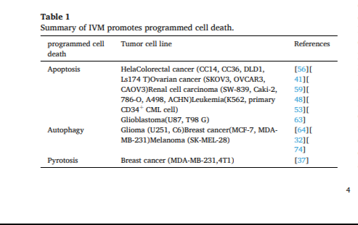
IVM-induced programmed cell death in tumor cells and related mechanisms
Apoptosis IVM induces different programmed cell death patterns in different tumor cells (Table 1). As shown in Table 1, the main form of IVM induced programmed cell death is apoptosis. Apoptosis is a programmed cell death that is regulated by genes to maintain cell stability.

Slide 19
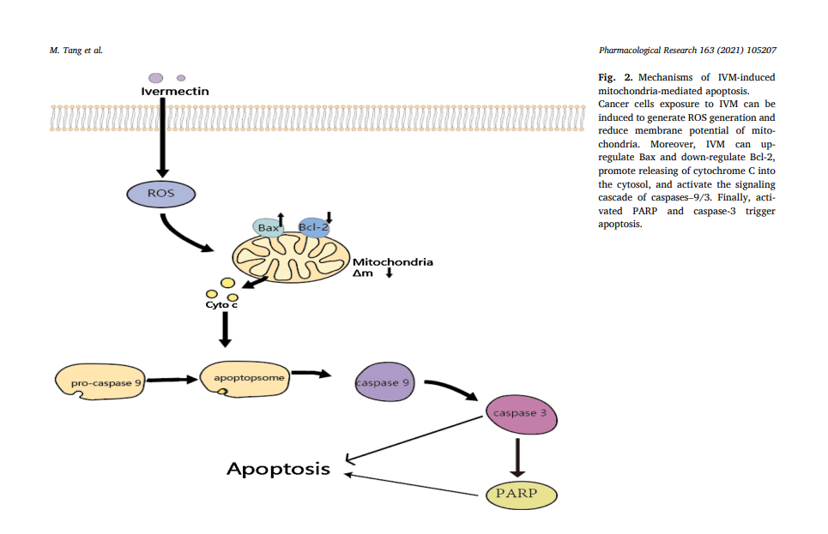

Slide 20
It can be triggered by two activation pathways: the endogenous endoplasmic reticulum stress/mitochondrial pathway and the exogenous death receptor pathway [75,76]. The decrease in the mitochondrial membrane potential and the cytochrome c is released from mitochondria into the cytoplasm was detected after the intervention of IVM in Hela cells [56]. Therefore, we infer that IVM induces apoptosis mainly through the mitochondrial pathway. In addition, morphological changed caused by apoptosis, including chromatin condensation, nuclear fragmentation, DNA fragmentation and apoptotic body formation were observed. Finally, IVM changed the balance between apoptosis-related proteins by upregulating the protein Bax and downregulating anti-apoptotic protein Bcl-2, thereby activating caspase-9/-3 to induce apoptosis [48,53,63]

Slide 21
Autophagy
Autophagy is a lysosomal-dependent form of programmed cell death. It utilizes lysosomes to eliminate superfluous or damaged organelles in the cytoplasm to maintain homeostasis. It is characterized by doublelayered or multilayered vacuolar structures containing cytoplasmic components, which are known as autophagosomes [77]. In recent years, many studies have shown that autophagy is a double-edged sword in tumor development. On the one hand, autophagy can help tumors adapt to the nutritional deficiency of the tumor microenvironment, and to a certain extent, protect tumor cells from chemotherapy- or radiotherapyinduced injury. On the other hand, some autophagy activators can in crease the sensitivity of tumors to radiotherapy and chemotherapy by inducing autophagy, and excessive activation of autophagy can also lead to tumor cell death [78–81]. Overall, the specific environment of tumor cells will determine whether autophagy enhances or inhibits tumor development and improving autophagy activity has also become a new approach in cancer therapy. Programmed cell death mediated by autophagy after IVM intervention and the enhancement of the anticancer efficacy of IVM by regulating autophagy are interesting topics. Inter vention with IVM in the breast cancer cell lines MCF-7 and MDA-MB-231 significantly increased intracellular autophagic flux and the expression of key autophagy proteins such as LC3, Bclin1, Atg5, and the formation of autophagosomes can be observed [32]. However, after using the autophagy inhibitors chloroquine and wortmannin or knocking down Bclin1 and Atg5 by siRNA to inhibit autophagy, the anticancer activity of IVM significantly decreased. This proves that IVM mainly exerts an antitumor effect through the autophagy pathway. In addition, re searchers also used the Akt activator CA-Akt to prove that IVM mainly induces autophagy by inhibiting the phosphorylation of Akt and mTOR (Fig. 3). The phenomenon of IVM-induced autophagy has also been re ported in glioma and melanoma [64,74]. All of the above findings indicate the potential of IVM as an autophagy activator to induce autophagy-dependent death in tumor cells.

Slide 22
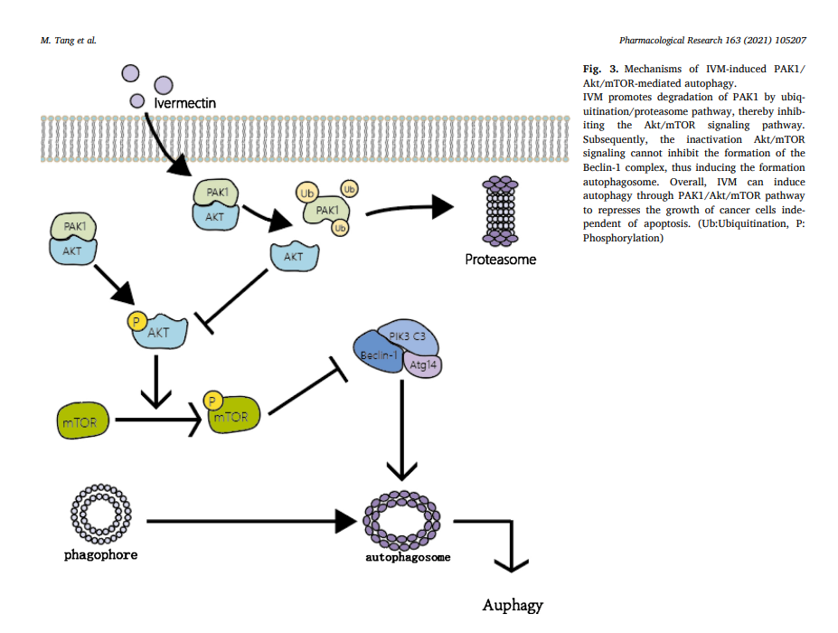

Slide 23
Cross talk between IVM-induced apoptosis and autophagy
The relationship between apoptosis and autophagy is very compli cated, and the cross talk between the two plays a vital role in the development of cancer [82]. Obviously, the existing results suggest that IVM-induced apoptosis and autophagy also exhibit cross talk. For example, it was found in SK-MEL-28 melanoma cells that IVM can promote apoptosis as well as autophagy [74]. After using the autophagy inhibitor bafilomycin A1 or siRNA to downregulate Beclin1, IVM-induced apoptosis was significantly enhanced, which suggested that enhanced autophagy will reduce IVM-induced apoptosis and that IVM-induced autophagy can protect tumor cells from apoptosis. How ever, in breast cancer cell experiments, it was also found that IVM could induce autophagy, and enhanced autophagy could increase the anti cancer activity of IVM [37]. The latest research shows that in normal circumstances autophagy will prevent the induction of apoptosis and apoptosis-related caspase enzyme activation will inhibit autophagy. However, in special circumstances, autophagy may also help to induce apoptosis or necrosis [83]. In short, the relationship between IVM-induced apoptosis and autophagy involves a complex regulatory mechanism, and the specific molecular mechanism needs further study. We believe that deeper exploration of the mechanism can further guide the use of IVM in the treatment of cancer.

Slide 24
Pyroptosis
Pyroptosis is a type of inflammatory cell death induced by inflammasomes. The inflammasome is a multimolecular complex containing pattern recognition receptor (PRR), apoptosis-associated speck-like protein containing a CARD (ASC), and pro-caspase-1. PRR can identify pathogen-associated molecular patterns (PAMPs) that are structurally stable and evolutionarily conserved on the surface of pathogenic mi croorganisms and damage-associated molecular patterns (DAMPs) pro duced by damaged cells [84,85]. Inflammasomes initiate the conversion of pro-caspase-1 via self-shearing into activated caspase-1. Activated caspase-1 can cause pro-IL-1β and pro-IL-18 to mature and to be secreted. Gasdermin D(GSDMD)is a substrate for activated caspase-1 and is considered to be a key protein in the execution of pyroptosis [86,87]. In an experiment by Draganov, it was found that the release of lactate dehydrogenase (LDH) and activated caspase-1 was significantly increased in breast cancer cells after IVM intervention [37]. In addition, characteristic pyroptosis phenomena such as cell swelling and rupturing were observed. The authors speculated that IVM may mediate the occurrence of pyroptosis via the P2 × 4/P2 × 7/NLRP3 pathway (Fig. 4), but there is no specific evidence to prove this speculation. Interestingly, in ischemia-reperfusion experiments, IVM aggravated renal ischemia via the P2 × 7/NLRP3 pathway and increased the release of proin flammatory cytokines in human proximal tubular cells [88]. Although there is currently little evidences showing that IVM induces pyroptosis, it is important to investigate the role of IVM in inducing pyroptosis in other cancers in future studies and realize that IVM may induce different types of programmed cell death in different types of cancer.

Slide 25
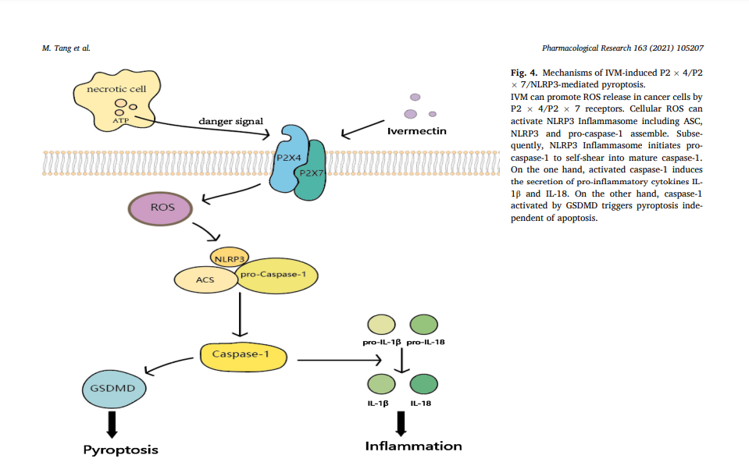

Slide 26
Anticancer effect of IVM through other pathways
Cancer stem cells Cancer stem cells (CSCs) are a cell population similar to stem cells with characteristics of self-renewal and differentiation potential in tumor tissue [89,90]. Although CSCs are similar to stem cells in terms of function, because of the lack of a negative feedback regulation mechanism for stem cell self-renewal, their powerful proliferation and multi directional differentiation abilities are unrestricted, which allows CSCs to maintain certain activities during chemotherapy and radiotherapy [90–92]. When the external environment is suitable, CSCs will rapidly proliferate to reactivate the formation and growth of tumors. Therefore, CSCs have been widely recognized as the main cause of recurrence after treatment [93,94]. Guadalupe evaluated the effect of IVM on CSCs in the breast cancer cell line MDA-MB-231 [95]. The experimental results showed that IVM would preferentially targeted and inhibited CSCs-rich cell populations compared with other cell populations in MDA-MB-231 cells. Moreover, the expression of the homeobox protein NANOG, octamer-binding protein 4 (OCT-4) and SRY-box 2 (SOX-2), which are closely related to the self-renewal and differentiation ability of stem cells in CSCs, were also significantly inhibited by IVM. This suggests that IVM may be used as a potential CSCs inhibitor for cancer therapy. Further studies showed that IVM could inhibit CSCs by regulating the PAK1-STAT3 axis [96].

Slide 27
Reversal of tumor multidrug resistance
MDR of tumor cells is the main cause of relapses and deaths after chemotherapy [97]. ATP binding transport family-mediated drug effluxand overexpression of P-glycoprotein (P-gp) are widely considered to be the main causes of tumor MDR [98–100]. Several studies have confirmed that IVM could reverse drug resistance by inhibiting P-gp and MDR-associated proteins [101–103]. In Didier’s experiments testing the effect of IVM on lymphocytic leukemia, IVM could be used as an in hibitor of P-gp to affect MDR [22]. In Jiang’s experiment, IVM reversed the drug resistance of the vincristine-resistant colorectal cancer cell line HCT-8, doxorubicin-resistant breast cancer cell line MCF-7 and the chronic myelogenous leukemia cell line K562 [104]. IVM inhibited the activation of EGFR and the downstream ERK/Akt/NF-kappa B signaling pathway to downregulate the expression of P-gp. Earlier, we mentioned the role of IVM in docetaxel-resistant prostate cancer [50] and gemcitabine-resistant cholangiocarcinoma [44]. These results indicated the significance of applying IVM for the treatment of chemotherapy patients with MDR

Slide 28
Enhanced targeted therapy and combined treatment
Targeted treatment of key mutated genes in cancer, such as EGFR in lung cancer and HER2 in breast cancer, can achieve powerful clinical effects [105,106]. HSP27 is a molecular chaperone protein that is highly expressed in many cancers and associated with drug resistance and poor prognosis. It is considered as a new target for cancer therapy [107]. Recent studies have found that IVM could be used as an inhibitor of HSP27 phosphorylation to enhance the activity of anti-EGFR drugs in EGFR/HER2- driven tumors. An experiment found that IVM could significantly enhance the inhibitory effects of erlotinib and cetuximab on lung cancer and colorectal cancer [50]. Earlier, we mentioned that IVM combined with conventional chemotherapeutic drugs such as cisplatin [60], paclitaxel [59], daunorubicin and cytarabine [51], or with targeted drugs such as dasatinib [53] and dapafenib [73] shows great potential for cancer treatment. The combination of drugs can effectively increase efficacy, reduce toxicity or delay drug resistance. Therefore, combination therapy is the most common method of chemotherapy. IVM has a variety of different mechanisms of action in different cancers, and its potential for synergistic effects and enhanced efficacy in combination therapy was of particular interest to us. Not only does IVM not overlap with other therapies in term of its mechanism of action, but the fact that of IVM has multiple targets suggests that it is not easy to produce IVM resistance. Therefore, continued study and testing of safe and effective combination drug therapies is essential to maximize the anticancer effects of IVM. Reduction of CPC, CSC, Vit/min Trace def., etc.

Slide 29
Molecular targets and signaling pathways involved in the anticancer potential of IVM
As mentioned above, the anticancer mechanism of IVM involves a wide range of signaling pathways such as Wnt/β-catenin, Akt/mTOR, MAPK and other possible targets such as PAK1 and HSP27, as well as other mechanisms of action (Table 2). We found that IVM inhibits tumor cell development in a PAK1-dependent manner in most cancers. Consequently, we have concentrated on discussing the role of PAK1 kinase and cross-talk between various pathways and PAK1 to provide new perspectives on the mechanism of IVM function.As a member of the PAK family of serine/threonine kinases, PAK1 has a multitude of biological functions such as regulating cell prolifer ation and apoptosis, cell movement, cytoskeletal dynamics and trans formation [108]. Previous studies have indicated that PAK1 is located at the intersection of multiple signaling pathways related to tumorigenesis and is a key regulator of cancer signaling networks (Fig. 5). The exces sive activation of PAK1 is involved in the formation, development, and invasion of various cancers [109,110]. Targeting PAK1 is a novel and promising method for cancer treatment, and the development of PAK1 inhibitors has attracted widespread attention [111]. IVM is a PAK1 in hibitor in a variety of tumors, and it has good safety compared to that of other PAK1 inhibitors such as IPA-3. In melanoma and nasopharyngeal carcinoma, IVM inhibited cell proliferation activity by inhibiting PAK1 to downregulate the expression of MEK 1/2 and ERK1/2 [69,73]. After IVM intervention in breast cancer, the expression of PAK1 was also significantly inhibited, and the use of siRNA to downregulate the expression of PAK1 in tumor cells significantly reduced the anticancer activity of IVM. Interestingly, IVM could inhibit the expression of PAK1 protein but did not affect the expression of PAK1 mRNA [32].The pro teasome inhibitor MG132 reversed the suppressive effect of IVM, which indicated that IVM mainly degraded PAK1 via the proteasome ubiq uitination pathway. We have already mentioned that IVM plays an anticancer role in various tumors by regulating pathways closely related to cancer development. PAK1 is at the junction of these pathways. Overall, we speculate that IVM can regulate the Akt/mTOR, MAPK and other pathways that are essential for tumor cell proliferation by inhib iting PAK1 expression, which plays an anticancer role in most cancers.

Slide 30
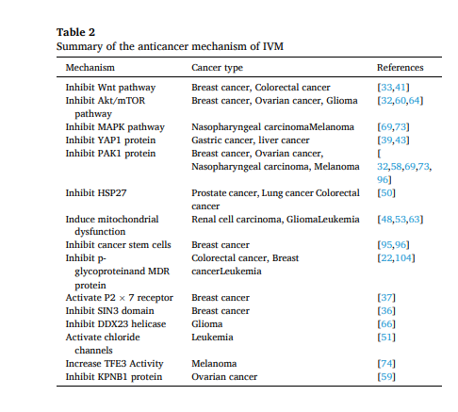

Slide 31
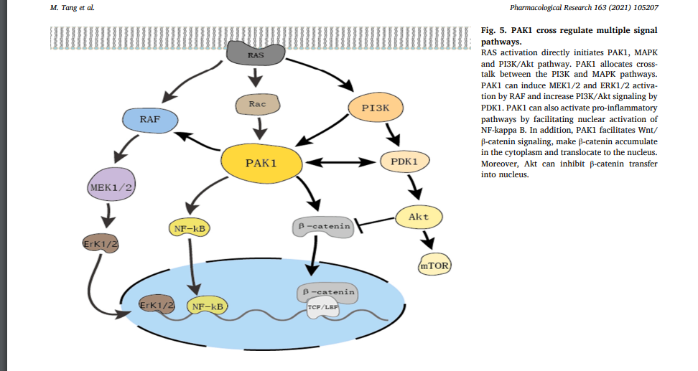

Slide 32
References
References [1] W.C. Campbell, M.H. Fisher, E.O. Stapley, G. Albers-Schonberg, T.A. Jacob, Ivermectin: a potent new antiparasitic agent, Science 221 (4613) (1983) 823–828, https://doi.org/10.1126/science.6308762. [2] R.K. Prichard, T.G. Geary, Perspectives on the utility of moxidectin for the control of parasitic nematodes in the face of developing anthelmintic resistance, Int J Parasitol Drugs Drug Resist 10 (2019) 69–83, https://doi.org/10.1016/j. ijpddr.2019.06.002. [3] D.S. Ashour, Ivermectin: From theory to clinical application, Int J Antimicrob Agents 54 (2) (2019) 134–142, https://doi.org/10.1016/j. ijantimicag.2019.05.003. [4] A.C. Goudie, N.A. Evans, K.A. Gration, B.F. Bishop, S.P. Gibson, K.S. Holdom, B. Kaye, S.R. Wicks, D. Lewis, A.J. Weatherley, et al., Doramectin–a potent novel endectocide, Vet Parasitol 49 (1) (1993) 5–15, https://doi.org/10.1016/0304- 4017(93)90218-c. [5] B.F. Bishop, C.I. Bruce, N.A. Evans, A.C. Goudie, K.A. Gration, S.P. Gibson, M. S. Pacey, D.A. Perry, N.D. Walshe, M.J. Witty, Selamectin: a novel broadspectrum endectocide for dogs and cats, Vet Parasitol 91 (3-4) (2000) 163–176, https://doi.org/10.1016/s0304-4017(00)00289-2.
[6] R. Laing, V. Gillan, E. Devaney, Ivermectin - Old Drug, New Tricks? Trends Parasitol 33 (6) (2017) 463–472, https://doi.org/10.1016/j.pt.2017.02.004. [7] A. Crump, Ivermectin: enigmatic multifaceted’ wonder’ drug continues to surprise and exceed expectations, J Antibiot (Tokyo) 70 (5) (2017) 495–505, https://doi.org/10.1038/ja.2017.11. [8] J.H. McKerrow, Recognition of the role of Natural Products as drugs to treat neglected tropical diseases by the 2015 Nobel prize in physiology or medicine, Nat Prod Rep 32 (12) (2015) 1610–1611, https://doi.org/10.1039/c5np90043c. [9] N.S. Kane, B. Hirschberg, S. Qian, D. Hunt, B. Thomas, R. Brochu, S.W. Ludmerer, Y. Zheng, M. Smith, J.P. Arena, C.J. Cohen, D. Schmatz, J. Warmke, D.F. Cully, Drug-resistant Drosophila indicate glutamate-gated chloride channels are targets for the antiparasitics nodulisporic acid and ivermectin, Proc Natl Acad Sci U S A 97 (25) (2000) 13949–13954, https://doi.org/10.1073/pnas.240464697. [10] L.C. Fritz, C.C. Wang, A. Gorio, Avermectin B1a irreversibly blocks postsynaptic potentials at the lobster neuromuscular junction by reducing muscle membrane resistance, Proc Natl Acad Sci U S A 76 (4) (1979) 2062–2066, https://doi.org/ 10.1073/pnas.76.4.2062. [11] M.R. Smit, E.O. Ochomo, G. Aljayyoussi, T.K. Kwambai, B.O. Abong’o, T. Chen, T. Bousema, H.C. Slater, D. Waterhouse, N.M. Bayoh, J.E. Gimnig, A.M. Samuels, M.R. Desai, P.A. Phillips-Howard, S.K. Kariuki, D. Wang, S.A. Ward, F.O. Ter Kuile, Safety and mosquitocidal efficacy of high-dose ivermectin when coadministered with dihydroartemisinin-piperaquine in Kenyan adults with uncomplicated malaria (IVERMAL): a randomised, double-blind, placebocontrolled trial

Slide 33
Lancet Infect Dis 18 (6) (2018) 615–626, https://doi.org/ 10.1016/s1473-3099(18)30163-4. [12] B.D. Foy, H. Alout, J.A. Seaman, S. Rao, T. Magalhaes, M. Wade, S. Parikh, D. D. Soma, A.B. Sagna, F. Fournet, H.C. Slater, R. Bougma, F. Drabo, A. Diabate, A. G.V. Coulidiaty, N. Rouamba, R.K. Dabire, Efficacy and risk of harms of repeat ivermectin mass drug administrations for control of malaria (RIMDAMAL): a cluster-randomised trial, Lancet 393 (10180) (2019) 1517–1526, https://doi.org/ 10.1016/s0140-6736(18)32321-3. [13] U.K. Udensi, A.F. Fagbenro-Beyioku, Effect of ivermectin on Trypanosoma brucei brucei in experimentally infected mice, J Vector Borne Dis 49 (3) (2012) 143–150. [14] N. Katz, N. Araujo, P.M.Z. Coelho, C.M. Morel, A.R. Linde-Arias, T. Yamada, Y. Horimatsu, K. Suzuki, T. Sunazuka, S. Omura, Ivermectin efficacy against Biomphalaria, intermediate host snail vectors of Schistosomiasis, J Antibiot (Tokyo) 70 (5) (2017) 680–684, https://doi.org/10.1038/ja.2017.31. [15] B. MM, E.-S. AA, Therapeutic potential of myrrh and ivermectin against experimental Trichinella spiralis infection in mice, The Korean journal of parasitology 51 (3) (2013) 297–304, https://doi.org/10.3347/ kjp.2013.51.3.297. [16] H.A. Hanafi, D.E. Szumlas, D.J. Fryauff, S.S. El-Hossary, G.A. Singer, S.G. Osman, N. Watany, B.D. Furman, D.F. Hoel, Effects of ivermectin on blood-feeding Phlebotomus papatasi, and the promastigote stage of Leishmania major, Vector Borne Zoonotic Dis 11 (1) (2011) 43–52, https://doi.org/10.1089/ vbz.2009.0030. [17] E. Mastrangelo, M. Pezzullo, T. De Burghgraeve, S. Kaptein, B. Pastorino, K. Dallmeier, X. de Lamballerie, J. Neyts, A.M. Hanson, D.N. Frick, M. Bolognesi, M. Milani, Ivermectin is a potent inhibitor of flavivirus replication specifically targeting NS3 helicase activity: new prospects for an old drug, J Antimicrob Chemother 67 (8) (2012) 1884–1894, https://doi.org/10.1093/jac/dks147. [18] K.M. Wagstaff, H. Sivakumaran, S.M. Heaton, D. Harrich, D.A. Jans, Ivermectin is a specific inhibitor of importin alpha/beta-mediated nuclear import able to inhibit replication of HIV-1 and dengue virus, Biochem J 443 (3) (2012) 851–856, https://doi.org/10.1042/bj20120150. [19] L. Caly, J.D. Druce, M.G. Catton, D.A. Jans, K.M. Wagstaff, The FDA-approved Drug Ivermectin inhibits the replication of SARS-CoV-2 in vitro, Antiviral Res (2020) 104787, https://doi.org/10.1016/j.antiviral.2020.104787. [20] S. Yan, X. Ci, N. Chen, C. Chen, X. Li, X. Chu, J. Li, X. Deng, Anti-inflammatory effects of ivermectin in mouse model of allergic asthma, Inflamm Res 60 (6) (2011) 589–596, https://doi.org/10.1007/s00011-011-0307-8. [21] K.M. Franklin, L. Asatryan, M.W. Jakowec, J.R. Trudell, R.L. Bell, D.L. Davies, P2X4 receptors (P2X4Rs) represent a novel target for the development of drugs to prevent and/or treat alcohol use disorders, Front Neurosci 8 (2014) 176, https:// doi.org/10.3389/fnins.2014.00176. [22] A. Didier, F. Loor, The abamectin derivative ivermectin is a potent p-glycoprotein inhibitor, Anticancer Drugs. 7 (7) (1996) 745–751, https://doi.org/10.1097/ 00001813-199609000-00005. [23] A. Markowska, J. Kaysiewicz, J. Markowska, A. Huczynski, Doxycycline, salinomycin, monensin and ivermectin repositioned as cancer drugs, Bioorg Med Chem Lett 29 (13) (2019) 1549–1554, https://doi.org/10.1016/j. bmcl.2019.04.045. [24] M. Juarez, A. Schcolnik-Cabrera, A. Duenas-Gonzalez, The multitargeted drug ivermectin: from an antiparasitic agent to a repositioned cancer drug, Am J Cancer Res 8 (2) (2018) 317–331. [25] J. Liu, K. Zhang, L. Cheng, H. Zhu, T. Xu, Progress in Understanding the Molecular Mechanisms Underlying the Antitumour Effects of Ivermectin, Drug Des Devel Ther 14 (2020) 285–296, https://doi.org/10.2147/dddt.S237393. [26] M. Antoszczak, A. Markowska, J. Markowska, A. Huczynski, Old wine in new bottles: Drug repurposing in oncology, Eur J Pharmacol 866 (2020) 172784, https://doi.org/10.1016/j.ejphar.2019.172784. [27] Y. Kobayashi, K. Banno, H. Kunitomi, E. Tominaga, D. Aoki, Current state and outlook for drug repositioning anticipated in the field of ovarian cancer, J Gynecol Oncol 30 (1) (2019) e10, https://doi.org/10.3802/jgo.2019.30.e10.

Slide 34
[28] G.J. Yoshida, Therapeutic strategies of drug repositioning targeting autophagy to induce cancer cell death: from pathophysiology to treatment, J Hematol Oncol 10 (1) (2017) 67, https://doi.org/10.1186/s13045-017-0436-9. [29] R. Wurth, S. Thellung, A. Bajetto, M. Mazzanti, T. Florio, F. Barbieri, Drugrepositioning opportunities for cancer therapy: novel molecular targets for known compounds, Drug Discov Today 21 (1) (2016) 190–199, https://doi.org/ 10.1016/j.drudis.2015.09.017. [30] N. Harbeck, F. Penault-Llorca, J. Cortes, M. Gnant, N. Houssami, P. Poortmans, K. Ruddy, J. Tsang, F. Cardoso, Breast cancer, Nat Rev Dis Primers 5 (1) (2019) 66, https://doi.org/10.1038/s41572-019-0111-2. [31] O. Ginsburg, F. Bray, M.P. Coleman, V. Vanderpuye, A. Eniu, S.R. Kotha, M. Sarker, T.T. Huong, C. Allemani, A. Dvaladze, J. Gralow, K. Yeates, C. Taylor, N. Oomman, S. Krishnan, R. Sullivan, D. Kombe, M.M. Blas, G. Parham, N. Kassami, L. Conteh, The global burden of women’s cancers: a grand challenge in global health, Lancet 389 (10071) (2017) 847–860, https://doi.org/10.1016/ s0140-6736(16)31392-7. [32] Q. Dou, H.N. Chen, K. Wang, K. Yuan, Y. Lei, K. Li, J. Lan, Y. Chen, Z. Huang, N. Xie, L. Zhang, R. Xiang, E.C. Nice, Y. Wei, C. Huang, Ivermectin Induces Cytostatic Autophagy by Blocking the PAK1/Akt Axis in Breast Cancer, Cancer Res 76 (15) (2016) 4457–4469, https://doi.org/10.1158/0008-5472.CAN-15- 2887. [33] H. Diao, N. Cheng, Y. Zhao, H. Xu, H. Dong, D.H. Thamm, D. Zhang, D. Lin, Ivermectin inhibits canine mammary tumor growth by regulating cell cycle progression and WNT signaling, BMC Vet Res 15 (1) (2019) 276, https://doi.org/ 10.1186/s12917-019-2026-2. [34] A. Diana, F. Carlino, E. Franzese, O. Oikonomidou, C. Criscitiello, F. De Vita, F. Ciardiello, M. Orditura, Early Triple Negative Breast Cancer: Conventional Treatment and Emerging Therapeutic Landscapes, Cancers (Basel) 12 (4) (2020), https://doi.org/10.3390/cancers12040819. [35] K.G.K. Deepak, R. Vempati, G.P. Nagaraju, V.R. Dasari, N. S, D.N. Rao, R.R. Malla, Tumor microenvironment: Challenges and opportunities in targeting metastasis of triple negative breast cancer, Pharmacol Res 153 (2020) 104683, https://doi. org/10.1016/j.phrs.2020.104683. [36] Y.J. Kwon, K. Petrie, B.A. Leibovitch, L. Zeng, M. Mezei, L. Howell, V. Gil, R. Christova, N. Bansal, S. Yang, R. Sharma, E.V. Ariztia, J. Frankum, R. Brough, Y. Sbirkov, A. Ashworth, C.J. Lord, A. Zelent, E. Farias, M.M. Zhou, S. Waxman, Selective Inhibition of SIN3 Corepressor with Avermectins as a Novel Therapeutic Strategy in Triple-Negative Breast Cancer, Mol Cancer Ther 14 (8) (2015) 1824–1836, https://doi.org/10.1158/1535-7163.MCT-14-0980-T. [37] D. Draganov, S. Gopalakrishna-Pillai, Y.R. Chen, N. Zuckerman, S. Moeller, C. Wang, D. Ann, P.P. Lee, Modulation of P2X4/P2X7/Pannexin-1 sensitivity to extracellular ATP via Ivermectin induces a non-apoptotic and inflammatory form of cancer cell death, Sci Rep 5 (2015) 16222, https://doi.org/10.1038/ srep16222. [38] P. Thanh Huong, S. Gurshaney, N. Thanh Binh, A. Gia Pham, H. Hoang Nguyen, X. Thanh Nguyen, H. Pham-The, P.T. Tran, K. Truong Vu, N. Xuan Duong, C. Pelucchi, C. La Vecchia, P. Boffetta, H.D. Nguyen, H.N. Luu, Emerging Role of Circulating Tumor Cells in Gastric Cancer, Cancers (Basel) 12 (3) (2020), https:// doi.org/10.3390/cancers12030695. [39] S. Nambara, T. Masuda, M. Nishio, S. Kuramitsu, T. Tobo, Y. Ogawa, Q. Hu, T. Iguchi, Y. Kuroda, S. Ito, H. Eguchi, K. Sugimachi, H. Saeki, E. Oki, Y. Maehara, A. Suzuki, K. Mimori, Antitumor effects of the antiparasitic agent ivermectin via inhibition of Yes-associated protein 1 expression in gastric cancer, Oncotarget 8 (64) (2017) 107666–107677, https://doi.org/10.18632/oncotarget.22587. [40] F. Zanconato, M. Cordenonsi, S. Piccolo, YAP and TAZ: a signalling hub of the tumour microenvironment, Nat Rev Cancer 19 (8) (2019) 454–464, https://doi. org/10.1038/s41568-019-0168-y. [41] A. Melotti, C. Mas, M. Kuciak, A. Lorente-Trigos, I. Borges, A. Ruiz i Altaba, The river blindness drug Ivermectin and related macrocyclic lactones inhibit WNTTCF pathway responses in human cancer, EMBO Mol Med 6 (10) (2014) 1263–1278, https://doi.org/10.15252/emmm.201404084. [42] J.D. Yang, P. Hainaut, G.J. Gores, A. Amadou, A. Plymoth, L.R. Roberts, A global view of hepatocellular carcinoma: trends, risk, prevention and management, Nat Rev Gastroenterol Hepatol 16 (10) (2019) 589–604, https://doi.org/10.1038/ s41575-019-0186-y. [43] M. Nishio, K. Sugimachi, H. Goto, J. Wang, T. Morikawa, Y. Miyachi, Y. Takano, H. Hikasa, T. Itoh, S.O. Suzuki, H. Kurihara, S. Aishima, A. Leask, T. Sasaki, T. Nakano, H. Nishina, Y. Nishikawa, Y. Sekido, K. Nakao, K. Shin-Ya, K. Mimori, A. Suzuki, Dysregulated YAP1/TAZ and TGF-beta signaling mediate hepatocarcinogenesis in Mob1a/1b-deficient mice, Proc Natl Acad Sci U S A 113 (1) (2016) 71–80, https://doi.org/10.1073/pnas.1517188113. [44] K. Intuyod, C. Hahnvajanawong, P. Pinlaor, S. Pinlaor, Anti-parasitic Drug Ivermectin Exhibits Potent Anticancer Activity Against Gemcitabine-resistant Cholangiocarcinoma In Vitro, Anticancer Res 39 (9) (2019) 4837–4843, https:// doi.org/10.21873/anticanres.13669. [45] Y. Wang, J. Su, Y. Wang, D. Fu, J.E. Ideozu, H. Geng, Q. Cui, C. Wang, R. Chen, Y. Yu, Y. Niu, D. Yue, The interaction of YBX1 with G3BP1 promotes renal cell carcinoma cell metastasis via YBX1/G3BP1-SPP1- NF-kappaB signaling axis, J Exp Clin Cancer Res 38 (1) (2019) 386, https://doi.org/10.1186/s13046-019- 1347-0. [46] W.H. Xu, S.N. Shi, Y. Xu, J. Wang, H.K. Wang, D.L. Cao, G.H. Shi, Y.Y. Qu, H. L. Zhang, D.W. Ye, Prognostic implications of Aquaporin 9 expression in clear cell renal cell carcinoma, J Transl Med 17 (1) (2019) 363, https://doi.org/10.1186/ s12967-019-2113-y. [47] R.L. Siegel, K.D. Miller, A. Jemal, Cancer statistics, 2019, CA Cancer J Clin 69 (1) (2019) 7–34, https://doi.org/10.3322/caac.21551.

Slide 35
[48] M. Zhu, Y. Li, Z. Zhou, Antibiotic ivermectin preferentially targets renal cancer through inducing mitochondrial dysfunction and oxidative damage, Biochemical and Biophysical Research Communications 492 (3) (2017) 373–378, https://doi. org/10.1016/j.bbrc.2017.08.097. [49] S. Arcangeli, V. Pinzi, G. Arcangeli, Epidemiology of prostate cancer and treatment remarks, World J Radiol 4 (6) (2012) 241–246, https://doi.org/ 10.4329/wjr.v4.i6.241. [50] L. Nappi, A.H. Aguda, N.A. Nakouzi, B. Lelj-Garolla, E. Beraldi, N. Lallous, M. Thi, S. Moore, L. Fazli, D. Battsogt, S. Stief, F. Ban, N.T. Nguyen, N. Saxena, E. Dueva, F. Zhang, T. Yamazaki, A. Zoubeidi, A. Cherkasov, G.D. Brayer, M. Gleave, Ivermectin inhibits HSP27 and potentiates efficacy of oncogene targeting in tumor models, J Clin Invest 130 (2) (2020) 699–714, https://doi.org/10.1172/ jci130819. [51] S. Sharmeen, M. Skrtic, M.A. Sukhai, R. Hurren, M. Gronda, X. Wang, S. B. Fonseca, H. Sun, T.E. Wood, R. Ward, M.D. Minden, R.A. Batey, A. Datti, J. Wrana, S.O. Kelley, A.D. Schimmer, The antiparasitic agent ivermectin induces chloride-dependent membrane hyperpolarization and cell death in leukemia cells, Blood 116 (18) (2010) 3593–3603, https://doi.org/10.1182/blood-2010-01- 262675. [52] J.F. Apperley, Chronic myeloid leukaemia, Lancet 385 (9976) (2015) 1447–1459, https://doi.org/10.1016/s0140-6736(13)62120-0. [53] J. Wang, Y. Xu, H. Wan, J. Hu, Antibiotic ivermectin selectively induces apoptosis in chronic myeloid leukemia through inducing mitochondrial dysfunction and oxidative stress, Biochem Biophys Res Commun 497 (1) (2018) 241–247, https:// doi.org/10.1016/j.bbrc.2018.02.063. [54] Z. Dong, C. Yu, K. Rezhiya, A. Gulijiahan, X. Wang, Downregulation of miR-146a promotes tumorigenesis of cervical cancer stem cells via VEGF/CDC42/PAK1 signaling pathway, Artif Cells Nanomed Biotechnol 47 (1) (2019) 3711–3719, https://doi.org/10.1080/21691401.2019.1664560. [55] S.R. Carneiro, A.A. da Silva Lima, G. de Fatima Silva Santos, C.S.B. de Oliveira, M. C.V. Almeida, M. da Conceicao Nascimento Pinheiro, Relationship between Oxidative Stress and Physical Activity in Women with Squamous Intraepithelial Lesions in a Cervical Cancer Control Program in the Brazilian Amazon, Oxid Med Cell Longev 2019 (2019), 8909852, https://doi.org/10.1155/2019/8909852. [56] P. Zhang, Y. Zhang, K. Liu, B. Liu, W. Xu, J. Gao, L. Ding, L. Tao, Ivermectin induces cell cycle arrest and apoptosis of HeLa cells via mitochondrial pathway, Cell Prolif 52 (2) (2019) e12543, https://doi.org/10.1111/cpr.12543. [57] S. Moufarrij, M. Dandapani, E. Arthofer, S. Gomez, A. Srivastava, M. LopezAcevedo, A. Villagra, K.B. Chiappinelli, Epigenetic therapy for ovarian cancer: promise and progress, Clin Epigenetics 11 (1) (2019) 7, https://doi.org/10.1186/ s13148-018-0602-0. [58] H. Hashimoto, S.M. Messerli, T. Sudo, H. Maruta, Ivermectin inactivates the kinase PAK1 and blocks the PAK1-dependent growth of human ovarian cancer and NF2 tumor cell lines, Drug Discov Ther 3 (6) (2009) 243–246. [59] M. Kodama, T. Kodama, J.Y. Newberg, H. Katayama, M. Kobayashi, S.M. Hanash, K. Yoshihara, Z. Wei, J.C. Tien, R. Rangel, K. Hashimoto, S. Mabuchi, K. Sawada, T. Kimura, N.G. Copeland, N.A. Jenkins, In vivo loss-of-function screens identify KPNB1 as a new druggable oncogene in epithelial ovarian cancer, Proc Natl Acad Sci U S A 114 (35) (2017) E7301–E7310, https://doi.org/10.1073/ pnas.1705441114. [60] X. Zhang, T. Qin, Z. Zhu, F. Hong, Y. Xu, X. Zhang, X. Xu, A. Ma, Ivermectin Augments the In Vitro and In Vivo Efficacy of Cisplatin in Epithelial Ovarian Cancer by Suppressing Akt/mTOR Signaling, Am J Med Sci 359 (2) (2020) 123–129, https://doi.org/10.1016/j.amjms.2019.11.001. [61] A.M. Molinaro, J.W. Taylor, J.K. Wiencke, M.R. Wrensch, Genetic and molecular epidemiology of adult diffuse glioma, Nat Rev Neurol 15 (7) (2019) 405–417, https://doi.org/10.1038/s41582-019-0220-2. [62] P.Y. Wen, S. Kesari, Malignant gliomas in adults, N Engl J Med 359 (5) (2008) 492–507, https://doi.org/10.1056/NEJMra0708126. [63] Y. Liu, S. Fang, Q. Sun, B. Liu, Anthelmintic drug ivermectin inhibits angiogenesis, growth and survival of glioblastoma through inducing mitochondrial dysfunction and oxidative stress, Biochem Biophys Res Commun 480 (3) (2016) 415–421, https://doi.org/10.1016/j.bbrc.2016.10.064. [64] J. Liu, H. Liang, C. Chen, X. Wang, F. Qu, H. Wang, K. Yang, Q. Wang, N. Zhao, J. Meng, A. Gao, Ivermectin induces autophagy-mediated cell death through the AKT/mTOR signaling pathway in glioma cells, Biosci Rep 39 (12) (2019), https:// doi.org/10.1042/bsr20192489. [65] H.J. Kwak, Y.J. Kim, K.R. Chun, Y.M. Woo, S.J. Park, J.A. Jeong, S.H. Jo, T. H. Kim, H.S. Min, J.S. Chae, E.J. Choi, G. Kim, S.H. Shin, H.S. Gwak, S.K. Kim, E. K. Hong, G.K. Lee, K.H. Choi, J.H. Kim, H. Yoo, J.B. Park, S.H. Lee, Downregulation of Spry2 by miR-21 triggers malignancy in human gliomas, Oncogene 30 (21) (2011) 2433–2442, https://doi.org/10.1038/onc.2010.620. [66] J. Yin, G. Park, J.E. Lee, E.Y. Choi, J.Y. Park, T.H. Kim, N. Park, X. Jin, J.E. Jung, D. Shin, J.H. Hong, H. Kim, H. Yoo, S.H. Lee, Y.J. Kim, J.B. Park, J.H. Kim, DEADbox RNA helicase DDX23 modulates glioma malignancy via elevating miR-21 biogenesis, Brain 138 (Pt 9) (2015) 2553–2570, https://doi.org/10.1093/brain/ awv167. [67] L.H. Kircik, J.Q. Del Rosso, A.M. Layton, J. Schauber, Over 25 Years of Clinical Experience With Ivermectin: An Overview of Safety for an Increasing Number of Indications, J Drugs Dermatol 15 (3) (2016) 325–332. [68] Y.P. Chen, A.T.C. Chan, Q.T. Le, P. Blanchard, Y. Sun, J. Ma, Nasopharyngeal carcinoma, Lancet 394 (10192) (2019) 64–80, https://doi.org/10.1016/s0140- 6736(19)30956-0. [69] F. Gallardo, B. Mariam´e, R. Gence, A.-F. Tilkin-Mariam´e, Macrocyclic lactones inhibit nasopharyngeal carcinoma cells proliferation through PAK1 inhibition

Slide 36
and reduce in vivo tumor growth, Drug Design, Development and Therapy 12 (2018) 2805–2814, https://doi.org/10.2147/dddt.S172538. [70] R. Thawani, M. McLane, N. Beig, S. Ghose, P. Prasanna, V. Velcheti, A. Madabhushi, Radiomics and radiogenomics in lung cancer: A review for the clinician, Lung Cancer 115 (2018) 34–41, https://doi.org/10.1016/j. lungcan.2017.10.015. [71] H. Patel, N. Yacoub, R. Mishra, A. White, Y. Long, S. Alanazi, J.T. Garrett, Current Advances in the Treatment of BRAF-Mutant Melanoma, Cancers (Basel) 12 (2) (2020), https://doi.org/10.3390/cancers12020482. [72] M.G. Franken, B. Leeneman, M. Gheorghe, C.A. Uyl-de Groot, J. Haanen, P.H. M. van Baal, A systematic literature review and network meta-analysis of effectiveness and safety outcomes in advanced melanoma, Eur J Cancer 123 (2019) 58–71, https://doi.org/10.1016/j.ejca.2019.08.032. [73] F. Gallardo, I. Teiti, P. Rochaix, E. Demilly, D. Jullien, B. Mariam´e, A.-F. TilkinMariam´e, Macrocyclic Lactones Block Melanoma Growth, Metastases Development and Potentiate Activity of Anti– BRAF V600 Inhibitors, Clinical Skin Cancer 1 (1) (2016) 4–14, https://doi.org/10.1016/j.clsc.2016.05.001, e3. [74] F. Deng, Q. Xu, J. Long, H. Xie, Suppressing ROS-TFE3-dependent autophagy enhances ivermectin-induced apoptosis in human melanoma cells, Journal of Cellular Biochemistry 120 (2) (2018) 1702–1715, https://doi.org/10.1002/ jcb.27490. [75] S. Nagata, Apoptosis and Clearance of Apoptotic Cells, Annu Rev Immunol 36 (2018) 489–517, https://doi.org/10.1146/annurev-immunol-042617-053010. [76] A. Degterev, J. Yuan, Expansion and evolution of cell death programmes, Nat Rev Mol Cell Biol 9 (5) (2008) 378–390, https://doi.org/10.1038/nrm2393. [77] L. Galluzzi, D.R. Green, Autophagy-Independent Functions of the Autophagy Machinery, Cell 177 (7) (2019) 1682–1699, https://doi.org/10.1016/j. cell.2019.05.026. [78] J.M.M. Levy, C.G. Towers, A. Thorburn, Targeting autophagy in cancer, Nat Rev Cancer 17 (9) (2017) 528–542, https://doi.org/10.1038/nrc.2017.53. [79] D.A. Gewirtz, The four faces of autophagy: implications for cancer therapy, Cancer Res 74 (3) (2014) 647–651, https://doi.org/10.1158/0008-5472.Can-13- 2966. [80] L. Galluzzi, F. Pietrocola, J.M. Bravo-San Pedro, R.K. Amaravadi, E.H. Baehrecke, F. Cecconi, P. Codogno, J. Debnath, D.A. Gewirtz, V. Karantza, A. Kimmelman, S. Kumar, B. Levine, M.C. Maiuri, S.J. Martin, J. Penninger, M. Piacentini, D. C. Rubinsztein, H.U. Simon, A. Simonsen, A.M. Thorburn, G. Velasco, K.M. Ryan, G. Kroemer, Autophagy in malignant transformation and cancer progression, Embo j 34 (7) (2015) 856–880, https://doi.org/10.15252/embj.201490784. [81] L. Galluzzi, J.M. Bravo-San Pedro, S. Demaria, S.C. Formenti, G. Kroemer, Activating autophagy to potentiate immunogenic chemotherapy and radiation therapy, Nat Rev Clin Oncol 14 (4) (2017) 247–258, https://doi.org/10.1038/ nrclinonc.2016.183. [82] G. Ravegnini, G. Sammarini, M. Nannini, M.A. Pantaleo, G. Biasco, P. Hrelia, S. Angelini, Gastrointestinal stromal tumors (GIST): Facing cell death between autophagy and apoptosis, Autophagy 13 (3) (2017) 452–463, https://doi.org/ 10.1080/15548627.2016.1256522. [83] G. Marino, M. Niso-Santano, E.H. Baehrecke, G. Kroemer, Self-consumption: the interplay of autophagy and apoptosis, Nat Rev Mol Cell Biol 15 (2) (2014) 81–94, https://doi.org/10.1038/nrm3735. [84] Y. Fang, S. Tian, Y. Pan, W. Li, Q. Wang, Y. Tang, T. Yu, X. Wu, Y. Shi, P. Ma, Y. Shu, Pyroptosis: A new frontier in cancer, Biomed Pharmacother 121 (2020) 109595, https://doi.org/10.1016/j.biopha.2019.109595. [85] T. Gong, L. Liu, W. Jiang, R. Zhou, DAMP-sensing receptors in sterile inflammation and inflammatory diseases, Nat Rev Immunol 20 (2) (2020) 95–112, https://doi.org/10.1038/s41577-019-0215-7. [86] X. Liu, Z. Zhang, J. Ruan, Y. Pan, V.G. Magupalli, H. Wu, J. Lieberman, Inflammasome-activated gasdermin D causes pyroptosis by forming membrane pores, Nature 535 (7610) (2016) 153–158, https://doi.org/10.1038/ nature18629. [87] Z. Zheng, G. Li, Mechanisms and Therapeutic Regulation of Pyroptosis in Inflammatory Diseases and Cancer, Int J Mol Sci 21 (4) (2020), https://doi.org/ 10.3390/ijms21041456. [88] S.J. Han, M. Lovaszi, M. Kim, V. D’Agati, G. Hasko, H.T. Lee, P2X4 receptor exacerbates ischemic AKI and induces renal proximal tubular NLRP3 inflammasome signaling, Faseb j 34 (4) (2020) 5465–5482, https://doi.org/ 10.1096/fj.201903287R. [89] C.A. O’Brien, A. Kreso, C.H. Jamieson, Cancer stem cells and self-renewal, Clin Cancer Res 16 (12) (2010) 3113–3120, https://doi.org/10.1158/1078-0432. CCR-09-2824. [90] Z. Huang, T. Wu, A.Y. Liu, G. Ouyang, Differentiation and transdifferentiation potentials of cancer stem cells, Oncotarget 6 (37) (2015) 39550–39563, https:// doi.org/10.18632/oncotarget.6098. [91] S. Bao, Q. Wu, R.E. McLendon, Y. Hao, Q. Shi, A.B. Hjelmeland, M.W. Dewhirst, D.D. Bigner, J.N. Rich, Glioma stem cells promote radioresistance by preferential activation of the DNA damage response, Nature 444 (7120) (2006) 756–760, https://doi.org/10.1038/nature05236. [92] M. Dean, T. Fojo, S. Bates, Tumour stem cells and drug resistance, Nat Rev Cancer 5 (4) (2005) 275–284, https://doi.org/10.1038/nrc1590. [93] X. Li, M.T. Lewis, J. Huang, C. Gutierrez, C.K. Osborne, M.F. Wu, S.G. Hilsenbeck, A. Pavlick, X. Zhang, G.C. Chamness, H. Wong, J. Rosen, J.C. Chang, Intrinsic resistance of tumorigenic breast cancer cells to chemotherapy, J Natl Cancer Inst 100 (9) (2008) 672–679, https://doi.org/10.1093/jnci/djn123. [94] M. Diehn, M.F. Clarke, Cancer stem cells and radiotherapy: new insights into tumor radioresistance, J Natl Cancer Inst 98 (24) (2006) 1755–1757, https://doi. org/10.1093/jnci/djj505.

Slide 37
[95] G. Dominguez-Gomez, A. Chavez-Blanco, J.L. Medina-Franco, F. SaldivarGonzalez, Y. Flores-Torrontegui, M. Juarez, J. Diaz-Chavez, A. Gonzalez-Fierro, A. Duenas-Gonzalez, Ivermectin as an inhibitor of cancer stemlike cells, Mol Med Rep 17 (2) (2018) 3397–3403, https://doi.org/10.3892/mmr.2017.8231. [96] J.H. Kim, H.S. Choi, S.L. Kim, D.S. Lee, The PAK1-Stat3 Signaling Pathway Activates IL-6 Gene Transcription and Human Breast Cancer Stem Cell Formation, Cancers (Basel) 11 (10) (2019), https://doi.org/10.3390/cancers11101527. [97] J. Wang, N. Seebacher, H. Shi, Q. Kan, Z. Duan, Novel strategies to prevent the development of multidrug resistance (MDR) in cancer, Oncotarget 8 (48) (2017) 84559–84571, https://doi.org/10.18632/oncotarget.19187. [98] M. Niazi, P. Zakeri-Milani, S. Najafi Hajivar, M. Soleymani Goloujeh, N. Ghobakhlou, J. Shahbazi Mojarrad, H. Valizadeh, Nano-based strategies to overcome p-glycoprotein-mediated drug resistance, Expert Opin Drug Metab Toxicol 12 (9) (2016) 1021–1033, https://doi.org/10.1080/ 17425255.2016.1196186. [99] J. Dong, Z. Qin, W.D. Zhang, G. Cheng, A.G. Yehuda, C.R. Ashby Jr., Z.S. Chen, X. D. Cheng, J.J. Qin, Medicinal chemistry strategies to discover P-glycoprotein inhibitors: An update, Drug Resist Updat 49 (2020) 100681, https://doi.org/ 10.1016/j.drup.2020.100681. [100] G. Kibria, H. Hatakeyama, H. Harashima, Cancer multidrug resistance: mechanisms involved and strategies for circumvention using a drug delivery system, Arch Pharm Res 37 (1) (2014) 4–15, https://doi.org/10.1007/s12272- 013-0276-2. [101] A. Lespine, J. Dupuy, S. Orlowski, T. Nagy, H. Glavinas, P. Krajcsi, M. Alvinerie, Interaction of ivermectin with multidrug resistance proteins (MRP1, 2 and 3), Chem Biol Interact 159 (3) (2006) 169–179, https://doi.org/10.1016/j. cbi.2005.11.002. [102] J.F. Pouliot, F. L’Heureux, Z. Liu, R.K. Prichard, E. Georges, Reversal of Pglycoprotein-associated multidrug resistance by ivermectin, Biochem Pharmacol 53 (1) (1997) 17–25, https://doi.org/10.1016/s0006-2952(96)00656-9. [103] A. Lespine, S. Martin, J. Dupuy, A. Roulet, T. Pineau, S. Orlowski, M. Alvinerie, Interaction of macrocyclic lactones with P-glycoprotein: structure-affinity relationship, Eur J Pharm Sci 30 (1) (2007) 84–94, https://doi.org/10.1016/j. ejps.2006.10.004. [104] L. Jiang, P. Wang, Y.J. Sun, Y.J. Wu, Ivermectin reverses the drug resistance in cancer cells through EGFR/ERK/Akt/NF-kappaB pathway, J Exp Clin Cancer Res 38 (1) (2019) 265, https://doi.org/10.1186/s13046-019-1251-7. [105] S. Loibl, L. Gianni, HER2-positive breast cancer, Lancet 389 (10087) (2017) 2415–2429, https://doi.org/10.1016/s0140-6736(16)32417-5. [106] S.M. Lim, N.L. Syn, B.C. Cho, R.A. Soo, Acquired resistance to EGFR targeted therapy in non-small cell lung cancer: Mechanisms and therapeutic strategies, Cancer Treat Rev 65 (2018) 1–10, https://doi.org/10.1016/j.ctrv.2018.02.006. [107] S.K. Choi, H. Kam, K.Y. Kim, S.I. Park, Y.S. Lee, Targeting Heat Shock Protein 27 in Cancer: A Druggable Target for Cancer Treatment? Cancers (Basel) 11 (8) (2019) https://doi.org/10.3390/cancers11081195. [108] R. Kumar, A.E. Gururaj, C.J. Barnes, p21-activated kinases in cancer, Nat Rev Cancer 6 (6) (2006) 459–471, https://doi.org/10.1038/nrc1892. [109] C.K. Rane, A. Minden, P21 activated kinase signaling in cancer, Semin Cancer Biol 54 (2019) 40–49, https://doi.org/10.1016/j.semcancer.2018.01.006. [110] K. Dammann, V. Khare, C. Gasche, Tracing PAKs from GI inflammation to cancer, Gut 63 (7) (2014) 1173–1184, https://doi.org/10.1136/gutjnl-2014-306768. [111] R. Kumar, D.Q. Li, PAKs in Human Cancer Progression: From Inception to Cancer Therapeutic to Future Oncobiology, Adv Cancer Res 130 (2016) 137–209, https://doi.org/10.1016/bs.acr.2016.01.002. [112] C.A. Guzzo, C.I. Furtek, A.G. Porras, C. Chen, R. Tipping, C.M. Clineschmidt, D. G. Sciberras, J.Y. Hsieh, K.C. Lasseter, Safety, tolerability, and pharmacokinetics of escalating high doses of ivermectin in healthy adult subjects, J Clin Pharmacol 42 (10) (2002) 1122–1133, https://doi.org/10.1177/009127002401382731. [113] J. Geyer, O. Gavrilova, E. Petzinger, Brain penetration of ivermectin and selamectin in mdr1a,b P-glycoprotein- and bcrp- deficient knockout mice, J Vet Pharmacol Ther 32 (1) (2009) 87–96, https://doi.org/10.1111/j.1365- 2885.2008.01007.x. [114] A. Gao, X. Wang, W. Xiang, H. Liang, J. Gao, Y. Yan, Reversal of P-glycoproteinmediated multidrug resistance in vitro by doramectin and nemadectin, J Pharm Pharmacol 62 (3) (2010) 393–399, https://doi.org/10.1211/jpp.62.03.0016.

Slide 38
Thank You

