Slide 1
Selecting Elliptic Curves for Cryptography
A presentation for the Crypto Forum Research Group (CFRG)
Joppe Bos NXP Semiconductors
Craig Costello Microsoft Research Patrick Longa Microsoft Research
Michael Naehrig Microsoft Research

Slide 2
Criteria for selecting elliptic curves for cryptography
ECDLP security and curve setting
Hardness of the underlying EC Discrete Logarithm Problem
Conservative choice of curve setting (curve type, group structure, etc.)
Publicly verifiable generation: minimal room for manipulation
Implementation security
Resilience to exception attacks, small subgroup attacks, invalid curve attacks, side-channel attacks
Efficiency (considering portability, ease of use, maintainability, scalability)
Runtime/power/memory use on different platforms: 8-bit, 32-bit, 64-bit
Security coverage
Curve selection targeting different security levels: 128-bit, 192-bit, 256-bit
Flexibility and robustness
Ease of adaptability to most protocols
Efficiency of different constructs: {variable-base, fixed-base, multi} scalar multiplication
Ease of curve replacement in case of disasters
1

Slide 3
Plan after preliminary analysis …
Demonstrate potential of new curves at protocol layer (e.g., inside TLS with PFS)
Constant-time, exception-free algorithms to do crypto
128-bit security
192-bit security
256-bit security
Weierstrass curves
twisted Edwards curves
Montgomery curves
Consider different families of primes for fast arithmetic
2

Slide 4
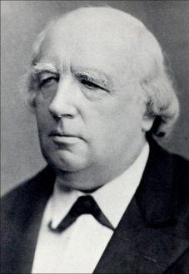





Forms of Elliptic Curves
Weierstrass curves
$$y^{2}=x^{3}+ax+b$$
Most general form
Prime order possible
Exceptions in group law
NIST and Brainpool curves
Montgomery curves
$$By^{2}=x^{3}+Ax^{2}+x$$
Subset of curves
Not prime order
Montgomery ladder
(Twisted) Edwards curves
$$ax^{2}+y^{2}=1+dx^{2}y^{2}$$
Subset of curves
Not prime order
Fastest arithmetic
Some have complete group law
3

Slide 5
Analyzing the different criteria

Slide 6
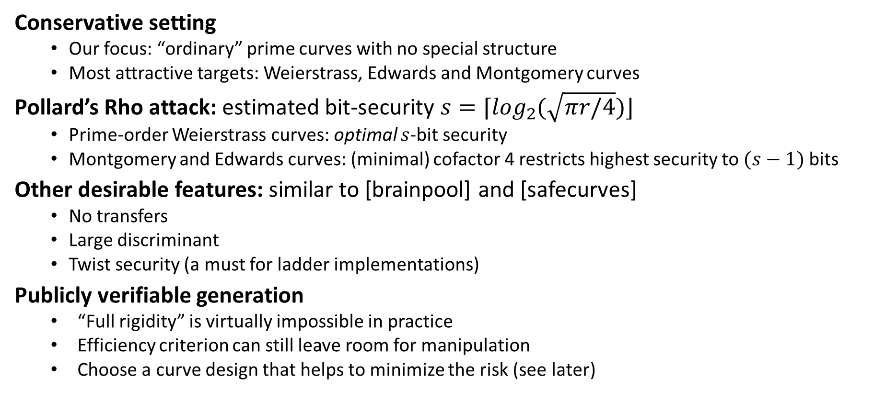
ECDLP Security and Curve Setting
Conservative setting
Our focus: “ordinary” prime curves with no special structure
Most attractive targets: Weierstrass, Edwards and Montgomery curves
Pollard’s Rho attack: estimated bit-security $s=⌈\log_{2}{(\sqrt{πr/4})}⌋$
Prime-order Weierstrass curves: optimal $s$-bit security
Montgomery and Edwards curves: (minimal) cofactor 4 restricts highest security to $(s−1)$ bits
Other desirable features: similar to [brainpool] and [safecurves]
No transfers
Large discriminant
Twist security (a must for ladder implementations)
Publicly verifiable generation
“Full rigidity” is virtually impossible in practice
Efficiency criterion can still leave room for manipulation
Choose a curve design that helps to minimize the risk (see later)
4

Slide 7
Implementation Security
Exception attacks
Failures during computations may leak information Solution: build exception-free scalar multiplications.
Small subgroup attacks
Not a problem for prime-order Weierstrass curves
“Clear” small torsion on Montgomery and twisted Edwards curves:
Inside scalar multiplication
Before scalar multiplication: this is the way we implemented it
Invalid curve attacks
Simple and inexpensive solution (for Weierstrass and twisted Edwards): validate input points
Not a problem for twist-secure Montgomery curves:
EXCEPT when one insists that all scalars up to group order are possible (see later)
5

Slide 8
Implementation Security
Side-channel attacks: timing, SSCA, DSCA, etc.
(At the very least) curves should support efficient “regular” arithmetic
Attractive alternatives: regular algorithms for scalar multiplication, use of unified addition
Regular scalar multiplication:
Fixed-window method [Okeya-Takagi 2003]: no curve restriction, adjustable window size, efficient for variable-base
Regular comb variants: no curve restriction, adjustable window size, efficient for fixed-base. E.g., [Hamburg 2012], [Faz et al. 2013]
Ladder: only efficient on Montgomery curves, only efficient for variable-base
Unified addition:
Simple and compact, but too expensive
6

Slide 9
Implementation Security
Related results from the project:
We have built rigorously proven exception-free, constant-time scalar multiplications using regular algorithms for Weierstrass, twisted Edwards and Montgomery curves
We also exploit (fastest) dedicated doubling and addition formulas and prove that they do not trigger exceptions
Slower, complete formulas not necessary until the very last addition (in variable-base case)
But what about a complete, exception-free addition formula for Weierstrass curves. It was previously thought to be very expensive compared to dedicated addition:
We have designed efficient complete addition formulas using masking techniques. All the required operations are typical in constant-time ECC implementations
The new additions require the same number of field multiplications and squarings that the dedicated, traditional formulas: overhead in practice < 10%
7

Slide 10
Overview of our constructions
Constant-time, exception-free scalar multiplications
shared or
similar functions
scalar arithmetic
Variable-base: fixed-window method
Fixed-base: modified LSB-set comb
Double-scalar: wNAF with interleaving
Variable-base: Montgomery ladder
separated
Weierstrass curves
Dedicated doubling: 4M+4S Dedicated addition: 11M+3S / 8M+3S
Dedicated doubling-addition: 16M+5S
Complete addition (*):11M+3S / 8M+3S
Twisted Edwards curves
Dedicated point doubling: 4M+3S Dedicated point addition: 8M / 7M
Complete addition (**): 8M / 7M
Montgomery curves
Dedicated point doubling: 3M+2S Diff. doubling-addition: 5M+4S+1m
point arithmetic
field arithmetic
fully shared
field arithmetic implementation
(*) Plus other smaller costs: a table lookup and some extra additions
(**) Exploiting precomputed values
M: field multiplication, S: field squaring, m: multiplication by a small constant
8

Slide 11
Implementation Security
For compact/simple implementations:
Weierstrass curves:
or
Twisted Edwards curves:
Relatively simple and compact implementations of the point arithmetic are also possible with Weierstrass curves.
Dedicated doubling: 4M+4S Dedicated addition: 11M+3S / 8M+3S
Complete addition (*):11M+3S / 8M+3S
Dedicated doubling: 4M+4S Complete addition (*):11M+3S / 8M+3S
Dedicated point doubling: 4M+3S Complete addition (**): 8M / 7M
9

Slide 12
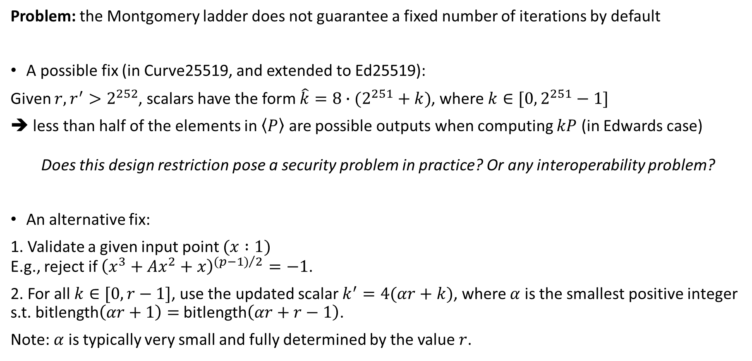
Observations on the Montgomery Ladder
Problem: the Montgomery ladder does not guarantee a fixed number of iterations by default
A possible fix (in Curve25519, and extended to Ed25519):
Given $r,r^{′}>2^{252}$, scalars have the form $\hat{k}=8∙(2^{251}+k)$, where $k∈[0,2^{251}−1]$
less than half of the elements in $\left\langle P\right\rangle$ are possible outputs when computing $kP$ (in Edwards case)
Does this design restriction pose a security problem in practice? Or any interoperability problem?
An alternative fix:
1. Validate a given input point $(x :1)$ E.g., reject if ${\left(x^{3}+Ax^{2}+x\right)}^{{(p−1)}/2}=−1$.
2. For all $k∈[0,r−1]$, use the updated scalar $k^{′}=4(αr+k)$, where $α$ is the smallest positive integer s.t. bitlength$\left(αr+1\right)=$ bitlength$\left(αr+r−1\right)$.
Note: $α$ is typically very small and fully determined by the value $r$.
10

Slide 13
Prime and Curve Selection

Slide 14
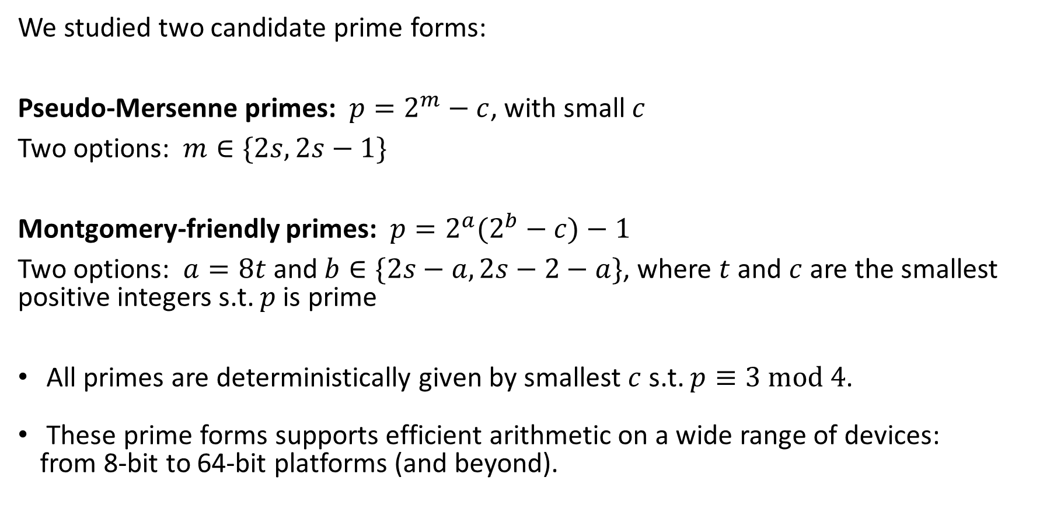
Prime Form Selection
We studied two candidate prime forms:
Pseudo-Mersenne primes: $p=2^{m}−c$, with small $c$
Two options: $m∈\{2s,2s−1\}$
Montgomery-friendly primes: $p=2^{a}(2^{b}−c)−1$
Two options: $a=8t$ and $b∈\{2s−a,2s−2−a\}$, where $t$ and $c$ are the smallest positive integers s.t. $p$ is prime
All primes are deterministically given by smallest $c$ s.t. $p≡3 mod 4$.
These prime forms supports efficient arithmetic on a wide range of devices: from 8-bit to 64-bit platforms (and beyond).
11

Slide 15
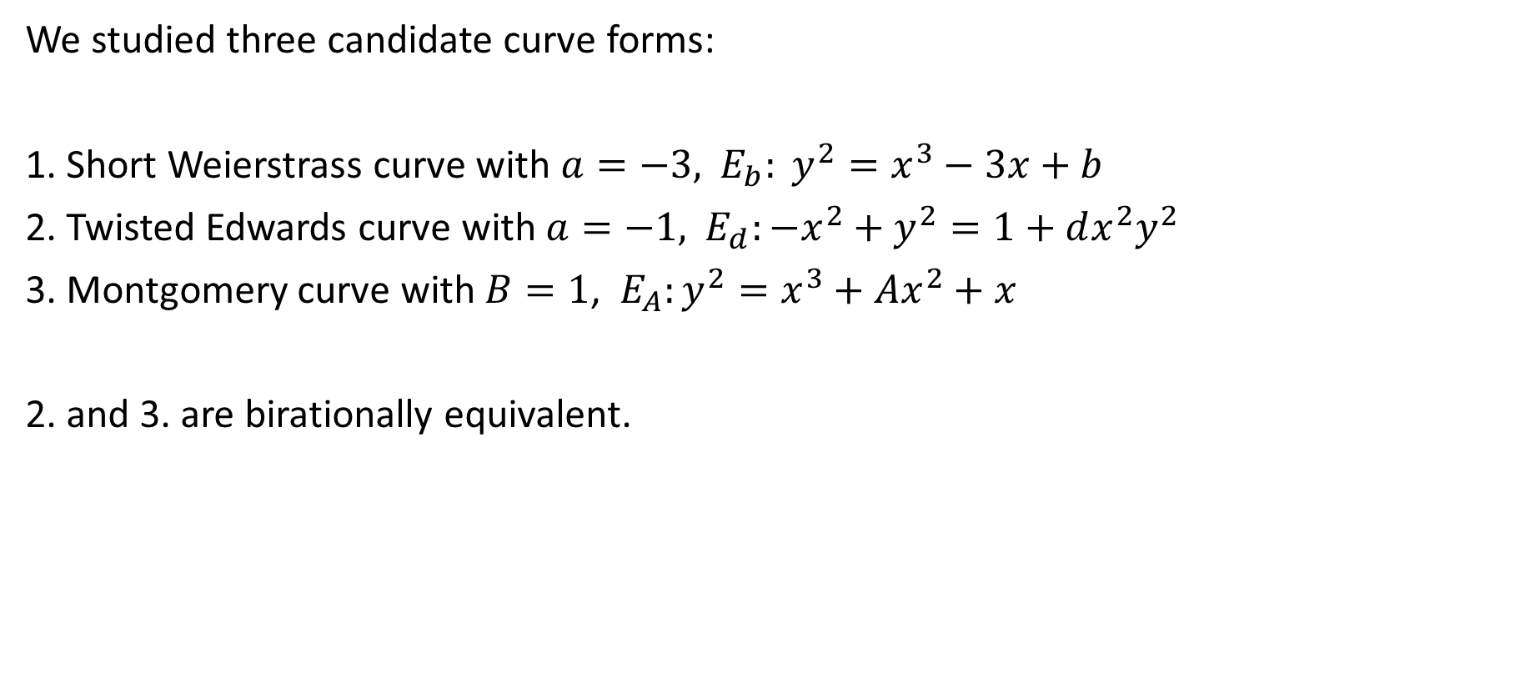
Curve Selection
We studied three candidate curve forms:
1. Short Weierstrass curve with $a=−3,$ $E_{b}: y^{2}=x^{3}−3x+b$
2. Twisted Edwards curve with $a=−1,$ $E_{d}:−x^{2}+y^{2}=1+dx^{2}y^{2}$
3. Montgomery curve with $B=1$, $E_{A}:y^{2}=x^{3}+Ax^{2}+x$
2. and 3. are birationally equivalent.
12

Slide 16
Experimental Results

Slide 17
A Note on Implementation Performance
A few attractive features in (crypto) libraries:
Portability
Scalability
Maintainability
Use of assembly: how much is too much w.r.t portability/scalability/maintainability?
Vectorized versus “standard” implementations
Several platforms support efficient SIMD instructions that might give an attractive performance boost (e.g., NEON on some ARM processors)
Consider that many platforms do not have such support (8-bit and many 32-bit platforms)
We focus on “standard” implementations for baseline comparisons. In some cases, they might favor scalability and be easier to maintain/keep up-to-date
13

Slide 18
Our Reference Implementation
We wrote a reference library mostly in C language.
All the curve arithmetic is “templated” and written in C: each curve function uses one single template to support all curves of common form and all fields (we currently support 15 different curves).
This “single-template” style was given priority at the expense of neglecting some optimizations in the field/curve functions
Only field operations are implemented and optimized in assembly:
We target x64 platforms but the library design allows easy expansion to support any other platform by plugging in a new field arithmetic layer
In contrast to several speed-focused implementations, field functions in assembly are not inlined in the curve functions: some impact on performance but a significant reduction in memory
All the reported results were obtained on an Intel Sandy Bridge machine running Windows 7, with TurboBoost and Hyper-threading disabled. The library was compiled with VS2012.
The following results include recent optimizations in the library. We will be updating our preprint soon.
NOTE: there is still room for improvement, especially at high security levels.
14

Slide 19
Experimental Results: effects of the prime form

Slide 20
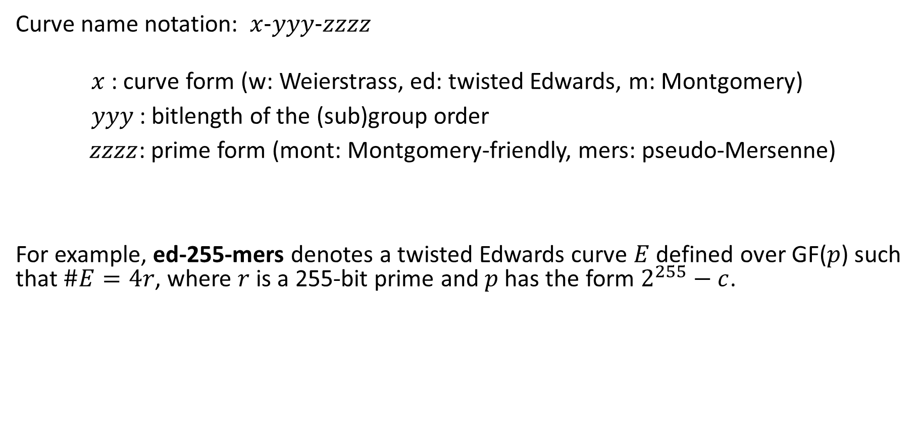
Curve name notation: $x\text{−}yyy\text{−}zzzz$
$x$: curve form (w: Weierstrass, ed: twisted Edwards, m: Montgomery)
$yyy$: bitlength of the (sub)group order
$zzzz$: prime form (mont: Montgomery-friendly, mers: pseudo-Mersenne)
For example, ed-255-mers denotes a twisted Edwards curve $E$ defined over GF($p$) such that $\#E=4r$, where $r$ is a 255-bit prime and $p$ has the form $2^{255}−c$.
15

Slide 21
For pseudo-Mersenne: reducing security in half a bit reduces cost by < 4%
(the same for 192-bit and 256-bit: < 4%)
Sec level | curve | variable-base | fixed-base | double-scalar
128 | w-256-mont | 280 | 115 | 287
 | w-256-mers | 281 | 119 | 288
 | ed-256-mont | 234 | 93 | 237
 | ed-254-mont | 196 | 76 | 198
 | ed-256-mers | 234 | 95 | 237
 | ed-255-mers | 226 | 94 | 228
 | m-254-mont | 224 | N/A | N/A
 | m-255-mers | 245 | N/A | N/A
* Results are expressed in terms of thousands of cycles, and were obtained on a 3.4GHz Intel Core i7-2600 Sandy Bridge machine.
16

Slide 22
Sec level | curve | variable-base | fixed-base | double-scalar
128 | w-256-mont | 280 | 115 | 287
 | w-256-mers | 281 | 119 | 288
 | ed-256-mont | 234 | 93 | 237
 | ed-254-mont | 196 | 76 | 198
 | ed-256-mers | 234 | 95 | 237
 | ed-255-mers | 226 | 94 | 228
 | m-254-mont | 224 | N/A | N/A
 | m-255-mers | 245 | N/A | N/A
For Montgomery-friendly: reducing security in one bit reduces cost by 19-22%
(192-bit case: 8-12%)
(256-bit case: 8-10%)
* Results are expressed in terms of thousands of cycles, and were obtained on a 3.4GHz Intel Core i7-2600 Sandy Bridge machine.
17

Slide 23
Sec level | curve | variable-base | fixed-base | double-scalar
128 | w-256-mont | 280 | 115 | 287
 | w-256-mers | 281 | 119 | 288
 | ed-256-mont | 234 | 93 | 237
 | ed-254-mont | 196 | 76 | 198
 | ed-256-mers | 234 | 95 | 237
 | ed-255-mers | 226 | 94 | 228
 | m-254-mont | 224 | N/A | N/A
 | m-255-mers | 245 | N/A | N/A
For full bitlength primes: Montgomery-friendly and pseudo Mersenne primes are in the same ballpark
(192-bit case: pseudo-Mersenne faster by 6-8%)
(256-bit case: pseudo-Mersenne faster by 11-14%)
* Results are expressed in terms of thousands of cycles, and were obtained on a 3.4GHz Intel Core i7-2600 Sandy Bridge machine.
18

Slide 24
Sec level | curve | variable-base | fixed-base | double-scalar
128 | w-256-mont | 280 | 115 | 287
 | w-256-mers | 281 | 119 | 288
 | ed-256-mont | 234 | 93 | 237
 | ed-254-mont | 196 | 76 | 198
 | ed-256-mers | 234 | 95 | 237
 | ed-255-mers | 226 | 94 | 228
 | m-254-mont | 224 | N/A | N/A
 | m-255-mers | 245 | N/A | N/A
For reduced bitlength primes: Montgomery-friendly is faster by 10-24%
(192-bit case: same ballpark)
(256-bit case: pseudo-Mersenne faster by 7-8%)
* Results are expressed in terms of thousands of cycles, and were obtained on a 3.4GHz Intel Core i7-2600 Sandy Bridge machine.
19

Slide 25
In summary:
Pseudo-Mersenne form is preferable if maximal ECDLP security is a must. Arguably, it also requires a “simpler” implementation and supports an easy-to-describe curve generation (see later).
Montgomery-friendly form achieves highest performance at the 128-bit security level, this at the expense of a slight reduction in security.
20

Slide 26
Experimental Results: effects of the curve form

Slide 27
Sec level | curve | variable-base | fixed-base | double-scalar
128 | w-256-mers | 281 | 119 | 288
 | ed-256-mers | 234 | 95 | 237
 | m-255-mers | 245 | N/A | N/A
192 | w-384-mers | 744 | 277 | 761
 | ed-384-mers | 617 | 231 | 624
 | m-383-mers | 666 | N/A | N/A
256 | w-512-mers | 1543 | 517 | 1592
 | ed-512-mers | 1293 | 446 | 1320
 | m-511-mers | 1392 | N/A | N/A
Twisted Edwards curves are:
∼ 20% faster than Weierstrass
11-15% faster than Montgomery (variable-base only)
* Results are expressed in terms of thousands of cycles, and were obtained on a 3.4GHz Intel Core i7-2600 Sandy Bridge machine.
21

Slide 28
A more precise assessment can be done at the protocol level:
Also, necessary since Montgomery curves do not support efficient fixed-base and multi-scalar multiplication.
For illustration purposes we performed the analysis in the TLS handshake using perfect forward secrecy (PFS): assume both server and client authentication using ECDSA
Estimates based on experimental results only take into account “ECC operations”.
Options that we consider:
w-xxx-mers: Weierstrass curve with full bitlength primes.
ed-xxx-mers: Twisted Edwards with full bitlength primes.
Hybrid 1: Montgomery form for ECDHE + twisted Edwards for signatures.
Hybrid 2: Montgomery form for variable-base scalar multiplication, twisted Edwards for fixed-base scalar multiplication, twisted Edwards for signatures.
22

Slide 29
* Results are expressed in terms of thousands of cycles, and were obtained on a 3.4GHz Intel Core i7-2600 Sandy Bridge machine.
Sec level | curve | T | ECDHE | ECDSA sign | ECDSA verify | TOTAL
128 | w-256-mers | U | 400 | 119 | 288 | 807
 |  | C | 425 |  |  | 832
 | ed-256-mers | U | 329 | 95 | 237 | 661
 |  | C | 354 |  |  | 686
 | hybrid 1 ed-255-mers + m-255-mers | C | 490 | 94 | 228 | 812
 | hybrid 2 ed-255-mers + m-255-mers | C | 339 | 94 | 228 | 661
256 | w-512-mers | U | 2060 | 517 | 1592 | 4169
 |  | C | 2168 |  |  | 4277
 | ed-512-mers | U | 1739 | 446 | 1320 | 3505
 |  | C | 1847 |  |  | 3613
 | hybrid 1 ed-511-mers + m-511-mers | C | 2784 | 436 | 1274 | 4494
 | hybrid 2 ed-511-mers + m-511-mers | C | 1828 | 436 | 1274 | 3538
U: transmission with uncompressed points
C: transmission using point compression
23

Slide 30
Estimates when adding input validation to Montgomery ladder (assuming that it is required)
U: transmission with uncompressed points
C: transmission using point compression
Sec level | curve | T | ECDHE | ECDSA sign | ECDSA verify | TOTAL
128 | w-256-mers | U | 400 | 119 | 288 | 807
 |  | C | 425 |  |  | 832
 | ed-256-mers | U | 329 | 95 | 237 | 661
 |  | C | 354 |  |  | 686
 | hybrid 1 ed-255-mers + m-255-mers | C | 490 | 94 | 228 | 812
 | hybrid 2 ed-255-mers + m-255-mers | C | 339 | 94 | 228 | 661
256 | w-512-mers | U | 2060 | 517 | 1592 | 4169
 |  | C | 2168 |  |  | 4277
 | ed-512-mers | U | 1739 | 446 | 1320 | 3505
 |  | C | 1847 |  |  | 3613
 | hybrid 1 ed-511-mers + m-511-mers | C | 2784 | 436 | 1274 | 4494
 | hybrid 2 ed-511-mers + m-511-mers | C | 1828 | 436 | 1274 | 3538
515
837
364
686
2886
4596
1930
3640
24

Slide 31
In summary:
The pure Edwards approach is in most cases faster than combining Montgomery form and twisted Edwards, AND does not require potentially expensive point conversions, support for different curves, etc.
Twisted Edwards are between 18-22% faster than Weierstrass curves.
In comparison with the state-of-the-art NIST P-256 implementation by [Gueron-Krasnov 2013]:
The proposed Weierstrass curves are ∼40% faster
The proposed twisted Edwards curves are ∼70% faster
(considering in both cases full bitlength primes for maximal ECDLP security possible)
25

Slide 32
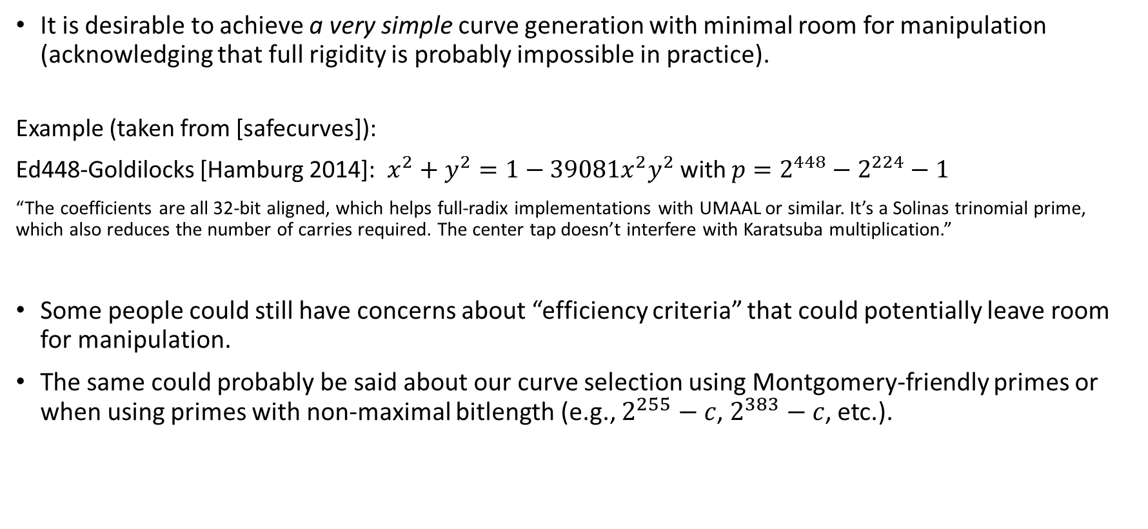
Additional Aspects of the Curve Generation
It is desirable to achieve a very simple curve generation with minimal room for manipulation (acknowledging that full rigidity is probably impossible in practice).
Example (taken from [safecurves]):
Ed448-Goldilocks [Hamburg 2014]: $x^{2}+y^{2}=1−39081x^{2}y^{2}$ with $p=2^{448}−2^{224}−1$
“The coefficients are all 32-bit aligned, which helps full-radix implementations with UMAAL or similar. It’s a Solinas trinomial prime, which also reduces the number of carries required. The center tap doesn’t interfere with Karatsuba multiplication.”
Some people could still have concerns about “efficiency criteria” that could potentially leave room for manipulation.
The same could probably be said about our curve selection using Montgomery-friendly primes or when using primes with non-maximal bitlength (e.g., $2^{255}−c$, $2^{383}−c$, etc.).
26

Slide 33
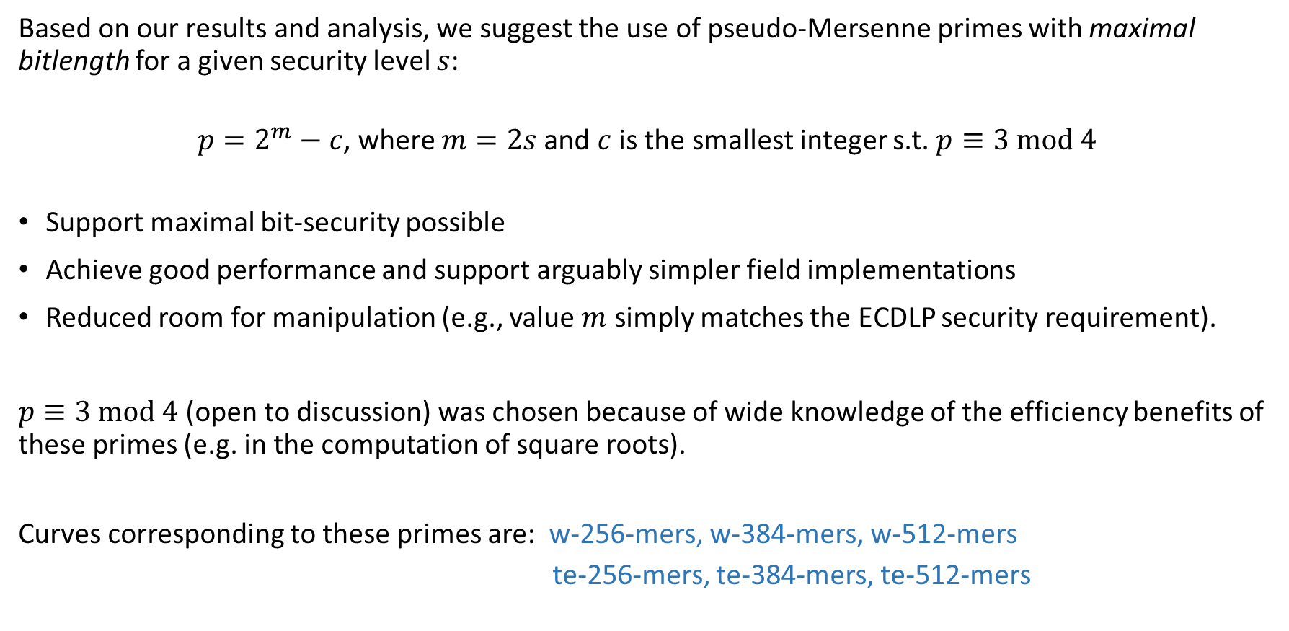
Proposing a Set of Curves
Based on our results and analysis, we suggest the use of pseudo-Mersenne primes with maximal bitlength for a given security level $s$:
$p=2^{m}−c$, where $m=2s$and $c$ is the smallest integer s.t. $p≡3 mod 4$
Support maximal bit-security possible
Achieve good performance and support arguably simpler field implementations
Reduced room for manipulation (e.g., value $m$ simply matches the ECDLP security requirement).
$p≡3 mod 4$ (open to discussion) was chosen because of wide knowledge of the efficiency benefits of these primes (e.g. in the computation of square roots).
Curves corresponding to these primes are: w-256-mers, w-384-mers, w-512-mers
te-256-mers, te-384-mers, te-512-mers
27

Slide 34
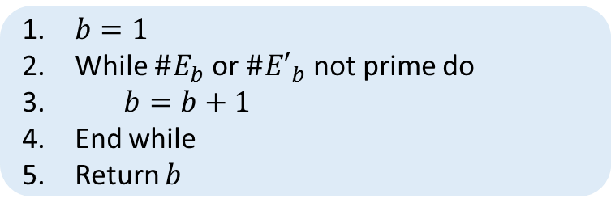

Proposed Publicly Verifiable Generation - Weierstrass
Define the short $a=−3$ Weierstrass curve $E_{b}: y^{2}=x^{3}−3x+b$ with quadratic twist ${E′}_{b}: y^{2}=x^{3}−3x−b$.
Pick a bit-security $s$ from the standard set {128, 192, 256}.
Fix $p=2^{2s}−c$, where $c$ is the smallest integer such that $p≡3 mod 4$.
Then compute:
$b=1$
While ${\#E}_{b}$ or ${\#E′}_{b}$ not prime do
$b=b+1$
End while
Return $b$
28

Slide 35
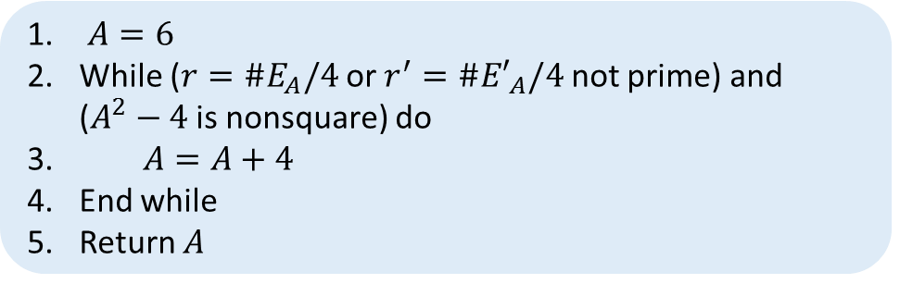

Proposed Publicly Verifiable Generation - Edwards
Define the $a=−1$ twisted Edwards curve $E_{d}:−x^{2}+y^{2}=1+dx^{2}y^{2}$ with quadratic twist ${E′}_{A}:y^{2}=x^{3}−Ax^{2}+x$, and birationally equivalent to the Montgomery curve $E_{A}:y^{2}=x^{3}+Ax^{2}+x$.
Pick a bit-security $s$ from the standard set {128, 192, 256}.
Fix $p=2^{2s}−c$, where $c$ is the smallest integer such that $p≡3 mod 4$.
Then compute:
$A=6$
While (${r=\#E}_{A}/4$ or ${r^{′}=\#E′}_{A}/4$ not prime) and ($A^{2}−4$ is nonsquare) do
$A=A+4$
End while
Return $A$
29

Slide 36
A Summary of the Proposed Curves: Weierstrass versus Edwards
Weierstrass curves: w-256-mers, w-384-mers, w-512-mers | Twisted Edwards curves: ed-256-mers, ed-384-mers, ed-512-mers
Optimal ECDLP security: ∼128, 192, 256 bits (respect.) | ECDLP security: ∼127, 191, 255 bits (respect.)
Support efficient variable-base, fixed-base, multi-scalar multiplication
Support constant-time, exception-free scalar multiplications through “practical” completeness | Support constant-time, exception-free scalar multiplications through complete addition law or “practical” completeness
Good performance: at least 40% improvement in comparison to NIST curves | Better performance: ∼20% speedup in comparison to new Weierstrass curves; at least 70% improvement in comparison to NIST curves
Good performance on a wide range of platforms: 8, 32, 64-bit
Inherent protection against any possible attack exploiting small torsion (e.g., small-subgroup attacks) | Susceptible to attacks exploiting small torsion
No change required to protocols | Require adjusting protocols for working with co-factor 4
High compatibility with current libraries supporting NIST curves | Require completely new implementations
Simple, deterministic and publicly verifiable curve generation with reduced room for manipulation
30

Slide 37
Final Remarks (1/2)
Standardizing both Weierstrass and twisted Edwards curves with efficient prime arithmetic support and maximal bitlength (using recommended pseudo-Mersenne primes) brings many benefits:
Relatively compact, secure and efficient cryptographic implementations supporting both curve forms are possible: shared field arithmetic; only point arithmetic would be completely different.
Edwards curves have the lead in terms of efficiency (around 20% perf improvement) and simpler/more compact point arithmetic.
Prime-order Weierstrass curves achieve optimal ECDLP bit-security, offer no room for potential future attacks that could take advantage of any small torsion (inherent to Edwards curves), and are backwards compatible with current NIST implementations (e.g., no changes at all are required at the protocol level).
Pseudo-Mersenne primes with maximal bitlength support minimalistic, publicly verifiable curve generation with little room for manipulation. These primes also:
Support efficient arithmetic for a wide range of platforms, from 8- to 32-, 64-bit architectures.
Offer a balanced performance between architectures with vector and non-vector support.
31

Slide 38
Final Remarks (2/2)
The Montgomery ladder may involve certain theoretical and practical considerations that might be tricky to deal with. In most cases, full use of twisted Edwards is recommended.
For a conservative approach, consider analyzing the addition of curves defined over pseudo-random primes:
Estimate: about two times slower than special-prime curves.
These curves could increase security robustness of a new curve set.
32

Slide 39
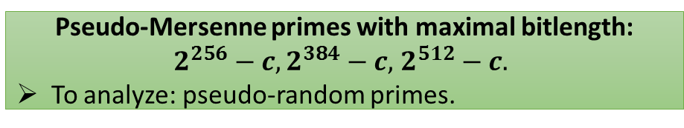
By the end of the project …
protocol layer
Constant-time, exception-free algorithms to do crypto
128-bit security
192-bit security
256-bit security
Weierstrass curves
twisted Edwards curves
Montgomery curves
Pseudo-Mersenne primes with maximal bitlength: $2^{256}−c,2^{384}−c,$ $2^{512}−c.$
To analyze: pseudo-random primes.
33

Slide 40
Reference
J. Bos, C. Costello, P. Longa and M. Naehrig, “Selecting Elliptic Curves for Cryptography: An Efficiency and Security Analysis”, Cryptology ePrint Archive: Report 2014/130.
http://eprint.iacr.org/2014/130
More, improved results are coming in the next few weeks.
34

Slide 41
Other References
[brainpool] ECC Brainpool Standard Curves and Curve Generation, http://www.ecc-brainpool.org/download/Domain-parameters.pdf, 2005.
[curve25519] D. J. Bernstein, “Curve25519: new Diffie-Hellman speed records”, in PKC 2006.
[Faz et al. 2013] A. Faz-Hernández, P. Longa, and A. Sánchez, “Efficient and secure algorithms for GLV-based scalar multiplication and their implementation on GLV-GLS curves” (extended version), http://eprint.iacr.org/2013/158.
[Gueron-Krasnov 2013] S. Gueron and V. Krasnov, “Fast prime field elliptic curve cryptography with 256 bit primes”, http://eprint.iacr.org/2013/816.
[Hamburg 2012] M. Hamburg, “Fast and compact elliptic-curve cryptography”, http://eprint.iacr.org/2012/309.
[Okeya-Takagi 2003] K. Okeya and T. Takagi, “The width-w NAF method provides small memory and fast elliptic curve scalars multiplications against side-channel attacks”, in CT-RSA 2003.
[safecurves] D. J. Bernstein and T. Lange, “SafeCurves: choosing safe curves for elliptic-curve cryptography”, http://safecurves.cr.yp.to.
35

Slide 42
Selecting Elliptic Curves for Cryptography
Questions?
Joppe Bos NXP Semiconductors
Craig Costello Microsoft Research Patrick Longa Microsoft Research
Michael Naehrig Microsoft Research

