Slide 1

TypeScript, Angular with Bootstrap

Slide 2
“
TypeScript lets you write JavaScript the way you really want to.
TypeScript is a typed superset of JavaScript that compiles to plain JavaScript.

Slide 3

Overview
Syntax based on ECMAScript proposals
TypeScript is first and foremost a superset of JavaScript
Any regular JavaScript is valid TypeScript Code

Slide 4
Installation
Install Node LTS version - https://nodejs.org/en/
Install / Update Visual Studio Code to Latest Release - https://code.visualstudio.com/
Extensions of VS Code
AutoFileName
vscode-icons
JavaScript (ES6) code snippets
After all Extensions are installed
File Menu -> Preferences -> File Icon Theme -> Select VScode Icons

Slide 5
JAVA / CS
TS
JAVAC / CSC
TSC
Byte Code / MSIL
JavaScript
JavaScript
JIT Compiler (JVM / CLR)
JavaScript Runtime
JavaScript Runtime
Native
Native
Native
O.S.
O.S.
O.S.

Slide 6
How to install?
Global Installation
npm install -g typescript
OR
npm i -g typescript
Check the TypeScript Compiler version installed
tsc –v
Compile a TypeScript File to JavaScript output
tsc <full path of ts file> e.g. tsc demo3.ts
Local Installation
npm install --save-dev typescript
OR
npm i -D typescript

Slide 7
.ts files
.ts files
Will be compiled by
Will be compiled by
Automate .ts
to .js file
Creation
Run tsc in
Watch mode
tsc
tsc
Convert to
Convert to
.js files
.js files
Refer in
Refer in
.html page
.html page
Open in
Open in
BROWSER
BROWSER

Slide 8
Local Installation – New Project
Create a new folder (TSDemos)
Open the folder path in terminal window
npm init -y
Changed the package.json file as required
npm i -D typescript@4.8.4
Create and configure tsconfig.json
Create a file 1_first-demo.ts in root folder
To run the compiler in watch mode, use the following command
npm run compile

Slide 9
Using the Shared Application
Download & extract TSDemos.zip file
Open the folder in VS Code
Open Terminal window on the folder path and run the following command
npm install
4. To run the compiler in watch mode, use the following command
npm run compile

Slide 10
ECMASCRIPT Versions - Target
ES3
ES5
ECMASCRIPT 2015
ECMASCRIPT 2016
ECMASCRIPT 2017
ECMASCRIPT 2018
ECMASCRIPT 2019
ECMASCRIPT 2020
ECMASCRIPT 2021
ECMASCRIPT 2022
ECMASCRIPT 2023

Slide 11
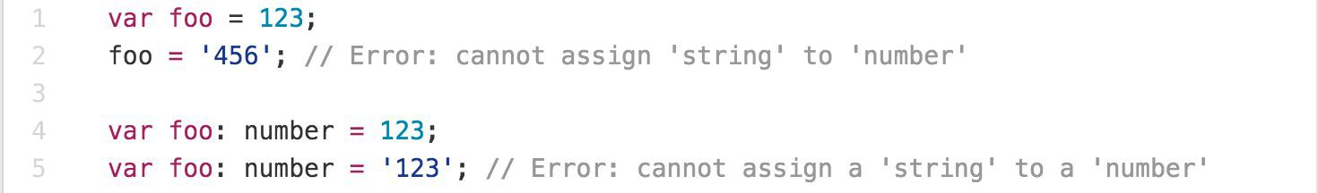
Main Goals of TypeScript
Provide an optional type system for JavaScript.
Provide planned features from future JavaScript editions to current JavaScript engines
Modular Development

Slide 12
TypeScript Features
Data Types Supported
Optional Static Type Annotation
Classes
Interface
Modules
Arrow Expressions
Type Assertions
Ambient Declarations
Source File Dependencies

Slide 13
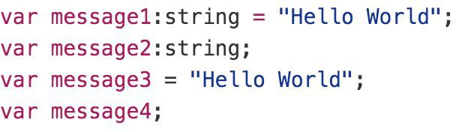
Type Inference
TypeScript tries to infer types
Four ways to variable declaration -
Type and Value in one statement
Type but no Value then Value will be undefined
Value but on Type then the it will be of Any type but maybe be inferred based on its value.
Neither Value nor Type then Type will be Any and Value will be undefined.

Slide 14
Data Types
Any
Never
Unknown
Primitive
Number
Boolean
String
Void
Null
Undefined
Array
Tuple
Enum

Slide 15
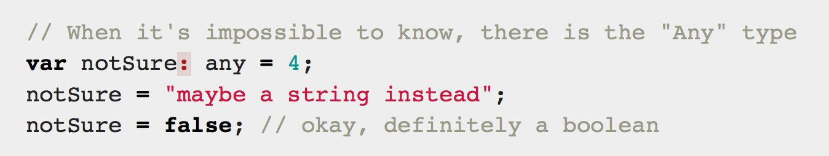
Any
Any is used when it’s impossible to determine the type

Slide 16
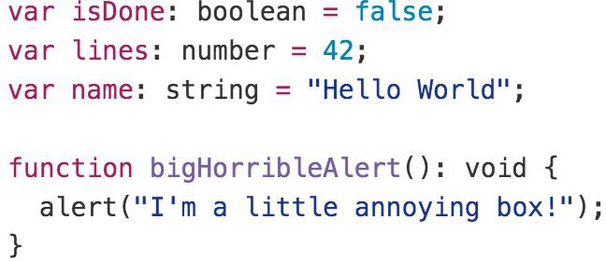
Primitive
Doesn’t have separate integers and float/double type. These all are floating point values and get the type ‘number’
boolean - true/false value
string - both single/double quote can be used
No separate char type
void - is used in function type returning nothing
null and undefined - functions as usual

Slide 17
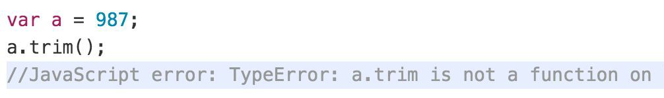
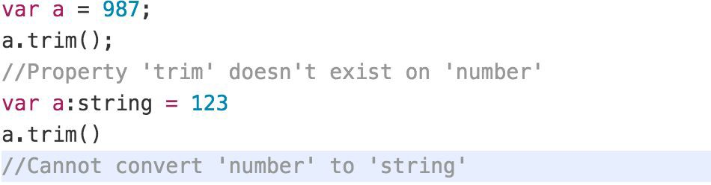
Type Annotations/Checking
JavaScript
TypeScript

Slide 18
Type Assertion
TypeScript's type assertion are purely, you telling the compiler that you know about the types better than it does, and that it should not second guess you.
Type assertion is a mechanism which tells the compiler about the type of a variable.
Type assertion is explicitly telling the compiler that we want to treat the entity as a different type.

Slide 19
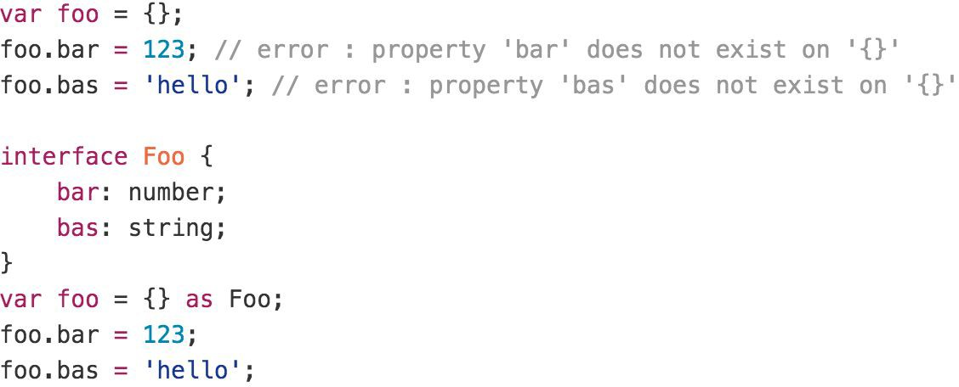
Type Assertion Example

Slide 20
Type Guards / Union Types
Type Guards allow you to narrow down the type of a variable within a conditional block.
Union types are a powerful way to express a value that can be one of the several types.
Two or more data types are combined using the pipe symbol (|) to denote a Union Type. In other words, a union type is written as a sequence of types separated by vertical bars.

Slide 21
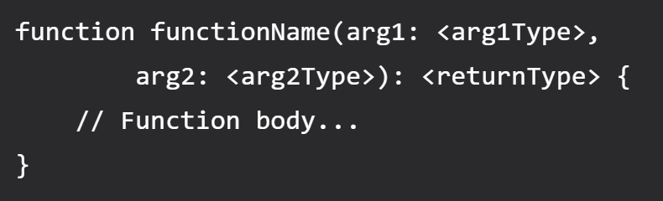
Functions
Writing a function in TypeScript is like writing them in JavaScript but with added parameters and return type.
Note that any JavaScript function is a perfectly valid TypeScript function. However, we can do better by adding type.
TypeScript function syntax (with two arguments)

Slide 22
Lambda Expression
Implicit return
No braces for single expression
Part of ES6 termed as Arrow Functions
Lexically scoped this
You don't need to keep typing function
It lexically captures the meaning of arguments

Slide 23
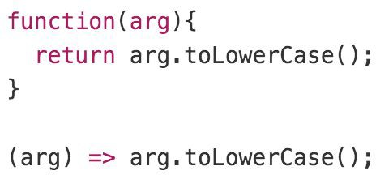
Lambda Example

Slide 24
Rest Parameter (…args)
A rest parameter allows you a function to accept zero or more arguments of the specified type.
In TypeScript, rest parameters follow these rules:
A function has only one rest parameter.
The rest parameter appears last in the parameter list.
The type of the rest parameter is an array type.
To declare a rest parameter, you prefix the parameter name with three dots and use the array type as the type annotation:

Slide 25
Rest vs Spread
Rest and spread are two related features in TypeScript that allow developers to work with arrays and objects more easily.
Rest Parameters
Rest parameters allow you to represent an indefinite number of arguments as an array.
You can use the rest parameter syntax (...) to indicate that a function should accept any number of arguments.
Spread Syntax
Spread syntax allows you to "spread" the elements of an array or object into another array or object.
You can use the spread syntax (...) to expand an array into its individual elements, or to merge two or more objects into a new object.

Slide 26
Shallow Copy
emp2
emp1
id: 1
ename: “Manish”
address:
id: 1
ename: “Manish”
address:
city: “Mumbai”

Slide 27
Deep Copy
emp2
emp1
id: 1
ename: “Manish”
address:
id: 1
ename: “Manish”
address:
city: “Mumbai”
city: “Pune”

Slide 28
Arrays
The use of variables to store values poses the following limitations −
Variables are scalar in nature. In other words, a variable declaration can only contain a single at a time. This means that to store n values in a program n variable declarations will be needed. Hence, the use of variables is not feasible when one needs to store a larger collection of values.
Variables in a program are allocated memory in random order, thereby making it difficult to retrieve/read the values in the order of their declaration.
TypeScript introduces the concept of arrays to tackle the same.
An array is a homogenous collection of values.
An array is a collection of values of the same data type.
It is a user defined type.

Slide 29
Features of an Array
An array declaration allocates sequential memory blocks.
Arrays are static. This means that an array once initialized cannot be resized.
Each memory block represents an array element.
Array elements are identified by a unique integer called as the subscript / index of the element.
Like variables, arrays too, should be declared before they are used. Use the var keyword to declare an array.
Array initialization refers to populating the array elements.
Array element values can be updated or modified but cannot be deleted.

Slide 30
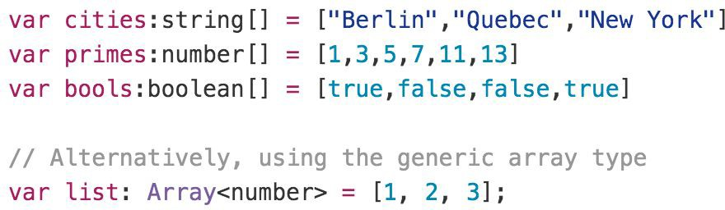
Array

Slide 31
Learn for Day 2
What are Modules in JavaScript?
CommonJS
Require
System
AMD
UMD
ESModule
Learn about the other compiler options in tsconfig.json file
https://www.typescriptlang.org/tsconfig

Slide 32
Tuple
As we know array consists value of Homogeneous types but sometimes, we need to store a collection of a different type value in a single variable. Then we will go with Tuples.
Tuples are just like structure in C programming and can also be passed as parameters in a function call.
To denote a multi-dimensional coordinate system the term used is tuple in abstract mathematics.
JavaScript doesn’t have tuples as data types, but in typescript Tuple's facility is available.
Tuple values are individually called items. Tuples are index based. This means that items in a tuple can be accessed using their corresponding numeric index.

Slide 33
Enum
Enums or enumerations are a new data type supported in TypeScript. Most object-oriented languages like Java and C# use Enums. This is now available in TypeScript too.
In simple words, Enums allow us to declare a set of named constants i.e., a collection of related values that can be numeric or string values.
Using Enum, we can make it easier to document intent, or create a set of distinct cases.
There are three types of Enums:
Numeric Enum
String Enum
Heterogeneous Enum

Slide 34
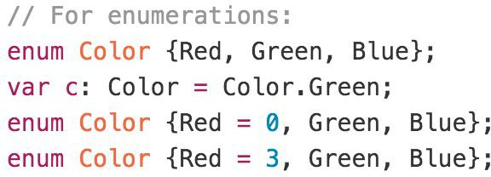
Enum
By default, Enums begin numbering their members starting at 0. You can change this by manually setting the value of one its members.

Slide 35
TypeScript Interface
Interface is a structure that defines the contract in your application.
Declared using interface keyword
Like other TypeScript features its design time features i.e., no extra code would be emitted to resultant JavaScript file
TypeScript compiler uses interface for type checking. This is also known as "duck typing" or "structural subtyping".
Errors being shown when interface signature and implementation doesn’t match.

Slide 36
TypeScript Class
In object-oriented programming languages like Java and C#, classes are the fundamental entities used to create reusable components.
TypeScript introduced classes to avail the benefit of object-oriented techniques like encapsulation and abstraction.
The class in TypeScript is compiled to plain JavaScript functions by the TypeScript compiler to work across platforms and browsers.
The concept of 'Encapsulation' is used to make class members public or private i.e., a class can control the visibility of its members. This is done using access modifiers.
There are three types of access modifiers in TypeScript:
public (Default)
private
protected.

Slide 37
TypeScript Class
A class can have the following features
Instance methods/members
Single constructor with Default/Optional parameter
Optional and Required Members in Strict Mode
Parameter Members
Static methods/members
Readonly Members
Can implement interfaces
Inheritance

Slide 38
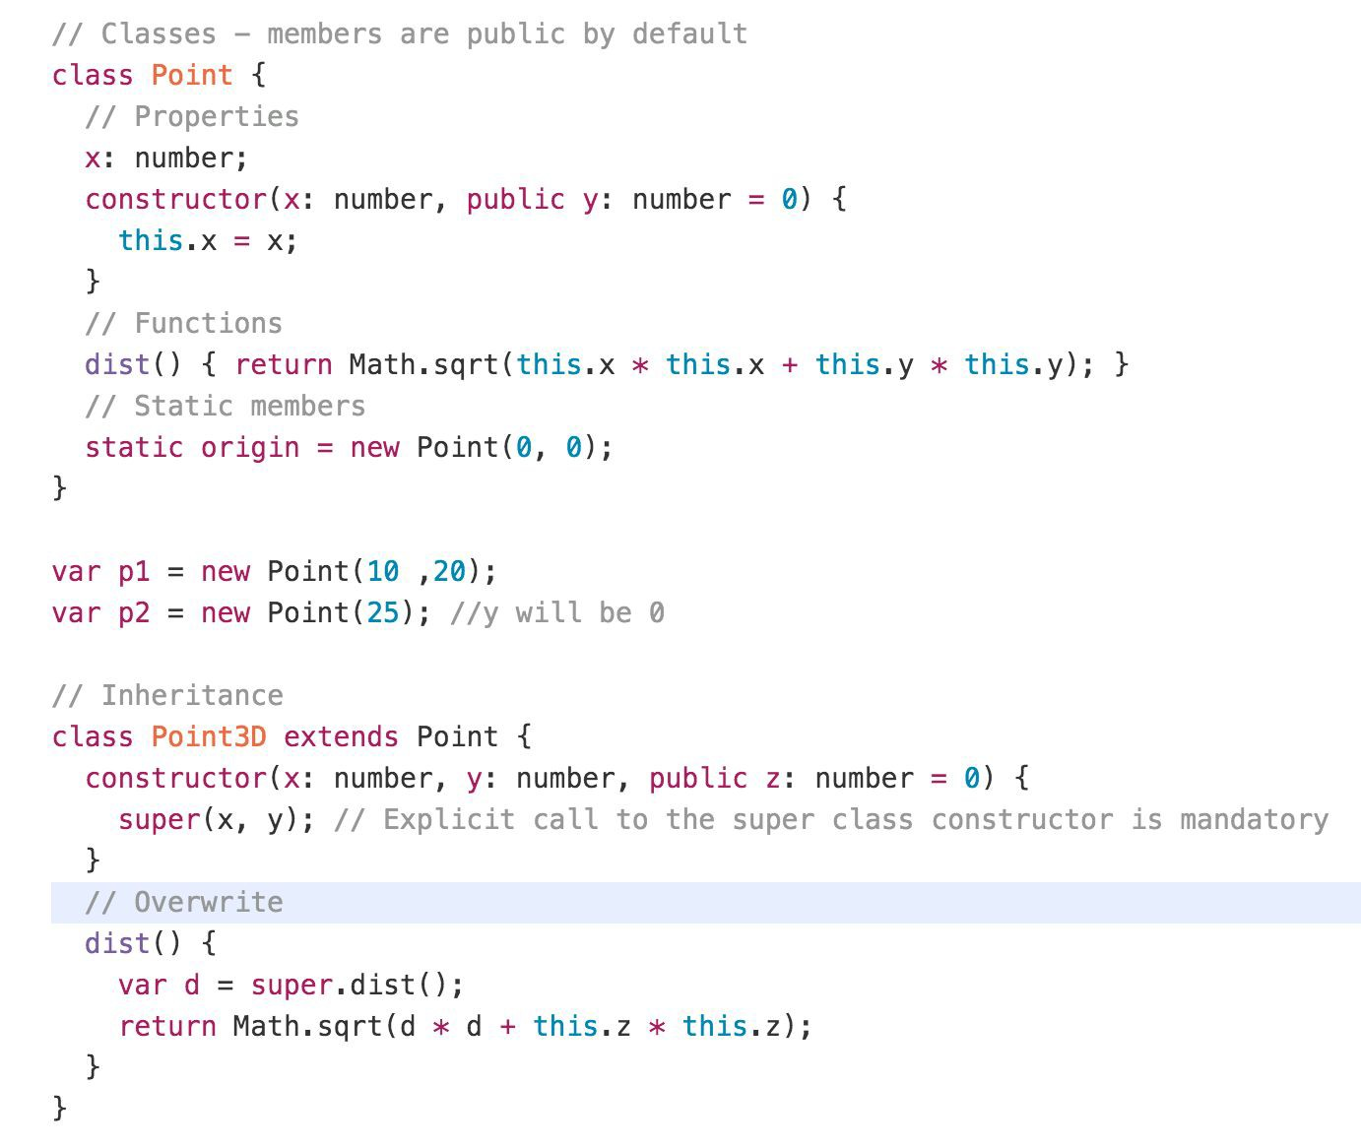
Class Example

Slide 39
Static
The static keyword defines a static method or property for a class, or a class static initialization block.
Neither static methods nor static properties can be called on instances of the class. Instead, they're called on the class itself.
Static methods are often utility functions, such as functions to create or clone objects, whereas static properties are useful for caches, fixed-configuration, or any other data you don't need to be replicated across instances.

Slide 40
Use cases for Static
Utility functions:
Static methods can be used to define utility functions that are related to a class but don't require an instance to be created. For example, a Math class could have a static method Math.random() that generates a random number.
Configuration:
Static properties can be used to store configuration values that apply to all instances of a class. For example, a Database class could have a static property Database.maxConnections that specifies the maximum number of connections allowed to the database.
Singleton pattern:
The static keyword can be used to implement the Singleton pattern, where a class has only one instance that is shared across the entire application.
Factory methods:
Static methods can be used as factory methods to create instances of a class. For example, a Person class could have a static method Person.create(name: string, age: number) that creates a new instance of the Person class with the specified name and age.

Slide 41
Readonly
The readonly keyword is used to indicate that a property or variable should not be modified after it has been initialized.
When a property is marked as readonly, it can only be set once either in its declaration or in the constructor of the class.
Similarly, when a variable is marked as readonly, it can only be assigned a value once.
Using “readonly” can help prevent accidental modifications to properties or variables, making code more robust and less error-prone.

Slide 42
Use cases for Readonly
Immutable data structures:
By marking properties as readonly, you can create immutable data structures that cannot be modified once they are initialized. This can help to prevent bugs that can be caused by unintended modifications to data.
Public API:
When creating a public API for a library or module, marking properties as readonly can help to ensure that users of the API do not accidentally modify values that are not intended to be changed.
Thread safety:
When multiple threads are accessing the same data, marking properties as readonly can help to prevent race conditions and ensure thread safety.
Performance optimization:
Marking properties as readonly can help the TypeScript compiler to optimize code, as it knows that these values will not change at runtime.

Slide 43
Generics
When writing programs, one of the most important aspects is to build reusable components. This ensures that the program is flexible as well as scalable in the long-term.
Generics offer a way to create reusable components. Generics provide a way to make components work with any data type and not restrict to one data type.
So, components can be called or used with a variety of data types, without loosing type safety and intellisense.
Generic Type can be used with
Functions
Class
Interface

Slide 44
Generic Constraints
As mentioned earlier, the generic type allows any data type. However, we can restrict it to certain types using constraints.
A constraint is specified after the generic type in the angle brackets.
Constraints can be applied using:
extends
Type Parameters
Class Types
keyof

Slide 45
Decorators
Decorators provide a way to add both annotations and a meta-programming syntax.
A Decorator is a special kind of declaration that can be attached to a class declaration, method, accessor, property, or parameter.
Decorators use the form @expression, where expression must evaluate to a function that will be called at runtime with information about the decorated declaration.
Decorators are just a clean syntax for wrapping a piece of code with a function

Slide 46
Inheritance
TypeScript is an object-oriented programming language that supports inheritance.
Inheritance is a mechanism that allows one class to inherit the properties and methods of another class.
In TypeScript, inheritance is achieved using the extends keyword.
When a class extends another class, it inherits all the properties and methods of the base class.
The subclass can also add its own properties and methods, and override or extend the behavior of the inherited methods.

Slide 47
Namespaces
The namespace is used for logical grouping of functionalities. A namespace can include interfaces, classes, functions and variables to support a single or a group of related functionalities.
A namespace can be created using the namespace keyword followed by the namespace name.
By default, namespace components cannot be used in other modules or namespaces.
You must export each component to make it accessible outside, using the export keyword
The generated JavaScript code for the namespace uses the IIFE pattern to stop polluting the global scope.

Slide 48
Modules
A module is just a file. One typescript file is one module. As simple as that.
A module may contain a class or a library of functions for a specific purpose.
Modules can load each other and use special directives export and import to interchange functionality, call functions of one module from another one:
export keyword labels variables and functions that should be accessible from outside the current module.
import allows the import of functionality from other modules.

Slide 49
Namespace vs Module
Namespace | Module
Must use the namespace keyword and the export keyword to expose namespace components. | Uses the export keyword to expose module functionalities.
Used for logical grouping of functionalities with local scoping. | Used to organize the code in separate files and not pollute the global scope.
To use it, it must be included using triple slash reference syntax e.g. ///<reference path="path to namespace file" />. | Must import it first in order to use it elsewhere.
Compile using the --outFile command. | Compile using the --module command.
Must export functions and classes to be able to access it outside the namespace. | All the exports in a module are accessible outside the module.
Namespaces cannot declare their dependencies. | Modules can declare their dependencies.
No need of module loader. Include the .js file of a namespace using the <script> tag in the HTML page. | Must include the module loader API which was specified at the time of compilation e.g. CommonJS, require.js etc.

Slide 50
Build Tools
Build Tools are utilities that help automate the transformation and bundling of your code into a single file. Most JavaScript projects use these build tools to automate the build process.
There are several common build tools available that can be integrated with TypeScript.
Some of the tools are:
Browserify
Grunt
Gulp
Webpack

Slide 51
.ts files
Will be compiled by
tsc
Convert to
.js files
Refer in
.html page
Open in
BROWSER

Slide 52
Client Side Build
TypeScript (s)
.ts
TSC
Build & Deploy your
Project on Local Server
Manual Configuration
Node JS
Webpack
TypeScript Config.
Build your project
Browser Compatible Files
(Multiple Files)
WEBPACK-DEV-
SERVER
WEBPACK
CLI
Bundling
BROWSER
WEBPACK
Single File / Set of Files
Local
HTTP Server
HTML PAGE
Deploy
Inject

Slide 53
Webpack Configuration Steps
Entry
Extensions
Loaders
Plugins
Optimization
Output

Slide 54
Steps to run the webpack application
Download and Extract the zip file.
Open the extracted folder in Visual Studio Code
Open the terminal window on the folder path and execute the following command
npm install
After the installation completes, execute the following command
npm run serve – To start the development server
npm run build – To create the dist folder with production build

Slide 55
Angular

Slide 56
BROWSER
SERVER
HTTP + URL
NAVIGATION
HTML PAGES
CSS
HTML + CSS
HTTP + URL
HTML + CSS
Page
Reload!

Slide 57
BROWSER
SERVER
HTTP + URL
NAVIGATION
HTML + CSS
Server PAGES
CSS
HTTP + URL
ASP
ASP .NET
JSP
PHP
Ruby
Express JS
HTML + CSS
Page
Reload!
DB

Slide 58
BROWSER
SERVER
HTTP + URL
NAVIGATION
Server PAGES
CSS
HTML + CSS + JS
AJAX - HTTP + URL
JS
Partial
Page
Reload!
PARTIAL HTML
<table>
<thead>
<tr>
<th>ID</th>
</tr>
</thead>
<tbody>
<tr>
<td>1</td>
</tr>
</tbody>
</table>
ASP
ASP.NET
JSP
PHP
Ruby
ASP .NET MVC
Spring MVC
Ruby On Rails
Laravel
ID
1
DB

Slide 59
SERVER
SINGLE PAGE APPLICATION – Cross Domain
SERVER PAGES
CSS
BROWSER
HTTP + URL
NAVIGATION
JS
HTML + CSS + JS
ASP
ASP .NET
JSP
PHP
Ruby
ASP .NET MVC
Spring MVC
Ruby On Rails
Laravel
<table>
<thead>
<tr>
<th>ID</th>
</tr>
</thead>
<tbody>
<tr>
<td>1</td>
</tr>
</tbody>
</table>
ID
1
SERVER
AJAX - HTTP + URL
RESTful API
ASP .NET Web API
JWS
Express JS
Python
DB
JSON to HTML on Client Side
JSON
{
“id”:1
}
Vanilla JS, jQuery, KO, BB, NG1,
NG2 & above, React, Vue

Slide 60
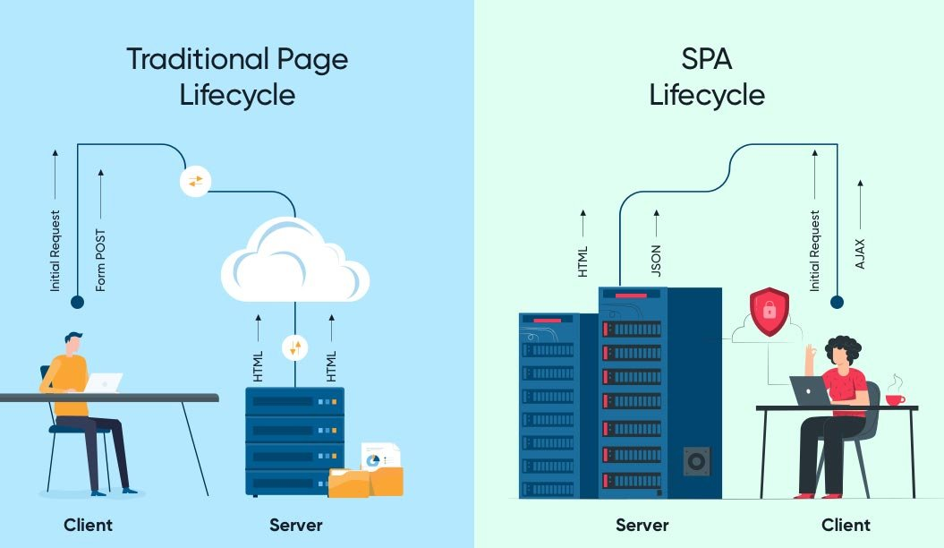

Slide 61
Single Page Application Pros - CSR
Quick Loading Time
Seamless User Experience
Ease in Building Feature-rich Apps
Uses Less Bandwidth

Slide 62
Single Page Application Cons (Purely CSR)
Doesn’t Perform Well With SEO
One of the metrics that search engines use is the number of pages a website has. However, since SPAs only load a single page, it serves as a disadvantage when ranking on search engines
Uses a Lot of Browser Resources
SPAs require many resources from the web browser since the browser is doing most of the tasks for the SPAs.
Security Issues
As compared to multi-page apps, SPAs are more prone to cross-site scripting attacks.

Slide 63
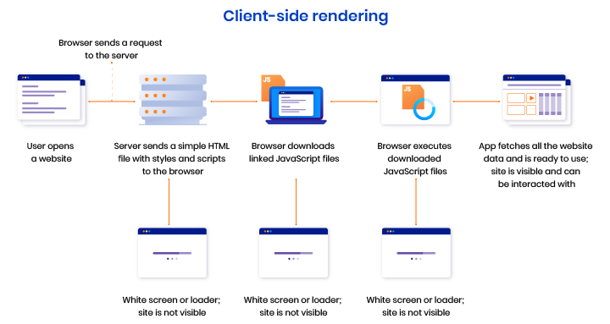

Slide 64
Library vs Framework
Library | Framework
Collection of API’s, targeted to do one specific task. | Collection of API’s, targeted for application creation. FW is a piece of code that dictates the architecture of your project.
You are in full control when you call a method from a library and the control is then returned. | The code never calls into a FW, instead the FW uses you code. We can only follow a FW.
It can be integrated seamlessly into an existing project. | FW cannot be integrated, we have to re-write the code.
jQuery – DOM Manipulation & Ajax Moment JS – Date and Time D3 JS – Data Visualization ReactJS – UI | Angular

Slide 65
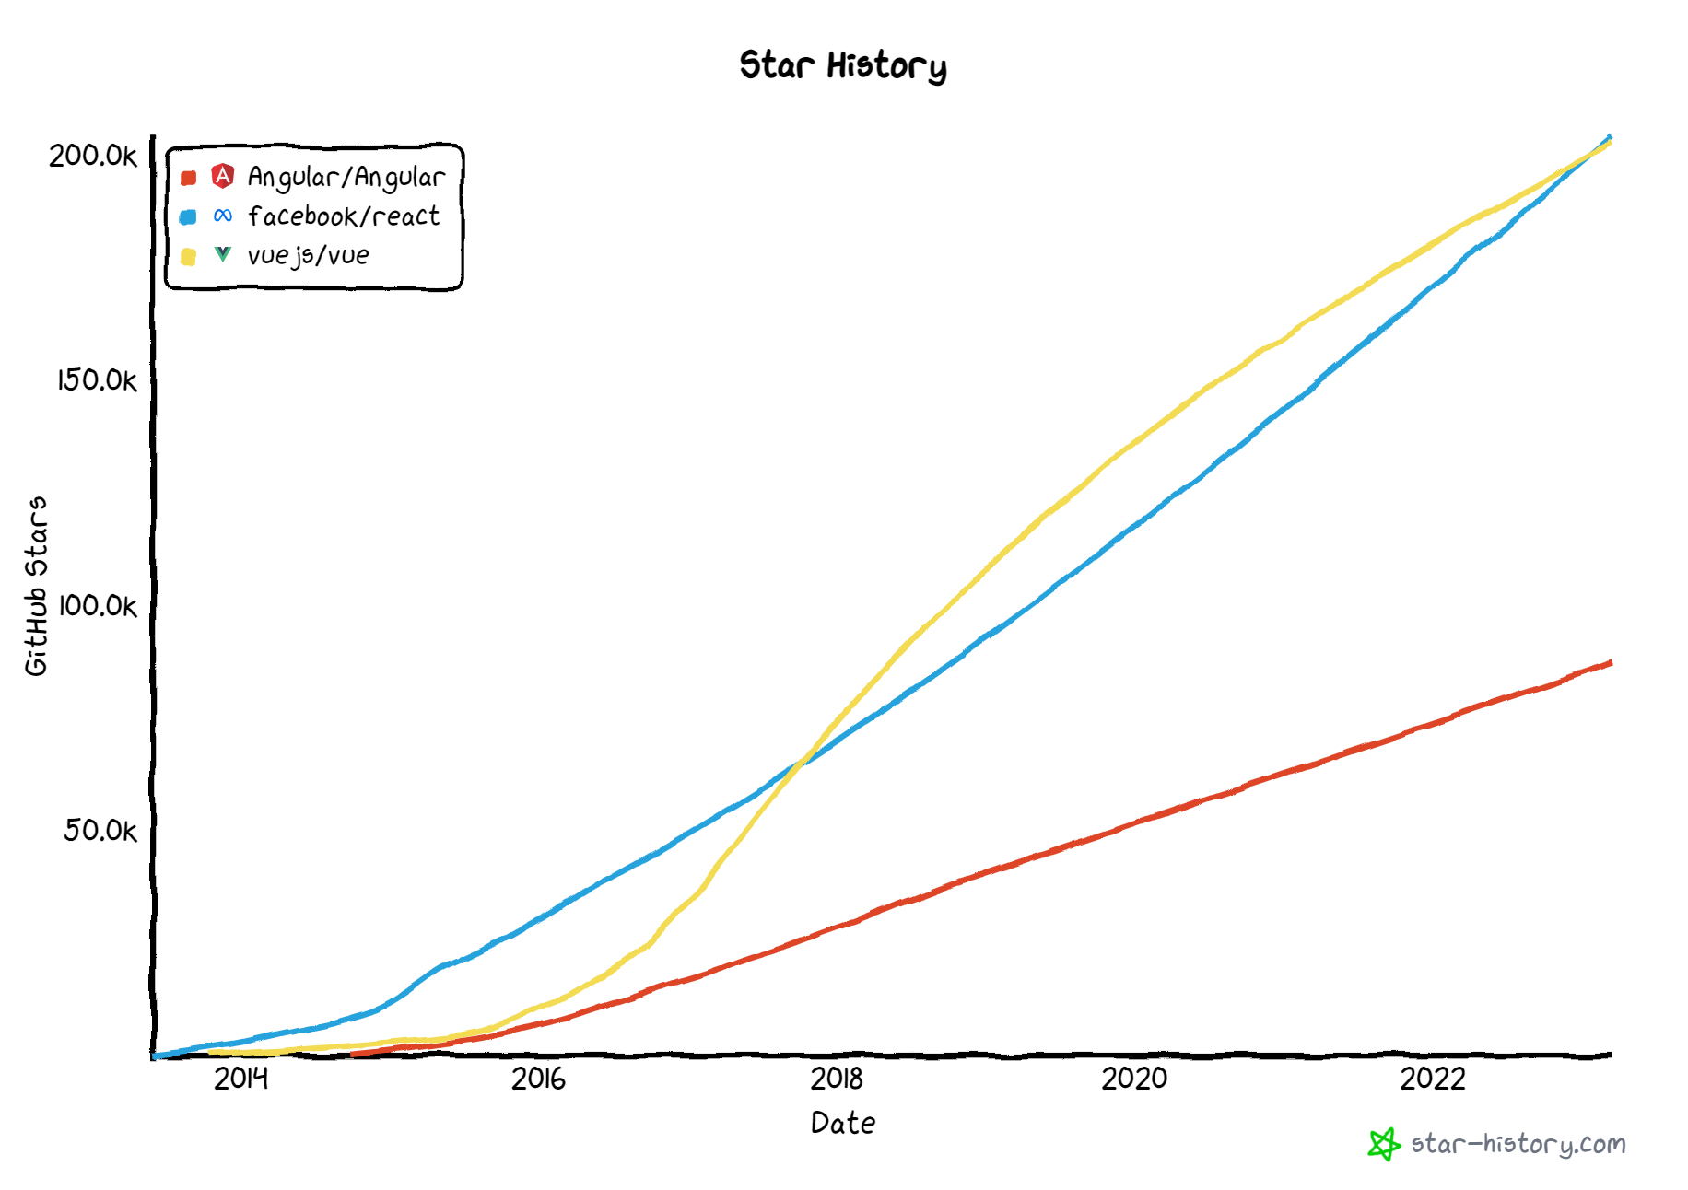

Slide 66
Component vs Traditional Approach
HTML and CSS
HTML and CSS
0
+
-
0
+
-
domHandler
domHandler
Counter
{
count: 0,
next: function() { this.count +=1; } ,
prev: function() { this.count -=1; }
}
Counter
{
count: 0,
next: function() { this.count +=10; } ,
prev: function() { this.count -=10; }
}
<Counter />
<Counter interval=“10”/>

Slide 67
Installation
Latest Version of Node JS (LTS v 16) - https://nodejs.org/en/
Latest version of Visual Studio Code - https://code.visualstudio.com/
Visual Studio Code Extensions
AutoFileName
vscode-icons
Angular Snippets
Angular Language Service
IntelliSense for CSS class names in HTML
CSS Formatter
After Installing the extensions, select the following in VS Code
File Menu -> Preferences -> File Icon Theme -> VSCode Icons
Chrome Extension
Angular DevTools – Offered by Angular Team - https://chrome.google.com/webstore/detail/angular-devtools/ienfalfjdbdpebioblfackkekamfmbnh?hl=en

Slide 68
ANGULAR CLIENT SIDE BUILD
TypeScript (s)
.ts
ng
Auto Configuration
Angular CLI
Build & Deploy your
Project on Local Server
ng serve
TSC
Build your project
ng build
Browser Compatible Files
(Multiple Files)
WEBPACK-DEV-
SERVER
WEBPACK
CLI
Bundling
BROWSER
WEBPACK
Single File / Set of Files
Local
HTTP Server
HTML PAGE
Deploy
Inject

Slide 69
Angular CLI
The Angular CLI is a command-line interface tool that you use to initialize, develop, scaffold, and maintain Angular applications directly from a command shell.
Installing Angular CLI
Open terminal window on any path and execute the following command
npm install --global @angular/cli
OR
npm install -g @angular/cli
OR
npm i -g @angular/cli

Slide 70
Angular CLI (Commands)
ng add | ng help
ng analytics | ng lint
ng build | ng new
ng config | ng run
ng deploy | ng serve
ng doc | ng test
ng e2e | ng update
ng extract-i18n | ng version
ng generate

Slide 71
Terminologies
Angular Workspace
A workspace is a collection of different projects. The ng new command creates a new workspace.
Angular Projects
Angular Library
A library is a collection of components, services, directives etc. that can be shared across different Angular projects.
A library can be packaged and published
Angular Application
An application is a collection of components, services, directives etc. that can be served as an output.
An application can be built and deployed.

Slide 72
Creating Application
Single Project in Single Workspace
ng new <app-name>
Run the Application
ng serve – This command will run the project in development
ng build – This command will create the production build
ng test – This command will run the jasmine tests

Slide 73
Creating Application
Multiple Projects in Single Workspace
ng new multi-apps --create-application=“false”
cd multi-apps
ng generate application app-one
ng generate application app-two
ng generate library my-lib
Run the Application
ng serve --project=app-one – This command will run the application project in development named app-one
Only project of type application will be served

Slide 74
ng generate
Generates and/or modifies files based on a schematic.
ng generate <schematic> [options]
ng g <schematic> [options]
https://angular.io/cli/generate
Schematic
app-shell | directive | interface | resolver
application | enum | library | service
class | guard | module | service-worker
component | interceptor | pipe | web-worker

Slide 75
Angular Packages
@angular/core: Critical runtime parts of the framework needed by every application. Includes all metadata decorators, Component, Directive, dependency injection, and the component lifecycle hooks.
@angular/common: The commonly needed services, pipes, and directives provided by the Angular team.
@angular/compiler: Angular Template Compiler. It understands templates and can convert them to code that makes the application run and render. Typically, you don’t interact with the compiler directly; rather, you use it indirectly via platform-browser-dynamic when JIT compiling in the browser.
@angular/platform-browser: Everything DOM and browser related, especially the pieces that help render into the DOM. This package also includes the bootstrapModuleFactory() method for bootstrapping applications for production builds that pre-compile with AOT.
@angular/platform-browser-dynamic: Includes Providers and methods to compile and run the app on the client using the JIT compiler.
@angular/forms: Support for both template-driven and reactive forms.
@angular/animations: Angular animations library makes it easy to define and apply animation effects such as page and list transitions. Read about it in the Animations guide.
@angular/router: The router module navigates among your app components/pages when the browser URL changes

Slide 76
RUNTIME
Vendor (Rxjs, Angular Packages)
Polyfills (Zone.js) - NgZone
MODULE
COMPONENT

Slide 77
Modules
Angular applications are modular and Angular has its own modularity system called NgModules.
NgModules are containers for a cohesive block of code dedicated to an application domain, a workflow, or a closely related set of capabilities.
They can contain components, service providers, and other code files whose scope is defined by the containing NgModule.
They can import functionality that is exported from other NgModules, and export selected functionality for use by other NgModules.

Slide 78
Component
Components are the most basic UI building block of an Angular app. An Angular app contains a tree of Angular components.
Angular components are a subset of directives, always associated with a template.
A component must belong to an NgModule, for it to be available to another component or application.

Slide 79
MODULE
COMPONENT
View (UI) * -
Template / Template URL
STYLE (Inline, CSS)
DATA
State (Inside)
Properties (Outside)
BEHAVIOURS (Methods)
Interactions

Slide 80
Steps to run the application
Download and Extract the zip file.
Open the extracted folder in Visual Studio Code
Open the terminal window on the folder path and run
npm install
Once the installation completes, run
ng serve – Starts the Development Server on port 3000 and opens the default browser on http://localhost:3000

Slide 81
Adding Bootstrap
Install Bootstrap and Bootstrap Icons
npm i bootstrap bootstrap-icons
Include the CSS and JS files in angular.json
styles: [
"node_modules/bootstrap/dist/css/bootstrap.css",
"node_modules/bootstrap-icons/font/bootstrap-icons.css",
]
scripts: [
"node_modules/bootstrap/dist/js/bootstrap.js"
]

Slide 82
Assignment
Create and Render the following Components in your application:
Component One
Hello from Component One (text-success)
Component Two
Hello from Component Two (text-primary)

Slide 83
Composite UI
APP COMPONENT
ADVERTISEMENT
COMPONENT
NAV COMPONENT + CSS
SIDE NAV COMPONENT
+ CSS
LIST COMPONENT
+ CSS
DETAILS COMPONENT
+ CSS
STATUS COMPONENT + CSS

Slide 84
Angular Providers
The Angular Provider is an instruction (or recipe) that describes how an object for a certain token is created.
The Angular Providers is an array of such instructions (Provider). Each provider is uniquely identified by a token (or DI Token ) in the Providers Array.

Slide 85
More on Modules – Multi Modules
Every Angular application has at least one NgModule class, the root module, which is conventionally named AppModule and resides in a file named app.module.ts. You launch your application by bootstrapping the root NgModule.
While a small application might have only one NgModule, most applications have many more feature modules.
Modules in angular are a great way to share and reuse code across your application.

Slide 86
Why use modules in Angular?
Develop a particular piece of functionality independently from the others
Manage teams more easily by enabling each development team to work on a separate feature
Explicitly define the list of modules that the current one requires to function
Deploy features gradually
Build scalable applications
Write tests easily

Slide 87
More on Modules – Multi Modules
Components, Directives, Pipes
Services
Declares
Provides
Other Modules
Angular Module
Other Modules
Imports
Exports

Slide 88
Types of Module
We can break our application into following modules:
Root module
The root module is the main module in an Angular application. It is generated by the Angular CLI as AppModule and bootstrapped when the application starts.
Every other Angular module depends either directly or indirectly on the root module. Only one root module can exist in an Angular application.
Core module
The core module usually contains components that are used once in an Angular application, such as a navigation bar, loader, footer, etc.
Shared module
A shared module is made up of directives, pipes, and components that can be reused in feature modules.
Feature modules
Feature modules house the main features of your Angular application.
If you’re building an ecommerce application, for example, you might have specific sets of functionalities, such as orders, products, cart, customers, etc.

Slide 89
Creating Angular Library & NPM publish
Create an Angular workspace for angular library which is not an application.
ng new my-library --create-application=false
Generate Angular Library in the workspace
ng g library manish-bfl-blr-apr23
Build the Library
ng build manish-bfl-blr-apr23
Publish the Library to npm
Register a free account on npmjs.com
On Command Prompt, login to npm
npm adduser
npm login
Navigate to Project Build folder in dist
npm publish

Slide 90
Consume the publish npm package
In your application folder path, install the npm package
npm i manish-bfl-blr-apr23
Import the Library Module in AppModule imports array
imports: [ManishBflBlrApr23Module]
Use the component in the application Root Component
<lib-manish-bfl-blr-apr23></lib-manish-bfl-blr-apr23>

Slide 91
Assignment
Create separate projects to use following component libraries in your application
ng bootstrap
ng Material

Slide 92
View Encapsulation
In Angular, component CSS styles are encapsulated into the component's view and don't affect the rest of the application.
Angular comes with view encapsulation built in, which enables us to use Shadow DOM or even emulate it.
What is Shadow DOM?
Shadow DOM is part of the Web Components standard and enables DOM tree and style encapsulation.
It basically means that Shadow DOM allows us to hide DOM logic behind other elements.
It enables us to apply scoped styles to elements without them bleeding out to the outer world.

Slide 93
View Encapsulation
Emulated
No Shadow DOM
Style Encapsulation
ShadowDom
Enable Shadow DOM
Style Encapsulation
None
No Shadow DOM
No Style Encapsulation
Value: 0
Value: 1
Value: 2

Slide 94
Data Binding
Data binding is the core concept of Angular and used to define the communication between a component and the DOM.
It is a technique to link your data to your view layer.
In simple words, you can say that data binding is a communication between your typescript code of your component and your template which user sees.
Data binding automatically keeps your page up-to-date based on your application's state.

Slide 95
Types of Data binding
Angular provides three categories of data binding according to the direction of data flow:
From the source to view
From view to source
In a two-way sequence of view to source to view

Slide 96
Data Binding (Flow of Data)
SOURCE
Component Class
Data Members
Properties
TARGET
Component Template
Element Properties
Element Attributes
Component Properties
Interpolation {{dName}}
One Way Binding
Property and Attribute Binding
[propertyName] or bind-propertyName
[attr.AttributeName]
One Way To Source Binding
Event Binding
(eventName) or on-eventName
Two Way Binding
[(ngModel)] or bindon-ngModel

Slide 97
Zone
Application state change can be caused by:
Events – User events click, change, input, submit
XMLHttpRequests – When fetching data from a remote service
Timers – setTimeout(), setInterval()
Angular takes advantage of Zones (NgZone)
Zone monkey-patches global asynchronous operations such as setTimeout() and addEventListener(), which is why Angular can easily find out, when to update the DOM.

Slide 98
When Angular needs to update the HTML?
Typically, updates occur for one of the following reasons:
Component initialization: When bootstrapping an Angular application, Angular loads the bootstrap component and triggers the ApplicationRef.tick() to call change detection and View Rendering
Event listener: The DOM event listener can update the data in an Angular component and trigger change detection.
HTTP Data Request. You can also get data from a server through an HTTP request.
MacroTasks, such as setTimeout() or setInterval(). You can also update the data in the callback function of a macroTask such as setTimeout()
MicroTasks, such as Promise.then(). Other asynchronous APIs return a Promise object (such as fetch), so the then() callback function can also update the data.
Other async operations. In addition to addEventListener(), setTimeout() and Promise.then(), there are other operations that can update the data asynchronously. E.g., WebSocket.onmessage()

Slide 99
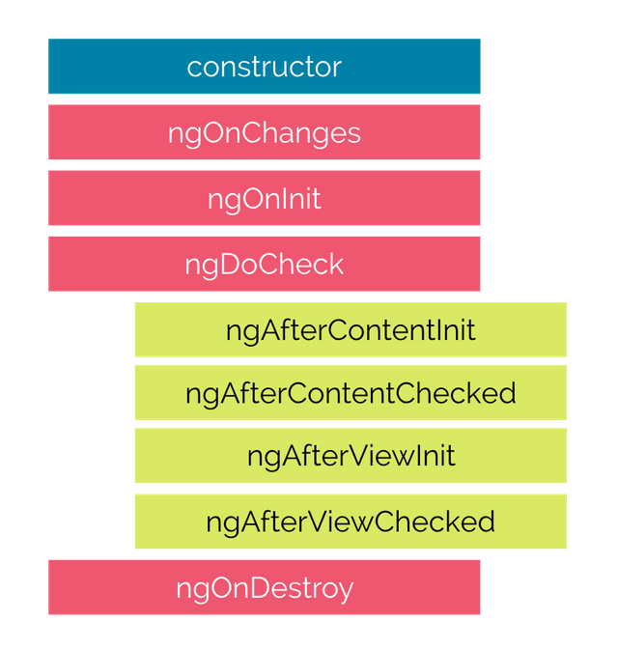
Life Cycle Hooks

Slide 100

Hooks for the Component
constructor : This is invoked when Angular creates a component or directive by calling new on the class.
ngOnChanges : Invoked every time, there is a change in one of the input properties of the component.
ngOnInit : Invoked when given component has been initialized. This hook is only called once after the first ngOnChanges
ngDoCheck : Invoked when the change detector of the given component is invoked. It allows us to implement our own change detection algorithm for the given component.
ngAfterContentInit : Invoked after Angular performs any content projection into the component’s
ngAfterContentChecked : Invoked each time the content of the given component has been checked by the change detection mechanism of Angular.
ngAfterViewInit : Invoked when the component’s view has been fully initialized.
ngAfterViewChecked : Invoked each time the view of the given component has been checked by the change detection mechanism of Angular
ngOnDestroy : This method will be invoked just before Angular destroys the component. Use this hook to unsubscribe observables and detach event handlers to avoid memory leaks.

Slide 101
Directives
Directives are classes that add additional behavior to elements in your Angular applications.
The different types of Angular directives are as follows:
Components—directives with a template. This type of directive is the most common directive type.
Attribute directives—directives that change the appearance or behavior of an element, component, or another directive. E.g., NgClass, NgStyle, NgModel
Structural directives—directives that change the DOM layout by adding and removing DOM elements. E.g., NgIf, NgFor, NgSwitch

Slide 102
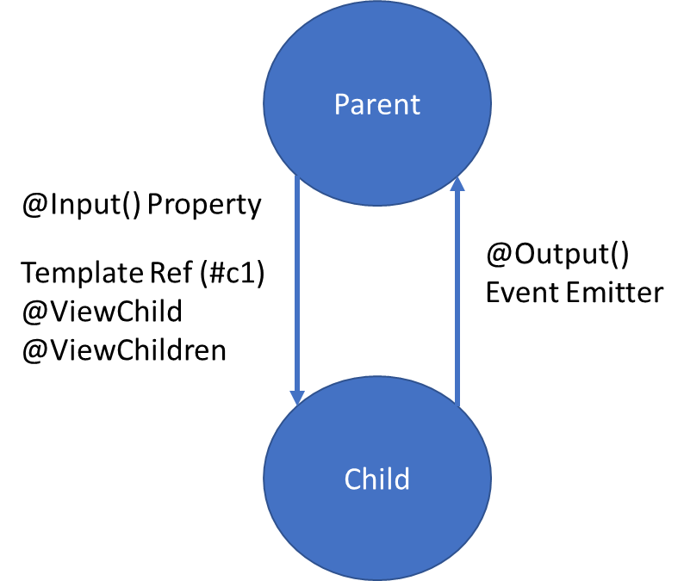
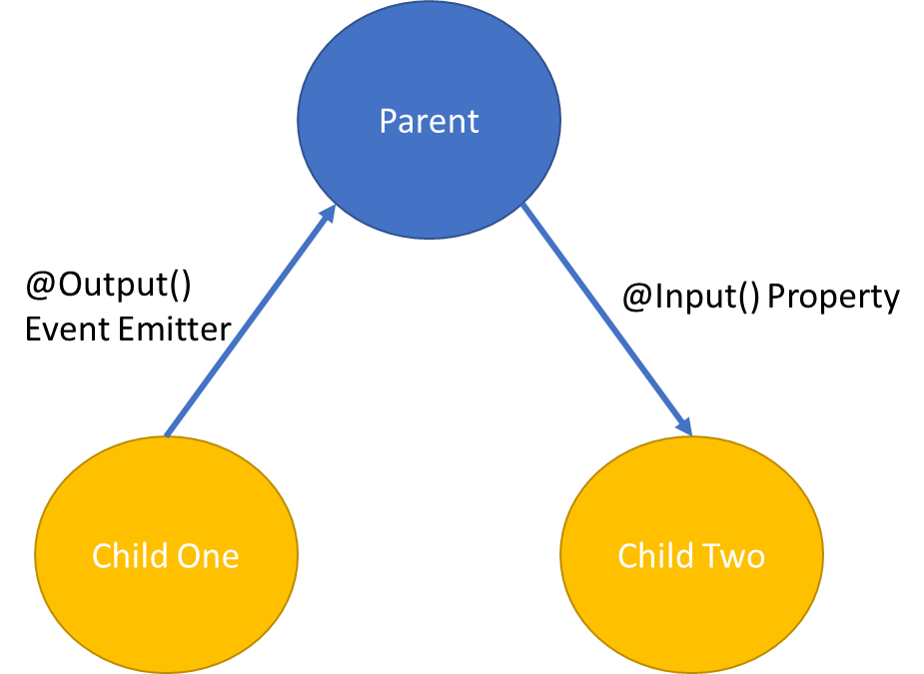
Parent Child Communication

Slide 103
Assignment
Create component to display Navigation Bar
Create a Form with Validation Message, to take username and password.
Display Array of Employees in a component using Table

Slide 104
Pipes
Angular provides built-in pipes for typical data transformations, including transformations for internationalization (i18n), which use locale information to format data.
The following are commonly used built-in pipes for data formatting:
DatePipe: Formats a date value according to locale rules.
UpperCasePipe: Transforms text to all upper case.
LowerCasePipe: Transforms text to all lower case.
CurrencyPipe: Transforms a number to a currency string, formatted according to locale rules.
DecimalPipe: Transforms a number into a string with a decimal point, formatted according to locale rules.
PercentPipe: Transforms a number to a percentage string, formatted according to locale rules.

Slide 105
Assignment
Learn how to download and use ngx pipes
https://github.com/danrevah/ngx-pipes
Create a custom pipe to sort the items in a list (orderBy)

Slide 106
Using 3rd party Libraries in Angular
Install the package/library
npm i <package-name>
npm i lodash
Install the type definition file of the library
npm i -D @types/<package-name>
npm i -D @types/lodash
If the package supports Angular schematics, we can use
ng add <package-name>

Slide 107
Forms
Reactive forms provide direct, explicit access to the underlying forms object model. Compared to template-driven forms, they are more robust: they're more scalable, reusable, and testable. If forms are a key part of your application, or you're already using reactive patterns for building your application, use reactive forms.
Template-driven forms rely on directives in the template to create and manipulate the underlying object model. They are useful for adding a simple form to an app, such as an email list signup form. They're easy to add to an app, but they don't scale as well as reactive forms. If you have very basic form requirements and logic that can be managed solely in the template, template-driven forms could be a good fit.

Slide 108
Key Differences
 | REACTIVE | TEMPLATE-DRIVEN
Setup of form model | Explicit, created in component class | Implicit, created by directives
Data model | Structured and immutable | Unstructured and mutable
Predictability | Synchronous | Asynchronous
Form validation | Functions | Directives

Slide 109
Form Builder
Creates an AbstractControl from a user-specified configuration.
The FormBuilder provides syntactic sugar that shortens creating instances of a FormControl, FormGroup, or FormArray.
It reduces the amount of boilerplate needed to build complex forms.

Slide 110
Built in Validators
min
max
required
requiredTrue
email
minLength
maxLength
pattern
nullValidator
compose
composeAsync

Slide 111
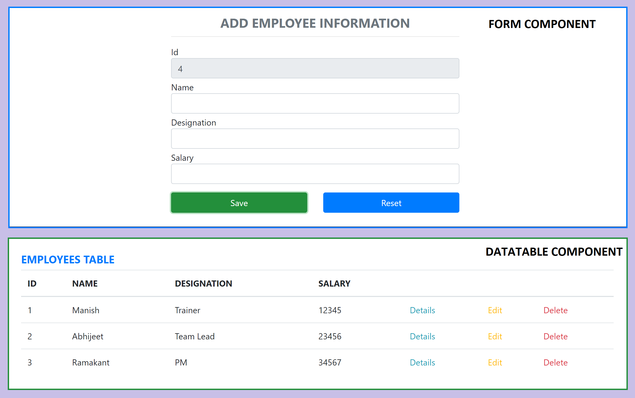
Assignment

Slide 112
Promise
The Promise object represents the eventual completion (or failure) of an asynchronous operation, and its resulting value.
It allows you to associate handlers with an asynchronous action's eventual success value or failure reason.
This lets asynchronous methods return values like synchronous methods: instead of immediately returning the final value, the asynchronous method returns a promise to supply the value at some point in the future.

Slide 113
RxJS
Reactive Extensions Library for JavaScript
RxJS is a library for reactive programming using Observables, to make it easier to compose asynchronous or callback-based code.
RxJS is a library for composing asynchronous and event-based programs by using observable sequences.
It provides one core type, the Observable, satellite types (Observer, Schedulers, Subjects) and operators inspired by Array#extras (map, filter, reduce, every, etc) to allow handling asynchronous events as collections.

Slide 114
Promise Vs Observable
Promise | Observables
Emit Single Value | Emit Multiple Values, over a period of time (Stream of Data)
Not Lazy | Lazy, observables will not execute unless we subscribe to it
Cannot be cancelled | Can be cancelled by using unsubscribe
Does not provide any operators | Observables provide a lot of built in operators i.e. map, forEach, filter, reduce, retry

Slide 115
Concepts in RxJS
Observable: represents the idea of an invokable collection of future values or events.
Observer: is a collection of callbacks that knows how to listen to values delivered by the Observable.
Subscription: represents the execution of an Observable, is primarily useful for cancelling the execution.
Operators: are pure functions that enable a functional programming style of dealing with collections with operations like map, filter, concat, reduce, etc.
Subject: is equivalent to an EventEmitter, and the only way of multicasting a value or event to multiple Observers.
Schedulers: are centralized dispatchers to control concurrency, allowing us to coordinate when computation happens on e.g. setTimeout or requestAnimationFrame or others.

Slide 116
Subject
A Subject is a special type of Observable that allows values to be multi-casted to many Observers.
A Subject is like an Observable but can multicast to many Observers.
Subjects are like EventEmitters: they maintain a registry of many listeners. Every Subject is an Observable and an Observer.
You can subscribe to a Subject and you can call next to feed values as well as error and complete.

Slide 117
Subject Type Variations to consider
Subject - a subscriber will only get published values that were emitted after the subscription.
BehaviorSubject - the last value is cached. A subscriber will get the latest value upon initial subscription. The semantics for this subject is to represent a value that changes over time.
ReplaySubject - it can cache up to a specified number of emissions if buffer Size is provided / else it is Infinity (Cache all published values). Any subscribers will get all the cached values upon subscription.

Slide 118
RxJS Operators
An operator is a pure function that takes in observable as input and the output is also an observable.
To work with operators, we need a pipe() method.
There are operators for different purposes, and they may be categorized as: creation, transformation, filtering, joining, multicasting, error handling, utility, etc.

Slide 119
Creation Operators
ajax
bindCallback
bindNodeCallback
defer
empty
from
fromEvent
fromEventPattern
generate
interval
of
range
throwError
timer
iif

Slide 120
Join Creation Operators
combineLatest
concat
forkJoin
merge
partition
race
zip
combineAll
concatAll
exhaust
mergeAll
startWith
withLatestFrom

Slide 121
Transformation Operators
buffer
bufferCount
bufferTime
bufferToggle
bufferWhen
concatMap
concatMapTo
exhaust
exhaustMap
expand
groupBy
map
mapTo
mergeMap
mergeMapTo
mergeScan

Slide 122
Transformation Operators
pairwise
partition
pluck
scan
switchMap
switchMapTo
window
windowCount
windowTime
windowToggle
windowWhen

Slide 123
Filtering Operators
audit
auditTime
debounce
debounceTime
distinct
distinctKey
distinctUntilChanged
distinctUntilKeyChanged
elementAt
filter
first
ignoreElements
last

Slide 124
Filtering Operators
sample
sampleTime
single
skip
skipLast
skipUntil
skipWhile
take
takeLast
takeUntil
takeWhile
throttle
throttleTime

Slide 125
Misc
Multicasting Operators
multicast
publish
publishBehavior
publishLast
publishReplay
share
Error Handling Operators
catchError
retry
retryWhen

Slide 126
Misc
Utility Operators
tap
delay
delayWhen
dematerialize
materialize
observeOn
subscribeOn
timeInterval
timestamp
timeout
timeoutWith
toArray

Slide 127
Misc
Conditional and Boolean Operators
defaultIfEmpty
every
find
findIndex
isEmpty
Mathematical and Aggregate Operators
count
max
min
reduce

Slide 128
RxJS Learning
https://rxjs.dev/
https://rxmarbles.com/

Slide 129
Communicating with backend services using HTTP
Most front-end applications need to communicate with a server over the HTTP protocol, to download or upload data and access other back-end services.
Angular provides a client HTTP API for Angular applications, the HttpClient service class in @angular/common/http.
The HTTP client service offers the following major features.
The ability to request typed response objects.
Streamlined error handling.
Testability features.
Request and response interception.

Slide 130
Commonly used HTTP Client Methods
get(url: string, options?: {params?: HttpParams; headers?: HttpHeaders; responseType?: 'json'; withCredentials?: boolean;}): Observable<any>
Sends an HTTP GET request to the specified URL and returns the response as an observable.
post(url: string, body: any, options?: {headers?: HttpHeaders; observe?: 'body'; responseType?: 'json'; withCredentials?: boolean;}): Observable<any>
Sends an HTTP POST request to the specified URL with the provided body and returns the response as an observable.
put(url: string, body: any, options?: {headers?: HttpHeaders; observe?: 'body'; responseType?: 'json'; withCredentials?: boolean;}): Observable<any>
Sends an HTTP PUT request to the specified URL with the provided body and returns the response as an observable.
delete(url: string, options?: {headers?: HttpHeaders; observe?: 'body'; responseType?: 'json'; withCredentials?: boolean;}): Observable<any>
Sends an HTTP DELETE request to the specified URL and returns the response as an observable.
patch(url: string, body: any, options?: {headers?: HttpHeaders; observe?: 'body'; responseType?: 'json'; withCredentials?: boolean;}): Observable<any>
Sends an HTTP PATCH request to the specified URL with the provided body and returns the response as an observable.

Slide 131
Communicating with backend services using HTTP
Most front-end applications need to communicate with a server over the HTTP protocol, to download or upload data and access other back-end services.
Angular provides a client HTTP API for Angular applications, the HttpClient service class in @angular/common/http.
The HTTP client service offers the following major features.
The ability to request typed response objects.
Streamlined error handling.
Testability features.
Request and response interception.

Slide 132
NODE SERVER
BROWSER
HTTP + URL (localhost:3000)
NAVIGATION
Angular Application
User clicks on Admin Link, component calls the API in ngOnInit(), modifies the state and displays the data
HTML Page + JS (Angular App)
NODE SERVER
EXPRESS JS
Web API
AJAX – localhost:8000/api/users
Database
JSON

Slide 133
Angular Route Guards
CanActivate
Checks to see if a user can visit a route.
CanActivateChild
Checks to see if a user can visit a routes children.
CanDeactivate
Checks to see if a user can exit a route.
CanLoad
Checks to see if a user can route to a module that is lazy loaded.
Resolve
Performs route data retrieval before route activation.

Slide 134
NODE SERVER
BROWSER
HTTP + URL (localhost:3000)
NAVIGATION
Angular Application
User clicks on Admin Link, execute a code to verify token or authentication status, if unauthenticated, redirect the request to Login Component
HTML Page + JS (Angular App)
HTTP + URL (AJAX) + Username & Password
NODE SERVER
EXPRESS JS
Web API
JSON with Token
{“token”:”___”}
Send Username, Password to server, who will verify and return a token, the received token will be stored in Session Storage of the browser
AJAX – localhost:8000/api/users + Token
Send the same token to access data from the server
Database
JSON
Added by TokenInterceptor Service

Slide 135
Secure Application using Route Guards
When user clicks the Admin Link, we need to verify that we have a token in session storage, and if the token in not there in the session storage, redirect the request to login component. (CanActivateAdminGuard)
CanActivateAdminGuard uses Authenticator Service, getToken() to get the token.
If token is undefined, the request is redirected to Login Component
If token is available, the request is allowed for Admin Component.
Logging and Token Management (Authenticator Service)
On Login Component, user must give username and password, which will be sent to Node API Server
If the username & password is correct, in the response token will come from the Server
Received token will be stored in the session storage of the browser.
Reading and Attaching Token (TokenInterceptor Service)
Whenever the AJAX request is made for api, tokenInterceptor, intercepts and attaches token in the request header.
It uses authenticator service to read the token from session storage.

Slide 136
Angular Animations
Animation provides the illusion of motion: HTML elements change styling over time.
Well-designed animations can make your application more fun and easier to use.
Animations can improve your application and user experience in several ways:
Without animations, web page transitions can seem abrupt and jarring.
Motion greatly enhances the user experience, so animations give users a chance to detect the application's response to their actions.
Good animations intuitively call the user's attention to where it is needed.
An HTML element can move, change color, grow or shrink, fade, or slide off the page.
These changes can occur simultaneously or sequentially.
You can control the timing of each transformation.

Slide 137
Angular Animations
Angular's animation system is built on CSS functionality
You can animate any property that the browser considers animatable.
This includes positions, sizes, transforms, colors, borders, and more.
To Enable Animations:
Import BrowserAnimationsModule, which introduces the animation capabilities into your Angular root application module.
Importing animation functions
Add the animation metadata property to the Component
Apply animation using HostBinding or Use it on specific area using @

Slide 138
Animation Methods
The following list shows some of the methods used to build Angular animations.
The trigger(...) method encapsulates a single element of animation inside the animations array.
The state(...) method declares an animation state within a trigger attached to an element.
style(…) method declares a key/value object containing CSS properties/styles that can then be used for an animation state, within an animation sequence, or as styling data for calls to animate() and keyframes().
animate(…) method produces a reusable animation that can be invoked in another animation or sequence
transition(…) method declares an animation transition as a sequence of animation steps to run when a given condition is satisfied.

Slide 139
What to learn next?
How to use Component Library with Angular
ng-bootstrap | Angular UI Component Library
ngx-bootstrap | Angular UI Component Library (Valor Software)
Material | Angular UI Component Library
PrimeNG | Angular UI Component Library (primefaces.org)
Kendo UI for Angular | Angular UI Component Library (Telerik)
NgRx
https://developer.mozilla.org/en-US/docs/Web/CSS

Slide 140
Contact Me
Manish Sharma | Gmail
Manish Sharma | WhatsApp
Manish Sharma | Facebook
Manish Sharma | LinkedIn

