Slide 1

Dot Net Core

Slide 2
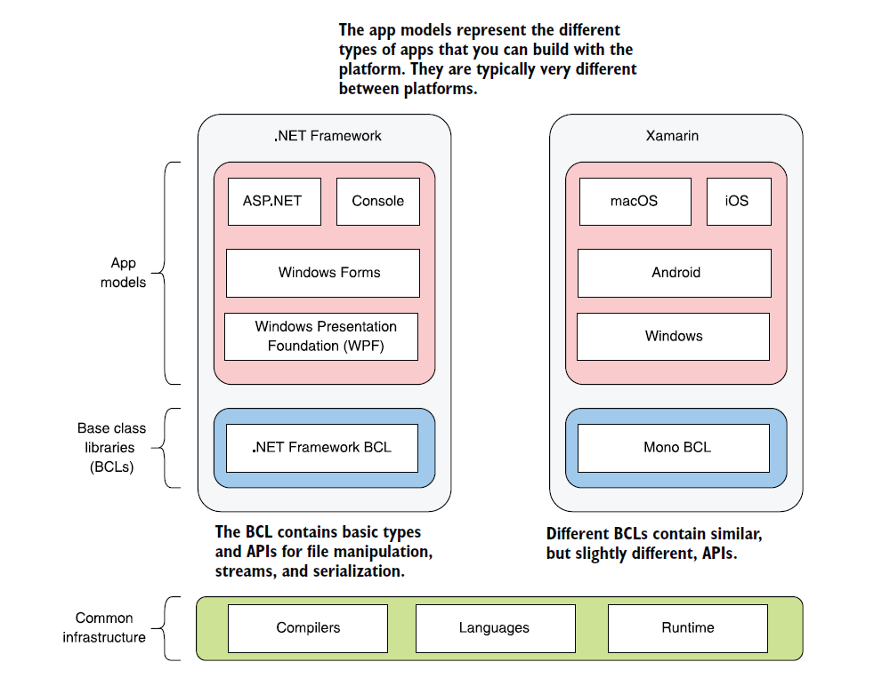

Slide 3
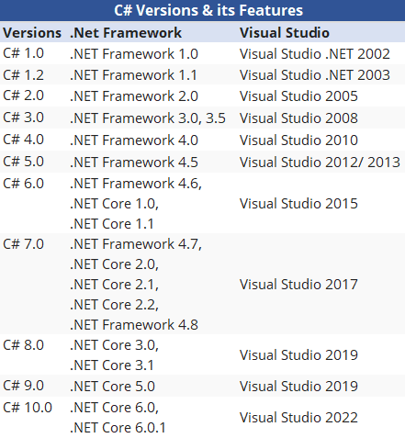

Slide 4
.NET Core
A cross-platform BCL
A cross-platform Runtime
The .NET CLI Tooling (dotnet cli)
ASP .NET Core and EF Core Libraries (App Layer)

Slide 5
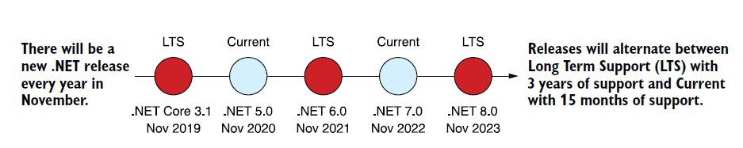

Slide 6
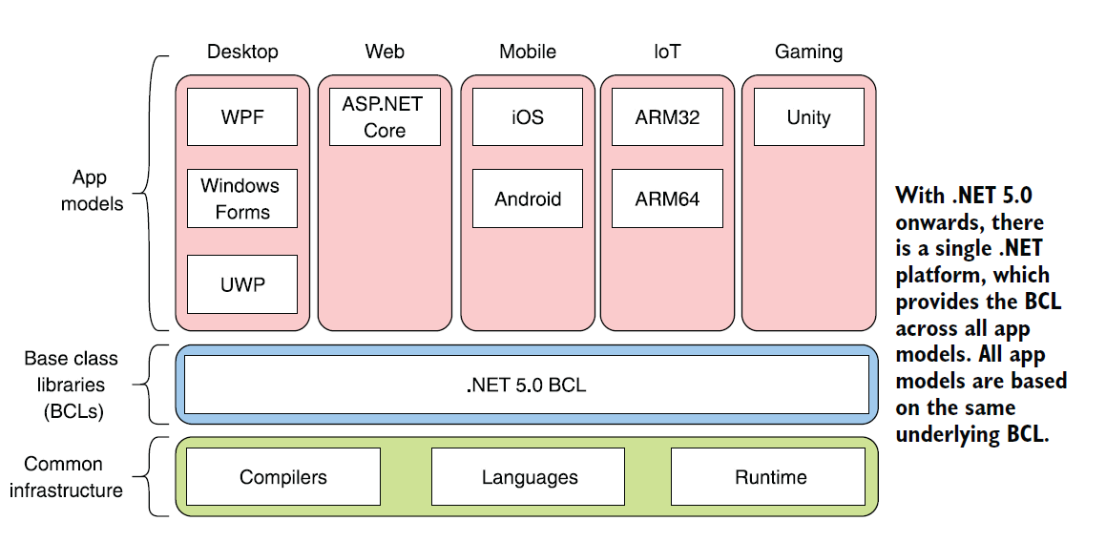

Slide 7
ASP .NET Core (Application Types)
Blazor - Interactive client-side
HTTP API apps - Develop HTTP services with ASP.NET Core
Page-focused web UI with Razor Pages - Develop page-focused web apps with a clean separation of concerns
Page-focused web UI with MVC - Develop web apps using the Model-View-Controller design pattern
Real-time web apps with SignalR - Add real-time functionality to your web app, enable server-side code to push content instantly
Remote Procedure Call (RPC) apps - gRPC services - Develop contract-first, high-performance services with gRPC in ASP.NET Core

Slide 8
BROWSER
SERVER
HTTP + URL
NAVIGATION
HTML PAGES
CSS
HTML + CSS
HTTP + URL
HTML + CSS
Page
Reload!

Slide 9
BROWSER
SERVER
HTTP + URL
NAVIGATION
HTML + CSS
Server PAGES
CSS
HTTP + URL
HTML + CSS
ASP .NET
Page
Reload!
DB

Slide 10

BROWSER
SERVER
HTTP + URL
NAVIGATION
Server PAGES
CSS
HTML + CSS + JS
AJAX - HTTP + URL
JS
Partial
Page
Reload!
PARTIAL HTML
<table>
<thead>
<tr>
<th>ID</th>
</tr>
</thead>
<tbody>
<tr>
<td>1</td>
</tr>
</tbody>
</table>
ASP .NET MVC
DB

Slide 11
SINGLE PAGE APPLICATION – Cross Domain
Client Side Rendering (CSR)
SERVER
SERVER PAGES
CSS
BROWSER
HTTP + URL
NAVIGATION
JS
HTML + CSS + JS
Client Side Application
ASP .NET MVC
<table>
<thead>
<tr>
<th>ID</th>
</tr>
</thead>
<tbody>
<tr>
<td>1</td>
</tr>
</tbody>
</table>
SERVER
AJAX - HTTP + URL
RESTful API
ASP .NET Web API
DB
JSON to HTML on Client Side
JSON
{
“id”:1
}
Vanilla JS, jQuery, KO, BB, NG1,
NG2 & above, React, Vue

Slide 12
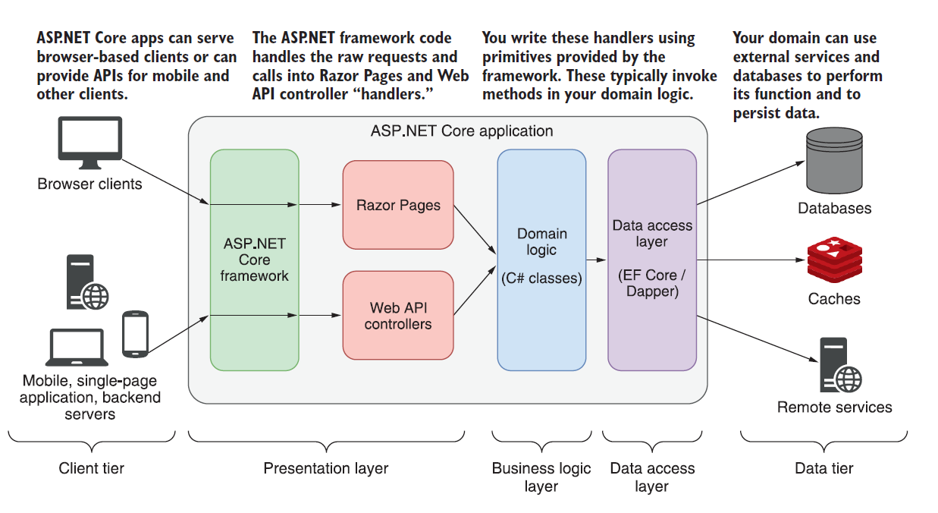

Slide 13
Entity Framework Core

Slide 14
Entity Framework Core
Entity Framework (EF) Core is a lightweight, extensible, open source and cross-platform version of the popular Entity Framework data access technology.
EF Core can serve as an object-relational mapper (O/RM), which:
Enables .NET developers to work with a database using .NET objects.
Eliminates the need for most of the data-access code that typically needs to be written.
EF Core supports many database engines, see Database Providers for details.

Slide 15
Database Providers
NuGet Package | Supported database engines | Maintainer / Vendor | Notes / Requirements | Built for version | Useful links
Microsoft.EntityFrameworkCore.SqlServer | SQL Server 2012 onwards | EF Core Project (Microsoft) |  | 5.0 | docs
Microsoft.EntityFrameworkCore.Sqlite | SQLite 3.7 onwards | EF Core Project (Microsoft) |  | 5.0 | docs
Microsoft.EntityFrameworkCore.InMemory | EF Core in-memory database | EF Core Project (Microsoft) | Limitations | 5.0 | docs
Microsoft.EntityFrameworkCore.Cosmos | Azure Cosmos DB SQL API | EF Core Project (Microsoft) |  | 5.0 | docs
Npgsql.EntityFrameworkCore.PostgreSQL | PostgreSQL | Npgsql Development Team |  | 5.0 | docs
Pomelo.EntityFrameworkCore.MySql | MySQL, MariaDB | Pomelo Foundation Project |  | 5.0 | readme
MySql.EntityFrameworkCore | MySQL | MySQL project (Oracle) |  | 5.0 | docs
Oracle.EntityFrameworkCore | Oracle DB 11.2 onwards | Oracle |  | 5.0 | website
And Many More - Database Providers - EF Core | Microsoft Docs
Entity Framework Core can access many different databases through plug-in libraries called database providers.
Most database providers for EF Core are distributed as NuGet packages, and can be installed by using NuGet Package Manager

Slide 16
Versions of EF (ORM)
EF-EF6 2008-2013
EF Core 2016
EF Core 2 2017
EF Core 3 2019
EF Core 5 2020
EF Core 6 Nov 2021
EF Core 7 Nov 2022
EF Core 8 Nov 2023

Slide 17
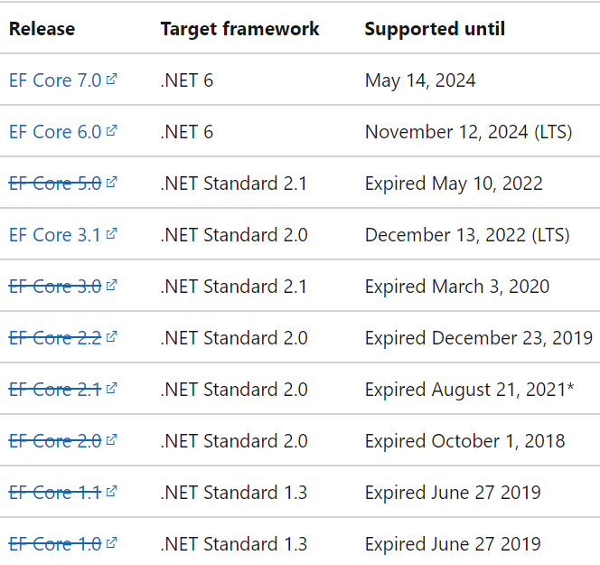
EF Core releases and support

Slide 18
Application Base
.NET 6.0 + ASP .NET Core 6.0 + EF Core 7.0
ASP .NET Core 6.0
ASP .NET Core Web App (MVC)
ASP .NET Core Web API

Slide 19
EF Core Basics
Database DbContext
Tables DbSet
Columns Data Members in Domain Class

Slide 20
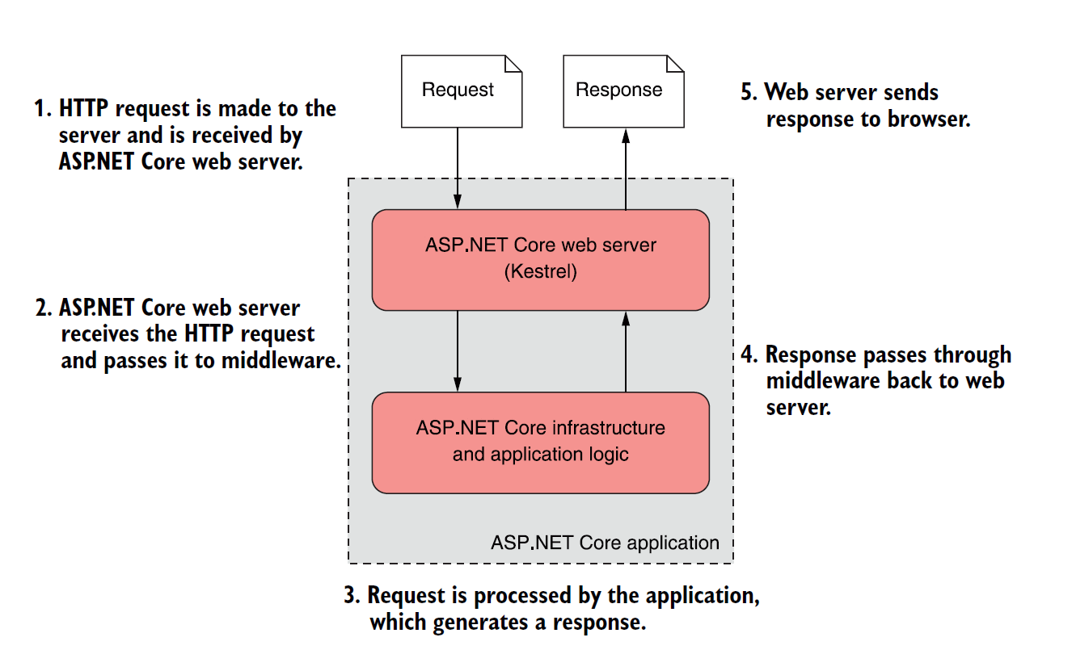

Slide 21
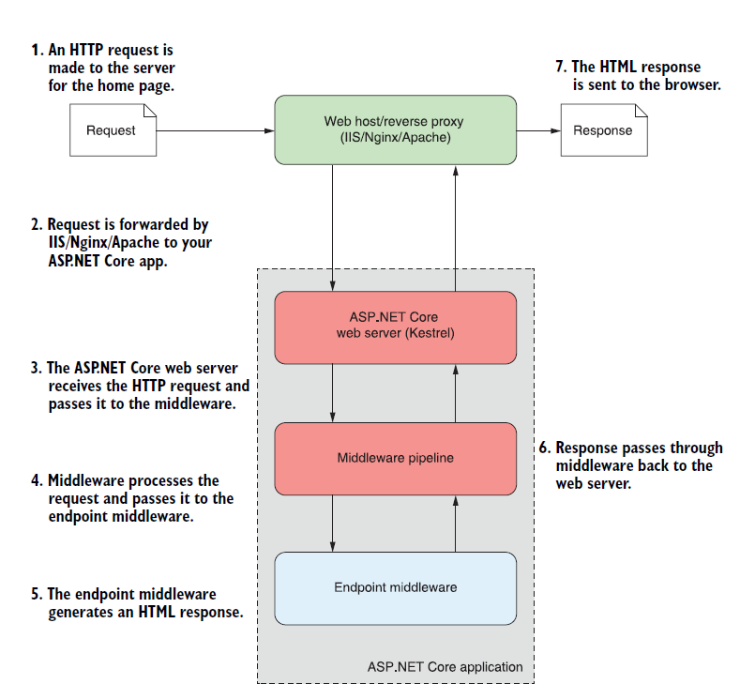

Slide 22
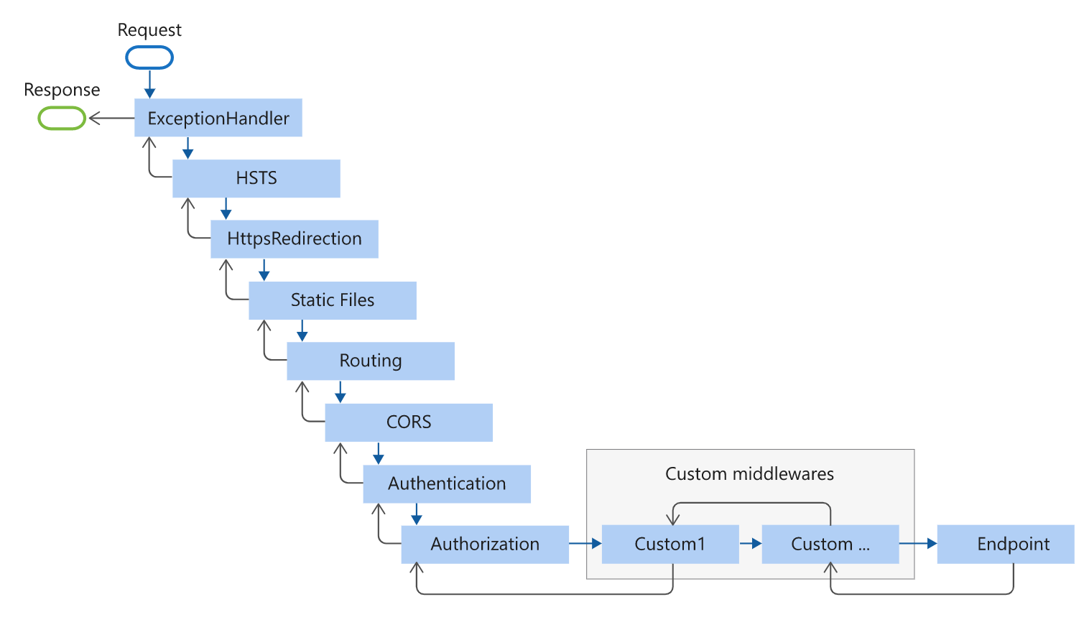

Slide 23
Contact Me
Manish Sharma | Gmail
Manish Sharma | WhatsApp
Manish Sharma | Facebook
Manish Sharma | LinkedIn

