Slide 1


Robust and High Performance
Consensus Protocols
PhD Private Defense
Pasindu Tennage Thesis director: Bryan Ford Thesis co-director: Lefteris Kokoris-Kogias

Slide 2


Consensus
State
State
State
C1
C2
C3
C4
C5
State
State
C1
C2
C3
C4
C5
State
C1
C2
C3
C4
C5
State
C1
C2
C3
C4
C5

Slide 3
High Performance
Existing Consensus Protocols
High Performance
High Robustness

Slide 4
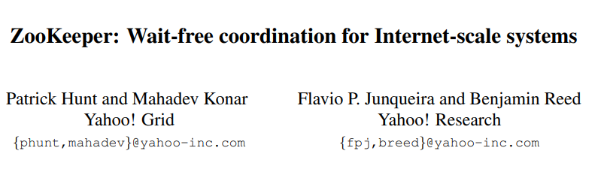
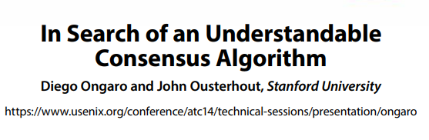
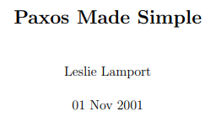

High Performance using Leader-based Consensus

Slide 5

Robustness Problem of Leader Based Protocols
Network partition.
Link failures.
DDoS attacks.
Leader crash.

Slide 6
High Performance
Existing Consensus Protocols
High Robustness
High Robustness

Slide 7
Robust randomized consensus protocols
Less efficient.
O(n²) / O(n³)
Hard to understand.
Rarely deployed.

Slide 8
Can we have the best of both worlds?
High Performance
Existing Consensus Protocols
High Robustness

Slide 9
Thesis goals
Explore the robustness and performance challenges of existing protocols
Design and evaluate new protocols that achieve both robustness and high performance

Slide 10

Thesis Contributions
Baxos
Baxos
Explores mechanisms to avoid the impact of leader-targeted attacks
RACS-SADL
Explores mechanisms to avoid leader performance bottleneck and the impact of network asynchrony
QuePaxa
QuePaxa
Explores mechanisms to avoid the tyranny of timeouts
Mahi-Mahi
Mahi-Mahi
Explores mechanisms to avoid high latency and high resource consumption in blockchain consensus protocols

Slide 11
Publications
QuePaxa
Published in SOSP 2023
Mahi-Mahi
Under review in ICDCS 2025
RACS-SADL
Under review in IEEE CLOUD 2025

Slide 12
Thesis Scope
In Scope
Out of Scope
Total Ordering.
Node / committee reconfiguration.
Transaction execution.
Sharding.
Distributed transactions.

Slide 13
Outline
Baxos
QuePaxa
Mahi-Mahi
Summary
Future Work

Slide 14
Baxos: Backing off for robust consensus
Pasindu Tennage*, Cristina Basescu, Lefteris Kokoris-Kogias, Ewa Syta, Philipp Jovanovic, Bryan Ford

Slide 15
Baxos Outline
Problems with leader based protocols.
Baxos design.
Evaluation.

Slide 16
Problems with leader-based protocols
Cost of view change
Cost of view change
Leader-targeted attacks
Variability in resource usage

Slide 17

Normal case operation of Multi-Paxos
Commit
Commit
R1
R2
Prepare
Promise
Propose
Accept
Propose
Accept
R3
R4
View 1

Slide 18

Timeout based view change in Multi-Paxos
Commit
R1
Prepare
Propose
R2
Accept
Promise
Propose
Accept
R3
R4
View Change
View 1
View 2

Slide 19
Problems with view change
No commands committed during view change
Complex and error prone
Catch-up.
Synchronizer.
Ignored in prototypes

Slide 20
Problems with leader-based protocols
Cost of view change
Leader-targeted attacks
Leader-targeted attacks
Variability in resource usage

Slide 21

Leader-targeted attacks

Slide 22
Problems with leader-based protocols
Cost of view change
Leader-targeted attacks
Variability in resource usage
Variability in resource usage

Slide 23

Resource utilization variability
L

Slide 24
Baxos Overview
Based on Paxos
Replaces view change with random exponential backoff

Slide 25
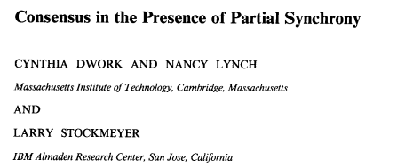
Threat Model
Up to f out of 2f+1 nodes can crash.
The network is partially synchronous.
GST
Network attacker
Can find and attack the current leader.
time

Slide 26
Baxos allows all replicas to propose
Propose

Slide 27
Contention under concurrent proposals
R1
R2
Prepare
Prepare
R3
Prepare
Prepare
R4

Slide 28
Random exponential backoff
Manage access to shared resources in networks (CSMA CD/CA)
Backing off before retrying to avoid contention
Can we apply REB to consensus to handle contention?

Slide 29
Baxos uses Random exponential Backoff
Commit
R1
R2
Prepare
Prepare
Promise
Propose
Accept
R3
Prepare
R4

Slide 30
Multi-Paxos vs Baxos
Multi Paxos
Baxos
Uses Paxos core
Uses Paxos core
Only the leader proposes
Every node proposes
Uses view change
Uses REB

Slide 31
Baxos Evaluation

Slide 32
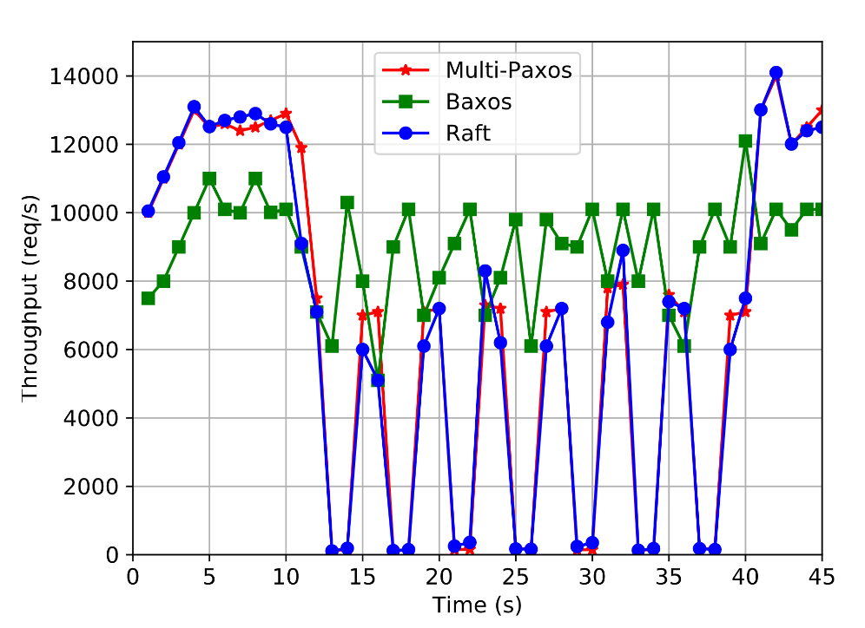
Robustness of Baxos
Baxos is resilient against leader-targeted attacks

Slide 33
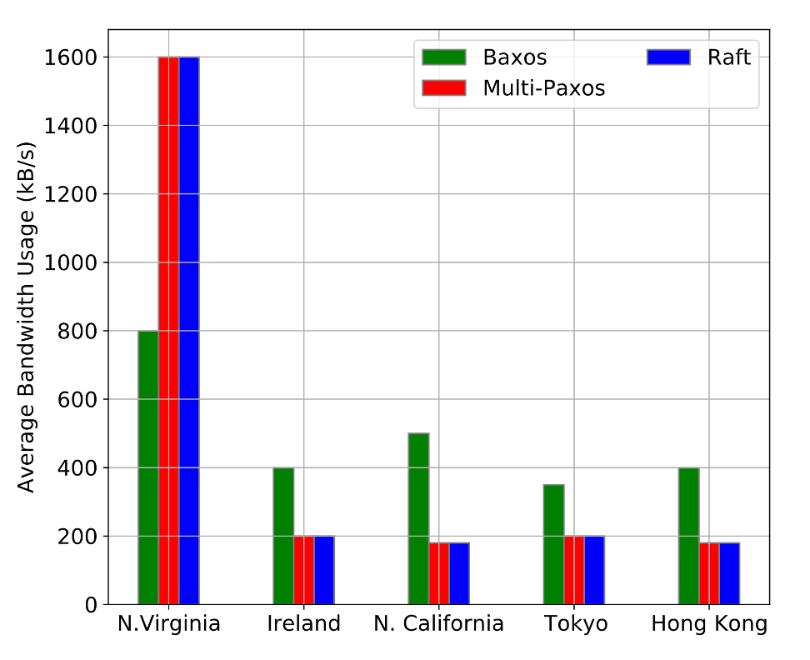
Resource utilization of Baxos
Baxos has uniform resource utilization across replicas

Slide 34
Baxos Summary
Avoid view changes
Robust against leader-targeted attacks
Uniform resource usage

Slide 35
Outline
Baxos
QuePaxa
Mahi-Mahi
Summary
Future Work

Slide 36
QuePaxa: Escaping the tyranny of timeouts
Pasindu Tennage*, Cristina Basescu, Lefteris Kokoris-Kogias, Ewa Syta, Philipp Jovanovic, Vero Estrada, Bryan Ford

Slide 37
QuePaxa Outline
Tyranny of timeouts.
QuePaxa.
Evaluation.

Slide 38
Tyranny of Timeout Problems in Consensus
Timeout based view change
Timeout based view change
Conservative timeouts
Manually configured timeouts

Slide 39
Timeout based view change
View change succeeds only when the network is synchronous
Loss of liveness under asynchronous networks

Slide 40
Tyranny of Timeout Problems in Consensus
Timeout based view change
Conservative timeouts
Conservative timeouts
Manually configured timeouts

Slide 41
Choosing Timeouts in leader based protocols
Low Timeout
High Timeout
High Timeout
Timeout

Slide 42
Timeout based view change [Multi-Paxos]
Commit
R1
Prepare
Propose
R2
Accept
Promise
Propose
Accept
R3
R4
View Change
View 1
View 2
High Recovery Time

Slide 43

Choosing Timeouts in leader based protocols
Low Timeout
Low Timeout
High Timeout
High Timeout
High Timeout
Timeout
High Recovery Time

Slide 44
Liveness loss with low timeouts
R1
Propose
R2
Prepare
…
R3
Prepare
R4
View 1
View 2
View 3
View 4

Slide 45

Choosing Timeouts in leader based protocols
Low Timeout
Low Timeout
High Timeout
High Timeout
High Timeout
Timeout
Liveness Loss
High Recovery Time

Slide 46
Tyranny of Timeout Problems in Consensus
Timeout based view change
Conservative timeouts
Manually configured timeouts
Manually configured timeouts

Slide 47
Manual configuration of timeouts
Slow but functioning leader.
Timeout does not adapt to changing network delay.

Slide 48
Are timeouts necessary for progress?
Can we eliminate the impact of timeout for liveness?

Slide 49

An alternative approach? (Hedging)
Leader 1
Commit
R1
Propose
Accept
Leader 2
Commit
R2
Propose
Accept
Accept
Leader 3
Propose
R3
Commit
R4
Leader 4
No view change
No view change

Slide 50

What if multiple leaders could cooperate instead of interfere?
Leader 1
commit
R1
Propose
Leader 2
R2
R3
Leader 3
R4
Leader 4
Round 1

Slide 51
QuePaxa Contributions
Optimal Performance under synchrony and asynchrony
Enables Hedging

Slide 52
Threat Model
Up to f out of 2f+1 nodes can crash.
The network is asynchronous – there exists no bound Δ on message transmission delay.
Network attacker
Can reorder and delay messages.
Cannot see internal replica state and message contents.

Slide 53
QuePaxa Architecture
Submitter
Submitter
Client Requests
Replica
Replica
Replica
Proposer
Proposer
Proposer
Recorder
Recorder
Recorder

Slide 54
QuePaxa Log Structure
Round 1
Round 2
Slot 1
P1
P2
P3
P4
Slot 2
Slot 3

Slide 55
QuePaxa Proposer Sequence
Proposer 1
Proposer 2
Proposer 3
Proposer 4

Slide 56

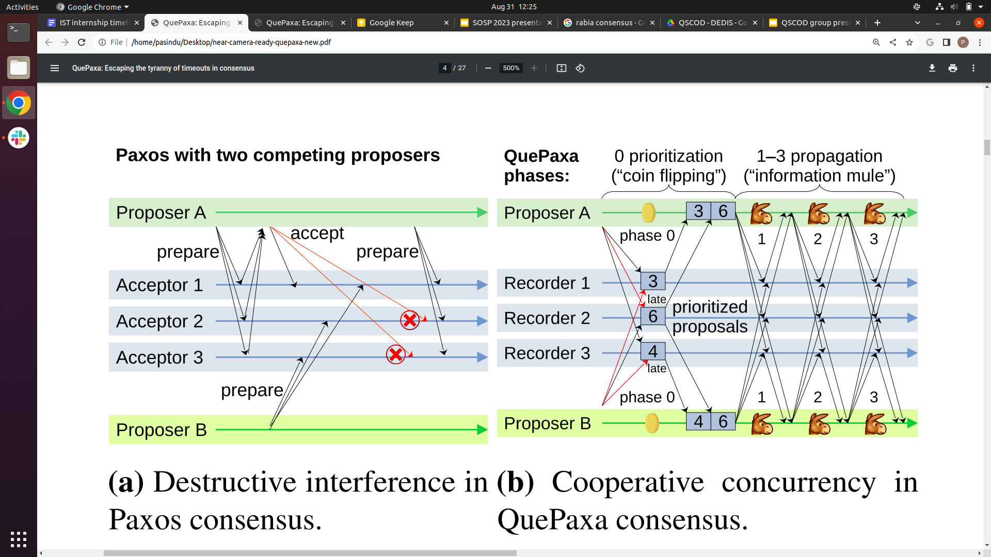
QuePaxa Protocol Diagram
Phase 0
Phase 1-3
Learn Majority Proposals
Information Propagation
Proposer 1
Recorder 1
Recorder 2
Recorder 3
Proposer 2

Slide 57
QuePaxa Synchronous Execution
Fast Path Decision
Phase 0
Learn Majority Proposals
Proposer 1
Recorder 1
Recorder 2
Recorder 3
Proposer 2

Slide 58
QuePaxa Asynchronous Execution
Slow Path Decision
Phase 0
Phase 1-3
Learn Majority Proposals
Information Propagation
Proposer 1
Recorder 1
Recorder 2
Recorder 3
Proposer 2

Slide 59
Hedging in QuePaxa
Proposer 1
Propose with 0×Δ delay
Proposer 2
Propose with 1×Δ delay
Proposer 3
Propose with 2×Δ delay
Proposer 4

Slide 60
Evaluation

Slide 61
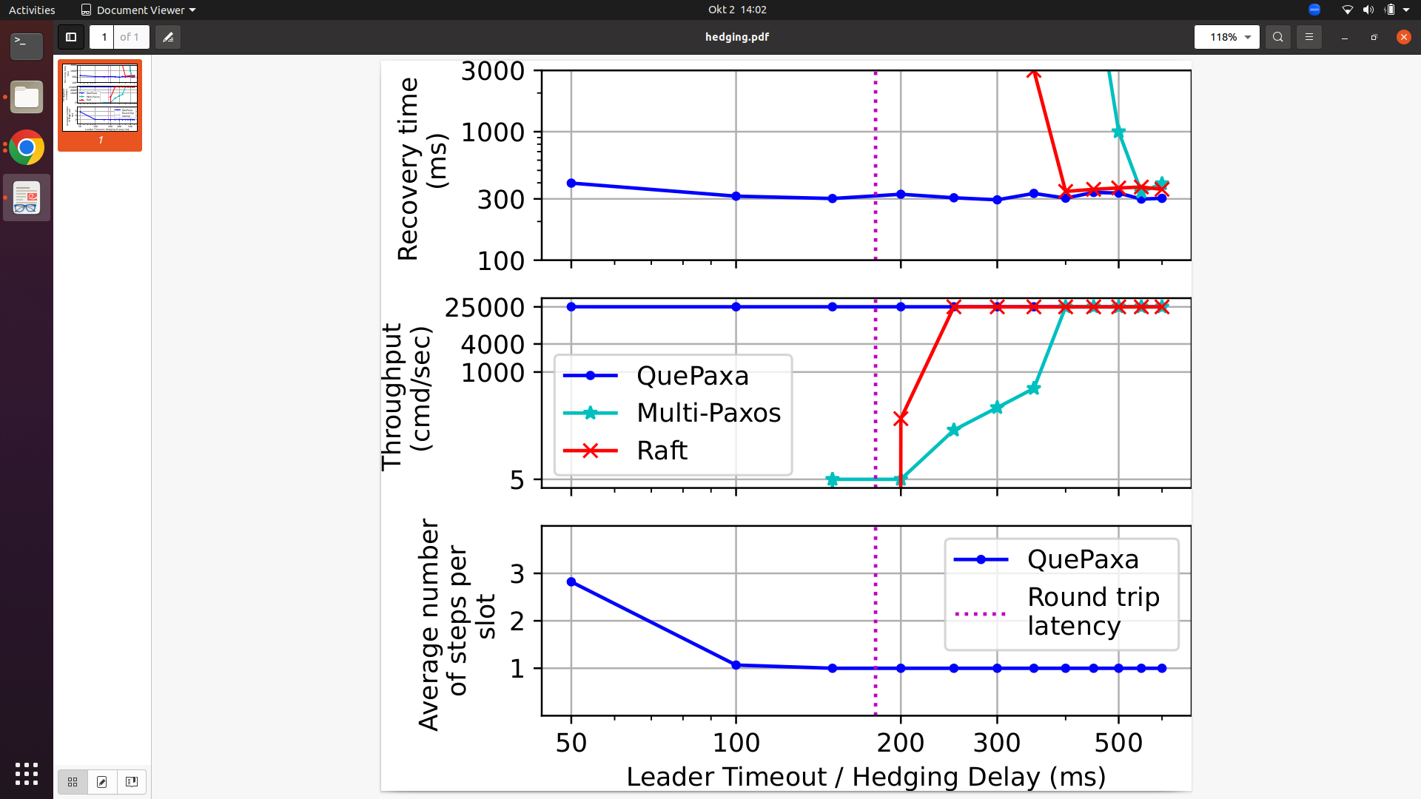
Effect of Hedging in Quepaxa
Throughput
Liveness of QuePaxa does not depend on the timeout

Slide 62

Effect of Hedging in Quepaxa
Throughput
Recovery Time
QuePaxa has low recovery time

Slide 63
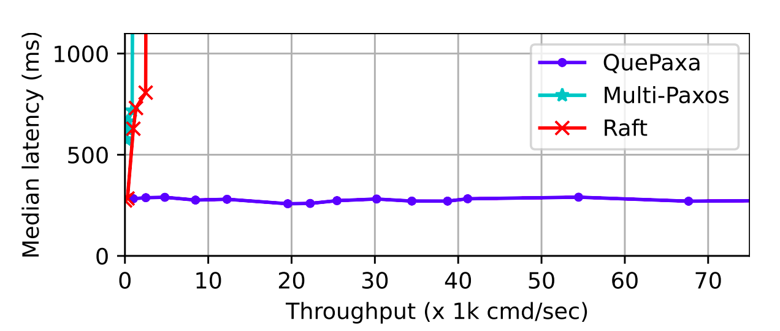
Performance under adversarial networks
QuePaxa is resilient to adversarial attacks and asynchronous network conditions

Slide 64
QuePaxa Summary
Optimal Performance under synchrony and asynchrony
Enables Hedging

Slide 65
Mahi-Mahi - Low latency DAG based BFT
Pasindu Tennage, Philipp Jovanovic, Lefteris Kokoris Kogias, Bryan Kumara, Alberto Sonnino , Igor Zablotchi

Slide 66
BFT Consensus
State
State
State
C1
C2
C3
C4
C5
State
State
C1
C2
C3
C4
C5
State
C1
C2
C3
C4
C5
State
C1
C2
C3
C4
C5

Slide 67
Mahi Mahi outline
Distributed Acyclic Graph (DAG) overview.
Limitations of DAG protocols.
Mahi-Mahi design.
Evaluation.

Slide 68
Why DAGs?
Single message type
Load balancing

Slide 71
2f+1 Hash Links
r
r+1

Slide 73
Local View of the DAG
Wave 1
Wave 2
r
r+1
r+2
r+3
r+4
r+5

Slide 74
Casual history in Local DAG View
B
A
C

Slide 75
Consensus in DAG based BFT
Round robin.
Threshold signature based.
Wave 1
Wave 2
Wave 3
r
r+1
r+2
r+3
r+4
r+5
r+6
r+7
r+8

Slide 76
Problems with existing DAG based protocols
Cost of certification
Cost of certification
High commit delay due to wave by wave design
High commit delay due to crashed validators

Slide 77
Equivocation in DAG based Consensus
r
r+1
r+2
r+3
r+4
r+5

Slide 78

Handling equivocation using certificates
BFT Reliable Broadcast
High resource usage
High Latency

Slide 79
Problems with existing DAG based protocols
Cost of certification
High commit delay due to wave by wave design
High commit delay due to wave by wave design
High commit delay due to crashed validators

Slide 80
Relative distance to the next committed leader
Wave 1
Wave 2
Wave 3
r
r+1
r+2
r+3
r+4
r+5
r+6
r+7
r+8

Slide 81
Problems with existing DAG based protocols
Cost of certification
High commit delay due to wave by wave design
High commit delay due to crashed validators
High commit delay due to crashed validators

Slide 82
Crash failures increase commit latency
Wave 1
Wave 2
Wave 3
r
r+1
r+2
r+3
r+4
r+5
r+6
r+7
r+8

Slide 83
Mahi-Mahi
Reduce resource consumption
Reduce commit latency
Have minimal impact from the crashed validators

Slide 84
Threat Model
Up to f out of 3f+1 nodes are malicious.
The network is asynchronous – there exists no bound Δ on message transmission delay.
Network attacker
Can delay and reorder messages.
Cannot intercept messages from honest nodes.

Slide 85
Mahi-Mahi uncertified DAG Wave
r
r+1
r+2
r+3
r+4
Lower resource usage.

Slide 86
Leader blocks in each round
r
r+1
r+2
r+3
r+4
Lower commit delay

Slide 87
Evaluation

Slide 88
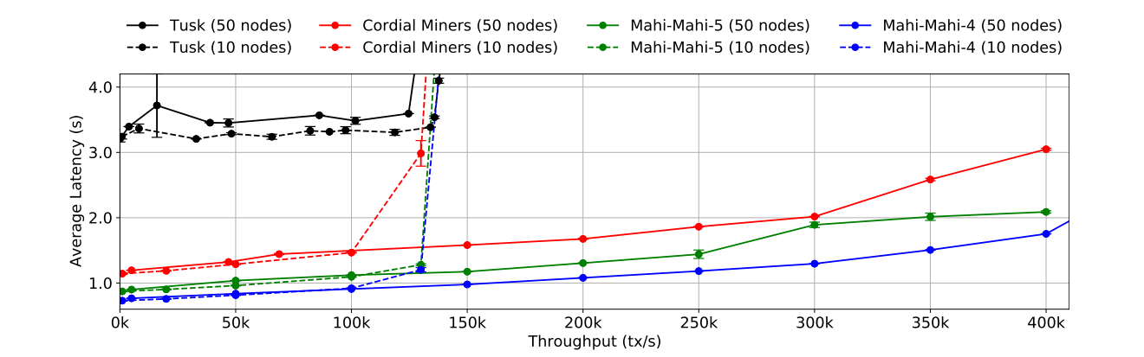
Normal Case Performance
Mahi-Mahi achieves higher throughput with lower latency

Slide 89
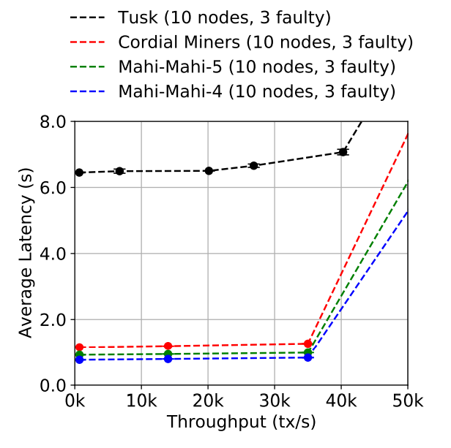
Performance under crash faults
Mahi-Mahi has minimal impact from crashed validators

Slide 90
Mahi-Mahi Summary
Reduce resource consumption
Reduce commit latency
Have minimal impact from the crashed validators

Slide 91
Summary of Thesis Contributions
Baxos
Baxos
REB as a replacement for leader election in Multi-Paxos to achieve high robustness
RACS-SADL
Avoid leader bottleneck and asynchronous liveness
QuePaxa
QuePaxa
Optimum performance under synchronous and asynchronous networks, support hedging
Mahi-Mahi
Mahi-Mahi
Low commit delay with low resource utilization for DAG based BFT

Slide 92
High Performance
Existing Consensus Protocols
High Robustness
This thesis
High Robustness
High Performance

Slide 93
Future Directions
Measuring adversarial performance.
Merging SADL and RACS to reduce latency.
Tuning consensus for high performance.

Slide 94
Summary of Thesis Contributions
Baxos
Baxos
REB as a replacement for leader election in Multi-Paxos to achieve high robustness
RACS-SADL
Avoid leader bottleneck and asynchronous liveness
QuePaxa
QuePaxa
Optimum performance under synchronous and asynchronous networks, support hedging and tuning
Mahi-Mahi
Mahi-Mahi
Low commit delay with low resource utilization for DAG based BFT

