Slide 1


Robust and High-Performance Wide-Area
Consensus Protocols
PhD Public Defense
Pasindu Tennage Thesis director: Bryan Ford Thesis co-director: Lefteris Kokoris-Kogias

Slide 2







Slide 3

14:58 Let’s meet at Cafe du flon
14:58 Let’s meet at Pizza place
Distributed Agreement is Hard
15:50 Sure, I am good with that
16:58 Which one you mean?
17:58 I assume it is Cafe du flon?

Slide 4

Consensus: an agreement about something

Slide 5
Consensus

Slide 6



Slide 7


Slide 8
Albert | 200
Albert | 200
Albert | 200

Slide 9
Albert | 200
Inconsistent State
Albert | 100
Albert | 200

Slide 10
Albert | 100
Consensus
Albert | 100
Albert | 100

Slide 11
Consensus protocols enable a distributed set of machines to agree on the same value

Slide 12
Robust and High-Performance Wide-Area
Consensus Protocols

Slide 13



Slide 14
Robust and High-Performance Wide-Area
Consensus Protocols

Slide 15
Distributed Consensus
80s/90s FLP Paxos View Stamp
2000 PBFT Fast Paxos
2010
Mencius
EPaxos Raft WPaxos Pig Paxos
2020
Hotstuff
Dag-Rider
Started thesis

Slide 16
High Performance
Existing Consensus Protocols
High Performance
High Robustness

Slide 17
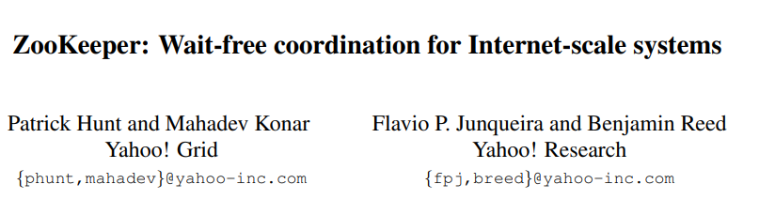
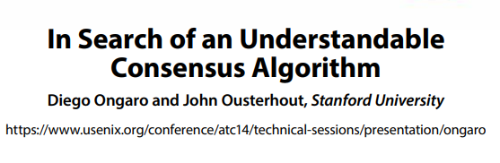
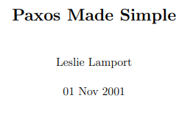


High Performance using Leader-based Consensus

Slide 18

Robustness Problem of Leader Based Protocols
Network partition.
Link failures.
DDoS attacks.
Leader crash.

Slide 19
High Performance
Existing Consensus Protocols
High Robustness
High Robustness

Slide 20
Robust randomized consensus protocols
Less efficient.
Hard to understand.
Rarely deployed.

Slide 21
Can we have the best of both worlds?
High Performance
Existing Consensus Protocols
High Robustness

Slide 22
Robust and High-Performance Wide-Area
Consensus Protocols

Slide 23
Robust and High-Performance Wide-Area
Consensus Protocols

Slide 24

Thesis Contributions
Baxos
RACS-SADL
QuePaxa
Mahi-Mahi

Slide 25
Thesis Contributions
Baxos
Robustness against leader-targeted attacks
RACS-SADL
Asynchronous liveness and high scalability
(IEEE CLOUD 2025)
QuePaxa
Mechanisms to avoid tyranny of timeout problems in consensus
(ACM SOSP 2023)
Mahi-Mahi
Scalable, asynchronous liveness in BFT
(IEEE ICDCS 2025)

Slide 26
Thesis Contributions
Baxos
RACS-SADL
QuePaxa
Mahi-Mahi

Slide 27
Outline
Consensus
Thesis Contributions
QuePaxa
Summary

Slide 28
Outline
Consensus
Thesis Contributions
QuePaxa
Summary

Slide 29

QuePaxa: Escaping the tyranny of timeouts in consensus
Pasindu Tennage*, Cristina Basescu*, Lefteris Kokoris-Kogias, Ewa Syta, Philipp Jovanovic, Bryan Ford
SOSP 2023

Slide 30
RoadMap
Tyranny of timeouts
Parallels of QuePaxa and hedging
QuePaxa algorithm
Evaluation

Slide 31
Tyranny of Timeout Problems in Consensus
Timeout based view change
Timeout based view change
Conservative timeouts
Manually configured timeouts

Slide 32

Timeout based view change [Multi-Paxos]
Commit
Commit
Commit
Commit
R1
R2
Propose
Accept
Propose
Accept
Propose
Accept
Propose
Accept
R3
R4
View 1
As long as the network is synchronous, the leader will keep committing new requests

Slide 33

Timeout based view change [Multi-Paxos]
Commit
R1
Prepare
Propose
R2
Accept
Promise
Propose
Accept
R3
R4
View Change
View 1
View 2
No new commands are committed during view change
Liveness depends on partial synchronous network conditions

Slide 34
Tyranny of Timeout Problems in Consensus
Timeout based view change
Conservative timeouts
Conservative timeouts
Manually configured timeouts

Slide 35
Choosing Timeouts in leader based protocols
Low Timeout
High Timeout
High Timeout
Timeout

Slide 36
Timeout based view change [Multi-Paxos]
Commit
R1
Prepare
Propose
R2
Accept
Promise
Propose
Accept
R3
R4
View Change
View 1
View 2
High Recovery Time
High timeouts result in high recovery time

Slide 37

Choosing Timeouts in leader based protocols
Low Timeout
Low Timeout
High Timeout
High Timeout
High Timeout
Timeout
High Recovery Time

Slide 38
Liveness loss with low timeouts
R1
Propose
R2
Prepare
…
R3
Prepare
R4
View 1
View 2
View 3
View 4
No commands are committed when the timeout is low

Slide 39

Choosing Timeouts in leader based protocols
Low Timeout
High Timeout
High Timeout
High Timeout
Timeout
Liveness Loss
High Recovery Time
Both choices of timeouts have negative consequences

Slide 40
Tyranny of Timeout Problems in Consensus
Timeout based view change
Conservative timeouts
Manually configured timeouts
Manually configured timeouts

Slide 41
Manual configuration of timeouts
Stuck with a live but slow leader replica
Do not consider dynamic network state for leader election
Manual timeouts are sub optimal

Slide 42
Are timeouts necessary for progress?
Can we eliminate the impact of timeout for liveness?

Slide 43
Do asynchronous protocols solve this problem?
Asynchronous protocols do not depend on timeout for progress
Use randomization to alleviate the FLP impossibility
Message complexity
In general asynchronous protocols have O(n²) / O(n³) complexity in the normal case
In contrast, partially synchronous protocols have O(n)
Less efficient than leader-based protocols
Hence rarely deployed
Asynchronous protocols are slow and rarely deployed

Slide 44

An alternative approach?
Leader 1
Commit
R1
Propose
Accept
Leader 2
Commit
R2
Propose
Accept
Accept
Leader 3
Propose
R3
Commit
R4
Leader 4
No view change
No view change
Can we change leaders without view changes if the current leader is sub optimal?

Slide 45

What if multiple leaders could cooperate instead of interfere?
Leader 1
commit
R1
Propose
Leader 2
R2
R3
Leader 3
R4
Leader 4
Round 1
Can we support multiple leaders to be non destructive?

Slide 46
RoadMap
Tyranny of timeouts
Parallels of QuePaxa and hedging
QuePaxa algorithm
Evaluation

Slide 47
Hedging
Hedging is a way to curb latency variability
Key idea: issue the same request to multiple replicas and use the results from whichever replica responds first
Multiple responses
do not interfere with each other
Server
Store 1
Store 2
Store 3
Can we apply hedging to consensus so that multiple proposers don’t interfere?

Slide 48
RoadMap
Tyranny of timeouts
Parallels of QuePaxa and hedging
QuePaxa algorithm
Evaluation

Slide 49
QuePaxa Contributions
A consensus protocol that eliminates the tyranny of timeouts problems
First consensus protocol to support hedging in consensus
A novel consensus protocol that
Under normal network conditions as good as Multi-Paxos /Raft
Under adversarial network conditions, provides liveness

Slide 50
QuePaxa RoadMap
Operation Overview
Abstract QuePaxa – a simplified version
Concrete QuePaxa overview

Slide 51
QuePaxa Architecture
Submitter
Submitter
Client Requests
Replica
Replica
Replica
Proposer
Proposer
Proposer
Recorder
Recorder
Recorder

Slide 52
QuePaxa Log Structure
Round 1
Round 2
Slot 1
P1
P2
P3
P4
Slot 2
Slot 3

Slide 53

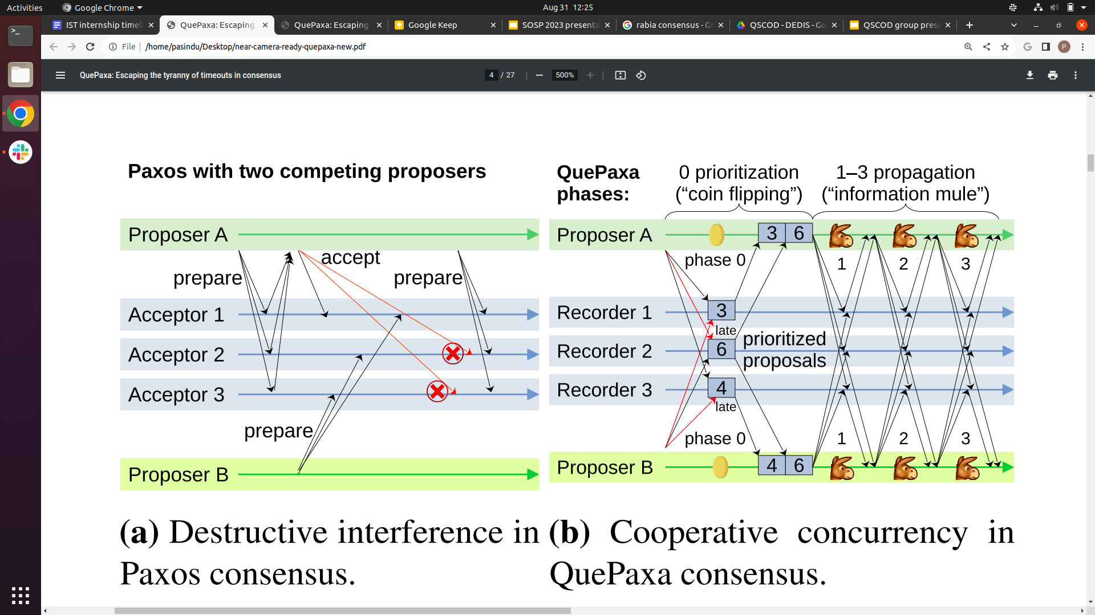
QuePaxa Protocol Diagram
Fast Path Decision
Slow Path Decision
Phase 0
Phase 1-3
Learn Majority Proposals
Information Propagation
Proposer 1
Recorder 1
Recorder 2
Recorder 3
Proposer 2
QuePaxa has a fast path decision and a slow path decision

Slide 54
QuePaxa RoadMap
Operation Overview
Abstract QuePaxa - a simplified version
Concrete QuePaxa overview
Abstract QuePaxa is a simplified version of QuePaxa

Slide 55
Introducing threshold broadcast (tcast)
Divide the problem in to two parts
Handling replica failures
Handling asynchrony
First ignore asynchrony and focus on replica failures
Using tcast let us assume a synchronous lock step network
tcast (threshold synchronous broadcast): an abstraction which provides lock step synchrony to the consensus layer
Abstract QuePaxa
tcast
Asynchronous Network
Abstract QuePaxa assumes synchrony and solves the replica failure challenge

Slide 56
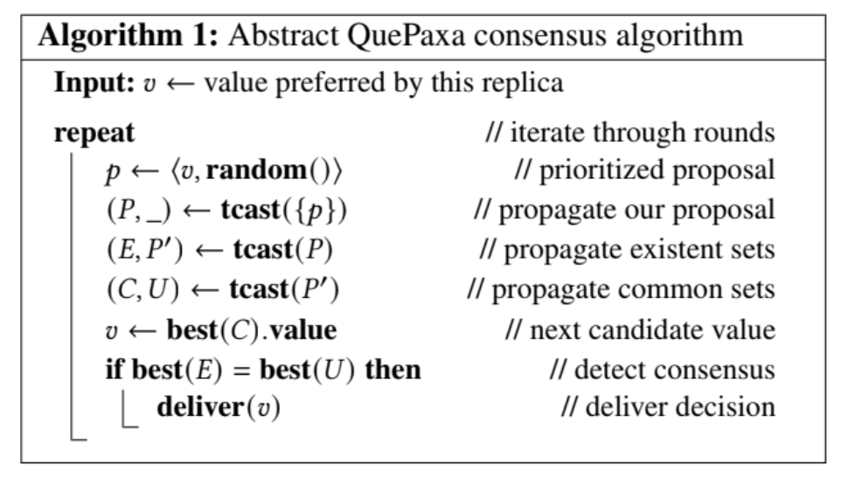
Abstract QuePaxa Algorithm
Abstract QuePaxa is just a few lines of pseudocode!

Slide 57
Proposals Bob knows to exist
Bob
Proposal Alice knows that all others know to exist
Propose B
Proposal Bob knows that all others know to exist
Proposal Charlie knows that all others know to exist
Propose A
tcast
Propose C
Alice
Charlie
Proposals Charlie knows to exist
Proposals Alice knows to exist
tcast property 1: each node learns a majority of proposals
tcast property 2: each node learns a proposal that all nodes know to exist
Nodes have no guarantee to learn the same sets! (no consensus yet)

Slide 58
Towards consensus: approximating what others know
Sets from one tcast invocation are insufficient for consensus
Repeat: three tcast invocations, giving each node i sets with increasing guarantees
Key relationship for consensus: Existent_{i} ⊇ Common_{j} ⊇ Universal_{k}
An existent set
A common set
A universal set

Slide 59
Consensus: reaching a safe decision
Only possible decision in future is V’ = best(Common_{Bob}) = best(Existent_{Alice}) = V
best(Common_{Bob})
Bob doesn’t decide, proposes V’
propose
best(Existent_{Bob}) ≠
best(Universal_{Bob})
Three tcast rounds
V’ = best(Common_{Bob})
NO
best(Existent_{X}) =
best(Universal_{X})
Existent_{Alice} ⊇ Common_{Bob}⊇ Universal_{Alice}
Alice decides V
YES
best(Universal_{Alice})
best(Existent_{Alice}) = V =
decide

Slide 60
Abstract QuePaxa
🙂
Liveness does not depend on timeout because the protocol is randomized
Robust against adversarial networks
O(n²) message complexity hence slow
Does not support hedging
🙂
😔
😔
Abstract QuePaxa is robust but inefficient

Slide 61
QuePaxa RoadMap
Operation Overview
Abstract QuePaxa
Concrete QuePaxa overview

Slide 62
From abstract to concrete QuePaxa
O(n) complexity in the normal case
Robust against asynchrony
Support hedging
Implementation ready (4368 LOC)
Abstract QuePaxa
Concrete QuePaxa
tcast
Interval Summary Register
Asynchronous Network
Asynchronous Network
Concrete QuePaxa has all we need!

Slide 63
QuePaxa Architecture
Submitter
Submitter
Client Requests
Replica
Replica
Replica
Proposer
Proposer
Proposer
Recorder
Recorder
Recorder

Slide 64
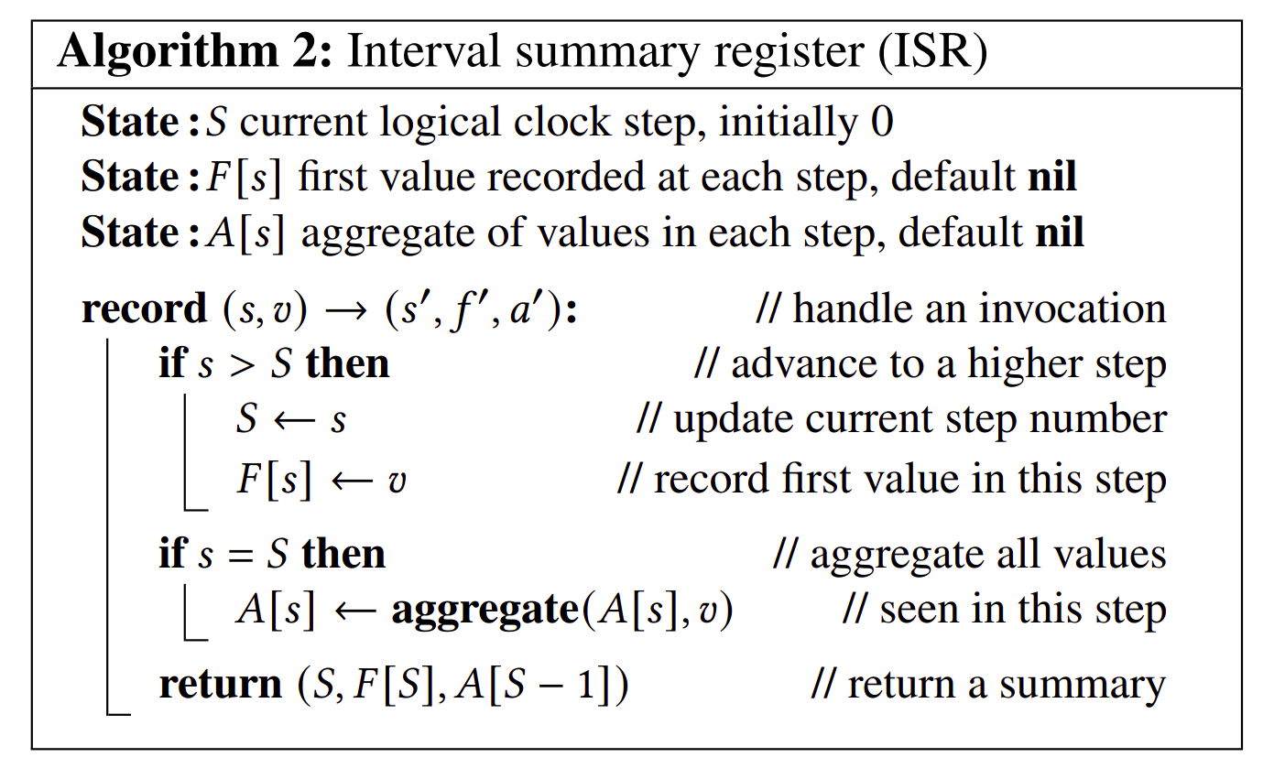
Concrete Recorder Protocol (ISR)
Simulates lock step synchrony using a threshold logical clock
For each step, records the the first value and the aggregate of the values submitted in the previous step
Constant space
QuePaxa Recorder is a constant space interval summary register

Slide 65
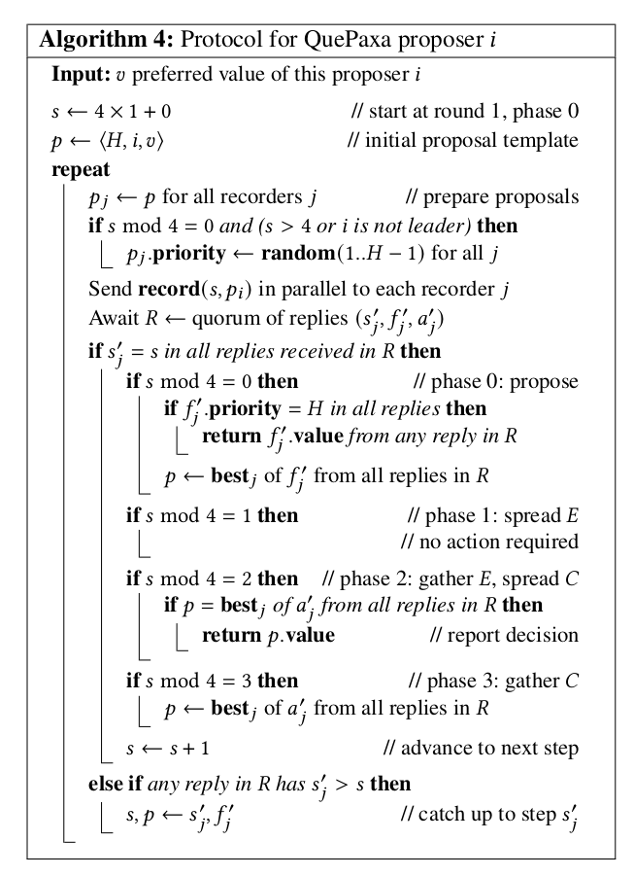
Proposer Code
QuePaxa proposer uses RPC in 4 phases to contact Recorders

Slide 66
Hedging in QuePaxa
Proposer 1
Propose with 0×Δ delay
Proposer 2
Propose with 1×Δ delay
Proposer 3
Propose with 2×Δ delay
Proposer 4
QuePaxa supports hedging because multiple proposers do not cancel each other

Slide 67
RoadMap
Tyranny of timeouts
Parallels of QuePaxa and hedging
QuePaxa algorithm
Evaluation

Slide 68
Evaluation
Can QuePaxa guarantee liveness under any timeout?
Under normal case executions, how does QuePaxa compare with leader-based protocols?
Under adversarial conditions, does QuePaxa provide liveness?

Slide 69

Setup
LAN (N. Virginia)
WAN (Tokyo, Mumbai, Singapore, Ireland, and São Paulo)
Replicas: c4.4xlarge
16 virtual CPUs, 30 GB memory
Submitters: c4.2xlarge
8 virtual CPUs, 15 GB memory

Slide 70
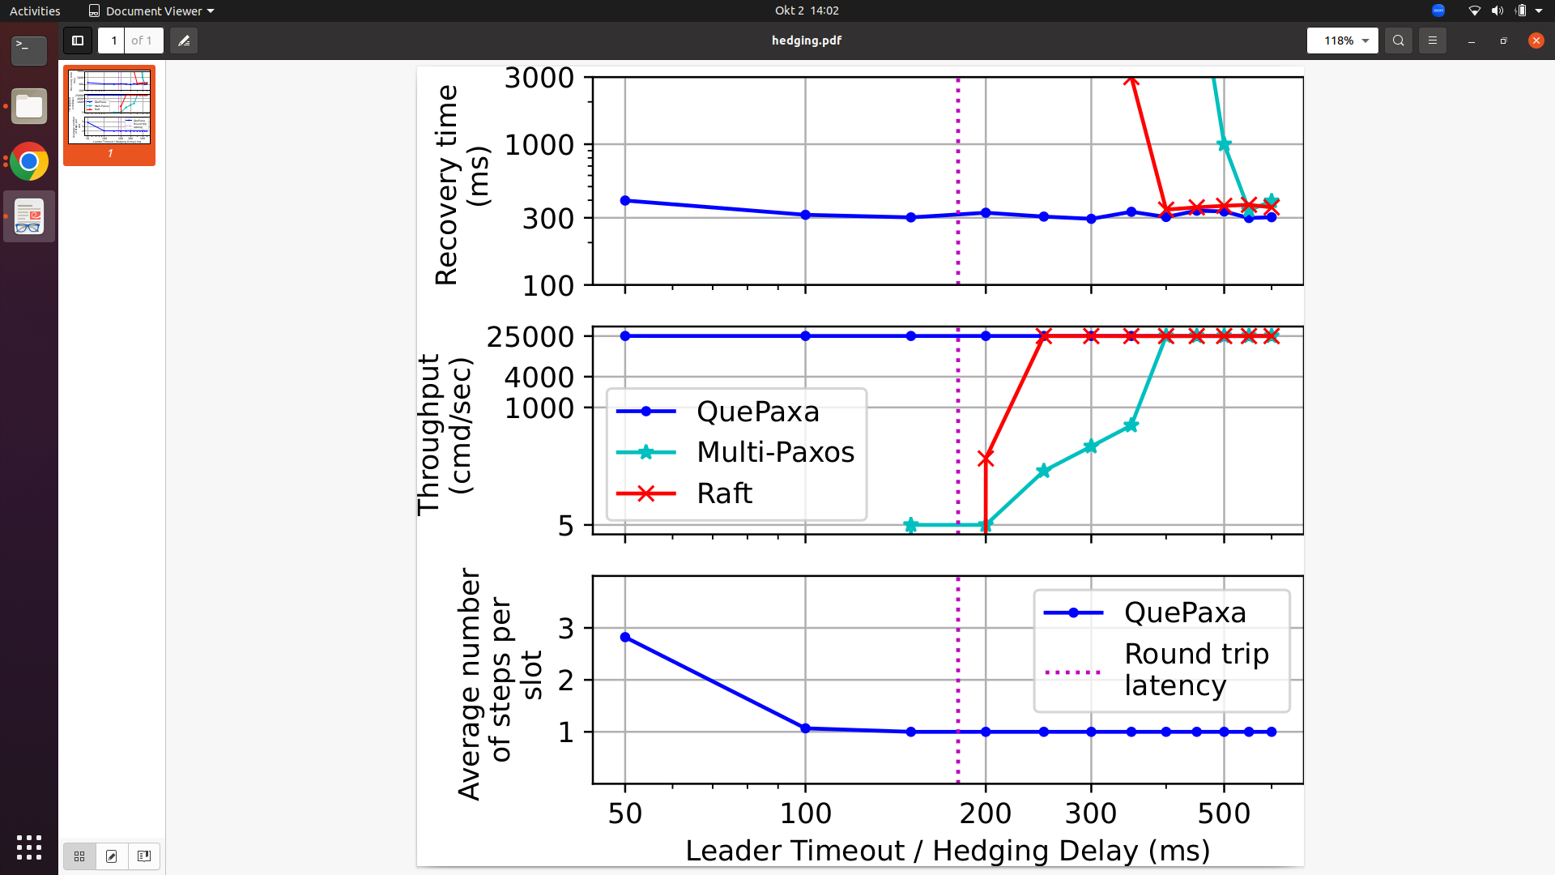
Effect of Hedging in Quepaxa
Throughput
QuePaxa is live for any hedging delay

Slide 71
Effect of Hedging in Quepaxa
Throughput
Bandwidth Cost
QuePaxa has an additional overhead only when hedging delay < RTT

Slide 72

Effect of Hedging in Quepaxa
Throughput
Bandwidth Cost
Recovery Time
QuePaxa has low recovery time

Slide 73
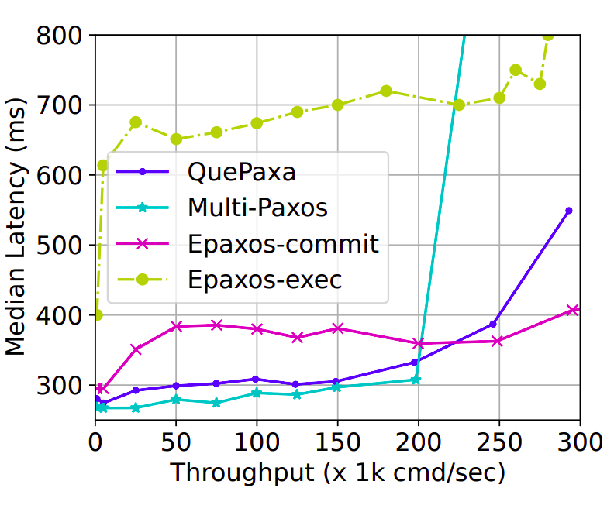
Normal case execution in a WAN
QuePaxa performs comparable to Multi Paxos

Slide 74
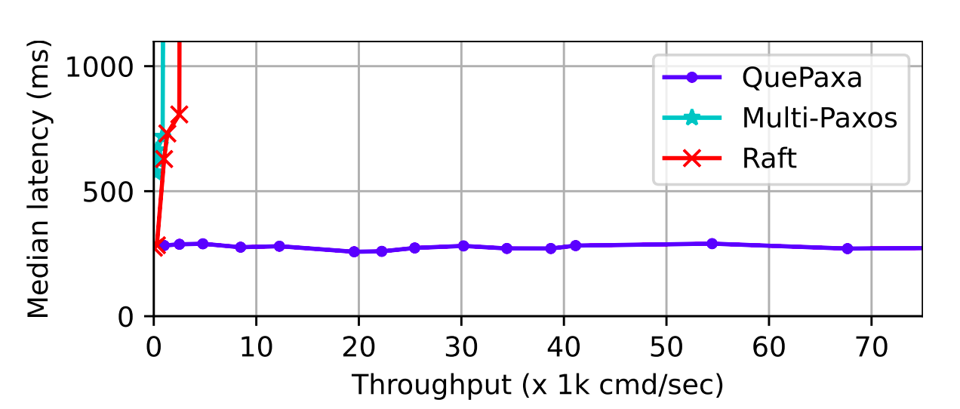
Performance under adversarial networks
QuePaxa is live under asynchrony

Slide 75
QuePaxa Contributions
A consensus protocol that eliminates the tyranny of timeouts problems
First consensus protocol to support hedging in consensus
A novel consensus protocol that
Under normal network conditions as good as Multi-Paxos /Raft
Under adversarial network conditions, provides liveness

Slide 76
Thesis Contributions
Baxos
Robustness against leader-targeted attacks
RACS-SADL
Asynchronous Liveness and high scalability
(IEEE CLOUD 2025)
QuePaxa
Mechanisms to avoid the tyranny of timeout problems in consensus
(ACM SOSP 2023)
Mahi-Mahi
Scalable, asynchronous byzantine fault tolerance
(IEEE ICDCS 2025)

Slide 77
High Performance
Existing Consensus Protocols
High Robustness
This thesis
High Robustness
High Performance

Slide 78
Distributed Consensus Timeline
80s/90s FLP Paxos View Stamp
2000 PBFT Fast Paxos
2010
Mencius
EPaxos Raft WPaxos Pig Paxos
2020
Hotstuff
Dag-Rider
2021
Baxos
2022
SADL-RACS
2023
QuePaxa
2024
Mahi-Mahi
Started thesis

Slide 79
Robust and High-Performance Wide-Area
Consensus Protocols
PhD Public Defense
Pasindu Tennage Thesis director: Bryan Ford Thesis co-director: Lefteris Kokoris-Kogias

