Slide 1
Proof-of-Personhood: Redemocratizing Permissionless Cryptocurrencies
Maria Borge, Eleftherios Kokoris-Kogias, Philipp Jovanovic, Linus Gasser, Nicolas Gailly and Bryan Ford
EPFL

Slide 2
Talk overview
Problem
Proof of personhood (PoP)
PoPCoin
Conclusions

Slide 3
Problem
Control in current permissionless blockchain-based cryptocurrencies systems lies in hands of a small number of entities
Re-centralization

Slide 4
Permissionless cryptocurrencies
Enable open participation
Provide pseudonymity
Avoid double spending attacks
Extend the blockchain in a secure manner

Slide 5
Proof-of-Work
Special purpose hardware
Massive consumption of electricity
Only entities with the resources are able to mine
Re-centralization!

Slide 6
Proof-of-Stake
Participants use their assets to create new assets
Rich participants have an advantage, more assets implies faster creation of new assets
Shareholder corporation that favors the rich

Slide 7
Goal
Create a sybil attack resistant cryptocurrency that ensures fair and accessible wealth creation process

Slide 8
Talk overview
Problem
Proof of personhood (PoP)
PoPCoin
Conclusions

Slide 9




Proof-of-Personhood (PoP)
Objective: Verify people, rather than identify them
How: Organizing a party and generate tokens
PoP-Token
PoP-Token
PoP-Token
Notes:
El punto es que al final de la fiesta cada personita sale con un PoP token

Slide 10
Proof-of-Personhood (PoP)
CoSi - Scalable collective signing
Cothority - Collective Authority
Linkable ring signatures - Anonymity and accountability in the same context
Notes:
List Building blocks
List of assumptions for pseudonym party:
Organizers each responsible for a node
Anytrust model
Attendees are trusted to safely store their private key
After the time barrier, no one gets in
Linkable ring signatures, even though they share anonymity group. The tags produced at different services, that is with different context, output distinct tags. That is the signatures are not realted between different anonymity groups.

Slide 11



Pseudonym party - Setup
Cothority
Organizers
Conode
Conode
Configuration-file:
- Start, End
- Location, Use
- Expiration
- Organizers’ public keys
Conode
Notes:
Lets take a first look at the pseudonym party setup, lets meet some of its main “actors”
First, we have the organizers
Organizers may be a group of volunteers, part of an entity, an association, an entity, basically any group of people.
Each organizer is associated to one server, that from now on is going to be called a conode.
The conodes and the organizers together form a collective authority.
We assume an anytrust model, in which people do not need to trust all organizer, they just need to trust that one of the organizers is honest and that he/she is not colluding with anyone else. And that their conode is also honest.
Some time before the party the organizers meet, to setup the details.
In particular start, end, location, use, expiration date, servers and they exchange their public keys. All of these details go to a configuration file that is made public after these meeting.
A set of independet of servers, in charge of taping the party are also selected. These observers do not belong to the organizers set of people, they are selected completely appart and independently.
They are in charge of taping the party for transparency issues. The tapes allow to prove if for example an organizer refused to sign a User PoP token, or if someone is getting double PoP-tokens.

Slide 12







Pseudonym party - Setup
Attendees
E Public keys
Private keys
Configuration-file:
- Start, End
- Location, Use
- Expiration
- Organizers’ public keys
Notes:
Attendees also need to do a setup before the party, we trust them to bring an ephemeral public key to use only at the party.
They need to download the configuration file that was uploaded by the organizers.
Attendees must downlaod the configuration file, as well as a software to generate the public/private/ephemeral keys. They input the configuration file and get a file as an output
These file contains three keys, one public key and one private key, to not be used at the party. And an ephemeral public key to be used at the party.
These will ideally prevent the user from using the same public key on different services. That is the user can reuse the public key on different services and that should not compromise
his/her anonymity.
So at the end of the step the attendees end up with a set of ephemeral public keys, and some private keys.

Slide 13

Pseudonym party
Registration-room
Party-room
Notes:
The pseudonym party is divided in two rooms.
A registration room and a party room.
Initially everyone enters to the registration room.
Everyone is allowed to enter to the registration room up to a point, the barrier point.
Once this point is reached no one can get in, but everyone can get out for security purposes.

Slide 14

Pseudonym party - Barrier Point
Registration-room
Party-room
Notes:
At the barrier point both organizers and attendees line up to collect the ephemeral public keys.
First organizers form a line, and the attendees also form a line, following the organizers.
Each attendee carries their ephemeral public key.
Organizers will collect each attendees eph public key.
Each organizer stamps an attendee, that way if an attendee attempts to go back in line, the organizer just needs to recognize his/her stamp, if the attendee has the stamp, then that means that he/she got in line for a second time.

Slide 15
Pseudonym party
Registration-room
Party-room
Notes:
Once attendees get to the end of line they move to the next room. The party room. They are not allowed to go back. Lets think of the door as a one way door. If they attempt to go back the observers will be recording all the process.
In the party room there might be an actual party or something, another incentive for people to go there.

Slide 16


Pseudonym party - Termination / Finalization
Cothority
Organizers
Conode
Private key
+
=
PoP-Token
Conode
Party Transcript:
-Configuration file
-Public keys of attendees
-Hash-file of videos
-Collective signature
Conode
Notes:
By the end of the party Organizers upload all the ephemeral public keys collected at the party to their respective conodes.
With them a Final transcript is created. And collectively signed by the cothority.
Each attendee ends up with a PoP-Token, formed by their private key and the party transcript.

Slide 17



Usage of PoP-Tokens
Attendee
Service
Context, M
Aggregate public key of trustworthy cothorities
Linkable Ring Signature
Attendees public keys
Attendees public keys
...
...
...
Table with tags

Slide 18
Talk overview
Problem
Proof of personhood (PoP)
PoPCoin
Conclusions

Slide 19
PoPCoin
Open membership: Proof-of-Personhood
Fairness: Randhound
Consensus: Byzcoin

Slide 20
PoPCoin - Implementation - Setup
Set of organizers throw a pseudonym party to create PoP-tokens
Attendees authenticate their PoP-tokens
If successfully authenticated attendee deposits a public key, to identify as a minter
The set of public keys form a minting-pool

Slide 21
PoPCoin - Implementation - Minting
Minters part of the minting-pool are eligible to create new blocks
Last N miners run RandHound, to select the next minter allowed to create next block
The process repeats every M minutes, if minter fails a new one is selected

Slide 22
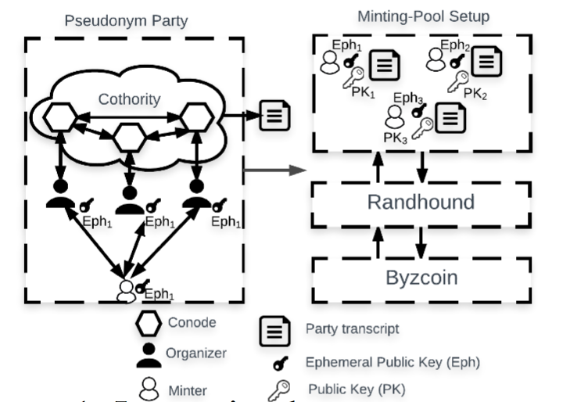
PoPCoin - Overview

Slide 23
PoPCoin - Deployment
Local cryptocurrency

Slide 24
Challenges
We propose a cryptocurrency that builds on:
Proof-of-Personhood
Randhound
Byzcoin

Slide 25
Related Work
We propose a cryptocurrency that builds on:
Proof-of-Personhood
Randhound
Byzcoin

Slide 26
Thank you!

Slide 27
Questions?

