Slide 1
UIA:
A Global Connectivity Architecture for Personal Mobile Devices
Bryan Ford
Massachusetts Institute of Technology
in collaboration with
Jacob Strauss, Chris Lesniewski-Laas,
Sean Rhea, Frans Kaashoek, Robert Morris
http://pdos.csail.mit.edu/uia

Slide 2

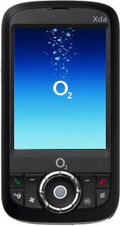
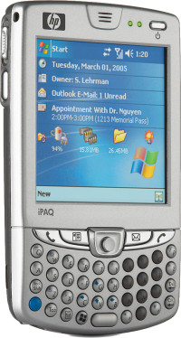
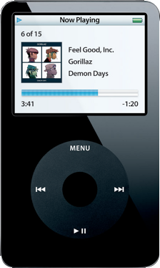
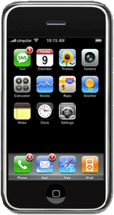
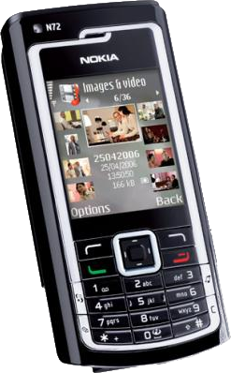
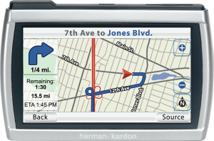

Personal devices everywhere
Internally they are like real computers
They will be part of the Internet
They will store data that people want to share

Slide 3
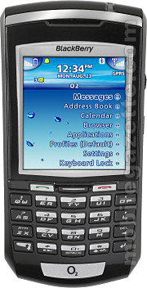


Global connectivity enables information sharing
Bluetooth
Alice and Bob meet
Alice
Bob
Alice & Bob later
share stuff remotely
Alice
Bob

Slide 4
Other examples
Upload picture from camera to mom’s iPhone
Stream video from ambulance to doctor’s PDA
Car-to-car local traffic information

Slide 5

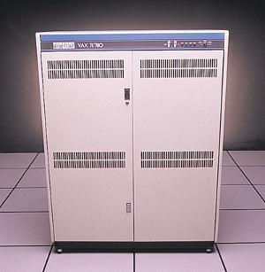


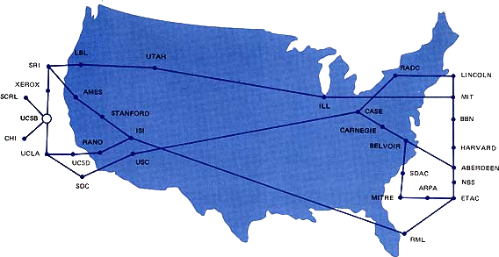
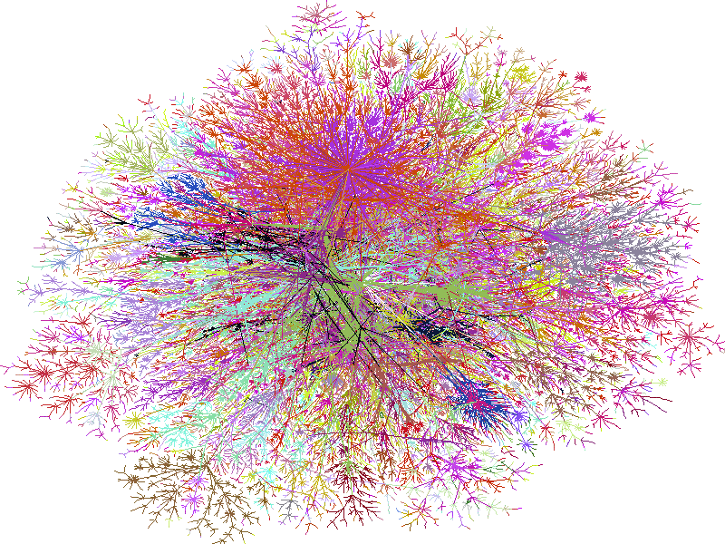
The Internet's Evolution
Internet designed for
  wired networks
  fixed computers
  expert operators
...but now supports:
  wireless nets
  mobile devices
  unskilled users

Slide 6
The Problem
old design assumptions
+
Internet evolution
=
connectivity challenges for personal devices

Slide 7

The Project
Unmanaged Internet Architecture (UIA)
Goal:
Make personal device connectivity “just work”
by rethinking basic networking concepts

Slide 8
Architecture Overview
Traditional Layers
UIA Enhancements
Transport: [SIGCOMM '07]
structured streams
Transport: TCP
serialized streams
Naming: [OSDI '06]
personal groups/names
Naming: DNS
global names
Routing: [OSDI '06]
unmanaged overlay
Routing: IP
managed infrastructure

Slide 9
Naming Scenario
Bob & Alice:
  Meet at conference
  Re-connect remotely over Internet
  Meet again off-Internet

Slide 10



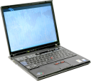
Naming Scenario (1)
Local Area Network
Alice's PDA
Bob's Laptop
Bob & Alice meet, connect [Bonjour] –
using local names (e.g., “Alice-PDA”)

Slide 11


Naming Scenario (2)
Internet
Alice's PDA
Bob's Laptop
Wish to re-connect remotely –
need different, global names & more setup
(e.g., “pda.alice1234.herisp.com”)

Slide 12

Naming Scenario (3)
Partitioned
Ad Hoc Network
Alice's PDA
Bob's Laptop
Meet again off-Internet – global names stop working!
Require different, local names (again)

Slide 13
Key Naming Challenges
Personal device names should be:
Convenient
  short, personally meaningful
Consistent
  usable on any device I own/manage
Available
  works even under disconnect/partition
#3 precludes central name service!

Slide 14
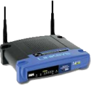


Key Naming Contribution
Personal Group:
distributed federation of personal devices
Internet
Camera
Laptop
Bob's Personal Group
Home PC
Work PC

Slide 15
What is a Personal Group?
Combination of:
A distributed namespace
of devices, users, ...
An ad hoc virtual private network (VPN)
A user identity for social networking
...with fully decentralized, user-friendly
management & operation

Slide 16
Outline
Introduction
Personal Group Naming Model
  from user's perspective ⟹ convenient
Implementing Personal Groups
  decentralized ⟹ consistent, available
Evaluation
Other thesis components
Related work, conclusion

Slide 17
Personal Names
Each personal group includes a distributed
personal namespace
Internet
“Camera”
“Laptop”
Bob's Personal Group
“Laptop”
“Camera”
“Home-PC”
“Work-PC”
“Home-PC”
“Work-PC”

Slide 18
Personal Names
...are short, local to personal group
 “laptop”, not “laptop.bob345.his-isp.com”
Internet
“Camera”
“Laptop”
Bob's Personal Group
“Laptop”
“Camera”
“Home-PC”
“Work-PC”
“Home-PC”
“Work-PC”

Slide 19
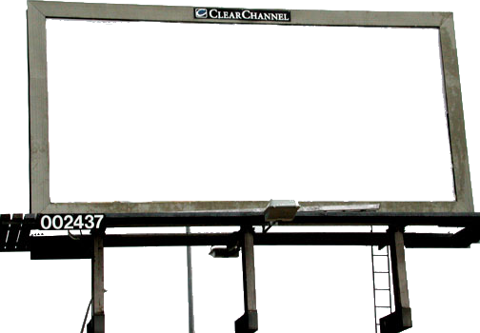
Why Local?
Global names:
  Perfect when global usability is the point
  Expensive, cumbersome in personal context
Personal names:
  Not globally unique, thus short, convenient
  ...but still usable for global connectivity!
amazon.com
bob.com?

Slide 20
Personal Names
...persistently represent the same target
regardless of location
Internet
Bob's Personal Group
“Laptop”
“Camera”
“Home-PC”
“Work-PC”
(personal
device
names)

Slide 21
How to Build Personal Groups?
Convenience goal precludes:
  assigning or entering IP addresses,
  MAC addresses, ...
  generating or distributing crypto keys, certificates
Name Bootstrap Problem:
  How to securely indicate device to be named,
  without referring to low-level identifiers?

Slide 22

Building Groups via Introduction
Common case: local, on home/office LAN
Also supported: remote, via global names
Internet
“bobs-pc.workplace.com”

Slide 23
Building Groups via Introduction
use
Device Mobility
to build a
Global Naming Federation
from
Local Pairwise Introductions
Internet
“bobs-pc.workplace.com”

Slide 24
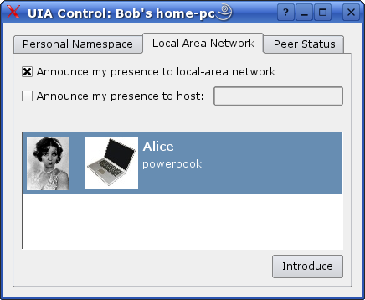
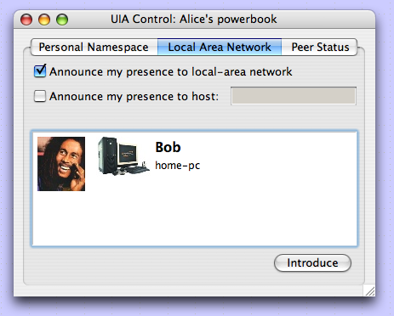
UIA Introduction Procedure
2-step process:
  Identify other device locally [Bonjour]
  Avoid MITM attacks [Dohrmann/Ellison]
(screen shots from working UIA prototype)

Slide 25
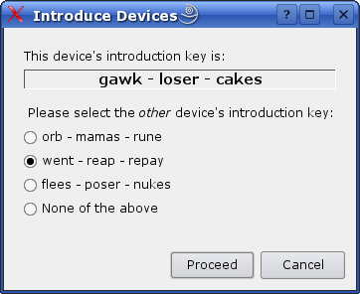
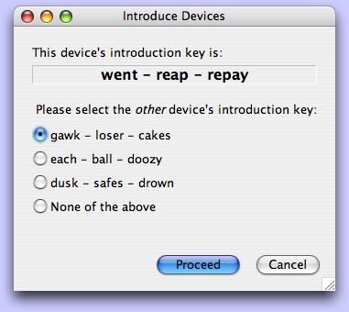
UIA Introduction Security
Refines prior introduction protocols
  Online protocol: resist attacks with fewer bits
  Multiple-choice: ensures user participation
But many other schemes possible! [MyNet]

Slide 26
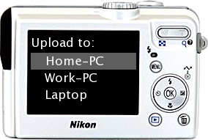
Remote Access
Names usable from any device in group
for local or remote access
“Camera”
Internet
“Laptop”
“Home-PC”
“Work-PC”

Slide 27

Remote Access
Names usable from any device in group
for local or remote access
“Camera”
Internet
“Laptop”
“Home-PC”
“Work-PC”

Slide 28
Security
All communication privacy-protected
as in virtual private network (VPN)
(crypto)
“Camera”
Internet
“Laptop”
(crypto)
“Home-PC”
“Work-PC”

Slide 29
Social Networking
Personal group provides user identity
Internet
Bob's Personal Group
Alice's Personal Group

Slide 30
Social Networking
Personal group provides user identity
“Hi Bob, I'm Alice!”
“Hi Alice, I'm Bob!”
Internet
Bob's Personal Group
“Alice”
Alice's Personal Group
“Bob”
(personal user names)

Slide 31
Social Networking
Personal user names also persist
Internet
Bob's Personal Group
“Alice”
Alice's Personal Group
“Bob”
(personal user names)

Slide 32
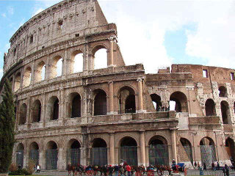
Social Networking
all devices in group represent same user
“Alice, look at this photo!”
“OK, it's from Bob”
Internet
Bob's Personal Group
“Alice”
Alice's Personal Group
“Bob”
(personal user names)

Slide 33
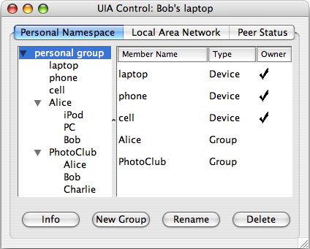
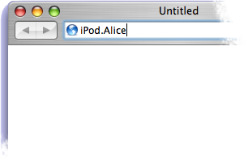
Using Personal Groups/Names
Browse groups,
control access
Enter user-relative
domain names

Slide 34
Implementing
Personal Groups
...while maintaining
consistency and availability
in a fully decentralized design

Slide 35
Key Technical Challenges
Device Location Independence
Network Partition Tolerance
State Synchronization, Consistency
Distributed Ownership, Revocation

Slide 36
Challenge:
Location Independence
How to identify personal devices
as they move, change IP addresses?

Slide 37
Solution: Endpoint Identifiers
Each device has endpoint identifier (EID)
  Hash of device's public key [SFS]
  Self-configured, stable, location-independent [HIP]
Camera
Laptop
Public Key: 56b19c28f35...
Public Key: 8b934a68cd5f...
Secure
Hash
Secure
Hash
EID: 123
EID: 456

Slide 38
Challenge: Partition Tolerance
Names must keep working off-Internet
Bob's Personal Group
“Alice”
Alice's Personal Group
“Bob”
Internet

Slide 39
Solution: State Replication
Each device keeps
change log
Grouped devices
replicate
each others' state
Log entries are
self-certifying,
fork-consistent
Camera
Camera's log
Laptop's log
“BobPix”
“Thinkpad”
Laptop
Laptop's log
Camera's log
“BobPix”
“Thinkpad”

Slide 40
Implementing Names and Groups
Device keeps a series
of change records
Start with default name
Camera: EID 123
Series 123
“Coolpix” → EID 123
Laptop: EID 456
Series 456
“Thinkpad” → EID 456

Slide 41
Implementing Names and Groups
Device keeps a series
of change records
Start with default name
To rename: cancel old,
write new name record
Camera: EID 123
Series 123
cancel
“BobPix” → EID 123
Laptop: EID 456
Series 456
“Thinkpad” → EID 456

Slide 42
Implementing Names and Groups
Device keeps a series
of change records
Start with default name
To rename: cancel old,
write new name record
To merge:
  Write merge records
Camera: EID 123
Series 123
Merge with Series 456
Laptop: EID 456
Series 456
Merge with Series 123

Slide 43
Implementing Names and Groups
Device keeps a series
of change records
Start with default name
To rename: cancel old,
write new name record
To merge:
  Write merge records
  Gossip series contents
Camera: EID 123
Series 123
Series 456 copy
“BobPix” → EID 123
“Thinkpad” → EID 456
Laptop: EID 456
Series 456
Series 123 copy
“BobPix” → EID 123
“Thinkpad” → EID 456

Slide 44



Serverless Name Resolution
Use replicated state – no communication
Resolution starts in device's own group
Resolve components right-to-left
Phone.Charlie.Bob
Bob's Group
Laptop”
“Camera”
“Home-PC”
“Work-PC”
“Alice”
“Charlie”
➌
➋
➊
Charlie's Group
“PC”
“Phone”
“Bob”
Alice's Group
“iPod”
“PowerBook”
“Bob”
➊
➋
➌

Slide 45

Challenge: Consistency
All devices in group must automatically
learn name & membership changes
Internet
Bob's Personal Group
“Alice”
Alice's Personal Group
“Bob”

Slide 46

Solution: Change Record Gossip
Devices gossip whenever possible with
  Other devices in personal group
  Devices in friends' groups
  (to limited social distance)
Alice's Group
Bob's Group
Charlie's Group

Slide 47
Name Conflicts
What if user groups two devices w/ same name?
⇒ merge succeeds, but creates conflict
(can't use name)
Resolve by renaming
(on either device)
Bob's Group
“Thinkpad”
“Coolpix”
“Coolpix”

Slide 48
Name Conflicts
What if user groups two devices w/ same name?
⇒ merge succeeds, but creates conflict
(can't use name)
Resolve by renaming
(on either device)
Bob's Group
“Thinkpad”
“Otherpix”
“Coolpix”

Slide 49
Challenge:
Ownership, Revocation
Key problem:
  Access control depends on membership,
  membership changes depend on access
  Devices can't tell true owner from thief
  Maintain device/group availability
  even under lack of consensus

Slide 50
Solution:
Group Versions, Successorship
Alice1
Bob1
On revocation:
  create new group version
  write successor record
  in old version
One “head” → OK
name
succ
Bob2

Slide 51
Solution:
Group Versions, Successorship
Alice1
Bob1
On revocation:
  create new group version
  write successor record
  in old version
One “head” → OK
Multiple “heads” → ownership conflict
Resolve conflicts by:
name
succ
succ
Bob2a
Bob2b

Slide 52
Solution:
Group Versions, Successorship
Alice1
Bob1
On revocation:
  create new group version
  write successor record
  in old version
One “head” → OK
Multiple “heads” → ownership conflict
Resolve conflicts by:
  merging heads
name
succ
succ
Bob2a
Bob2b
merge
Bob3

Slide 53
Solution:
Group Versions, Successorship
Alice1
Bob1
On revocation:
  create new group version
  write successor record
  in old version
One “head” → OK
Multiple “heads” → ownership conflict
Resolve conflicts by:
  merging heads
  re-introducing friends
name
succ
succ
Bob2a
Bob2b

Slide 54
Implementation Status
“Version 1” prototype:
Runs on Linux, Mac OS X, Nokia Internet Tablet
UIA Control/
Group Browser
UIA-Aware
Application
Legacy
Application
UIA Name Daemon
DNS Proxy
UIA Overlay Router
tun Wrapper
Operating System Kernel

Slide 55
Implementation Status
“Version 2” prototype under development
  More robust ownership/revocation algorithm
  Scalable routing protocol (compact routing)
  Structured stream transport (SST) integration
  Fewer dependencies, easier to install
  ...

Slide 56
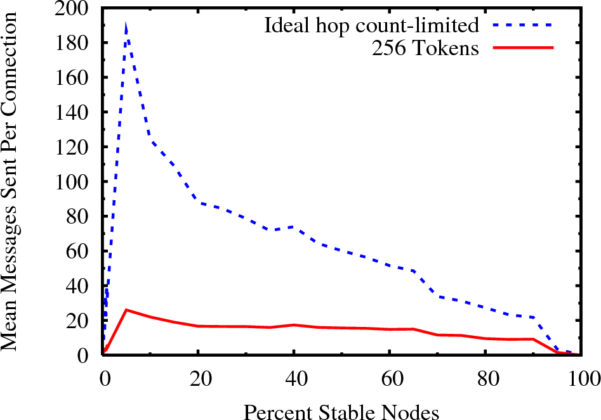
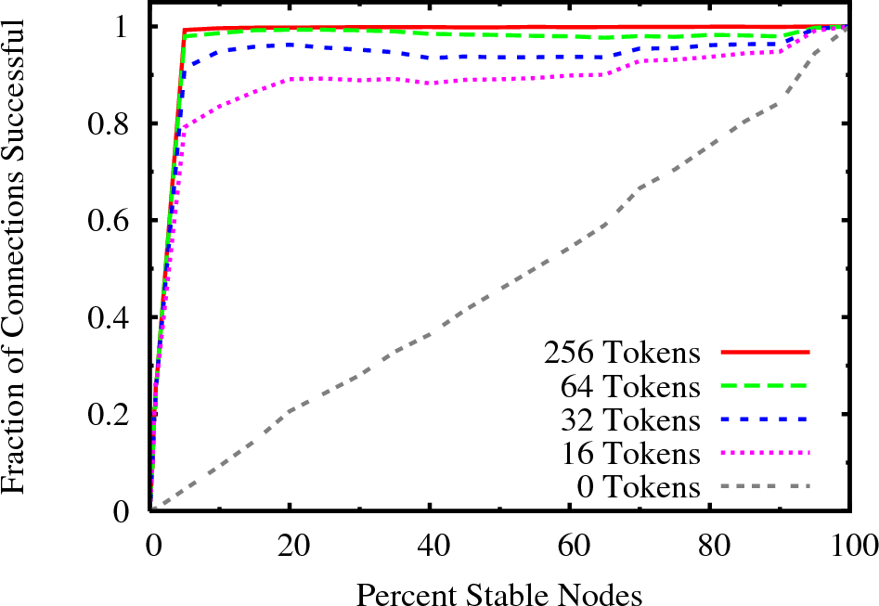
Evaluation

Slide 57
[Video]

Slide 58
Implementation Observations
Proof-of-concept prototype
  Works, many rough edges...
But demonstrates the architecture
  Logs not too big: ~40K in example
    Small name records, infrequent changes
  Router tables, overhead not too large
    Only track “social neighbors”, not whole world

Slide 59
Routing
(brief summary)

Slide 60
Routing to Personal Devices
Application
Application
Personal Name
(“laptop”)
UIA Naming
Endpoint
Identifier (EID)
UIA Routing
UIA Routing
UIA Routing
IP Address
Domain 1
IP Address
Domain 2

Slide 61
Routing Requirements
Challenges:
  Avoid management by users
  Handle mobility, network partitions
  Minimize overhead
Opportunities:
  Use global Internet when available
  Use social network

Slide 62
Opportunistic routing via social networks
Location query:
where is “ipod.bob”?
Gossip waypoint information
Simple, works when communication is between:
  User’s devices
  Immediate friends
“I'm here!”
“I'm here!”
“Persistent Personal Names for
Globally Connected Mobile Devices”,
OSDI 2006

Slide 63
Scalable compact routing
Provable stretch, small routing tables
[TZ 2001, etc.]
Extend TZ to:
  be a distributed protocol
  limit path congestion
  provide fault tolerance
Work in Progress

Slide 64
Transport
(brief summary)

Slide 65
Problem
TCP designed for serial operation
Modern interactive apps are parallel
SYN
HTML
HTML
Image
Image
Image
...
Image
HTML
Image
Image

Slide 66
Structured Stream Transport
Supports efficient,
short-lived streams
  Stream “fork”
  operation
  No handshake,
  quick shutdown
  Subsumes datagrams

Slide 67
Benefits of SST
Ex. HTTP over SST: more responsive
  No unnecessary request serialization
  Fork provides out-of-band communication
⇨Dynamically prioritize requests
(Demo)

Slide 68
Related Work
Dynamic DNS, Mobile IP, IPSEC VPNs
Decentralized security: SDSI/SPKI
Host identities: SFS, HIP, JXTA, i3
Naming/routing: DDNS, TRIAD, i3, CoDoNS
Optimistic replication: Ficus, Coda, Ivy
Mobile data: Rumor, P-Grid, Roma, Footloose
Social networking: Turtle, Sprout, F2F, Tribler

Slide 69
Conclusion
UIA delivers new network abstractions
for tomorrow's personal devices
  Personal Groups, Personal Names [OSDI '06]
  Structured Streams [SIGCOMM '07]
  ..and more...
http://pdos.csail.mit.edu/uia/

Slide 70
Acknowledgments
UIA Team
Jacob Strauss, Chris Lesniewski-Laas, Sean Rhea
Thesis Committee
Frans Kaashoek, Robert Morris, Hari Balakrishnan
Naming, Routing [OSDI '06]
Franklin Reynolds, MyNet Team – Nokia Research
Martín Abadi, Tom Rodeheffer – Microsoft Research
Transport [SIGCOMM '07]
Craig Partridge, Chip Elliott, Lars Eggert
NAT Traversal [USENIX '05]
Pyda Srisuresh, Dan Kegel, Henrik Nordstrom,
Christian Huitema, Justin Uberti, Mema Roussopoulos
Funding: NSF (Project IRIS, UIA), MIT/Quanta T-Party

