Slide 1
Structured Streams:
A New Transport Abstraction
Bryan Ford
Computer Science and Artificial Intelligence Laboratory
Massachusetts Institute of Technology
ACM SIGCOMM, August 30, 2007
  http://pdos.csail.mit.edu/uia/sst/

Slide 2
Current Transport Abstractions
Streams
  Extended lifetime
  In-order delivery
Examples:
  TCP
  SCTP
Datagrams
  Ephemeral lifetime
  Independent delivery
Examples:
  UDP
  RDP
  DCCP

Slide 3
Simplistic Overview
The Problem:
Streams don't quite match applications' needs
Datagrams make the application do everything
The Solution:
Structured Streams: like streams, only better

Slide 4
How Applications Use TCP
Natural approach: streams as transactions or
application data units (ADUs) [Clark/Tennenhouse]
Example: HTTP/1.0
Web
Client
TCP
Stream
Web
Server
GET
GET
GET
200 OK
<...>
200 OK
<...>
200 OK
<...>
GET
200 OK
<...>

Slide 5
TCP Streams as Transactions/ADUs
Advantages:
  Reliability, ordering within each ADU
  Independence, parallelism between ADUs
  ☞ Application-Layer Framing [Clark/Tennenhouse]
Disadvantages:
  Setup cost: 3-way handshake per stream
  Setup cost: slow start per stream
  Shutdown cost: 4-minute TIME-WAIT period
  Network cost: firewall/NAT state per stream
  Network cost: unfair congestion control behavior

Slide 6
How Applications Use TCP
Practical approach: streams as sessions
SSH
Client
TCP
Stream
SSH
Server
POP
Client
TCP
Stream
POP
Server
Web
Client
TCP
Stream
Web
Server
Cmd
LIST
GET
Echo
+OK
1 <...>
200 OK
<...>
CR
Echo
RETR
+OK
<...>
GET
200 OK
<...>
Cmd
Output
RETR
Cmd
+OK
<...>
Echo
GET
200 OK
<...>
CR
DELE
Echo
+OK

Slide 7
TCP Streams as Sessions
Advantages:
  Stream costs amortized across many ADUs
Disadvantages:
  TCP's reliability/ordering applies across many ADUs
    Unnecessary serialization: no parallelism between ADUs
    Head-of-line blocking: one loss delays everything behind
    ⇒ TCP unusable for real-time video/voice conferencing
    ⇒ HTTP/1.1 made web browsers slower! [Nielsen/W3C]
  Makes applications more complicated
    Pipelined HTTP/1.1 still not widely used after 7 years!

Slide 8
What about Datagrams?
“Do Everything Yourself”:
  Tag & associate related ADUs
  Fragment large ADUs (> ~8KB)
  Retransmit lost datagrams (except w/ RDP)
  Perform flow control
  Perform congestion control (except w/ DCCP)
⇒ complexity, fragility, duplication of effort...

Slide 9
Structured Stream Transport
“Don't give up on streams; fix 'em!”
Goals:
  Make streams cheap
    Let application use one stream per ADU, efficiently
  Make streams independent
    Preserve natural parallelism between ADUs
  Make streams easy to manage
    Don't have to bind, pass IP address & port number,
    separately authenticate each new stream

Slide 10
What is a Structured Stream?
Unix “fork” model
for stream creation
Given parent stream s between A and B
B listens on s
A creates child s' on s
B accepts s' on s

Slide 11
Talk Outline
Introduction to Structured Streams
SST Protocol Design
Prototype Implementation
Evaluation, Related Work
Conclusion

Slide 12
SST Protocol Design

Slide 13
SST Transport Services
Independent per stream:
  Data ordering
  Reliable delivery (optional)
  Flow control (receive window)
Shared among all streams:
  Congestion control
  Replay/hijacking protection
  Transport security (optional)

Slide 14
SST Organization
Application Protocol
Streams
Structured
Stream
Transport
(SST)
Stream Protocol
Channels
Channel Protocol
Negotiation Protocol
Sessions
Underlying Protocol (e.g., UDP, IP, link layer)

Slide 15
Streams, Channels, Packets

Slide 16
SST Packet Header
(Typical header overhead: 16 bytes + MAC)

Slide 17
Channel Protocol Design
Sequencing
Acknowledgment
Congestion Control
Security (see paper)

Slide 18
Channel Protocol: Sequencing
Every transmission gets new packet sequence #
  Including acks, retransmissions [DCCP]
Transmissions
(retransmit #2)
1
2
3
4
6
5
7
8
9
1
3
6
4
5
8
9
Arrivals

Slide 19
Channel Protocol: Acknowledgment
All acknowledgments are selective [DCCP]
  No cumulative ack point as in TCP, SCTP

Slide 20
Channel Protocol: Acknowledgment
All acknowledgments are selective [DCCP]
Each packet acknowledges a sequence range

Slide 21
Channel Protocol: Acknowledgment
All acknowledgments are selective [DCCP]
Each packet acknowledges a sequence range
  Successive ACKs usually overlap
    ⇒ redundancy against lost ACKs
  No variable-length SACK headers needed
    ⇒ all info in fixed header

Slide 22
Channel Protocol: Acknowledgment
All acknowledgments are selective [DCCP]
Each packet acknowledges a sequence range
Congestion control at channel granularity
  Many streams share congestion state

Slide 23
Stream Protocol Design
Stream Creation
Data Transfer
Best-effort Datagrams
Stream Shutdown/Reset (see paper)
Stream Migration (see paper)

Slide 24
Stream Protocol: Creating Streams
Goal:
  Create & start sending data on new stream
  without round-trip handshake delay
Challenges:
  What happens to subsequent data segments
  if initial “create-stream” packet is lost?
  Flow control: may send how much data before
  seeing receiver's initial window update?

Slide 25
Stream Protocol: Creating Streams
Solution:
  All segments during 1st round-trip carry “create” info
    (special segment type, parent & child stream IDs)
  Child borrows from parent stream's receive window
    (“create” packets belong to parent stream for flow control)
31
24
23
16
15
8
7
0
Local Stream Identifier (LSID)
Type
—
P
C
—
Window
Parent Stream Identifier (PSID)
Byte Sequence Number (BSN)
Application Payload

Slide 26
Stream Protocol: Data Transfer
Regular data transfer (after 1st round-trip):
  32-bit wraparound byte sequence numbers (BSNs)
    (just like TCP)
  Unlimited stream lifetime
    (just like TCP)
31
24
23
16
15
8
7
0
Local Stream Identifier (LSID)
Type
—
P
C
—
Window
Byte Sequence Number (BSN)
Application Payload

Slide 27
Stream Protocol:
Best-effort Datagrams
“Datagrams” are ephemeral streams
  Semantically equivalent to:
    Create child stream
    Send data on child stream
    Close child stream
  ...but without buffering data for retransmission
    (like setting a short SO_LINGER timeout)

Slide 28
Stream Protocol:
Best-effort Datagrams
When datagram is small:
  Stateless best-effort delivery optimization
    (avoids need to assign stream identifier to child)
31
24
23
16
15
8
7
0
Parent Stream Identifier (PSID)
Type
—
F
L
—
Window
Application Payload
Flags:
F First Fragment
L Last Fragment

Slide 29
Stream Protocol:
Best-effort Datagrams
When datagram is small:
  Stateless best-effort delivery optimization
When datagram is large:
  Fall back to delivery using regular child stream
Makes no difference to application;
datagrams of any size “just work”!

Slide 30
Implementation
&
Evaluation

Slide 31
Current Prototype
User-space library in C++
Application-linkable ⇒ simple deployment
Runs atop UDP ⇒ NAT/firewall compatibility
~13,000 lines; ~4,400 semicolons
  (including crypto security & key agreement)
Available at:
http://pdos.csail.mit.edu/uia/sst/

Slide 32
Performance
Transfer performance vs native kernel TCP
  Minimal slowdown at DSL, WiFi LAN speeds
TCP-friendliness
  Congestion control fair to TCP within ± 2%
Transaction microbenchmark: SST vs TCP, UDP
Web browsing workloads
  Performance: HTTP on SST vs TCP
  Responsiveness: request prioritization

Slide 33
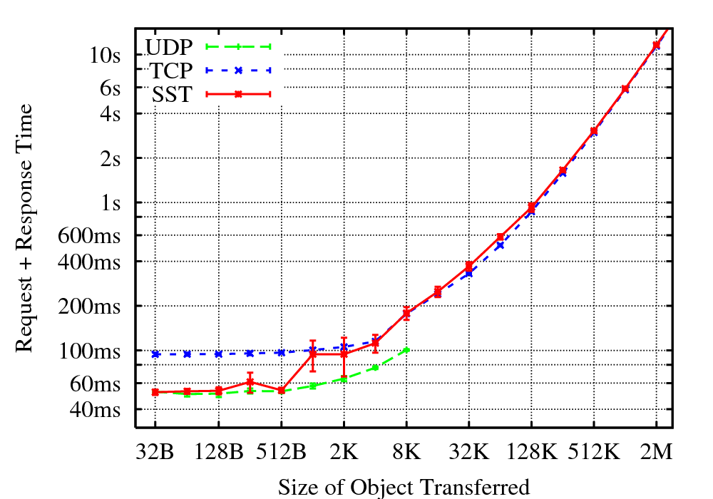
Transaction Microbenchmark

Slide 34
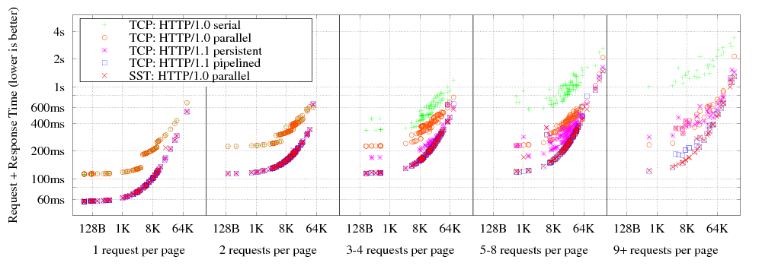
Web Browsing Workloads
Performance of transactional HTTP/1.0 on SST:
    Much faster than HTTP/1.0 on TCP
    Faster than persistent HTTP/1.1 on TCP [most browsers]
    As fast as pipelined HTTP/1.1 on TCP [Opera browser]

Slide 35
Web Browsing Workloads
HTTP/1.0 over SST can be more responsive
  No unnecessary request serialization
  Simple out-of-band communication via substreams
⇨Easy to dynamically prioritize requests
(Demo)

Slide 36
Related Work
Application-Layer Framing [Clark/Tennenhouse]
Transports: TCP, RDP, VMTP, SCTP, DCCP
Multiplexers: SSL, SSH, MUX, BXXP/BEEP
T/TCP: TCP for Transactions [Braden]
TCP congestion state sharing [Touch],
Congestion Manager [Balakrishnan]
Transport-layer migration support [Snoeren]
Network-layer prioritization for QoS [...many...]

Slide 37
Conclusion
SST enables applications to use streams as:
  Sessions (as in legacy TCP apps), or
  ADUs/Transactions (as in HTTP/1.0), or
  Datagrams (as in VoIP, RPC over UDP)
...without:
  TCP's per-stream costs, unnecessary serialization
  UDP's datagram size limits
http://pdos.csail.mit.edu/uia/sst/

Slide 38
“Can't HTTP/1.1 over TCP do this?”
Answer: “Sort of, if you work really hard.”
  Enable HTTP/1.1 pipelining
    Most browsers still don't because servers get it wrong!
  Fragment large downloads via Range requests
    Pummel server with many small HTTP requests
    Risk atomicity issues with dynamic content
  Track round-trip time, bandwidth in application
    Try to keep pipeline full without adding extra delay
But:
  Still get head-of-line blocking on TCP segment loss!

Slide 39
Comparing SST to SCTP
SCTP:
No dynamic stream creation/destruction
No per-stream flow control (just per session)
Best-effort datagrams limited in size
SST:
No multihoming/failover (yet)
  ...but channel/stream split should facilitate

Slide 40
Comparing SST to DCCP
DCCP:
No reliability, ordering, flow control
No association between packets
No cryptographic security
SST:
No congestion control negotiation (yet)

Slide 41
Channel Protocol: Security
Design based on IPsec
Cryptographic security mode:
  Encrypt-then-MAC + replay protection [IPsec]
TCP-grade security mode:
  No encryption
  MAC = 32-bit checksum + 32-bit “key”
    depends on system time [Tomlinson], secret data [Bellovin]
    stronger protection than TCP: “validity window” size = 1

