Slide 1
Persistent Personal Names for
Globally Connected Mobile Devices
  Bryan Ford, Jacob Strauss, Chris Lesniewski-Laas,
  Sean Rhea, Frans Kaashoek, Robert Morris
  Massachusetts Institute of Technology
  http://pdos.csail.mit.edu/uia

Slide 2



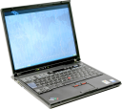

Connectivity Scenario: Stage 1
Local Area Network
Alice's PDA
Bob's Laptop
Bob & Alice meet, connect [Bonjour] –
using local names (e.g., “Alice-PDA”)

Slide 3


Connectivity Scenario: Stage 2
Internet
Alice's PDA
Bob's Laptop
Wish to re-connect remotely –
need different, global names & more setup
(e.g., “pda.alice1234.herisp.com”)

Slide 4

Connectivity Scenario: Stage 3
Disconnected
Local Area Network
Alice's PDA
Bob's Laptop
Meet again off-Internet – global names stop working!
Require different, local names (again)

Slide 5

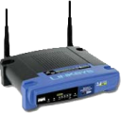


UIA: Unmanaged Internet Architecture
Global Connectivity via Personal Names
  Like nicknames in cell phone address book
“Camera”
Internet
“Laptop”
“Home-PC”
“Work-PC”

Slide 6
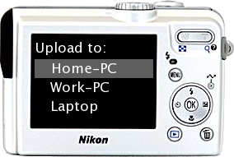
UIA: Unmanaged Internet Architecture
Global Connectivity via Personal Names
  Persistent: usable for local or remote access
“Camera”
Internet
“Laptop”
“Home-PC”
“Work-PC”

Slide 7

UIA: Unmanaged Internet Architecture
Global Connectivity via Personal Names
  Persistent: usable for local or remote access
“Camera”
Internet
“Laptop”
“Home-PC”
“Work-PC”

Slide 8
Challenges
Intuitive setup
  As easy as plugging local devices together
Secure self-managing operation
  Don't make users understand key management
Namespace synchronization
  Changes on one device propagate to others
Partitioned Operation
  Remains available under limited connectivity
Namespace access control and revocation
  Handling lost or stolen devices

Slide 9
Contributions/Outline
Usability Concepts:
Local Introduction, Remote Access
Merging Devices to form Personal Groups
Linking Groups via Personal User Names
Design Concepts:
Secure device identities
Optimistic state replication via change logs
Overlay routing protocol leveraging social links

Slide 10
Usability Concept 1
Local Introduction,
Remote Access

Slide 11

Local Introduction, Remote Access
Bob buys WiFi-enabled digital camera,
“introduces” it to desktop PC at home

Slide 12
Local Introduction, Remote Access
Bob buys WiFi-enabled digital camera,
“introduces” it to desktop PC at home
Bob takes camera on trip, stops at cyber-cafe,
uploads pics to home PC for storage & sharing
Internet

Slide 13
Local Introduction, Remote Access
Bob buys WiFi-enabled digital camera,
“introduces” it to desktop PC at home
Bob takes camera on trip, stops at cyber-cafe,
uploads pics to home PC for storage & sharing
Use
Device Mobility
to solve
Name Bootstrap Problem
Internet

Slide 14
Design Requirements for
Local Introduction, Remote Access
Devices need:
Stable identities
Secure introduction procedure
Way to route to current location

Slide 15
Endpoint Identifiers
Each device has an endpoint identifier (EID)
  Formed from hash of device's public key [SFS]
  Self-configured, stable, location-independent [HIP]
Camera
Laptop
Public Key: 56b19c28f35...
Public Key: 8b934a68cd5f...
Secure
Hash
Secure
Hash
EID: 123
EID: 456

Slide 16
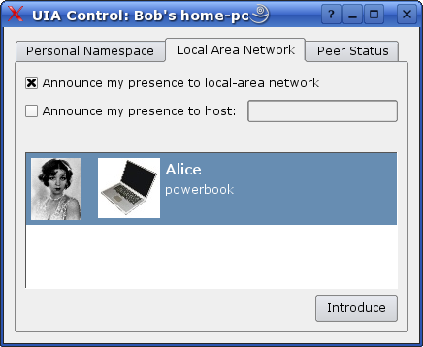
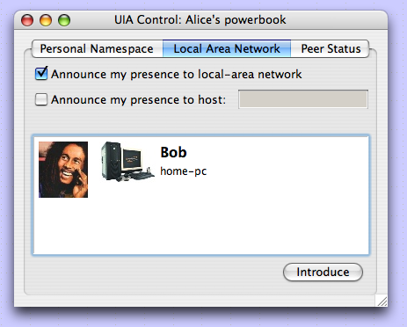
Device Introduction
Common case: meet in person on common LAN
  Browse network to find other device [Bonjour]
  Avoid man-in-the-middle attacks [Dohrmann/Ellison]
    (screen shots from working UIA prototype)

Slide 17
Implementing Device Introduction
Devices exchange EIDs on introduction
  Use for finding + securely connecting in future
Camera
Laptop
EID: 123
EID: 456
“Laptop”
→ EID 456
“Camera”
→ EID 123

Slide 18
Routing to Devices
Application
Application
Personal Name
(“laptop”)
UIA Naming
Endpoint
Identifier (EID)
UIA Routing
UIA Routing
UIA Routing
IP Address
Domain 1
IP Address
Domain 2

Slide 19
Routing to Devices
Overlay routing protocol [RON, i3, ...]
Devices track peers in social neighborhood
  Localized: works under partitioned operation
Find mobile targets via limited flooding [Gnutella]
(more details in paper...)

Slide 20
Usability Concept 2
Merging Devices
into
Personal Groups

Slide 21
Device Names and Personal Groups
Each device has a user-controlled personal name
User merges devices to form personal groups
Internet
“Camera”
“Laptop”
Bob's Personal Group
“Laptop”
“Camera”
“Home-PC”
“Work-PC”
“Home-PC”
“Work-PC”

Slide 22

Personal Device Names
Short, convenient
  Like nicknames in cell phone address book
  Each device ships with manufacturer default name
“Camera”
“Laptop”
“Tablet”
“Player”

Slide 23
Personal Device Names
Short, convenient
  Like nicknames in cell phone address book
  Each device ships with manufacturer default name
“Coolpix”
“Thinkpad”
“Nokia770”
“iPod”

Slide 24
Personal Device Names
Short, convenient
  Like nicknames in cell phone address book
  Each device ships with manufacturer default name
  Binds human-readable string to device EID
“Coolpix”
→ EID 123
“Thinkpad”
→ EID 456
“Nokia770”
→ EID 234
“iPod”
→ EID 345

Slide 25
Personal Device Names
Short, convenient
  Like nicknames in cell phone address book
  Each device ships with manufacturer default name
  Binds human-readable string to device EID
  User can change as desired
“Coolpix”
→ EID 123
“Thinkpad”
→ EID 456
“Nokia770”
→ EID 234
“iPod”
→ EID 345

Slide 26
Personal Device Names
Short, convenient
  Like nicknames in cell phone address book
  Each device ships with manufacturer default name
  Binds human-readable string to device EID
  User can change as desired
“BobPix”
→ EID 123
“Blinkpad”
→ EID 456
“Tabloid”
→ EID 234
“MyPod”
→ EID 345

Slide 27
Merging Devices into Groups
Uses Device Introduction Procedure
Personal Group
“BobPix” → EID 123
“Tabloid” → EID 234
Personal Group
“BobPix” → EID 123
“Tabloid” → EID 234
“MyPod” → EID 345
“Blinkpad” → EID 456
Personal Group
“MyPod” → EID 345
“Blinkpad” → EID 456
“BobPix”
→ EID 123
“Blinkpad”
→ EID 456
“Tabloid”
→ EID 234
“MyPod”
→ EID 345

Slide 28
Design Requirements for
Personal Groups
Names Always Accessible from Any Device
Support Partitioned Operation
Consistency Management
Revocation, Lost/Stolen Devices (see paper)

Slide 29
Implementing Names and Groups
Device keeps a series
of change records
Start with default name
Camera: EID 123
Series 123
“Coolpix” → EID 123
Laptop: EID 456
Series 456
“Thinkpad” → EID 456

Slide 30
Implementing Names and Groups
Device keeps a series
of change records
Start with default name
To rename: cancel old,
write new name record
Camera: EID 123
Series 123
cancel
“BobPix” → EID 123
Laptop: EID 456
Series 456
“Thinkpad” → EID 456

Slide 31
Implementing Names and Groups
Device keeps a series
of change records
Start with default name
To rename: cancel old,
write new name record
To merge:
  Write merge records
Camera: EID 123
Series 123
Merge with Series 456
Laptop: EID 456
Series 456
Merge with Series 123

Slide 32
Implementing Names and Groups
Device keeps a series
of change records
Start with default name
To rename: cancel old,
write new name record
To merge:
  Write merge records
  Gossip series contents
Camera: EID 123
Series 123
Series 456 copy
“BobPix” → EID 123
“Thinkpad” → EID 456
Laptop: EID 456
Series 456
Series 123 copy
“BobPix” → EID 123
“Thinkpad” → EID 456

Slide 33
Handling Name Conflicts
What if user merges two devices w/ same name?
⇒ merge succeeds, but creates name conflict
  (can't use name)
Resolve by renaming
  (on either device)
Bob's Group
“Thinkpad”
“Coolpix”
“Coolpix”

Slide 34
Handling Name Conflicts
What if user merges two devices w/ same name?
⇒ merge succeeds, but creates name conflict
  (can't use name)
Resolve by renaming
  (on either device)
Bob's Group
“Thinkpad”
“Otherpix”
“Coolpix”

Slide 35
Implementing Conflict Resolution
When user merges two devices w/ same name:
Camera: EID 123
Series 123
“Coolpix” → EID 123
Camera: EID 456
Series 456
“Coolpix” → EID 456

Slide 36
Implementing Conflict Resolution
When user merges two devices w/ same name:
Bindings of same name
to different target EIDs
⇒ conflict
Camera: EID 123
Series 123
Series 456 copy
“Coolpix” → EID 123
“Coolpix” → EID 456
Camera: EID 456
Series 456
Series 123 copy
“Coolpix” → EID 456
“Coolpix” → EID 123

Slide 37
Implementing Conflict Resolution
When user merges two devices w/ same name:
Bindings of same name
to different target EIDs
⇒ conflict
On rename, write:
  Cancel for old name
  New name
Camera: EID 123
Series 123
Series 456 copy
“Otherpix” → EID 123
“Coolpix” → EID 456
Camera: EID 456
Series 456
Series 123 copy
“Otherpix” → EID 123
“Coolpix” → EID 456

Slide 38
Usability Concept 3
Linking Groups
via
Personal User Names

Slide 39



Personal User Names
Assign short personal names to friends
for easy communication and sharing
Alice's Group
“iPod”
“PowerBook”
“Bob”
Bob's Group
Laptop”
“Camera”
“Home-PC”
“Work-PC”
“Alice”
“Charlie”
Charlie's Group
“PC”
“Phone”
“Bob”

Slide 40
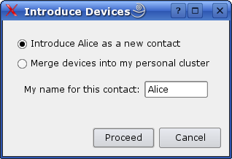
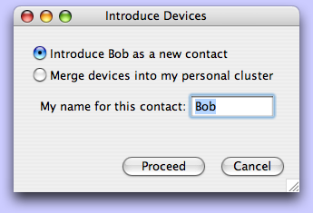
Introducing Users
Meet, find other user's device in LAN browser
Click “Introduce as New Contact”
Enter personal name for user

Slide 41
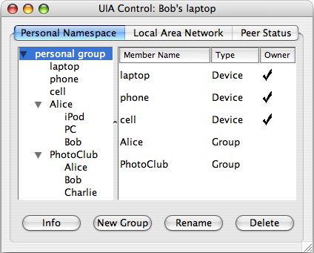
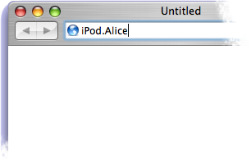
User-Relative Naming
Browse tree to find desired device
Enter user-relative domain name

Slide 42
Implementing User Names
On introduction:
  Exchange EIDs
  Write User records:
  name → series
  Gossip series contents
Groups remain separate,
only linked via names
Implicit notion of “user”
 no per-user keys
Bob's Laptop: EID 456
Series 456
“Alice” → Series 789
Series 789 copy
Alice's Laptop: EID 789
Series 789
“Bob” → Series 456
Series 456 copy

Slide 43
Gossip Among Multiple Devices
Devices gossip whenever possible with
  Other devices in personal group
  Devices in friends' groups
Alice's Group
Bob's Group
Charlie's Group

Slide 44
Name Resolution
Resolution starts in device's own group
Resolve components right-to-left
Use gossiped records – no communication
“Phone.Charlie.Bob”
Bob's Group
Laptop”
“Camera”
“Home-PC”
“Work-PC”
“Alice”
“Charlie”
➌
➋
➊
Alice's Group
“iPod”
“PowerBook”
“Bob”
Charlie's Group
“PC”
“Phone”
“Bob”
➊
➋
➌

Slide 45
Other Design Elements
See paper on:
Device introduction security
Groups shared between users (“PhotoClub”)
Group ownership
Revocation – lost/stolen devices
Access control using personal names
Routing efficiency

Slide 46
Implementation Status
Runs on Linux, Mac OS X, Nokia 770 Tablet
UIA Control/
Group Browser
UIA-Aware
Application
Legacy
Application
UIA Client
API Library
UIA Client
API Library
Sockets
API
DNS
Resolver
RPC
UIA Name
Daemon
DNS
Proxy
UIA
Router
tun
Wrapper
Operating System Kernel
TCP/IP Protocol Stack
Network Drivers
tun Driver

Slide 47
Legacy Application Support
Disguises
  UIA names as DNS names
  EIDs as IP addrs
SSH, HTTP to NATted devices via UIA names
  Transparent connection migration, etc.
Creates virtual LAN of personal devices
  LAN local discovery apps work remotely via UIA
  (e.g., Apple File Sharing using Bonjour)

Slide 48
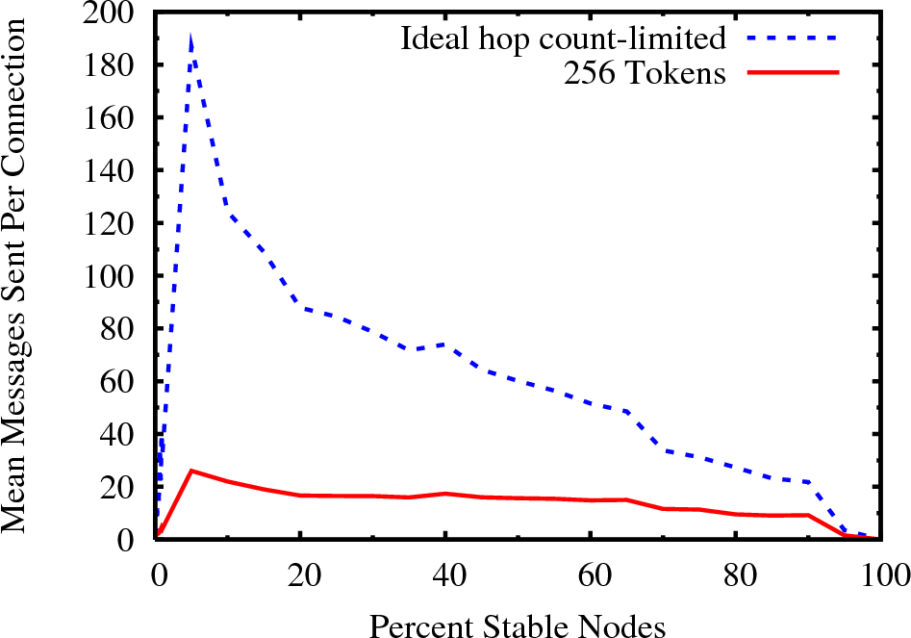
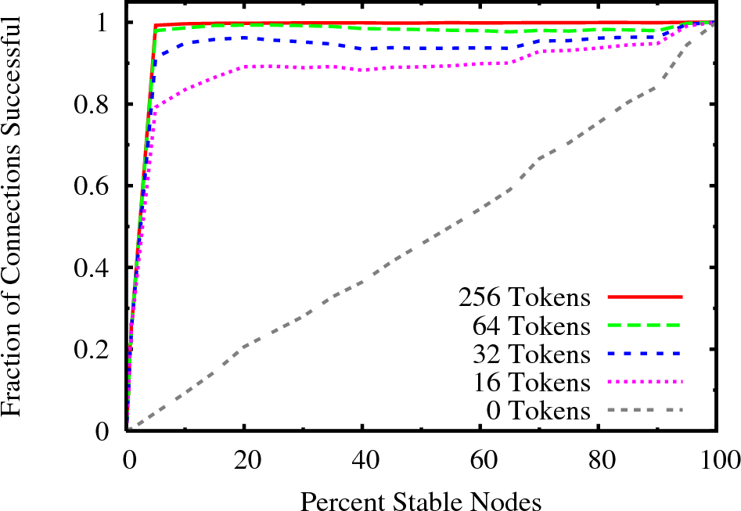
Evaluation

Slide 49
Demo Video

Slide 50
Implementation Observations
Proof-of-concept prototype
  Many rough edges...
But demonstrates the architecture
  Logs not too big: ~40K in example
    Small name records, infrequent changes
  Router tables, overhead not too large
    Only track “social neighbors”, not whole world

Slide 51
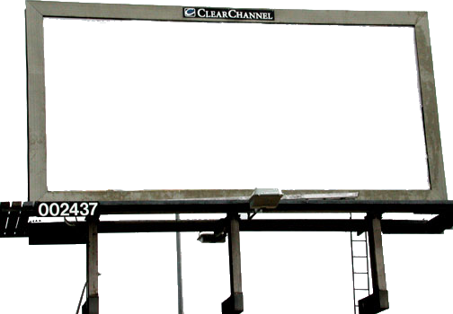
Discussion: Global vs Local Names
Global names:
  Perfect when global usability is the whole point
  Rare, expensive, cumbersome in personal context
Persistent personal names:
  Short, convenient, unrestricted assignment
  Work anywhere, any time, on all user's devices
amazon.com
bob.com?

Slide 52
Future Work
More flexible group management
Better Access Control
  “Allow Bob's devices to print”
  Hide Alice from Carol
Scalability issues
  How far, how long to gossip name state
  How widely router should monitor peers
Wider deployment

Slide 53
Related Work
Dynamic DNS, Mobile IP, IPSEC VPNs
Decentralized security: SDSI/SPKI
Host identities: SFS, HIP, JXTA, i3
Naming/routing: DDNS, TRIAD, i3, CoDoNS
Optimistic replication: Ficus, Coda, Ivy
Mobile data: Rumor, P-Grid, Roma, Footloose
Social networking: Turtle, Sprout, F2F, Tribler

Slide 54
Summary
UIA simplifies global device connectivity
through persistent personal names
Based on three key usability concepts:
  Local Introduction, Remote Access
  Merging Devices to form Personal Groups
  Linking Groups via Personal User Names
http://pdos.csail.mit.edu/uia/

Slide 55
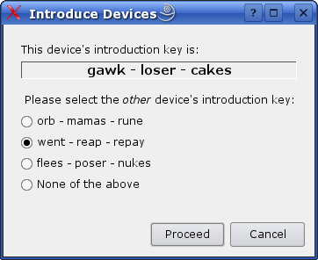
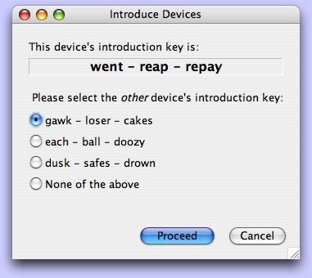
Device Introduction Security
Users exchange random words out-of-band
  Short: need only resist online attacks
  Multiple-choice: ensures user participation

Slide 56
Routing via Opportunistic Rendezvous
Bob’s
Laptop
Charlie's PC
Alice’s
Laptop
NAT
NAT
I’m here
I’m here
Laptops have moved, both now behind different NATs
  Each reconnect to previous neighbors (if available)
Routing layer must re-connect devices
  Leverages stable hosts as rendezvous points (desktop)
  Use desktop to forward packets or punch holes in NATs
  Unlike Mobile IP or VPNs, no need to configure a home agent

Slide 57
Shared Groups
Users can organize names in shared groups
  Ex: Bob creates “PhotoClub” group,
  adds Alice & friends interested in photo sharing
  Alice copies Bob's “PhotoClub” link into her group
Bob's Group
Laptop”
“Camera”
“Home-PC”
“Work-PC”
“Alice”
“PhotoClub”
Alice's Group
“iPod”
“PowerBook”
“Bob”
“PhotoClub”
PhotoClub Group
“Bob”
“Alice”
“Charlie”
...

Slide 58
Simulation Studies
Key questions:
  Can UIA's algorithms provide reliable connectivity on larger, realistic (social) networks?
  How much overlay overhead does it impose
  to provide this service?

Slide 59
Simulation Methodology
Uses partial crawl of Orkut tree [LiXXX]
  2363 users in social network
  Highly skewed friendship degree:
  median 7, maximum over 1000.
  Assume one device per person (pessimistic)
Simulate construction of UIA routing overlay,
then simulate searches for particular nodes
  Primarily interested in searches for “friends”
  Secondarily in 2nd or 3rd degree neighbors

Slide 60
Search Success Rate

Slide 61
Search Overhead

