Slide 1

Internet Performance Transparency
Georgia Fragkouli
Private Thesis Defense
24/06/2022

Slide 2
Internet’s goal: enable end-systems to communicate
w/ good performance
end-users
end-users
Netflix servers
N1
N2
Bitcoin node
Bitcoin node
Users need to trace performance attacks
Networks need to prove competitive performance
Regulators need to verify SLAs and neutrality rules
[Apostolaki et al. 2017]
Users & regulators need to localize performance issues to networks
2

Slide 3



Why is localizing performance issues hard?
Networks
Users
Generate performance
measurements
Unreliable access to measurements
Exaggerate network
performance
Reliably assess
network performance
Bridge gap to enable network performance transparency
3

Slide 4
Transparency goals
Accuracy
Usefulness of
performance conclusions
Anonymity
Efficiency
Hiding users’ communication patterns
Bandwidth for publishing
reports
No existing design with good balance
4

Slide 5
Existing designs rely on fine-grained reporting
Networks report on individual packets
Networks sample packet reports
Networks accurately report fate of individual packets
Requires incentives for honestly reporting fate of individual packets
Reveals users’ communication patterns
Inaccuracy because of unrealistic incentives & lower anonymity
5

Slide 6
Thesis
Accurate and efficient Internet performance transparency is possible
by adapting the incentive structure to the underlying honesty incentives and combining incentives with mathematical tools;
adapting the report granularity eases the transparency-anonymity tussle.
6

Slide 7
Outline
Accurate & efficient Internet performance transparency
Split-responsibility for verifiable, user-based average metrics
Policy-based grouping of traffic for verifiable jitter
Reconcile transparency with anonymity
Time granularity as noise
Adaptive reports for anonymity
7

Slide 8
Transparency protocols
Data plane: sampling packets
+ consistent => same samples
+ secure => representative samples
Control plane: per-network performance estimation
loss rates & delay averages
jitter & neutrality
N1
N2
arbitrarily inaccurate
monitor
N1’s loss rate
arbitrarily inaccurate
N1’s average delay
N1’s jitter
Need: accurate network statistics despite inaccurate packet reports
8

Slide 9


Packet delay
100ms
N1
N2
t’ = t - 40ms
0ms
60ms
externalizability
40ms
20ms
40ms
someone has to
take responsibility
for orphan delay
Externalizability not enough for accuracy
9

Slide 10
Creating incentives for honesty through conflict
100ms
N1
N2
t’ = t - 40ms
30ms
70ms
split-responsibility
50ms
50ms
lying about pkt delay
=> blaming neighbor
=> conflict
Networks have an incentive to honestly report packet delay
10

Slide 11
The impact of lying about individual packets
lying about packet delay
split-responsibility
blaming neighbor
requires that individual packet delay impacts user experience
conflict
11

Slide 12
The impact of lying about individual packets
lying about packet delay
split-responsibility
blaming neighbor
no conflict
conflict
requires that individual packet delay impacts user experience
e.g., “no real need to recover all missing [video] packets”
[Feamster and Balakrishnan 2002]
Lying does not always lead to conflict => inaccurate packet delays
11

Slide 13
Accurate metrics from inaccurate packet delays
lying about traffic aggregates = user-defined sets of packets
lying about <traffic unit>
split-responsibility aggregate delay averages
blaming neighbor
by definition, traffic aggregates impact user experience
conflict
Accurate delay averages by adapting to user interests
12

Slide 14
Jitter
Conflicts on jitter?
BUT jitter not externalizable:
jitter(X + Y) = jitter(X) + jitter(Y)
jitter(X + Y)
+ 2cov(X,Y)
N1
N2
packet delay X
packet delay Y
jitter(X)
jitter(Y)
Jitter not externalizable => conflicts not enough
13

Slide 15
Accuracy for jitter: a unifying perspective
Similarly treated traffic subject to math constraints
Jitter reliably extracted from delay averages & math constraints
14

Slide 16
Neutrality
Pkt delay
x
x
x
x
Defining neutrality
exposing packets to same network conditions
same packet delay distribution
Measuring neutrality
“draw” distributions & check if similar
BUT cannot directly see distributions
x
x
x
x
x
x
x
x
x
Time
x
x
x
Aggregate delay average
Gap between metric of interest and incentivizable info
15

Slide 17
Neutrality imposes constraints
Pkt delay
x
x
x
x
CLT ties together aggregate delay averages
each average follows same normal distribution
take many averages to draw normal distribution
x
x
x
x
x
x
x
x
x
Time
x
PDF
x
x
x
normal
x
x
x
x
x
x
x
Aggregate delay average
Reliably extract neutrality via normality check over delay averages
16

Slide 18
Impose neutrality on networks?
Pkt delay
x
x
x
x
No universal but per traffic class neutrality
traffic class = subset of packets treated the same
networks free to declare traffic classes
monitor checks normality within each class
Dishonest class declaration?
networks risk failing normality checks
incentive for honest class declaration
x
x
x
x
x
x
x
x
x
x
Time
PDF
normal
normal
x
x
x
x
x
x
not normal
x
x
x
x
x
x
x
x
x
x
x
x
x
x
Aggregate delay average
No universal neutrality but transparent class declaration
17

Slide 19
Jitter
σ = ?
Pkt delay
σ = ?
Estimate jitter one-class-at-a-time
allows using CLT
jitter = known function of known quantities
x
x
x
x
x
x
x
x
x
x
x
x
aggregate
of size n
Time
x
PDF
normal
σ =
σ'
x
√n
x
x
x
x
x
x
x
x
x
x
Aggregate delay average
Reliably extracted from delay averages
18

Slide 20
Recap
Accurate averages via split-responsibility & alignment with user interests
Class verification via normality check on accurate averages
Accurate jitter via per-class verification
19

Slide 21
Experimental setup & methodology
Input traffic: 21 one-hour CAIDA traces
Under different network conditions
5% sampling => <1% bandwidth overhead
Non-overlapping, equi-length epochs
Aggregation: /24 src-dst prefix pairs
Metrics: per-epoch delay averages, neutrality & jitter
20

Slide 22
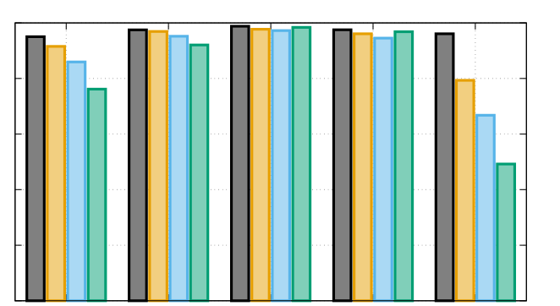
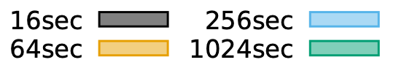
Neutrality verification accuracy
Epoch length
100
16s
64s
80
256s
60
1024s
Accuracy (%)
40
20
0
0.7
0.9
1.0
1.1
1.4
Congestion factor
>78% accuracy across diverse scenarios
21

Slide 23
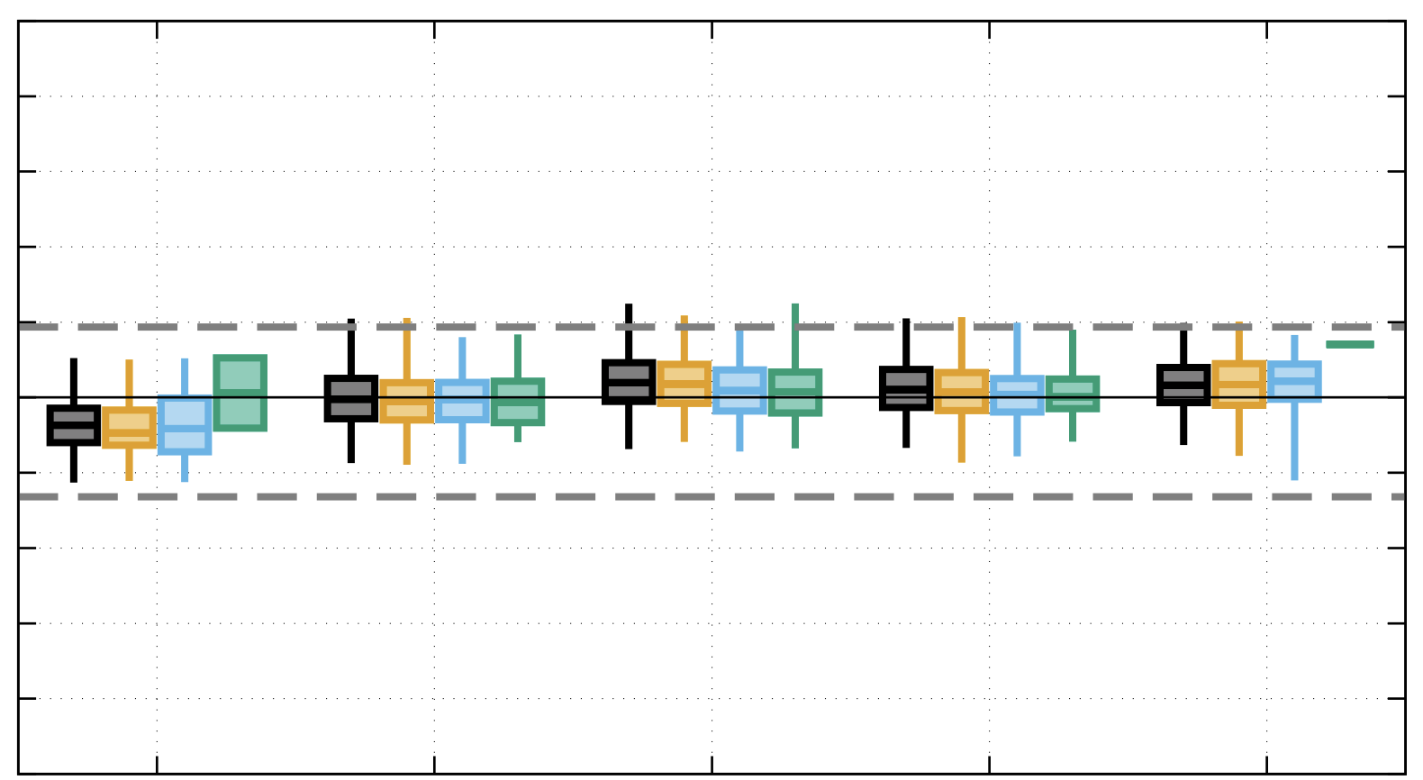
Jitter estimation accuracy
100
Epoch length
80
16s
60
64s
40
256s
20
1024s
Error (%)
0
-20
-40
-60
-80
-100
0.7
0.9
1.0
1.1
1.4
Congestion factor
75th percentile <10% & 99th percentile <25%
22

Slide 24
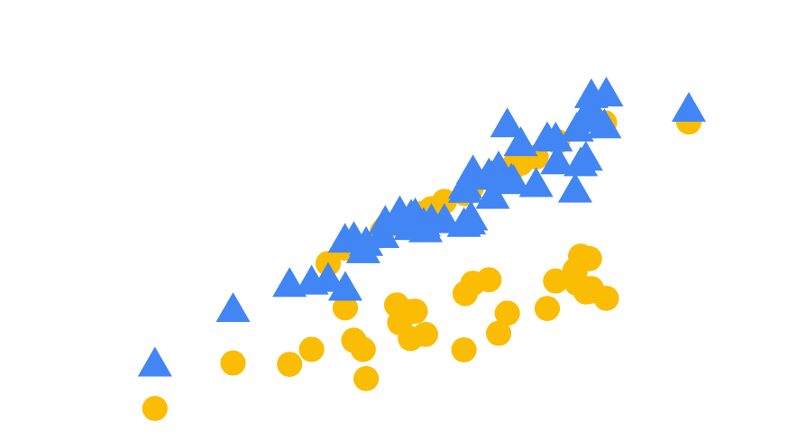
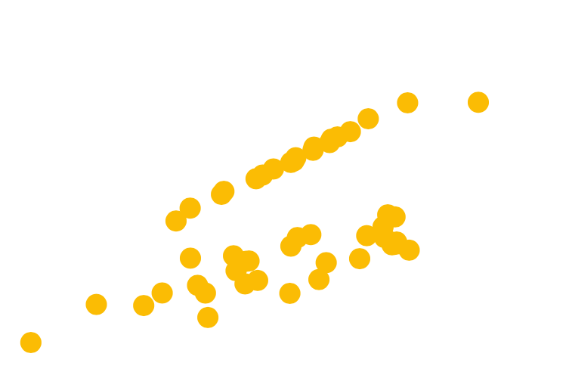
Accuracy gains under dishonesty
N1
N2
ideal
max absolute
relative est error
unaffected
delay averages
125
baseline
our approach
<19%
100
our approach: 3x better
75
Exaggerated estimate (ms)
<65%
50
25
0
0
25
50
75
100
125
True estimate (ms)
3x better accuracy by relying on incentivizable information
23

Slide 25


Transparency
SLAs & neutrality
Anonymity
Tor-like overlays
24

Slide 26
Outline
Accurate & efficient Internet performance transparency
Split-responsibility for verifiable, user-based average metrics
Policy-based grouping of traffic for verifiable jitter
Reconcile transparency with anonymity
Time granularity as noise
Adaptive reports for anonymity
25

Slide 27
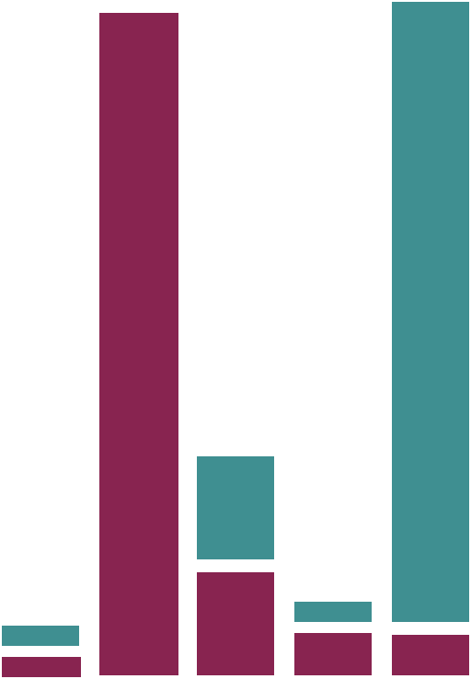

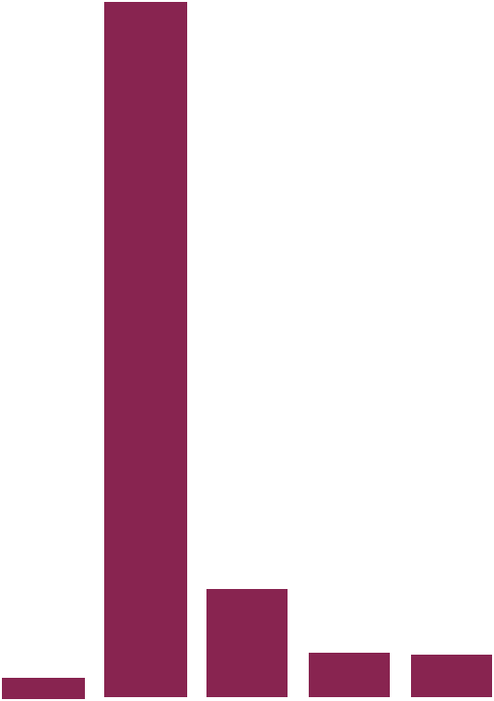
Transparency weakens Tor anonymity
aggregate =
pkt cnt series
of multiple flows
flow =
pkt cnt series
Such global adversaries are rare
N1
N2
alice
bob
monitor
alice talks
to bob!
eve @ left
eve @ right
eve @ everywhere
Transparency introduces global adversary
26

Slide 28
Quantifying anonymity
aggregate
X
correct
aggregate
flow
Anonymity
internet
X
Anonymity
N1
N2
alice
bob
X
flow in
which
aggregate?
Anonymity
eve
T-anonymity set size captures deviation from ground truth
27

Slide 29
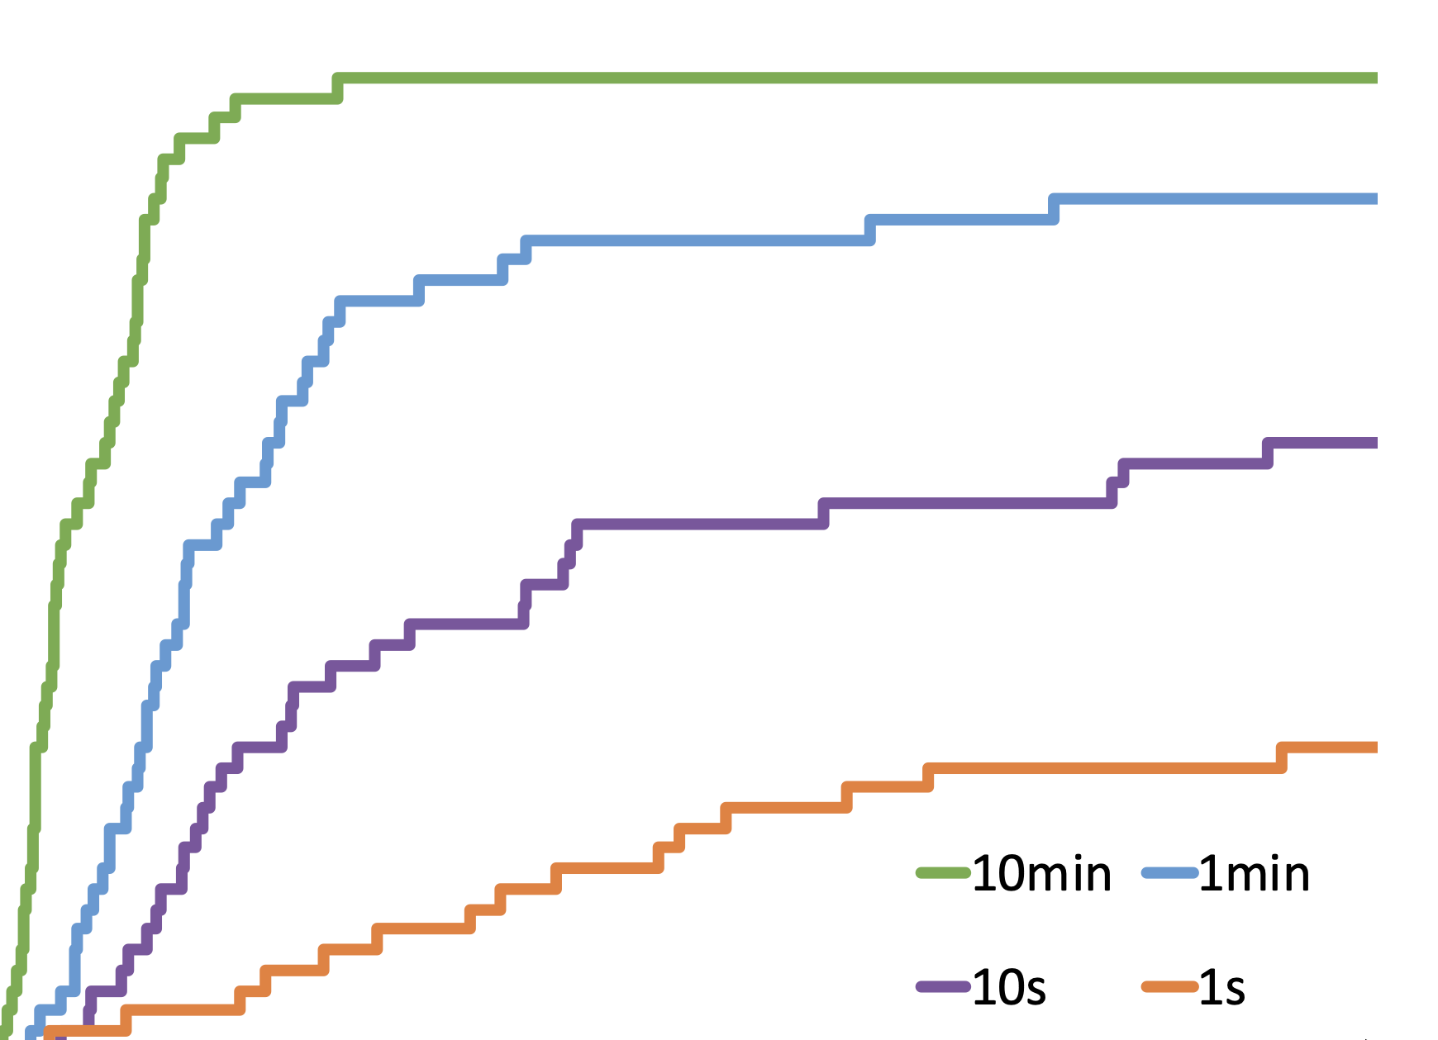
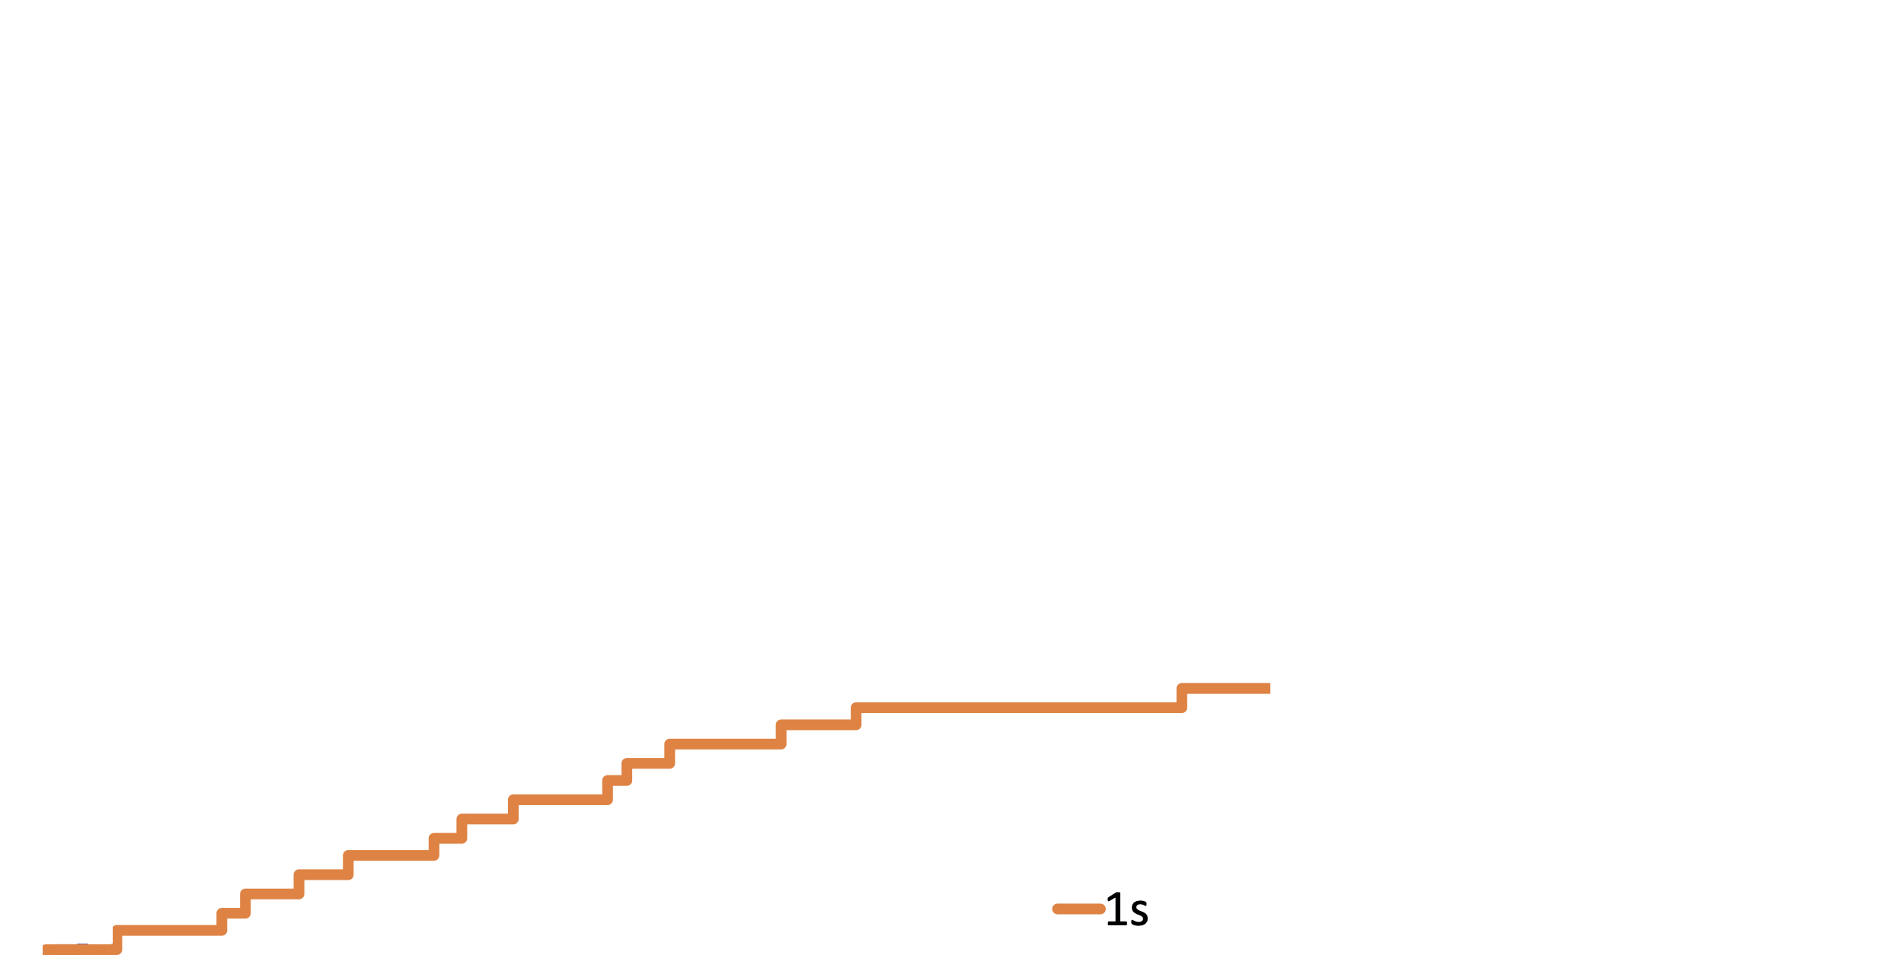
Effect of transparency on anonymity
2018 CAIDA traces
50 target flows/aggregates
512 flows per aggregate
reports per 1ms
100
80
Observation
duration
60
CDF
10min
40
1min
10s
20
1s
0
0
10
20
30
40
50
T-anonymity set size
Given enough time, adversary deanonymizes ~60% of cases
28

Slide 30
Constraints
Any flow could be a target
No network coordination
Improve anonymity for all flows with network-local decisions
29

Slide 31
Time granularity as noise
Input
Transparency
packet reports
Packet count
coarser reports
Time
better
Output
no reports
Packet count
Anonymity
Time
Hides sensitive flow patterns but impacts report utility
30

Slide 32
Networks adaptively time-bin reports
Input
hide flow
unmodified
Packet count
hide both
Leakage for flow
hide flow
Time
Output
Packet count
Leakage for flow
Time
Pick the binning that minimizes leakage for most-leaking flow
31

Slide 33
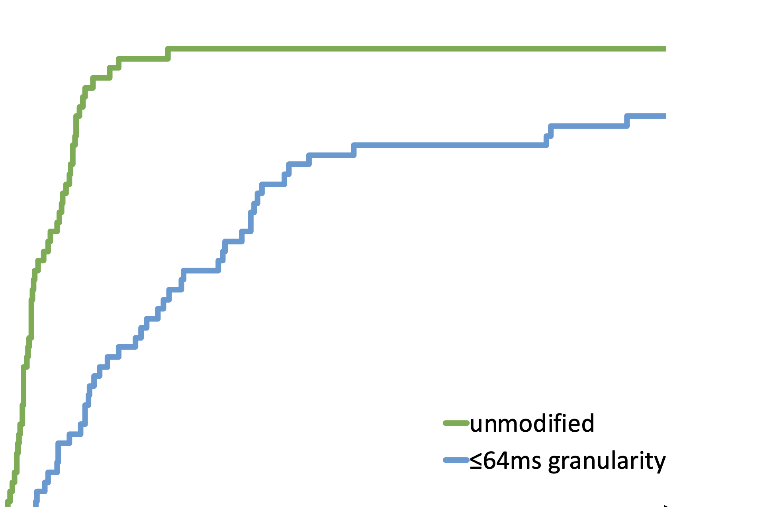
Effect of coarser reports on anonymity
2018 CAIDA traces
50 target flows/aggregates
512 flows per aggregate
10min observation
100
80
60
Coarsest bin
CDF
1ms
40
4x
64ms
20
0
0
10
20
30
40
50
T-anonymity set size
4x improvement at sub-second granularity
32

Slide 34
Accurate, efficient & anonymous transparency
Accurate & efficient Internet performance transparency
Split-responsibility for verifiable, user-based average metrics
Policy-based grouping of traffic for verifiable jitter
Reconcile transparency with anonymity
Time granularity as noise
Adaptive reports for anonymity
33

