Slide 1
HSOAG QUALITY LINE OF EFFORT
Measuring quality where
capability is not guaranteed
Four efforts, one measurement architecture — Early Warning, Crisis Standards of Care, Simulation, and Diagnostic Safety
PRIMARY
ALTERNATE
CONTINGENCY
EMERGENCY
CDR Brian S. Ford, MC, USN
HSOAG · October 2026
Chief Medical Officer, 1st Medical Battalion
Notes:
Framing: these are not four separate projects competing for the same attention. They are one architecture. Each answers a different question about the same problem — how do we know the quality of medical care when the conditions that quality depends on are degrading.

Slide 2
THE PROBLEM
Quality is asserted, not measured
Garrison medicine measures quality against a stable standard. Operational medicine has no stable standard — capability degrades with logistics, evacuation, and personnel. We currently have no shared definition of what good care is at each level of degradation, no way to test a configuration before it deploys, and no systematic way to find what was missed after.
MEASUREMENT GAP
Every quality mechanism we own assumes the standard of care is fixed.
In LSCO it is not.
1
No agreed standard
2
No prospective test
3
No retrospective detection
JTS CPGs tier recommendations, but nothing links those tiers to operational triggers. Providers improvise the transition.
Configuration decisions — team counts, billet substitutions, evacuation posture — are made SME-qualitatively, not quantitatively.
Peer review samples records at random. In a young, healthy population that finds almost nothing.
Source: CSC PACE one-pager (09 May 2026); Measure Dx analysis, docs/01-why-random-review-fails.md
Notes:
The three gaps map one-to-one onto the three lines of effort plus Measure Dx. This slide is the reason the portfolio is coherent rather than opportunistic.

Slide 3
HOW IT FITS TOGETHER
Four efforts, one architecture
Each effort answers a different question about the same problem. They share one currency — the PACE tier — and one measuring stick — the JTS CPGs.
LOE 1
LOE 2
LOE 3
ENABLING
EWP
CSC / PACE
Simulation
Measure Dx
→
→
→
What is coming?
What is good, right now?
Where does it break?
What did we miss?
Anticipate
Define the standard
Test before deploying
Detect in the record
The loop closes. What Measure Dx detects in the record becomes the next scenario the simulation tests, and the next trigger the PACE framework names.
Notes:
The point of this slide is that removing any one of the four leaves a gap the others cannot cover. CSC without simulation is an untested assertion. Simulation without CSC has no outcome to report against. Both without Measure Dx never learn from what actually happened.

Slide 4
LINE OF EFFORT 1
EWP — [expansion pending]
CONTENT PENDING. This slide is scaffolded against the structure used for the other two lines of effort. Supply the EWP project material and it populates without touching the rest of the deck.
Objective
Current state
What the effort is for, in one sentence a non-medical action officer can repeat.
Where it stands now — what exists, what is in work, what is blocked.
Output
Ask
What it produces that CSC, simulation, or Measure Dx consumes.
The decision, endorsement, or resourcing sought at HSOAG.
Placeholder structure — replace with EWP project content.
Notes:
Awaiting EWP source material. Slide structure mirrors the CSC and simulation slides so the three lines of effort read as parallel.

Slide 5
LINE OF EFFORT 2
Crisis Standards of Care — a PACE framework
The USMC lacks a shared mental model for stepwise degradation of care standards during contested operations. JTS CPGs already tier recommendations. PACE supplies the decision framework that links those tiers to operational triggers — so every transition is planned, briefed, and recognized, not improvised.
PACE LEVEL | JTS CPG TIER | CLINICAL POSTURE | TRANSITION TRIGGER | ETHICAL FRAME
PRIMARY | Preferred (Best) | Full Role 2 capability; component blood therapy, dual surgical teams, complete AMAL | Class VIII resupply < 24 h; evacuation within doctrinal timelines | Prudence
ALTERNATE | Acceptable (Better) | Degraded but capable; known substitutions within CPG | Resupply 24–72 h; evacuation delayed but functional; key billets gapped | Prudence + Justice
CONTINGENCY | Minimum standard | Capability gaps present; triage shifts to reverse triage protocols | Resupply > 72 h or interdicted; evacuation non-functional; MASCAL | Justice + Courage
EMERGENCY | Below minimum | Survivability focus for the unit; reverse triage to sustain the force | Supply chain severed; no movement possible; comms degraded or lost | Courage + Temperance
Source: CSC PACE one-pager v2 (09 May 2026). Co-authors: Dan Hanfling, MD and John L. Hick, MD — the architects of the civilian CSC field.
Notes:
This table is the manuscript's centerpiece and the white paper's foundation. The key move is that it requires no new doctrine — PACE and the JTS CPGs both already exist. The virtue-ethics column is what makes the moral burden institutional rather than individual.

Slide 6
LINE OF EFFORT 2 · STATUS
Path to HSOAG, October 2026
Confirmed
MILESTONES
Three-imperative thesis (operational / moral / ethical)
Co-authors secured — Hanfling and Hick
PACE → JTS CPG → virtue-ethics mapping complete
Rev 3 outline complete; ~30–35 references staged
Worked vignette drafted; one-pager in circulation
MAVEN / MedCOP institutional hook identified
Late Jun 2026
Military Medicine Perspective submitted
Aug 2026
White paper draft v1
Sep 2026
Internal review — TMO, BUMED, JTS
Oct 2026
White paper delivered to HSOAG
Critical path risk. Military Medicine review-to-publication for Perspectives typically runs 4–8 months. Submission by late June is required for “in press” status by the October HSOAG. Decision needed: does “accepted / in press” suffice for TMO, or is full publication required?
Recipient: DC I&L via The Medical Officer of the Marine Corps. CSC adoption is a logistics and resource-allocation policy decision.
Notes:
The ask on this slide is the publication-timing decision. It is the only thing on the critical path that someone else controls.

Slide 7
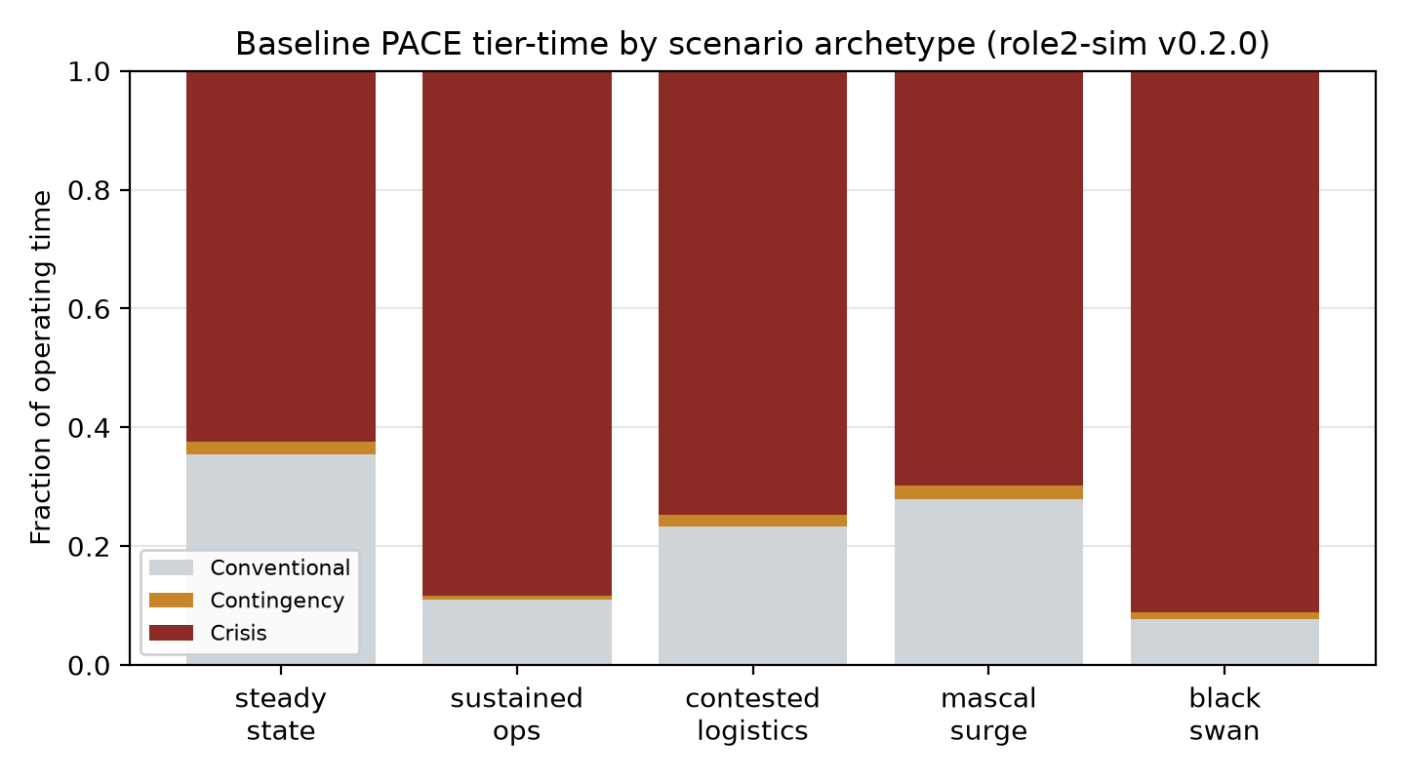
LINE OF EFFORT 3
Testing the configuration before it deploys
A glass-box discrete-event Monte Carlo of an integrated USMC Role 2 (STP → FRSS → Holding) under stochastic casualty flow and resource conditions. Outputs graded PACE tier distributions across a factorial sweep of configurations — the same PACE construct the CSC framework defines.
Crisis is the expected state
Not the exception — the numerically expected operating state of a Role 2 in LSCO.
The top lever is a re-slate, not a buy
Holding-OIC → intensivist re-slate: −1.80 DOW per scenario (9.7% of LSCO baseline), edging out +50% MEDEVAC slots.
PACE tier distribution by scenario archetype — role2-sim
The constraint is downstream of surgery
Status
Evacuation and holding critical care bind — not surgical capacity.
Engine, PACE monitor, scenario library and analysis layers built and tested. Phase 8 calibration in progress; not yet SME face-validity reviewed.
Source: role2sim docs/WHITE_PAPER.md rev. 3 (13 Jul 2026), post Phase-R1 corrections. Provisional parameters tracked in docs/OPEN_PROVISIONAL_PARAMS.md.
Notes:
Be careful to state the limitation out loud: several parameters remain provisional and the model has not passed SME face validity. The robust unconditional claim is the third one — the binding constraint is downstream of surgery. The MEDEVAC-versus-intensivist ordering flips depending on transit mortality of un-operated evacuees, which is the single most decision-relevant open SME question.

Slide 8
ENABLING EFFORT
Finding what the record already knows
AHRQ's diagnostic safety construct, adapted to the operational forces and applied to MHS GENESIS. Replaces random chart sampling with triggers that sample backward from an outcome — the surgery, the MEDEVAC, the medical board — so the index note becomes judgeable.
Unique to the FMF
A true denominator — unit rosters and DEERS
Near-universal autopsy on active-duty death
Guaranteed annual re-contact at PHA
LIMDU / MEB as adjudicated outcomes
0.2%
31.8%
24
Yield of random
chart review
Yield of triggered
review (AHRQ, 11 sites)
Operational triggers
specified
A reviewer sampling 20 charts a quarter has a 73% chance of finishing an entire tour without ever encountering a harmful diagnostic event. That is not a program performing poorly — it is a program whose expected yield is near zero by construction.
Built and running
Working tool reads a GENESIS extract and returns a FIN-keyed worklist of notes warranting review. 15 of 24 triggers implemented; 44 tests; runs today on synthetic data with no PHI.
Source: AHRQ Pub. 22-0030; Bradford et al., J Gen Intern Med 2025;40(4):782–9. Repository: Measure-Dx-Genesis.
Notes:
The 31.8% figure is the published multi-site result, not a projection. Emphasize that this is the only one of the four efforts that already has running code against real data structures.

Slide 9
WHAT MAKES THIS ONE PROGRAM
One currency, one measuring stick
The PACE tier is the shared unit of account
CSC defines the tiers and their triggers. The simulation reports its outcomes as tier distributions. Both speak the same language to a commander, and both surface in MedCOP via MAVEN.
JTS CPGs remain the measuring stick at every level
Quality improvement does not stop when the standard degrades. The CPG is executable guidance at Primary and a recovery target at Emergency — so there is always something to measure against.
Measure Dx supplies the empirical floor
The simulation predicts where care breaks. Measure Dx observes where it actually broke, with a true denominator no civilian system can compute. One is a hypothesis; the other is evidence.
Take any one away and the others lose a function: an untested standard, an outcome with no definition, or a prediction that is never checked against what happened.
Notes:
This is the slide to land if you only get one. The portfolio argument is stronger than any individual effort's argument.

Slide 10
DECISIONS REQUESTED
What we need from HSOAG
CSC
Confirm whether “accepted / in press” satisfies the citation requirement, and identify the I&L action officer to staff the white paper.
Simulation
Sponsor an SME face-validity review panel. The model cannot be cited in a decision until it has one.
Measure Dx
Authorize a 12-month pilot at one division, and name the analytic partner for the data extract.
EWP
[Ask pending EWP material.]
Common thread: none of these asks is a resourcing request. Each is a decision, an endorsement, or an authority — the things HSOAG is positioned to give and we cannot generate ourselves.
Notes:
Close on the common thread. It reframes the brief from four project updates into one governance request.

