Slide 1
Crisis Standards of Care For Large Scale Combat Operational Planning
A Staged Military Planning Framework
CDR Brian S. Ford, MC, USN
Chief Medical Officer, 1st Medical Battalion, 1st MLG
National Academies MedPrep Forum · Crisis Standards of Care · 11 June 2026
The views expressed are those of the author and do not necessarily reflect the official policy or position of the Department of the Navy, the Department of Defense, or the U.S. Government. Slides designed with Artifical Intelligence Resources.
Notes:
DISCLOSURE (≈15 sec): The views I share today are my own and do not represent the Department of the Navy, the Department of Defense, or the U.S. Government.

Slide 2
Risk by Design: Operational Risk Management and Crisis Standards of Care
Identify hazards
Assess hazards
Develop controls
Implement controls
Supervise and Evaluate
Quality Expectations
Safe
Timely
Effective
Efficient
Equitable
Patient-centered
Accept no Unnecessary Risk
Accept risk when benefits outweight the costs
make risk decisions at the right level
anticipate and manage risk by planning.
In austere care you cannot maximize every aim at once — decide which to flex and which to protect.
Notes:
Marines don't improvise risk — doctrine says anticipate and manage it by planning, and push the decision to the level with authority and context. CSC is deliberate ORM applied to medical degradation: it does the deliberate risk work in advance so the bedside decision, under time pressure, is already framed, bounded, and pre-authorized. That ethos is a direct design input to the Medical Cross-Functional Team I lead. The reframe for this room: in austere conditions you can't hold all six aims at once — the six aims you defined become levers, and CSC is how you decide, at the right level and in advance, which you pull and which you protect.

Slide 3
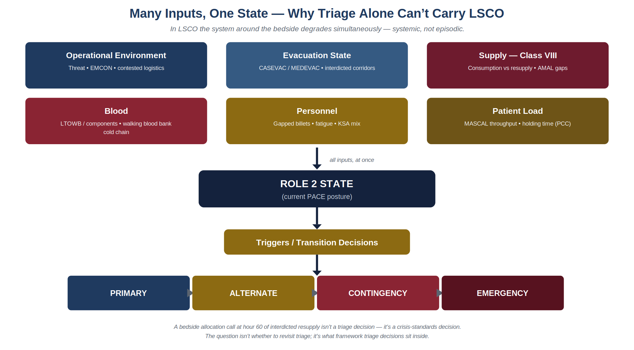
Why Triage Alone Can't Carry It
Notes:
Triage is essential but narrow — it allocates clinical attention among the casualties in front of you. Reverse triage, expectant management, SALT are tactics inside a system. In LSCO the system itself degrades — supply outpaced, evacuation interdicted, billets gapped, comms down, blood short — often at once. This is the COVID lesson at higher amplitude: crisis is systemic (space, staff, stuff, standards). LSCO removes the recovering supply chain civilian CSC assumes.
In the DOD I am less concerned about an experienced trauma surgeon’s ability to inact their mental model. I am far more concerned as a medical leader about the moral injury that junior clinicians and other medical professionals and support will feel when unable to help.
'The question isn't whether to revisit triage — it's what framework triage decisions sit inside.'

Slide 4
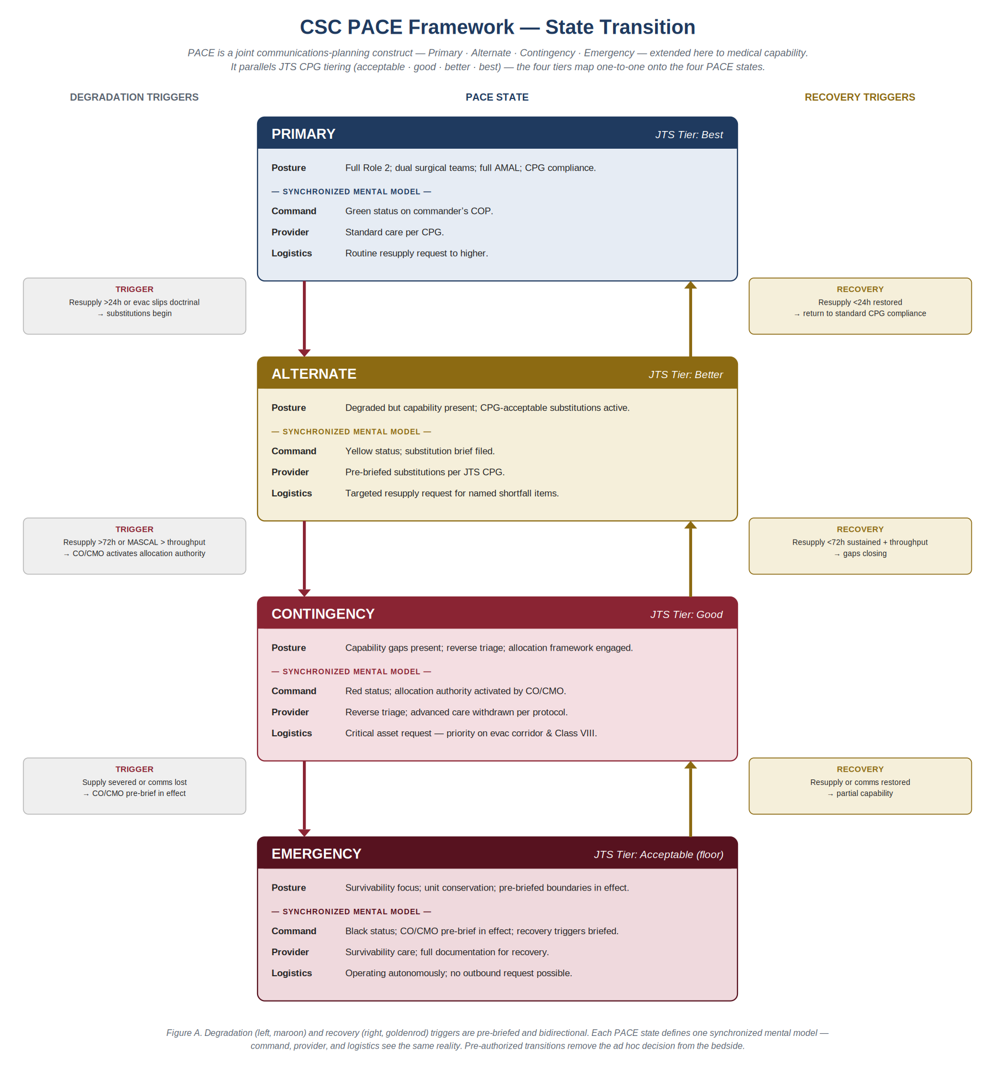
PACE ↔ Conventional · Contingency · Crisis
PACE is the joint communications construct (Primary · Alternate · Contingency · Emergency)
conventional–contingency–crisis tiers and onto JTS CPG tiering: acceptable · good · better · best.
Degradation and recovery triggers are pre-briefed and bidirectional — the decision leaves the individual at the bedside.
Operational, moral, and ethical framework to minimize individual moral hazard and offer leadership
Notes:
Oldjoint planner's communications construct: Primary, Alternate, Contingency, Emergency, how we already pre-build redundancy. I'm extending that vocabulary to medical capability. It maps cleanly onto your conventional–contingency–crisis taxonomy and onto how JTS already writes its CPGs — acceptable, good, better, best — and those four tiers line up one-to-one with the four PACE states. The framework activates existing doctrine rather than competing with it. Mechanism: degradation triggers on the left, recovery on the right — pre-briefed, bidirectional, tied to operational reality (Class VIII, evac, MASCAL, comms). Payoff: each state is one synchronized mental model, and the pre-authorized transition moves the decision off the bedside. Your tiers describe the system state; PACE adds the pre-built triggers and the recovery path civilian frameworks tend to under-specify.

Slide 5
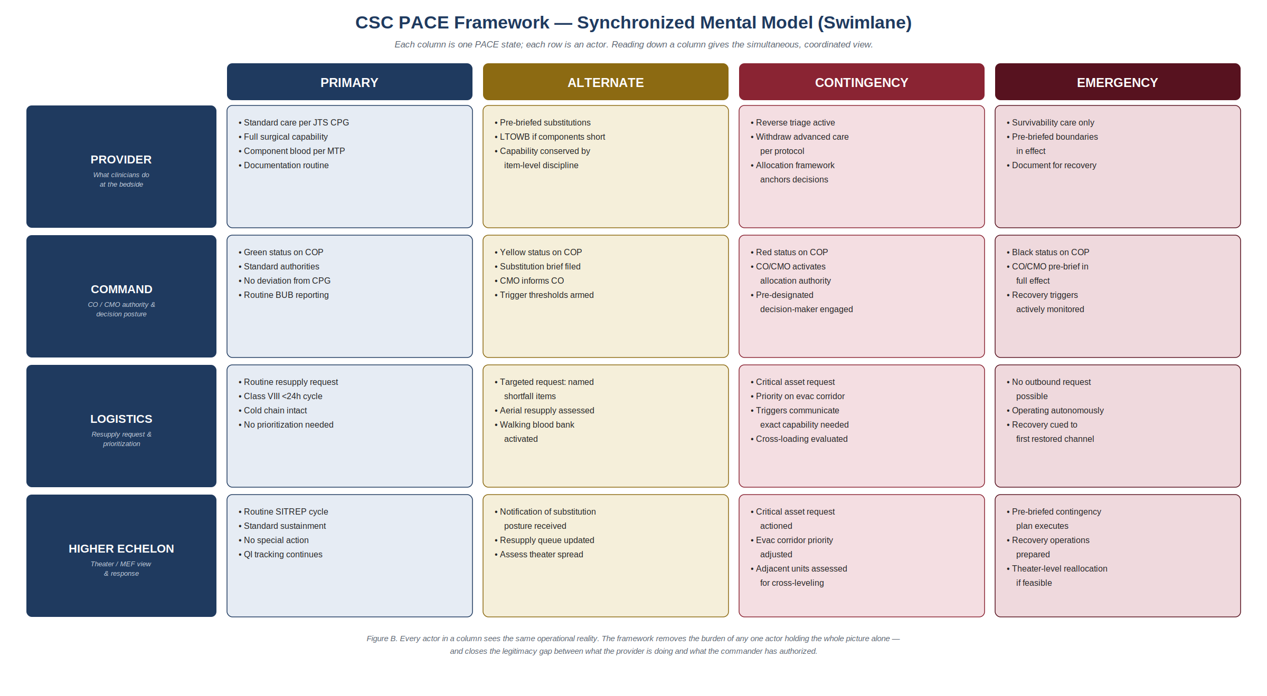
Synchronized Mental Model
Notes:
This synchronized mental model is the single most transferable idea here. Read any column top to bottom: in a given PACE state, provider, command, logistics, and higher echelon are all working from the same picture at the same time. it removes the burden of any one person holding the whole situation alone it also closes the legitimacy gap: what the clinician does at the bedside is exactly what the commander has authorized. The decision is shared and pre-sanctioned, not improvised and defended after the fact. Civilian analog: the gap between a triage officer's call and the institution's stated policy — regional load-balancing, a MOCC making allocation decisions. The swimlane is a template for collapsing those into one view.

Slide 6
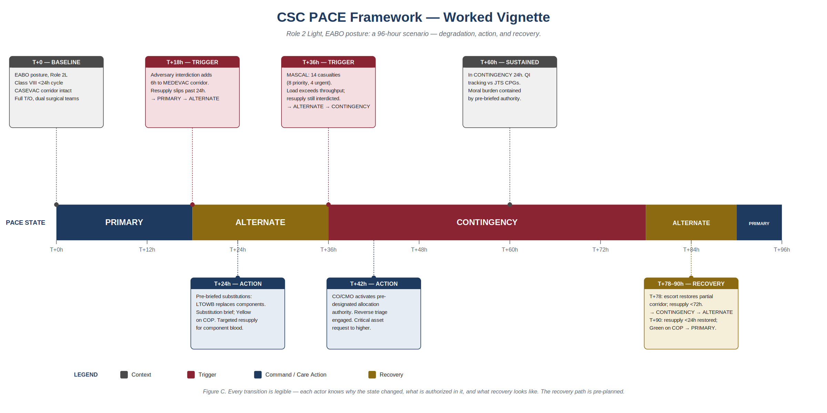
Worked Vignette — A 96-Hour Scenario
Notes:
Now watch it run. A Role 2 Light in an EABO posture over 96 hours: PRIMARY → ALTERNATE → CONTINGENCY → back to ALTERNATE → PRIMARY. Walk the beats: T+18 interdiction slips resupply past 24h (trigger). T+24 pre-briefed substitution — LTOWB for components — and a targeted resupply request. T+36 a MASCAL pushes past throughput (trigger). T+42 CO/CMO activates pre-designated allocation authority; reverse triage engaged. T+60 sustained in CONTINGENCY — QI still tracks against JTS CPGs, and moral burden is contained by pre-briefed authority. T+78 partial corridor restored (recovery), T+90 full recovery and QI review. The point: every transition is legible — each actor knows why the state changed, what is authorized in it, and what recovery looks like. The recovery path is pre-planned, not improvised.

Slide 7
Crisis Standards of Care Lessons Learned: Great Power Competition
CSC as told through the tourniquet
Golden hour → Golden day
Airway is not a part of early assessments in some units
Denied evacuation mandates longer care in place with less resources
Blood as leading finite asset
Drones impair the discernment of the frontline and the rear

Slide 8
Where Civilian CSC Strains — and Where We Align
Where civilian CSC strains under LSCO | What military planning offers
Assumes a recovering supply chain. | Pre-built triggers with bidirectional recovery paths.
Assumes intact higher-echelon coordination and regulatory scaffolding (declarations, waivers). | Shared status in a common operating picture — regional load-balancing and communications to higher headquarters
Under-specifies recovery, contested comms, and prolonged resource constraint. | Pre-authorization at the right level — moral burden becomes institutional.
Austerity treated as the crisis, not the baseline. | Treat CSC as a rehearsed capability, not a document on a shelf.
Notes:
Civilian CSC quietly assumes a recovering supply chain, intact higher-echelon coordination, and a regulatory scaffold — governor's declaration, EMTALA waivers. Military medicine starts from a posture civilian systems would call catastrophic; austerity is the baseline. And civilian guidance tends to under-specify the recovery path, contested comms, and prolonged constraint. The alignment is concrete: borrow PACE's pre-built triggers and — critically — its bidirectional recovery; put medical status in a shared common operating picture, your analog being regional load-balancing and MOCCs; pre-authorize at the right level so moral burden is institutional, not individual; and treat CSC as a rehearsed capability, not a binder.

Slide 9
Frameworks Are Scaffolding, Not Playbooks
Treat CSC as a living, rehearsed capability — invest in indicators / sensing and communicate triggers, recovery, a shared operating picture, pre-authorization, and rehearsal before first contact.
Hypothesis for field testing: A unit that has rehearsed PACE-mapped CSC before first contact will allocate, substitute, and recover better — and bring its people home with less moral injury.
Notes:
Restate the thesis in operational terms: a framework's value is the planning, rehearsal, and synchronized decision-making it enables — not the document. CSC frameworks are starting points, not end-state solutions. The one ask for this body: as you update CSC, design for the living capability — pre-built triggers, an explicit recovery path, a shared operating picture, pre-authorization at the right level, and rehearsal. Close on the force-readiness line, then thank the Forum and invite discussion.

