Slide 1
Crisis Standards of Care For Large Scale Combat Operational Planning
A Staged Military Planning Framework
CDR Brian S. Ford, MC, USN
Chief Medical Officer, 1st Medical Battalion, 1st MLG
National Academies MedPrep Forum · Crisis Standards of Care · 11 June 2026
The views expressed are those of the author and do not necessarily reflect the official policy or position of the Department of the Navy, the Department of Defense, or the U.S. Government. Slides designed with Artifical Intelligence Resources.
Notes:
DISCLOSURE (≈15 sec): The views I share today are my own and do not represent the Department of the Navy, the Department of Defense, or the U.S. Government.

Slide 2
Risk by Design: Operational Risk Management and Crisis Standards of Care
Identify hazards
Assess hazards
Develop controls
Implement controls
Supervise and Evaluate
Quality Expectations
Safe
Timely
Effective
Efficient
Equitable
Patient-centered
Accept no Unnecessary Risk
Accept risk when benefits outweight the costs
make risk decisions at the right level
anticipate and manage risk by planning.
In austere care you cannot maximize every aim at once — decide which to flex and which to protect.

Slide 3
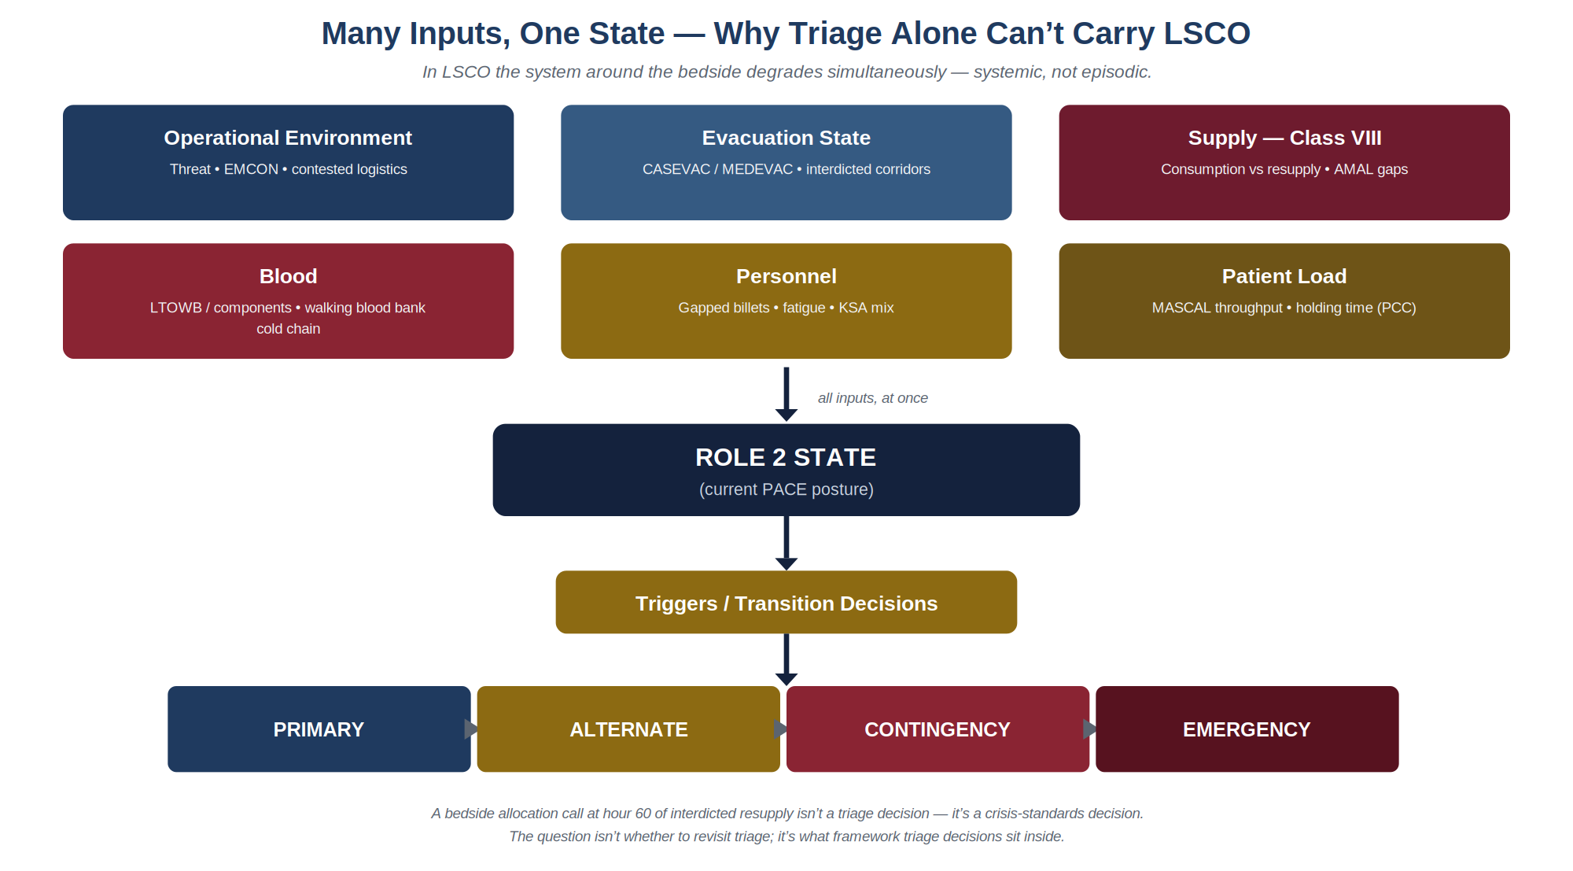
Why Triage Alone Can't Carry It

Slide 4
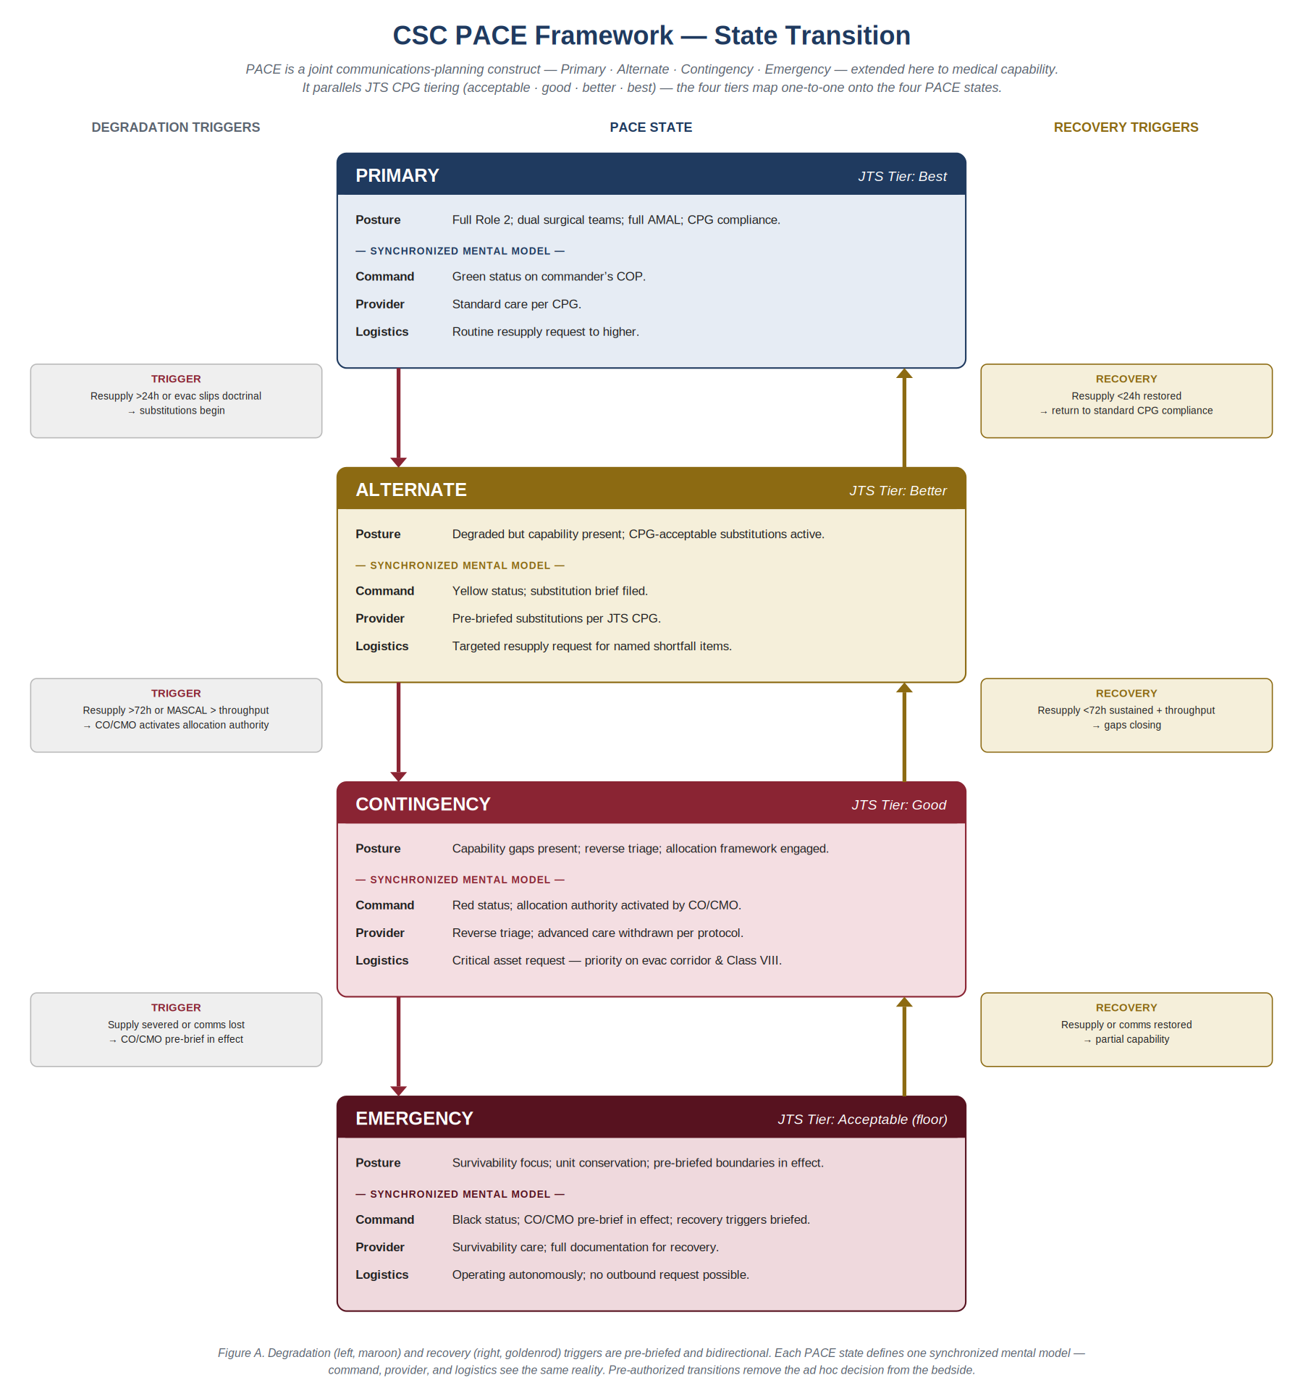
PACE ↔ Conventional · Contingency · Crisis
PACE is the joint communications construct (Primary · Alternate · Contingency · Emergency)
conventional–contingency–crisis tiers and onto JTS CPG tiering: acceptable · good · better · best.
Degradation and recovery triggers are pre-briefed and bidirectional — the decision leaves the individual at the bedside.
Operational, moral, and ethical framework to minimize individual moral hazard and offer leadership

Slide 5
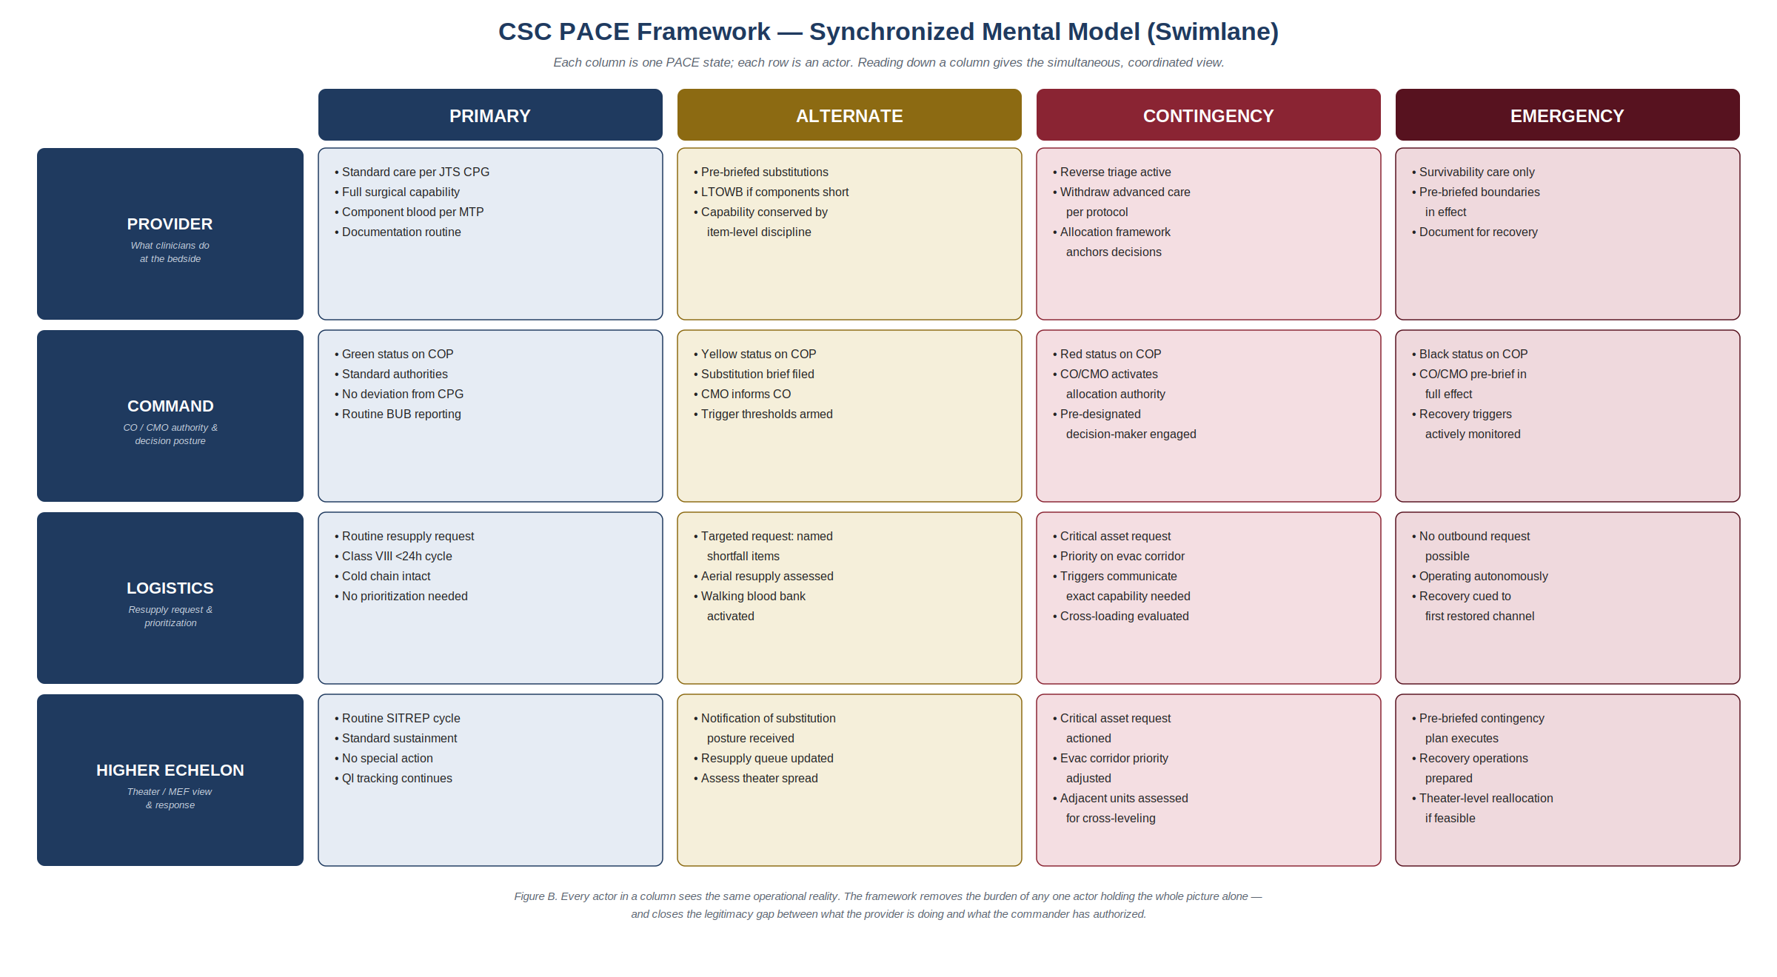
Synchronized Mental Model

Slide 6
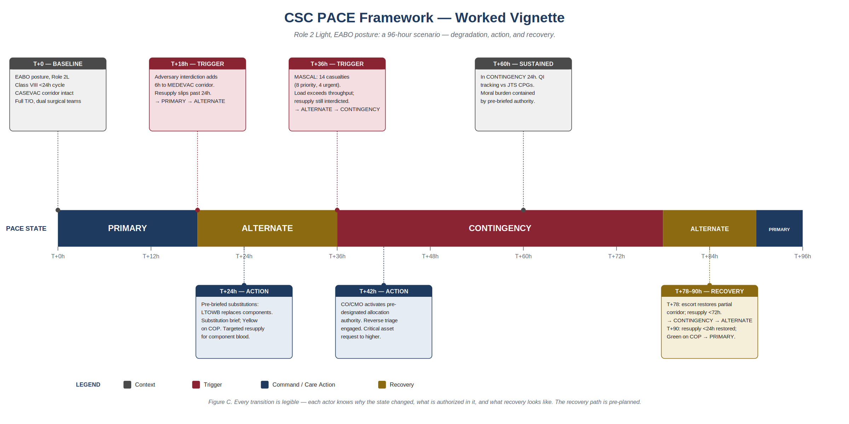
Worked Vignette — A 96-Hour Scenario

Slide 7
Crisis Standards of Care Lessons Learned: Great Power Competition
CSC as told through the tourniquet
Golden hour → Golden day
Airway is not a part of early assessments in some units
Denied evacuation mandates longer care in place with less resources
Blood as leading finite asset
Drones impair the discernment of the frontline and the rear

Slide 8
Where Civilian CSC Strains — and Where We Align
Where civilian CSC strains under LSCO | What military planning offers
Assumes a recovering supply chain. | Pre-built triggers with bidirectional recovery paths.
Assumes intact higher-echelon coordination and regulatory scaffolding (declarations, waivers). | Shared status in a common operating picture — regional load-balancing and communications to higher headquarters
Under-specifies recovery, contested comms, and prolonged resource constraint. | Pre-authorization at the right level — moral burden becomes institutional.
Austerity treated as the crisis, not the baseline. | Treat CSC as a rehearsed capability, not a document on a shelf.

Slide 9
Frameworks Are Scaffolding, Not Playbooks
Treat CSC as a living, rehearsed capability — invest in indicators / sensing and communicate triggers, recovery, a shared operating picture, pre-authorization, and rehearsal before first contact.
Hypothesis for field testing: A unit that has rehearsed PACE-mapped CSC before first contact will allocate, substitute, and recover better — and bring its people home with less moral injury.

