Slide 1

AWS AUTOMATION USING BOTO3 How To Create VPC Using Boto3 Python Tutorial :11

Slide 2
Pre-requisites
pip install boto3
pip install awscli

Slide 3
Create IAM user
Nagivate to aws console
Search for iam service
Create new user
Give programmatic access
Add to administrator policy
Save access id and secret key

Slide 4
Configure awscli
aws configure
Enter access id , secret key,region, outfput type

Slide 5
What is vpc?
https://docs.aws.amazon.com/vpc/latest/userguide/what-is-amazon-vpc.html
Amazon Virtual Private Cloud (Amazon VPC) enables you to launch AWS resources into a virtual network that you've defined. This virtual network closely resembles a traditional network that you'd operate in your own data center, with the benefits of using the scalable infrastructure of AWS.

Slide 6
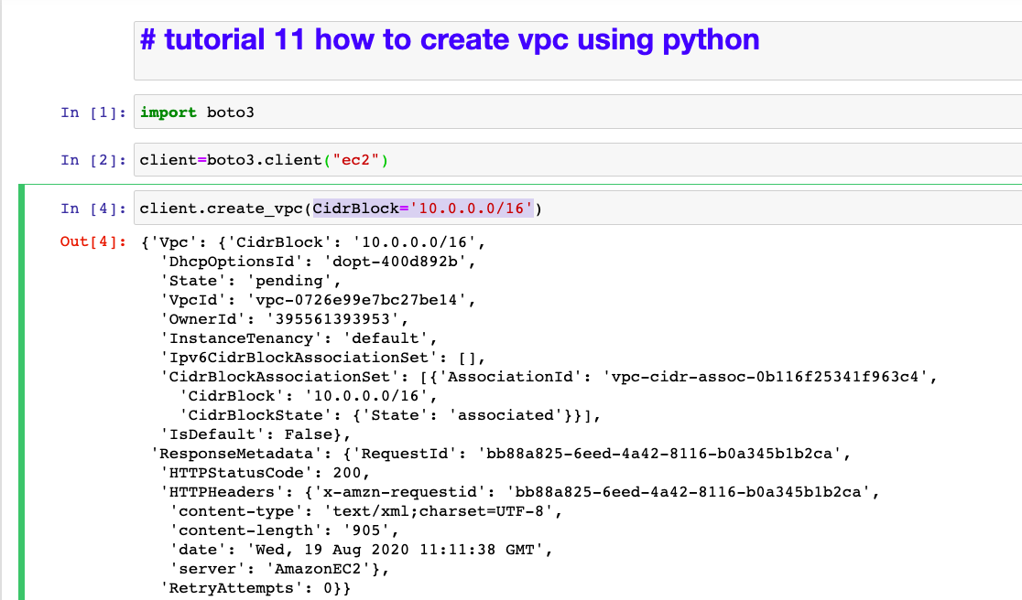
How to create vpc? Sample code

