Slide 1

AWS AUTOMATION USING BOTO3 How To DescribeVPC’s Using Boto3 Python Tutorial :12

Slide 2
Pre-requisites
pip install boto3
pip install awscli

Slide 3
Create IAM user
Nagivate to aws console
Search for iam service
Create new user
Give programmatic access
Add to administrator policy
Save access id and secret key

Slide 4
Configure awscli
aws configure
Enter access id , secret key,region, outfput type

Slide 5
What is describe?
Gives information about one or more than one vpcs

Slide 6
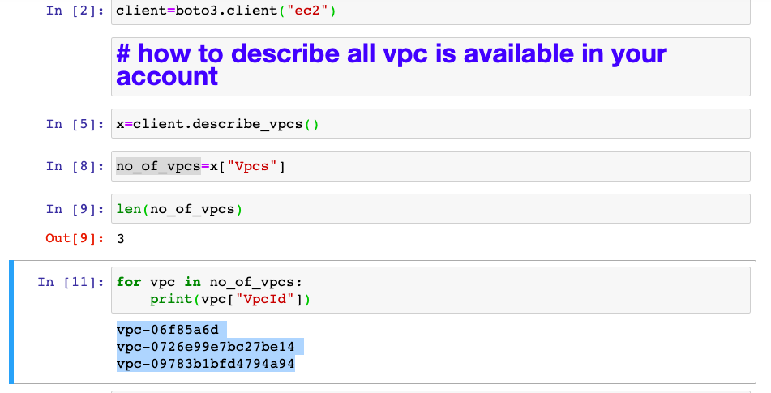
How to describe vpc? Sample code

Slide 7
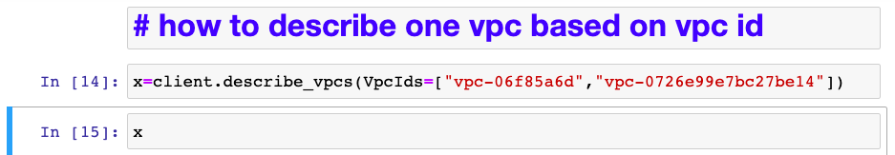
How to describe vpc using vpcid? Sample code

Slide 8
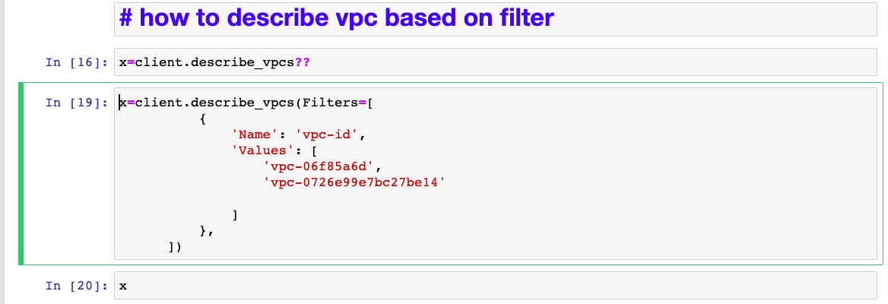
How to describe vpc using filters? Sample code

