Slide 1

AWS AUTOMATION USING BOTO3 How To Describe Security Groups Using Boto3 Python Tutorial :13

Slide 2
Pre-requisites
pip install boto3
pip install awscli

Slide 3
Create IAM user
Nagivate to aws console
Search for iam service
Create new user
Give programmatic access
Add to administrator policy
Save access id and secret key

Slide 4
Configure awscli
aws configure
Enter access id , secret key,region, outfput type

Slide 5
What is security group in aws?
A security group acts as a virtual firewall for your EC2 instances to control incoming and outgoing traffic. Inbound rules control the incoming traffic to your instance, and outbound rules control the outgoing traffic from your instance. When you launch an instance, you can specify one or more security groups. If you don't specify a security group, Amazon EC2 uses the default security group.

Slide 6
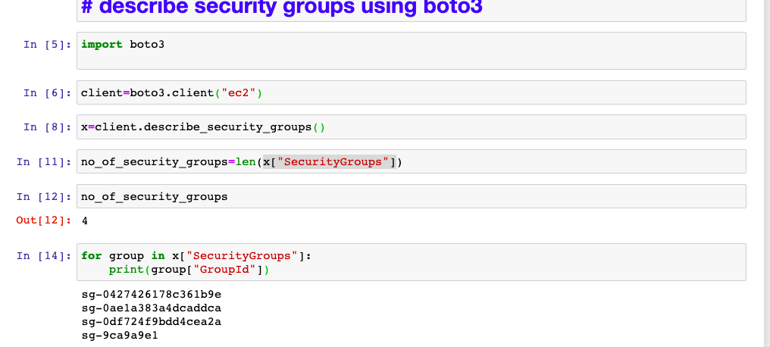
How to describe security groups? Sample code

Slide 7
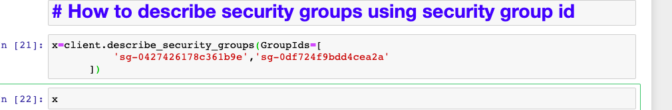
How to describe security groups using security group id? Sample code

Slide 8
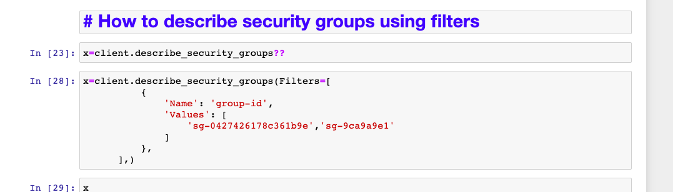
How to describe security groups using filters? Sample code

