Slide 1

AWS AUTOMATION USING BOTO3 How To Add Inbound Rule To Security Groups Using Boto3 Python Tutorial :15

Slide 2
Pre-requisites
pip install boto3
pip install awscli

Slide 3
Create IAM user
Nagivate to aws console
Search for iam service
Create new user
Give programmatic access
Add to administrator policy
Save access id and secret key

Slide 4
Configure awscli
aws configure
Enter access id , secret key,region, outfput type

Slide 5
What is inbound rule ?
When you create a security group, it has no inbound rules. Therefore, no inbound traffic originating from another host to your instance is allowed until you add inbound rules to the security group. By default, a security group includes an outbound rule that allows all outbound traffi

Slide 6
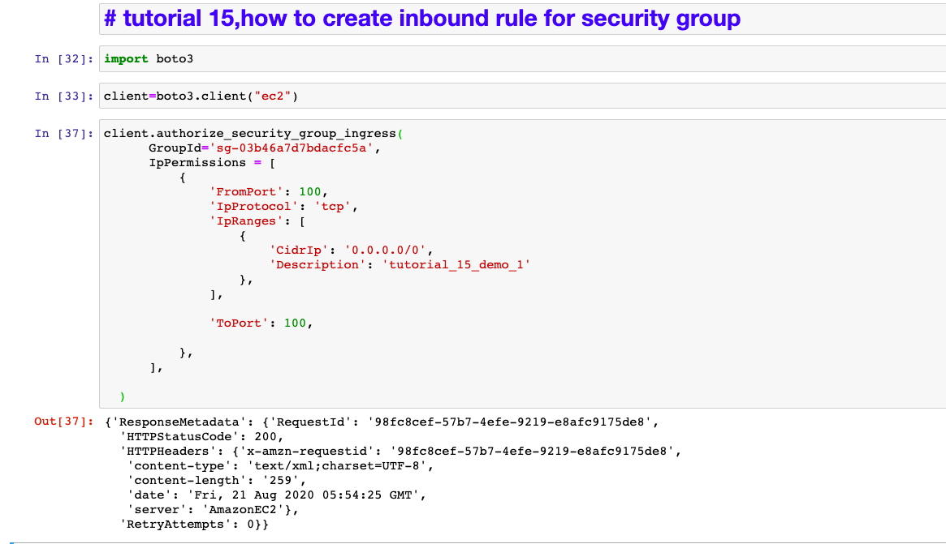
How To Create Inbound Rule for security groups? Sample code

