Slide 1

AWS AUTOMATION USING BOTO3 How To Create Outbound Rule For AWS Security Group Using Boto3 Python Tutorial :18

Slide 2
Pre-requisites
pip install boto3
pip install awscli

Slide 3
Create IAM user
Nagivate to aws console
Search for iam service
Create new user
Give programmatic access
Add to administrator policy
Save access id and secret key

Slide 4
Configure awscli
aws configure
Enter access id , secret key,region, outfput type

Slide 5
What is outbound rule ?
By default, security groups allow all outbound traffic. Security group rules are always permissive; you can't create rules that deny access. Security groups are stateful — if you send a request from your instance, the response traffic for that request is allowed to flow in regardless of inbound security group rules

Slide 6
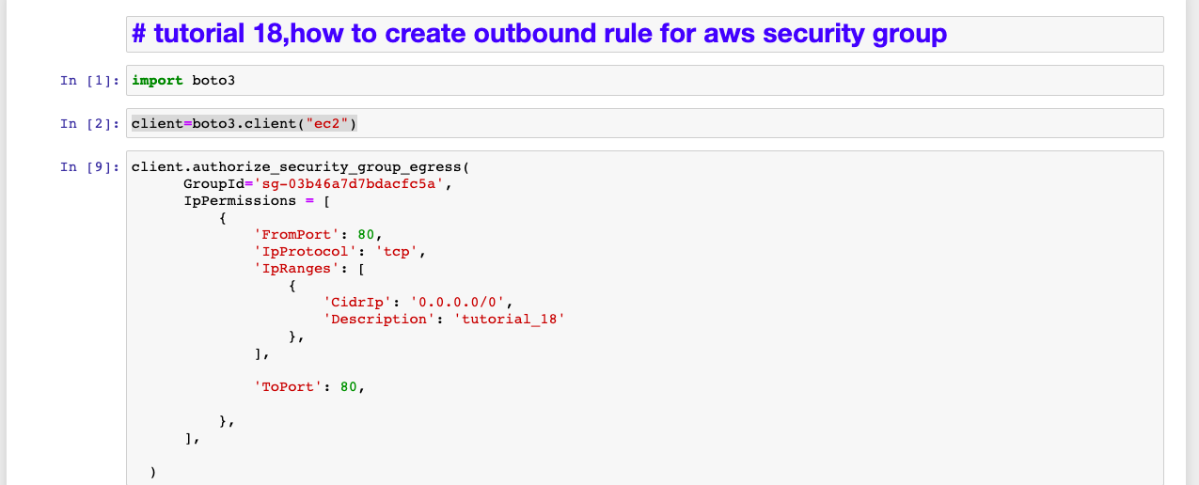
How To Create Outbound Rule For Aws Security Group Sample code

