Slide 1

AWS AUTOMATION USING BOTO3 How To Enable/Disable Monitoring Ec2 Instances Using Boto3 Python Tutorial :29

Slide 2
Pre-requisites
pip install boto3
pip install awscli

Slide 3
Create IAM user
Nagivate to aws console
Search for iam service
Create new user
Give programmatic access
Add to administrator policy
Save access id and secret key

Slide 4
Configure awscli
aws configure
Enter access id , secret key,region, outfput type

Slide 5
What is Ec2
Amazon Elastic Compute Cloud (Amazon EC2) is a web service that provides secure, resizable compute capacity in the cloud. It is designed to make web-scale cloud computing easier for developers. Amazon EC2's simple web service interface allows you to obtain and configure capacity with minimal friction.
https://aws.amazon.com/ec2/

Slide 6
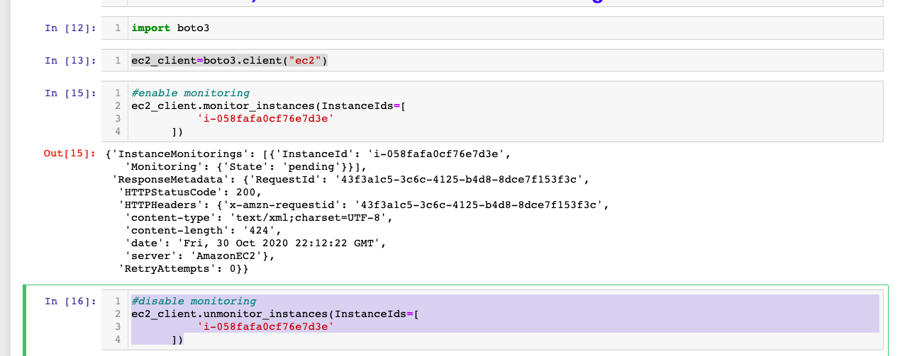
How To Enable/Disable Monitoring Ec2 Instances

