Slide 1

AWS AUTOMATION USING BOTO3 How To Launch AWS Ec2 Instance From Csv Input Using Boto3 Python Tutorial :37

Slide 2
Pre-requisites
pip install boto3
pip install awscli

Slide 3
Create IAM user
Nagivate to aws console
Search for iam service
Create new user
Give programmatic access
Add to administrator policy
Save access id and secret key

Slide 4
Configure awscli
aws configure
Enter access id , secret key,region, outfput type

Slide 5
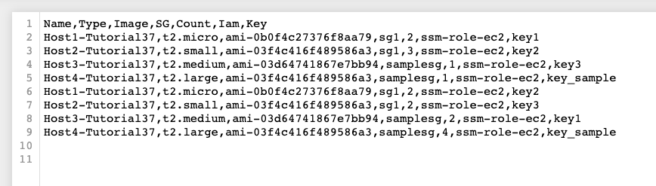
Input file structure

Slide 6
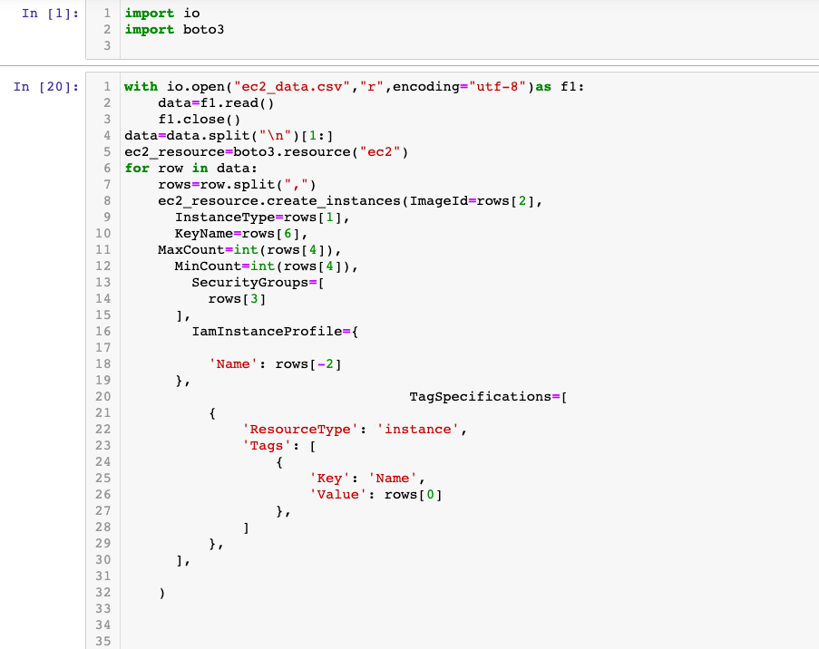
How To launch aws ec2 insatance from csv input using boto3 python

