Slide 1

AWS AUTOMATION USING BOTO3 How To Detach Aws EBS Volume From Ec2 Instance Using Boto3 Python Tutorial :40

Slide 2
Pre-requisites
pip install boto3
pip install awscli

Slide 3
Create IAM user
Nagivate to aws console
Search for iam service
Create new user
Give programmatic access
Add to administrator policy
Save access id and secret key

Slide 4
Configure awscli
aws configure
Enter access id , secret key,region, outfput type

Slide 5
What is aws ebs volume
An Amazon EBS volume is a durable, block-level storage device that you can attach to your instances. After you attach a volume to an instance, you can use it as you would use a physical hard drive. EBS volumes are flexible. For current-generation volumes attached to current-generation instance types, you can dynamically increase size, modify the provisioned IOPS capacity, and change volume type on live production volumes
https://docs.aws.amazon.com/AWSEC2/latest/UserGuide/ebs-volumes.html

Slide 6
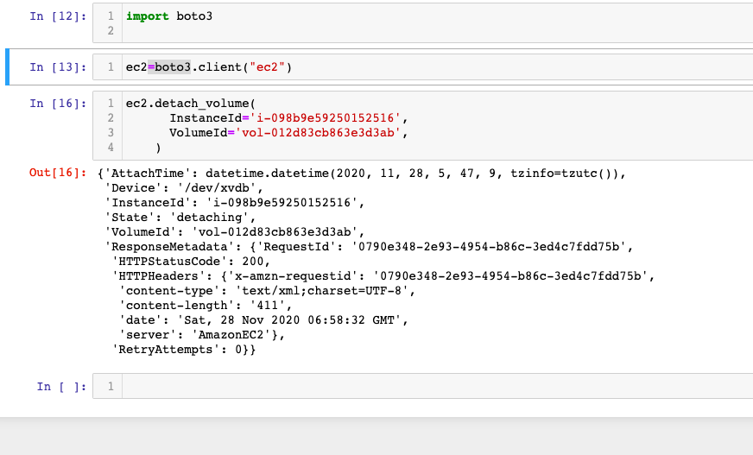
How To detach Aws EBS Volume From Ec2 Instance Using boto3 python

