Slide 1

AWS AUTOMATION USING BOTO3 How To Create Aws EBS Snapshot Using Boto3 Python Tutorial :46

Slide 2
Pre-requisites
pip install boto3
pip install awscli

Slide 3
Create IAM user
Nagivate to aws console
Search for iam service
Create new user
Give programmatic access
Add to administrator policy
Save access id and secret key

Slide 4
Configure awscli
aws configure
Enter access id , secret key,region, outfput type

Slide 5
What is aws ebs snapshot
An EBS snapshot is a point-in-time copy of your Amazon EBS volume, which is lazily copied to Amazon Simple Storage Service (Amazon S3). EBS snapshots are incremental copies of data. This means that only unique blocks of EBS volume data that have changed since the last EBS snapshot are stored in the next EBS snapshot.
https://docs.aws.amazon.com/AWSEC2/latest/UserGuide/EBSSnapshots.html

Slide 6
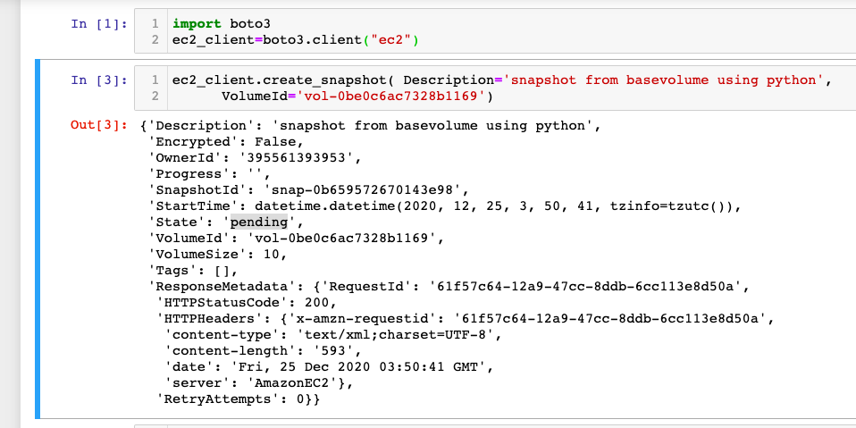
How To create aws ebs snapshot Using boto3 python

