Slide 1
BFS : Capstone Approach
Aditya Kumar
Raghuram Krishnamurthy
Rohit Saini
Veenu Bhanot

Slide 2
Business problem
Understand the factors on which the factor leads to customer default
Approach
Logistic Regression to bring out the findings
Data drilldown
Data exploration to support the findings
Observation
Key findings from the data, model building
Directional guidance for next steps

Slide 3
Problem Statement
CredX is a leading credit card provider that gets thousands of credit card applicants every year. But in the past few years, it has experienced an increase in credit loss. The CEO believes that the best strategy to mitigate credit risk is to ‘acquire the right customers
Key focus areas :
Identify the right customer using the predictive models using the past data
Identify which customer has high probability to default in the future and ddetermine the factors that are driving default rates
Strategy to mitigate the acquisition risk, and cost benefit analysis after model implementation
Datasets
Demographic data : Information collected at the time of application about of an customer demographic like age, income, number of dependents
Credit bureau:: Information sourced from credit bureau, which represents credit history of the customer. Data represents information on - number of times 30 DPD , number of times 60 DPD , number of times 90 DPD , Total outstanding balance, number of trade lines opened, number of enquires.
Default Definition : performance tag which represents whether the applicant has gone 90 days past due or worse in the past 12-months (i.e. defaulted) after getting a credit card.
Data Preparation
Missing Value Treatment through WoE and IV analysis

Slide 4
CRISP DM- Framework
Start
Step1 – Business
Understanding
(looking at Business
Objective and Business
Strategy and determine the
goal of data analysis)
Step2 – Data
Understanding
(exploring the data sets and
performing quality checks)
Step3 – Data Preparation
(collating data sets,
addressing missing values,
constructing, integrating
and formatting data)
Step 4– Data Modeling
(running specific queries on
the data sets to get the
desired output)
Step5 – Model Evaluation
(Reviewing outputs and
evaluating effectiveness)
Step 6 – Model
Deployment (for decision
making)
Stop

Slide 5
Data Understanding- Demographic Variables
Demographic Data
Variables | Description
Application ID | Unique ID of the customers
Age | Age of customer
Gender | Gender of customer
Marital Status | Marital status of customer (at the time of application)
No of dependents | No. of childrens of customers
Income | Income of customers
Education | Education of customers
Profession | Profession of customers
Type of residence | Type of residence of customers
No of months in current residence | `
No of months in current company | No of months in current company of customers
Performance Tag | Status of customer performance (" 1 represents "Default")

Slide 6
Data Understanding : Bureau Variables
Credit Bureau Data
Variable | Description
Application ID | Customer application ID
No of times 90 DPD or worse in last 6 months | Number of times customer has not payed dues since 90days in last 6 months
No of times 60 DPD or worse in last 6 months | Number of times customer has not payed dues since 60 days last 6 months
No of times 30 DPD or worse in last 6 months | Number of times customer has not payed dues since 30 days days last 6 months
No of times 90 DPD or worse in last 12 months | Number of times customer has not payed dues since 90 days days last 12 months
No of times 60 DPD or worse in last 12 months | Number of times customer has not payed dues since 60 days days last 12 months
No of times 30 DPD or worse in last 12 months | Number of times customer has not payed dues since 30 days days last 12 months
Avgas CC Utilization in last 12 months | Average utilization of credit card by customer
No of trades opened in last 6 months | Number of times the customer has done the trades in last 6 months
No of trades opened in last 12 months | Number of times the customer has done the trades in last 12 months
No of PL trades opened in last 6 months | No of PL trades in last 6 month of customer
No of PL trades opened in last 12 months | No of PL trades in last 12 month of customer
No of Inquiries in last 6 months (excluding home & auto loans) | Number of times the customers has inquired in last 6 months
No of Inquiries in last 12 months (excluding home & auto loans) | Number of times the customers has inquired in last 12 months
Presence of open home loan | Is the customer has home loan (1 represents "Yes")
Outstanding Balance | Outstanding balance of customer
Total No of Trades | Number of times the customer has done total trades
Presence of open auto loan | Is the customer has auto loan (1 represents "Yes")
Performance Tag | Status of customer performance (" 1 represents "Default")

Slide 7
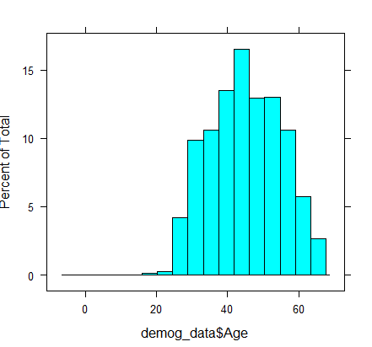
Univariate Analysis :

Slide 8
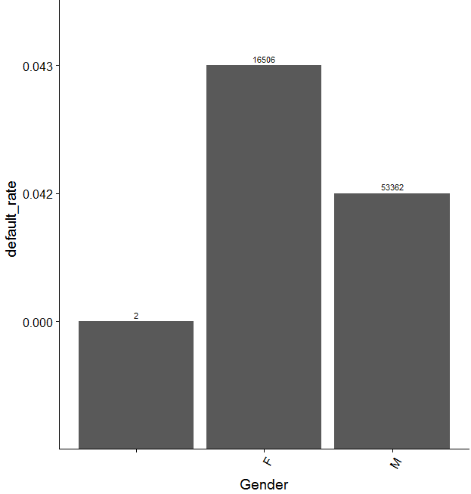
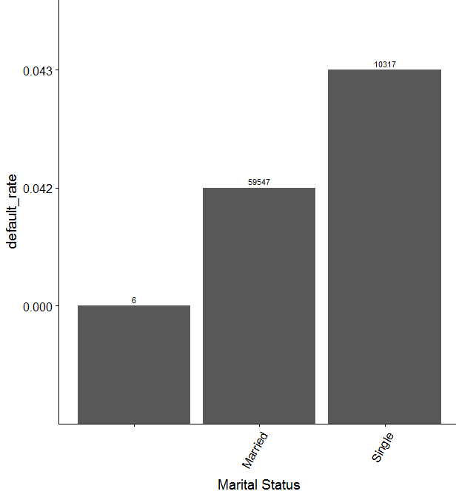
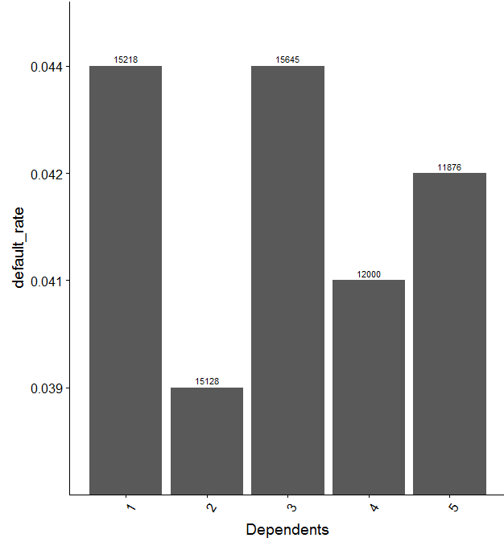
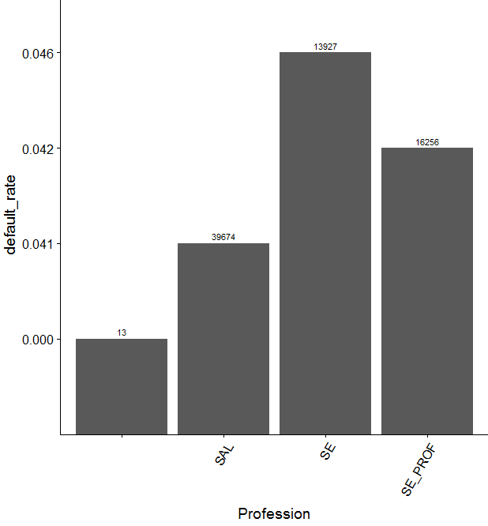
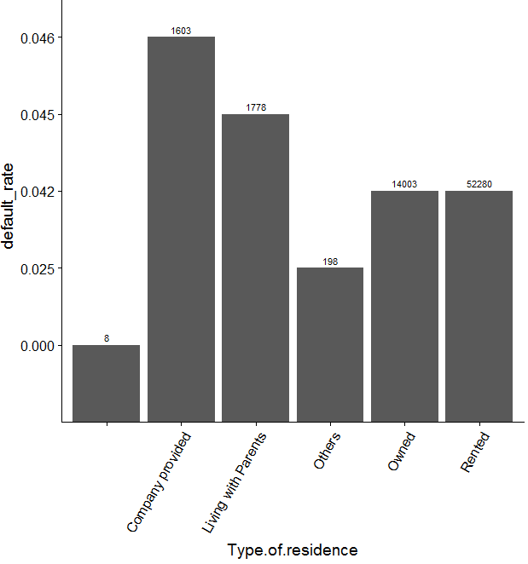
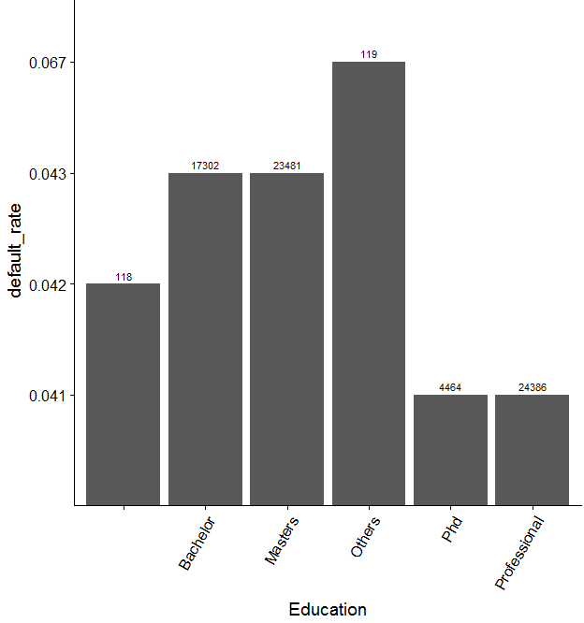
Univariate Analysis :

Slide 9
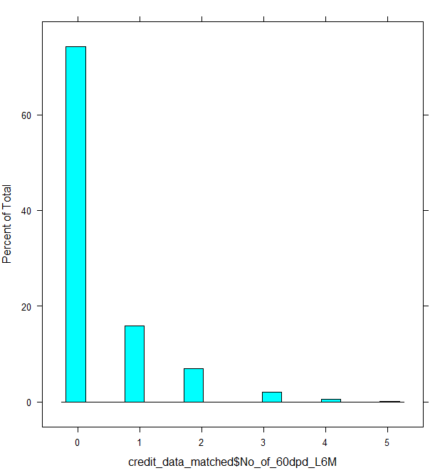
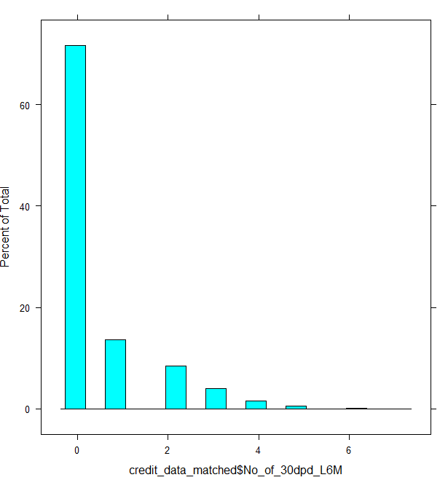
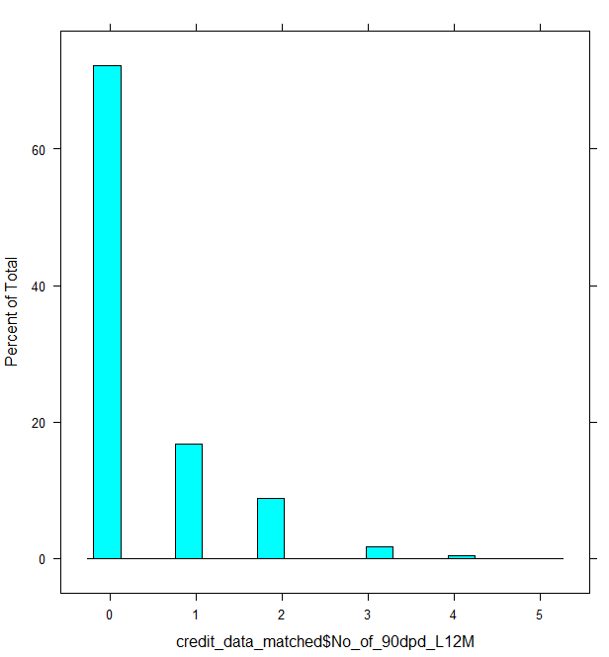
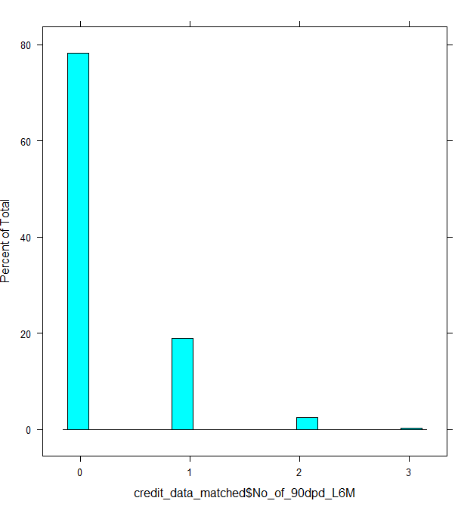
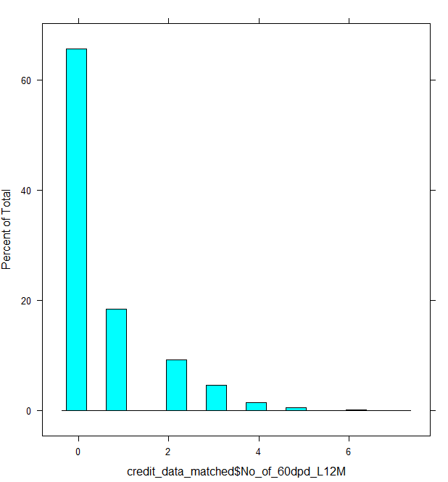
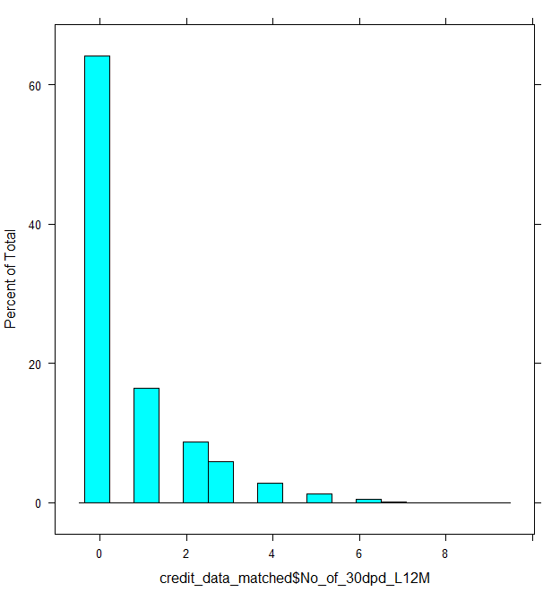
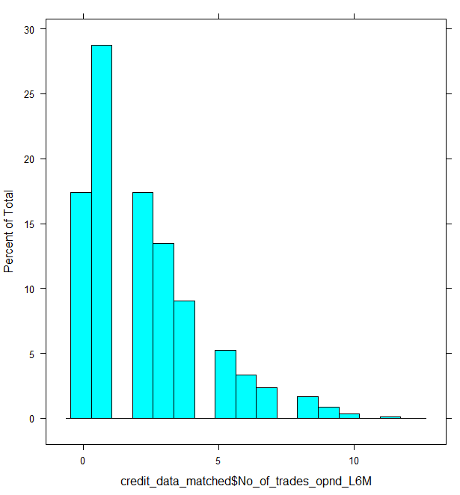
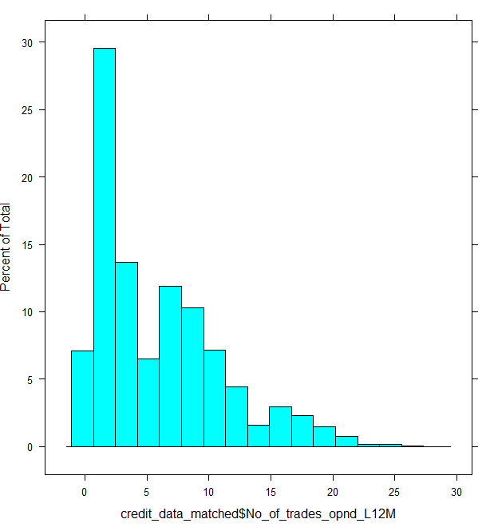
Univariate Analysis :

Slide 10
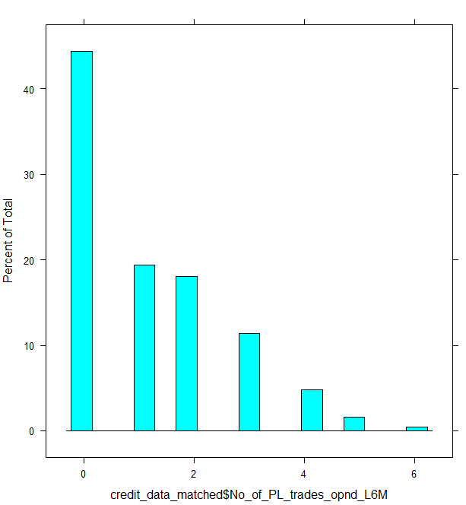
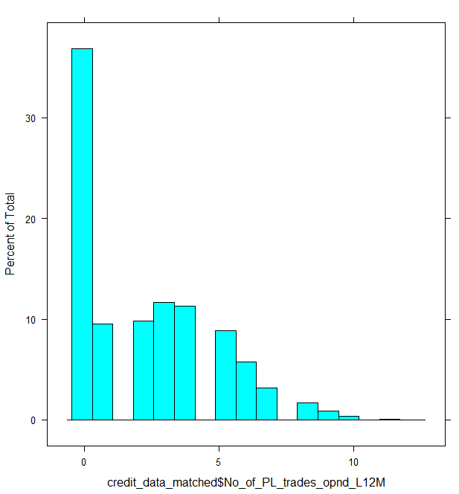
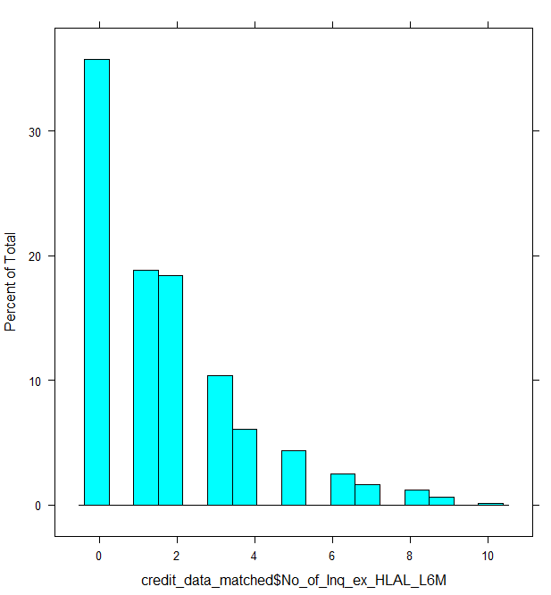
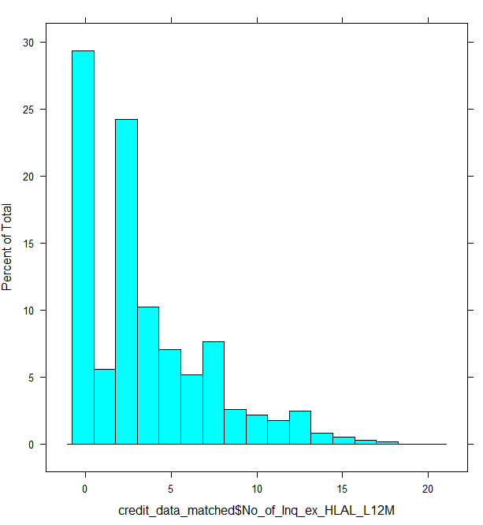
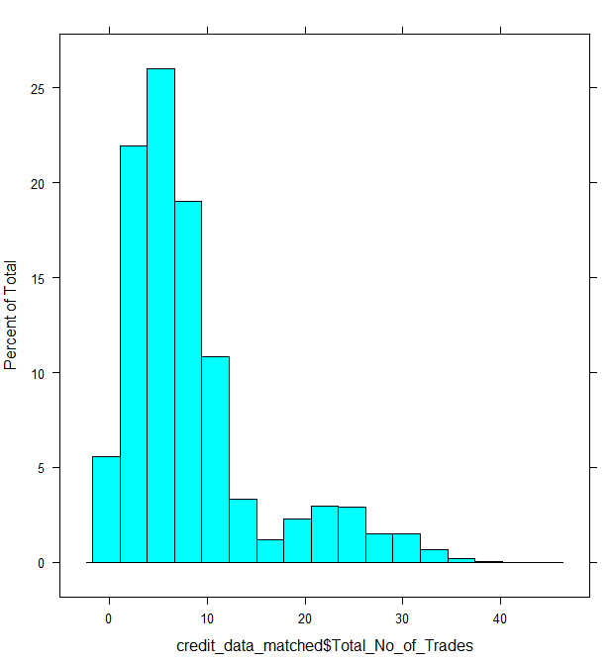
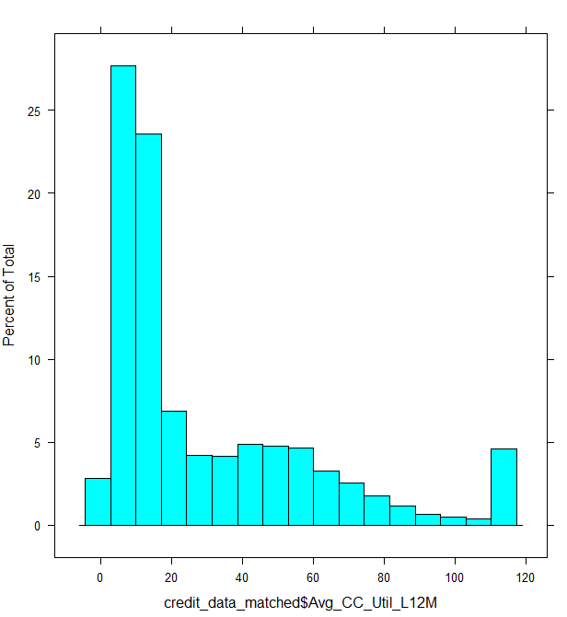
Univariate Analysis :

Slide 11
Univariate Analysis :

Slide 12
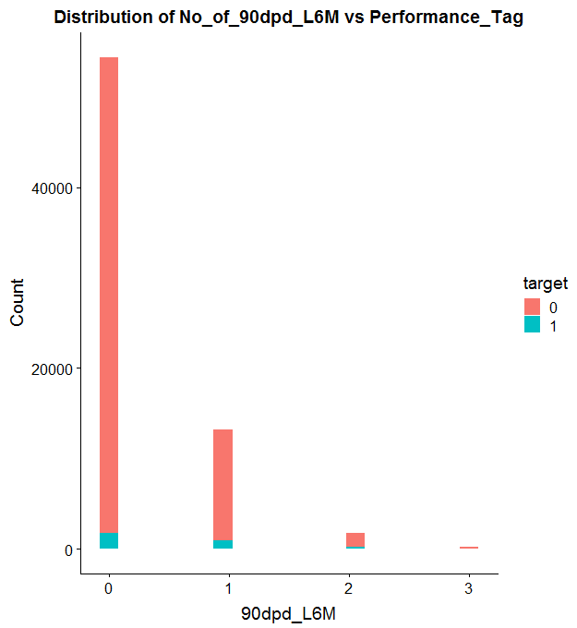
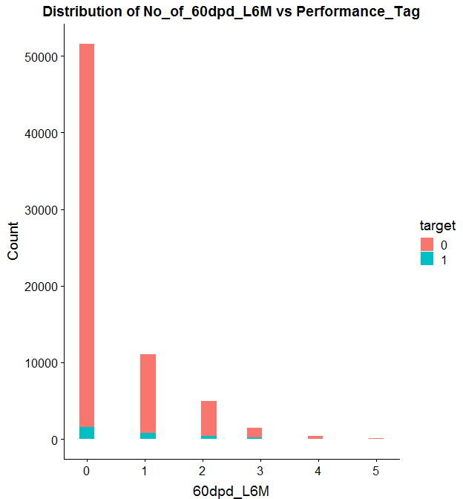
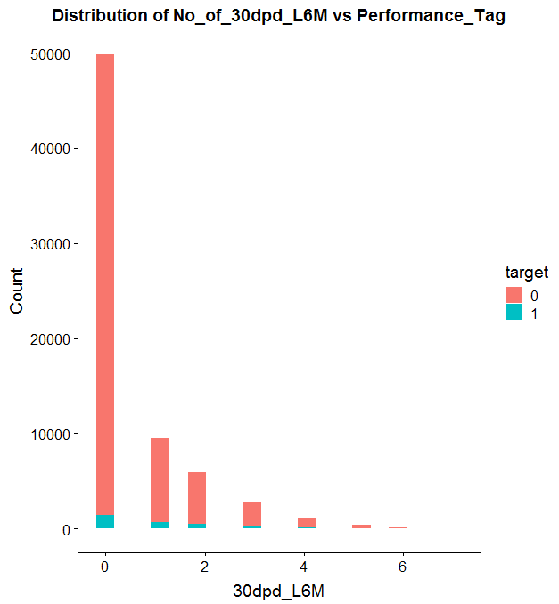
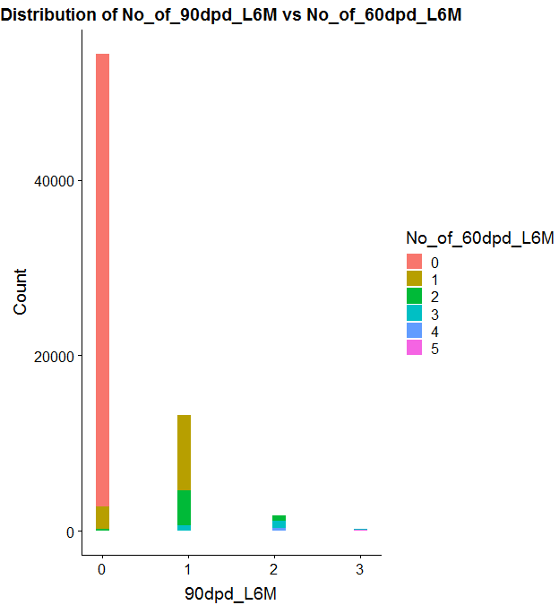
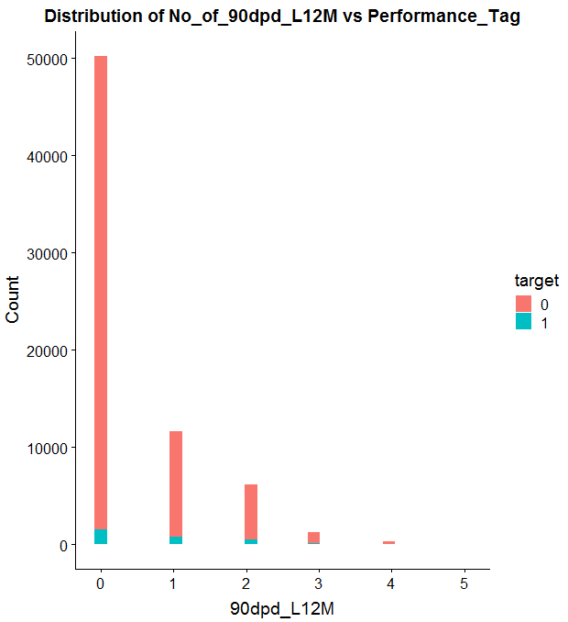
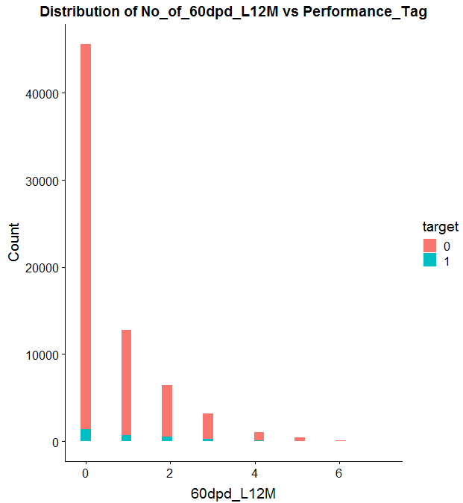
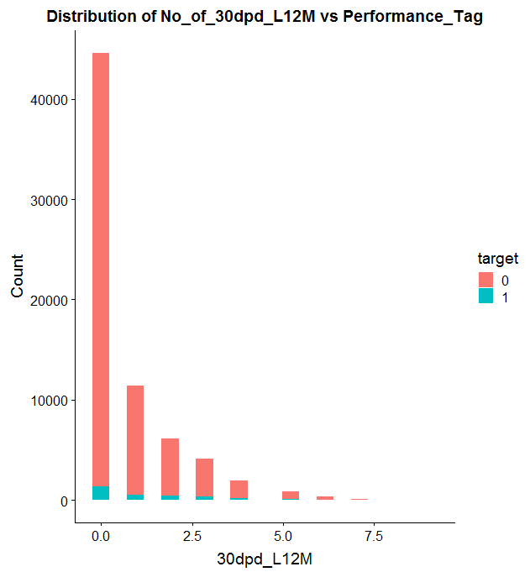
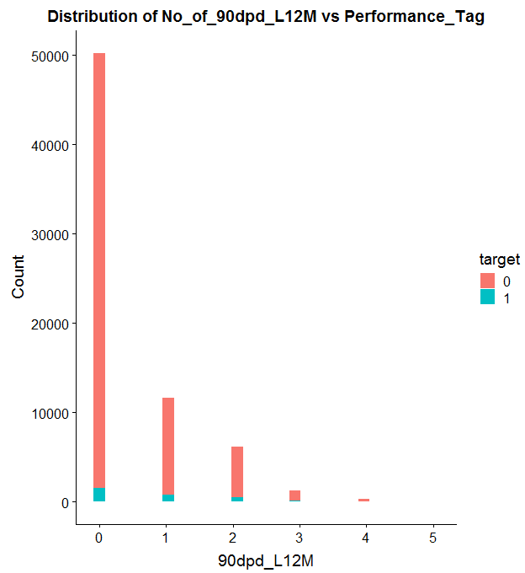
Bivariate Analysis

Slide 13
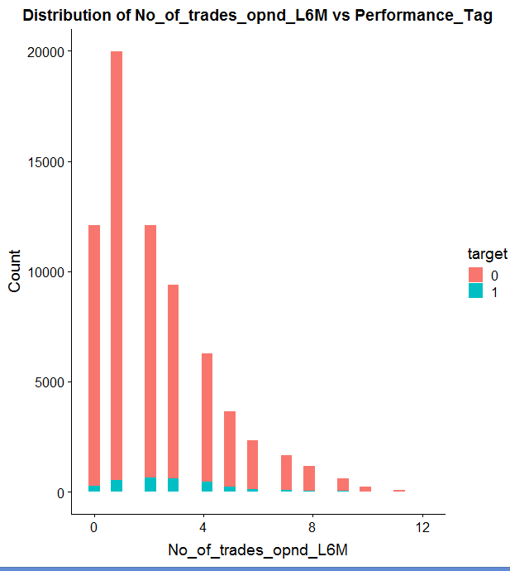
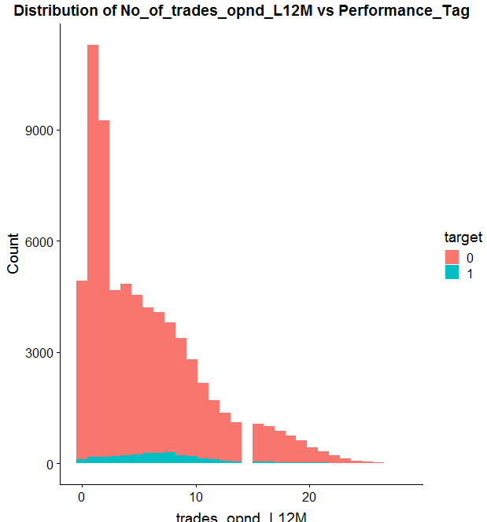

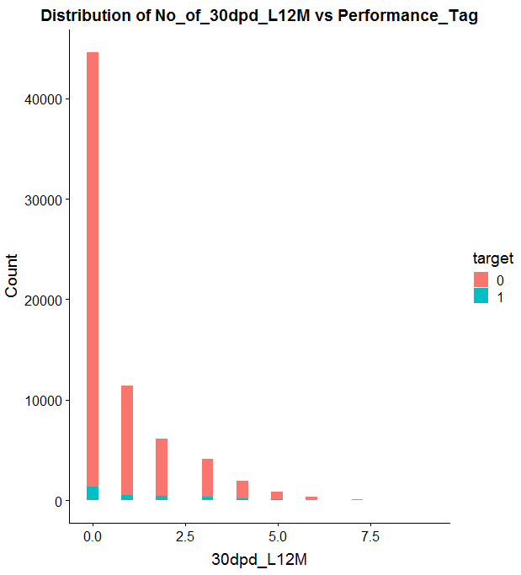
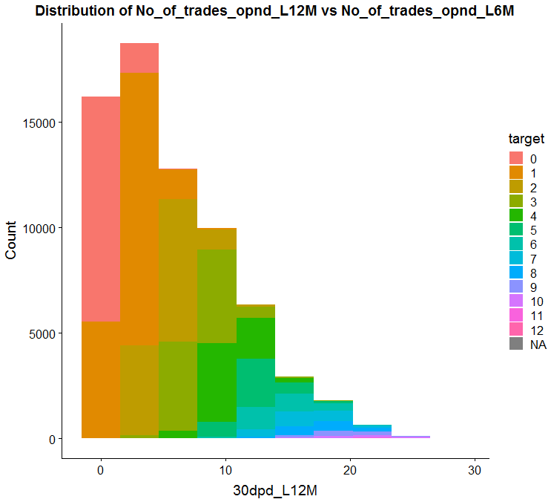
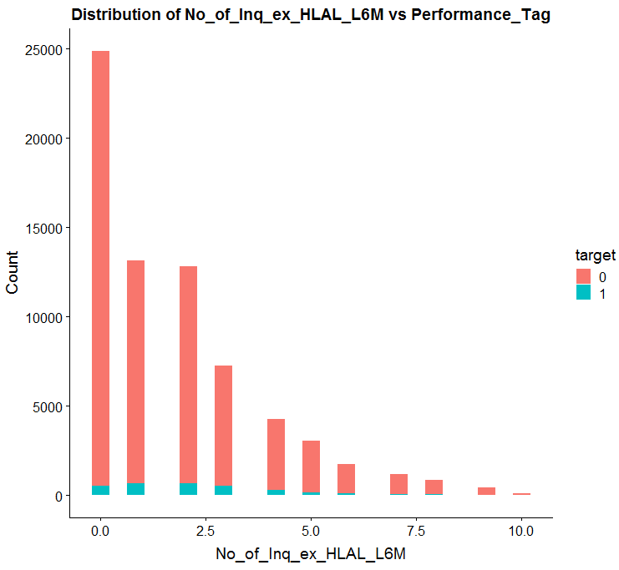
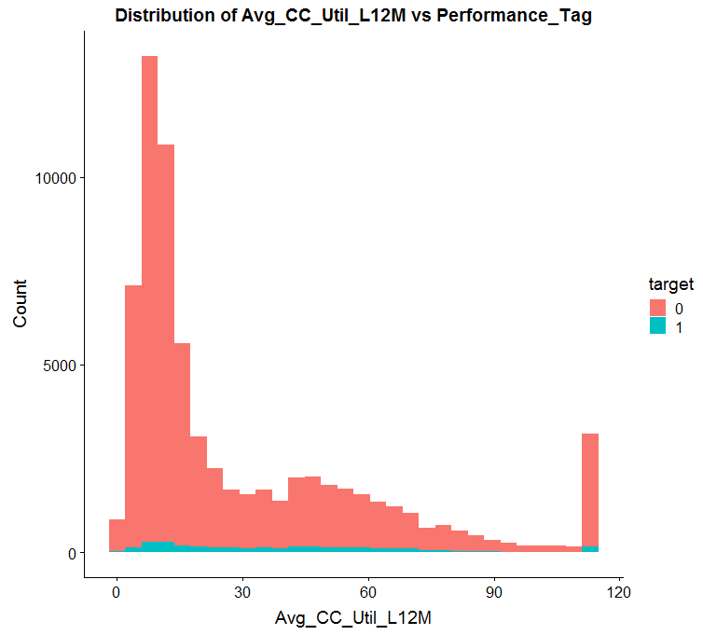
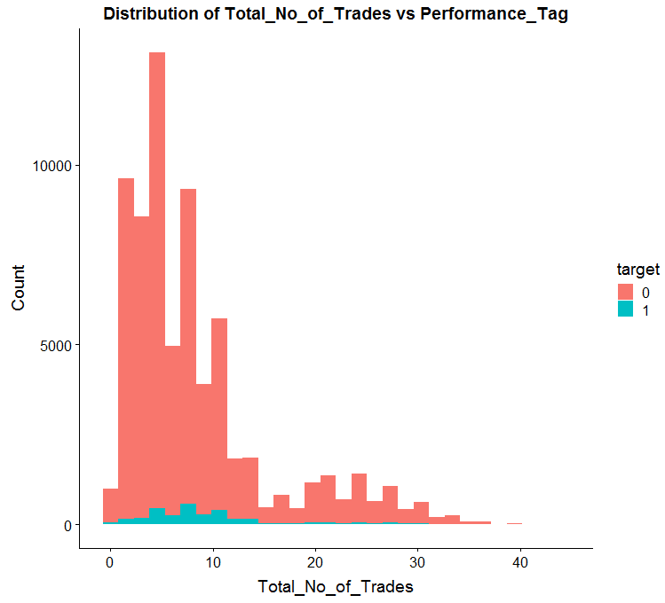
Bivariate Analysis

Slide 14
Bivariate Analysis

Slide 15
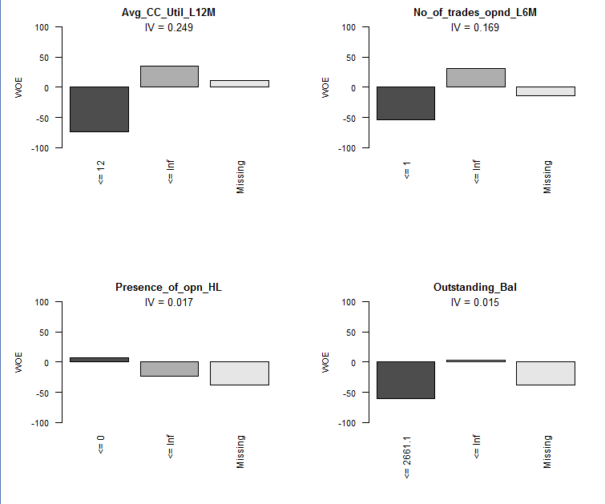
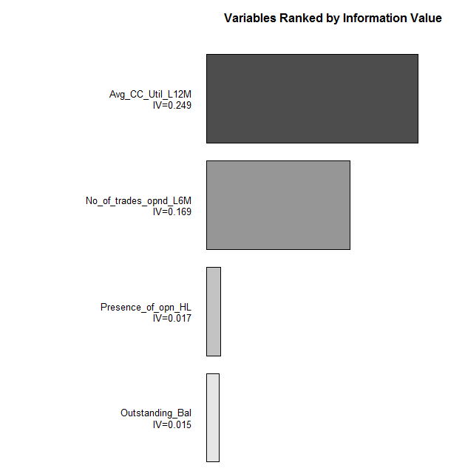
Woe Binning

Slide 16
Data Treatment
Exploratory Data Analysis :
Missing Value Treatment– Removed NA’s in the main data as it is less than 2% of the total observations
Variable Scaling for continuous variables to standardise the values
Outlier Treatment has been done to cap outliers with Box Plot
Data Split to create train and test sample using seed and sample.split function
Model Building :
Glm() function has been used to built a model, significant variables are identified using
Stepwise Variable Selection Method on AIC.
Backward Variable Selection Method on VIF and P Value

Slide 17
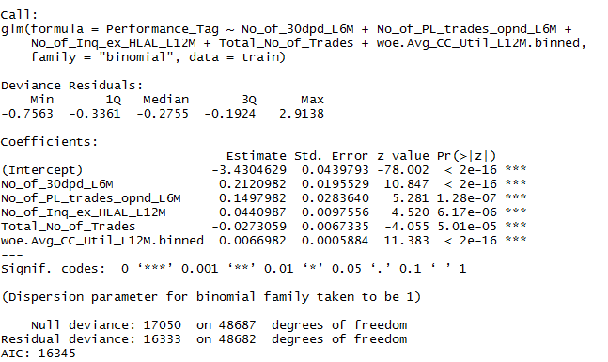
Final Model & Model Interpretation
Accuracy | 0.62
Sensitivity | 0.60
Specificity | 0.62
Probability Cutoff | 0.046

