Slide 1
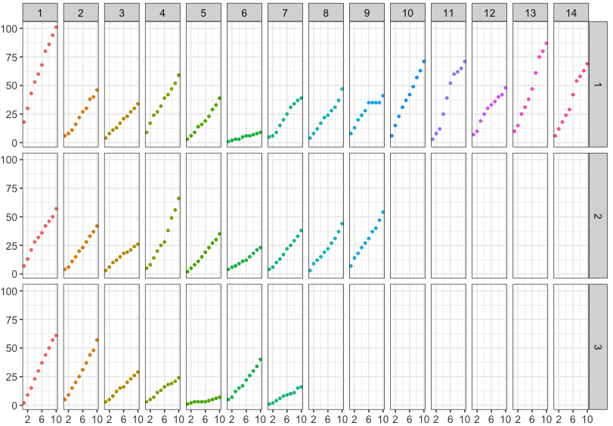
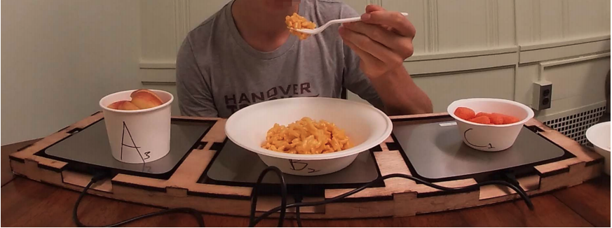
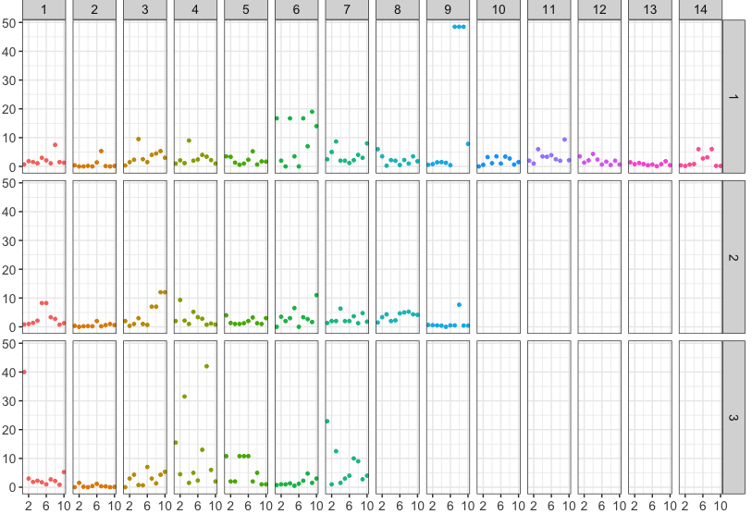
Stability of Meal Microstructure in Youth
Within-meal cumulative bite and inter-bite-interval patterns were more similar across meals consumed by the same youth relative to meals consumed by different youths
Assessing pattern similarity across meals
Root mean square error (RMSE) was computed between cumulative bite patterns and IBI patterns for each pair of meals
Lower RMSE indicates greater similarity between patterns
For each participant with >1 session, average RMSE for WP and BP comparisons were computed
BP comparisons included meals consumed by all participants
Bari Fuchs¹, Alaina Pearce¹, Kathleen Keller¹, Diane Gilbert-Diamond², David Kotz³, Travis Masterson¹
¹ The Pennsylvania State University, PA, USA
² Dartmouth Geisel School of Medicine, Hanover, NH, USA
³ Dartmouth College, Hanover, NH, USA
Cumulative Bite Patterns by Participant
Introduction
Eating behaviors (e.g., bites) within a meal, termed meal microstructure, have been used to understand the control of food intake
However, the stability of within-meal microstructure patterns is unclear
Here, we tested the hypotheses that within-meal patterns of cumulative bites and inter-bite-intervals (IBIs) would be more similar within-person (WP) than between-person (BP) in youth 4-17 years
Results
 |  | Cumulative bite pattern RMSE |  | IBI pattern RMSE
Participant | # of Sessions | WP | BP | WP | BP
1 | 3 | 32.00 | 15.01 | 3.08 | 12.93
2 | 3 | 2.88 | 13.34 | 1.68 | 5.56
3 | 3 | 4.15 | 14.98 | 4.38 | 5.38
4 | 3 | 7.08 | 15.32 | 3.73 | 16.66
5 | 3 | 2.05 | 25.95 | 1.07 | 7.50
6 | 3 | 8.46 | 11.50 | 9.94 | 4.54
7 | 3 | 3.19 | 20.85 | 3.54 | 9.16
8 | 2 | 1.70 | 11.89 | 2.94 | 4.90
9 | 2 | 6.05 | 13.00 | 25.18 | 4.63
Mean (SD) | -- | 7.51 (9.47) | 15.76(4.71) | 6.17 (7.57) | 7.92 (4.28)
Cumulative # of bites
Meal (session) number
Participants
14 youth participated in a 3-session repeated-measures study
9 youth completed >1 session (WP sample)
 |  | Full sample (N=14) | WP sample (N=9)
Age in years, Mean (SD) |  | 12.77 (4.43) | 12.15 (4.75)
Sex, N | Male | 6 | 6
 | Female | 8 | 3
Body Mass Index, Mean (SD) |  | 21.34 (4.86) | 19.56 (3.67)
Meal increment
Cumulative bite patterns were more similar WP than BP in 89% (n=8) of youth
Video-recorded meal paradigms
Inter-bite-interval Patterns by Participant
Bold indicate WP < BP RMSE
Meals consisted of mac and cheese, apples, and carrots and were consumed ad libitum
The start and end of each bite were manually coded from videos
On average, for participants with >1 session, RMSE for cumulative bite and IBI patterns were lower WP than BP
Within-meal cumulative bite patterns and IBI patterns are displayed graphically in the middle panel
Screenshot from a video-recorded meal
Conclusions
Characterization of within-meal microstructure patterns
Average IBI (seconds)
These data suggest that patterns of meal microstructure are relatively stable within youth
Future research should assess the stability of these measures in larger samples and determine how they relate to individual differences (e.g., age, energy intake)
Cumulative number of bites and average IBIs were sampled every 10% of each meal (i.e., each meal was divided into 10 intervals of equal duration)
This enabled comparing meal microstructure patterns across meals of variable durations
The cumulative number of bites at an interval reflects the total number of bites taken so far in the meal
The average IBI at an interval* reflects the average duration between the start of each bite in the interval and the end of the preceding bite
*For intervals with no bites, the average IBI was set equal to the duration of the interval
Meal (session) number
Contact and Support
Supported by NIH R01 DK110060
Email baf44@psu for discussion or questions
https://sites.psu.edu/barifuchs/
Meal increment
IBI patterns were more similar WP than BP in 78% (n=7) of youth
Orange boxes highlight participants with WP error (i.e., WP RMSE) < BP error (i.e., BP RMSE)

