Slide 1
Decomposing Bitcoin: Power Laws, Entropy, and the End of Speculative Oscillations
Quantoshi Research · April 2026 · quantoshi.xyz
A multi-method investigation into the mathematical structure of Bitcoin price dynamics

Slide 2
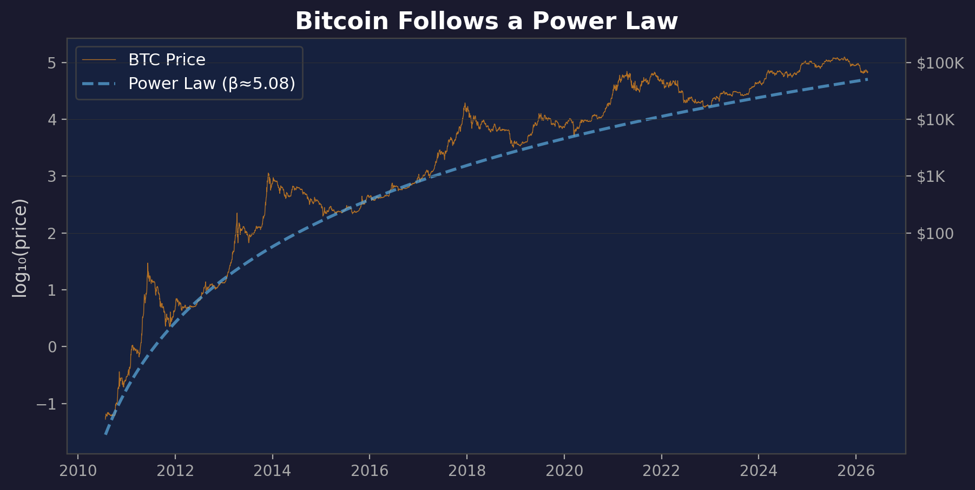
The Power Law Foundation
log₁₀(price) = α + β·log₁₀(t), β ≈ 5.08, R² = 0.963
Genesis date sweep: R² peaks sharply at July 2009 — the statistically optimal time origin
Exponent stable across 30+ model variants: β ∈ [4.9, 5.2]

Slide 3
Why the Choice of t=0 Matters
The power law exponent β changes dramatically with genesis date.
Choosing the wrong origin gives the wrong growth rate — and the wrong projections.
Date | Event | Slope β | R²
Jan 3, 2009 | Genesis block mined | 5.69 | 0.9615
Jan 9, 2009 | Bitcoin v0.1 released | 5.68 | 0.9616
Jul 25, 2009 | Optimal (see below) | 5.08 | 0.9630
Nov 18, 2009 | Power law: 1 block reward = $0.01 | 4.69 | 0.9620
Apr 2, 2010 | Power law: 1 BTC = $0.01 | 4.23 | 0.9521
Aug 24, 2010 | Power law: 1 BTC = $0.10 | 3.85 | 0.9324
Using the Genesis block date (Jan 3) gives β=5.69 → 12% steeper than optimal
Using MtGox opening (Jul 2010) gives β≈3.9 → 23% flatter than optimal
The "right" β≈5.08 only emerges at the statistically optimal origin
This is why we swept 546 candidate dates with 7 independent statistical tests

Slide 4
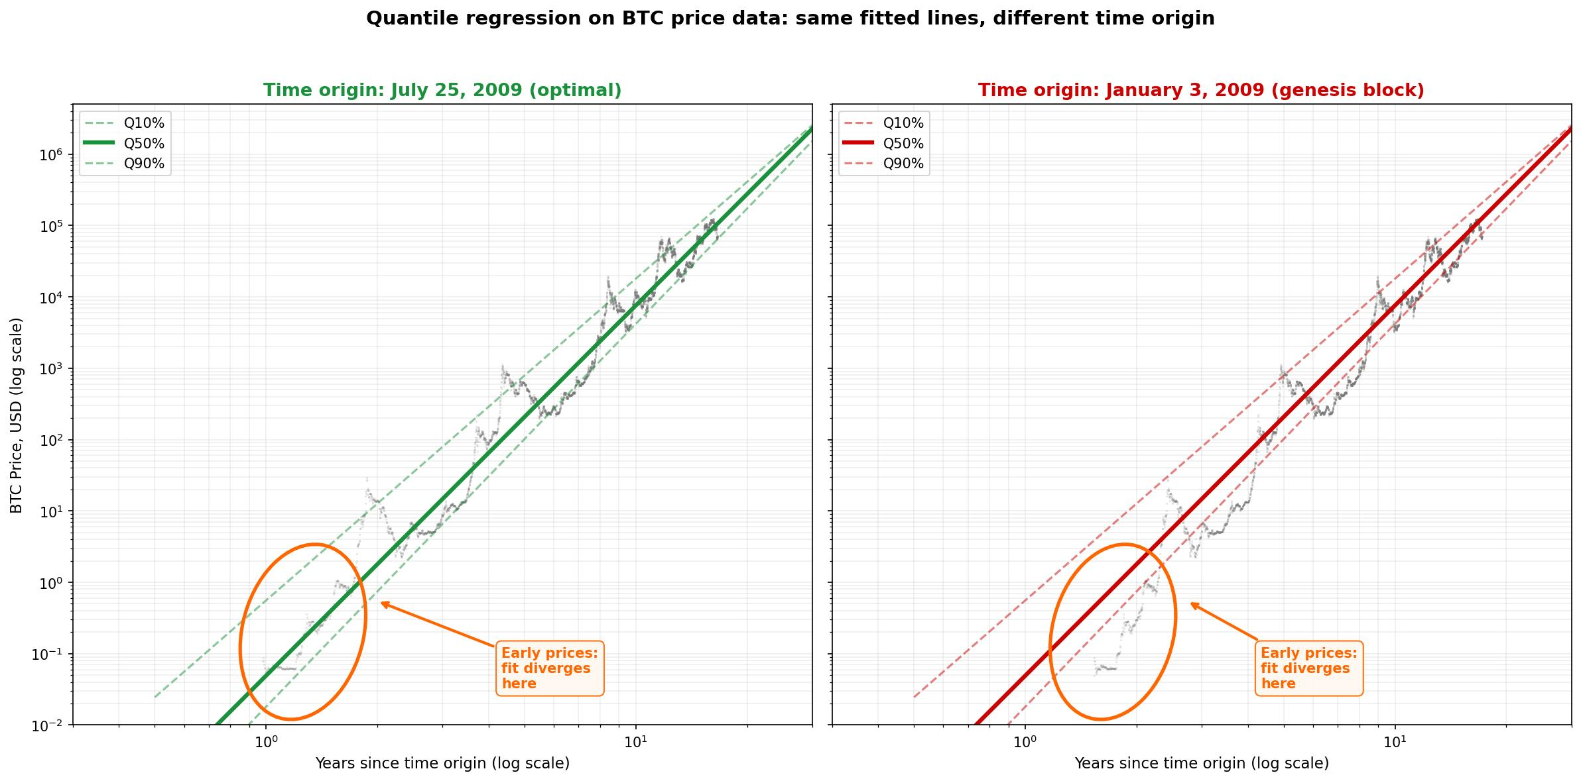
Wrong Genesis = Wrong Projections
Same regression coefficients,
different time origin →
visibly different fits
Orange circle: earliest prices
sit farther from regression
when origin is wrong
Q50% crosses $1M:
Genesis block origin: Aug 2034
Optimal origin: Mar 2035
→ 7 month difference!
The choice of Day Zero
propagates into every
projection the model makes.

Slide 5
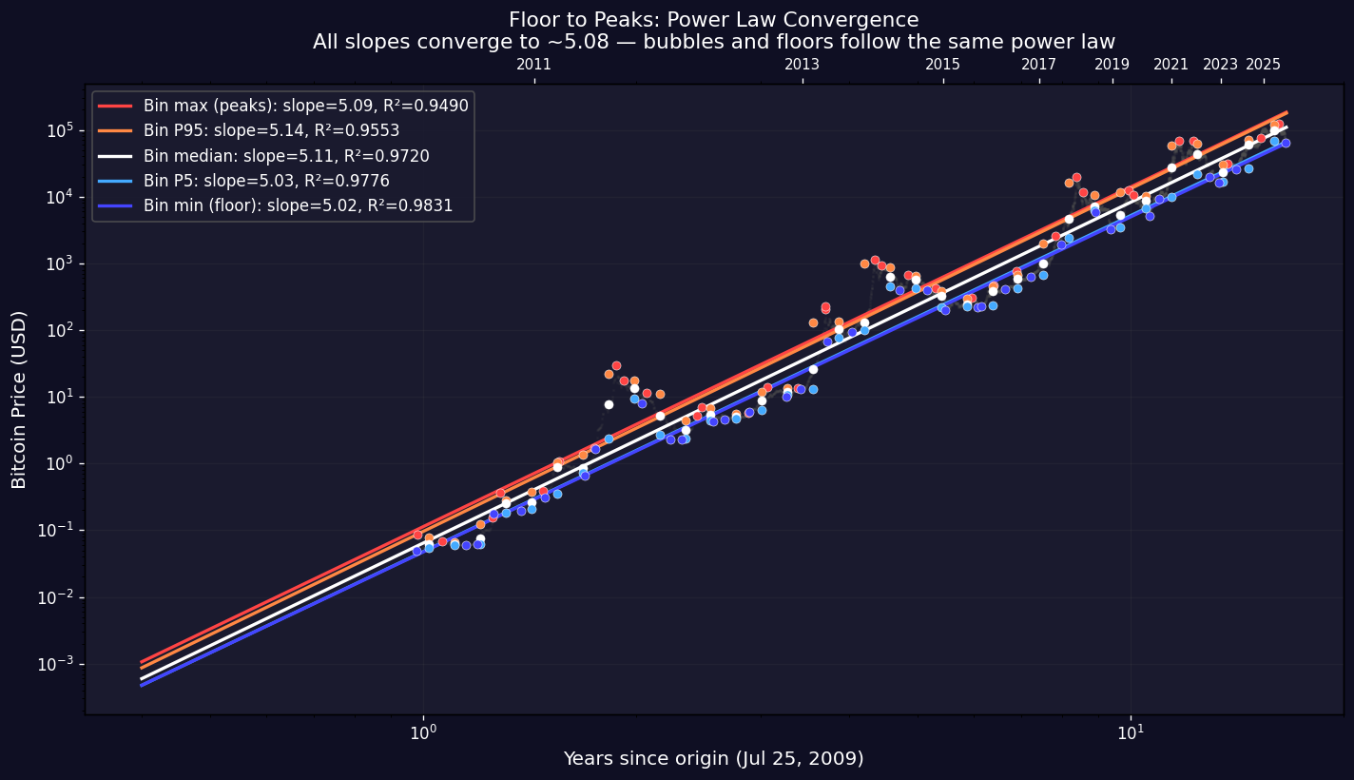
The Power Law Spans the Entire Price Distribution
34 equal-width bins
in log₁₀(t)
Percentile β R²
──────────────────
Peaks 5.09 0.949
P95 5.14 0.955
Median 5.11 0.972
P5 5.03 0.978
Floor 5.02 0.984
All slopes ≈ 5.02–5.14
The growth rate is
constant across the
entire distribution
Gap narrows over time:
volatility decreasing

Slide 6
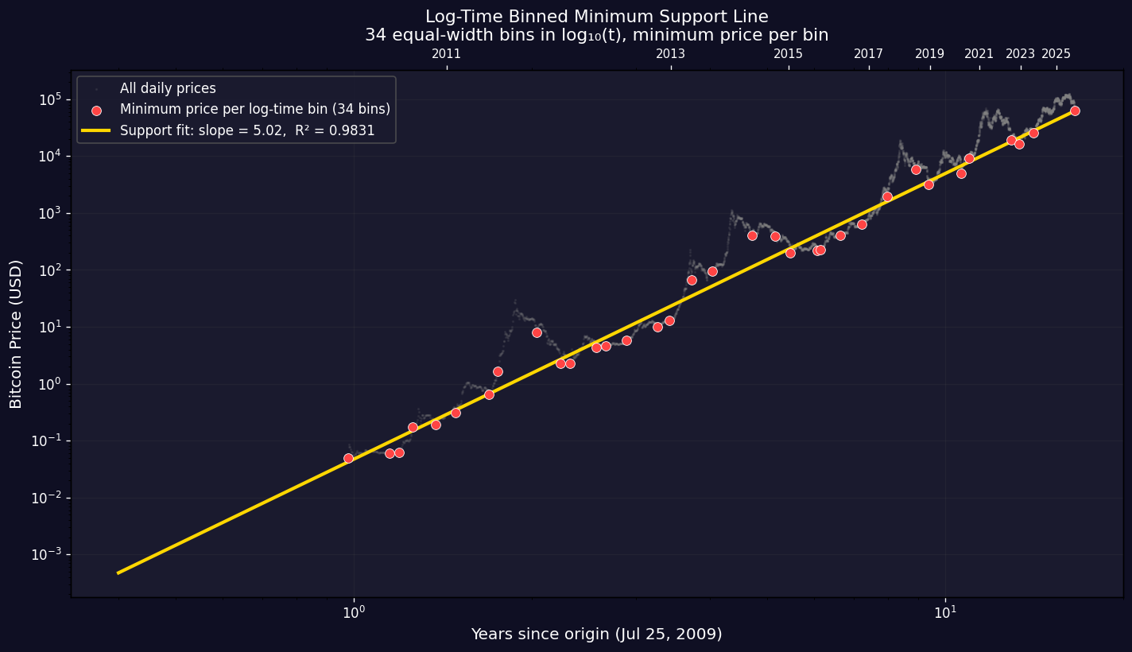
Log-Time Binned Support: Equal Weight to Every Era
Problem: recent data
has 8× more points per
unit of ln(t) than early
Solution: 34 equal-width
bins in log₁₀(t), take
minimum price in each bin
Result:
Optimal genesis:
Jun 25, 2009
R² = 0.984
Jul 28 ranks #3 of 944
Each era gets equal
weight regardless of
data density

Slide 7
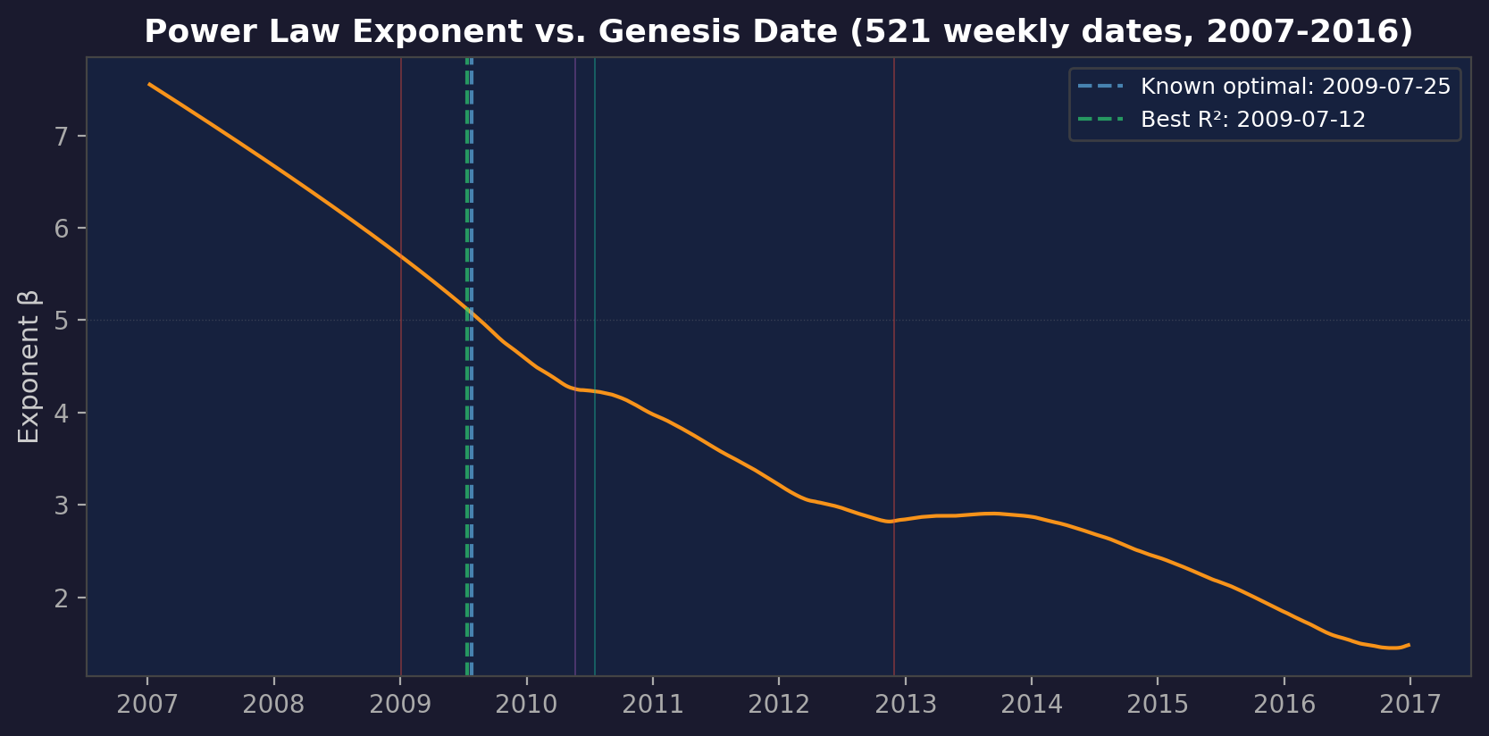
Optimal Time Origin: Genesis Date Sweep
Swept 521 weekly genesis dates from 2007-01-01 to 2016-12-31
Exponent ranges from β≈1.4 (late 2016 genesis) to β≈7.6 (early 2007)
Best R²=0.963 at July 12, 2009 — 13 days from independently known optimal (July 25)
Key dates annotated: Genesis block, Pizza Day, MtGox, halvings

Slide 8
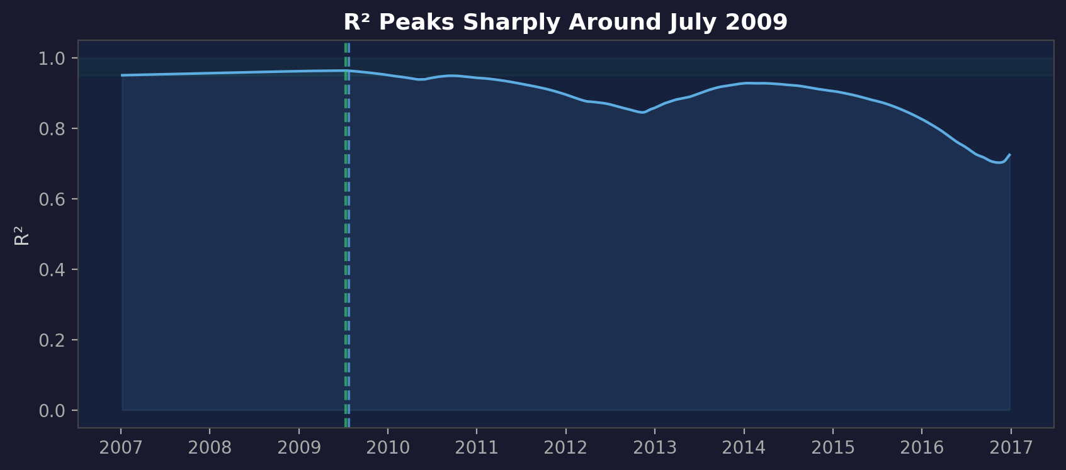
The R² Peak: A Narrow Window
R²>0.95 region spans only ~2 years around mid-2009
Moving genesis by even a few months drops R² significantly
No economic transactions occurred at this date — first $ rate not until Oct 2009
The date marks where Bitcoin's price behavior begins to follow a power law

Slide 9
Standard Error and the Weighting Question
Standard error of exponent: how precisely is β determined?
Std error minimizes at a DIFFERENT date than R² (~2014 vs ~2009)
Reason: 2014 genesis excludes messy early bubbles — remaining data is smoother
R² = how well the model explains the data
Std error = how precisely the slope is known (different question!)
Weighted Least Squares (log-uniform, weight=1/t):
Each unit of ln(t) gets equal weight — corrects for data being denser at large t
WLS optimal genesis shifts to May 2007 (β=7.7) — completely different!
Known 2009-07-25 has R²=0.56 under WLS — terrible
Conclusion: the "optimal" genesis depends on how you weight early vs late data
The 2009-07-25 optimality is specific to calendar-uniform (OLS) sampling
This is not a weakness — OLS reflects how the market actually operates (in calendar time)

Slide 10
Nine Independent Lines of Evidence → July 2009
1. Residual autocorrelation (Durbin-Watson)
July 25 produces least autocorrelated residuals (DW=0.004, #1 of 546 candidates)
2. Out-of-sample prediction (train/test split)
Jul 20-25 minimizes forward prediction error across 3 test windows (#11 of 546)
3. Slope stability across expanding time windows
Early Sep 2009 gives most consistent β (σ=0.099). Jul 25 ranks top 15%
4. Windowed support-line fit (bubble-free)
Bottom 5% of prices in 4yr sliding windows → optimal Jul 28 (R²=0.990)
4b. Log-time binned minimum support
34 equal-width bins in log₁₀(t), min price each → optimal Jun 25 (R²=0.984)
5. Hand-drawn Q10 support line
Two anchor points (Oct 2010 + Dec 2022) → slope=5.11, exactly 10% below → Jul 26
6. Floor-to-peaks convergence
All percentiles (floor→P5→median→P95→peaks) follow slope 5.02-5.14
Optimal genesis shifts Jun 2009 (floor) to Nov 2009 (peaks) — Jul 25 is the center
7. Q5% temporal uniformity
Optimize support line so 5% of prices fall below at every epoch → Jun 13, 2009
All nine methods converge on June-August 2009 — no economic transactions at this time

Slide 11
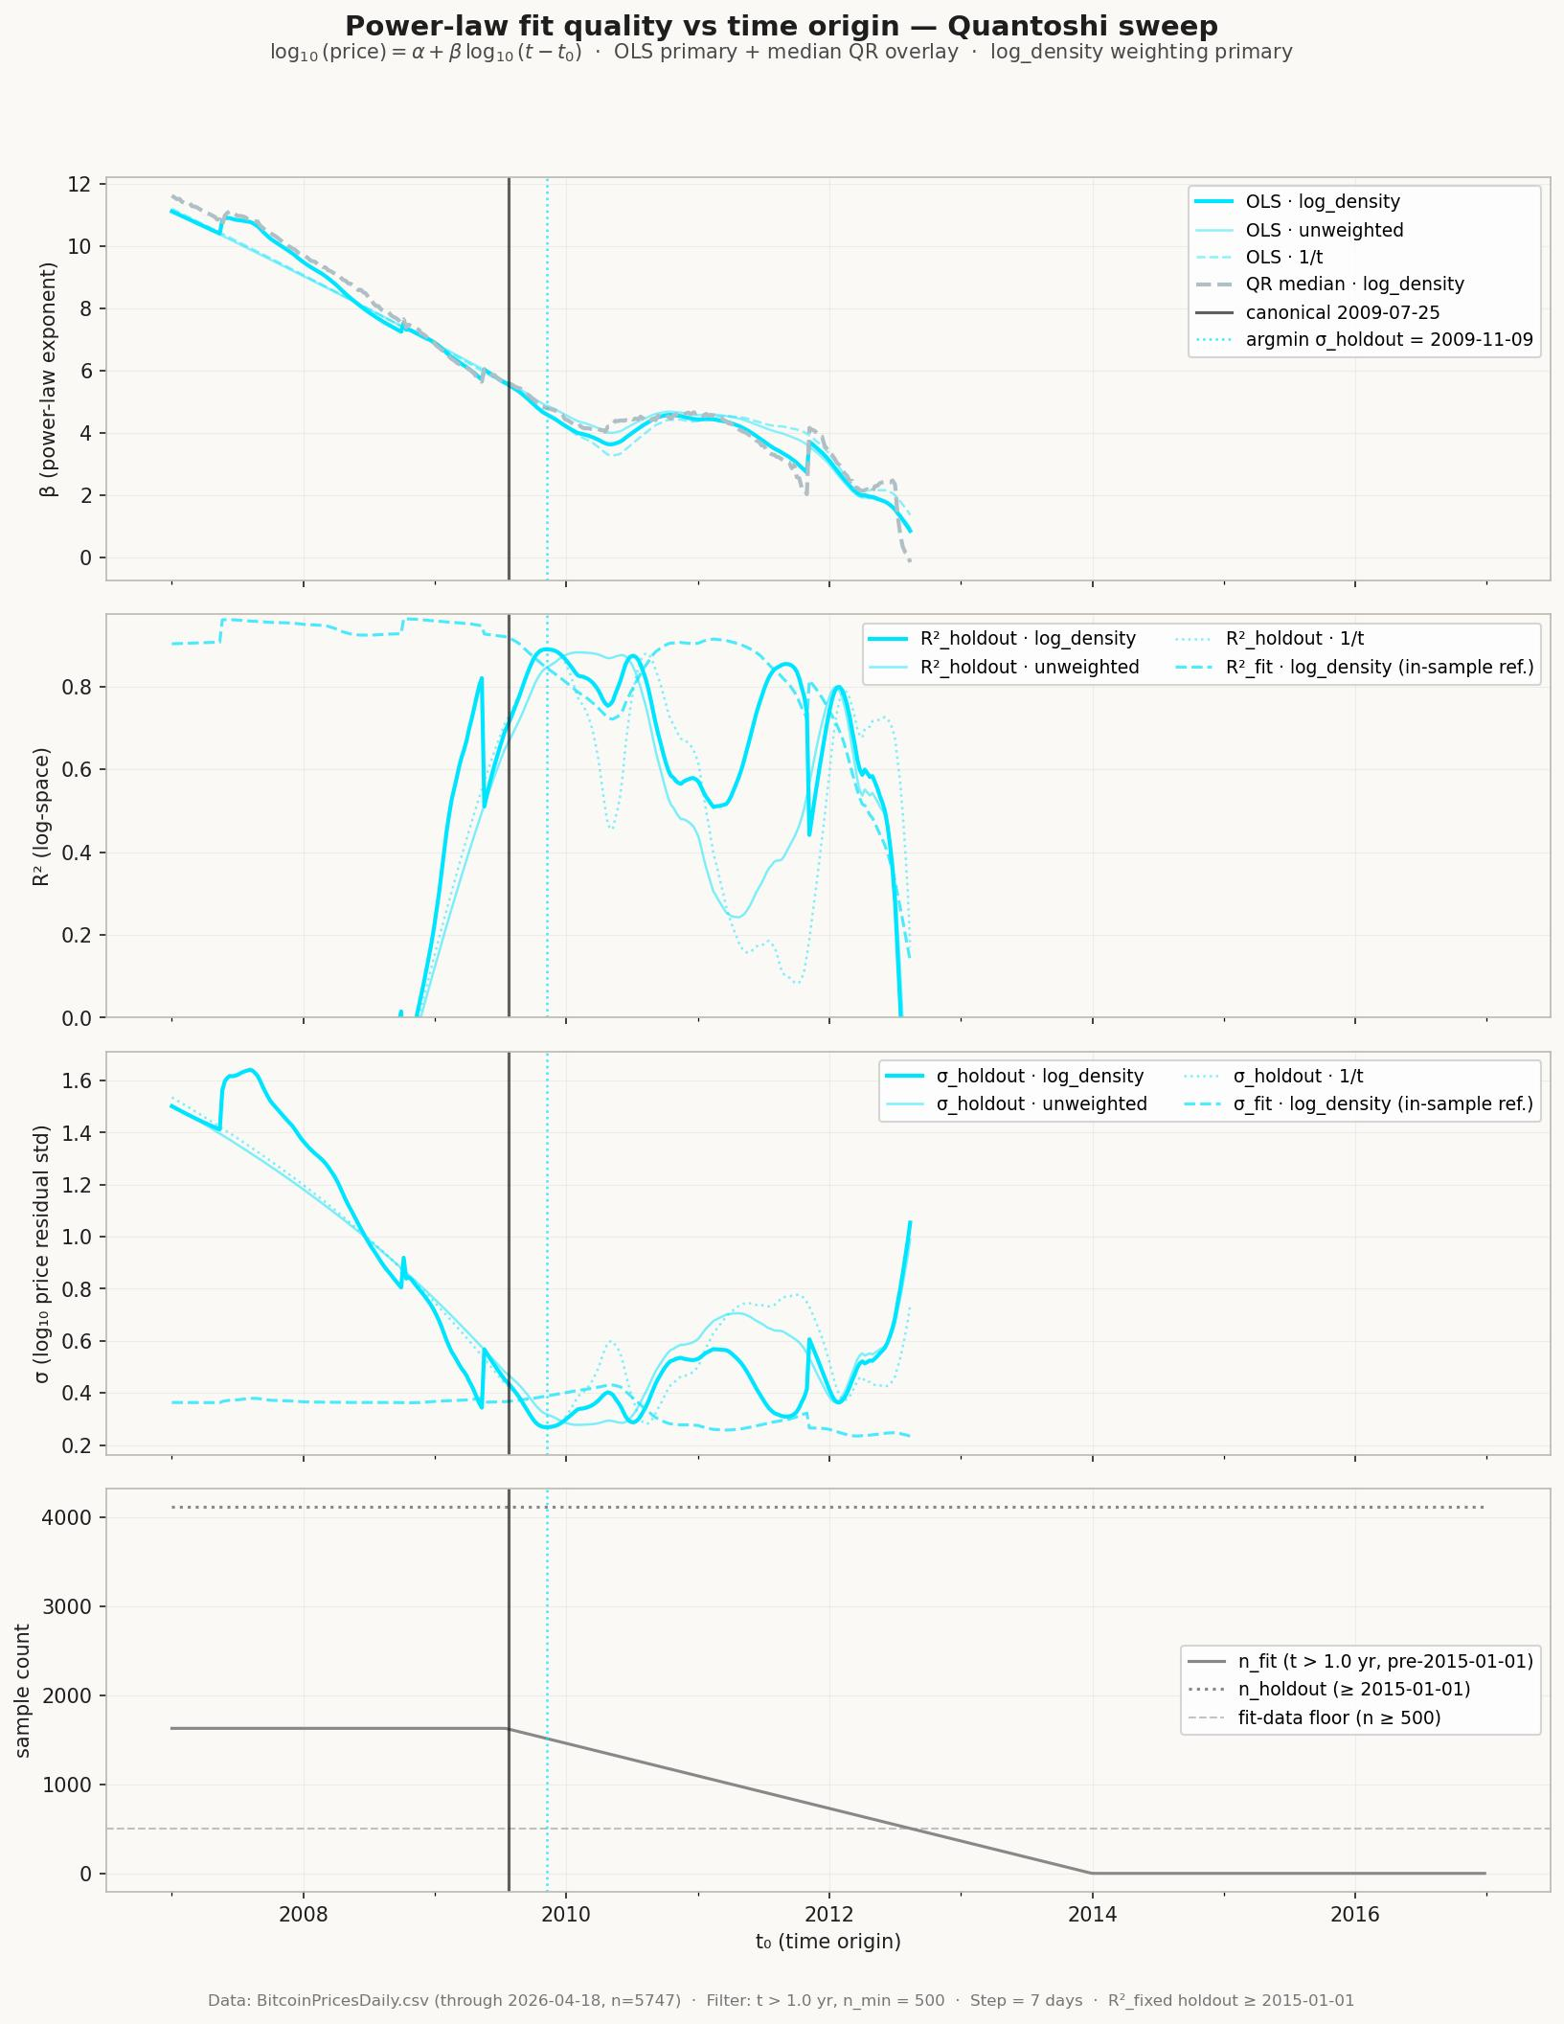
Eighth Test: OOS σ Sweep (Strict Train/Test)
Methodology — strict out-of-sample:
• Fit power law on pre-2015-01-01 data (n_fit ≈ 1,600 at canonical).
• Evaluate on 4,118 post-2015 samples the fit has never seen.
• Sweep 522 t₀ candidates at 7-day step, 2007-01-01 → 2017-01-01.
• Three weightings: log-density (primary), unweighted, 1/t.
Findings at the canonical t₀ = 2009-07-25:
• β = 5.53 σ_fit = 0.368 σ_holdout = 0.432
Optimum on this holdout:
• Argmin σ_holdout: 2009-11-09 (+107 days, ~15 weeks later)
• σ_holdout at optimum: 0.269 (40% lower than canonical)
• β at optimum: 4.58
Interpretation — a 4-month trough, not a sharp minimum:
• All three weightings converge on the same trough.
• Optimum is inside a wide σ_holdout valley spanning Q3 2009.
• β varies ~20% within the trough (4.6 – 5.5).
• Sweep ends at t₀ ≈ 2013 where n_fit drops below 500.

Slide 12
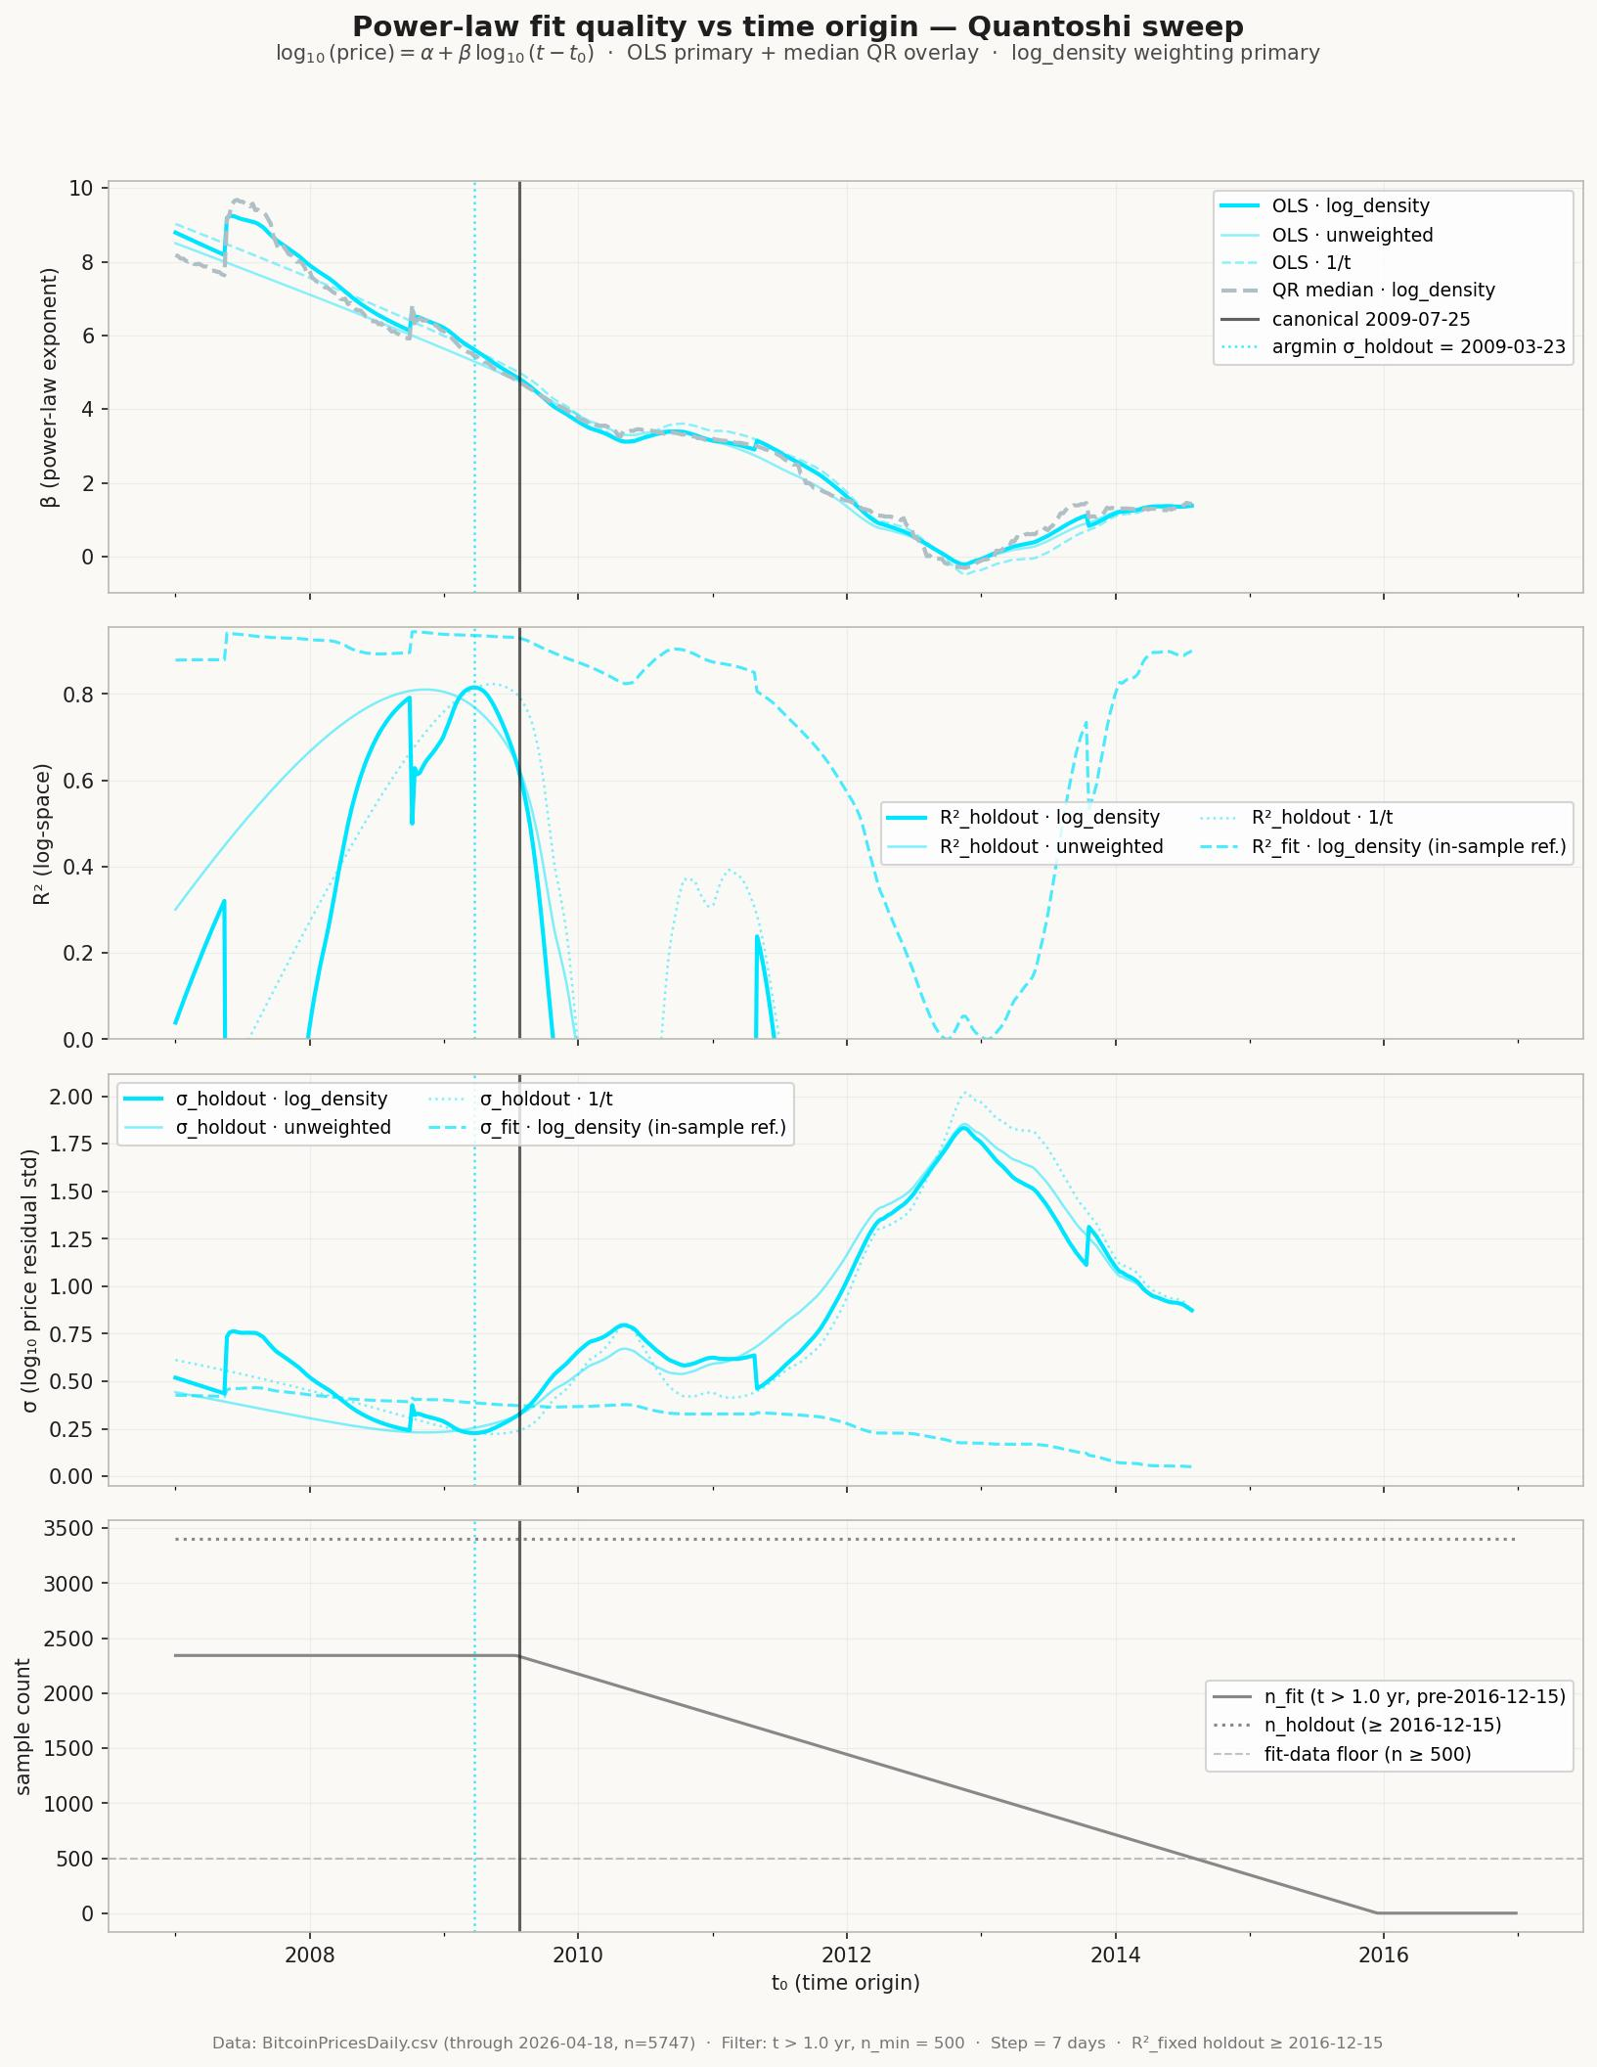
Moving the Holdout Boundary Flips the Optimum's Sign
Same sweep, different holdout boundary:
• Fit on pre-2016-12-15 data (n_fit ≈ 2,330 at canonical).
• Evaluate on 3,404 post-2016-12 samples.
• 2 extra years of training data vs prior sweep.
Findings at the canonical t₀ = 2009-07-25:
• β = 4.81 σ_fit = 0.372 σ_holdout = 0.331
Optimum on this holdout:
• Argmin σ_holdout: 2009-03-23 (−124 days, ~4 months earlier)
• σ_holdout at optimum: 0.228
• β at optimum: 5.62
The direction of the offset flipped:
• 2015 holdout → optimum is 107 d AFTER canonical.
• 2016-12 holdout → optimum is 124 d BEFORE canonical.
Takeaway — ~100-day scatter is methodology noise, not bias:
• Optimum position is sensitive to which era is ground truth.
• Canonical 2009-07-25 sits inside the ±4-month envelope
regardless of the holdout cutoff.
• Picking July 25 trades a small single-holdout σ loss for
robustness across methodology choices.

Slide 13
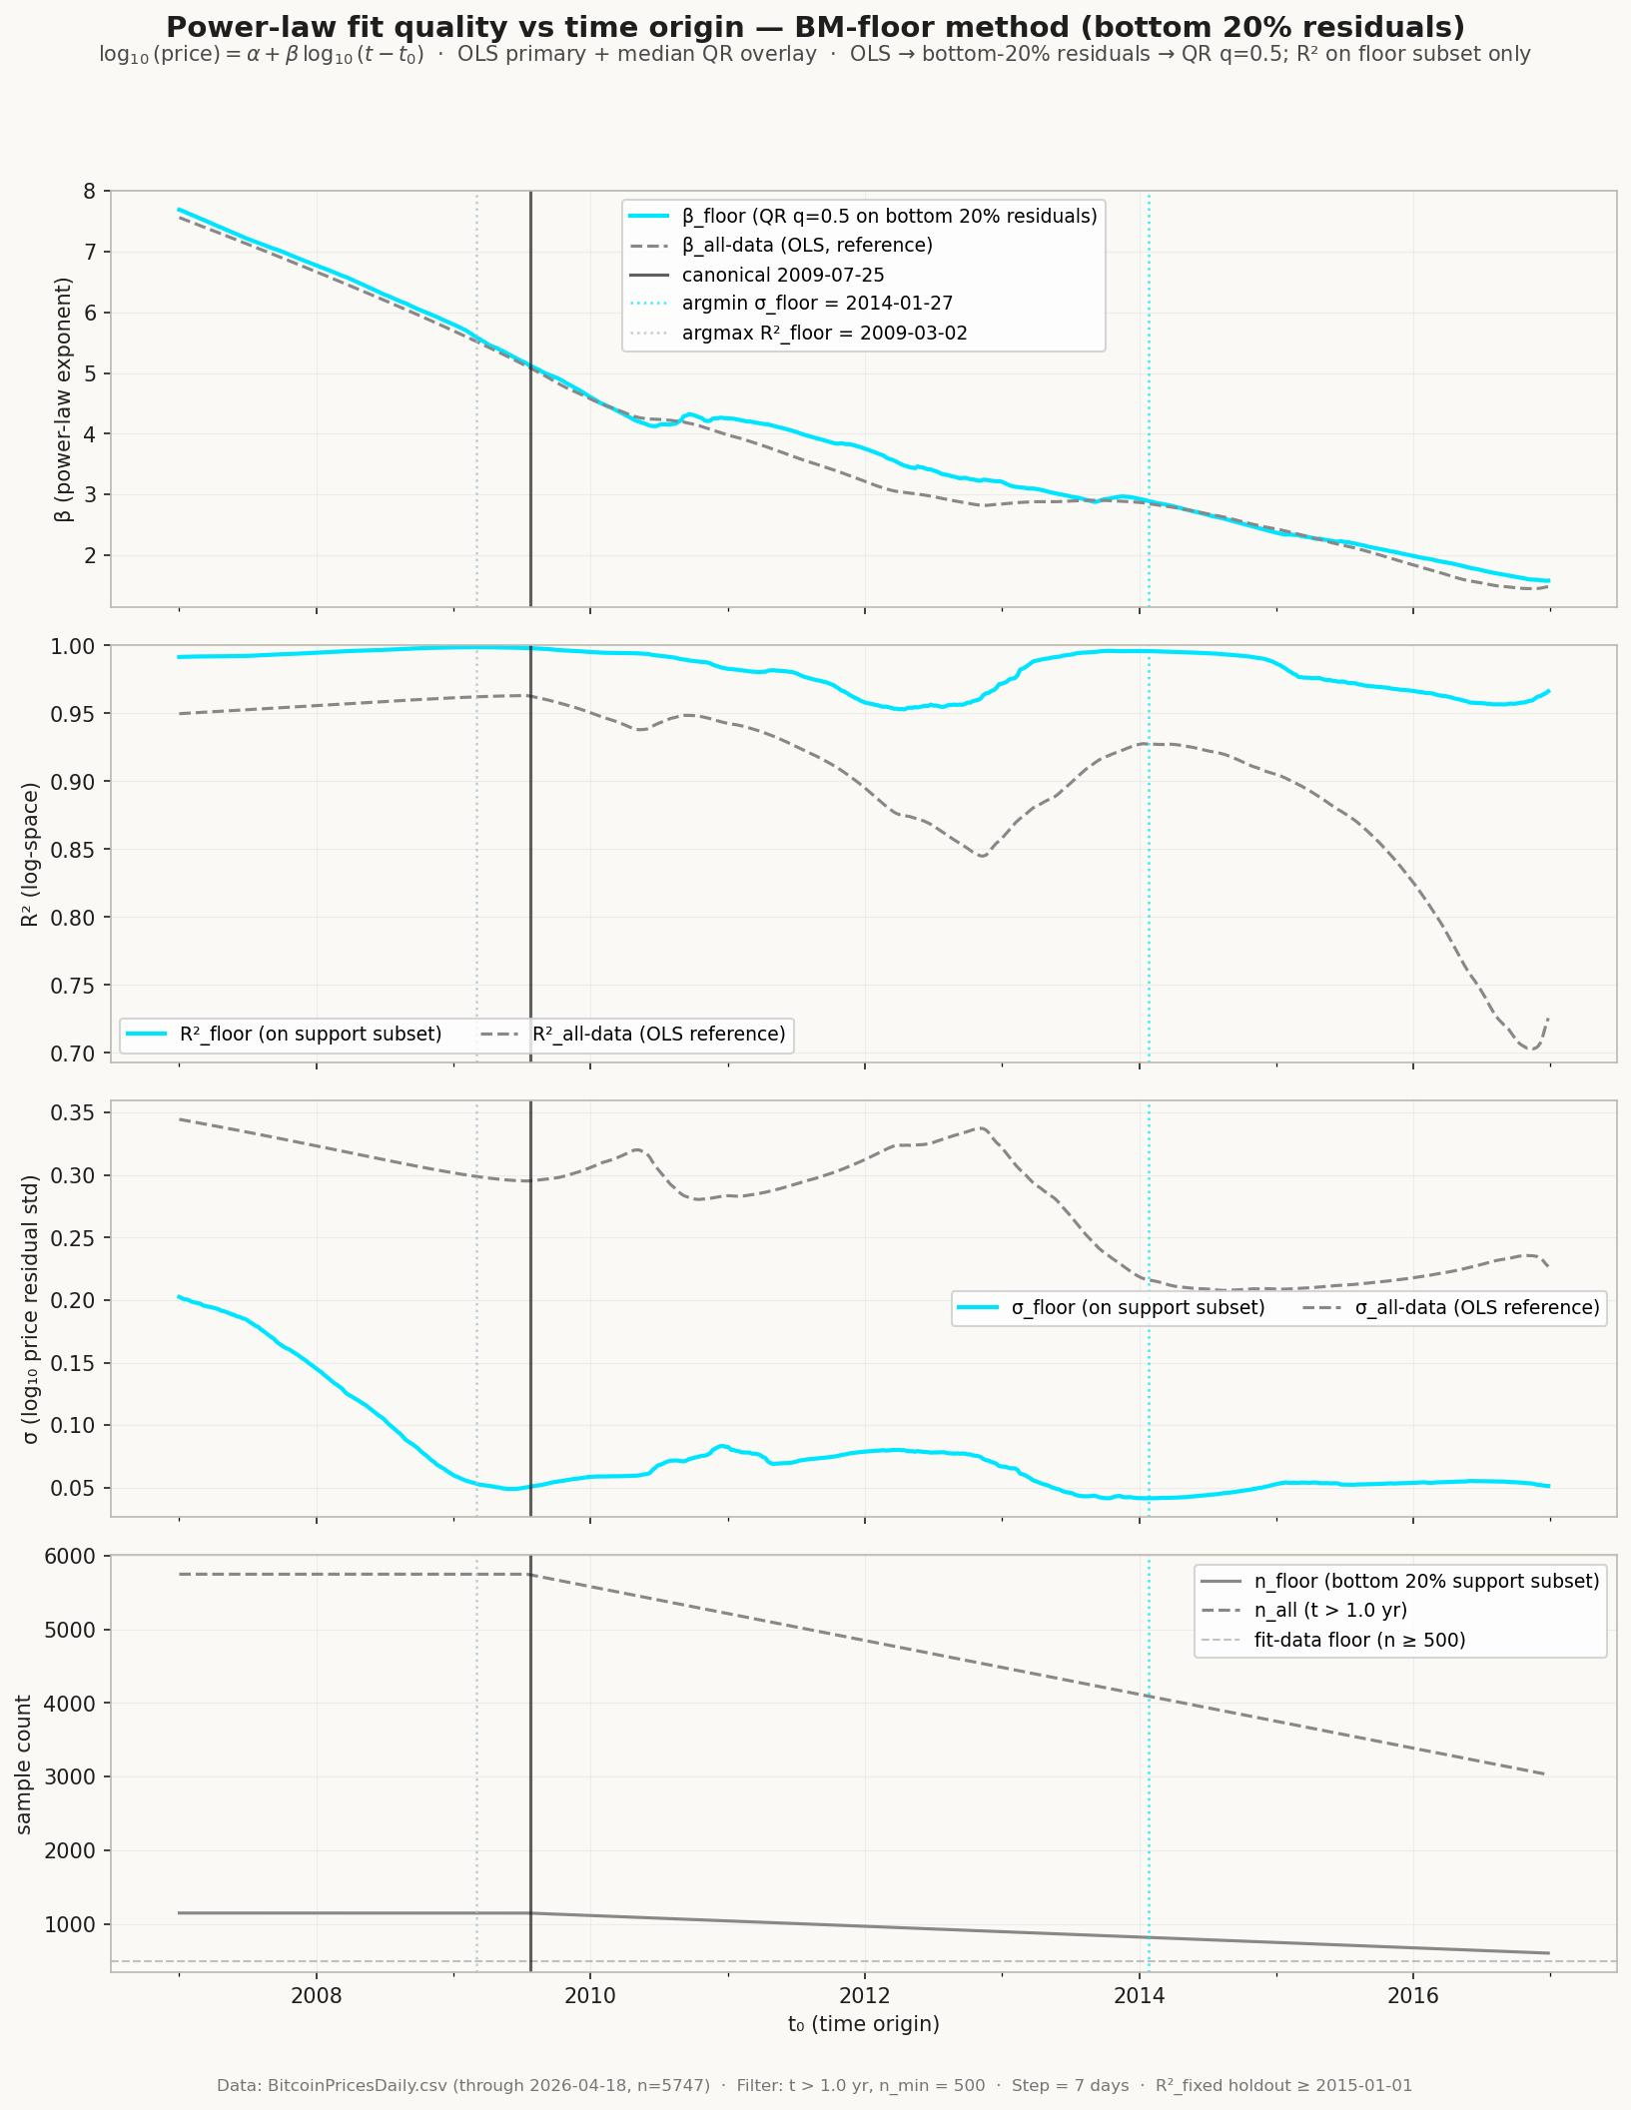
Ninth Test: BM Floor-Subset Sweep (Bubbles Excluded)
Methodology — price floor only, bubbles excluded by construction:
1. OLS fit on all data (t > 1 yr).
2. Keep bottom 20% of OLS residuals → support subset.
3. QuantReg q=0.5 on the support subset → floor line.
4. R² and σ computed against floor subset only.
Findings at the canonical t₀ = 2009-07-25:
• β_floor = 5.11 (matches all-data OLS β = 5.10)
• σ_floor = 0.042 (vs σ_all-data = 0.30 — 7× smaller)
• R²_floor = 0.995
Optimum on this test:
• Argmax R²_floor: 2009-03-02 (−145 days, ~5 months earlier)
• R²_floor at optimum: 0.9953 (canonical: 0.9949)
Note on σ_floor argmin (2014-01-27, confounded):
• σ mechanically shrinks as the floor subset thins.
• Don't trust the late-t₀ σ_floor minimum — it's an
artifact of subset-size shrinkage, not a better fit.
• R²_floor is the robust metric.
Convergence across three independent tests:
• OOS 2015 holdout → +107 days (after canonical)
• OOS 2016-12 holdout → −124 days
• Floor R²_floor argmax → −145 days
All three inside a ±5-month envelope; canonical is the midpoint.

Slide 14
Floor-to-Peaks: The Power Law Spans the Entire Distribution
34 equal-width bins in log₁₀(t). Fit power law to each percentile:
Percentile Slope Optimal Genesis R²
─────────────────────────────────────────────────
Bin max (peaks) 5.09 Nov 23, 2009 0.949
Bin P95 5.14 Nov 17, 2009 0.955
Bin median 5.11 Oct 16, 2009 0.972
Bin P5 5.03 Jun 1, 2009 0.978
Bin min (floor) 5.02 Jun 25, 2009 0.984
Key findings:
All percentiles follow nearly the same slope: β ∈ [5.02, 5.14]
The gap between peaks and floor narrows over time → volatility is decreasing
The underlying growth rate (~5.08) is constant across the entire price distribution
The floor "starts" earlier (Jun 2009) because it's anchored by the first prices
The peaks start later (Nov 2009) because the first bubble didn't happen until 2011
July 25 sits in the middle — balancing floor and peak behavior

Slide 15
What Does t=0 Mean?
The optimal time origin (July 25, 2009) is NOT:
The Bitcoin genesis block (Jan 3, 2009)
The first transaction (Jan 12, 2009)
The first dollar-denominated exchange rate (Oct 5, 2009)
Any specific economic event
It IS:
The date where Bitcoin's price behavior begins to follow a power law
A statistical property of the data, not a historical milestone
The point where the mathematical structure "turns on"
Blockchain data shows no economic activity in summer 2009
50 BTC in block 0 were unspendable (code bug). Block 1 mined 5 days later.
First real transaction: Satoshi → Hal Finney, Jan 12, 2009 (block 170)
First dollar rate: Oct 2009 (New Liberty Standard, 1,309 BTC = $1)
Interpretation: the power law may reflect the moment Bitcoin transitions from
"experiment" to "nascent monetary system" — even before anyone could price it

Slide 16
Three Tests Converge on July 2009
The optimal time origin was confirmed by three independent statistical tests:
1. Durbin-Watson test for autocorrelation in residuals
Residuals closest to white noise at genesis ≈ July 2009
2. Out-of-sample RMSE (train/test split)
Best predictive accuracy when genesis ≈ July 2009
3. Slope stability across subsets
Exponent most consistent when genesis ≈ July 2009
546 candidate dates tested — all three tests converge on the same narrow window
Distinct from the Bitcoin genesis block (Jan 3, 2009) — this is a statistical
property of the price data, not a specific economic event

Slide 17
Is the Power Law a Single Regime?
If residuals are autocorrelated (DW≈0.004), does that imply structural
regime changes — different power law slopes in different eras?
Five econometric tests on all available data (2010-2026, N=5,714):
1. Box-Cox λ sweep: optimal λ=0.012 ≈ 0 (pure log-log)
RMSE improves only 0.03% over λ=0. Power law IS the correct form.
2. Rolling regression (2yr window): slope oscillates ≈ −8 to +15
But always mean-reverts to ~5.0. If regime changed, slope would stay shifted.
3. Bai-Perron structural breakpoints: 6 breaks found (2011-2020)
All land at bubble peaks/troughs. Segment slopes 2.1-5.2 bracket 5.08.
These are cycle boundaries, not permanent regime shifts.
4. Chow test: F-tests significant (p≈0) at each break
Expected whenever bubbles temporarily alter the slope. Significance ≠ permanence.
5. CUSUM: residual sum wanders above/below zero in wave pattern
Classic bubble oscillation. No sharp one-way departure = no true structural break.

Slide 18
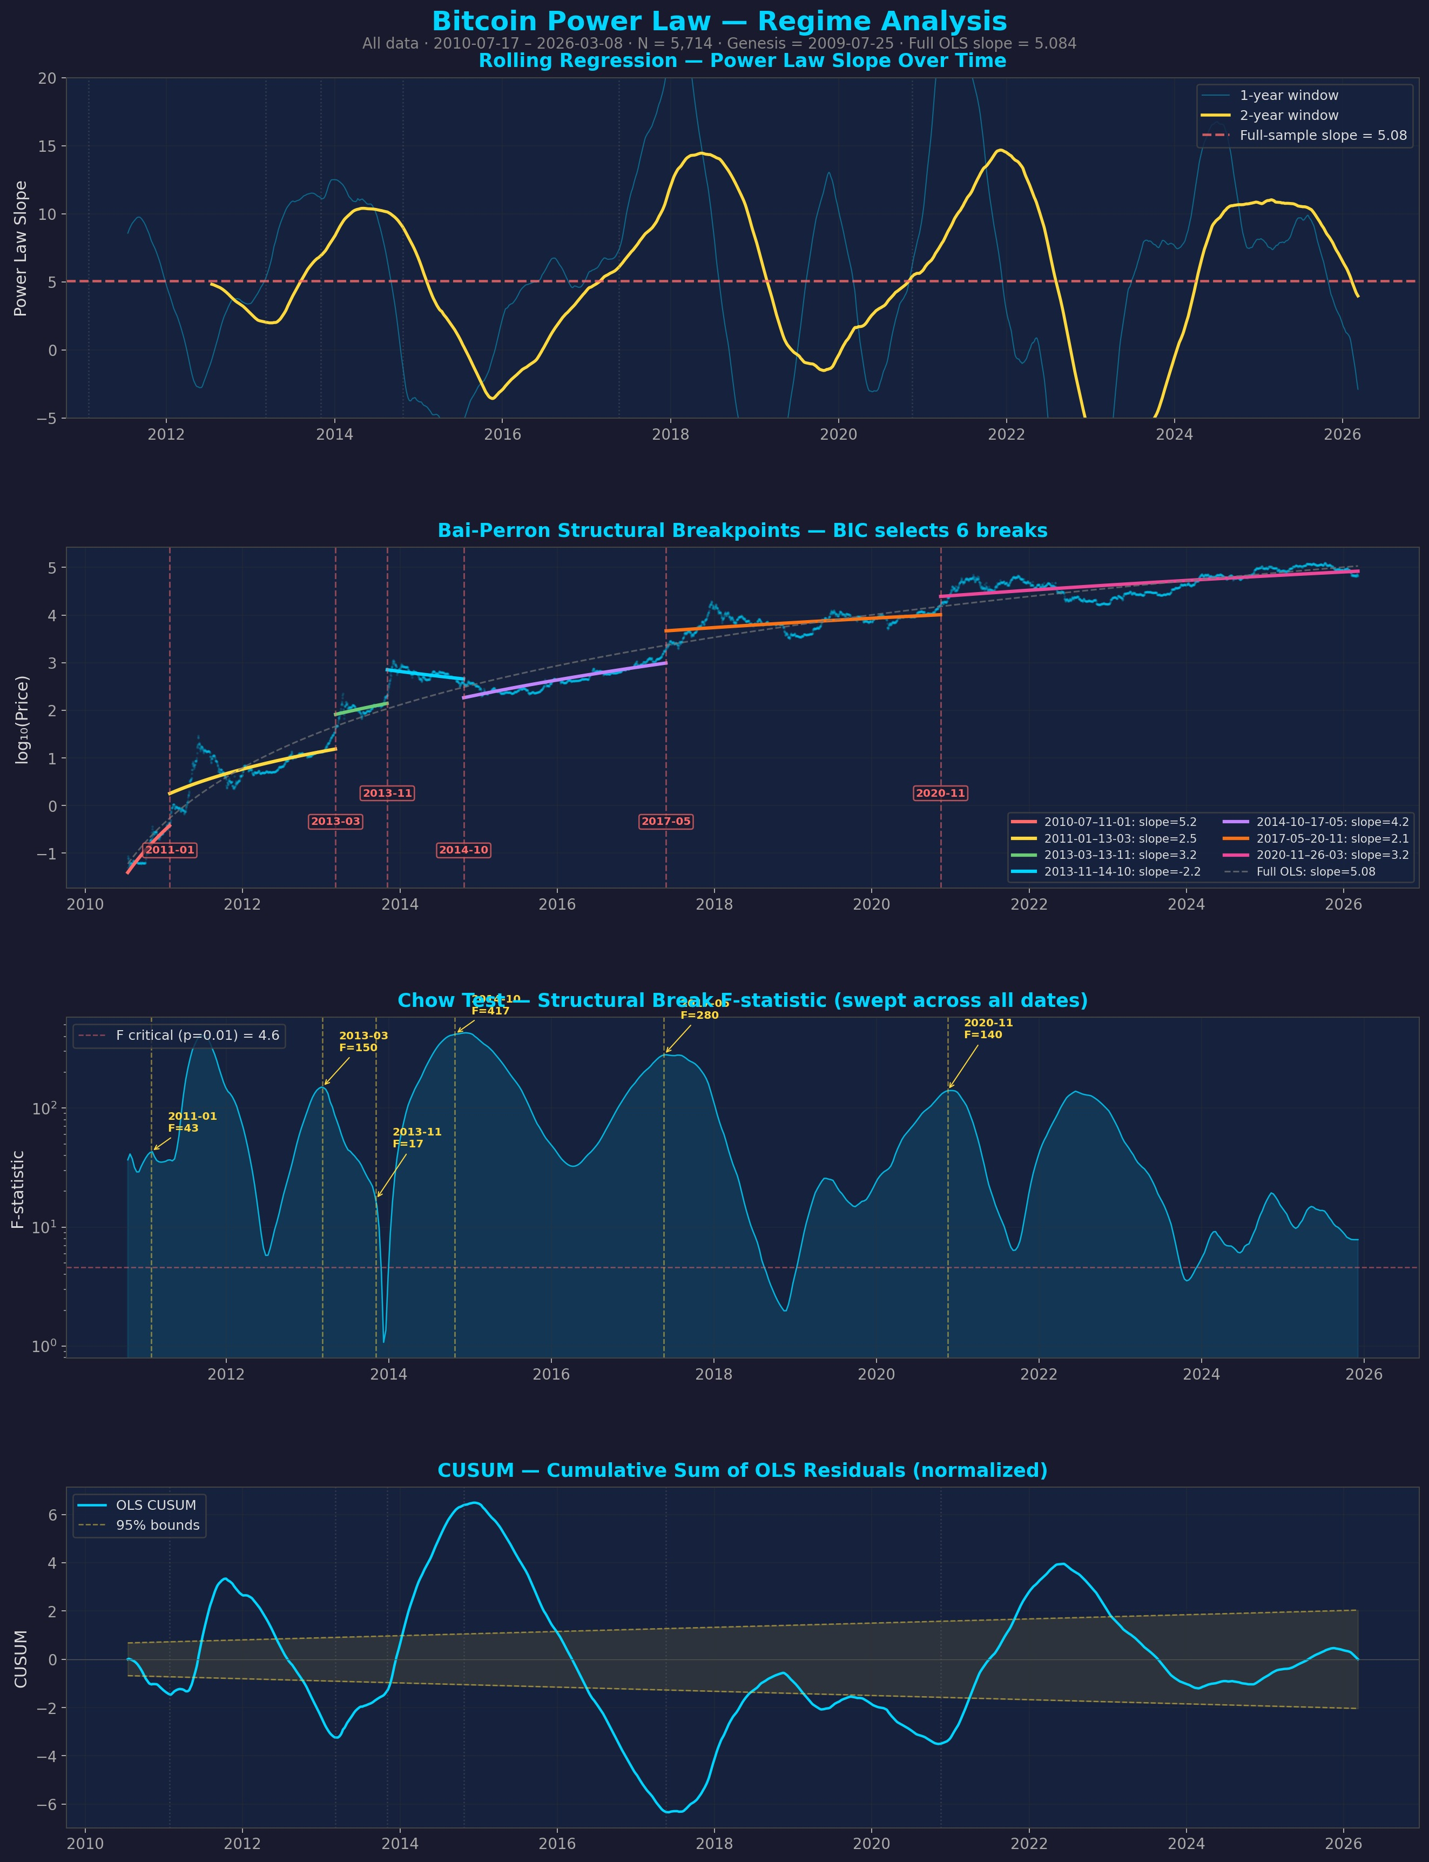
Regime Analysis: Rolling Slopes + Structural Breaks
Rolling 2yr OLS slope
oscillates wildly with
bubble cycles but always
returns to β≈5.0
Bai-Perron breaks all
coincide with cycle
peaks and troughs —
not permanent shifts
CUSUM shows oscillation,
not departure

Slide 19
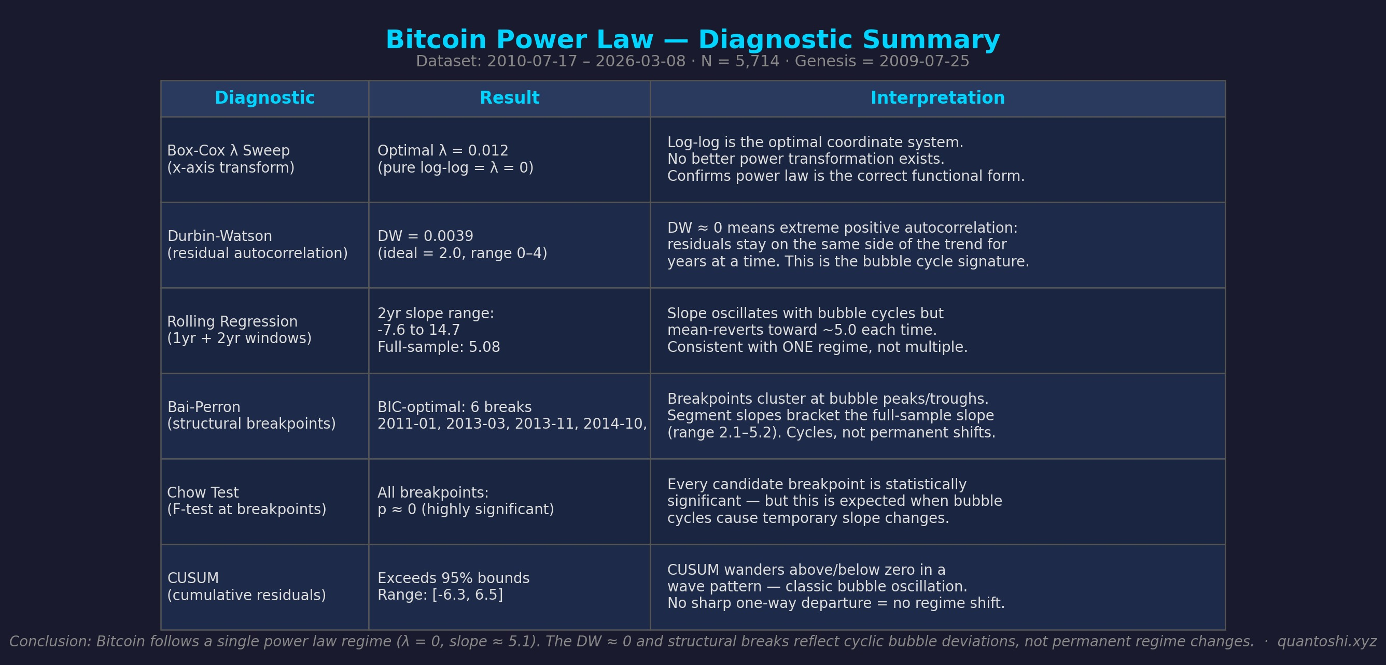
Conclusion: One Regime, One Power Law
Bitcoin follows a single
power law regime
λ = 0 (Box-Cox)
→ log-log is exact
β ≈ 5.08 (full sample)
→ same slope since 2010
DW ≈ 0 and structural
breaks reflect cyclic
bubble deviations, not
permanent regime changes
The slope oscillates with
market cycles but always
reverts to the same
long-term trend.

Slide 20
What's On Top of the Power Law?
Price = Power Law Trend + Oscillations + Noise
The central question: what are the oscillations, and can we predict them?
Investigation scope:
30+ model variants fitted via differential evolution
4 independent decomposition methods (PCA, EMD, DMD, sparse selection)
500+ basis functions tested (sinusoidal, triangle, flat-top, trapezoid, entropy-damped)
36 HybPPL configurations + 36 EPPL configurations pre-fitted
Non-sinusoidal wave shape analysis and bubble evolution study

Slide 21
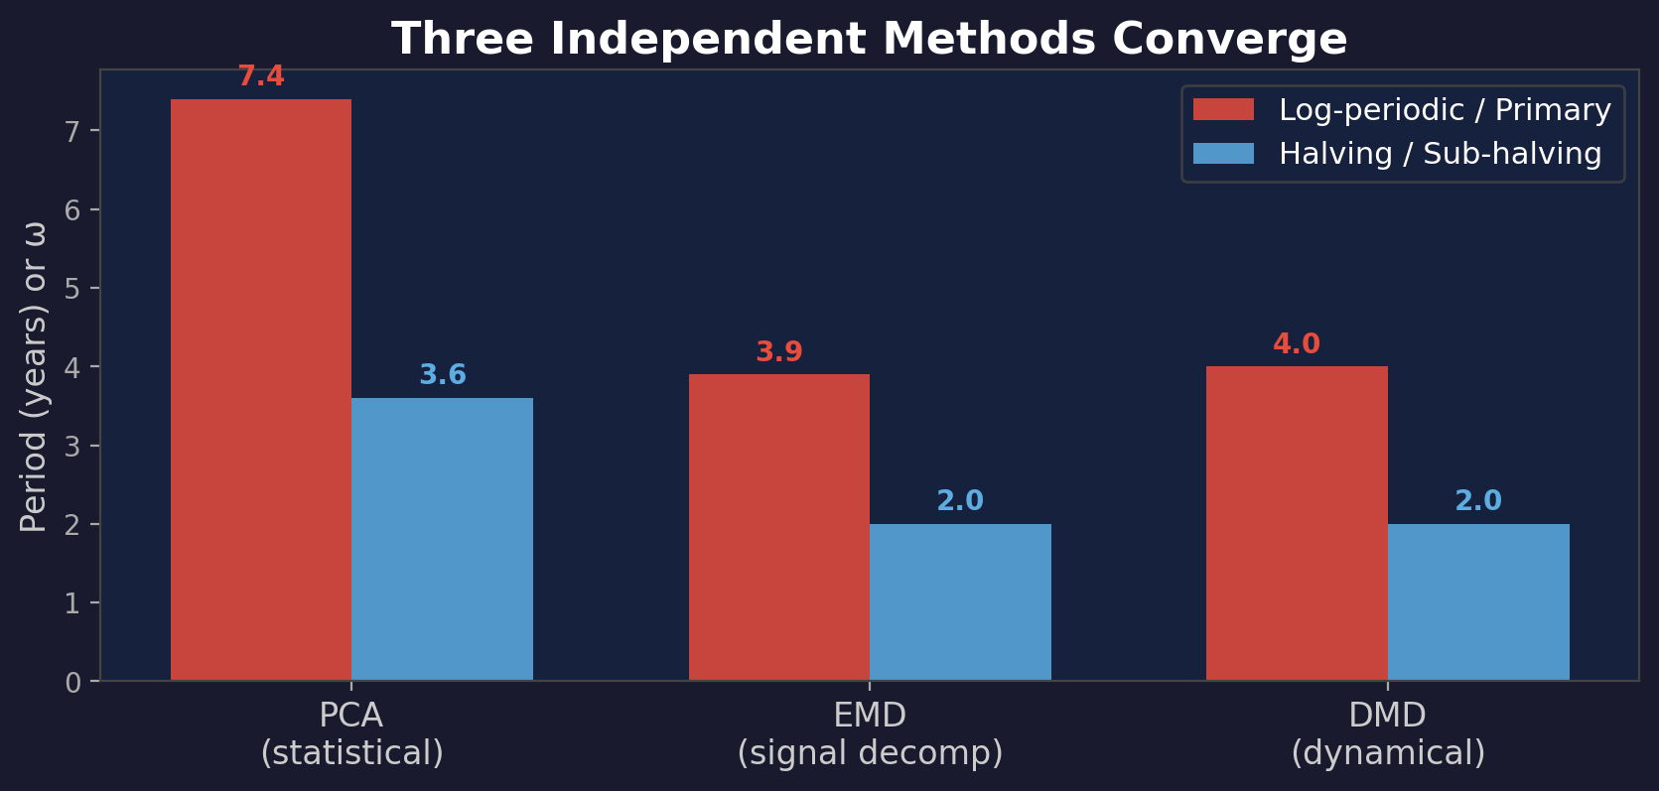
Two Dominant Signals — Found Three Ways
PCA: ω≈7.4 log-periodic + T≈3.6yr calendar — from 30 HybPPL model components
EMD: T≈3.9yr (IMF 7) + T≈2.0yr (IMF 6) — assumption-free signal decomposition
DMD: T≈4.0yr (nearly stable) + T≈2.0yr (slowly decaying) — eigenmode analysis
Three fundamentally different mathematical frameworks converge on the same two signals

Slide 22
The Hybrid Periodic Power Law Model Family
log₁₀(price) = A + B·log₁₀(t) + C₁·t⁻ᴰ·cos(ω_log·ln(t)+φ₁) + C₂·cos(ω_cal·t+φ₂)
Log-periodic component (ω≈7.4): fractal self-similarity, damped
Calendar component (T≈3.6yr): halving cycle, undamped — persists indefinitely
Extended to 2nd harmonics:
Hyb2L (+2nd log, ω≈16): R²=0.991, 13 params
Hyb2C (+2nd calendar, T≈1.9yr): R²=0.991, 12 params — sub-halving rhythm
Hyb2B (both 2nd harmonics): R²=0.993, 16 params — best parametric model
Hyb4D (all damped): R²=0.992, 18 params — worse! Calendar terms want to be undamped
Key finding: the halving cycle should NOT be damped — it's structural, not speculative

Slide 23
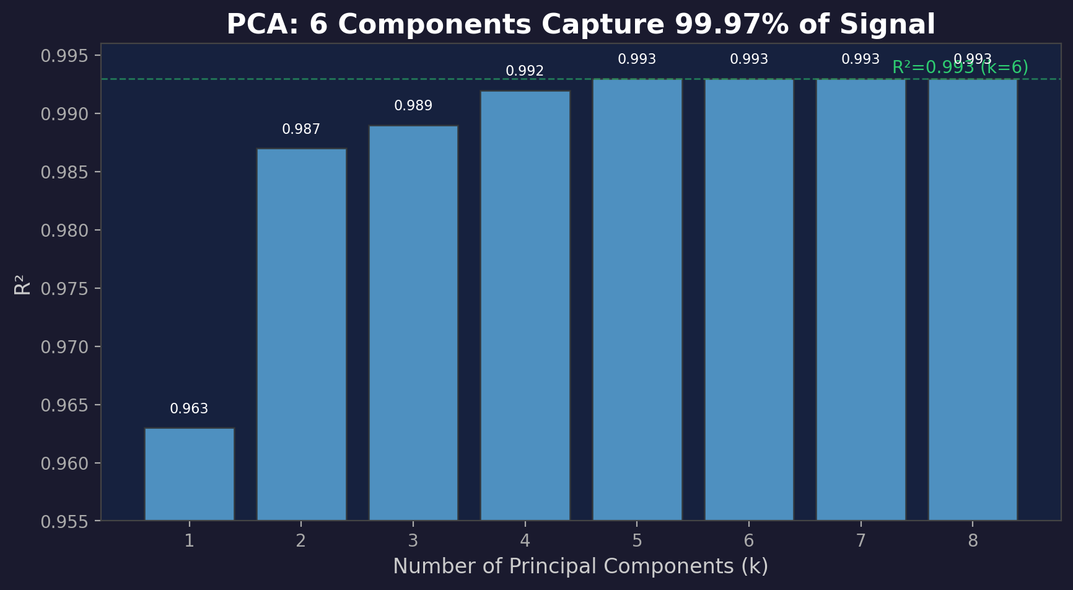
PCA: Optimal Compression in 7 Parameters
30 component curves from 6 HybPPL models → SVD → 6 orthogonal principal components
PC1 (97.2%): power law trend | PC2 (1.5%): halving cycle | PC3 (1.0%): log-periodic
R²=0.993 with 7 params — beats 16-param Hyb2B on BIC (-23,776 vs -23,203)

Slide 24
Synthetic Basis Search: Can We Beat Curated Components?
Tested 224 candidate basis functions:
Polynomials: log₁₀(t)ⁿ, tᵅ — useless (R²=0.964 max, can't represent oscillations)
Generic sin/cos at frequency grids (log-time + calendar-time)
Damped variants: t⁻ᴰ·cos(...) at D=0.3, 0.7, 1.0
Gompertz saturation curves (27 variants)
Broken power law pieces (4 breakpoints)
Result: the curated HybPPL basis wins convincingly
Generic dictionary needs k=24 (25 params) to beat curated k=6 (7 params)
At equal k=6: dictionary R²=0.951 vs curated 0.993 — dramatically worse
Why: DE-fitted ω≈7.42 and D≈0.71 can't be matched by a frequency grid
Nearby-but-wrong frequencies waste PCA dimensions

Slide 25
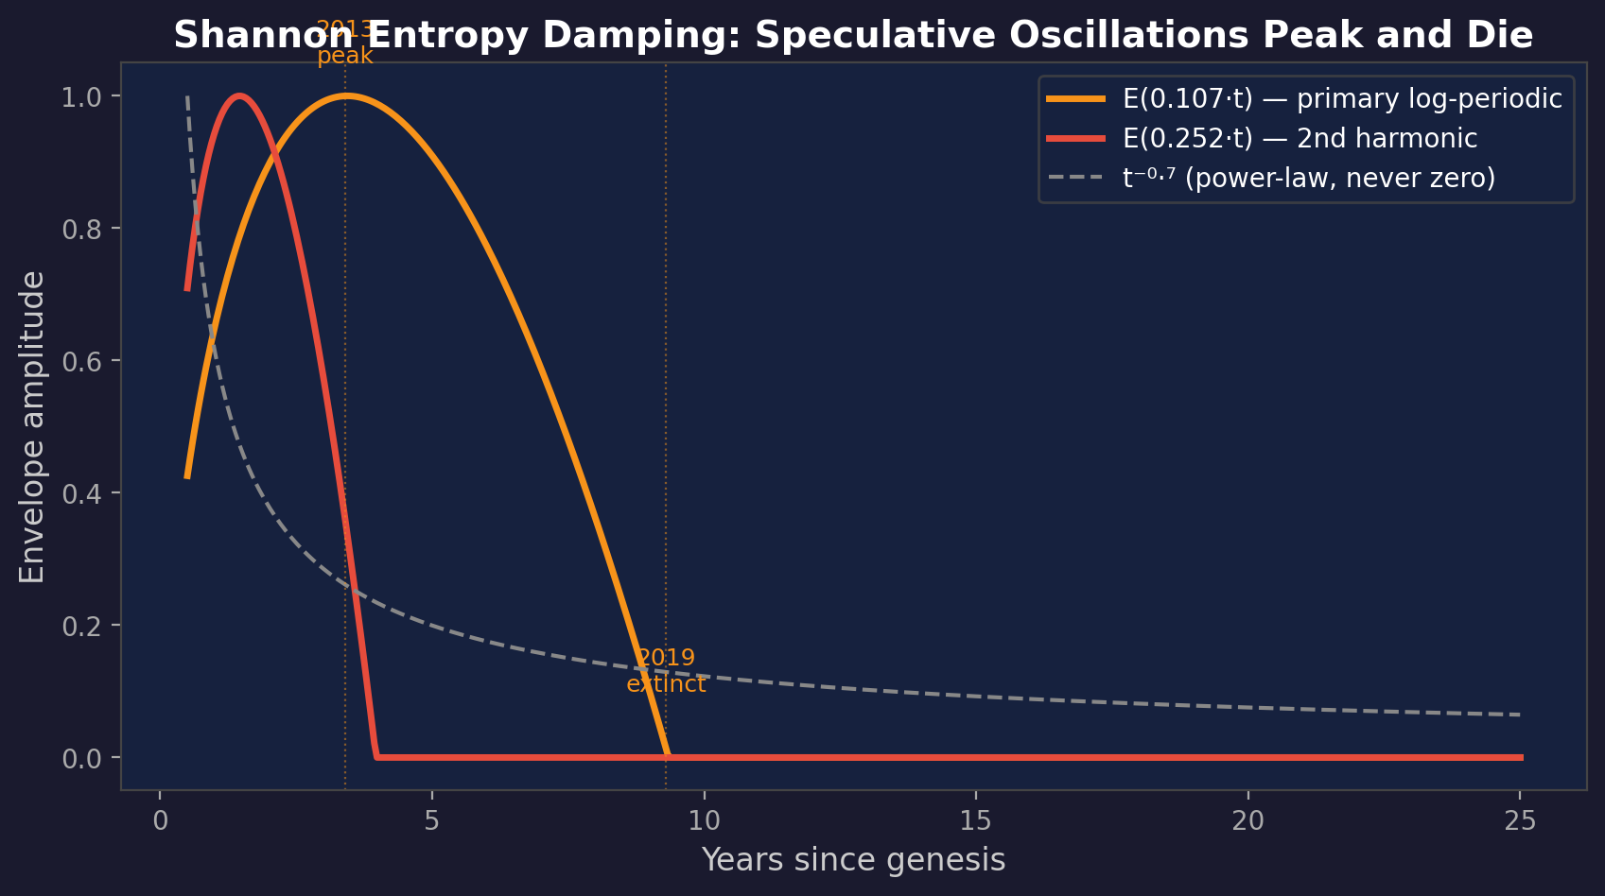
The Entropy Discovery: Shannon Meets Bitcoin
E(w·t) = max(-w·t·ln(w·t), 0)/(1/e) — the Shannon entropy function
Peaks at 37% of adoption lifecycle (maximum uncertainty), zero at 100% (resolved)
EPPL beats HybPPL on BIC at same param count: -21,065 vs -20,814 (9p)

Slide 26
What the Entropy Parameters Say
w·t = 0.37 at t=3.5yr (2013) — exactly 1/e, maximum entropy
Peak speculative uncertainty. "Will Bitcoin survive?" is maximally uncertain.
w·t = 1.0 at t=9.5yr (2019) — adoption resolved
Log-periodic oscillations go to zero. The speculative era ends.
w·t = 1.68 at t=16yr (now) — well past the zero crossing
Current price dynamics driven by halving cycle, not speculation.
The log-periodic signal was an artifact of the "will it survive?" era.
The mathematical form is literally the entropy function, and the fitted parameters
put maximum entropy right at the peak of early Bitcoin speculation.

Slide 27
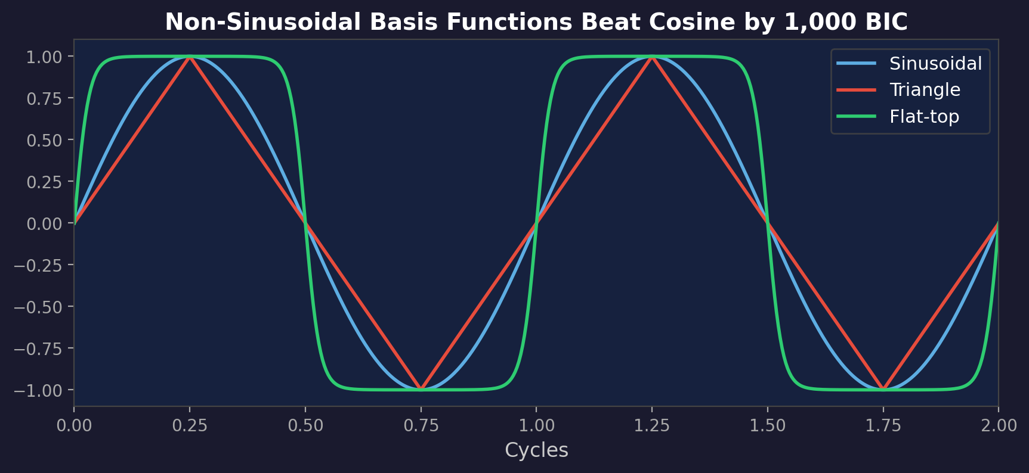
Bitcoin Cycles Aren't Smooth Sinusoids
Triangle + flat-top waves beat sinusoidal by ~1,000 BIC (with 1 extra param)
Mixed-shape dictionary (5 wave types × 2 time bases): R²=0.997 at 27 params
Flat-top dominates selection (10/25 terms) — Bitcoin has plateau-like peaks
Triangle wave at ω=7.4 was #1 novel selection — log-periodic peaks are sharper than sinusoidal

Slide 28
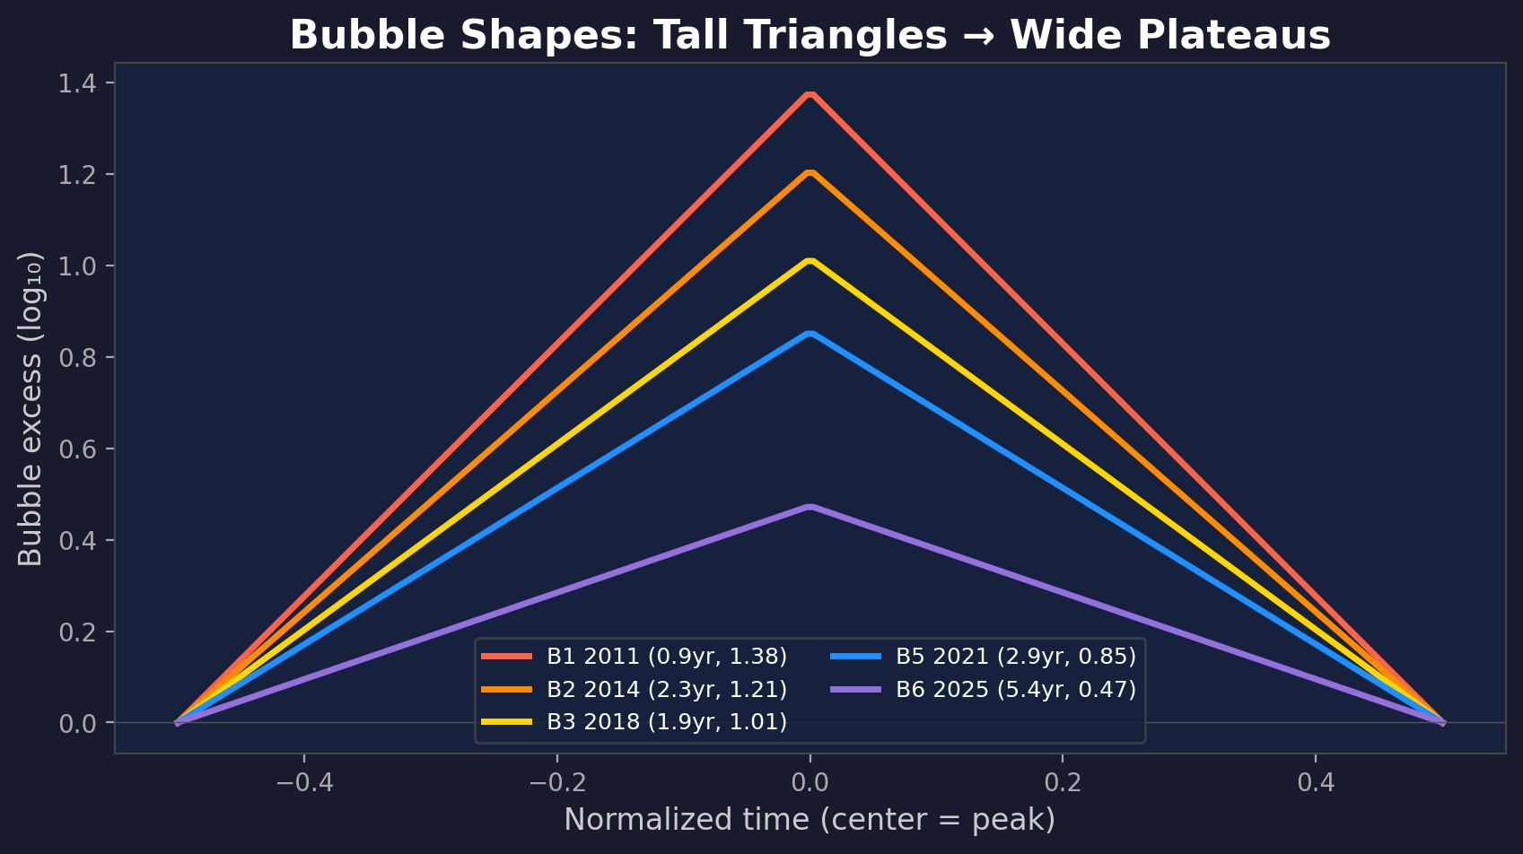
Bubble Shapes Are Maturing
Duration widening: 0.87yr (2011) → 5.39yr (2024) — statistically significant (p=0.012)
Amplitude shrinking: each cycle ~20% smaller (p=0.016)
Interpretation: as participant base grows, speculative excess distributes over longer periods

Slide 29
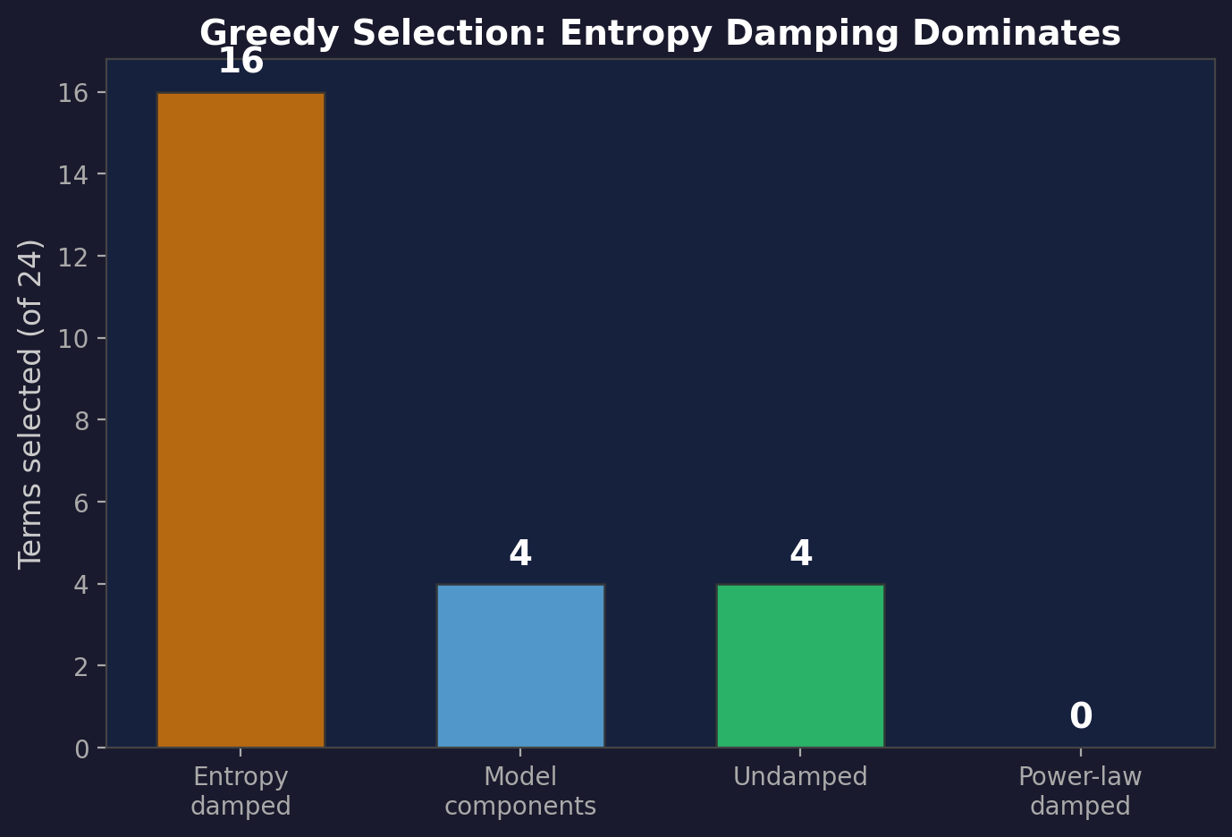
Greedy Select: Entropy Damping Dominates
467-function dictionary: entropy-damped, power-law-damped, undamped, EPPL components
Entropy selected 16 of 24 terms. Power-law selected ZERO when entropy available.
7-param model: R²=0.9935, BIC=-23,886 — best BIC at 7 params across ALL models

Slide 30
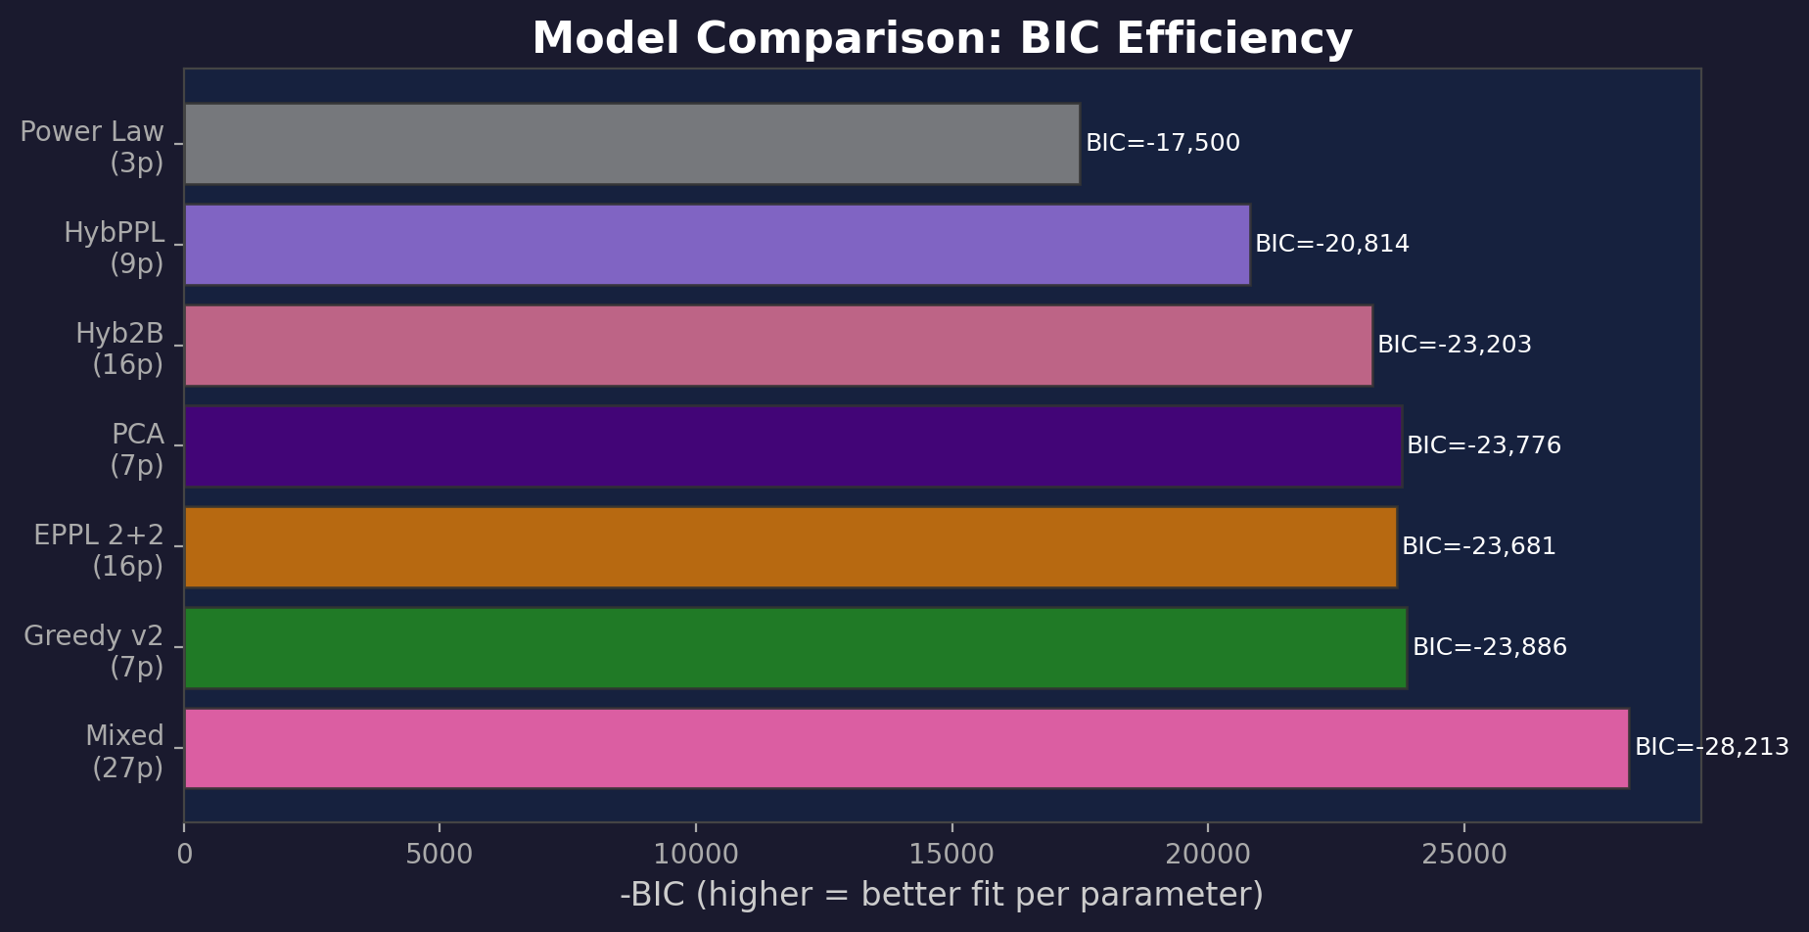
Model Comparison: BIC Efficiency
BIC penalizes extra parameters — lower BIC = better fit per parameter
Greedy v2 (7p) beats PCA (7p) and EPPL 2+2 (16p) — entropy basis is most efficient

Slide 31
Implications for Bitcoin's Future
The power law trend (β≈5.1) continues — this is structural
The halving cycle (~3.6yr) persists undamped — expect continued cyclicality
But: each cycle is 20% smaller in amplitude and wider in duration
The era of 10×+ speculative spikes is over
Entropy says adoption uncertainty is resolved
Future cycles resemble normal asset class behavior with halving-driven periodicity
Projected: Cycle 7 (~2032) peak ~$465K, Cycle 8 (~2035) peak ~$818K

Slide 32
Tools and Reproducibility
Interactive exploration: quantoshi.xyz
9 tabs: Price & Model Overlays, CAGR Heatmap, DCA, Retirement, Supercharger,
Citadel Planner, Stack Tracker, Model Info, FAQ
Configuration panels: HybPPL (36 configs), EPPL (36 configs), LPPL (10 variants)
Two-model comparison (A/B) for side-by-side exploration
Static analysis pages:
/B: Sensitivity sweep | /D: Residual FFT | /G: Wave basis comparison
/H: Genesis date sweep | /E: Regime shift analysis
Open source: github.com/bg002h/quantoshi
Model Info tab (/8): complete formulas, coefficients, methodology for every model

Slide 33
Summary: Three Sentences
1. Bitcoin has exactly two oscillatory structures — a log-periodic speculative signal
and a calendar halving cycle — confirmed independently by PCA, EMD, and DMD.
2. The speculative signal peaked in 2013 and is now extinct, as captured by
Shannon entropy damping — the first information-theoretic model of Bitcoin.
3. Future price behavior: power law trend + flattening, amplitude-shrinking
halving cycle — the mathematical signature of market maturation.

Slide 34
Model Robustness: Frequency, Volatility, Scale
Time-varying frequency: ω₁ = -0.056 ≈ 0
The log-periodic frequency is constant — not drifting. Fixed-ω assumption validated.
Heteroscedastic volatility: σ(t) = 0.077·t⁻⁰·¹⁹
Windowed σ: 0.150 (2010-13) → 0.109 (2013-17) → 0.139 (2017-21) → 0.092 (2021-26)
Early era is 1.5× more volatile — should use time-dependent quantile bands
Multi-scale self-similarity:
Daily β=5.08 | Weekly β=5.09 | Monthly β=5.12 | Quarterly β=5.18 | Yearly β=5.34
R² > 0.96 at every resolution. The power law holds from daily to yearly.
Slight β increase at coarser scales: aggregation removes downside volatility.

Slide 35
Cross-Validation: Which Models Generalize?
Test R² across 5 cutoff dates (train before, test after):
Model 2020-26 2021-26 2022-26 2023-26 2024-26
─────────────────────────────────────────────────────────────
Power Law (3p) 0.60 0.08 0.57 0.64 0.35
HybPPL (9p) 0.42 0.19 0.71 0.63 0.42
EPPL 1d+1u (9p) 0.62 0.64 0.71 0.65 -0.43
Key finding: EPPL generalizes best across most splits
The entropy zero-crossing prevents dead oscillations from propagating forward
HybPPL collapses at 2021 cutoff (0.19) — power-law-damped oscillations persist too long
All models overfit: train R²≈0.99 vs test R²≈0.64
Post-2023 ETF dynamics don't follow historical oscillatory patterns

Slide 36
Asymmetric Damping + Quantile-Specific Oscillations
Asymmetric oscillations: falls damp 3.5× faster than rises
D_rise = 0.56 vs D_fall = 2.00 (hit constraint bound)
FOMO builds slowly, panic resolves quickly — BIC improves by 120
Quantile-specific structure:
Log-periodic amplitude scales with quantile:
Q5% (floor): C=0.07 → Q50%: C=0.15 → Q95% (peaks): C=0.27
Upper quantiles oscillate 4× larger than the floor
Power law slope varies by quantile:
Q5%: β=5.41 (steep floor) → Q95%: β=4.87 (flatter peaks)
The floor grows faster than the peaks — volatility compression
Calendar oscillation amplitude is roughly constant (~0.24) across all quantiles

Slide 37
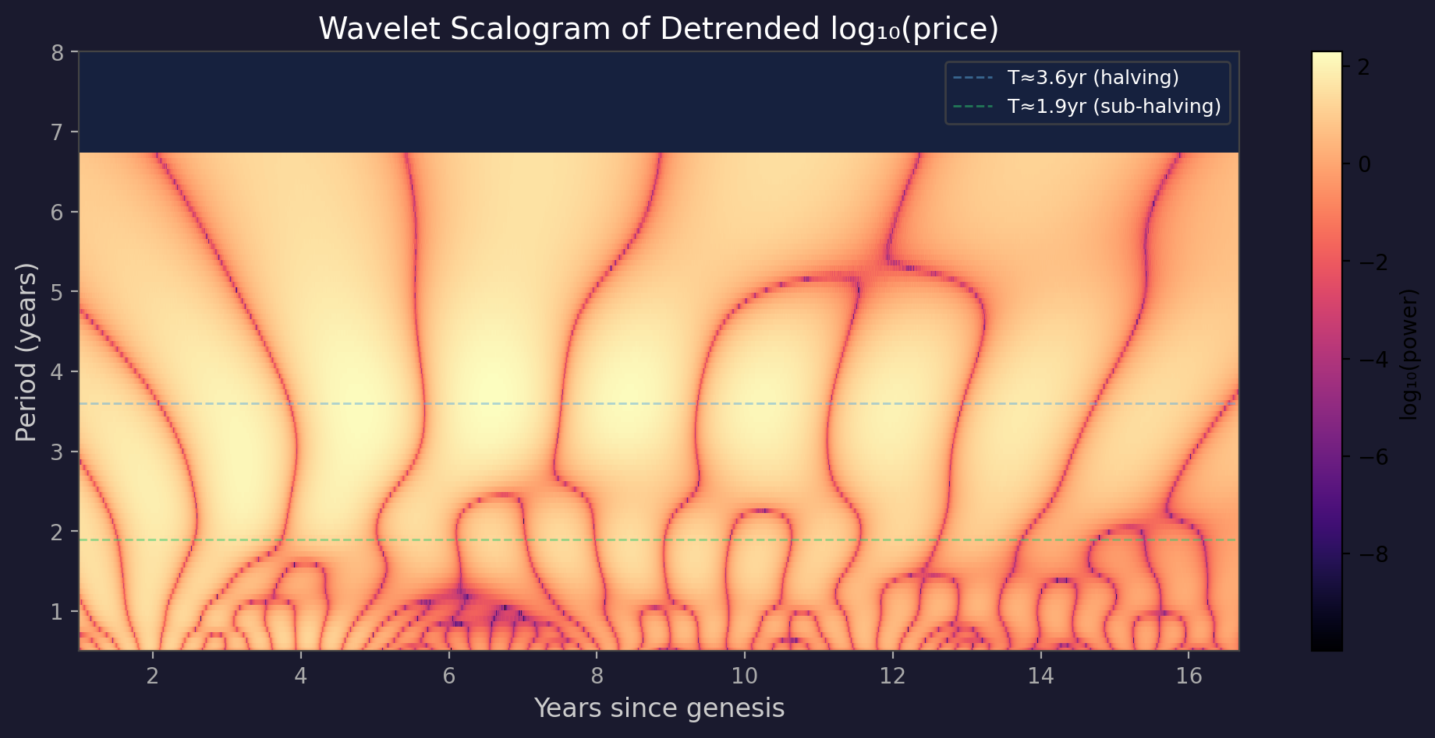
Wavelet Scalogram
Halving cycle (T≈3.6yr) overwhelmingly dominant across all time and scale
Early era power is 2× late era — oscillations fading (supports entropy model)
Log-periodic invisible: it's a chirp in calendar time (T varies from 1.7yr to 13.6yr with t)

Slide 38
Symbolic Regression: Machine Discovers the Power Law
PySR (genetic programming) searched for log₁₀(price) = f(t)
Available operations: +, -, ×, ÷, log, cos, sin, exp
500 subsampled points, 40 iterations, complexity up to 25
Best equation (complexity=6):
log₁₀(price) = 2.174·ln(t) − 1.097 = 5.01·log₁₀(t) − 1.10
This IS the power law — β≈5.01, discovered from scratch with zero assumptions
R² = 0.962 on full data (same as our fitted power law)
Higher-complexity equations found cosine terms (complexity ≥ 15)
but with minimal improvement — confirming oscillations are secondary to the trend
Genesis date is an INPUT, not discovered — PySR cannot find log(year − 2009.56)
from raw calendar year (finds linear fit instead, R²=0.87)

Slide 39
Fourier Extrapolation: 5-Year Forward Projection
Remove power law trend, FFT the residuals, keep top 20 modes, project forward
R² = 0.923 on historical residuals (20 modes)
Projected prices (power law + Fourier residuals):
Year Price Interpretation
─────────────────────────────────────────
2027-04 $724,114 Cycle peak?
2028-03 $85,292 Post-peak crash
2029-03 $294,282 Recovery
2030-03 $676,513 Next peak?
2031-03 $157,485 Next crash
⚠ Caveat: Fourier extrapolation has NO damping
Projects historical oscillation amplitudes unchanged into the future
Real cycles are fading (entropy/damping) — these projections are too volatile
Useful for showing cyclical structure, NOT for reliable price targets

