Slide 1
An Introduction to Time Series Forecasting with Python
Andri Gakhov, PyCon UA, Kharkiv, April 28-29, 2018

Slide 2
What is a Time Series?

Slide 3
A sequential set of data points measured over time.
x(t),, t = 0, 1, 2, 3, . . .
t - a variable that represents the elapsed time.

Slide 4
Examples
hourly number of page views for a website daily air temperature in a city
monthly average number of reported bugs quarterly income for a company
annual population data in a country

Slide 5
A Time Series may contain information about general tendency in data,
seasonal effects, occasional events, and so on.

Slide 6
Time Series Decomposition

Slide 7


Trend
The general (long-term, non-periodic) tendency of a time series
Often modeled using the logistic growth model, or can be extracted from data using Moving Average technique

Slide 8
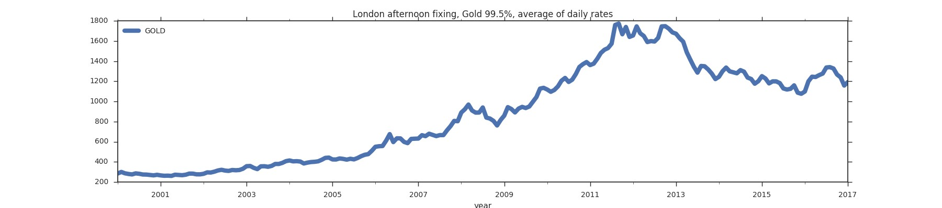
Example
The WoldBank Dataset, London afternoon fxing, Gold 99.5%, average of daily rates

Slide 9
Seasonal
The periodic fluctuations caused by regular influences
Can be modeled using Fourier series

Slide 10
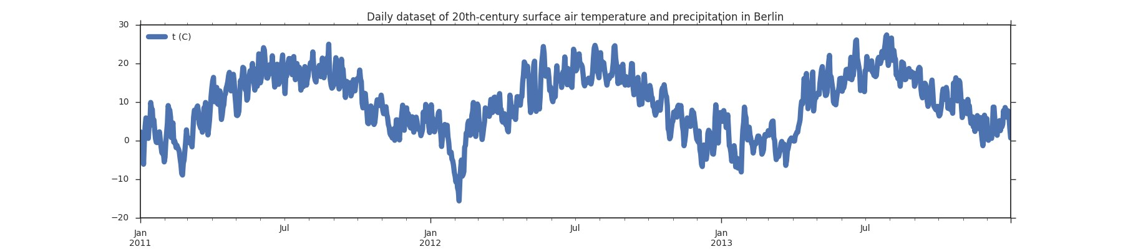
Example
European Climate Assessment & Dataset, Air temperature in Berlin

Slide 11
Cyclical
The medium-term fluctuations caused by cyclicaly occured non-periodic influences

Slide 12
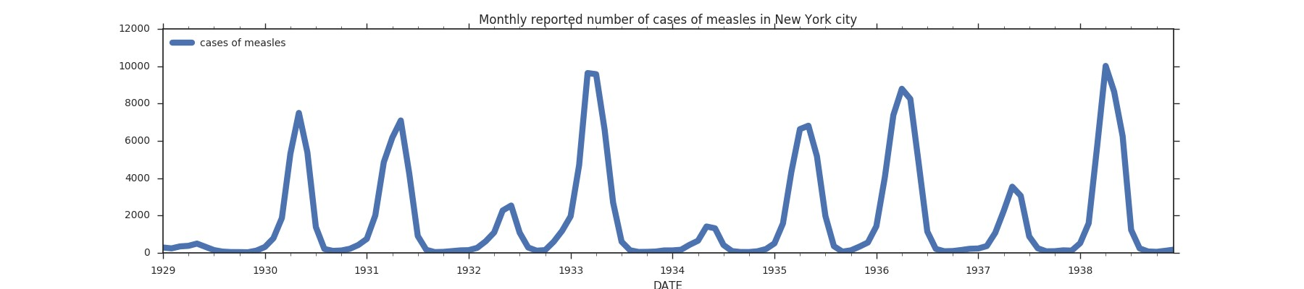
Example
London W., Yorke J.A., The monthly reported number of cases of measles, New York city

Slide 13
I regular
Random variations caused by unpredictable influences

Slide 14
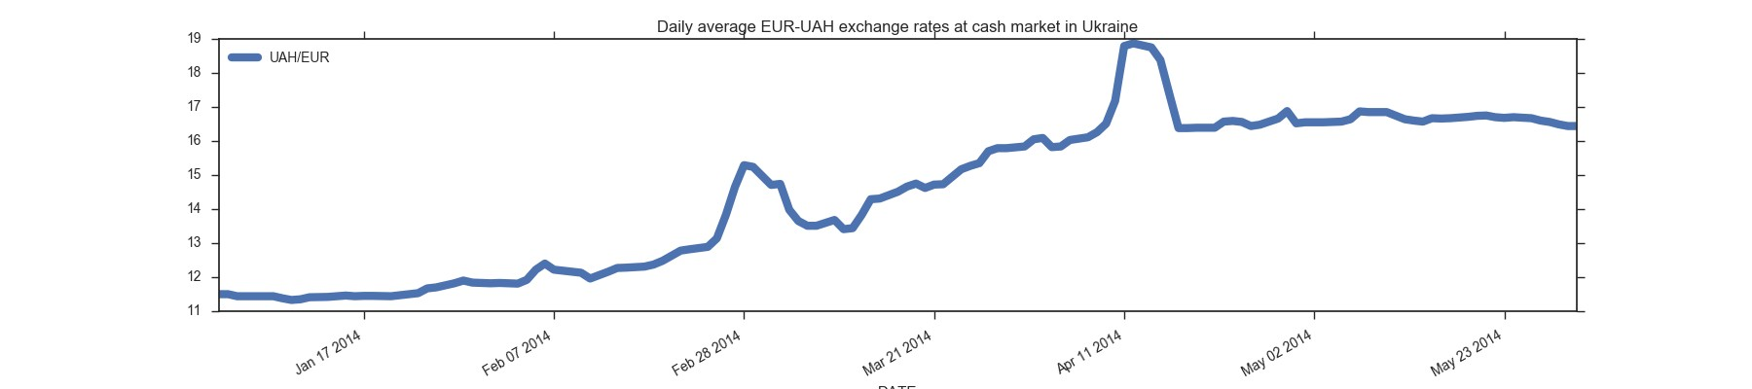
Example
valuta.today, Daily average EUR-UAH exchange rates in the cash market, Ukraine

Slide 15
Time Series Decomposition Model
There are 2 main models that generally used to model the effects of these components
The choice of the decomposition model is called test for log-level specifcation.

Slide 16
Additive model
Assumes that the four components are independent
Y(t) = T(t) + S(t) + C(t) + I(t)

Slide 17
When to choose the Additive model
The behaviors of the components are independent,
i.e. an increase in the trend-cycle will not cause an increase in the magnitude of seasonal
The difference of the trend and the raw data is roughly constant in similar periods of time irrespectively of the tendency of the trend
The pa tern of seasonal variation is roughly stable over the year
i.e. the seasonal movements are the approximately same from year to year
https://ec.europa.eu/eurostat/sa-elearning/additive-decomposition-0

Slide 18
Multiplicative model
Assumes that the components are dependent
Y(t) = T(t) ⋅ S(t) ⋅ C(t) ⋅ I(t)
By taking logs it is possible to present the multiplicative model in an additive form. This is called log-additive model.

Slide 19
When to choose the Multiplicative model
Components on the graph jump in magnitude over time The seasonal and irregular fluctuations
change in a specifc manner after the trend
i.e. the amplitude of the seasonality increase (decrease) with an increasing (decreasing) trend

Slide 20
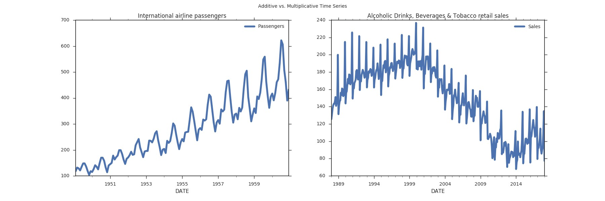
Additive vs. Multiplicative
Additive: Alcoholic Drinks, Beverages & Tobacco retail sales, UK; Multiplicative: International airline passengers

Slide 21
Demo
Meet the dataset
Total number of visits to the UK by overseas residents
Source: Office for National Statistics
h tps: /github.com/gakhov/pycon-ua-2018/blob/master/look-into-the-data.ipynb

Slide 22
The Roadmap
Data - Decomposition Model -
- Forecasting Model - Training - Prediction

Slide 23
How To Measure
The Forecast Performance

Slide 24
The Mean Forecast Error (MFE)
_{n ∑} (x_{t} − f_{t} )
1
n
t=1
A good forecast has the MFE close to zero
Provides the direction of the error
MFE = 0 doesn't guarantee that the forecast contains no errors (positives can cancel negative errors)
Sensitive to observations scale and data transformations
Doesn't penalize extreme errors

Slide 25
The Mean Squared E rror (MSE)
1
n
∑ (x_{t} − f_{t} )²
t=1
n
from sklearn.metrics import mean_squared_error
A good forecast has the MSE close to zero
Shows the overall idea of the error
Emphasizes the fact that the total forecast error is much affected by large individual errors
Sensitive to observations scale and data transformations
Penalizes extreme errors

Slide 26
The Normalized Mean Squared Error (NMSE)
1
n
∑ (x_{t} − f_{t} )²
2
σ n
t=1
The smaller the NMSE, the better the forecast
It's balanced error measure
Very effective in judging forecast accuracy of the model

Slide 27
The Coefficient of Determination (R² )
∑ (x_{t} − f_{t} )²
_{R}2
= 1 −
∑ (x_{t} − x)²
from sklearn.metrics import r2_score
A good forecast has the R² close to one
Estimates the variability of the forecast around its mean
_{R}2
≤ 1
Doesn't indicate whether the model is adequate

Slide 28
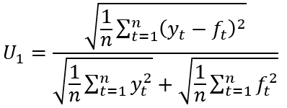
Theil's U
√ 1
n
∑n
(x_{t} − f_{t} )²
t=1
U =
‾‾‾‾‾‾‾‾‾‾‾‾‾‾‾
√ + √
1
n
∑ f ²
1
n
∑ x²
t
t
A good forecast has the U close to zero
A normalized measure of total forecast error
0 ≤ U ≤ 1
U = 0 means the perfect ft

Slide 29
Models
There are many different approaches, but here we focus on the top 3 families.

Slide 30
Stochastic Models
with Python

Slide 31
ARMA Model
Assumes that data are
a realization of a stationary process
Augmented Dickey-Fuller (ADF) unit root test, Kwiatkowski-Phillips-Schmidt-Shin (KPSS) test

Slide 32
AR - autoregression process (long memory)
Have a relatively long memory, because the current observation
is correlated with all previous ones, although with decreasing coefficients
MA - moving average process (short memory)
Have a short-term memory, since it's just a function of a fnite, and generally small, number of its past observations.
ARMA is to combine these properties and represent model in a simplifed form whose frst q coefficients can be any,
whereas the following ones decay according to simple rules.

Slide 33
ARMA(p, q)
p - the lag order (AR)
the number of lag observations to include
q - the order of moving average (MA)
the size of the moving average window

Slide 34
ARIMA
Autoregressive Integrated Moving Average
A generalization of an ARMA for Integrated (Difference Stationary) Time Series
Non-stationary time series whose differences of some order are stationary.
Non-stationary time series are differenced
until stationarity is achieved (Box–Jenkins method)
Doesn't support seasonal component modeling

Slide 35
ARIMA(p, d, q)
p - the lag order (AR)
the number of lag observations to include
d - the degree of differencing (I)
the number of times that the raw observations were differenced
q - the order of moving average (MA)
the size of the moving average window
The data has to be prepared by a degree of differencing to make time series stationary,
i.e. by removing trend and seasonal structures that negatively affect the regression model. ARMA corresponds to d=0.

Slide 36
SARIMA
Seasonal Autoregressive Integrated Moving Average
A modifcation of ARIMA to support a seasonal time series.
ARIMA(p, d, q) × (P, D, Q)_{s}
(p,d,q) are the non-seasonal parameters
(P, D, Q) the seasonal component of the time series.
s is the seasonal periodicity
(4 for quarterly periods, 12 for yearly periods, etc.)

Slide 37
Check whether there is any evidence of a trend or seasonal effects
Stationarization by taking differences Seasonal component research

Slide 38
Python Tools
Statsmodels
A high-level module to work with statistical models, conducting statistical tests and data exploration.
https: /www.statsmodels.org/

Slide 39
from statsmodels.tsa.statespace import sarimax
model = sarimax.SARIMAX( X_train,
trend='n', order=(1,1,1),
seasonal_order=(1,1,0,12), enforce_stationarity=True, enforce_invertibility=True)
results = model.fit()
steps = X_train.shape[0]
forecast = results.get_forecast(steps=steps) forecast_ci = forecast.conf_int()
yhat_test = forecast.predicted_mean.values

Slide 40
Demo
Build a Seasonal AutoRegressive Integrated Moving Average model to predict the number of visits to the UK by overseas residents
https: /github.com/gakhov/pycon-ua-2018/blob/master/stochastic-models.ipynb

Slide 41
Python Tools
Prophet
A tool for producing forecasts for time series data
that has multiple seasonality with linear or non-linear growth. h tps: /github.com/facebook/prophet

Slide 42
Prophet Forecasting Model
Based on ARIMA and utilizes a Bayesian-based curve f ting method
X(t) = T(t) + S(t) + H(t) + ε_{t}
T(t) - trend, S(t) - seasonal effects, H(t) - holidays (potentially irregular), ε_{t} - unpredicted effects.
The seasonality is modeled by the Fourier Series.

Slide 43
from fbprophet import Prophet
m = Prophet() m.fit(df)
forecast = m.predict(df) m.plot(forecast)
m.plot_components(forecast);

Slide 44
Demo
Build a Prophet Forecasting Model
to predict the number of visits to the UK by overseas residents
https: /github.com/gakhov/pycon-ua-2018/blob/master/prophet.ipynb

Slide 45
Artificial Neural Networks
with Python

Slide 46
ANN can be seen as a computational graph
nodes are computing units
directed edges transmit numeric information
Each computing unit (neuron) is capable of evaluating
a single primitive function (activation function) of its input.
At practive, units are organized in layers.

Slide 47
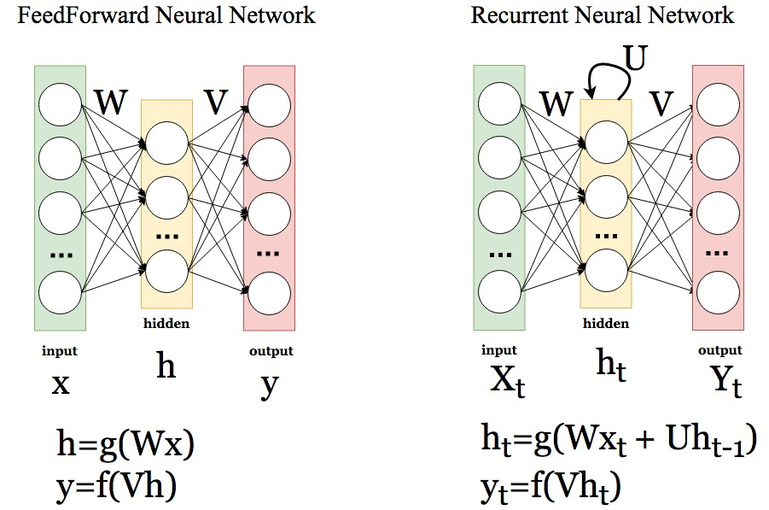
Popular ANNs types

Slide 48
Recu rent Neural Network
Similar to Feedforward networks, but allows a recurrent hidden state with activation depended on the previous cycles.
Long Short-Term Memory (LSTM) architecture
Unlike the traditional recurrent unit, which overwrites its content each timestep,
the LSTM unit can decide whether to keep the existing memory via introduced additional convolution steps (gates)
Read More: https: /www.slideshare.net/gakhov/recurrent-neural-networks-part-1-theory

Slide 49
The main problem while working with ANNs is the choice of the network's parameters,
such as the number of layers and number of neurons.

Slide 50
SANN
Seasonal Artifcial Neural Networks
only 1 hidden layer
number of input and output neurons
can be taken as number of observations in a season
number of hidden nodes
should be detemined experimentally (a few)
* as recommended by C. Hamzaçebi.

Slide 51
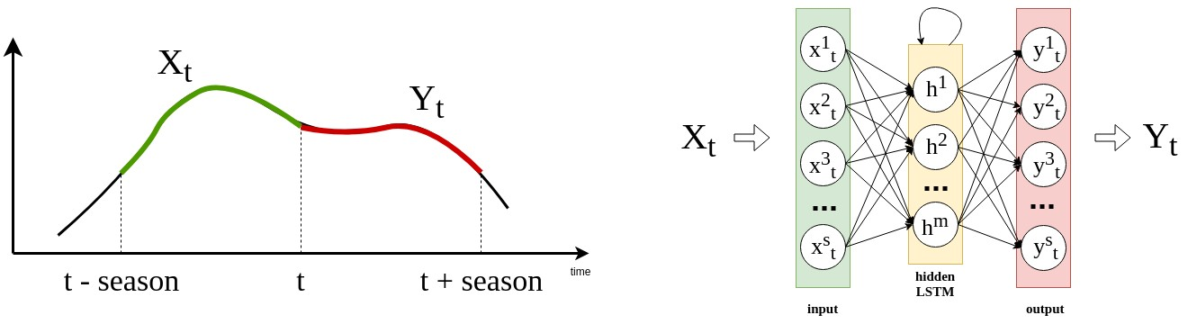
How to build a model
We want to teach SANN to learn next season value from the previous season values
Using sliding-window technique transform time series to a number of s-dimensional vectors

Slide 52
Python Tools
Keras
A high-level neural networks API,
capable of running on top of TensorFlow, CNTK, or Theano. https://keras.io/

Slide 53
from keras.layers import InputLayer, Dense, LSTM from keras.models import Sequential
from keras.optimizers import SGD
model = Sequential()
model.add(InputLayer(input_shape=(1, seasons), name="input")) model.add(
LSTM(4, name="hidden", activation='sigmoid', use_bias = True, bias_initializer='ones')
)
model.add(
Dense(seasons, name="output", activation='linear', use_bias = True, bias_initializer='ones')
)
model.compile(loss='mean_squared_error',
optimizer=SGD(lr=0.05, decay=1e-6, momentum=0.9), metrics=["mae", "mse"])
history = model.fit(X_train, y_train, epochs=100, batch_size=1,
validation_data=(X_val, y_val))
yhat_test = model.predict(X_test[::seasons])

Slide 54
Demo
Build a Seasonal Artifcial Neural Network with LSTM layer to predict the number of visits to the UK by overseas residents
https://github.com/gakhov/pycon-ua-2018/blob/master/artifcial-neural-networks.ipynb

Slide 55
Support Vector Machines
with Python

Slide 56
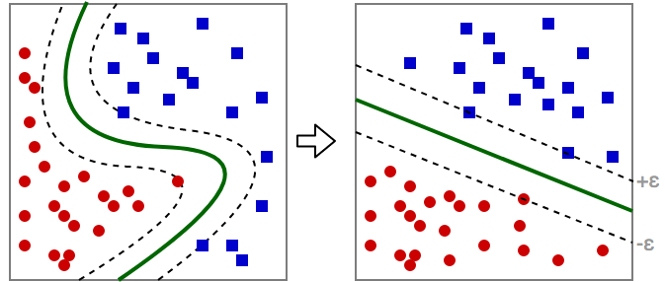
A technique that maps data
into a high-dimensional feature space where it can be linearly separable in the best way.
Support vectors are "critical" observations that fully specify the decision function

Slide 57
Support Vector Machine Regre sion
Performs a linear regression
in the high-dimension feature space
with a special ε-intensive loss function.

Slide 58
Main SVM meta-parameters
ε-tube for no penalty
Controls the width of the ε-insensitive zone, used to ft the training data.
Bigger ε-values result in more 'flat' estimates (fewer support vectors).
Penalty parameter C
Controls the amount up to which deviations larger that ε is tolerated.
Prevents overf ting and in a trade-off with the model complexity.
Kernel function type
Induces the high-dimentinal feature space.
Most popular are linear, polynomial and Gaussian Radial Basis Function (RBF) kernels.

Slide 59
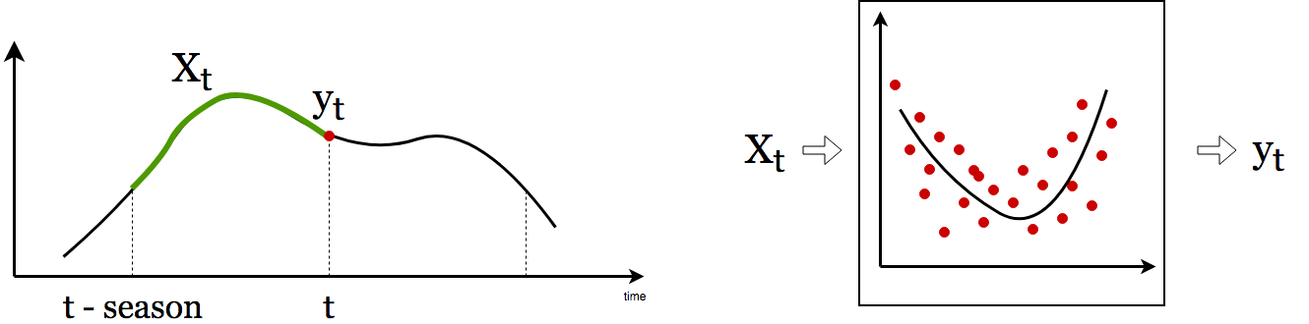
How to build a model
We want to train SVM Regressor to learn value at time t from the previous season values
Using sliding-window technique transform time series to a number of s-dimensional vectors

Slide 60
Python Tools
Scikit-learn
A simple and efficient tool for machine learning, data mining and data analysis.
http: //scikit-learn.org/

Slide 61
from sklearn import svm
from sklearn.model_selection import GridSearchCV from sklearn.model_selection import ShuffleSplit
C_range = np.logspace(-2, 10, 5)
gamma_range = np.logspace(-9, 3, 5) param_grid = {
"gamma": gamma_range, "C": C_range,
"epsilon": 0.1
}
cv = ShuffleSplit(n_splits=3, test_size=0.25, random_state=73) grid = GridSearchCV(
svm.SVR(kernel="rbf", max_iter=100), param_grid=param_grid,
cv=cv)
grid.fit(X_train, y_train) model = grid.best_estimator_
yhat_test = model.predict(X_test)

Slide 62
Demo
Build a Seasonal Support Vector Regressor
to predict the number of visits to the UK by overseas residents
https://github.com/gakhov/pycon-ua-2018/blob/master/support-vector-machines.ipynb

Slide 63
Final Notes
Always visualize the data
Think which decomposition model be ter describes you data
Select a proper forecasting model
Divide the raw data into 2 parts (training / test sets). Small part of the training set reserve for validation

Slide 64
Final Notes
The observations only from the training set shell be used for the model construction
Use the test set to verify how accurate the constructed model performs
Many models expect normalized, scaled data as input
(check Box-Cox Transformation, log-scaling, etc.)

Slide 65
Thank you
These slides can be found at
h tps: /github.com/gakhov/pycon-ua-2018
Andrii Gakhov, ferret go GmbH www.gakhov.com
PyCon UA, Kharkiv, April 28-29, 2018

