Slide 1
DSC 530 Final Project
Name: Bhargava Gaggainpali
Date: 05/30/2020
Course: DSC 530 Data Exploration and Analysis
Assignment: 12.2 - Term Project

Slide 2
This data set can be found at the kaggle :
https://www.kaggle.com/shivam2503/diamonds/

Slide 3
Five main features which are used to access the quality of a diamond, are listed down below.
Carat, Weight, Cut, Clarity & Color
Carat Weight : Carat is a metric that is used to measure the weight of a diamond. One carat is equivalent to 200mg. Diamond prices increase with diamond carat weight, which means bigger the diamond higher the price. If two diamonds weights are equal, then other features are used to determine the price.
Clarity : Diamonds are generated from sheer pressure and heat below the ground. Therefore, there will be some inclusion inside a diamond i.e., a mark or line pattern inside a diamond.
Cut: This feature is an important thing to notice in a diamond as it measures three crucial things, such as Brilliance, Fire, Scintillation.
Depth %: Depth is the distance from a top surface i.e., table to a culet. The depth percentage is calculated by dividing the diamond depth by the overall width of a diamond. Lower the depth percentage the bigger the diamond looks from the below i.e., pavilion.
Table %: The table is the topmost surface of a diamond and the most significant facet of the round diamond. An appropriate width of a table will allow the light to enter and reflect on the appropriate direction.
Color: Color measurement in diamond measures lacks color. If the diamond color is like a drop of water that is colorless, it will have a high value. As then only it can scatter the light without observing.

Slide 4
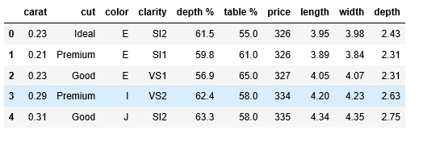
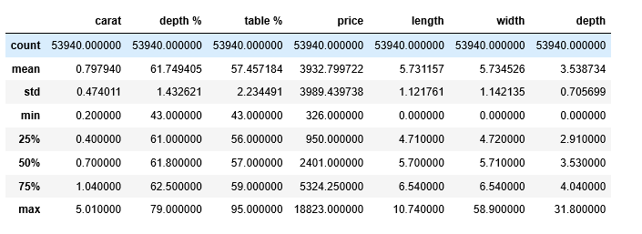
Sample Data set
Description of the Data set

Slide 5
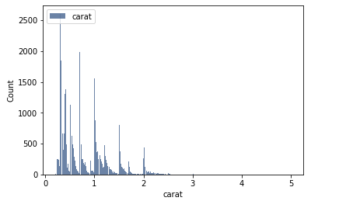
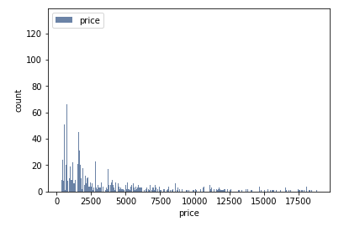
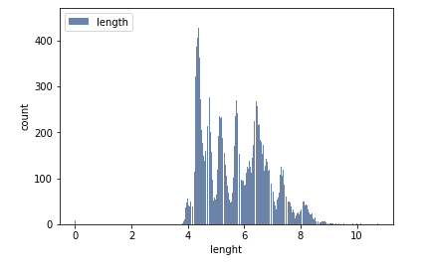
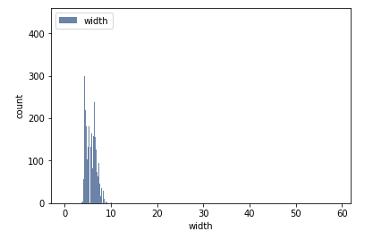
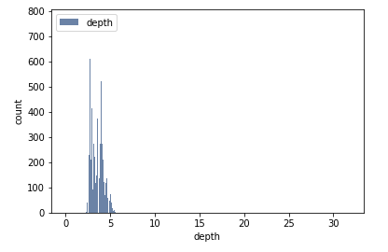
Histogram of the variables

Slide 6
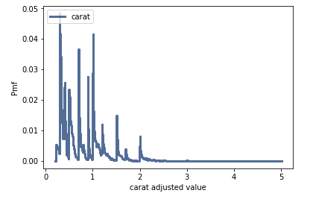
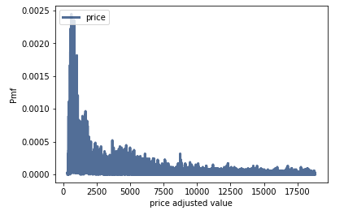
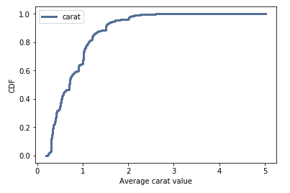
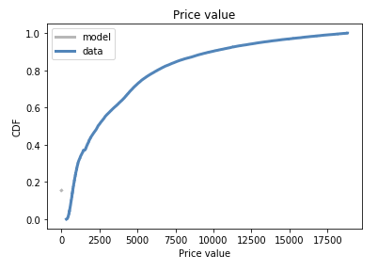
PMF of the variable’s ‘carat’ and ‘price’
CDF of the variable’s ‘carat’ and ‘price’
It looks like less than 5% of carat values are below 0.5 and nearly 90% of the carat values are above 1.5.
Common carat values appear as the steeper portion of our line, likely above the value of ~2.0

Slide 7
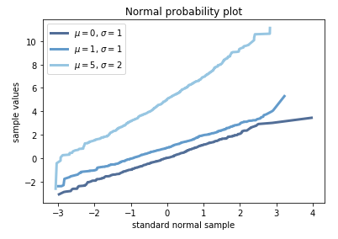
Normal Distribution Plot
This is a visual test for normality. Our plot shows that the plot is approximately straight if the data are in fact part of a normal distribution.

Slide 8
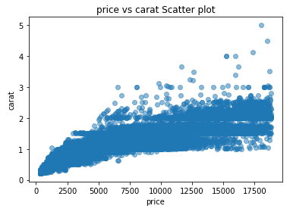
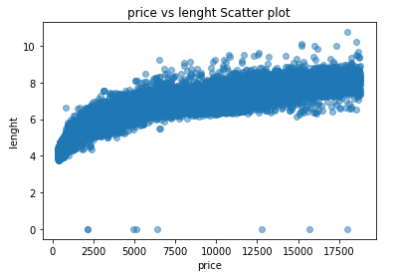
Scatterplots to Compare Variables

