Slide 1
2023
IMAGE PROCESSING
BHAVYA GUPTA
2018764
B. Tech CSE
Under the Mentorship of
Mr. Ashwini Kumar,
Assistant Professor , Department of CSE,
GEU, Dehradun

Slide 2
INTRODUCTION
What Is an Image?
An image is represented by its dimensions (height and width) based on the number of pixels.
This pixel is a point on the image that takes on a specific shade it is an integer value ranging between 0 and 255(0 is completely black and 255 is completely white and all other colors range in between these values).
It is usually represented in one of the following:
Grayscale
RGB
RGBA

Slide 3

What Is Image Processing?
Image processing is the process of transforming an image into a digital form and performing certain operations to get some useful information from it.
The image processing system usually treats all images as 2D signals when applying certain predetermined signal processing methods.
Image processing requires fixed sequences of operations that are performed at each pixel of an image.

Slide 4

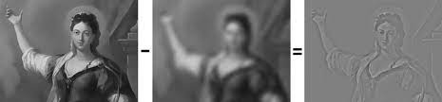
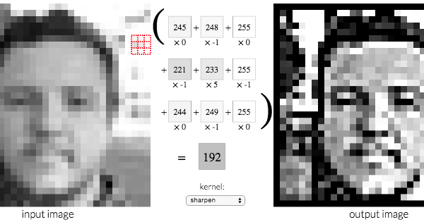
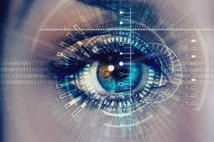
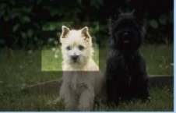
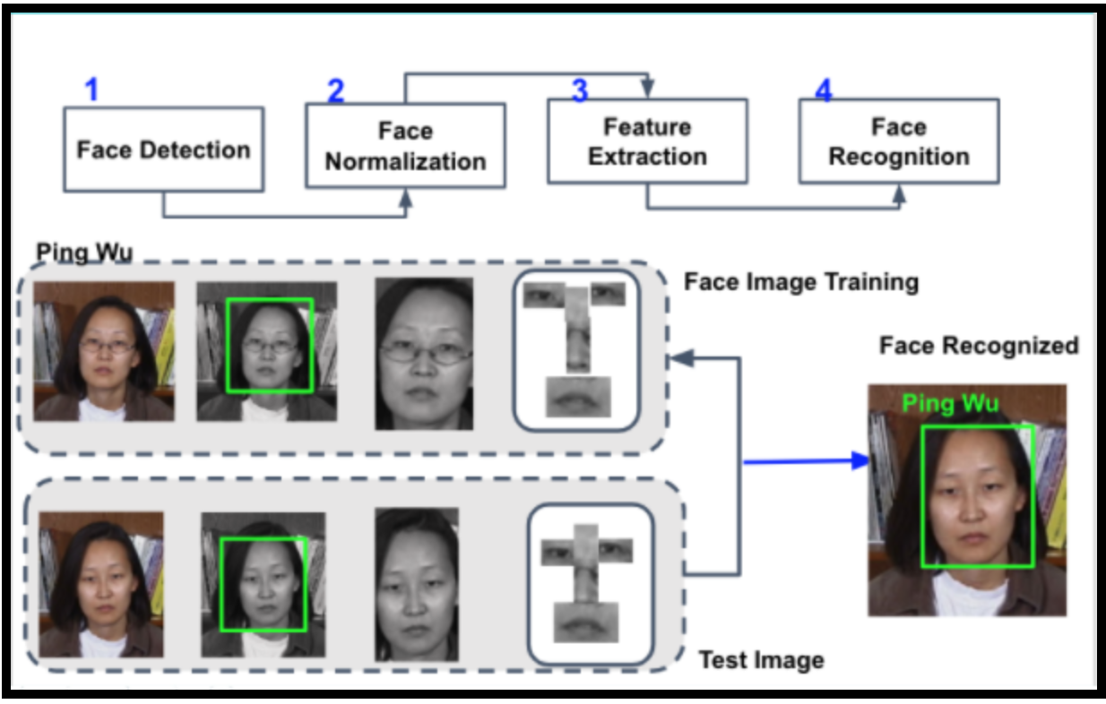
Types of Image Processing
Pattern Recogntion
Sharpening and Restoration
Visualization
Retrieval
Recognition

Slide 5
Applications of Image Processing
Medical Image Retrieval
Gamma ray imaging
PET scan
X Ray Imaging
Medical CT
UV imaging
Medical CT
UV imaging
Machine/Robot Vision
Hurdle Detection
Line Follower Robot
Traffic Signal Detection
Object Recognition
Image Reconstruction
Old Pictures Reconstruction
Image Encoding and Decoding for Transmission
Morphed Images Detectiono
Face Detection
Lip Reading
Facial Emotion Detection
Motion Capture

Slide 6
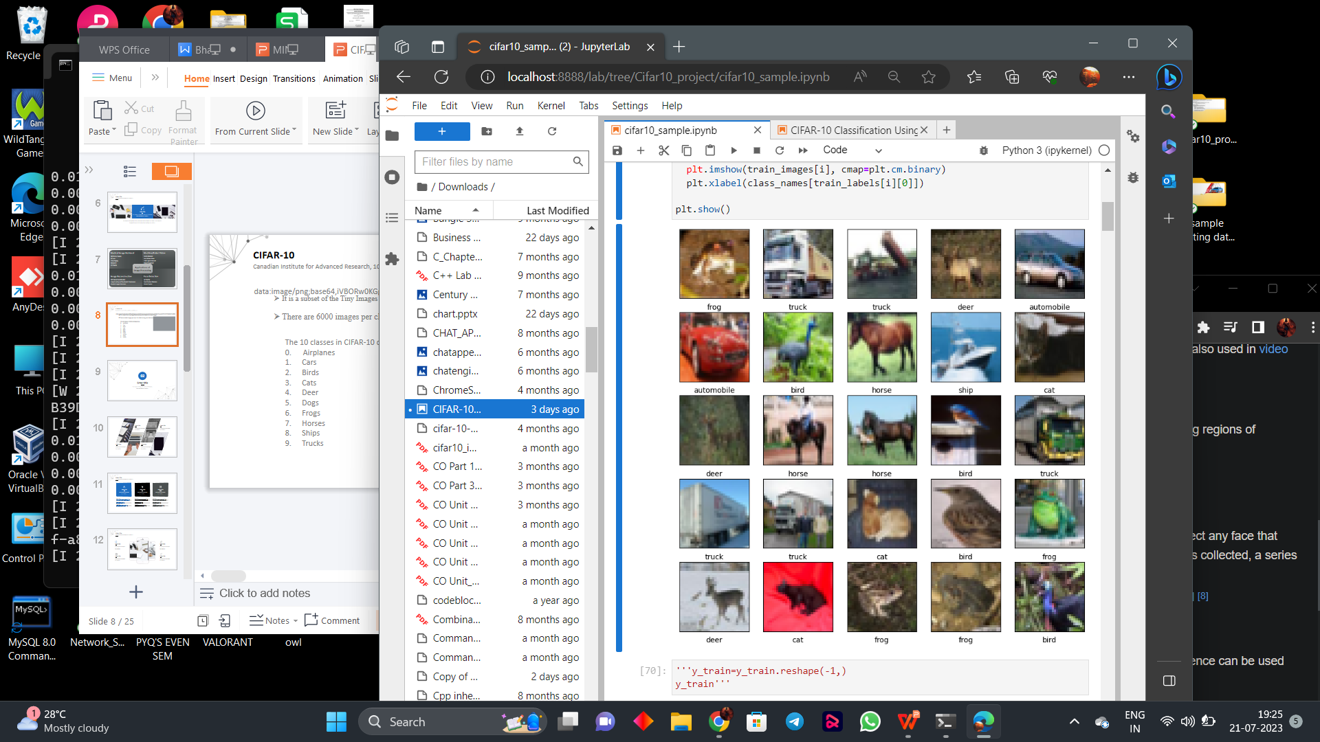
CIFAR-10
Canadian Institute for Advanced Research, 10 classes
It is a subset of the Tiny Images dataset and consists of 60000 32x32 color images
There are 6000 images per class with 5000 training and 1000 testing images per class.
The 10 classes in CIFAR-10 dataset are:
0. Airplanes
Cars
Birds
Cats
Deer
Dogs
Frogs
Horses
Ships
Trucks

Slide 7
Building blocks of the project:
Python
Tkinter
Keras
Tensor Flow
Convolution Neural Netwoks (CNN)

Slide 8
Why Convolutional Neural Networks?
Convolution is needed to reduce the amount of computation we need to do when doing image recognition and classification.
A simple neural network may get around 3 billion weigths and biases for out RGB channel which is too heavy to handle, hence we use convolution neural networks to reduce the dimensions hence less calculations and computations.

Slide 9
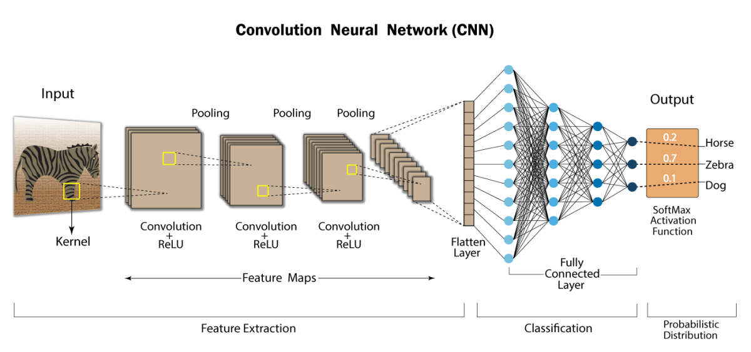

Slide 10
METHODOLOGY
Deployement
Predicting the Results
Visualizing the Evaluation
Building the CNN Model using Keras
Data Pre-processing
Some EDA
(Exploratory Data Analysis)
Reading the cifar10 dataset & setting train and test data
Importing Dependencies

Slide 11
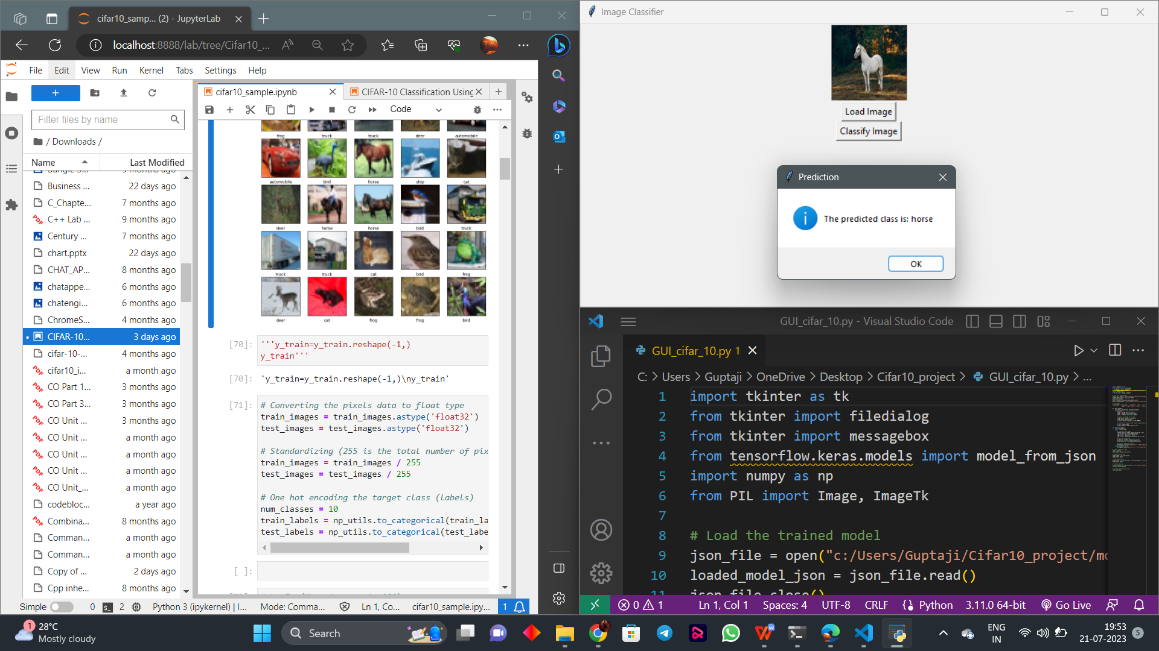

Slide 12
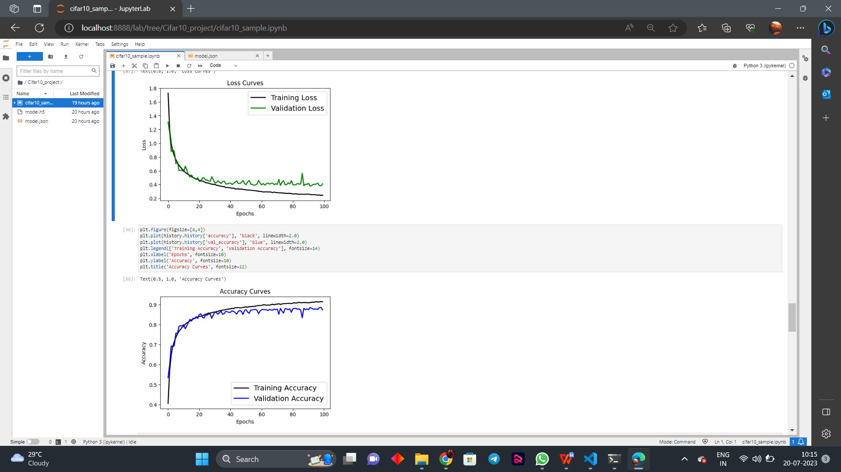
Visualizing the Evaluation
Comparing the Training Loss with the Testing Loss over increasing Epochs.
Comparing the Training Accuracy with the
Testing Accuracy over increasing epochs

Slide 13
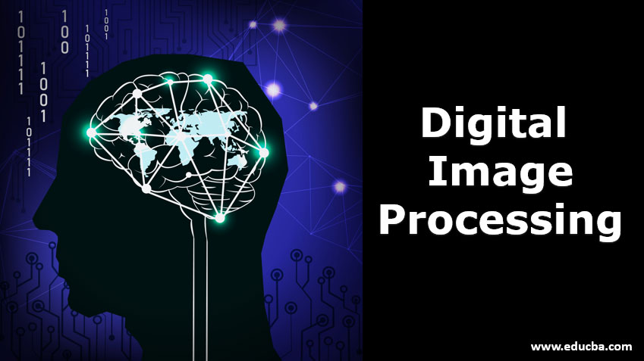
Limitations
u Limited dataset size u Low resolution u Limited class diversity u Lack of context u Overfitting u Fine-grained tasks u Transfer learning challenges u Real-world variations

Slide 14
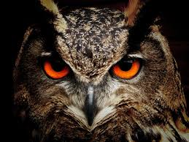
FUTURE WORK
Larger and diverse datasets
Higher resolution images
Transfer learning
Data augmentation
Use of advanced architectures

Slide 15
Conclusion
The implementation of image processing techniques has had a
massive impact on many tech organizations.
Some of the most useful benefits of image processing, regardless of the field of operation:
Image Classification
Transfer Learning
Feature Extraction
Data Augmentation
Understanding Model Performance
Educational Purposes
Research and Development
Model Interpretability

Slide 16
The future use of a CIFAR-10 trained model is not limited to a single application but can be leveraged in various ways to solve a wide range of image-related problems and research tasks.

Slide 17
THANK YOU

