Slide 1





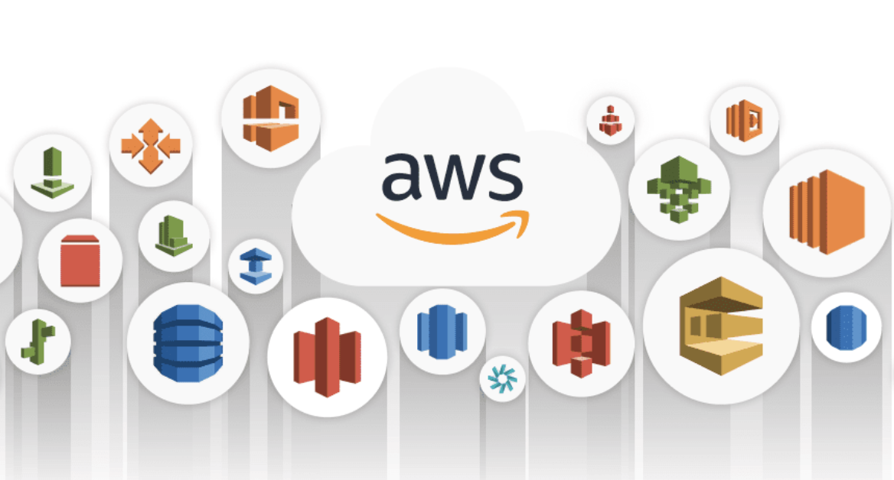






Frontend/Backend App
Private Cloud, On-Premise, Laptop
Public Cloud (AWS, etc.)
Environment
Variables
nginx-aws-signature
S3 Gateway
Lambda Gateway
API Gateway
Canonical request parameters
Client Auth Request
Signing Request
Key/Val
Cache
Fetch Credentials
Validate Signature
Access Key Id
Secret Key
Session Token
Expiration
S3
Integration
Lambda
Integration
Other Services
Integration
. . .
EC2, IAM, ECS, STS
S3
(AWS S3 or S3 compatible service)
Lambda

