Slide 1
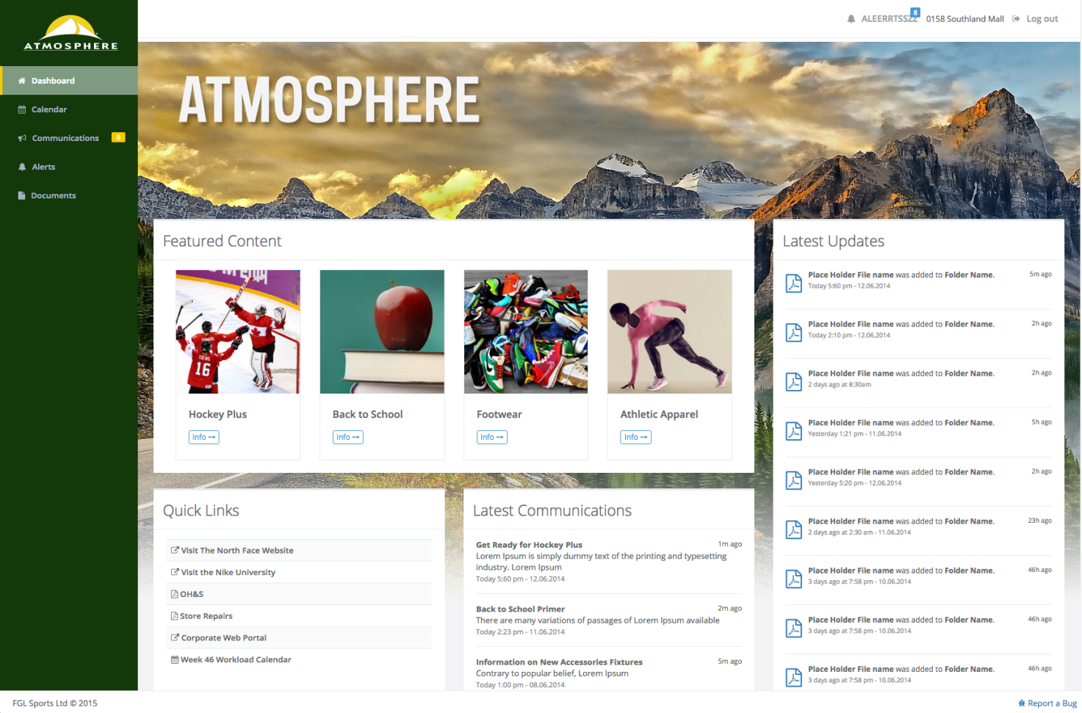
[ Store Communications Site ] 1.0 Update February 19, 2016

Slide 2
1.0 Feature Set
Dashboard (Homepage)
Optional Left Navigation (added Jan. 2016)
Urgent Messaging (added Jan. 2016)
Security compliance (added Jan. 2016)
Document Library
Archive mode (added Mar. 2016)
Communications
Featured Content
Calendar
Alerts

Slide 3
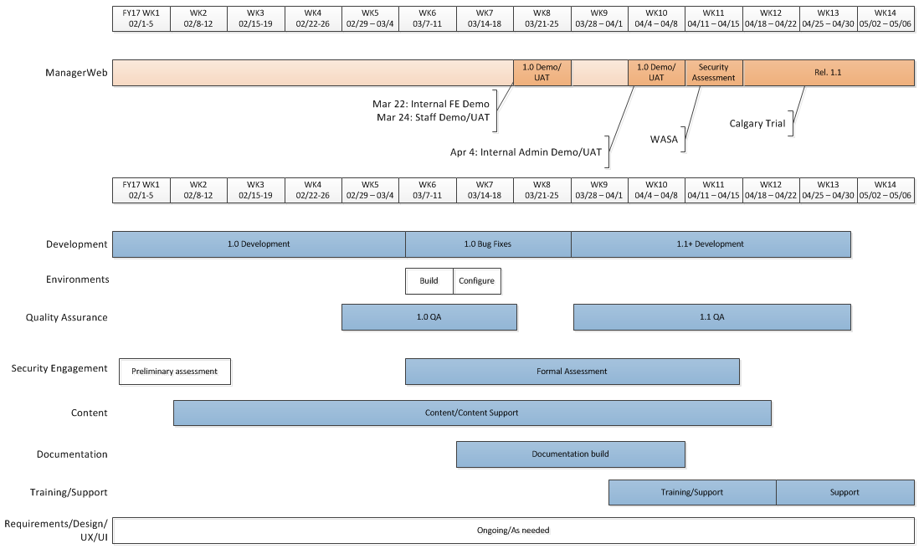
Timelines

Slide 4
Deliverables
Development
Release 1.0: Internal Demo
Release 1.1: Limited release (Calgary)
Release 1.2: First National release
Release 2.0+: Subsequent National releases
Content
Direct content population during limited release
Information Architecture (IA) and Taxonomy
Process outline
Training/Support
Feature overview/training
Content management best practices, workflow
One-on-one training and/or workshops
Documentation
Application documentation
Content delivery/management documentation
Quality Assurance / UAT
Once-over of each release
UAT: Ops resources actually use the application and provide feedback
Requirements/Design/UX/UI/PM
Wireframes/Mockups, User Stories, Formal/Informal Requirements
Feedback/Survey/Focus Groups, Resource Coordination

Slide 5
Development Status
Feature | Ready for Staff Demo/UAT | Ready for Admin Demo/UAT
Dashboard (Homepage) | yes | yes
Featured Content | yes | no
Search (Global) | yes | n/a
Archive Mode | no | no
Store-filtered content | no | no
Communications | yes | yes
Quicklinks | yes | yes
Document Library | yes | yes
Urgent Messaging | no | no

