Slide 1
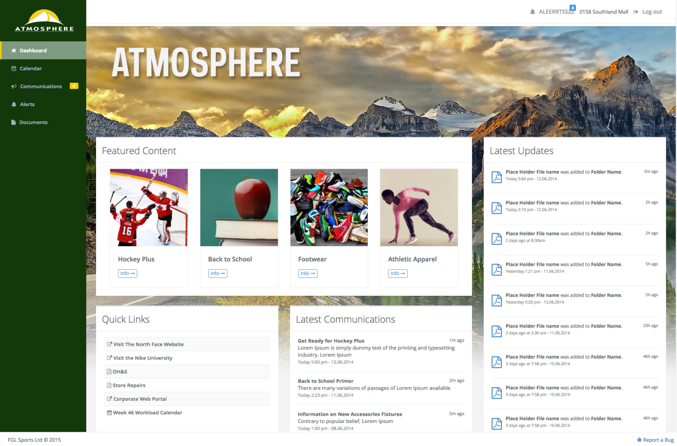
ManagerWeb 1.0 Update January 22, 2016

Slide 2
1.0 Feature Set
Dashboard (Homepage)
Document Library
bona fide content management
abandonment of rigid, pre-determined information hierarchy
Communications
selected, regular communications transitioned from traditional email distribution
persistent, accessible archive
Packages (Featured Content)
Calendar
Alerts

Slide 3
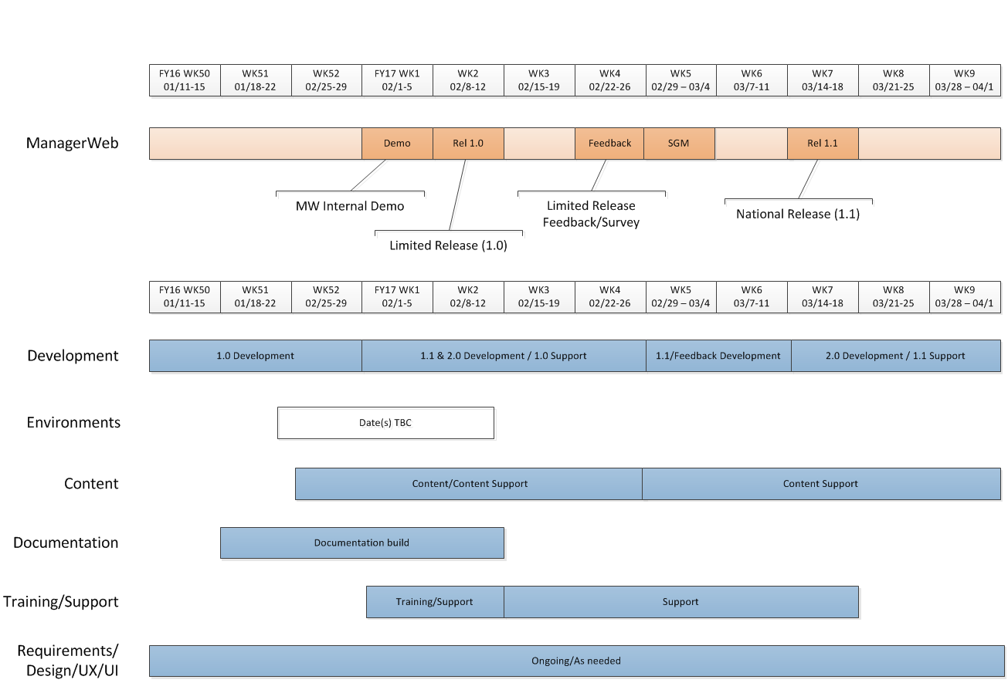
Timelines

Slide 4
Deliverables
Development
Release 1.0: Limited release
Release 1.1: First National release
Release 2.0+: Subsequent National releases
Content
Direct content population during limited release
Information Architecture (IA) and Taxonomy
Process outline
Training/Support
ManagerWeb feature overview/training
Content management best practices, workflow
One-on-one training and/or workshops
Documentation
Application documentation
Content delivery/management documentation
Requirements/Design/UX/UI/Project Management
Wireframes/Mockups, User Stories, Formal/Informal Requirements
Feedback/Survey/Focus Groups, Resource Coordination

Slide 5
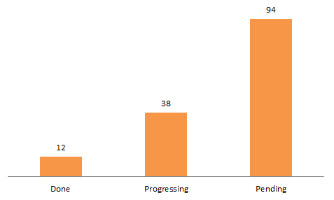
Development Status
Priorities
Document Library
Alerts
Featured Content
Communications
 | Dev Tasks | Done | Progressing | Pending
Count | 149 | 12 | 38 | 94
% | 100% | 8% | 26% | 63%

