Slide 1
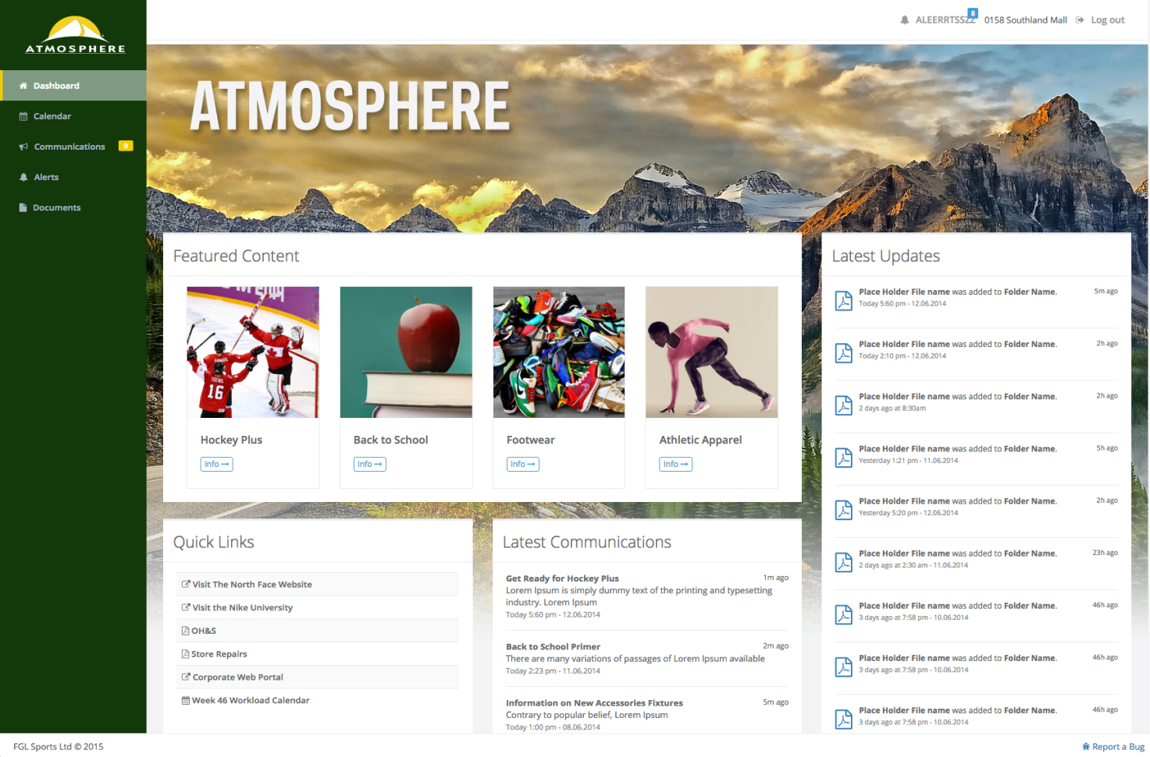
ManagerWeb 1.0 Update February 12, 2016

Slide 2
1.0 Feature Set
Dashboard (Homepage)
Optional Left Navigation (added Jan. 2016)
Urgent Messaging (added Jan. 2016)
Security compliance (added Jan. 2016)
Document Library
bona fide content management
abandonment of rigid, pre-determined information hierarchy
Communications
selected, regular communications transitioned from traditional email distribution
persistent, accessible archive
Packages (Featured Content)
Calendar
Alerts

Slide 3
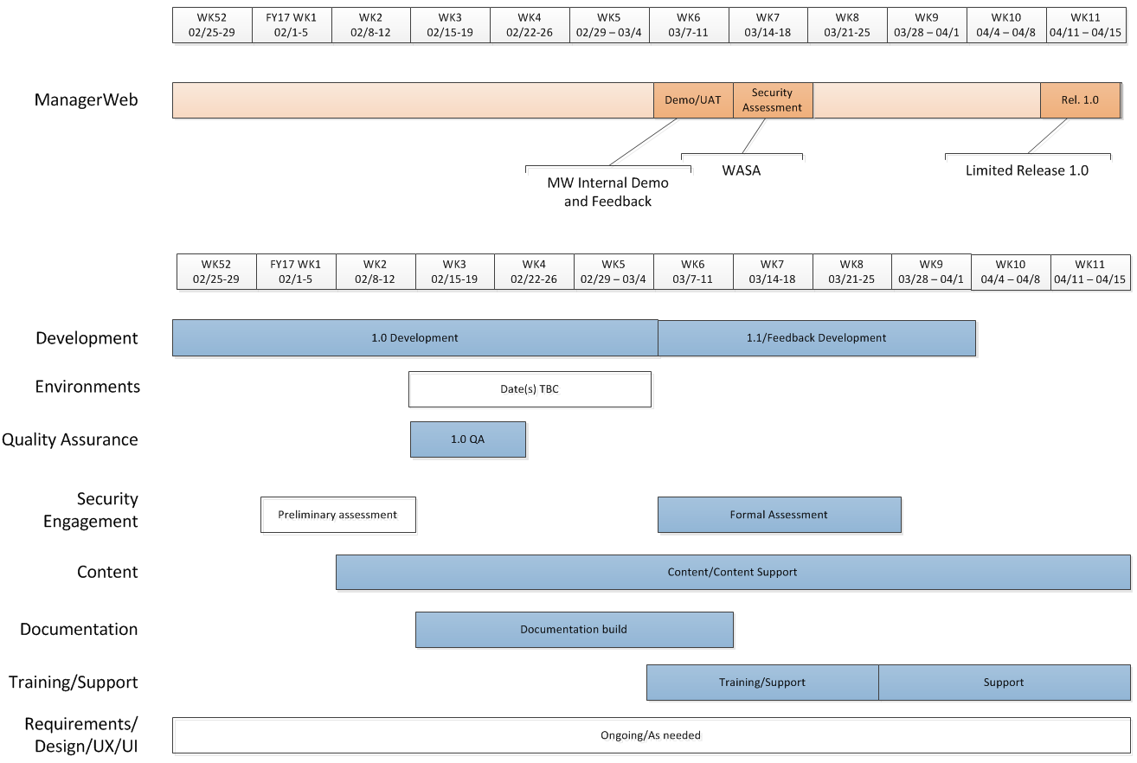
Timelines

Slide 4
Deliverables
Development
Release 1.0: Limited release
Release 1.1: First National release
Release 2.0+: Subsequent National releases
Content
Direct content population during limited release
Information Architecture (IA) and Taxonomy
Process outline
Training/Support
ManagerWeb feature overview/training
Content management best practices, workflow
One-on-one training and/or workshops
Documentation
Application documentation
Content delivery/management documentation
Requirements/Design/UX/UI/PM
Wireframes/Mockups, User Stories, Formal/Informal Requirements
Feedback/Survey/Focus Groups, Resource Coordination
Quality Assurance / UAT
Once-over of each release
UAT: Ops resources actually use the application and provide feedback

Slide 5
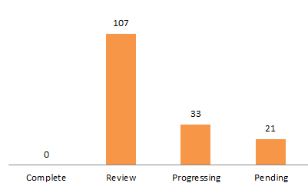
Development Status
Priorities
Document Library
Alerts
Featured Content
Urgent Notice
 | Total Tasks | Complete* | Review* | Progressing | Pending
Count | 157 | 0 | 107 | 33 | 21
% | 100% | 0% | 68% | 21% | 13%
Previous Update – Feb. 5
 | Total Tasks | Complete* | Review | Progressing | Pending
Count | 157 | 0 | 36 | 100 | 21
% | 100% | 0% | 23% | 64% | 13%
*Complete: No further development/adjustments
prior to demo/UAT
*Review: Ready for QA

