Slide 1
MaaS Hackfest - blockchain and OpenAPI –
JR East & Mizuho IR
Game plan
Ver 0.4
2018.12.12

Slide 2
Introduction
MaaS is an acronym for “Mobility as a Service", it is a big important keyword for realizing Smart City in the world as well as Japan.
What is MaaS by MaaS Alliance
https://maas-alliance.eu/homepage/what-is-maas/
Japan is preparing for the Olympic Games in 2020, and many visitors are expected to visit Japan from abroad. It goes without saying that the transportation will greatly influence the behavior of such visitors and the operation of the Olympic Games.
In addition, Microsoft positions MaaS as an important element in the realization of Workstyle Modernization.
Many companies and laws are involved in the realization of MaaS, and there are many barriers to realizing it. Collaboration among private companies is one of them.

Slide 3
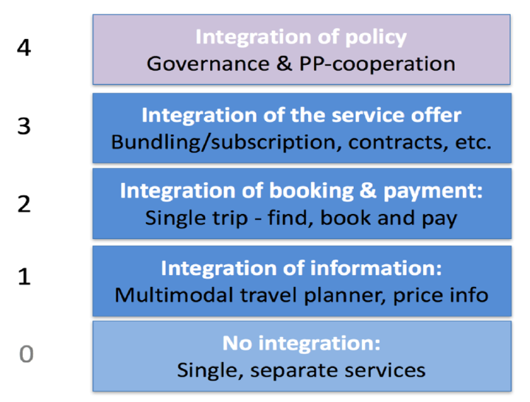



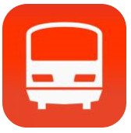

Situation in Japan
There are some definition of MaaS. Following figure is the one defined by the Chalmers University of Technology. Ministry of Land, Infrastructure and Transport and many of private companies references this definitions.
With 1: 1 collaboration, several companies have realized an integrated payment model. However, this is assumed to be predefined route, use in a predetermined area, and it can not respond flexibly to process change. To realize this layer, transparency of traveler’s transportation and payment should be resolved at first.
Each route search provider integrate “reservation button” in its UX. But reservation and payment process is separated from route search apps.
This layer is almost realized by 3rd company, and quality is being higher. But openizing the data format is struggling.
Currently, Taxi is out of scope since its uncertainty.
Top 5 route search provider
Val Lab.
Navitime
Jordan
google

Slide 4
Reference from http://www.itsinternational.com/sections/nafta/features/level-of-maas-provides-step-by-step-roadmap-to-integrated-transport/
Level Zero reflects the situation today, with a plethora of account-based systems where each individual transportation mode has a bespoke digitised interface and online traveller information. The traveller must surf the multiple websites, apps and interfaces to cobble together an A-to-B journey of multiple segments and modes. The first step (Level One) will see one-to-one integration between some private services with duets of services developing joint offerings (e.g. tolling + car park, private car + ferry and car park + ride bus services). Level Two will see increased (but still limited) integration of services at both ends of the journey. Integration of payment and ticketing across some public and private transportation services may emerge, although other public transport modes may remain sceptical and continue to stay aloof. At Level Three unified interfaces start to appear, allowing a ‘meta-operator’ to provide a single account to be used across multiple modes of transport, enabling a traveller to find journeys through one traveller account. The meta-operator becomes the focal point and manager of multiple agreements with each operator of the independent services. The unified and agreed data exchange between all the parties provides travellers the opportunity to experience multimodal trips through suggested options presented by the meta-operator’s app. Moving to Level Four requires that routing, ticketing and payment for all modes (private and public) are integrated. This will build on the open data and standards defined at Level Three and whose expansion will be used by all transportation providers. At this stage, the market may see multiple MaaS meta-operators competing to provide services for travellers. By Level Five, AI presents the trip choices based on the traveller’s profile, preferences and trip patterns. Near real-time data will make or suggest ad hoc changes during journeys (to avoid delays and cancellations). Travellers’ trust in the suggested trip changes will grow as their journeys become more seamless and reliable. Ultimately, at Level Six, MaaS will include all the above and interface with smart work spaces, smart homes, smart building and smart cities (including general services) to provide a convenient and seamless interface with the traveller’s ecosystem. While MaaS continues to focus on the traveller’s mobility, inputs and outputs of any journey will help feed and derive other dynamic interfaces.

Slide 5






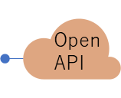







MaaS overview
companies
Railway(217)
Airlines(?)
Bus(2,267)
Taxi(51,371)
Rent-a-car(506,966)
Hotels(78,898)
Sync data
Timetable
vacancy
delay,
cancellation
Identity provider
Route search provider
app
Level１
login
Search route
Reservation/payment center
Level2
ticketing
reserve
Open
API
Ticket/voucher
Instruct payment
Subscription provider
= JR East
Financial Service
Level3
subscribe
personal account
Corporate account
Ticket/voucher
Instruct
payment
Report usage
personal
provider
rate
calculation

Slide 6
Objective of Hackfest
Realizing transparency of transportation and automated payment process
MaaS L3 requires realizing “subscription model” for payment on transportation fee. For that, it is necessary to solve the following 3 problems.
Transparency of transportation, There is a need for a mechanism that allows travelers to record which transportation was used at any time and which can not be tampered with in any way. Blockchain is thought to be useful as a base for storing trails.
Transparency of calculating amount and automated payment process, It is necessary to clarify the process of calculating the amount paid to transportation companies. The payment amount is automatically calculated, and the payment is automatically completed by cooperation with the payment API provided by the financial institution. Also record and share whether it was paid correctly.
Ease of business participation, Not only major transportation operators use these mechanisms. We have to assume that local small bus companies and taxi companies will also use this system. In other words, it is necessary to set barriers to entry such as technical capability and necessary cost as low as possible. This is an option in this Hackfest.
In this hackfest, we are going to focus Blockchain and Financial API connected to Blockchain

Slide 7
Team
JR East and JR East Information System
Mizuho Information & Research
Fujimoto
Others
Microsoft
Nashimoto
Anno
Takagi
Gojugi

Slide 8






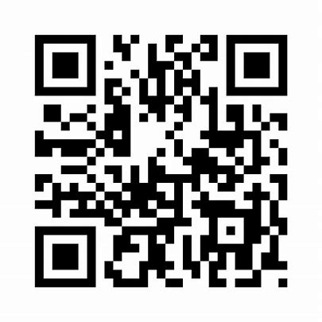


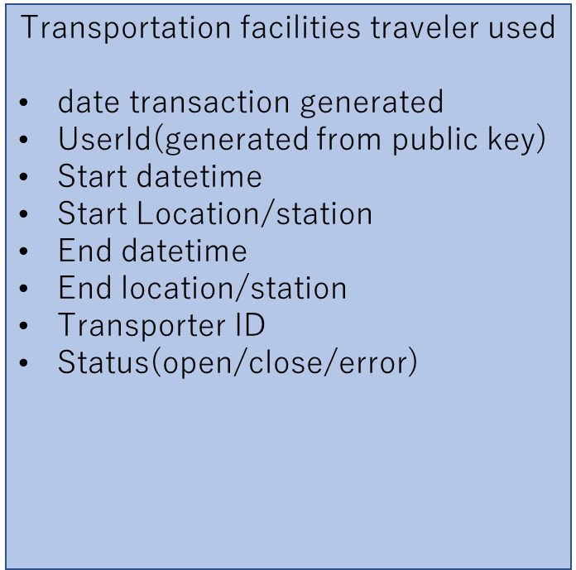

flow ~ overview
Subscription provider
app
login
Show
Qr-code
airport
hotel
ledger
Status = on

Slide 9


flow ~ sign-in using my number card (out of scope)
My number is the best solution to identifying Japanese people.
“My number” is the National Identity in Japan. “My number card” is an IC card which can identify. Although Japanese government expects citizens to have My Number card, the penetration rate of my number card is only about 10% currently. This is due to less convenience to my number cards.
Therefore, the Japanese government started reviewing legal revision to allow electronic certificates in my number card to be stored in smartphones. This should undoubtedly spur the popularity of my number cards.
Private companies such as financial institutions also have great interest in utilizing my number cards at KYC. Currently we need to visit the window to present an identity card to create a bank account. However, by connecting my number card and smartphone, you can complete application for account creation online only.
My number card will be integrated with smartphone in the near future
利用者証明用電子証明書
Digital certificate for user certification
App on
Smartphone which have IC card reader
My number card
Read card
show
Input pin
xxxx
Basic info
My number
Name
Birthday
address
User cert.
Encrypted nonce
Public key
Confirm effectiveness
Certificate Authority
Local Government
Information System Organization
地方公共団体情報システム機構

Slide 10
flow2 ~ create new bank account(out of focus)
署名用電子証明書
Digital certificate for signing
MaaS App or
Bank’s provisioning App
My number card
Read card
show
Input password
password
Certificate Authority
cert.
Encrypted request document
Public key
Local Government
Information System Organization
地方公共団体情報システム機構
Bank account id
Confirm effectiveness
Bank’s API don’t have user’s password. User signin with my number card. So Bank have to confirm effectiveness of user cert.
MaaS app or Bank’s provisioning App receive cert, encrypted request and public key which sent from My Number card, and redirect to the bank’s provisioning API.
Bank account id should store in the app when user agreed.
Same process will be done when user create new account for the MaaS system.
Financial Service
Provisioning
process
provision

Slide 11
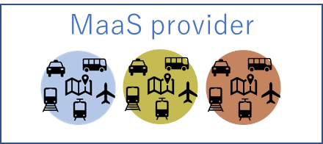
flow3 ~ buying new subscription ticket
In the production environment, it is necessary to present my number card for payment. But this is out of scope in this hackfest. Subscription ticket is stored in the distributed ledger and smartphone. Ticket on the smartphone is displayed as a qr-code.
MaaS App
Ticket list
List ticket
Select subscription ticket
Request to buy
buy
Certificate Authority
password
Request my number card
Local Government
Information System Organization
地方公共団体情報システム機構
This part is out of scope
Encrypted document
Account id
Amount
certificate
This part is out of scope
Confirm effectiveness
Financial Service
distributed ledger
Smart contract
pay
payment
process
Create ticket
Ticket
Ticket ID
Ticket type
Validity period
Start date
Ticket owner ID
Start date will be set when user use ticket first.
MaaS
provider’s
account
personal
account
Subscription ticket

Slide 12



flow4 ~ tracking transportation
airport
Show
Qr-code
Read qr-code of transporter
Show
Qr-code
Read qr-code of transporter
hotel
MaaS Provider
new_route
set_startdate
end_route
new_route
end_route
Route
ID
Ticket ID
transpoter
datetimeFrom
From(station/GPS)
datetimeTo
To(station/GPS)
Route
ID
Ticket ID
transpoter
datetimeFrom
From(station/GPS)
datetimeTo
To(station/GPS)
Route
ID
Ticket ID
transpoter
datetimeFrom
From(station/GPS)
datetimeTo
To(station/GPS)
Route
ID
Ticket ID
transpoter
datetimeFrom
From(station/GPS)
datetimeTo
To(station/GPS)
Ticket
Ticket ID
Ticket owner ID
Ticket type
Start date
Validity period

Slide 13
flow ~ calculate payment ratio
On going
Financial Service
personal account
Corporate account
personal
provider

Slide 14
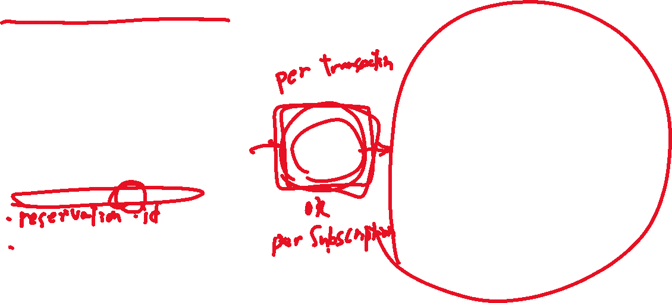
Two types of transaction in the ledger
Transportation facilities traveler used
date transaction generated
UserId(generated from public key)
Start datetime
Start Location/station/GPS
End datetime
End location/station/GPS
Transporter ID
Status(open/close/error)
Payment to each company/refund
Date transaction generated
Pay From userId(generated from public key)
Pay To Transporter ID
Amount of money
Status(outstanding/settled/error)
Smart contract

Slide 15
consideration
How to manage user identity
Access control
Self service signup
Authentication, low cost/risk with smart phone????
How to invite local transportation companies to this MaaS network
Privacy
User’s history
How to opt-in/out
Payment
Relation with Banking system

Slide 16
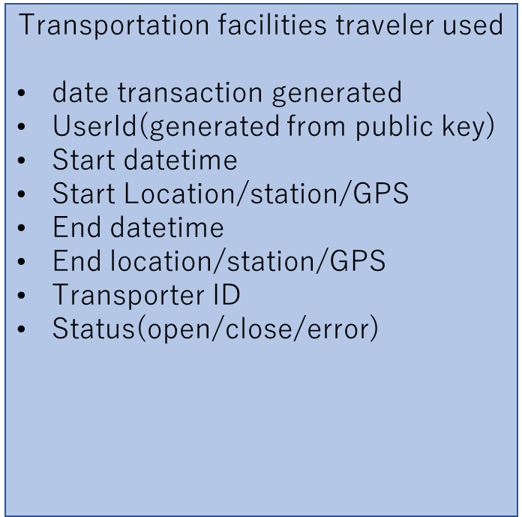
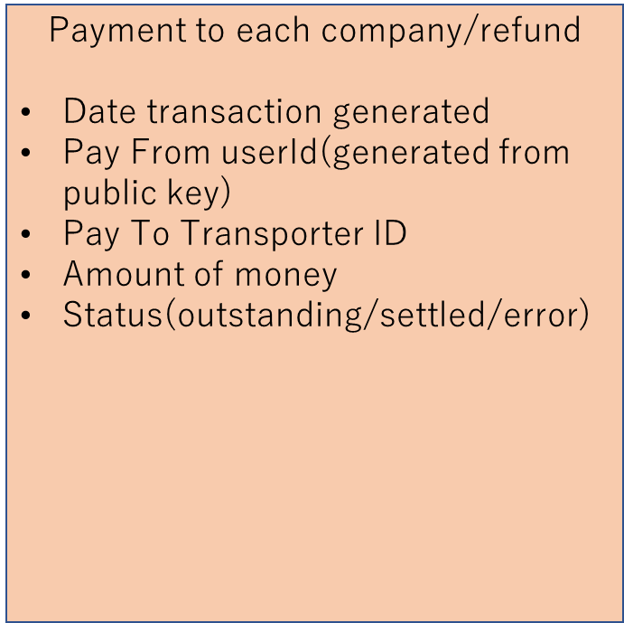


payment
Payment transaction
Status = “open”
Status = “close”
outstanding
settled
需給によって金額が変える？
航空会社のような仕組？
銀行ももっている。
watcher
watcher
launch
Smart contract
Smart contract
generate
Banking system
Calc amount
payment
API
事業者間清算
1日の終わりに清算する仕組み
いつを「終わり」にするのか？
（前提）月額生産モデル

Slide 17
Schedule
 | 1/28 | 1/29 | 1/30 | 1/31 | 2/1

Slide 18
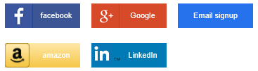










CONSUMER
IdP for consumers
Customer’s web
Customer’s API
GitHub
Microsoft Account
CONSUMER
Twitter
Ethereum
IdP
Workbench API
Smart Contract Admins are registered here
Signer
watcher
Workbench Web
Public IP

Slide 19
新規参入の障壁を下げるには
Webjetの事例
新規ノードの作成
データの保護

Slide 20
事前準備
Blockchain Workbenchの検証
サンプル投入データ
事業者データ
性能テストのシナリオ

