Slide 1


Enzyme allocation and stoichiometry in soil organic matter models.
Thomas Wutzler
MPI for Biogeochemistry, BGC-Integration
Vienna, April 2014
Notes:
TODO Quasom logo

Slide 2
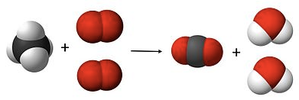
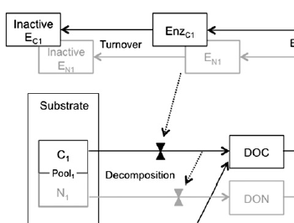

Outline
Wrapup stoichiometry
Eezy model of Moorhead 2011
Different strategies of enzyme allocation and their consequences
Notes:
Image from ocal and csal on clker

Slide 3
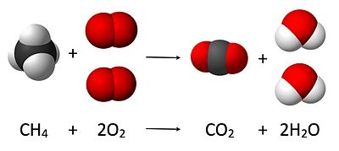
Stoichiometry
Definition (Sterner & Elser 2002)
branch of chemistry
that deals with the application of the law of definite proportions and conservations of mass
Often expressed as a ratio of elements, E.g. C/N ratio
Stoichiometric: compounds are formed with strict and definite proportions
Macro elements are more stoichiometry than microelements
C: 40%-50% dry biomass of most living things
most inorganic earth crust, sea water, gases: non-stoichiometric
Autotrophs: stoichiometric but high variability
Heterotrophs: low stoichiometric variability
Marine plankton (C:N:P): 106:16:1 (Redfied Ratio)

Slide 4
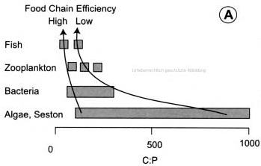
Stoichiometric imbalance and Yield
Stoichiometric imbalance: Resource ≠Consumer
Instead of “you are what you eat”
Homeostatic regulation:
Notes:
Strategies dealing with imbalances during growth
Change own biomass ratio
Get rid of “access” element
Adjust resource
Get external inputs
Invest into enzymes

Slide 5
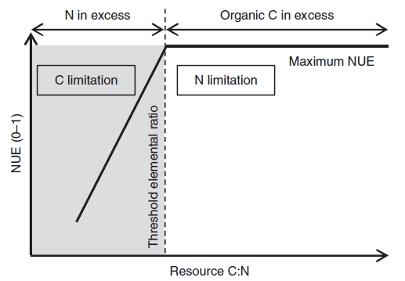
TER: Threshold Elemental Ratios
NUE, CUE, yield
[Nutrient / Nitrogen / Carbon] Use Efficiency
amount of product or biomass obtained per unit reactant
Mooshammer et al. (2014)

Slide 6
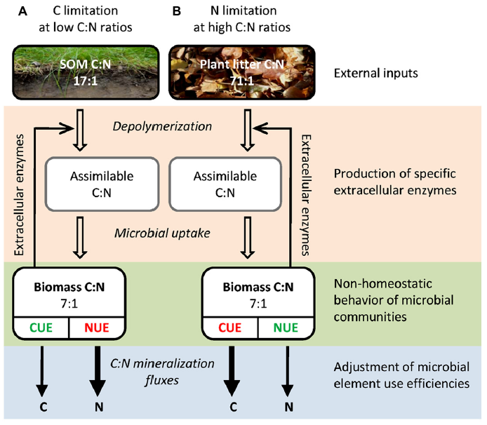
Strategies to deal with imbalance
Mooshammer M, Wanek W, Zechmeister-Boltenstern S & Richter A (2014) Stoichiometric imbalances between terrestrial decomposer communities and their resources: mechanisms and implications of microbial adaptations to their resources. Frontiers in Microbiology

Slide 7
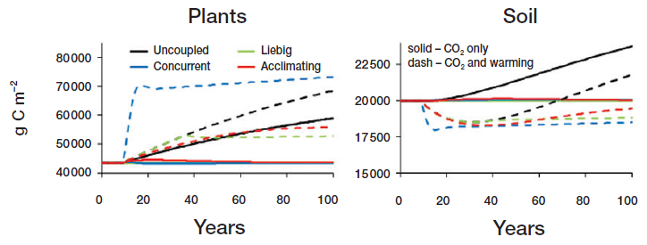
Profound consequences
Rastetter E (2011) Modeling coupled biogeochemical cycles. Frontiers in Ecology and the Environment
Notes:
Modelled different formulations of coupling of element cycles (microbial imbalance)

Slide 8
Outline
Introduction to stoichiometry
Eezy model of Moorhead 2012
Different strategies of enzyme allocation and their consequences
Notes:
Image from ocal and csal on clker

Slide 9
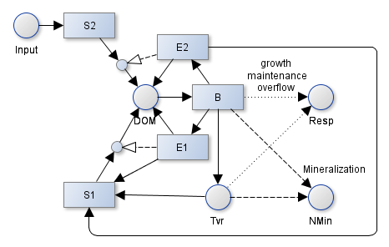
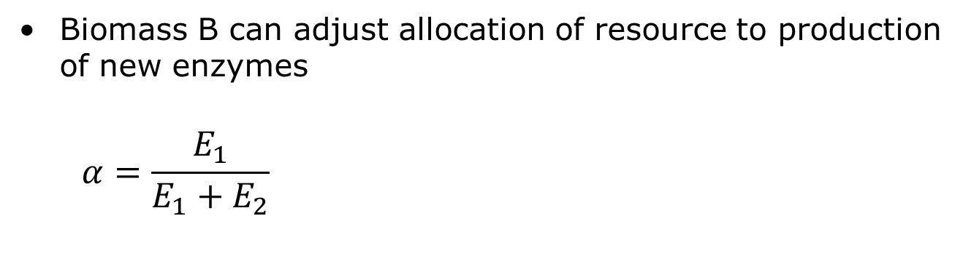
Soil Enzyme Allocation Model
Biomass B can adjust allocation of resource to production of new enzymes
$$α=\frac{E_{1}}{E_{1}+E_{2}}$$

Slide 10
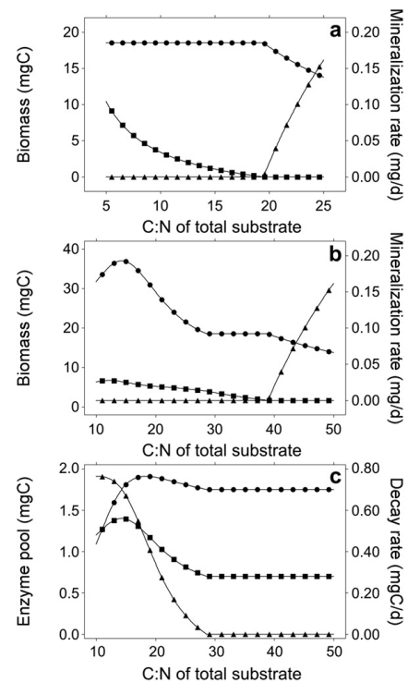
Eezy predictions
Providing constant C substrate, steady state:
One substrate only:
Access element is mineralized
Choosing substrate
More dynamics
Less Mineralization per biomass
C₂=0
M. biomass
N-min
overflow
C₂=C₁
C₂=C₁
Decomp C₁
EC₁ + EC₁
Decomp C₂

Slide 11
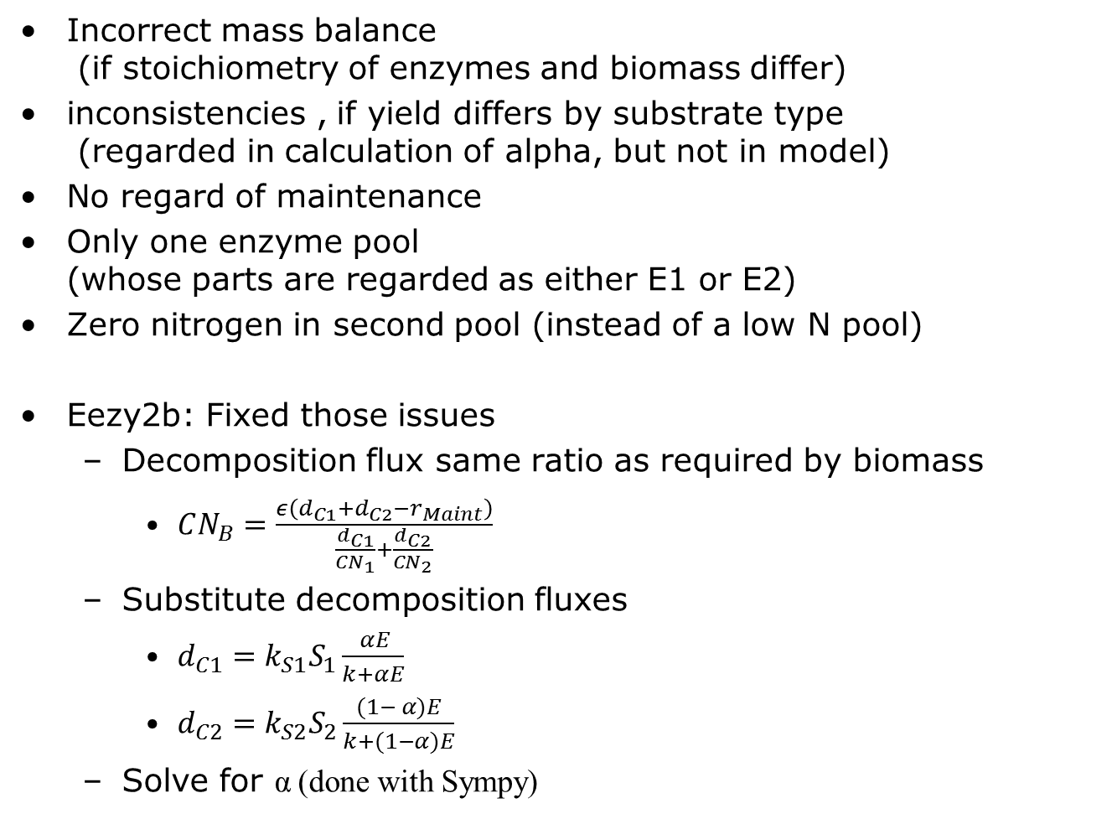
Issues with the EEZY
Incorrect mass balance (if stoichiometry of enzymes and biomass differ)
inconsistencies , if yield differs by substrate type (regarded in calculation of alpha, but not in model)
No regard of maintenance
Only one enzyme pool (whose parts are regarded as either E1 or E2)
Zero nitrogen in second pool (instead of a low N pool)
Eezy2b: Fixed those issues
Decomposition flux same ratio as required by biomass
$CN_{B}=\frac{ε\left(d_{C1}+d_{C2}−r_{Maint}\right)}{\frac{d_{C1}}{CN_{1}}+\frac{d_{C2}}{CN_{2}}}$
Substitute decomposition fluxes
$d_{C1}=k_{S1}S_{1}\frac{ αE}{k+αE}$
$d_{C2}=k_{S2}S_{2}\frac{(1− α)E}{k+(1−α)E}$
Solve for α (done with Sympy)

Slide 12
Balanced decomposition
Maximum biomass at pool 1 slightly higher CN as biomass
Providing constant substrate, steady state
No overflow respiration and No N-min over wide range
No N-mineralization at all

Slide 13
Outline
Introduction to stoichiometry
Eezy model of Moorhead 2012
Different strategies of enzyme allocation and their consequences
Notes:
Image from ocal and csal on clker

Slide 14
Is balanced stoichiometry the best strategy?
When explicitly tracking substrate pools (Eezy2c) and supplying constant inputs:
Inefficient Enzyme investment into small low N pool
Could grow better on S1, despite N mineralization
Role of biomass?
Making enzyme production proportional to uptake aka decomposition decouples enzyme production and decomposition from current microbial biomass Almost zero biomass may produce big enzyme pool
Suggestion: make enzyme investment a proportion of microbial biomass similar to maintenance

Slide 15
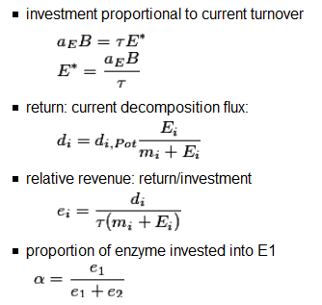
Revenue: Return / Investment

Slide 16
Investment proportional to revenue
When supplying constant input of S1 and S2
Now biomass growing on S1 as well
But yielding some N-mineralization
Lower biomass (Scale of magnitude)
Ratio of enzyme investment not optimized yet
Interestingly settling to alpha near 0.5
Notes:
Model 4b

Slide 17
Feeding back turnover to S1
Fixed Allocation: α =0.5
No other input to S1 pool now, but still input to S2
Compared to fixed allocation
Less overflow respiration in the beginning
Slightly higher biomass (used S2 more efficiently)
N-mineralization only negligibly decreased
Again: alpha near 0.5 in quasi-steady state
Notes:
Priming experiments: initial preferential substrate usage for N-rich substrate?

Slide 18
Decreased Mineralization and Overflow
Fixed C-pools, varying N in S2 pool

Slide 19
Long-term state differs with Allocation
Applied same input of 300g/m2 CN=30 to the system
Match strategy:
Does not take into account the sizes of the pools
Biomass allocates to small matching pool and starves
Flexible (optimized Revenue) strategy:
Higher proportion of N-rich S1 pool
higher biomass and higher total stocks

Slide 20
Redistribution Between Pools
Simulated increase of C-input by 20% during years 10-60
Flexible Allocation: decrease in N-rich S1 pool
When C is abundant: use more N from slow N-rich pool to sustain microbial biomass
When N is abundant: use more C from fast C-rich pool

Slide 21
Stronger Priming and N-Mining
Simulated S1 pulse of 50 gC/m2 on a 500yr depleted soil
Increased decomposition of slow S1 due to priming effect
With Flexible allocation: Higher decomposition of N-rich slow pool

Slide 22
Slowing Down of Decomposition Rate
Simulated decrease of input to 1/100 during years 10-210
Both allocation schemes
Slowing down of decomposition
Effect slightly pronounced with flexible allocation

Slide 23
Summary
Stoichiometric imbalance (Resource ≠Consumer )
Leads to excretion of resource -> consumer driven nutrient recycling
Constrains growth and Element cycling
Different strategies of enzyme allocation
Decrease stoichiometric imbalance
Extreme case: eliminate imbalance
Optimize growth
Lower mineralization
Difference to fixed enzyme allocation
Not to big in examples studied so far
Why does it settle for near

Slide 24
Outlook
Explore further allocation strategies ?
Determine Quasi-steady state
To optimize allocation to enzymes Which fraction of uptake is allocated?
Simplify model descriptions for upscaling

Slide 25



Data without models are chaos.
Models without data are philosophies.
Thanks to QUASOM funding by ERC, DFG

Slide 26
Moorhead D, Lashermes G & Sinsabaugh R (2012) A theoretical model of C-and N-acquiring exoenzyme activities, which balances microbial demands during decomposition. Soil Biology and Biochemistry, Elsevier, 53, 133-141

Slide 27
Priming simulation

Slide 28
Simplification: Quasi steady state

Slide 30
4bc
Not much different to fixed allocation (lower alpha10)

Slide 31
Purpose of this talk
Give an introduction into stoichiometry
Present my current thinking and work
Get constructive feedback
Preparation for and EGU talk/poster
In session SSS4.7 Soil microorganisms as a drivers of humification and mineralisation
Educate each other

Slide 32
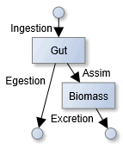
Stoichiometric imbalance and Yield
Stoichiometric imbalance: Resource ≠Consumer
Instead of “you are what you eat”
Homeostatic regulation:
Yield, NUE, CUE
amount of product or biomass obtained per unit reactant
Strategies dealing with imbalances during growth
Get rid of “access” element
Store “access” intermediately
Suppress growth
Invest into breakdown of OM of different stoichiometry
Consumer driven nutrient recycling

Slide 33

Decomposition matching demand
$CN_{opt}=\frac{C_{syn}}{N_{Syn}}=\frac{ syn_{E} + syn_{B}}{\frac{syn_{E}}{CN_{E}} + \frac{syn_{B}}{CN_{B}}}=\frac{ε \left(dec_{S1}+dec_{S2}−r_{Maint}\right)}{\frac{dec_{S1}}{CN_{S1}}+\frac{dec_{S2}}{CN_{S2}}}$
Solve for $α$ in decomposition equations
$dec_{S1}=k_{1}S_{1}\frac{ αE }{k_{m1}+αE)}$
$dec_{S2}=k_{1}S_{2}\frac{ (1−α)E }{k_{m2}+(1−α)E)}$
Notes:
Including enzyme tvr: $CN_{opt}=\frac{CN_{E} syn_{E}+CN_{B} syn_{B}}{syn_{E}+syn_{B}}=\frac{C_{syn}}{N_{Syn}}=\frac{ε \left(dec_{S1}+dec_{S2}+tvr_{E}−r_{Maint}\right)}{\frac{dec_{S1}}{CN_{S1}}+\frac{dec_{S2}}{CN_{S2}}+\frac{tvr_{E}}{CN_{E}}}$

Slide 34
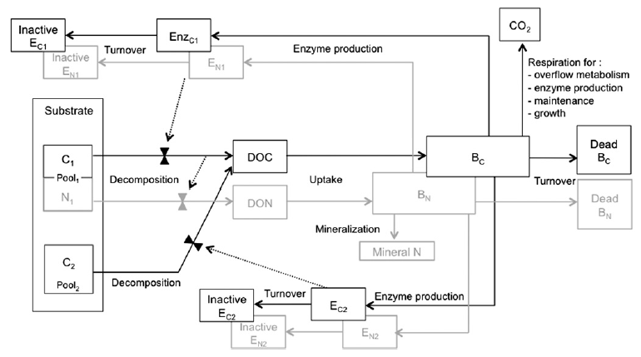
Moorhead 2012: EEZY
Calculates the ratio of Enzymes,α, so that stoichiometry of decomposition flux matches biomass + growth respiration

Slide 35
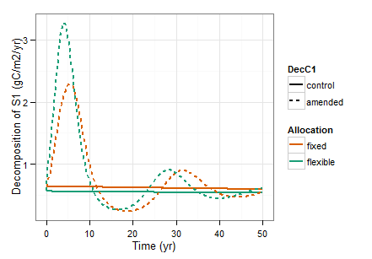
Priming oscillations?

