Slide 1


Enzyme allocation and stoichiometry in soil organic matter models.
Thomas Wutzler
MPI for Biogeochemistry, BGC-Integration
Vienna, April 2014
Notes:
TODO Quasom logo

Slide 2
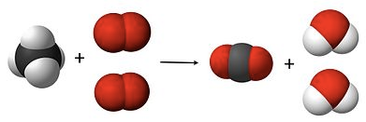
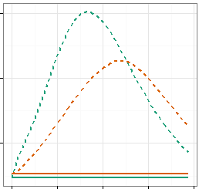

Outline
Stoichiometry - Recapitulation
Enzyme allocation strategies
Consequences for SOM dynamics
$$α=\frac{E_{1}}{E_{1}+E_{2}}$$
Notes:
Image from ocal and csal on clker

Slide 3
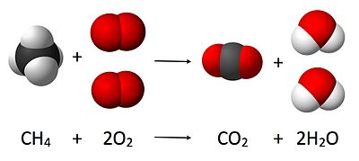
Stoichiometric: definite elemental ratios
Definition (Sterner & Elser 2002)
branch of chemistry
that deals with the application of the law of definite proportions and conservations of mass
Often expressed as a ratio of elements, E.g. C/N ratio
Stoichiometric: compounds are formed with strict and definite proportions
most inorganic earth crust, sea water, gases: non-stoichiometric
Autotrophs: stoichiometric but high variability
Heterotrophs: low stoichiometric variability
Marine plankton (C:N:P): 106:16:1 (Redfied Ratio)
Notes:
Macro elements are more stoichiometry than microelements
C: 40%-50% dry biomass of most living things

Slide 4
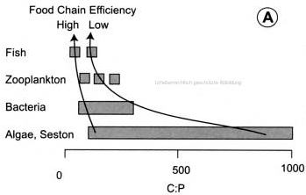
Imbalance and Regulation
Stoichiometric imbalance: Resource ≠Consumer
Instead of “you are what you eat”
Homeostatic regulation:
Notes:
Strategies dealing with imbalances during growth
Change own biomass ratio
Get rid of “access” element
Adjust resource
Get external inputs
Invest into enzymes

Slide 5
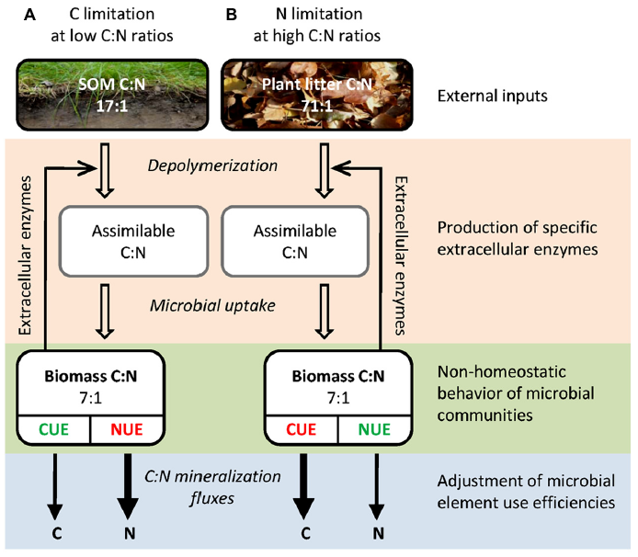
Strategies to deal with imbalance
Mooshammer et. al (2014) Stoichiometric imbalances between terrestrial decomposer communities and their resources: mechanisms and implications of microbial adaptations to their resources. Frontiers in Microbiology

Slide 6
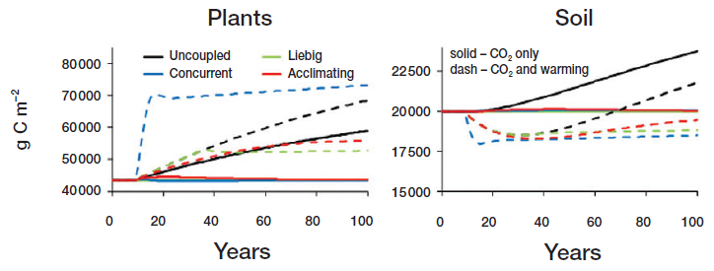
Profound consequences for global change
Rastetter E (2011) Modeling coupled biogeochemical cycles. Frontiers in Ecology and the Environment
Notes:
Modelled different formulations of coupling of element cycles (microbial imbalance)

Slide 7
Outline
Stoichiometry - Recapitulation
Enzyme allocation strategies
Consequences for SOM dynamics
$$α=\frac{E_{1}}{E_{1}+E_{2}}$$
Notes:
Image from ocal and csal on clker

Slide 8
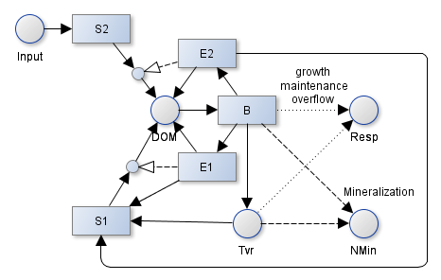
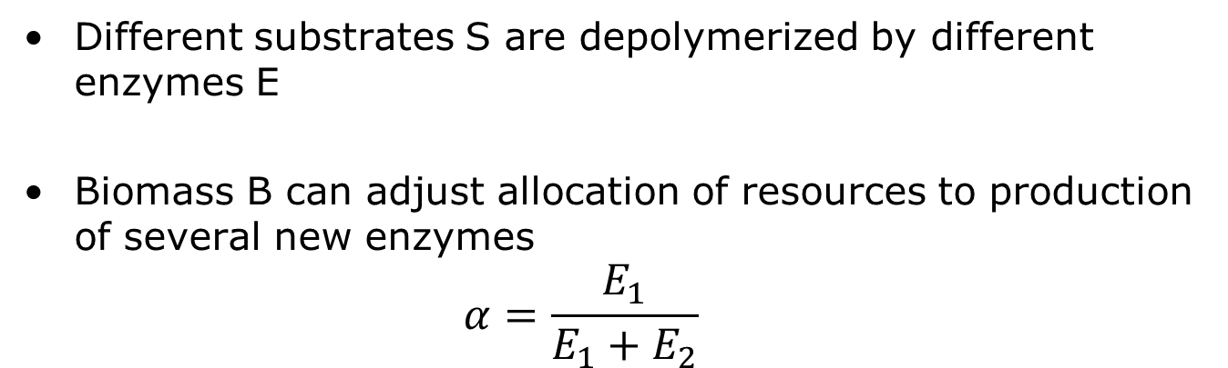
Soil Enzyme Allocation Model
Carbon-rich
Nutrient-rich
Different substrates S are depolymerized by different enzymes E
Biomass B can adjust allocation of resources to production of several new enzymes
$$α=\frac{E_{1}}{E_{1}+E_{2}}$$

Slide 9



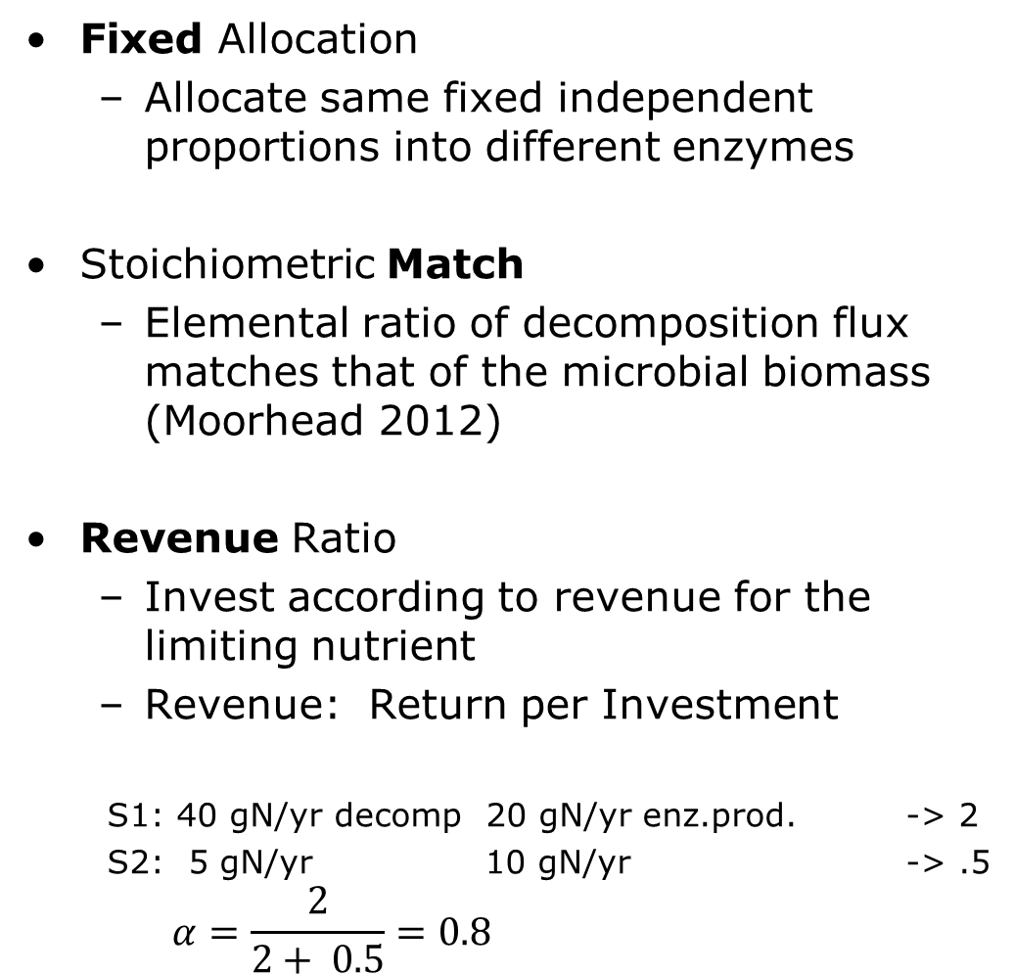
Fixed Match Revenue Strategies
Fixed Allocation
Allocate same fixed independent proportions into different enzymes
Stoichiometric Match
Elemental ratio of decomposition flux matches that of the microbial biomass (Moorhead 2012)
Revenue Ratio
Invest according to revenue for the limiting nutrient
Revenue: Return per Investment
S1: 40 gN/yr decomp 20 gN/yr enz.prod. -> 2
S2: 5 gN/yr 10 gN/yr -> .5
$$α=\frac{2}{2+ 0.5}=0.8$$

Slide 10
Outline
Stoichiometry - Recapitulation
Enzyme allocation strategies
Consequences for SOM dynamics
$$α=\frac{E_{1}}{E_{1}+E_{2}}$$
Notes:
Image from ocal and csal on clker

Slide 11
Decreased Mineralization and Overflow
Fixed C-pools (800 and 400 gC/m2 in S1 and S2 pool)
Varying N in S2 pool
Notes:
C

Slide 12
Long-term state differs with Allocation
Applied same input of 300g/m2 CN=30 to the system
Match strategy:
Almost all enzymes allocated to S1 pool
Biomass starves
Does not take into account the sizes of the pools
Revenue strategy:
Higher proportion of N-rich S1 pool
Higher biomass and higher total stocks

Slide 13
Redistribution Between Pools
Simulated increase of C-input by 20% during years 10-60
Flexible Allocation: decrease in N-rich S1 pool
When C is abundant: use more N from slow N-rich pool to sustain microbial biomass
When N is abundant: use more C from fast C-rich pool

Slide 14
Stronger Priming and N-Mining
Simulated S1 pulse of 50 gC/m2 on a 500yr depleted soil
Increased decomposition of slow S1 due to priming effect
With Flexible allocation: Higher decomposition of N-rich slow pool

Slide 15
Slowing Down of Decomposition Rate
Simulated decrease of input to 1/100 during years 10-210
Both allocation schemes
Slowing down of decomposition
Effect pronounced with flexible allocation

Slide 16



Summary
Regulation of stoichiometric imbalance
Fixed / Match / Revenue Allocation
Consequences for SOM dynamics
Decreased Mineralization and Overflow
Differing Long-term State
Redistribution Between Pools
Stronger Priming and N-Mining
$$α=\frac{E_{1}}{E_{1}+E_{2}}$$
Notes:
Image from ocal and csal on clker

Slide 17



Data without models are chaos.
Models without data are philosophies.
Thanks to QUASOM funding by ERC, DFG

Slide 18
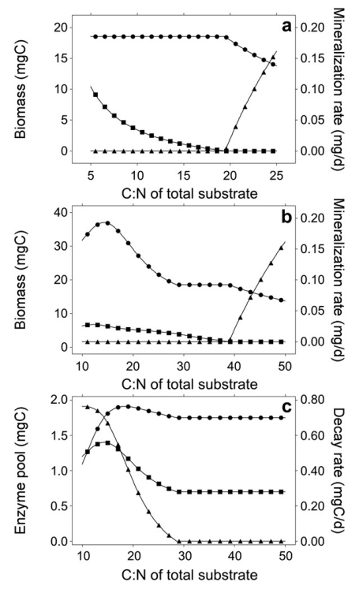
Eezy predictions
Providing constant C substrate, steady state:
One substrate only:
Access element is mineralized
Choosing substrate
More dynamics
Less Mineralization per biomass
C₂=0
M. biomass
N-min
overflow
C₂=C₁
C₂=C₁
Decomp C₁
EC₁ + EC₁
Decomp C₂

Slide 19
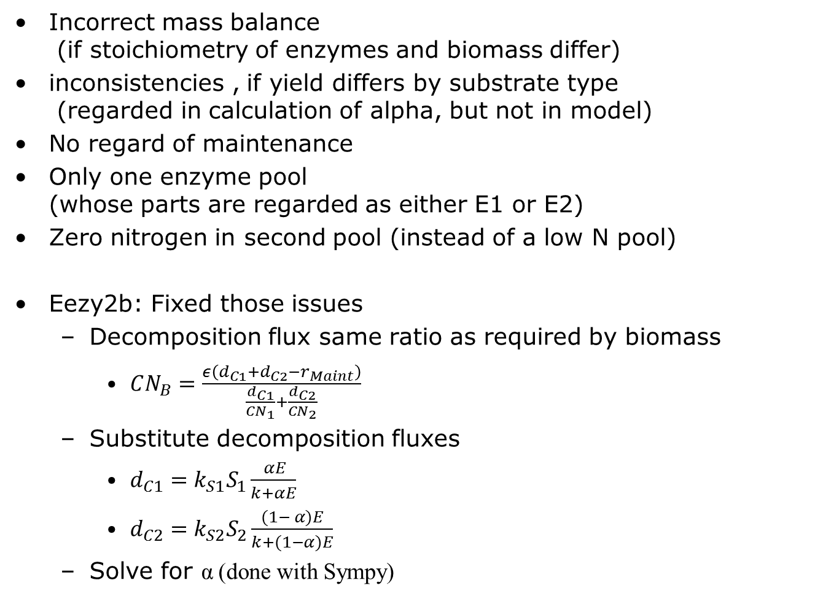
Issues with the EEZY
Incorrect mass balance (if stoichiometry of enzymes and biomass differ)
inconsistencies , if yield differs by substrate type (regarded in calculation of alpha, but not in model)
No regard of maintenance
Only one enzyme pool (whose parts are regarded as either E1 or E2)
Zero nitrogen in second pool (instead of a low N pool)
Eezy2b: Fixed those issues
Decomposition flux same ratio as required by biomass
$CN_{B}=\frac{ε\left(d_{C1}+d_{C2}−r_{Maint}\right)}{\frac{d_{C1}}{CN_{1}}+\frac{d_{C2}}{CN_{2}}}$
Substitute decomposition fluxes
$d_{C1}=k_{S1}S_{1}\frac{ αE}{k+αE}$
$d_{C2}=k_{S2}S_{2}\frac{(1− α)E}{k+(1−α)E}$
Solve for α (done with Sympy)

Slide 20
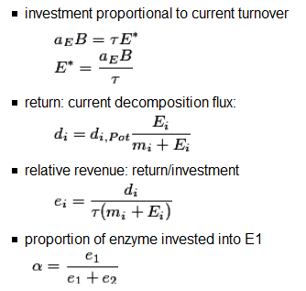
Revenue: Return / Investment

Slide 21
Balanced decomposition
Maximum biomass at pool 1 slightly higher CN as biomass
Providing constant substrate, steady state
No overflow respiration and No N-min over wide range
No N-mineralization at all

Slide 22
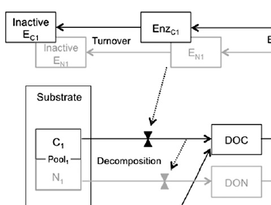

Outline
Introduction to stoichiometry
Eezy model of Moorhead 2012
Different strategies of enzyme allocation and their consequences
Notes:
Image from ocal and csal on clker

Slide 23
Is balanced stoichiometry the best strategy?
When explicitly tracking substrate pools (Eezy2c) and supplying constant inputs:
Inefficient Enzyme investment into small low N pool
Could grow better on S1, despite N mineralization
Role of biomass?
Making enzyme production proportional to uptake aka decomposition decouples enzyme production and decomposition from current microbial biomass Almost zero biomass may produce big enzyme pool
Suggestion: make enzyme investment a proportion of microbial biomass similar to maintenance

Slide 24
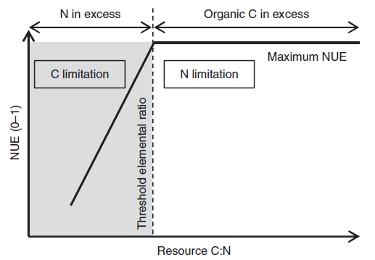
TER: Threshold Elemental Ratios
NUE, CUE, yield
[Nutrient / Nitrogen / Carbon] Use Efficiency
amount of product or biomass obtained per unit reactant
Mooshammer et. al (2014) Stoichiometric imbalances between terrestrial decomposer communities and their resources: mechanisms and implications of microbial adaptations to their resources. Frontiers in Microbiology

Slide 25
Moorhead D, Lashermes G & Sinsabaugh R (2012) A theoretical model of C-and N-acquiring exoenzyme activities, which balances microbial demands during decomposition. Soil Biology and Biochemistry, Elsevier, 53, 133-141

Slide 26
Priming simulation

Slide 27
Simplification: Quasi steady state

Slide 29
4bc
Not much different to fixed allocation (lower alpha10)

Slide 30
Purpose of this talk
Give an introduction into stoichiometry
Present my current thinking and work
Get constructive feedback
Preparation for and EGU talk/poster
In session SSS4.7 Soil microorganisms as a drivers of humification and mineralisation
Educate each other

Slide 31
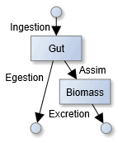
Stoichiometric imbalance and Yield
Stoichiometric imbalance: Resource ≠Consumer
Instead of “you are what you eat”
Homeostatic regulation:
Yield, NUE, CUE
amount of product or biomass obtained per unit reactant
Strategies dealing with imbalances during growth
Get rid of “access” element
Store “access” intermediately
Suppress growth
Invest into breakdown of OM of different stoichiometry
Consumer driven nutrient recycling

Slide 32

Decomposition matching demand
$CN_{opt}=\frac{C_{syn}}{N_{Syn}}=\frac{ syn_{E} + syn_{B}}{\frac{syn_{E}}{CN_{E}} + \frac{syn_{B}}{CN_{B}}}=\frac{ε \left(dec_{S1}+dec_{S2}−r_{Maint}\right)}{\frac{dec_{S1}}{CN_{S1}}+\frac{dec_{S2}}{CN_{S2}}}$
Solve for $α$ in decomposition equations
$dec_{S1}=k_{1}S_{1}\frac{ αE }{k_{m1}+αE)}$
$dec_{S2}=k_{1}S_{2}\frac{ (1−α)E }{k_{m2}+(1−α)E)}$
Notes:
Including enzyme tvr: $CN_{opt}=\frac{CN_{E} syn_{E}+CN_{B} syn_{B}}{syn_{E}+syn_{B}}=\frac{C_{syn}}{N_{Syn}}=\frac{ε \left(dec_{S1}+dec_{S2}+tvr_{E}−r_{Maint}\right)}{\frac{dec_{S1}}{CN_{S1}}+\frac{dec_{S2}}{CN_{S2}}+\frac{tvr_{E}}{CN_{E}}}$

Slide 33
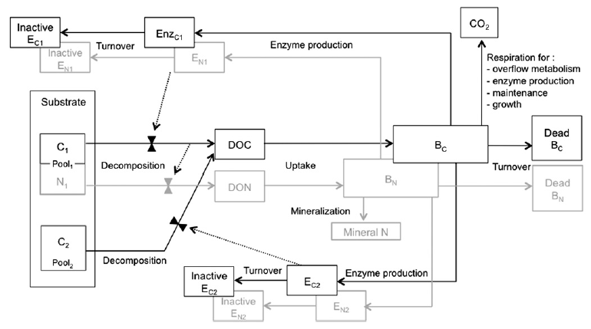
Moorhead 2012: EEZY
Calculates the ratio of Enzymes,α, so that stoichiometry of decomposition flux matches biomass + growth respiration

Slide 34
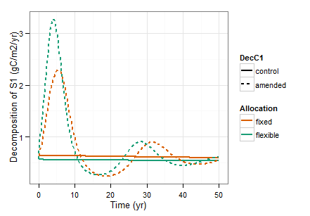
Priming oscillations?

