Slide 1


Enzyme allocation and stoichiometry in soil organic matter models.
Thomas Wutzler
MPI for Biogeochemistry, BGC-Integration
Vienna, May 2014
Notes:
TODO Quasom logo

Slide 2
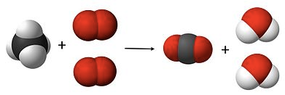
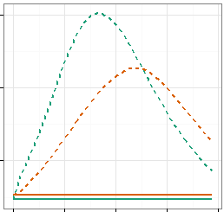

Outline
Stoichiometry - Recapitulation
Enzyme allocation strategies
Consequences for SOM dynamics
$$α=\frac{E_{1}}{E_{1}+E_{2}}$$
Notes:
Image from ocal and csal on clker

Slide 3
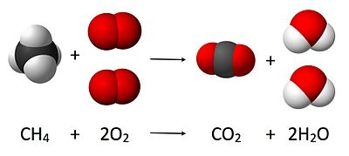
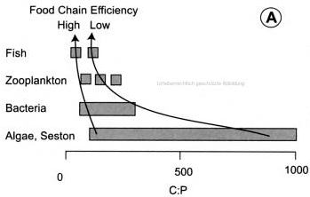
Imbalance and Regulation
Definite proportion of masses Mass-Balance: Resource and Product
Stoichiometric imbalance: Resource ≠Consumer
Homeostatic regulation: low C/Nutrient use efficiency
Notes:
Strategies dealing with imbalances during growth
Change own biomass ratio
Get rid of “access” element
Adjust resource
Get external inputs
Invest into enzymes

Slide 4
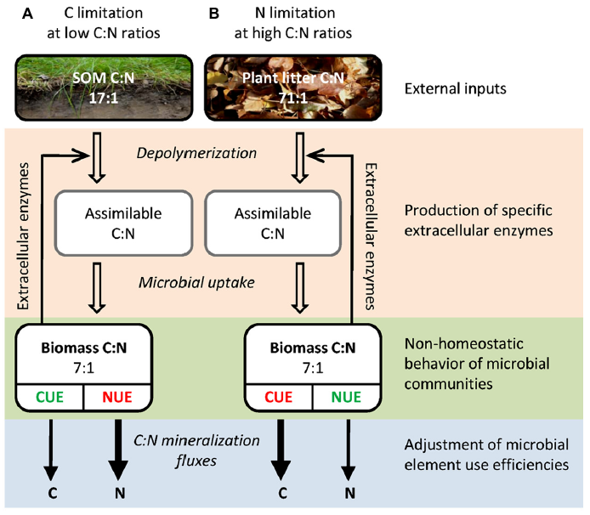
Strategies to deal with imbalance
Explore by simple conceptual model
Polymerization
Profound consequences for soil C-Stocks with CO2 fertilization
Mineralization
Mooshammer et. al (2014) Stoichiometric imbalances between terrestrial decomposer communities and their resources: mechanisms and implications of microbial adaptations to their resources. Frontiers in Microbiology

Slide 5
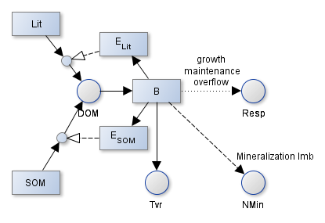
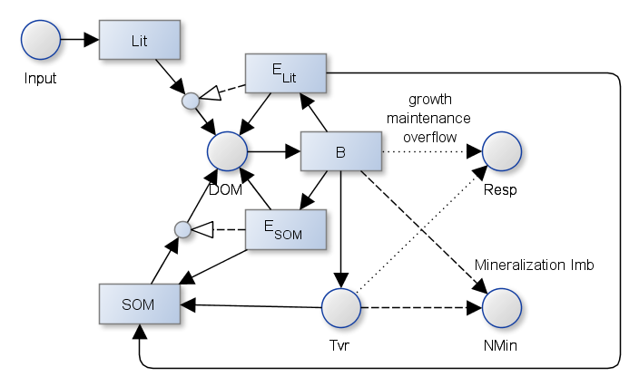
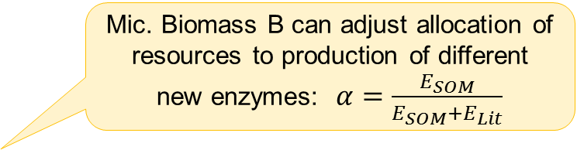
Conceptual Soil Enzyme Allocation Model
Mic. Biomass B can adjust allocation of resources to production of different new enzymes: $α=\frac{E_{SOM}}{E_{SOM}+E_{Lit}}$
Carbon-rich
Substrates of different C/N depolymerized by different enzymes
Mineralization or Overflow respiration due to stoichiometric imbalance
Nutrient-rich
Biomass and enzymes feeding back to SOM pool
Predation mineralization flux

Slide 6



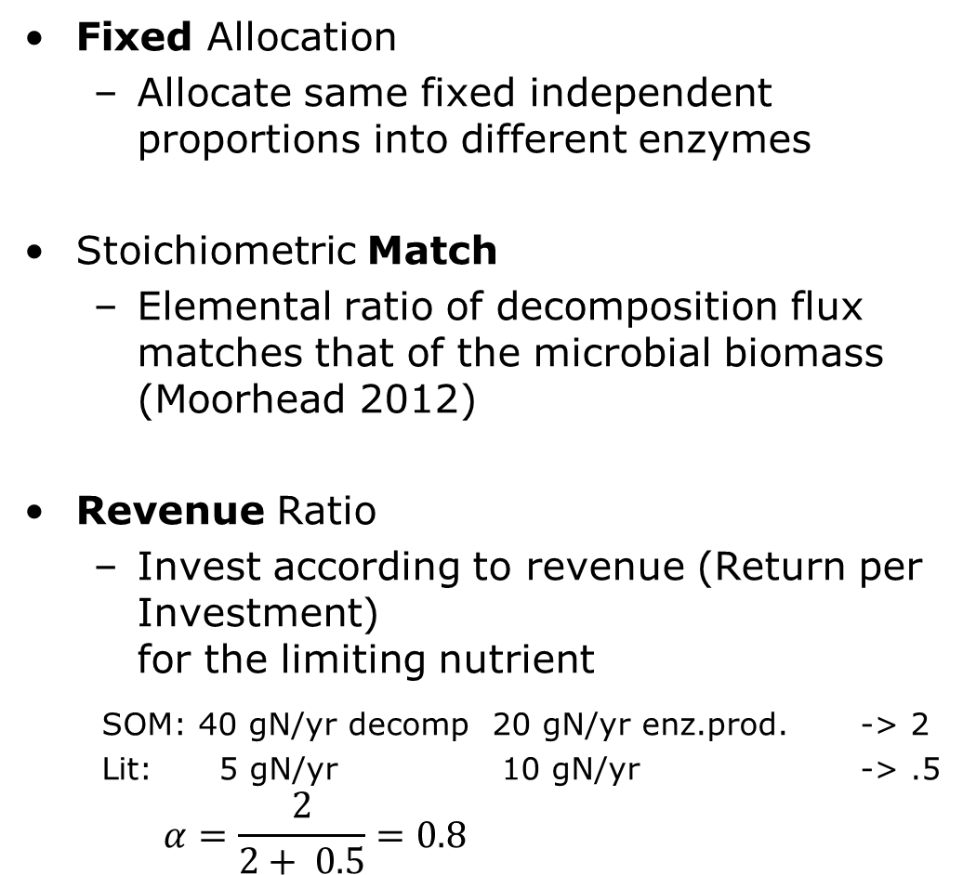
Fixed Match Revenue Strategies
Fixed Allocation
Allocate same fixed independent proportions into different enzymes
Stoichiometric Match
Elemental ratio of decomposition flux matches that of the microbial biomass (Moorhead 2012)
Revenue Ratio
Invest according to revenue (Return per Investment) for the limiting nutrient
SOM: 40 gN/yr decomp 20 gN/yr enz.prod. -> 2
Lit: 5 gN/yr 10 gN/yr -> .5
$$α=\frac{2}{2+ 0.5}=0.8$$

Slide 7
Fixed C-Pools, Varying N
Steady State
C/N = 3.1
Carbon-rich
Steady State
C/N = 7.16
400 gC/ m²
C/N varying
Tvr=1 yr
800 gC/ m²
C/N = 6.8
Tvr= 10 yr
Nutrient-rich

Slide 8
Decreased Mineralization and Overflow
High N
Low N
Notes:
C

Slide 9
Changing Substrate pools
Size and C/N of substrates now depend on inputs / outputs
300 gC/ m²/yr
C/N = 30

Slide 10
Long-term state differs with Allocation
Notes:
Match strategy:
Almost all enzymes allocated to S1 pool
Biomass starves
Does not take into account the sizes of the pools
Revenue strategy:
Higher proportion of N-rich S1 pool
Higher biomass and higher total stocks

Slide 11
Stronger Priming and N-Mining
Litter pulse of 50 gC/m2 on a 500yr depleted soil
Notes:
Increased decomposition of slow S1 due to priming effect
With Flexible allocation: Higher decomposition of N-rich slow pool

Slide 12
CO2-Fertilization: Substrate Redistribution
+20% C-input during years 10 to 60
Decrease in SOM: Mining for N
Notes:
Revenue Allocation: decrease in N-rich S1 pool
When C is abundant: use more N from slow N-rich pool to sustain microbial biomass
When N is abundant: use more C from fast C-rich pool

Slide 13



Wrapup
Cope with Stoichiometric Imbalance
Pool sizes important turnover (predation) important
With flexible (Revenue) allocation
Decreased Mineralization and Overflow
Stronger Priming and N-Mining -> more plant available N
Redistribution Between Pools on C-Inputs
“bank mechanism”
Outlook: Integrate into full model
and compare to observations
$$α=\frac{E_{SOM}}{E_{SOM}+E_{Lit}}$$
Notes:
Image from ocal and csal on clker

Slide 14



Data without models are chaos.
Models without data are philosophies.
Thanks to QUASOM funding by ERC, DFG

Slide 15
Stoichiometric: definite elemental ratios
Definition (Sterner & Elser 2002)
branch of chemistry
that deals with the application of the law of definite proportions and conservations of mass
Often expressed as a ratio of elements, E.g. C/N ratio
Stoichiometric: compounds are formed with strict and definite proportions
most inorganic earth crust, sea water, gases: non-stoichiometric
Autotrophs: stoichiometric but high variability
Heterotrophs: low stoichiometric variability
Marine plankton (C:N:P): 106:16:1 (Redfied Ratio)
Notes:
Macro elements are more stoichiometry than microelements
C: 40%-50% dry biomass of most living things

Slide 16
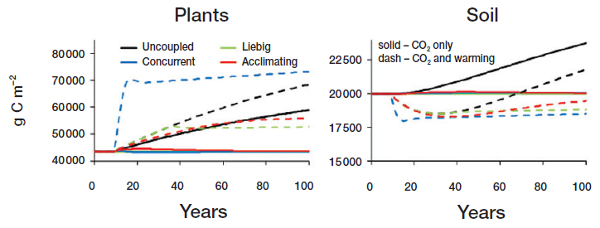
Profound consequences for global change
Rastetter E (2011) Modeling coupled biogeochemical cycles. Frontiers in Ecology and the Environment
Notes:
Modelled different formulations of coupling of element cycles (microbial imbalance)

Slide 17
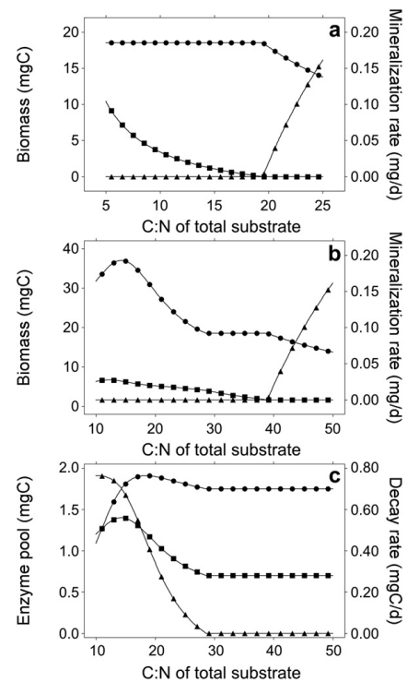
Eezy predictions
Providing constant C substrate, steady state:
One substrate only:
Access element is mineralized
Choosing substrate
More dynamics
Less Mineralization per biomass
C₂=0
M. biomass
N-min
overflow
C₂=C₁
C₂=C₁
Decomp C₁
EC₁ + EC₁
Decomp C₂

Slide 18
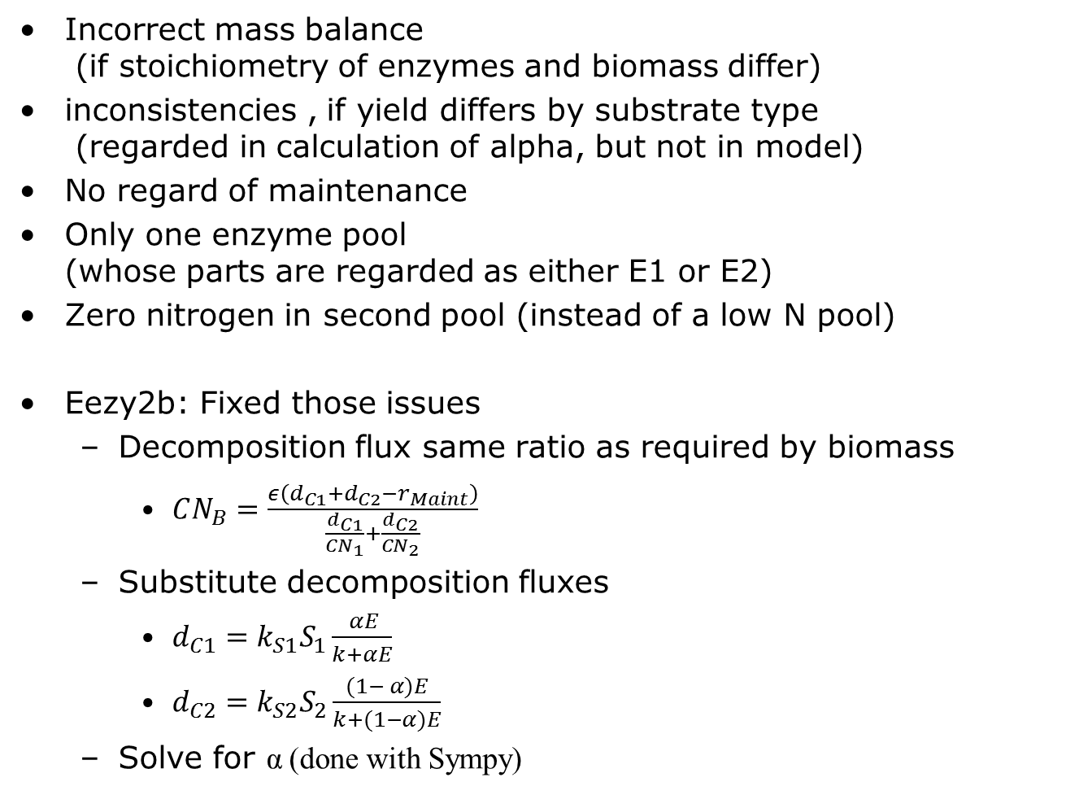
Issues with the EEZY
Incorrect mass balance (if stoichiometry of enzymes and biomass differ)
inconsistencies , if yield differs by substrate type (regarded in calculation of alpha, but not in model)
No regard of maintenance
Only one enzyme pool (whose parts are regarded as either E1 or E2)
Zero nitrogen in second pool (instead of a low N pool)
Eezy2b: Fixed those issues
Decomposition flux same ratio as required by biomass
$CN_{B}=\frac{ε\left(d_{C1}+d_{C2}−r_{Maint}\right)}{\frac{d_{C1}}{CN_{1}}+\frac{d_{C2}}{CN_{2}}}$
Substitute decomposition fluxes
$d_{C1}=k_{S1}S_{1}\frac{ αE}{k+αE}$
$d_{C2}=k_{S2}S_{2}\frac{(1− α)E}{k+(1−α)E}$
Solve for α (done with Sympy)

Slide 19
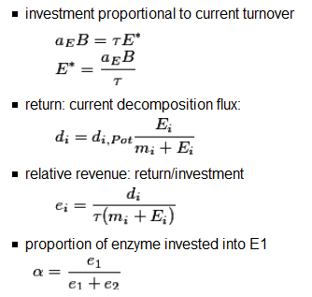
Revenue: Return / Investment

Slide 20
Balanced decomposition
Maximum biomass at pool 1 slightly higher CN as biomass
Providing constant substrate, steady state
No overflow respiration and No N-min over wide range
No N-mineralization at all

Slide 21
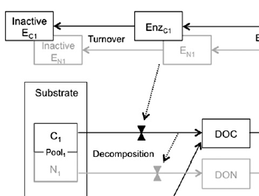

Outline
Introduction to stoichiometry
Eezy model of Moorhead 2012
Different strategies of enzyme allocation and their consequences
Notes:
Image from ocal and csal on clker

Slide 22
Is balanced stoichiometry the best strategy?
When explicitly tracking substrate pools (Eezy2c) and supplying constant inputs:
Inefficient Enzyme investment into small low N pool
Could grow better on S1, despite N mineralization
Role of biomass?
Making enzyme production proportional to uptake aka decomposition decouples enzyme production and decomposition from current microbial biomass Almost zero biomass may produce big enzyme pool
Suggestion: make enzyme investment a proportion of microbial biomass similar to maintenance

Slide 23
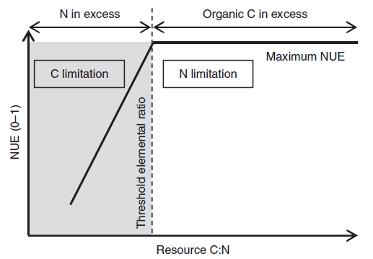
TER: Threshold Elemental Ratios
NUE, CUE, yield
[Nutrient / Nitrogen / Carbon] Use Efficiency
amount of product or biomass obtained per unit reactant
Mooshammer et. al (2014) Stoichiometric imbalances between terrestrial decomposer communities and their resources: mechanisms and implications of microbial adaptations to their resources. Frontiers in Microbiology

Slide 24
Moorhead D, Lashermes G & Sinsabaugh R (2012) A theoretical model of C-and N-acquiring exoenzyme activities, which balances microbial demands during decomposition. Soil Biology and Biochemistry, Elsevier, 53, 133-141

Slide 25
Priming simulation

Slide 26
Simplification: Quasi steady state

Slide 28
4bc
Not much different to fixed allocation (lower alpha10)

Slide 29
Purpose of this talk
Give an introduction into stoichiometry
Present my current thinking and work
Get constructive feedback
Preparation for and EGU talk/poster
In session SSS4.7 Soil microorganisms as a drivers of humification and mineralisation
Educate each other

Slide 30
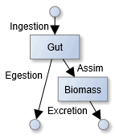
Stoichiometric imbalance and Yield
Stoichiometric imbalance: Resource ≠Consumer
Instead of “you are what you eat”
Homeostatic regulation:
Yield, NUE, CUE
amount of product or biomass obtained per unit reactant
Strategies dealing with imbalances during growth
Get rid of “access” element
Store “access” intermediately
Suppress growth
Invest into breakdown of OM of different stoichiometry
Consumer driven nutrient recycling

Slide 31

Decomposition matching demand
$CN_{opt}=\frac{C_{syn}}{N_{Syn}}=\frac{ syn_{E} + syn_{B}}{\frac{syn_{E}}{CN_{E}} + \frac{syn_{B}}{CN_{B}}}=\frac{ε \left(dec_{S1}+dec_{S2}−r_{Maint}\right)}{\frac{dec_{S1}}{CN_{S1}}+\frac{dec_{S2}}{CN_{S2}}}$
Solve for $α$ in decomposition equations
$dec_{S1}=k_{1}S_{1}\frac{ αE }{k_{m1}+αE)}$
$dec_{S2}=k_{1}S_{2}\frac{ (1−α)E }{k_{m2}+(1−α)E)}$
Notes:
Including enzyme tvr: $CN_{opt}=\frac{CN_{E} syn_{E}+CN_{B} syn_{B}}{syn_{E}+syn_{B}}=\frac{C_{syn}}{N_{Syn}}=\frac{ε \left(dec_{S1}+dec_{S2}+tvr_{E}−r_{Maint}\right)}{\frac{dec_{S1}}{CN_{S1}}+\frac{dec_{S2}}{CN_{S2}}+\frac{tvr_{E}}{CN_{E}}}$

Slide 32
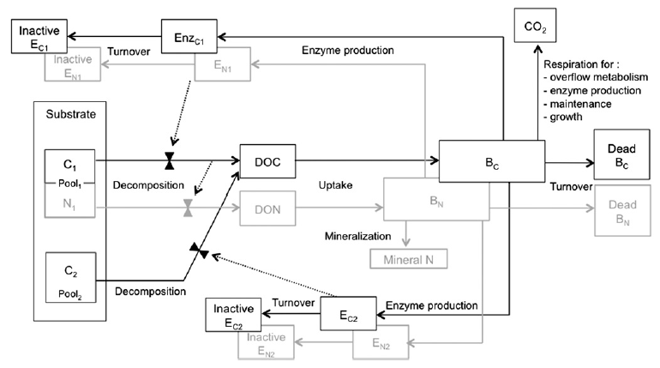
Moorhead 2012: EEZY
Calculates the ratio of Enzymes,α, so that stoichiometry of decomposition flux matches biomass + growth respiration

Slide 33
Slowing Down of Decomposition Rate
Simulated decrease of input to 1/100 during years 10-210
Both allocation schemes
Slowing down of decomposition
Effect pronounced with flexible allocation

Slide 34
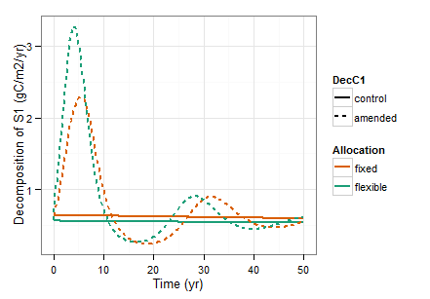
Priming oscillations?

