Slide 1




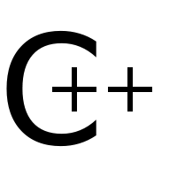

twNlme
Prediction of with mixed models in R
Intra -> Code repository

Slide 2
Grouping: non-Independence
Example: Tree biomass as a function of diameter
diameter dbh [cm] and stem biomass [kg] of trees
Reported by different authors
At different locations
With slight differences in methods

Slide 3
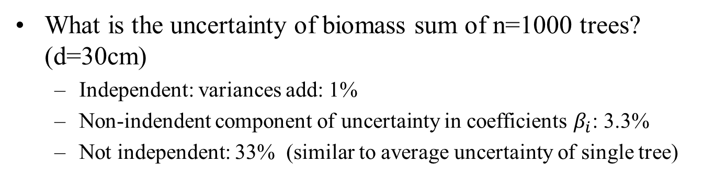
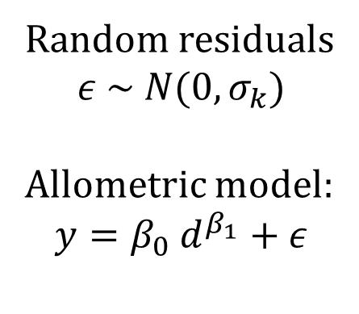
Single fit to all data
Random residuals
$$ε \sim N(0,σ_{k})$$
Allometric model:
$$y=β_{0} d^{β_{1}}+ε$$
What is the uncertainty of biomass sum of n=1000 trees? (d=30cm)
Independent: variances add: 1%
Non-indendent component of uncertainty in coefficients $β_{i}$: 3.3%
Not independent: 33% (similar to average uncertainty of single tree)

Slide 4
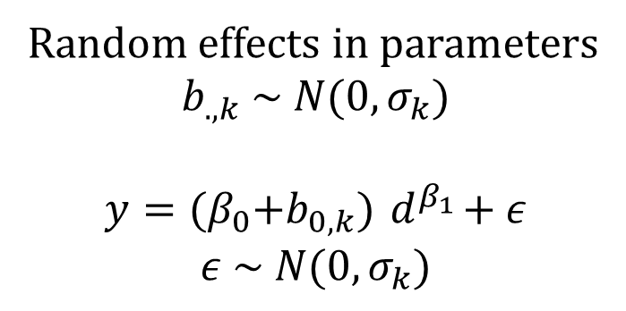
Mixed model
Random effects in parameters
$$b_{.,k} \sim N(0,σ_{k})$$
$$y={(β}_{0}+b_{0,k}){ d}^{β_{1}}+ε$$
$$ε \sim N(0,σ_{k})$$
Components of variance of sum over 1000 trees
Uncertainty of residuals cv=0.7%
Uncertainty of fixed effects cv=6%
Uncertainty of random effects cv=17%
Overall (variances sum up): cv=18%
Uncertainty of fixed and random effects does not decrease with n

Slide 5
See vignette of package twNlme

