Slide 1
Exceptions handling in R
Conditions:
Errors. Terminate program. stop()
Warnings. Potential problem. warning()
Messages. Informative output for user. message()
Handling tools:
try(). Continue implementation after the condition.
tryCatch(). Gives you an opportunity to do something about an error by handler
withCallingHandlers() are called in the context of the call,
that generated the condition

Slide 2
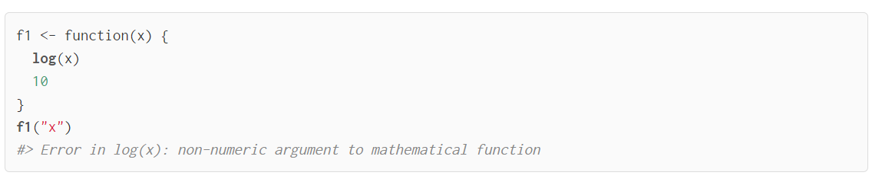
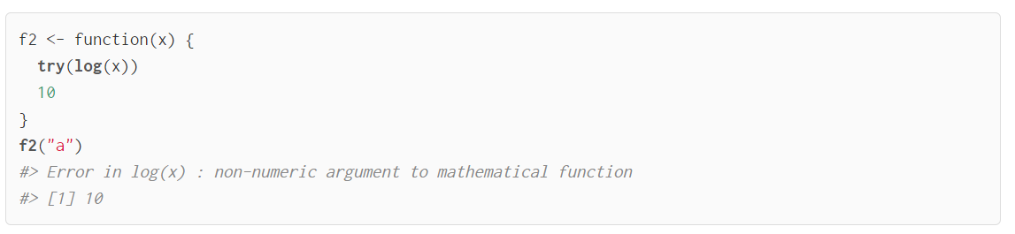
Ignore errors with try()
try() will print the error but the execution will continue
You can suppress it by try (…, silent = TRUE)

Slide 3
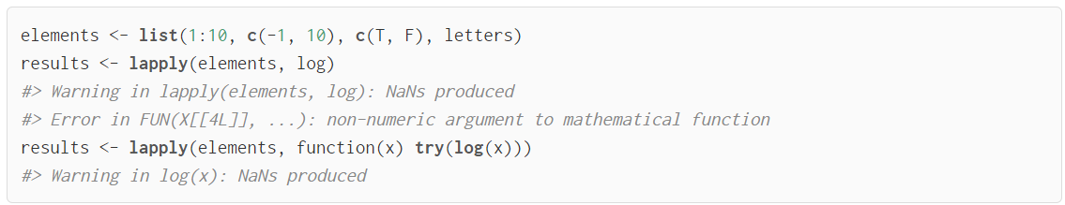
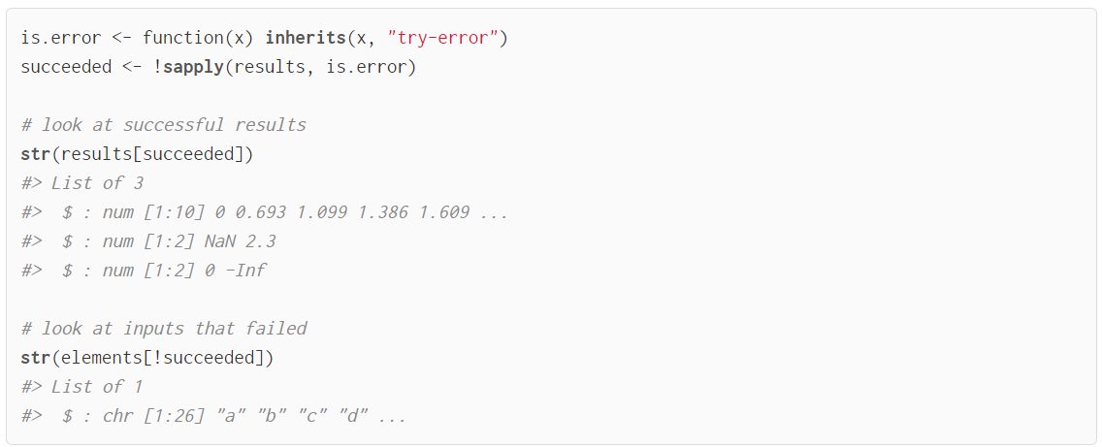
Use try() to see with what values in the data error occurred

Slide 4
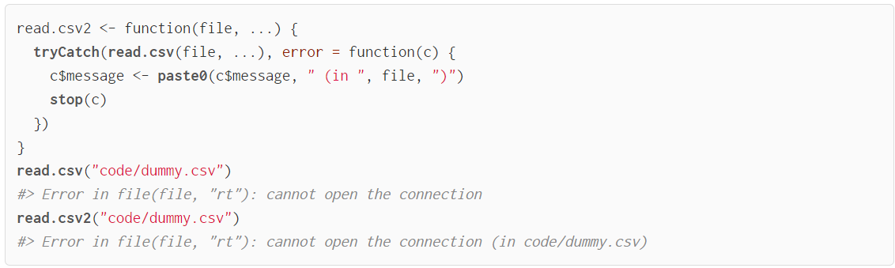
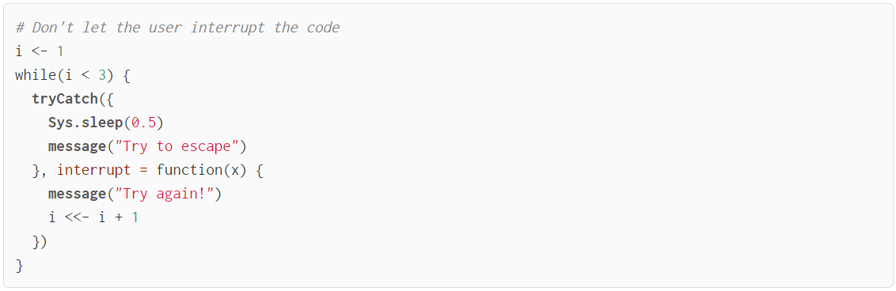
Usage of tryCatch()
Create more informative error messages
Try to escape from program aborting

Slide 5
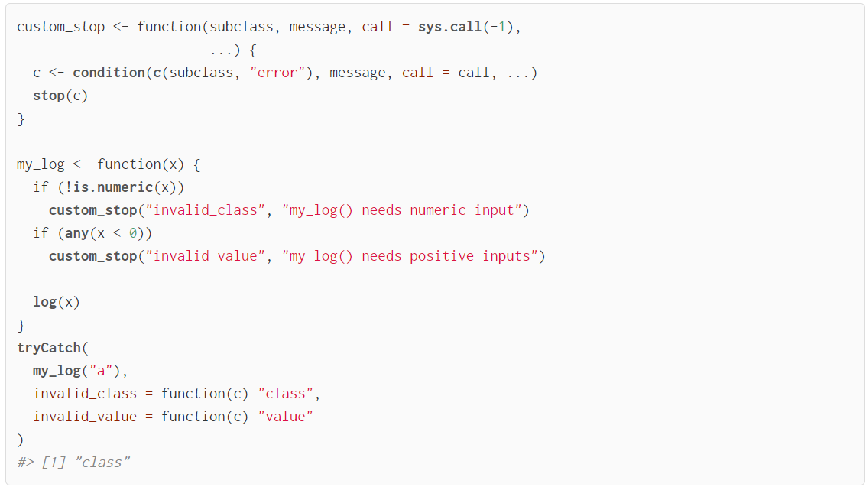
Create your own conditions

Slide 6
“Fail fast” principle
Check the type of the arguments.
stopifnot(),
if statements with stop(),
assertthat package
Avoid non-standard evaluation. Functions like
subset
transform
with
Avoid functions that return different types based on inputs
use drop = TRUE, when subletting data frames in a function
do not use sapply() inside functions. Instead use vapply()

