Slide 2
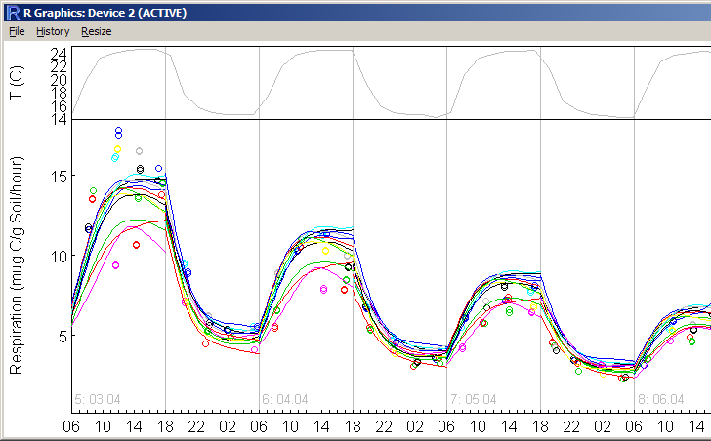
The problem
Need to fit and display many curves
  R goes out of memory – Windows freezes because of too much swap
Option 1:
  Try to store fits on hard disc instead of memory
    Each single fit? Series of fits? – Need to program a lot

Slide 3
Problem option 2
Option 2:
  Use something that acts like a list but actually stores its data on disk instead of memory
  Support
    a <- myobject[[<index]]
    myobject[[<index>]] <- a
  Have this something reusable for other purposes

Slide 4
Setup a package
Advantages
  Can be shared by R-archives
  Standards of documentation, directories etc
  using by calling “library” instead of sourcing many R files
  Less name conflicts (other objects of the same name from other sources)

Slide 5
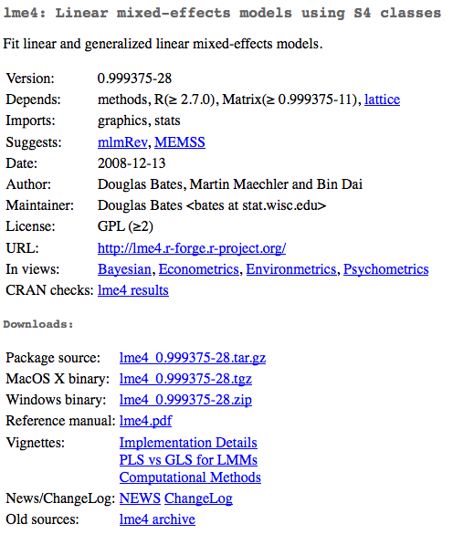
CRAN: package archives
Package pages contain links to
• Package dependencies
• Package source
• Package binaries
• Reference manual
• Maintainer contact info
And, if applicable,
• Project URL
• Task Views
• Vignettes (study cases)

Slide 6
Using R packages
after you found package with your functionality (web search) identified by package name and repository
within R type
  install.packages(„mvtnorm“) # easy install
  library( mvtnorm ) # loading into R
  ?rmvnorm # html-help
obtaining source code
  for single functions just type the name
  link at CRAN
  using versioning system at R-Forge (svn checkout URL)
  own local repositories
Notes:
multivariate normal distribution

Slide 7
R package coding guidelines
Directory structure
Documentation
Checks of codes
  unused variables
  code/doc mismatches
  Running Doc Examples
  Unit-Tests

Slide 8
Directory structure
A DESCRIPTION file
  with meta information such as the package name, version, and author, and other packages on which the package depends.
An optional NAMESPACE file
  enumerating the objects that are “exported” from the package.
An R subdirectory
  containing .R files with R code for creating objects such as functions.
A man (“manual”) subdirectory
  that includes .Rd documentation files (using LaTeX-like markup).
  Including examples
A data subdirectory
  containing data objects, such as text files that can be read as R data frames.
An inst (“install”) subdirectory
  containing arbitrary files and subdirectories to be installed, e.g. unit tests
src subdirectory
  for compiled C or Fortran code

Slide 9
How to Create an R Package
Copy existing package(s)
“package.skeleton” function
Writing R Extensions” manual
  http://cran.r-project.org/doc/manuals/R-exts.pdf
Other references:
  Leisch, Friedrich (2008) Creating R Packages: A Tutorial: http://epub.ub.uni-muenchen.de/6175/

Slide 10
Example package listf
Description file
Package: listf
Title: list backed by filesystem
Version: 1.0
Date: 2012-03-15
Author: Thomas Wutzler
Maintainer: Thomas Wutzler <twutz@bgc-jena.mpg.de>
Description: list backed by filesystem
License: GPL-2
LazyLoad: yes
Depends: R (>= 1.10.0)
Namespace file
exportPattern("^[^\\.]") #exports all variables that do not start with a period.
#import(aNamespace) # only required when extending S3 methods
#useDynLib(ProjectsDllBaseName) # only required when supplying C code

Slide 11
Simple to Complex (Mock objects)
Idea start with a very simple implementation of functionality
Successively add functionality and more sophisticated code
Test alongside development
data <- list() # (soon we will use objects to avoid global variables)
set = function(i, value) {
'Setting one entry in the list'
if( length(data) < i) length(data) <<- i # extend list
data[[i]] <<- value
}
get = function(i) {
'Getting one entry in the list'
data[[i]]
},

Slide 12
Unit Testing
Check functionality during development
Single expectations:
  expect_that(model, is_a("lm"))
Single function :
  test_that("floor_date works for different units", { … })
R-File (Related functionality)
  context("My context").
Put test into inst/tests dir
  call autotest to automaticall run tests on each file save
context("listf")
test_that("length l1 intially empty",{
l1 <- listf$new()
expect_that( length(l1), equals(0) )
})
Wickham et. al Get Started with Testing The R Journal, 2011, 3, 5–10

