Slide 1
Visual Scene Understanding through Neuro-Symbolic Reasoning
Bachelor's Thesis
Bogdan Đukić, RA98/2021
Supervisor: Dr. Milan Segedinac
University of Novi Sad, Faculty of Technical Sciences

Slide 2
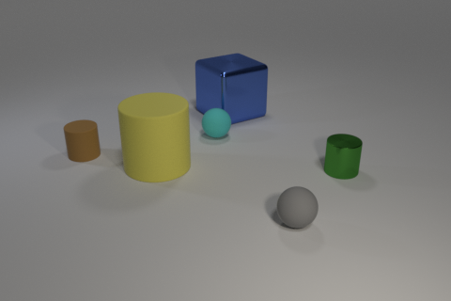
Problem: Visual Question Answering (VQA)
Input: image + natural-language question → Output: answer (number / yes-no / attribute)
End-to-end neural models: high accuracy, but a black box
The problem: when a model makes a mistake—where did the error occur?
Question: "How many cylinders are there in the image?" → Answer: 3

Slide 3
Solution: A Neuro-Symbolic Approach
PERCEPTION
image → scene graph
REASONING
question → DSL program
Symbolic program execution
on the scene graph → answer

Slide 4
System Architecture
PERCEPTION
Input Image
Perception Module
Scene Graph
Symbolic Executor
(deterministic)
Answer
YOLOv8
FastSAM
MiDaS
CLIP
REASONING
Question
T5-small (fine-tuned)
DSL Program

Slide 5
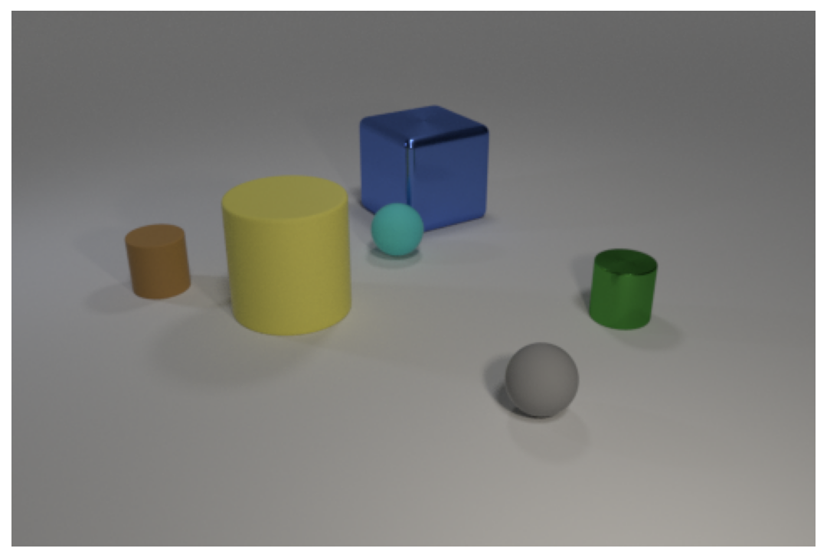
System Input
Input Image
The system receives an image of a scene and a natural-language question. The expected answer is a number, yes/no, or an attribute value.
Question: "What color is the cube behind the cyan sphere?"

Slide 6
Object Detection
YOLOv8m × FastSAM
Hybrid Detection
YOLOv8 detects the bounding boxes of all six objects; FastSAM in "segment everything" mode supplements detections missed by YOLO. The results are merged using intersection over union (IoU).
Question: "What color is the cube behind the cyan sphere?"

Slide 7
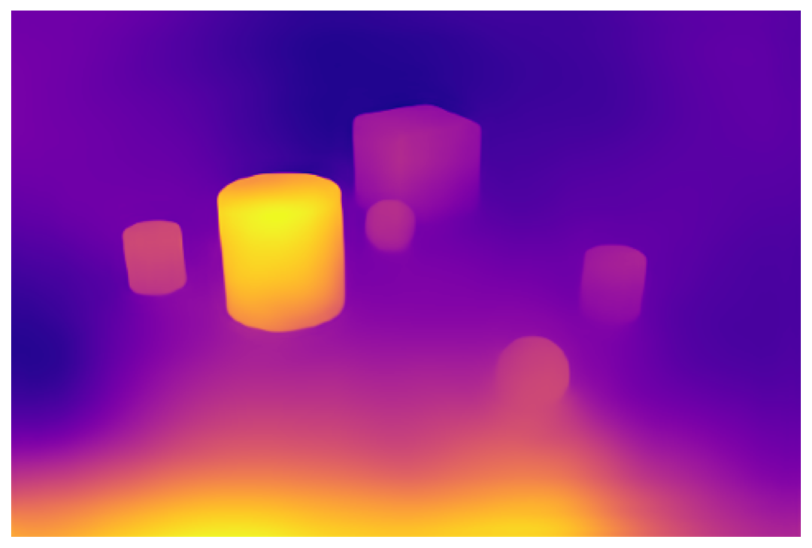
Depth Estimation
MiDaS
Relative Depth Map
MiDaS estimates relative depth from a single image: brighter regions are closer. Depth helps determine front/behind relationships and resolve overlapping masks in the next step.
Question: "What color is the cube behind the cyan sphere?"

Slide 8
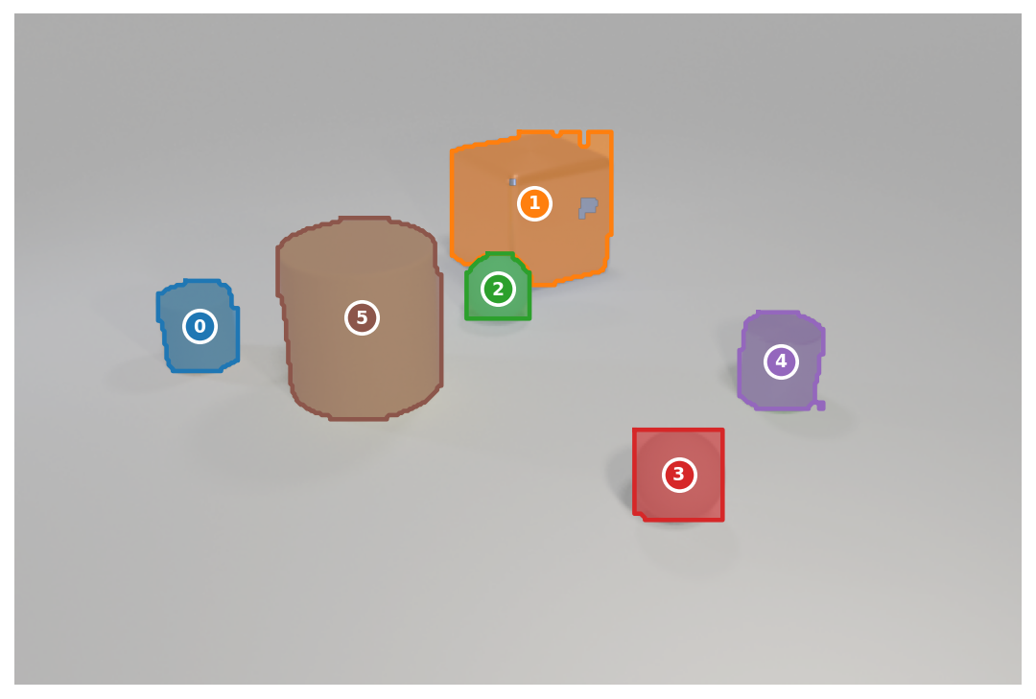
Masks and Z-Buffer
FastSAM × Z-Buffer
Non-overlapping Segmentation
A precise mask is extracted for each bounding box. The Z-buffer assigns each pixel to exactly one object.
Question: "What color is the cube behind the cyan sphere?"

Slide 9
Attributes → Scene Graph
CLIP (zero-shot)
Attributes → Scene Graph
CLIP classifies each object's color, shape, and material.
objects:
0 brown cylinder rubber S
1 yellow cylinder rubber L
2 blue cube metal L
3 cyan sphere rubber S
4 green cylinder metal S
5 gray sphere rubber S
relationships:
behind[3] = [2] ← behind the cyan sphere
left[2] = [0, 1]
right[3] = [4, 5]
…
Question: "What color is the cube behind the cyan sphere?"

Slide 10
Question → DSL Program
T5-small (fine-tuned)
Question → DSL Program
1 scene
2 filter_color[cyan]
3 filter_shape[sphere]
4 unique
5 relate[behind]
6 filter_shape[cube]
7 unique
8 query_color
Question: "What color is the cube behind the cyan sphere?"

Slide 11
Symbolic Execution
Executor - deterministic
The program is executed step by step
ANSWER
1 scene
2 filter_color[cyan]
3 filter_shape[sphere]
4 unique
5 relate[behind]
6 filter_shape[cube]
7 unique
8 query_color
reference
Answer: “blue”
Question: "What color is the cube behind the cyan sphere?"

Slide 12
Experimental Setup
CLEVR
Synthetic scenes and template-generated questions - used for training and baseline evaluation.
Two Evaluation Pipelines
GT Pipeline (Reference)
Ground-Truth Scene Graph → Program → Answer
Isolates reasoning performance
CLEVR-CoGenT
Previously unseen attribute combinations not found in training - tests compositional generalization.
E2E Pipeline (Full System)
Image → Generated Scene Graph → Program → Answer
CLEVR-Humans
Natural-language questions written by humans, including synonyms.

Slide 13
Question-to-DSL Translation (Reference Pipeline)
Dataset | Accuracy | Valid Programs | Execution Failures
CLEVR (reference) | 99.9% | 100.0% | 0.0%
CLEVR-CoGenT valB | 99.7% | 100.0% | 0.1%
CLEVR-Humans (before RL) | 41.4% | 90.5% | 25.5%
CLEVR-Humans (after RL) | 57.1% | 92.6% | 0.6%
REINFORCE (without any program annotations from CLEVR-Humans)
Accuracy: 41.4% → 57.1% (+15.7 pp)
Execution failures: 25.5% → 0.6% (−24.9 pp)

Slide 14
Direct Perception Evaluation: Error Localization
Detection | Value
Recall | 97.5%
Precision | 88.7%
F1 Score | 92.9%
FN / image | 0.16
FP / image | 0.80
CLIP Attributes | Accuracy
Shape | 95.5%
Material | 94.4%
Size | 92.8%
Color | 87.8%
Spatial Relations | Accuracy
front | 68.6%
right | 66.7%
left | 66.5%
behind | 44.3%
Overall | 61.5%
green | blue | red | yellow | gray | brown
97% | 91% | 90% | 87% | 86% | 71%

Slide 15
What Is the Cost of Perception?
Dataset | GT Pipeline | E2E Pipeline | Gap (pp)
CLEVR val | 99.9% | 79.0% | −20.9
CoGenT valB | 99.7% | 79.0% | −20.7
CLEVR-Humans (before RL) | 41.4% | 32.7% | −8.7
CLEVR-Humans (after RL) | 57.1% | 45.6% | −11.5
Sanity check - a typical program filters by color, shape, and material:
P(all 3 filters correct) ≈ 0.878 × 0.955 × 0.944 ≈ 79.2%
Measured E2E accuracy: 79.0% ✓

Slide 16
Comparison with IEP and NS-VQA
Dataset | IEP | NS-VQA | Proposed - E2E | Proposed - GT
CLEVR val | 96.9% | 99.8% | 79.0% | 99.9%
CoGenT B | 73.7% | 63.9% | 79.0% | 99.7%
CLEVR-Humans | 66.6% | 67.0% | 45.6% | 57.1%
GT pipeline matches leading neuro-symbolic systems (99.9% vs. 99.8% for NS-VQA).
On CoGenT, our E2E system outperforms both methods - separate attributes in the DSL ≠ learned correlations (NS-VQA: 48 combined classes → 63.9%).

Slide 17
Conclusions and Future Work
Three Key Findings
Neuro-symbolic reasoning: ~99.9% accuracy given a correct scene graph
Key advantage: errors can be localized by stage (color and spatial relations)
RL adapts to natural language without program annotations (+15.7 pp)
Future Work
Dedicated color classifier
Improved depth estimation for spatial relationships
Extend the DSL (superlatives, “between,” most frequent attribute)

Slide 18
Thank You!
Questions?

