Slide 1
BZAN 554 · Group Assignment 1
Incremental Learning on Large Data
Feed-forward neural network predicting quantity sold
Input
Hidden
Output
Group 7: Ansley Smith, Rebecca Drake & Ximin Zeng
Notes:
Group 7. Lead with the headline: test R2 = 0.536, which is well above a linear regression baseline of 0.374 on the identical split. 500,000 records learned one mini-batch at a time, 45 seconds, under 424 MB of RAM during training.

Slide 2
Key Results
Test R²
0.536
Training time
45 s
Peak RAM
424 MB
Records
500k

Slide 3
The Data
500,000
records
5
input features
0
missing values
19 MB
on disk
Inputs → predict quantity
Target: quantity
• sku — product identifier
• price — listed price
• order — nth time in stock
• duration — time on site
• category — product category
Statistic | Value
Mean | 22.82
Std. deviation | 50.51
Range | 0 – 4,165
Heavily right-skewed → we standardize the target before training
Split the dataset at 80/20, i.e., 400,000 records for training, 100,000 records for testing.
Notes:
Categoricals are already integer-encoded and numerics divided by a constant, per the assignment note. Zero missing values, so no imputation. The key observation is the target scale: mean 23 but max 4,165. That skew drove a design decision on slide 6.

Slide 4
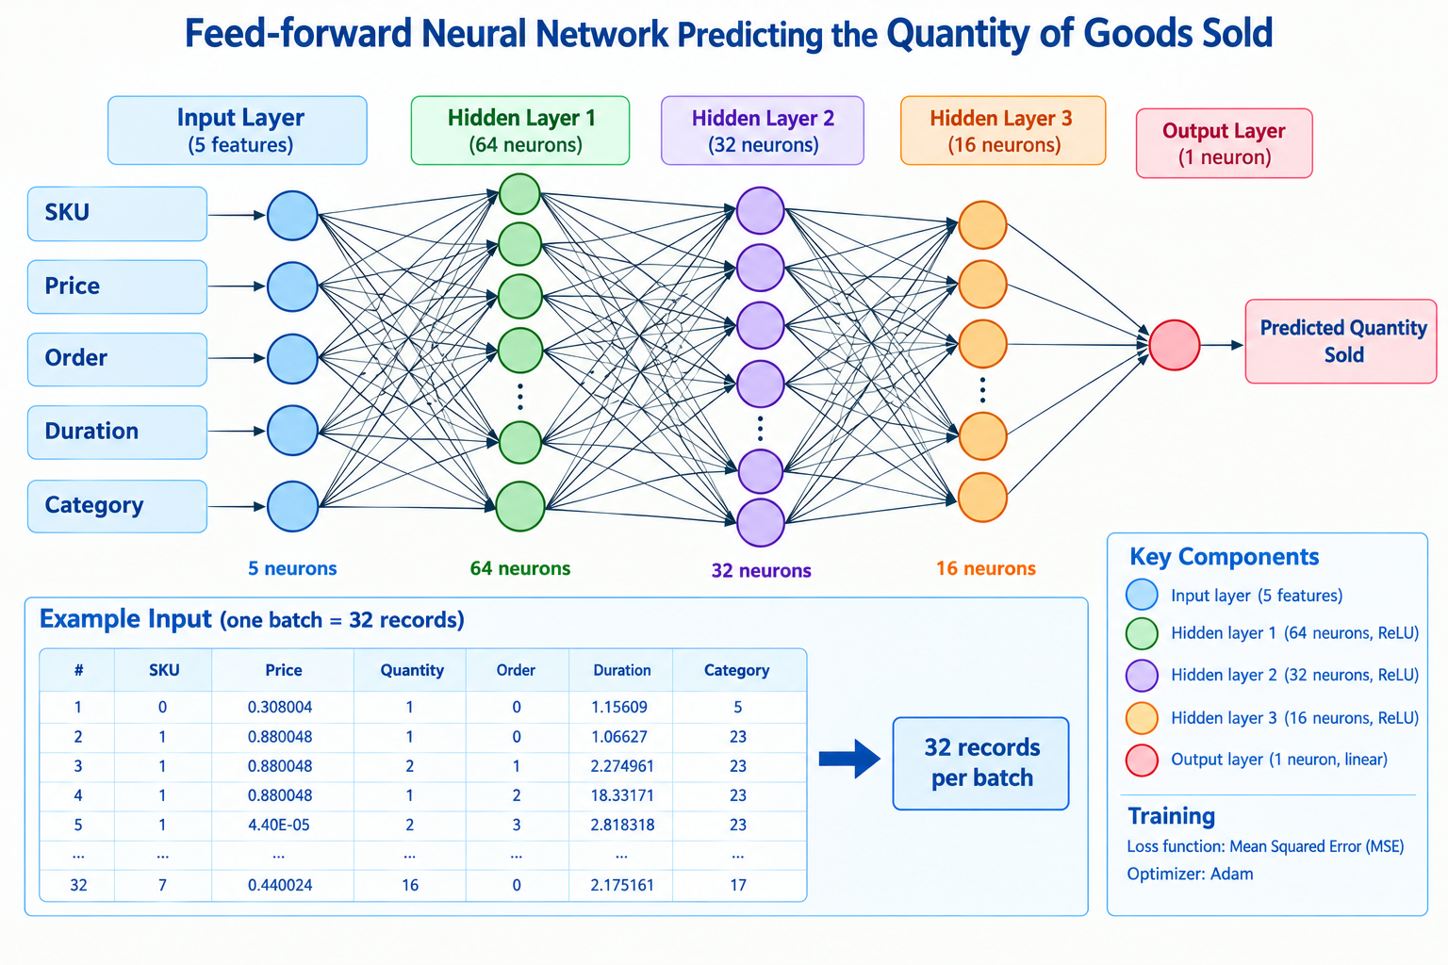
Network Architecture
3 hidden layers · sigmoid activation · linear output for regression · One pass
Notes:
Matches the specification exactly: three hidden layers, sigmoid activation. Parameter count derivation, useful for the exam: (5x64+64)=384, (64x32+32)=2080, (32x16+16)=528, (16x1+1)=17, total 3,009. Why 64-32-16? A funnel compresses 5 inputs into progressively coarser features. Why is the output layer linear? Quantity is unbounded and positive; a sigmoid output would squash predictions into (0,1) and cap them.

Slide 5
How the Model Learns Incrementally
for X_batch, y_batch in create_mini_batches(X_train, y_train):
model.train_on_batch(X_batch, y_batch)
mse_history.append(loss)
log_memory(batch_count)
Never train on the full data at a time
• 32 rows per batch
• 12,500 batches (32*12,500=400,000)
• one pass (1 epoch)
Key design decision
Decision | Why | Effect on test R²
Standardize the target y | Raw y (max 4,165) forced huge gradients that saturated the sigmoid units | 0.35 → 0.52
Learning rate 0.001 → 0.005 | Sigmoid gradients are small; larger steps needed within a single pass | 0.519 → 0.532
Notes:
This is the strongest slide for showing understanding. The target-scaling fix was diagnosed, not guessed: raw y has mean 23 and max 4,165 while inputs sit near zero, so the network had to emit large values, producing large gradients that pushed the sigmoid units into their flat regions where the derivative approaches zero. Standardizing y fixed it and gained about 0.17 R2. IMPORTANT: do not attribute the improvement from 0.32 to 0.54 to random seed variation. It came from these two deliberate changes. Also note MSE is reported in original units by multiplying by the variance of y (sigma squared, not sigma).

Slide 6
Results — R²
0.5362
Training set R²
0.5356
Test set R²
Benchmarked on the identical 80/20 split
Model | Test R² | Test MSE
Predict the mean | 0.000 | 2,478.8
Linear regression | 0.374 | 1,550.7
Our neural network | 0.536 | 1,151.2
Train ≈ test → no overfitting. Beats linear regression by 0.16 R².
Notes:
Test set created by train_test_split with seed 42, 400k train / 100k test, and never used for training or tuning. The gap between train and test is 0.0007, so there is no overfitting. The comparison table is what makes the number meaningful: R2 = 0.536 on its own is just a number, but beating a linear model by 0.16 shows the network is capturing genuine non-linearity. R2 = 0 is exactly the performance of predicting the mean for every row.

Slide 7
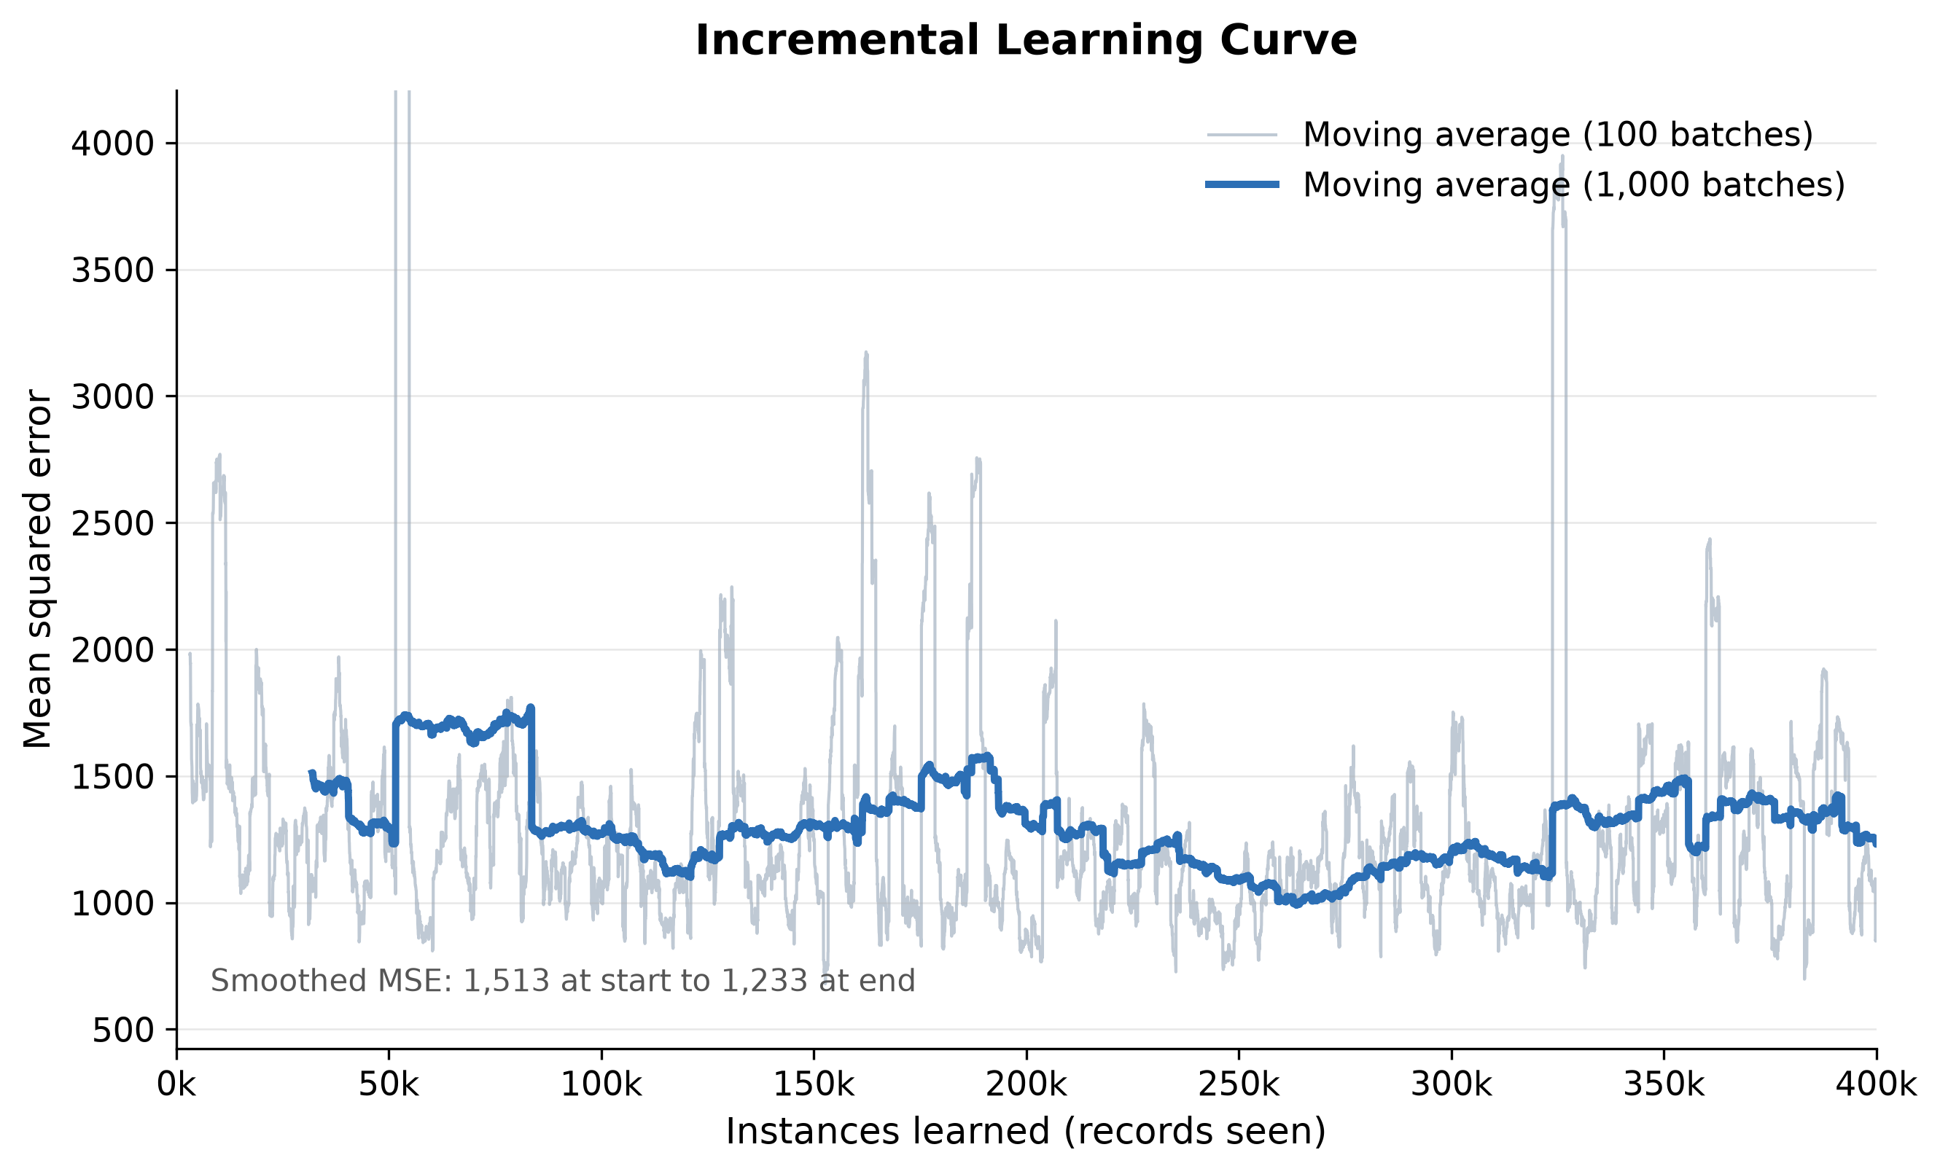
Learning Curve
Moving-average MSE falls 1,461 → 1,257 across 400,000 records learned.
Individual batches are noisy (32 rows each); the moving average shows the trend.
Notes:
X-axis is instances learned, y-axis is the moving average of MSE, exactly as specified. The moving average is essential: a single 32-row batch ranges from about 300 to 5,000 MSE, so raw per-batch values look like pure noise. Do NOT quote MSE_first_batch (455) against MSE_last_batch (1,747) from metrics.csv as evidence of anything. Those are single batches and they suggest the model got worse, which is an artifact of batch-level variance. The smoothed trend is the honest measure. The curve is still descending at the end, which tells us a second epoch would likely help.

Slide 8
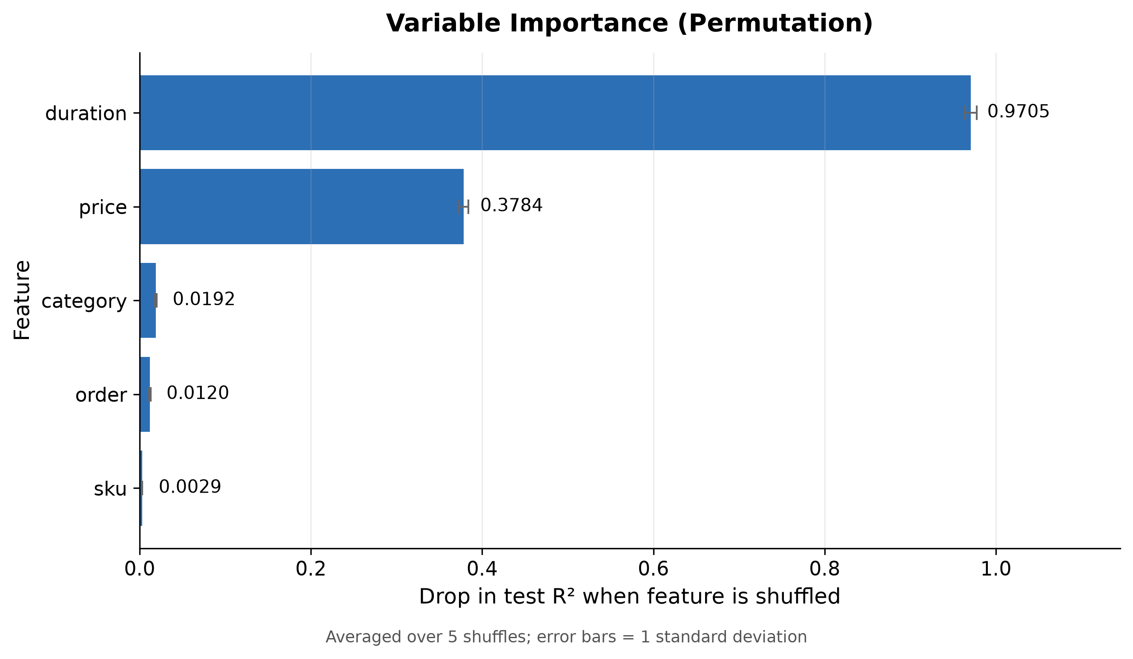
Variable Importance
duration and price carry almost all signal.
sku, order, category are nearly irrelevant.
Notes:
Method: permutation importance. Shuffle one feature in the test set, re-predict, and measure how far R2 falls. Averaged over 5 shuffles; error bars are one standard deviation. Why can the drop exceed 1.0? Shuffling duration makes predictions worse than simply predicting the mean, so R2 goes negative and the drop from 0.536 exceeds 1. That is expected, not a bug. Caveat worth mentioning: sku and category were standardized as if numeric, which understates their importance because the network sees a meaningless ordering. One-hot encoding would be the fix.

Slide 9
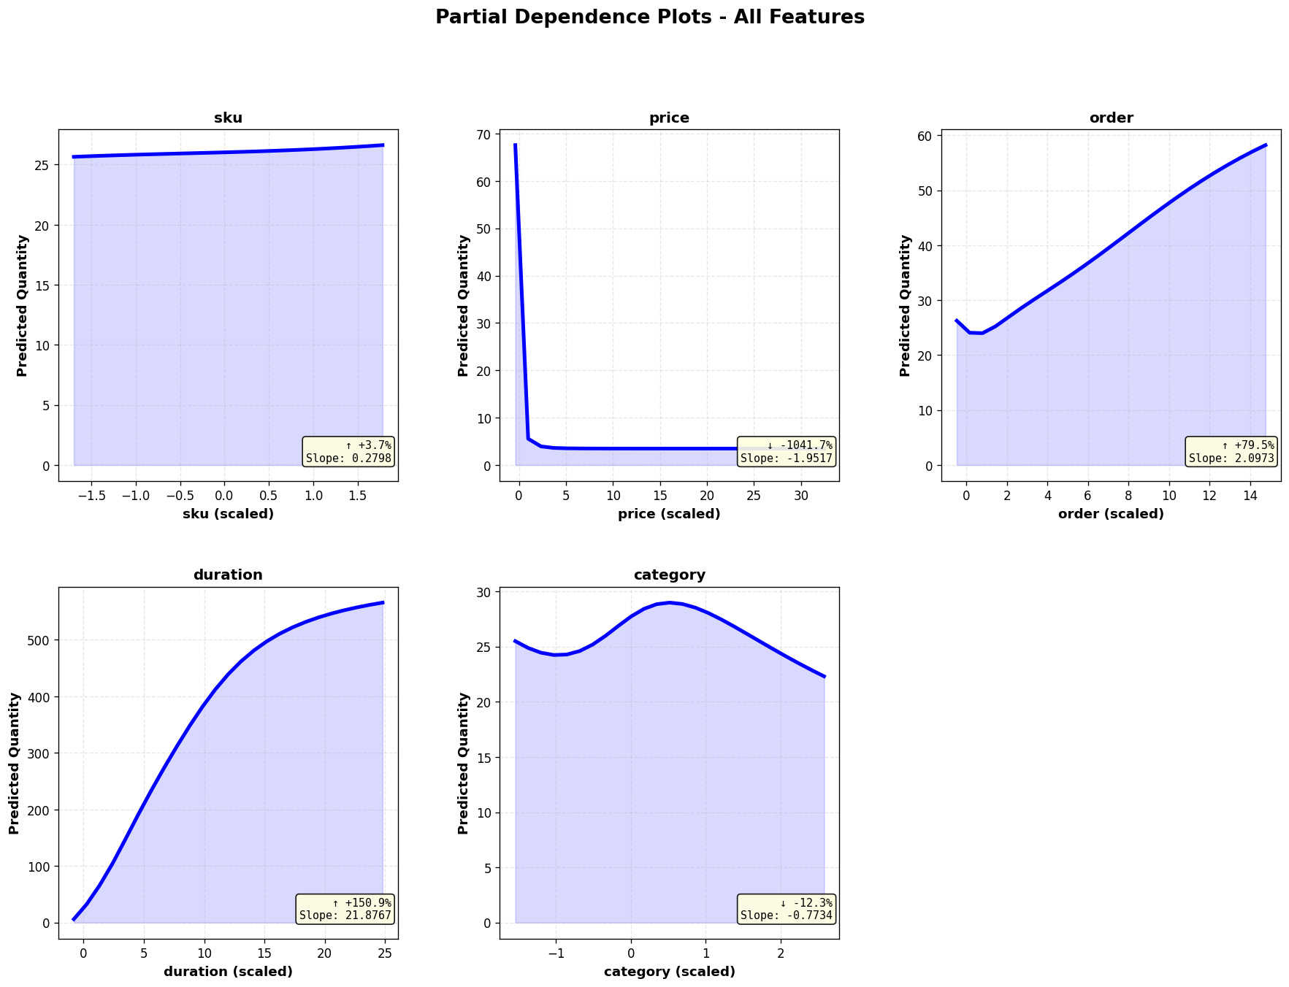
PDP Analysis
Duration and price dominate the model's predictions
  quantity rises steeply with duration and falls sharply with price
sku, order, and category are effectively flat, matching the permutation-importance ranking.
Feature | Direction
sku | Flat
price | Negative, then flat
order | Flat where data exists
duration | Strong positive
category | Mild wave
Notes:
order has a weak, slightly negative association with quantity within the observed range, and the apparent upturn is an artifact of extrapolation.

Slide 10
RAM Usage & Training Time
Memory
Time
Stage | MB
At start | 346.4
After data load | 383.7
Peak during training | 423.7
Drift over 12,500 updates | +6.5
Measure | Value
Total training | 45.0 s
Per mini-batch | 3.6 ms
Records / second | ≈ 8,900
Memory is flat during training.
Incremental Learning (Mini-batching) means RAM does not grow with the number of records.
12,500 weight updates in 45 seconds on a laptop.
Honest limitation: we still read the whole CSV once (19 MB fits in RAM).
The training loop is genuinely incremental and would scale unchanged to a file larger than RAM using pandas chunksize.

Slide 11
Team Contributions
Member | Contributions
Ansley | Fine tune training model, Finish training/prediction, Revise PowerPoint
Rebecca | Create GitHub Team Repo, Coordinate teamwork, Initialize model, Revise PowerPoint
Ximin | Testing &evaluation, Documentation, Create PowerPoint slides
Notes:
Required by the assignment. Confirm each description with Ansley and Rebecca before submitting so everyone agrees with how their work is represented.

Slide 12
What We Learned & What We'd Do Next
What worked
Known limitations
• Mini-batch updates keep RAM flat
• Target scaling mattered most (+0.17 R²)
• Beat linear regression by 0.16 R²
• Clean split - no leakage, no overfitting
• Whole CSV read once, not chunked
• Single epoch - curve still descending
• sku / category scaled as if numeric
• Scaler not saved with the model
Next steps, measured not guessed
Change | Expected test R² | Note
Batch 256 + 10 epochs, lr 0.01 | ≈ 0.550 | also ~2× faster
One-hot encode category | - | removes false ordering
Notes:
Closing on limitations reads as understanding rather than oversight. The batch-size figure comes from an actual sweep: at a fixed single epoch, larger batches are WORSE (batch 256 scores about 0.521 versus 0.532 at batch 32) because batch size divides the number of weight updates. 400k rows at batch 32 gives 12,500 updates; at batch 256 only 1,563. Larger batches only win when the saved time is spent on more epochs. A gradient boosting model on these same five features reaches about 0.589, so the remaining gap is mostly the three sigmoid layers, not the batch size.

